Slide 1

Case Study on firm’s profitability prediction
by Tania Laha

Slide 2
Problem statement
Financial Analysts would want to predict if the company would be profitable in next 5 years or not.
Why profit does matter
Both revenues and profits are crucial indicators of a company’s financial strength. A company’s revenues drive its operations, and also contribute to its profitability in the long run if there is a steady flow. If the bottom-line, or profit, is growing, it means the company is running its operations efficiently.
Target Variable Description
‘class’ is the target variable with two labels ‘0’ and ‘1’ which denotes ‘not profitable’ and ‘profitable’ respectively.

Slide 3
Business understanding
Profitability analysis helps stakeholders as well as investors to determine future strategies, investments, and the performance of the business by analyzing the current financial position.
Solution of this case study will help business to identify the growth metrics and how those are influencing the profitability.
Maintain a long-term sustainability and avoid any significant losses to incur.
Objective:
As a financial analyst, our end goal will be to enable shareholders optimizing growth parameters using prediction output along with keep investors aware of current business trend for making a profitable investment.

Slide 4
Finalizing the error metrics
It is important for business to find out the correct predictions out of total predictions so that they can clearly visualize the current financial situation of their firm. Hence, accuracy and f1-score might be the choices here.
Due to presence of class imbalance in target variable, it is preferred to go with f1-score for model evaluation and a higher f1-score signify the model as best fit.
Also the final model must be able to reduce the false positives (i.e. identifying non-profitable firms as profitable) to avoid financial losses which investors may face due to spending money on non-profitable organizations. Therefore, a high precision value is preferable.

Slide 5
Data understanding
Data consists of total 43261 rows and 16 columns.
There are 1 object column, 9 float columns, 6 integer columns.
Types of columns:
Continuous predictors – ‘Total liabilities vs Total Assets’, ‘Working Capital vs total assets’,
‘Current Assets vs short-term liabilities’, ‘Retained earning vs total assets’, ‘Sales vs total assets’, ‘Equity vs total assets’ , ‘gf and interest vs total assets’ , ‘total liabilities vs gross profit and depreciation’.
Categorical predictors – ‘Industry type’, ‘Distance from airport’, ‘Employee strength’ , ‘MNC or not’ , ‘Location’ , ‘Distances from water source’ , ‘powered by green energy’.
Target variable is having a distribution as : 71% 0’s and 29% 1’s. As this is a binary variable, a classification model will be built on given data.

Slide 6
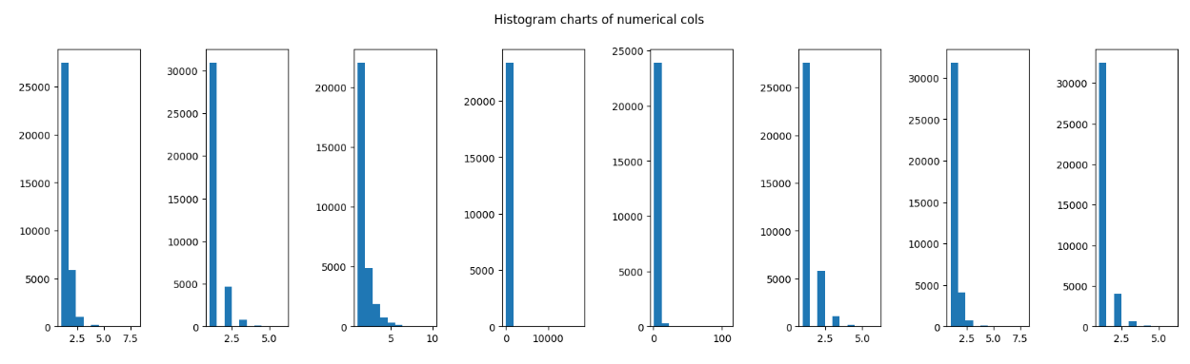
Data pre-processing
Data type conversion – Converted columns with less numbers of unique values to ‘category’.
Missing value treatment –
1) Filled missing values of ‘powered by green energy’ using mode value (column contains close to 5% null entries).
2) Dropped all other columns contain missing values (~0%).
Univariate Analysis of continuous data -
Plotted histogram charts for continuous predictors which clearly show presence of skewness in all columns.
Hence performed outlier treatment
to remove skewness from these
columns.

Slide 7
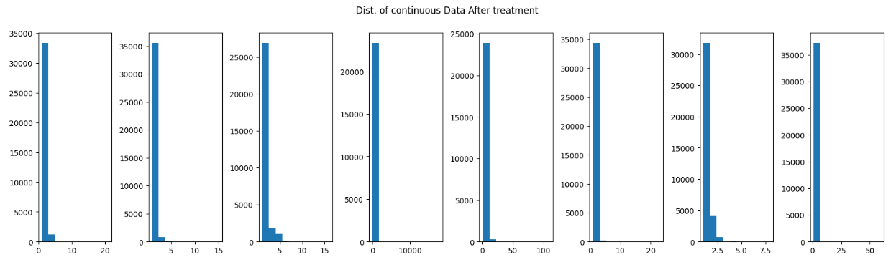
Outlier Treatment –
1) Standard normalized all numeric columns by calculating z-score of each one.
2) Eliminated all those rows which is having z-score >3 or z-score < -3 from main data (as per statistics, data points fall beyond +3 or -3 standard deviation from mean on z-scale can be considered as outliers).
Observations:
This has been observed that, although outliers has been treated skewness remains within data due to the in built narrow distribution of all numeric columns. Hence, those values cannot be considered as outliers completely and needed for model building.
Below is the histograms after outlier treatment :

Slide 8
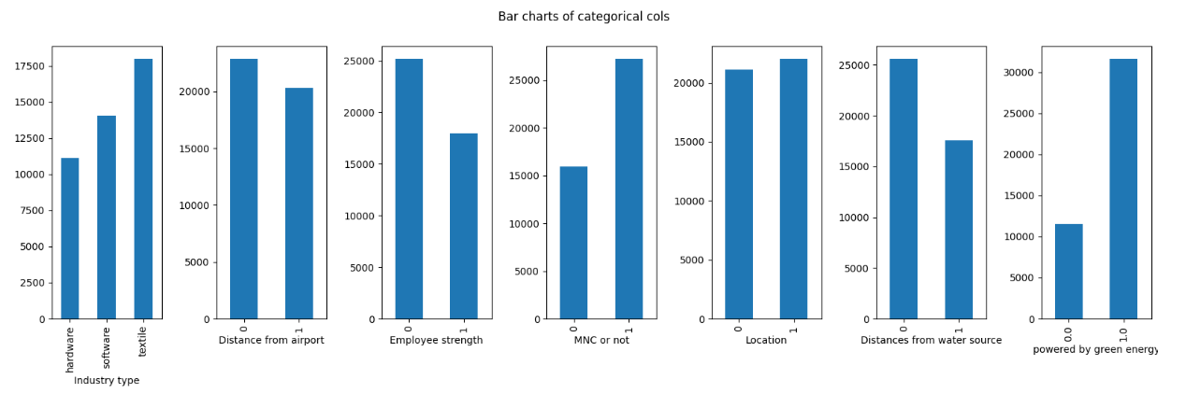
Univariate analysis of categorical columns –
Plotted individual bar charts to visualize the categorical data distribution.
Observations -
1) ‘Textile’ is the largest segment to contribute compared to other industries.
2) More number of industries are situated in ‘Metropolitan’ areas.
3) There are larger number of firms which are more than 30% powered by green energy.
4) Most of the companies have employee strength less than 5000 and MNCs are higher than non MNCs.
5) Mainly industries are built closer to airport and water source.

Slide 9
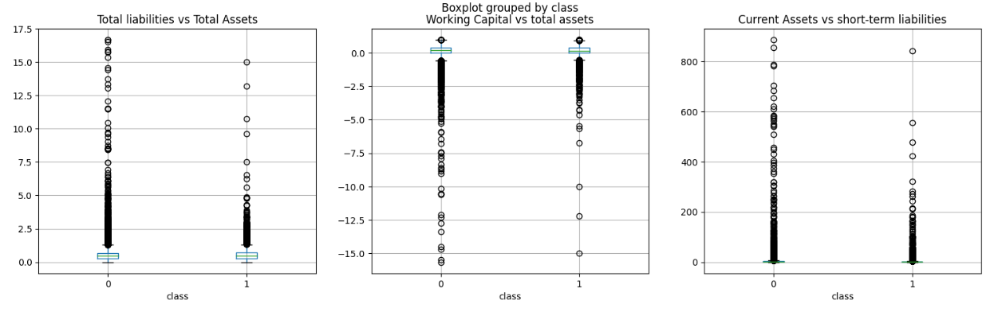
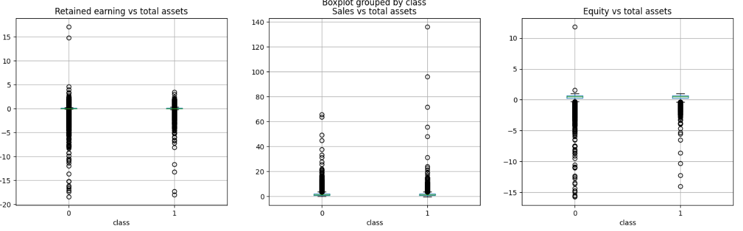
Bi-variate analysis
Plotted Group boxplots to visualize the relationship between target variable and continuous predictors.
To validate the exploration from above charts (less interpretable due to skewed distribution) statistical feature selection ‘Anova test’ has been performed on same columns which helped to finalize on best predictors.

Slide 10
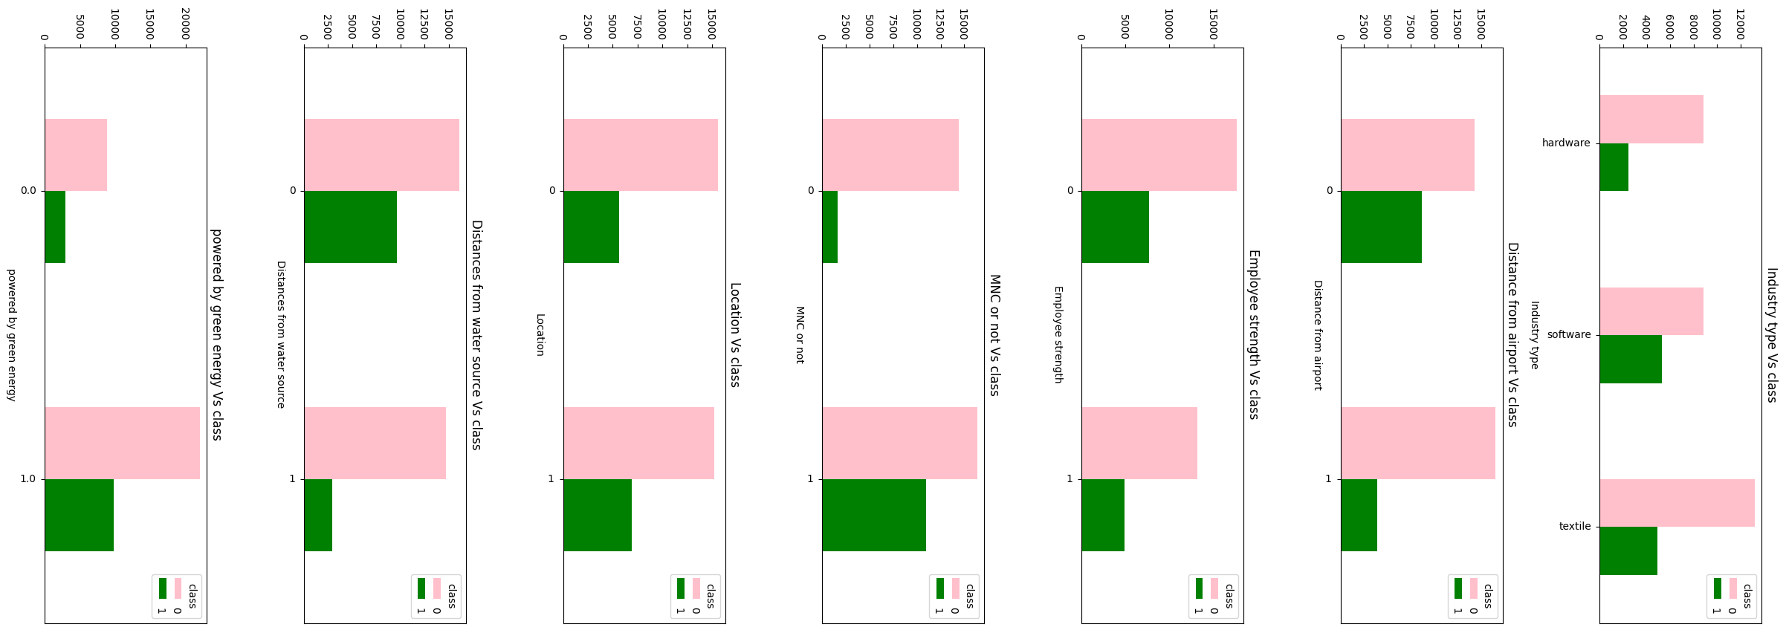
Grouped bar plots are used to analyze the relationship of categorical predictors vs categorical target variable.
Observations:
Textile is facing losses than other two sectors in last 5 years.
Companies closer to airports supposed to be more profitable than farther ones.
Although non-profitable firms are equal in both rural and urban areas but most of the profitable firms are located in metropolitans.

Slide 11
Feature Engineering and Feature Selection
A new feature named ‘Altman score’ has been created to decide if any organization is going to become profitable or bankrupt in next two years. It may help investors to decide whether to invest for a long-term or withdraw their capital.
‘Altman score’ takes into account five financial ratios such as : 'Working Capital vs total assets’, 'Retained earning vs total assets', 'Sales vs total assets', 'Equity vs Total liabilities', 'gf and interest vs total assets’ (‘Equity vs Total liabilities’ is derived dividing ‘Equity vs total assets’ by ‘Total liabilities vs Total Assets’).
An Altman score close to 1.8 suggests a company might be headed for bankruptcy, while a score closer to 3 suggests a company is in solid financial positioning.
Final continuous and categorical predictors have been chosen(both existing and newly created) through ‘Anova test’ and ‘Chi-square test’ respectively.
Observations from feature selection tests –
‘Altman score’ did not show a strong correlation with ‘class’ variable.
2) ‘total liabilities vs gross profit and depreciation’ and ‘Equity vs Total liabilities’ also got rejected in correlation test.

Slide 12
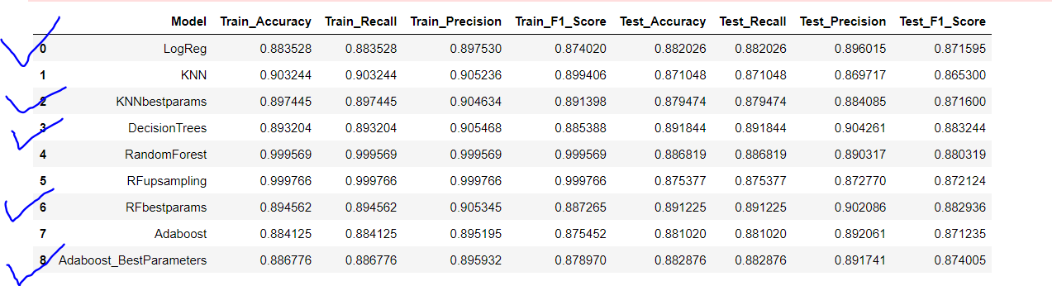
Interpretation of predictive model’s output
Built five different classification models to predict the output – Logistic Regression, KNN, Decision tree, Random forest and Adaboost. Below is given a screenshot of performance of each predictive model on validation data.
It is clearly visible that, Random forest with hyperparameter tuning and Decision tree seem to be the best fit models however tunned Adaboost,KNN and Logistic regression also fit better.
Random Forest and Decision tree are drawing highest accuracy of 0.89. As we are more concerned about better precision score which Decision tree and Random forest both draw as good as 0.90 on validation set.
Highest F1-score of 0.88 can be seen for both Decision tree and Random Forest.
Considering the precision and F1-score value this two models are best performers among all and can be implemented for real-life problem solving.

Slide 13
Problems risen during model building –
1) Heavily skewed numeric columns are not interpretable through Box-whisker plots and almost all data points fall under outlier region which is really ambiguous.
Solution : Relied on Histogram plots to visualize those features and conversion to z-score helped to eliminate real outliers from data.
2) During Anova test, some numeric columns shows p-value very close to 5% in correlation with target variable.
Solution : Built model twice, before and after deleting the non correlated columns. Observed improved performance post deletion of these columns.
3) GridSearchCV consumes a lot of runtime and crashes the notebook.
Solution : Implementing Halving GridSearchCV reduced runtime hugely. Halving Grid Search, a new class of successive Halving, where training is performed on the subsets of data, rather than on all the data. It performs 11x times faster than regular GridSearch.

Slide 14
Insights drawn from case study analysis:
Continuous predictors must be scaled (standardize or normalize) before using them for model training.
Numeric columns need to be analyzed very carefully before outlier treatment due to its heavy skewness.
For Random Forest classifier model, categorical predictors like – ‘MNC or not’, ‘Distance from airport’,’Distance from water source’ and ‘Location’ are observed to be most important features among all.
Up-sampling of target variable did not work in betterment of model’s performance rather it had reduced the accuracy as well as precision score than non-sampled version.
Altman score can not be used to predict the profitability for upcoming five years and it may be because this score is valid till only two years of prediction.
There is very close competition in model’s performance for each one of algorithms hence an in-depth evaluation is mandatory to look for the best fit model.

Slide 15
THANK YOU

