Slide 1

Introduction to GIT
Yurii Drozd
23 March 2016

Slide 2
Basics of VCS
VSC stands for Version Control System
This is a tool for managing changes in file or set of files, so you can rollback to specific state if needed.
In software development it allow developers to track code changes.
In manual software testing it allow testers to track test suites evolution
In automated software testing it allow to track automation scripts code changes.
There are Centralized and Distributed Version Control Systems.

Slide 3
Basics of VCS
The basic idea of VCS is to have a repository, that will track changes of your files and will allow you to:
Add changes
Revert changes
View difference

Slide 4
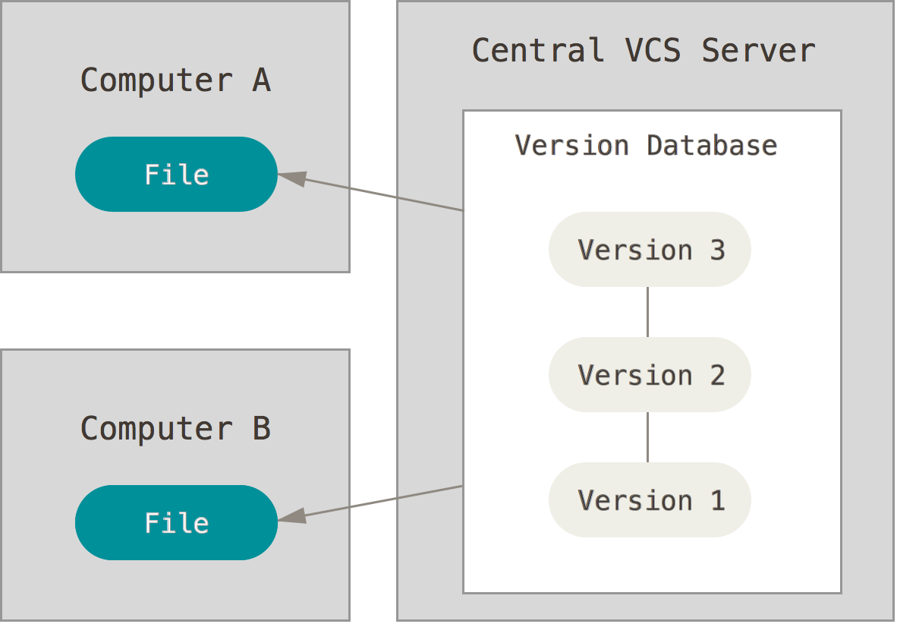
CVCS
Central VCS is when your repository is located on remote server
You can send changes to server
You can get other guys changes from server
Pros:
Better then nothing
Cons:
Need periodic backup
You cannot get specific version if server is unavailable

Slide 5
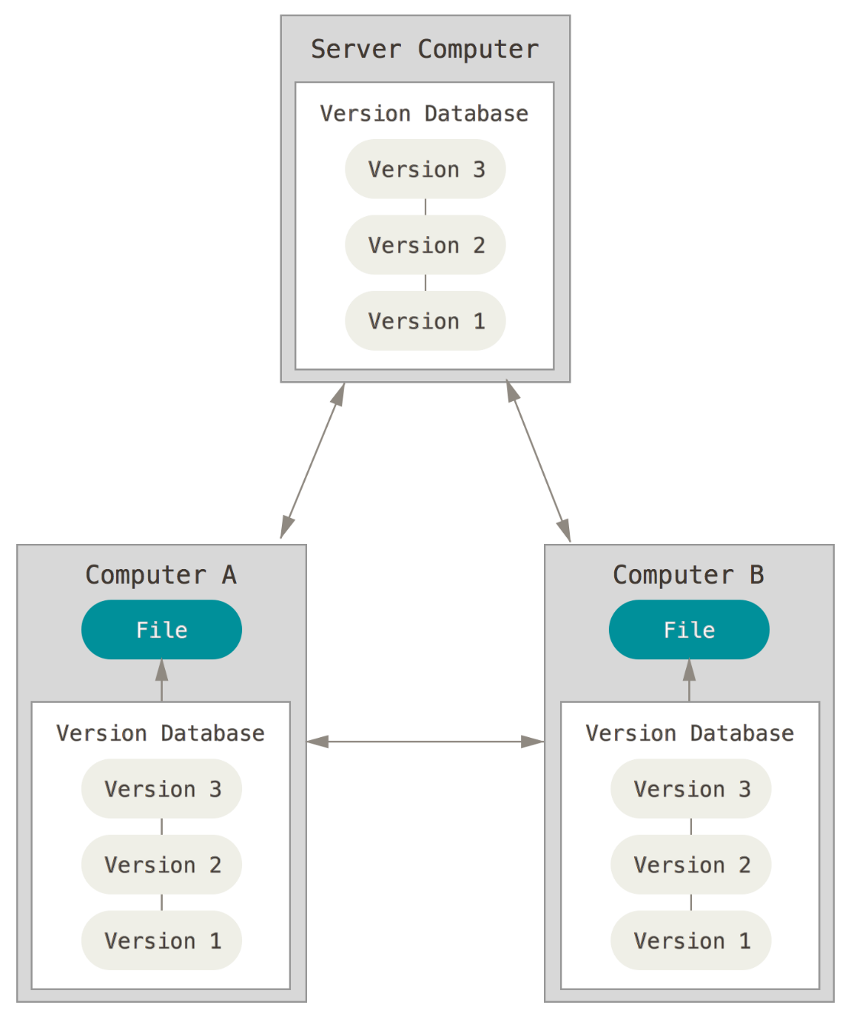
DVCS
Distributed VCS is the same as CVCS, but you have it full copy locally.
Pros:
You won’t lose you files as you can recover from anybody else from the team
It allows you to work offline
Cons:
Any known ☺

Slide 6
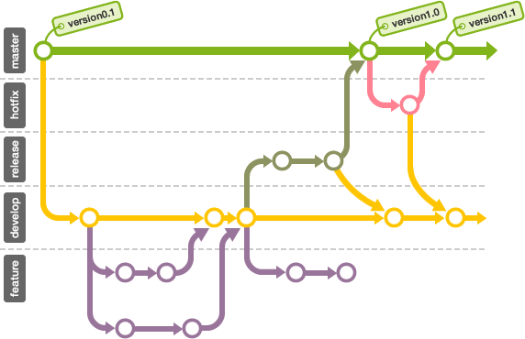
Commit and Branch
Commit is the way to record changes in repository.
Branches are used to develop features isolated from each other.

Slide 7

GIT
GIT is a DVCS.
GIT is a command-line tool.
GIT is easy.
GIT is cool.
GIT creation was inspired by legendary Linus Torvald for tracking Linux kernel development.

Slide 8
Get installation
First, you need to install GIT client on your PC:
https://git-scm.com/downloads
After installation you need to tell GIT who you are:
git config --global user.name <username>

Slide 9

Basics

Slide 10
Create a new repository
create a new directory, open it and perform a
git init
to create a new git repository.

Slide 11
Add & commit
to add changes to Index, perform below command
git add <filename>
run
git commit -m <commit_message>
to commit changes to HEAD

Slide 12
Look around
in order to see existing commits, run
git log
to checkout some specific commit, run
git checkout <revision>
git checkout -

Slide 13
Get in touch with remote repo
you can get remote repo copy by running
git clone <URL>
or add remote repo by running
git remote add origin <URL>

Slide 14
Push
your commits can be proposed for remote server by
git push origin master
origin is a name of remote
master is local branch name that will be pushed

Slide 15
Task
Open git.epam.com
Login with your EPAM credentials
Create new repository
Create local GIT repository with few files
Push local repository to remote
Send link to result to Yurii_Drozd@epam.com

Slide 16
Questions?

Slide 17
Thanks for attention!

