Slide 1

Introduction to GIT…
AND CI
Yurii Drozd
23 March 2016

Slide 2
Open questions
How to find all local repositories? Basically there is no GIT command for searching local repositories… but you can always search for .git folders.
How to clone only specific branch?
git init
git remote add -t refspec remotename host:/dir.git
git fetch
Typical issues of first usage.
Putting large files into repo
Not writing commit messages

Slide 3
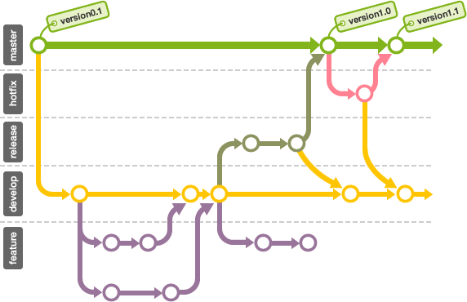
Branching
The most powerful feature of GIT is branching.
Basically it’s an ability to work in parallel with different people and different tasks

Slide 4
Branching
you can create branch in local repository by running
git checkout –b <branch name>
OR
git branch <branch_name>
git checkout <branch_name>

Slide 5
Merging
you can merge branch1 into branch2 to by runnning
git checkout branch2
git merge branch1

Slide 6
Merging strategies
There are different states of branches merging can be done with different strategies
Resolve – safe and fast
Recursive – default
Octopus – for more then 2 HEADs
Ours – override other branches
Subtree – advanced recursive

Slide 7
Fetch
you can update your repository history with remote with:
git fetch <remote>
git fetch <remote> <rbranch>:<lbranch>

Slide 8
Sync
you can update your branch state with remote changes with:
git fetch <remote>
git merge <branch> <remote>/<branch>
OR
git pull <remote> <rbranch>

Slide 9
Pulling is bad
Running just git pull without parameters is considered a bad practice
You don’t know what are you going to merge automatically
With even auto merges you will get merge commit (fast-forward is exception)
Forget about git pull!

Slide 10
True way to update
I found this way of update to be working the best:
git pull –-rebase <remote> <rbranch>

Slide 11
Pull (merge) request
Pull requests are the way to review changes that are going to be merged from feature branch to develop. This is not a standard GIT option, it’s built on top of it.
Pull requests visualize the result of the following command without actually applying changes:
git fetch
git checkout origin/develop
git checkout origin/feature git checkout –b temporary
git merge feature

Slide 12
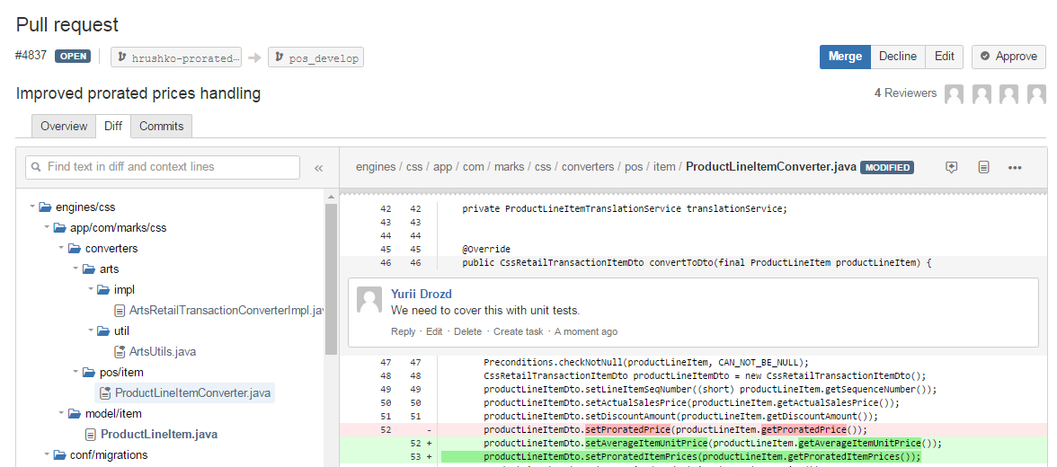
Pull (merge) request

Slide 13
Continuous Integration
CI is a development practice that requires developers to integrate code into a shared repository several times a day. Each check-in is then verified by an automated build, allowing teams to detect problems early.
There are many CI tools that enables teams to do automated builds flexible and reliable.
CI is impossible without VCS.
Continuous Deployment is closely related to Continuous Integration and refers to the release into production of software that passes the automated tests.

Slide 14
Jenkins
Jenkins is one of the most popular CI tools on market. It’s open-source, free and cross-platform.
Basics of Jenkins are nodes, executors and jobs.
Node is a remote machine with Jenkins agent running on. It suites as a build server and actually assembles artifacts.
Executor is a thread on a node that can run one job at a time.
Job is a sequence of actions that generates/deploy artifact.

Slide 15
Pipeline
Sequence of CI jobs is often called “Pipeline”. It looks like below steps:
Checkout code from VCS to temporary folder
Invoke build tool (Maven, MSBuild)
Deploy artifact to remote repository (Artifactory, Nexus)
Trigger next job
Checkout artifact from repository
Deploy to target environment
Trigger next job
Checkout tests code from VCS to temporary folder
Invoke build tool
Publish tests results
Trigger next job…

Slide 17
Questions?

Slide 18
Thanks for attention!

