Slide 1
Seasafe staffing agency
Tania Zakowski
Houleye Anne
Lucie Stenger
Shashi Bhushan Singh

Slide 2

Project overview
Description of the dataset and hypothesis:
Shark attacks over different territories
how, when, and who
media covering
“There are more fatal shark attacks in Florida”
Our cleaning process:
Exploring dataset (number of unique values per column, general quality)
Defining our hypothesis, and deciding to focus on the USA data, and only keep specific columns
Cleaning the columns, re-formatting values, removing rows with outliers, adding new columns for the purpose of our analysis (date & season) using various data cleaning methods including RegEx.
Notes:
The original dataset gather records of shark attacks over different territories. It includes information on how and when the attacks happened, who was involved, and how it was recorded in the medias.
As a US staffing agency dealing with beach staffing, we believe there are more fatal attacks in Florida. Knowing if this is true or not, we will be able to optimize the number of staff and trainings.

Slide 3
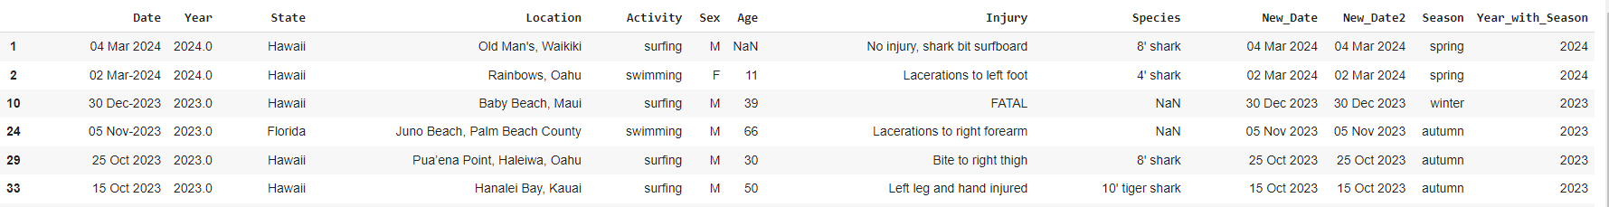
Data Wrangling and Cleaning
Significant data cleaning challenges encountered:
Many values were text entries making it difficult to categorize them and therefore analyse them. In particular, the activity the victim was doing when the attack occurred, the date of the attack, and the shark species.

Slide 4
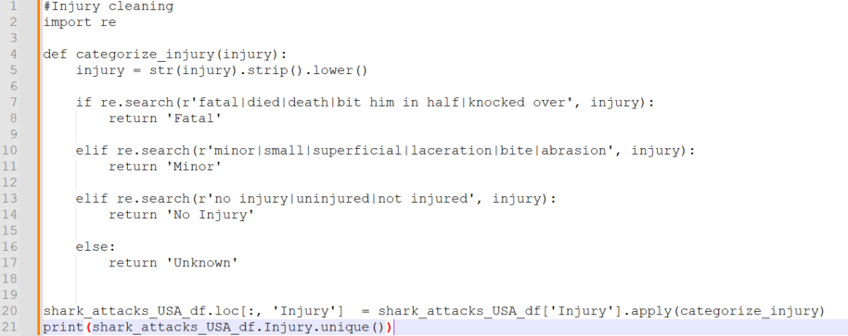
Data Wrangling and Cleaning
Explain how we resolved these challenges:
Using RegEx (re.search, re.match) and using replace function when a certain value is included in the text
limiting data referring to time by using the column Date and creating new variables
based on it to work on the same rows. Ex:

Slide 5
Exploratory Data Analysis
Methods used:
  value.count, describe(),
  groupby
  scatterplot
  library import for analysis and visualisation (numpy, seaborn, matpotlib)
Insights and pattern found:
  Most of the attacks happened during Summer and in Florida
  Most of the person attacked suffered minor injuries
Notes:
print(filtered_df.groupby(['State', 'Season'])[['Season']].count()) count of attacks per state, season, and type of injury
print(filtered_df.groupby('State')[['State']].count())
number of attacks per season, state, injury - univariate, bivariate analysis
find correlation between the location, the season and the activity

Slide 6
Major Obstacle
Biggest obstacle and difficulties:
Trying to implement a new type of data, i.e. a time serie to get timesteps logged and follow the evolution of datas through time.
The cleaning of columns and null values could be complicated because the data type must be taken into account
What we learned from it and how it influenced your project:
Dependencies resulting of the working conditions (tools and libraries/packages) especially when all collaborators don’t have similar settings

Slide 7
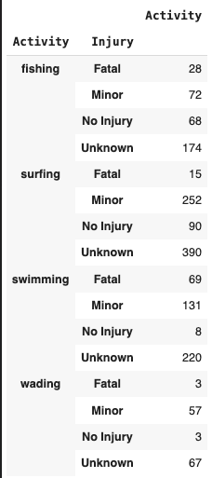
Conclusion and Insights
Our initial hypothesis is supported by the very large variability of the number of attacks depending on the location (particularly Florida), a seasonal effect can be seen in Florida while not in Hawaii. We observed more fatal attacks in Florida.
Attacks were found for many categories of activity, but their number is largely dominated by surfing, followed by swimming. Nonetheless, attacked were more likely to be deadly when swimming than surfing.
Potential implications of our findings: implementation of timestamp would be useful for our company, checking if adjustment in staff have meaningful impact and if global warming impacts the location of attacks.

Slide 8
Thank you!
Seasafe staffing agency
Tania Zakowski
Houleye Anne
Lucie Stenger
Shashi Bhushan Singh

