Slide 1
Recurrent Problem

Slide 2

2.1 RECURRENCE RELATIONS
Define and develop a recurrence relation
Model a problem using recurrence relation
Find the solution of recurrence relations
with the given initial conditions
CHAPTER 2 ADVANCE COUNTING TECHNIQUE
Notes:
‹#›

Slide 3
2.1 RECURRENCE RELATION
Motivation
The number of bacteria in a colony doubles every hour. If the colony begins with 5 bacteria, how many will be present in n hours?
Let an : the number of bacteria at the end of n hours
Then;
an = 2an-1, a0=5
What we are doing actually?
We find a formula/model for an (the relationship between an and a0) – this is called recurrence relations between the term of sequence.
Solution:
By using recursive definition
Since bacteria double every hour Initial condition

Slide 4
Recursive (Inductive) Definitions
Recursion – a process to define an object explicitly
The object can be a sequence, function or set (for BCT2078 purposes)
The ideas – construct new elements from known elements.
Process – specify some initial elements in a basis step and provide a rule for constructing new elements from those we already have in the recursive step.
Mathematical Induction can be used to prove the result.
The given complex problem
Can be
solved if
This simple version can be solved
Can be
solved if
Can be
solved if
This simple version can be solved
an = 2an-1 an-1 = 2an-2, a1 = 2a0, a0=5

Slide 5
Recurrence Relation
A recurrence relation for the sequence {an} is an equation that expresses an in terms of one or more of the previous terms of the sequence, namely, a0, a1,…, an-1, for all integers n with n ≥ n0, where n0 is a nonnegative integer.
A sequence is call solution of a recurrence relation if its term satisfy the recurrence relation.
an = 2an-1
a0 = 5
Recurrence relation
Recursive
definition
Initial condition
A recursive algorithm provides the solution of a problem of size n in term of
the solutions of one or more instances of the same problem in smaller size.
The initial condition specify the terms that precede the first term where
the recurrence elation takes effect.

Slide 6
Example 2.1.1
Let {an} be a sequence that satisfies the recurrence relation an = an-1 – an-2 for n = 2, 3,4, and suppose that a0 =3 and a1 = 5.
List the first four term.
a0 = 3
a1 = 5
a2 = a1 – a0 = ___________________
a3 = __________________________
What is a5?
a5 = __________________________

Slide 7
Example 2.1.2
Determine whether {an} where an = 3n for every nonnegative integer n, is a solution of recurrence relation an = 2an-1 – an-2 for n = 2, 3, 4, …
Suppose that an = 3n for every nonnegative integer n, Then for n ≥ 2;
2an-1 – an-2 = ___________________
Therefore,
Determine whether {an} where an = 5 for every nonnegative integer n, is a solution of recurrence relation an = 2an-1 – an-2 for n = 2, 3, 4, …
2an-1 – an-2 = ___________________

Slide 8
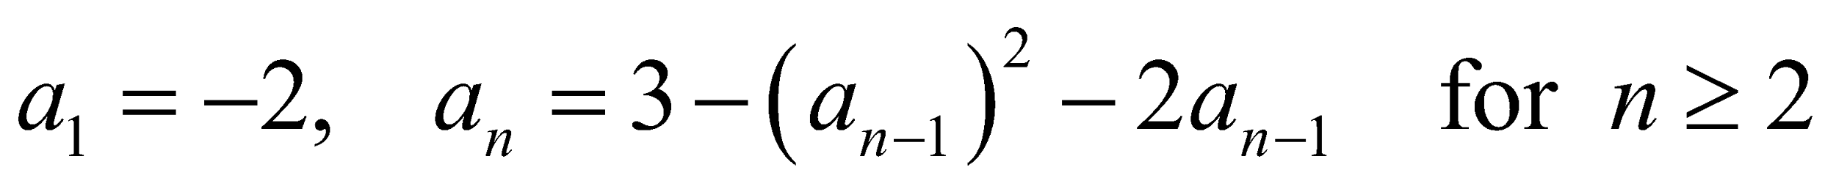
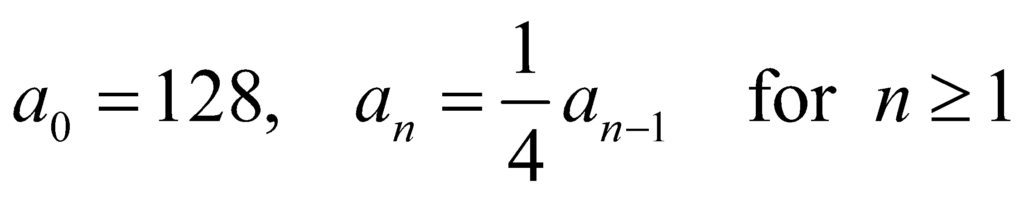
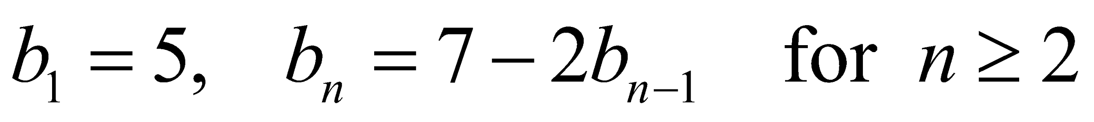
EXERCISE 2.1
Let an denotes the nth term of a sequence satisfying the given initial condition (s) and the recurrence relation. Compute the first four terms of the sequence.
A
B
C
D
E

Slide 9
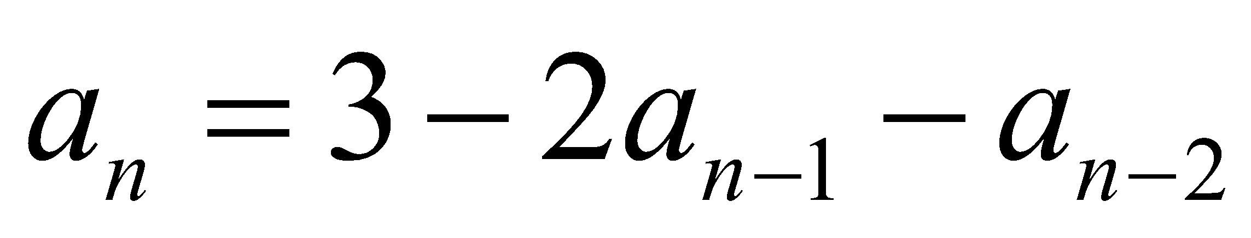
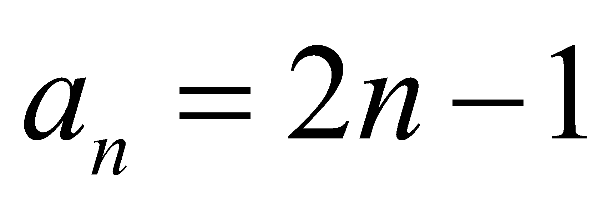
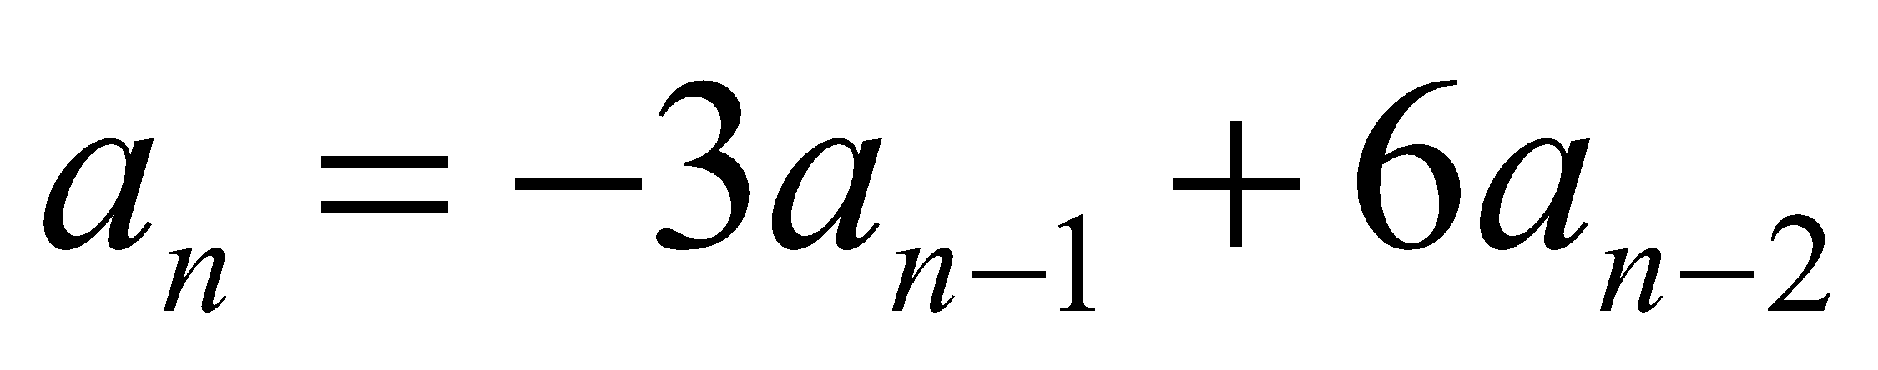
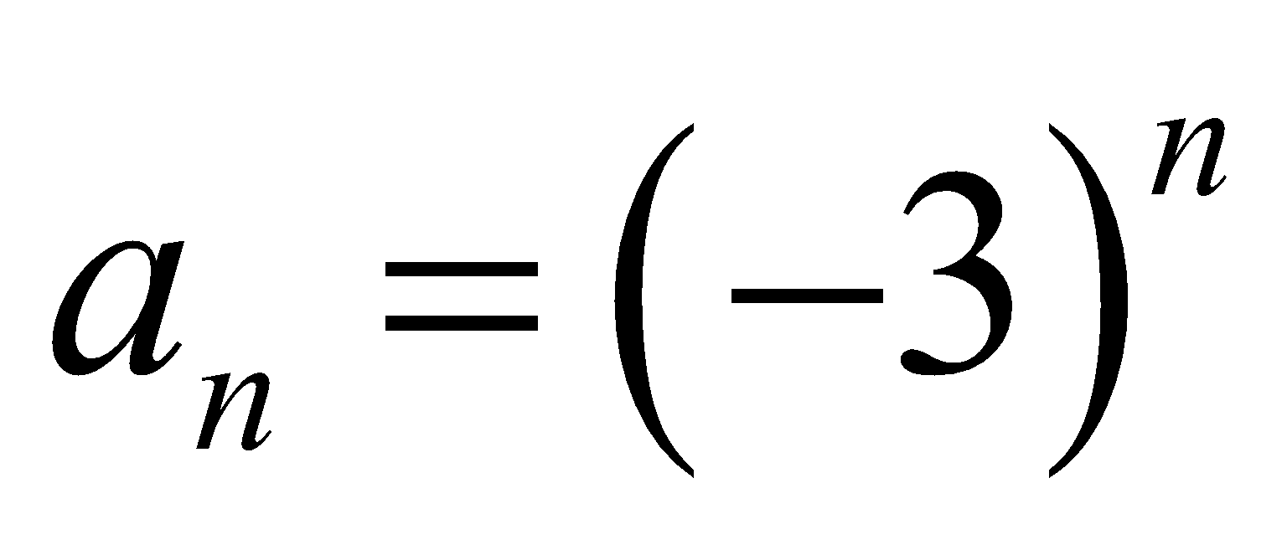
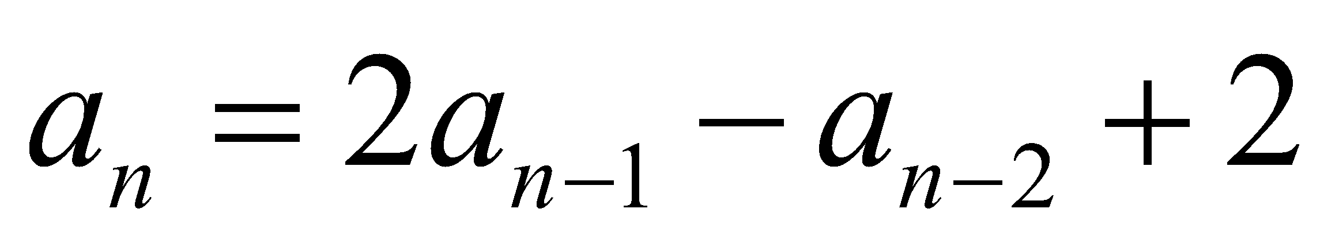
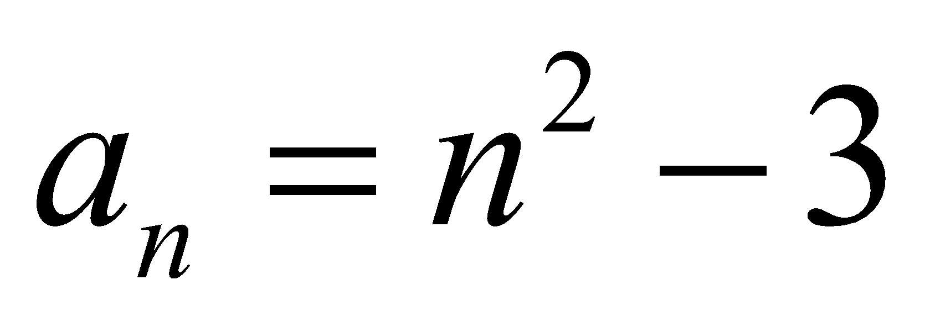
EXERCISE 2.1
Is the sequence {an} a solution of the if
Is the sequence {an} a solution of the if
Show that the sequence {an} is a solution of the recurrence
relation if

Slide 10
Modeling with Recurrence Relation
We can use recurrence relation to model a wide variety of problems such as
Finding a compound interest
Counting a population of rabbits
Determining the number of moves in the Tower of Hanoi puzzle
Counting bit strings

Slide 11
Example 2.1.3: Compound interest
Suppose that a person deposits RM10,000 in a savings account at a bank yielding 11% per year with interest compounded annually. Define recursively the compound amount in the account at the end of n years.
Let an : the amount in the account after n years
Then;
an = (compound amount at the end of (n -1)th years)
+ (interest for the nth years)
an = an-1 + 0.11an-1
= 1.11 an-1
With initial condition; a0 = 10,000
Solution:

Slide 12
Example 2.1.4: Population of rabbits
A young pair of rabbits (one of each sex) is placed on an island. A pair of rabbits does not breed until they are 2 months old. After they are 2 months old, each pair of rabbits produces another pair each month. Find a recurrence relation for the numbers of pairs of rabbits on the island after n months if all the rabbits alive.
Let fn : the numbers of pairs of rabbits on the island after n months
Then;
fn = (number of pairs of rabbits in (n -1)th months)
+ (number of newborn pairs of rabbits)
fn = fn-1 + fn-2
With initial condition; f1 = 1 and f2 = 1 ; n ≥ 3
Solution:
WHY???
[Problem develop by Leonardo Pisano (Liber abaci, 13th century) – lead to Fibonacci number]

Slide 13
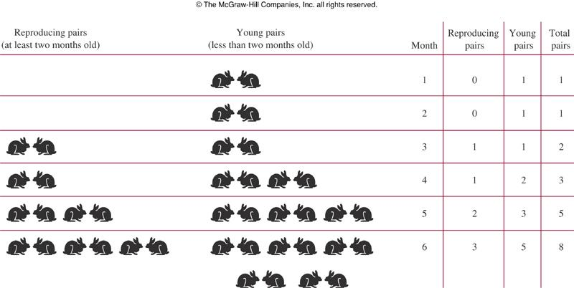
Example 2.1.4: Population of rabbits

Slide 14
Problems with Recursive Solution
Easy to solve small problem.
Refers to previous steps and so on becomes hard to solve problems that are relatively large.

Slide 15
Tower of Hanoi Problem
Invented by the French mathematician Edouard Lucas in 1883.
Given a tower of n disks, initially stacked in decreasing size on one of three pegs.
The objective is
Transfer the entire tower to one of the other pegs.
Move only one disk at a time.
Never move a larger one onto a smaller.

Slide 16
Tower of Hanoi : 3 Disks START
BEG
AUX
END

Slide 17
Tower of Hanoi : 3 Disks FINISH
BEG
AUX
END

Slide 18
Tower of Hanoi : Recursive Solution
Let’s call the three peg BEG(Source), AUX(Auxiliary) and END(Destination).
Move the top N – 1 disks from the BEG to AUX tower using END
Move the Nth disk from BEG to END tower
Move the N – 1 disks from AUX tower to END tower using BEG

Slide 19
Tower of Hanoi : 3 Disks
Move n-1 disks from BEG to AUX using END
BEG
AUX
END

Slide 20
Tower of Hanoi : 3 Disks
BEG
AUX
END

Slide 21
Tower of Hanoi : 3 Disks
BEG
AUX
END

Slide 22
Tower of Hanoi : 3 Disks
Move largest one from BEG to END
BEG
AUX
END

Slide 23
Tower of Hanoi : 3 Disks
Move n-1 disks from AUX to END using BEG
BEG
AUX
END

Slide 24
Tower of Hanoi : 3 Disks
BEG
AUX
END

Slide 25
Tower of Hanoi : 3 Disks
BEG
AUX
END

Slide 26
Tower of Hanoi : 3 Disks
BEG
AUX
END

Slide 27
Tower of Hanoi : No. of Moves, T_{n}
for 1 disk it takes 1 move to transfer 1 disk from BEG to END;
for 2 disks, it will take 3 moves: 2 T_{n-1} + 1 = 2(1) + 1 = 3
for 3 disks, it will take 7 moves: 2 T_{n-1} + 1 = 2(3) + 1 = 7
for 4 disks, it will take 15 moves: 2 T_{n-1} + 1 = 2(7) + 1 = 15
for 5 disks, it will take 31 moves: 2 T_{n-1} + 1 = 2(15) + 1 = 31
for 6 disks... ?

Slide 28
Tower of Hanoi : No. of Moves, T_{n}
Explicit Pattern
Number of Disks Number of Moves 1 1 2 3 3 7 4 15 5 31
T₀ = 0
T_{n} = 2 T_{n-1} + 1,n>0

Slide 29
Tower of Hanoi : Recursive Solution Difficulties
T₇ = ?
T₇ = 2 T₆ + 1
= 2(2 T₅ + 1) + 1
= 4(2 T₄ + 1) + 3
= 8(2 T₃ + 1) + 7
= 16(2 T₂ + 1) + 15
= 32(2 T₁ + 1) + 31
= 64(2 T₀ + 1) + 63
= 64 × 0 + 64+ 63
= 127
T₅₀ = ?
T₅₀ = 2 T₄₉ + 1
= 2(2 T₄₈ + 1) + 1
= 4(2 T₄₇ + 1) + 3
= 8(2 T₄₆ + 1) + 7
……………………….
=?

Slide 30
Tower of Hanoi : Finding Closed Form
Explicit Pattern
Number of Disks Number of Moves 1 1 2 3 3 7 4 15 5 31
Powers of two help reveal the pattern
Number of Disks Number of Moves 1 2¹ - 1 = 2 - 1 = 1 2 2² - 1 = 4 - 1 = 3 3 2³ - 1 = 8 - 1 = 7 4 2⁴ - 1 = 16 - 1 = 15 5 2⁵ - 1 = 32 - 1 = 31
T_{n} = 2 ^{n} - 1
A Closed Form

