Slide 1
CSE235 Numerical Methods
Md. Monarul Islam Mithu
Lecturer, Daffodil International University
Dept. Of CSE

Slide 2
Course Introduction
Name: Numerical Methods / Numerical Analysis (Theory Course)
Credit: 3
Batch: 59
Section: B

Slide 3
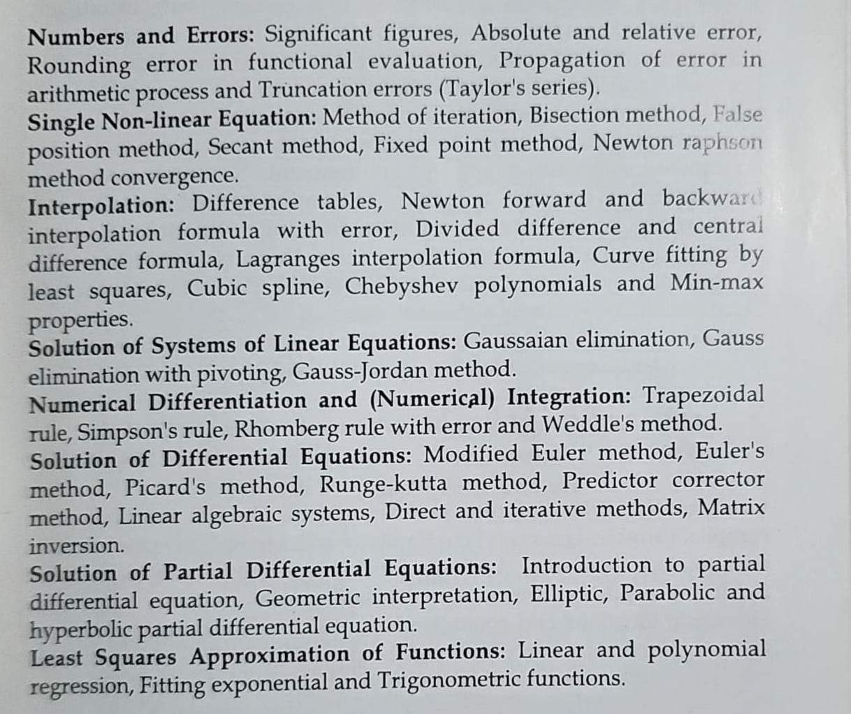
Course Contents

Slide 4
What is Numerical Analysis
Numerical methods provide a way to solve problems quickly and easily compared to analytic solutions.
What is analytical solution?? What is difference between analytical solution vs numerical solution ??

Slide 5
Why Numerical Analysis ??
Computing integrals and derivatives
Solving differential equations
Building models based on data, be it through interpolation, Least Square, or other methods
Root finding and numerical optimization
Estimating the solution to a set of linear and nonlinear equations
Computational geometry

Slide 6
Why Numerical Analysis for CSE engineers??
Development and computation of optimal control algorithms
Machine learning algorithms, like estimating optimal weights of parametric models using only subsets of the full dataset (like stochastic gradient descent)
Filtering of noisy data based on an approximately expected machine learning model.

Slide 7
Be Careful!!
Numerical analysis is typically hard course but I will try to make it easy if you all are cooperative with me.

Slide 8
Thank you

