Slide 1

Introduction
Prepared by: Tanim Ahmed

Slide 2
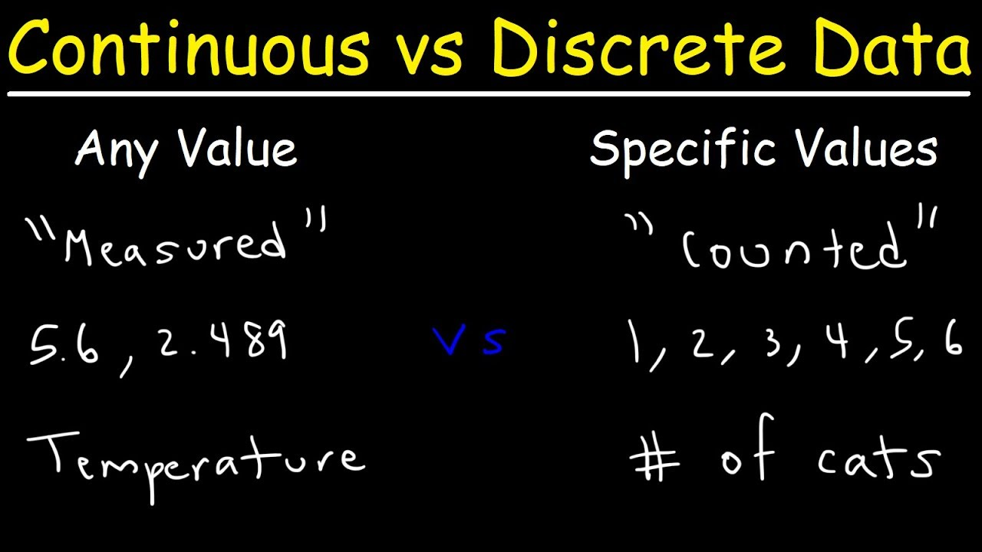
Discrete vs Continuous

Slide 3
Why do we need to study Math for CS?
Improving problem solving capabilities
Logical Reasoning
Mathematical Proofs
Complexity of Algorithm

Slide 4

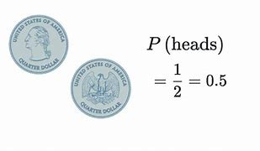
Probability

Slide 5
Others Issue
Graph
Tree
Sorting
Counting

Slide 6
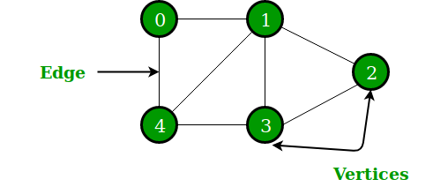
Graph
Application:
1.Google Maps
2.Facebook friends mutual, post suggestion,
Friend suggestion, recommendation in social media content
3.In search engine web page ranking

Slide 7
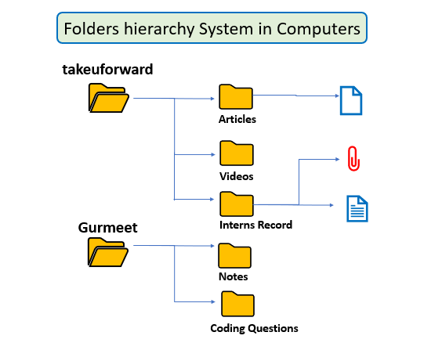
Tree data structure

Slide 8
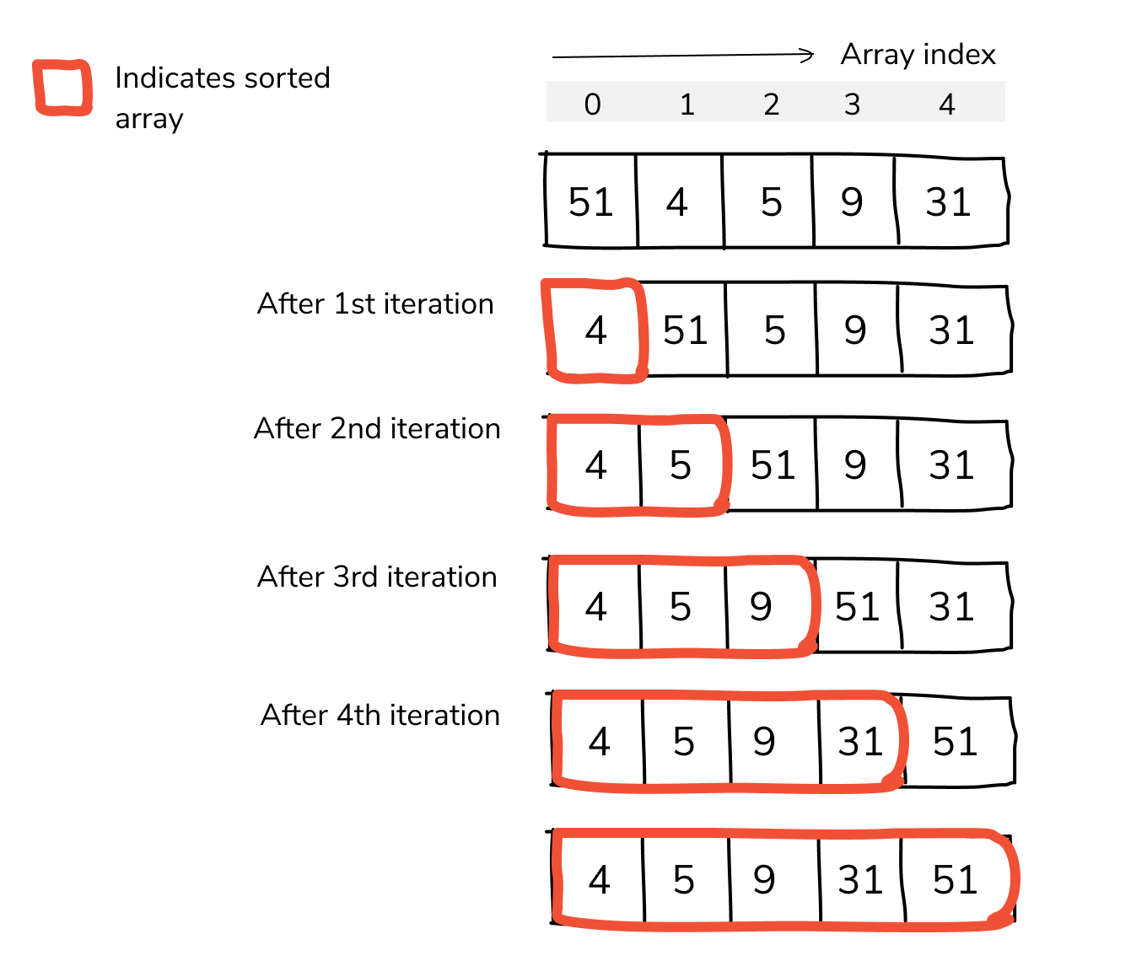
Sorting and Counting

