Slide 1
Superstore Sales Dashboard Summary
Created using Power BI
June 2025

Slide 2
Objective
To design an interactive dashboard that provides key business insights to stakeholders.
Built using Power BI with slicers, time analysis, KPIs, and visual interactivity.

Slide 3
Dataset Used
Dataset: Superstore Sales (from Kaggle)
Metrics tracked: Sales, Profit, Order Quantity, Category, Region, Date

Slide 4
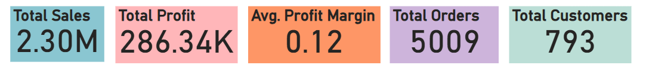
Key Performance Indicators
Total Sales
Total Profit
Average Order Value
Monthly Growth Rate
Top Region & Top Product

Slide 5
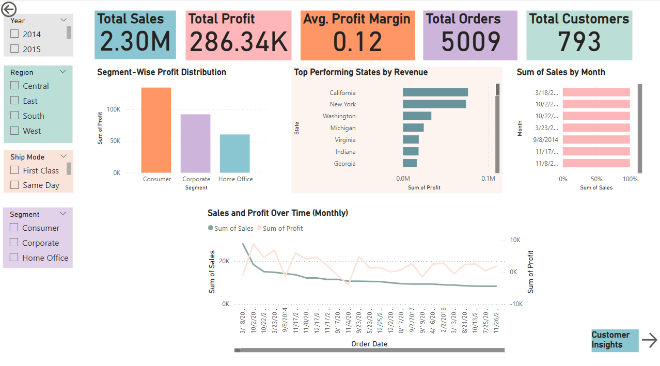
Interactivity & Features
Slicers: Filter by Year, Region, Category
Time-series charts for trend analysis
Cards summarizing totals
Category-wise sales performance
Consistent theme and color palette

Slide 6
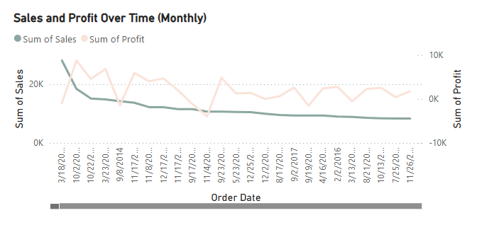
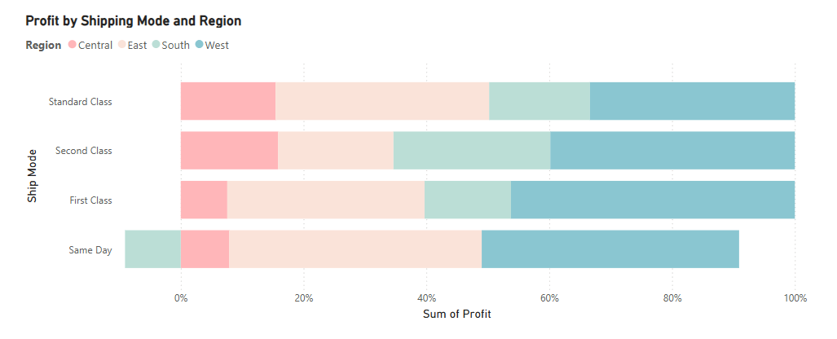
Key Insights
Q4 has the highest sales every year.
2023 recorded the highest overall sales.
Technology is the most profitable category.
West region leads in both sales and profit.
Phones top sales; Copiers top profit.
Tables result in lowest or negative profit.
Corporate segment drives the most revenue; Home Office is growing fast.

Slide 7



Navigation & Bookmarks
Implemented bookmark buttons for easy navigation.
Pages: Sales Overview, Customer Insights, Product Analysis, Region Performance.

Slide 8
Conclusion
Dashboard enables quick, visual decisions.
Interactive filters allow user-driven exploration.
Strong foundation for future analytics reporting.

Slide 9
Thank You
Questions? Feedback?
Name – Tanima Das
Email – tanimadas700@gmail.com

