Slide 1
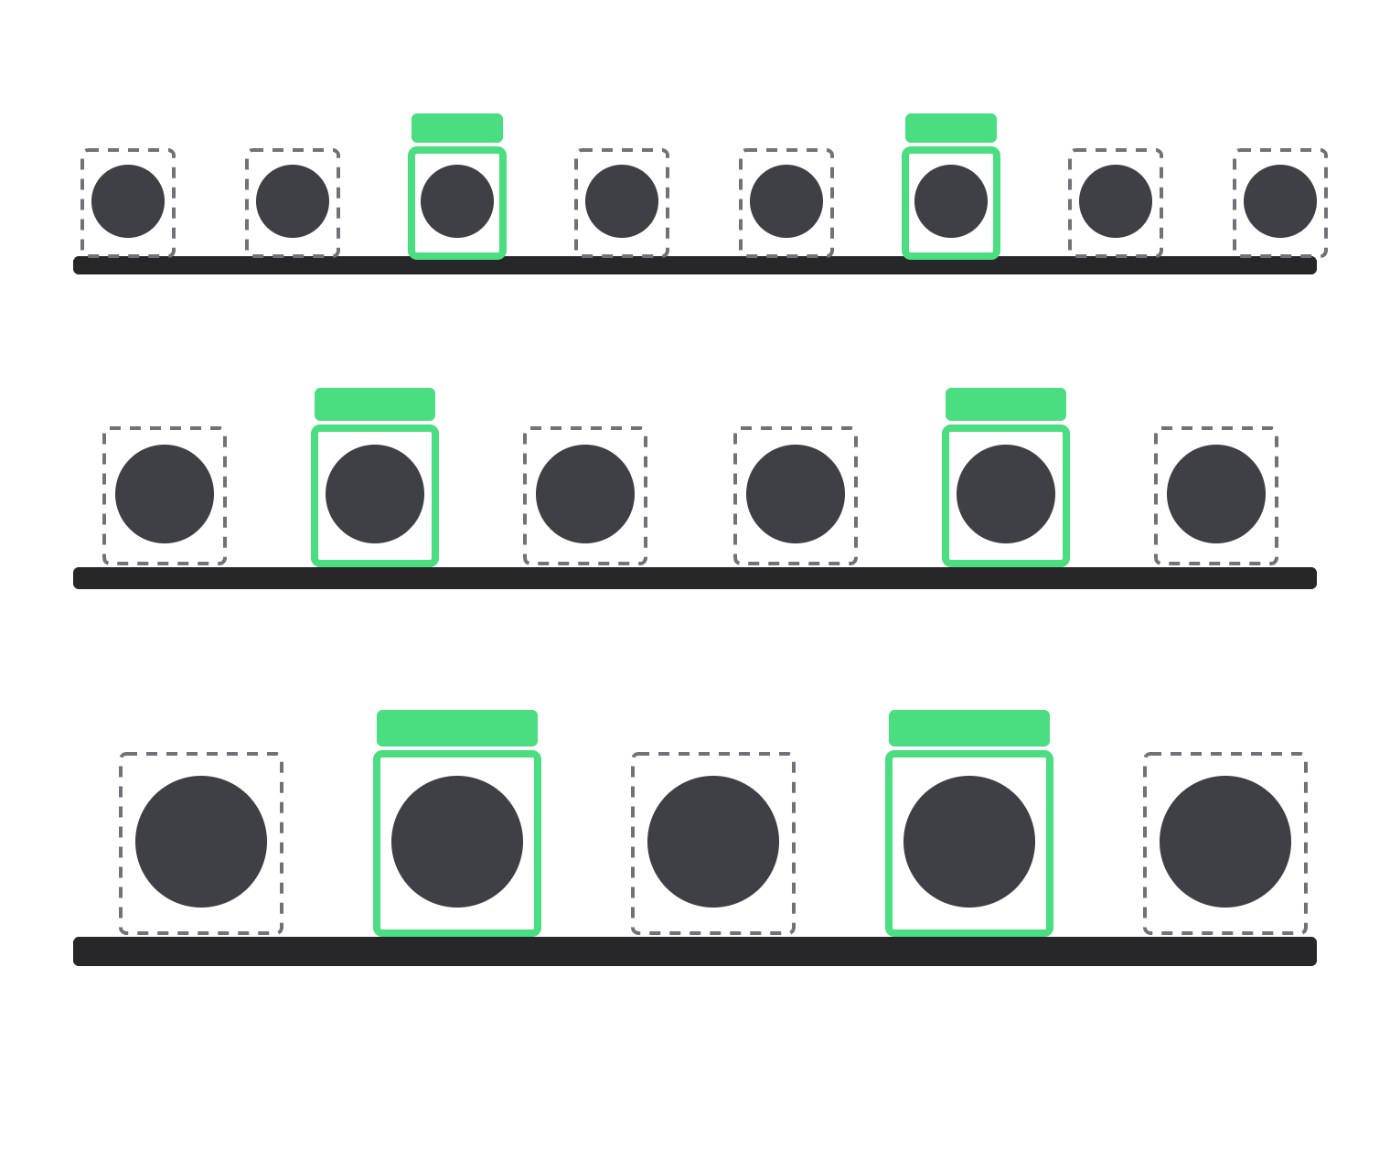
QuickPic
IPCV · SEMESTER VII · TEAM 25
One photo. The whole register.
Open-set face recognition for classroom attendance from a single group photograph
Tanish Mittal · Shashank Kanaujiya · Utkarsh Raj Singh · Shinde Ritesh Tirupati
Motilal Nehru National Institute of Technology Allahabad
Notes:
Tanish opens. “Good evening. We are Team 25. Our project is QuickPic: the teacher takes one photo of the class, and the system produces the attendance register.” Introduce the four members in one line each; say each will present the part they built.

Slide 2
Roll call takes minutes. One class photo should be enough, but three things make it hard.
TANISH · THE PROBLEM
30 px
~85 %
69–102
Tiny faces
Mostly strangers
Real conditions
Back-row faces are a few dozen pixels tall, far below what detectors and recognisers are tuned for.
Most faces in our photos belong to people who are not enrolled. The system must say “unknown”, not guess.
Faces per photo, with turned heads, uneven light, and photos taken two years before enrollment.
QuickPic · Team 25
02
Notes:
Tanish. The setting: the teacher takes ONE photo of the whole room. Three difficulties. (1) Size: back-row faces are only ~30 pixels tall. (2) Open set: of 804 labelled faces in our 10 class photos, only 117 are enrolled students, so about 85% must be rejected as unknown. A system that always returns the nearest student would mark absent students present. (3) Real conditions: up to 102 faces per photo, turned heads, uneven light; our class photos are from 2024, enrollment photos from 2026.

Slide 3
Frozen pretrained networks, plus our own classroom-aware decision layer
TANISH · OUR APPROACH
Detect
Tiling
Align
Embed
Match
Assign
SCRFD, 5 landmarks
ours
112 × 112
ArcFace, 512-d
degraded gallery · ours
Hungarian · ours
Why not retrain?
What we built instead
ArcFace learned from hundreds of thousands of people. Retraining on a few hundred Indian faces would likely make it worse, and needs a GPU.
Three classroom fixes around the networks, each switchable, so we can measure exactly what each one adds.
QuickPic · Team 25
03
Notes:
Tanish. The pipeline: detect faces and 5 landmarks (eyes, nose, mouth corners), align each face to a fixed 112×112 template, turn it into a 512-number “signature” with ArcFace, compare signatures with enrolled students, and decide names. Grey boxes are pretrained and frozen. Green boxes are our contribution. Each green part can be switched off, which is how we prove it helps (the ablation later). Hand over to Shashank for detection.

Slide 4
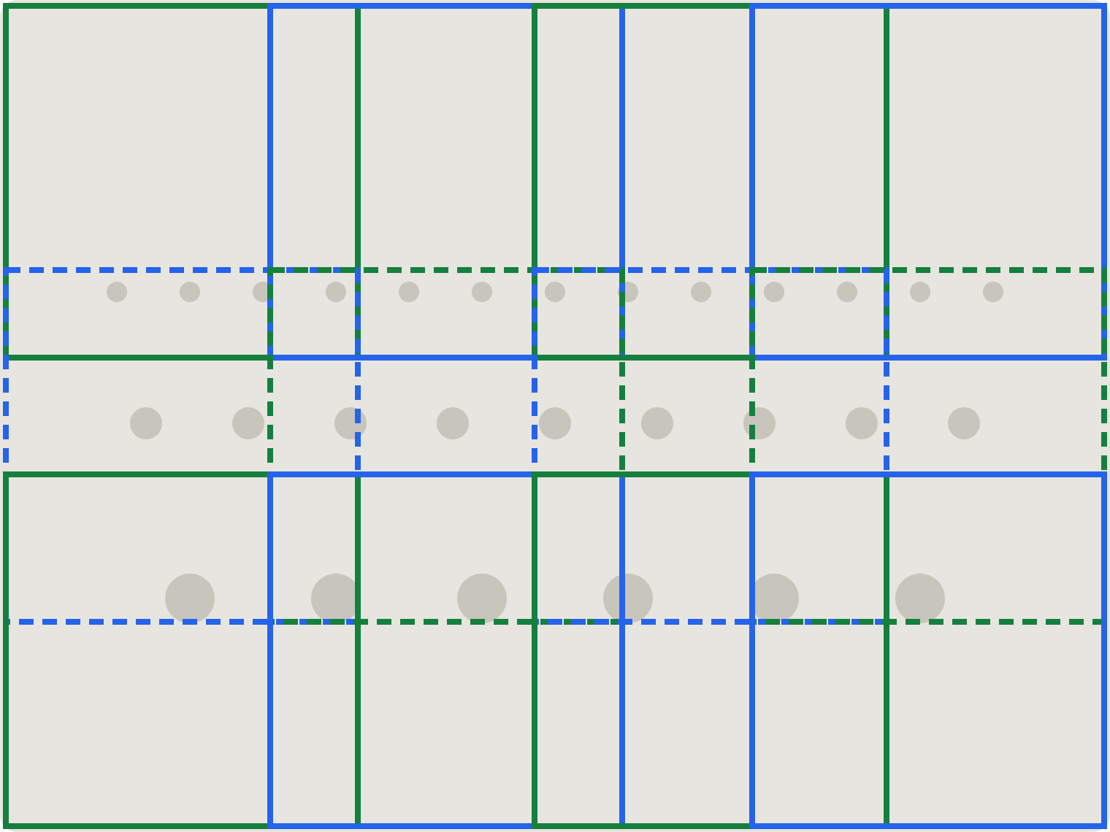
Tiling: look at the photo at full resolution
SHASHANK · DETECTION
Detectors shrink every photo to 640 px. In a 4032-px class photo, a 40-px face becomes 6 px and vanishes.
1. Cut the photo into overlapping 1280-px tiles (25 % overlap) and detect in each, plus one pass on the whole photo.
2. Drop boxes cut by a tile edge; merge duplicates with non-maximum suppression.
3. Smallest face found reliably: 96 px → 28 px.
A 4032 × 3024 phone photo covered by 12 overlapping 1280-px tiles
QuickPic · Team 25
04
Notes:
Shashank. Detectors resize the input to 640×640, so a 4032-pixel photo is shrunk about 6 times and small faces disappear. Our fix: overlapping 1280-pixel tiles at full resolution, plus one full-image pass for large faces. Boxes cut by an inner tile edge are dropped (the neighbouring tile sees that face whole), then duplicates are merged with non-maximum suppression at IoU 0.4. On a controlled test (a sample photo shrunk to each size), the smallest reliably detected face went from 96 px to 28 px for SCRFD-10GF.

Slide 5
Tiling raises recall for every detector we tried
SHASHANK · DETECTION RESULTS
Detector | Whole photo | With tiles | ms / photo
SCRFD-10GF (used) | 87.9 % | 97.4 % | 1167
SCRFD-500MF | 80.5 % | 94.6 % | 135
YuNet | 83.4 % | 96.3 % | 102
Haar cascade | 5.0 % | 74.8 % | 347
5 → 75 %
Even the classical Haar detector (2001) goes from almost nothing to three faces in four.
YuNet is close to SCRFD but adds 66 false boxes, so we keep SCRFD.
Recall on 793 hand-labelled faces in 10 real class photos (4032 × 3024). CPU time on an Apple M2 laptop.
QuickPic · Team 25
05
Notes:
Shashank. Recall = share of labelled faces the detector finds (a detection counts if it overlaps a labelled box at IoU ≥ 0.4). We labelled every face in 10 class photos ourselves with a small labelling tool: 793 faces. Tiling helps every detector: SCRFD 87.9 → 97.4%, YuNet 83.4 → 96.3%, the old Haar cascade 5 → 75%. Cost: about 12× more computation, roughly a second per photo on CPU, under a second on the laptop GPU. Honest caveat: the labelling tool proposed boxes using tiled SCRFD, which slightly favours it. Next: the answer key we scored against.

Slide 6
Building the answer key: every face in 10 photos, labelled by hand
SHASHANK · GROUND TRUTH
01
Propose every possible face
Our labelling tool runs tiled SCRFD at a low threshold (0.3), so almost nothing is missed.
804
117
faces labelled
student appearances
02
Tag each box
An enrolled student’s roll number, “unknown”, or “not a face”. Click the photo to add a face the detector missed.
676
11
03
Score against it
A detection counts as a face when it overlaps a labelled box by IoU ≥ 0.4. Runs locally; no photo leaves the laptop.
strangers to reject
false boxes, not faces
QuickPic · Team 25
06
Notes:
Shashank. No public dataset matches our task, so we built our own answer key. A small local web tool shows each class photo with every candidate face: tiled SCRFD at a deliberately low threshold of 0.3, so that as few faces as possible are missed. For each box we choose an enrolled student’s roll number, leave it as unknown, or mark it as not a face; faces the detector missed can be added by clicking. The boxes are frozen into a JSON label file per photo. Result: 804 labelled faces across 10 photos (69–102 each): 117 appearances of our 15 enrolled classmates, 676 other people who must be rejected, and 11 boxes that were not faces. Every accuracy number in this talk is scored against this key. It runs only on our laptop, and only aggregate numbers leave it. Honest caveat: since the tool proposes boxes with SCRFD, detection recall slightly favours SCRFD.

Slide 7
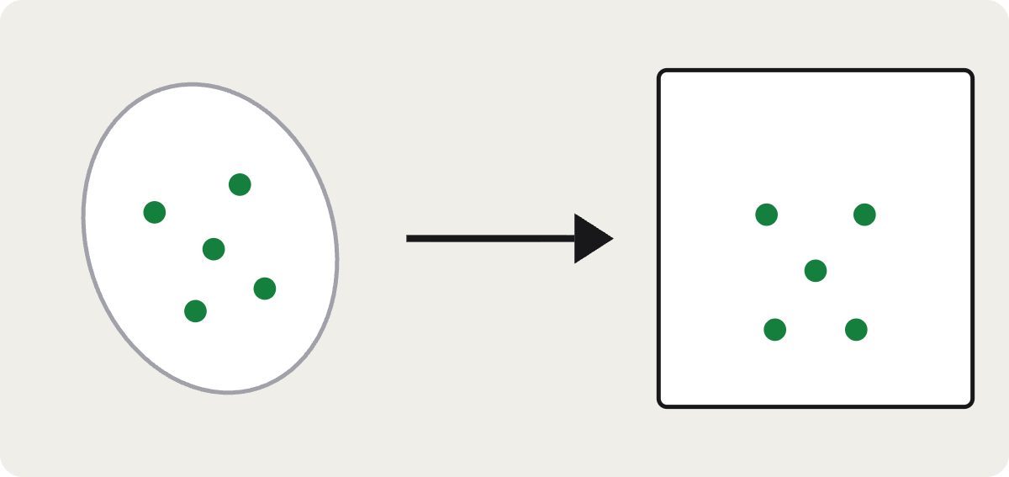
Image processing prepares every face
SHASHANK · ALIGNMENT AND IMAGE QUALITY
Quality checks on registration photos
Check | How it is measured
Sharpness | Variance of the Laplacian ≥ 15
Lighting | Mean brightness 45–215
Size | Face at least 120 px tall
Head turn | Nose offset ÷ eye distance
Five landmarks are mapped onto a fixed template by a least-squares similarity transform (rotate, scale, shift): an upright 112 × 112 crop.
The head-turn estimate tells “facing the camera” (under 0.15) from “turned to one side” (0.12–0.8), with no extra model.
QuickPic · Team 25
07
Notes:
Shashank. After detection, every face is aligned. The detector gives five landmarks. We solve, by least squares, for the similarity transform (rotation + uniform scale + translation, 4 parameters) that best maps them onto the standard ArcFace template, and warp the face with OpenCV into an upright 112×112 crop. A similarity transform keeps the face’s shape; an affine or perspective warp would distort it. Alignment matters a lot: the same face aligned from two different detectors’ landmarks scored 0.75–0.98 similarity, different people at most 0.21. For registration photos we use classical image-quality measures instead of another network: sharpness is the variance of the Laplacian (edge energy; a blurred photo has few edges), brightness is the mean grey level of the aligned crop, size is the face box height, and head turn is the horizontal offset of the nose from the midpoint between the eyes, divided by the eye distance. The same yaw measure checks that the left and right photos are turned in opposite directions. Hand back to Tanish for recognition.

Slide 8
Two fixes so that the right student gets the name
TANISH · RECOGNITION
Degraded enrollment
One face per student
Registration selfies are sharp; classroom faces are small and blurry. So each student is stored with 10 extra copies of every photo, made to look like a back-row face.
Faces are named jointly with the Hungarian method: highest total similarity, each student used once, scores under 0.35 stay unknown.
score | S1 | S2 | assigned
Face 1 | 0.62 | 0.31 | S1
Face 2 | 0.41 | 0.38 | S2, not S1 again
Face 3 | 0.29 | 0.12 | unknown
original
shrunk to 24–48 px
blurred
darker / brighter
JPEG
flipped
QuickPic · Team 25
08
Notes:
Tanish. Each face becomes a 512-number signature; we compare it with every enrolled signature by cosine similarity (1 = identical). Fix 1, degraded enrollment: a student registers 4 sharp photos; we add 10 synthetic copies of each (shrunk to 24–48 px and back, Gaussian blur, gamma/brightness, JPEG compression, horizontal flip), so a blurry back-row face has something similar to match. Fix 2, one-to-one assignment: deciding each face on its own can give two faces the same name. We solve it as an assignment problem (Hungarian method, scipy): maximise total score, each student at most once, plus an “unknown” option worth zero, so anything under the 0.35 threshold stays unknown. The table is an illustrative example: Face 2 would independently also be S1; jointly it goes to S2.

Slide 9
When two students look alike, it asks the teacher instead of guessing
TANISH · KNOWING WHEN IT IS UNSURE
If the second-best student scored almost as high as the best (gap under 0.06), the name is shown in amber with “?” on the review screen.
2 of 2
borderline mistakes flagged for review
example | score | gap | shown
correct | 0.38 | 0.071 | green
correct | 0.40 | 0.073 | green
wrong | 0.37 | 0.054 | amber ?
wrong | 0.36 | 0.053 | amber ?
2 of 115
correct names flagged unnecessarily (a plain score cut-off flagged 6)
QuickPic · Team 25
09
Notes:
Tanish. We found this while testing a fresh class photo: two strangers were given an enrolled student’s name with scores just above the 0.35 threshold. Raising the threshold would lose correct names, because some students always score low. What separated the mistakes was the gap to the runner-up: in both mistakes another student scored almost the same. So the app flags a name when the gap is under 0.06; the teacher confirms or fixes it with one click. On our 10 labelled photos it flags both borderline mistakes and only 2 of 115 correct names; a plain score cut-off at 0.42 flagged 6 correct names. The table shows the four real cases from the two test photos. Hand over to Utkarsh for benchmarks.

Slide 10
Four datasets, one honest test protocol
UTKARSH · HOW WE MEASURED
Dataset | What it contains | What it tests
LFW | 13,233 web photos of 5,749 people | Clear faces; calibration training
TinyFace | 169k natively tiny faces, about 20 × 16 px | Rejecting strangers on tiny faces
ICFD (IIT Madras) | Indian students filmed in real classrooms | Indian faces without retraining
Our class | 10 photos, 804 faces we labelled, 15 enrolled | The real task, end to end
Leave one photo out
Metrics that matter
Error bars
The cut-off is tuned on 9 photos and tested on the 10th, never on the photo being scored.
Attendance F1, students named correctly, and strangers wrongly named.
95 % intervals from 2,000 bootstrap resamples of the photos.
QuickPic · Team 25
10
Notes:
Utkarsh. Before results, how we measured. Three public datasets, each answering one question: LFW, the standard benchmark of clear web photos (and the pairs we trained calibration on); TinyFace, natively tiny faces, to test rejecting strangers when faces are small; and the ICFD sample from IIT Madras, Indian students in real classrooms, to check that the pretrained model works on Indian faces. The decisive test is our own class: 10 photos, every one of 804 faces labelled with our labelling tool, 15 enrolled classmates. To avoid fooling ourselves: the threshold is chosen leave-one-photo-out, so no photo is ever scored with a threshold tuned on itself. We report attendance F1 (quality of the present list), how many enrolled appearances are named correctly, and how many strangers get a student’s name, which is the costliest error. Error bars come from bootstrapping the 10 photos. The public benchmarks ran on a Colab GPU; class photos never left the laptop.

Slide 11
Near-perfect on clear faces, much harder on tiny ones
UTKARSH · PUBLIC BENCHMARKS
Face model | LFW | TinyFace | TinyFace open-set | Indian classroom
ArcFace ResNet-50 (used) | 99.8 % | 43.3 % | 15.0 % | 98.5 %
ArcFace MobileFaceNet | 99.5 % | 36.9 % | 21.0 % | 98.0 %
SFace | 99.4 % | 26.1 % | 17.2 % | 95.5 %
LBP histograms (classical) | 58.5 % | 20.0 % | 16.4 % | 8.0 %
No retraining needed for Indian faces
Calibration: an honest negative
98.5 % on real classroom footage from IIT Madras, with the model as it is.
Our score calibration lifts 12-px faces from 86 % to 93 % accepted, but does not help at classroom sizes, so it is off.
LFW: verification · TinyFace: rank-1 and open-set (1 % false alarms) · Indian: ICFD rank-1
11
Notes:
Utkarsh. We tested four face models on public datasets, run on a Colab GPU. LFW is the classic benchmark of clear web photos: all deep models are about 99.5%; the classical LBP method is barely above chance. TinyFace has natively tiny faces (about 20×16 px): every model drops sharply. Interesting: ResNet-50 finds the right person most often (43%) but in the open-set test (must reject strangers) MobileFaceNet does better, because ResNet-50 gives strangers high scores on tiny faces. That motivated our calibration idea: a small logistic model that adjusts the score using face size and sharpness, trained on 46,000 LFW pairs. It helps tiny faces (12 px: 86 → 93% accepted at 1% false accepts) but our class faces are 50–130 px, where it does not help, so the deployed system leaves it off. The ICFD sample from IIT Madras (Indian students in real classrooms) gives 98.5% rank-1, which is why we did not retrain on Indian faces. Next: how the same models do on our own class.

Slide 12
On our own class, ArcFace ResNet-50 is the clear choice
UTKARSH · FACE MODELS ON OUR CLASS
FACE MODEL
NAMED CORRECTLY (OF 117)
STRANGERS
121
ResNet-50 (used)
115
6
MobileFaceNet
112
6
strangers named by the classical LBP method
SFace
100
15
Hand-crafted texture features do not survive real classroom photos; learned features do.
LBP (classical)
6
121
All four models run inside the same final pipeline (tiling, degraded enrollment, one-to-one), on the same 10 photos.
QuickPic · Team 25
12
Notes:
Utkarsh. Same question as the benchmarks, but on our real task: we swap only the face model and keep everything else of the final pipeline. ResNet-50 names 115 of 117 student appearances with 6 strangers wrongly named (F1 0.966). The smaller MobileFaceNet is close (112, F1 0.962) and would be the choice on a phone. SFace misses 17 appearances (F1 0.914). The classical LBP method, texture histograms from the pre-deep-learning era, is unusable: at its best setting it names 121 strangers and only 6 students correctly. The ranking matches TinyFace rank-1, so the public benchmark predicted the classroom result. Hand over to Tanish for the effect of our fixes.

Slide 13
Each fix removes mistakes: 5× fewer strangers given a student’s name
TANISH · RESULTS ON OUR CLASS
CONFIGURATION
STRANGERS NAMED
F1
Pretrained baseline
32
0.954
115/117
+ tiling
15
0.954
+ degraded enrollment
15
0.966
+ one-to-one (final)
6
0.966
student appearances named correctly
0.8 teacher corrections per photo, down from 1.1
10 real class photos · 804 hand-labelled faces · 15 enrolled students · threshold never tuned on the photo being scored
QuickPic · Team 25
13
Notes:
Tanish. This is our main result, an ablation: we add one fix at a time and measure. The test set is 10 real class photos of our section with all 804 faces labelled by us, and 15 enrolled classmates (117 appearances). The threshold is chosen “leave-one-photo-out”: for each photo it is tuned on the other nine, never on the photo itself. The pretrained model alone is already good at the attendance list (F1 0.954), but it gives 32 strangers an enrolled student’s name. Tiling halves that to 15, degraded enrollment improves F1 to 0.966, and one-to-one assignment brings strangers named down to 6: a 5× reduction. Final system: 115 of 117 appearances named correctly, under one teacher correction per photo. Hand over to Ritesh for the app.

Slide 14

The system drafts the register; the teacher confirms it
SHINDE RITESH · THE WEB APP
1 · Create a course
Students join with a six-letter code.
2 · Upload one class photo
Every face is found and named in about a second on the laptop GPU.
3 · Review on the photo
Green named, amber ? unsure, dashed unknown. Fix any face with a click.
4 · Confirm
The photo is deleted. Insights, edits and CSV export stay.
Django + Django Ninja API · React + TypeScript · SQLite · runs fully offline on one laptop
14
Notes:
Shinde Ritesh. The web app has two roles. The teacher creates a course; students join with its code. To take attendance the teacher uploads one class photo. The server runs the whole pipeline (on the laptop GPU through Apple CoreML, under a second; 6 seconds on CPU) and opens a review screen: the photo with a box on every face, green for named students, amber with a question mark when two students looked alike, dashed for unknown people. The teacher can rename or reject any face; one face per student is enforced. On confirm, attendance is saved and the class photo is deleted. The course page (shown, with invented students) has per-lecture charts, students below 75%, and CSV export. Stack: Django with a typed JSON API (Django Ninja), SQLite, and a React + TypeScript frontend.

Slide 15
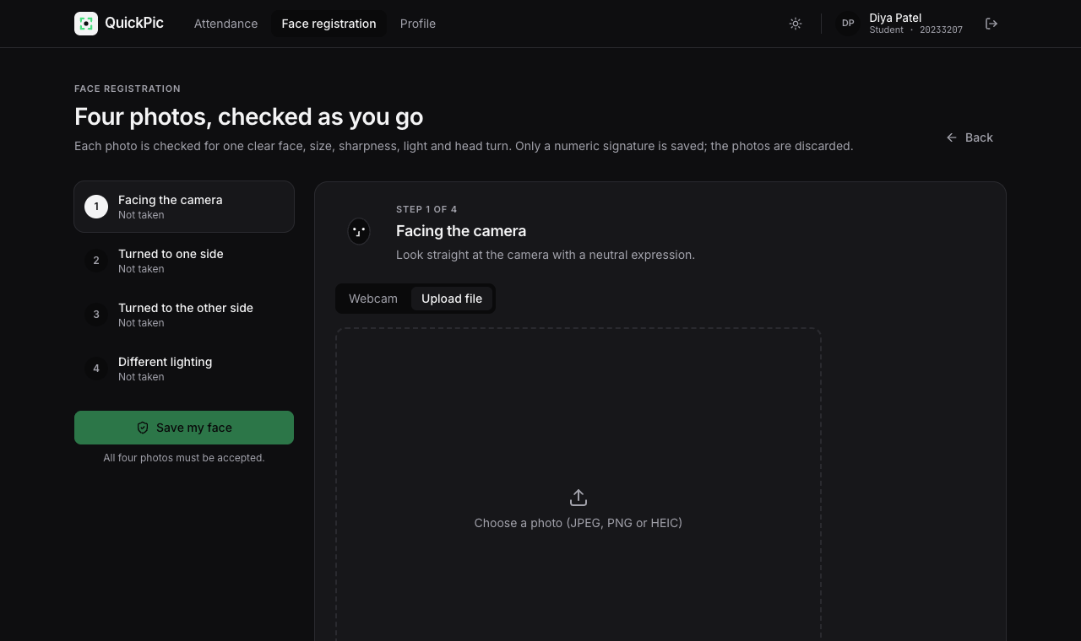
Students register themselves; privacy is built in
SHINDE RITESH · STUDENTS AND PRIVACY
Four guided photos
Front, left, right, other light; webcam or file. Each is checked instantly: one face, big enough, sharp, evenly lit, head turned as asked.
Signatures, not photos
Only face signatures are stored. Class photos are deleted on confirm. Students can delete their data any time. Nothing leaves the laptop.
QuickPic · Team 25
15
Notes:
Shinde Ritesh. Students sign up with a roll number, join a course with its code, and register their face in four guided steps: facing the camera, turned left, turned right, in different light. Each photo is checked the moment it is taken: exactly one face, at least 120 px tall, sharp (Laplacian variance), evenly lit, and a head turn estimated from the five landmarks that matches the step. A rejected photo gets a specific instruction, e.g. “Turn your head a little more.” The student sees the aligned 112×112 face the system will use. Privacy: only the 512-number signatures (plus the degraded copies) are stored; the photos are discarded. Class photos are deleted when the teacher confirms. Students can delete their face data or whole account. Everything runs on one laptop, offline.

Slide 16
From research code to a working product
TANISH · SYSTEM ARCHITECTURE
React app · TypeScript
6 s → 0.5 s
Review screen: zoomable photo, editable face boxes, one-face-per-student rule
Django JSON API · typed, CSRF-protected
per class photo on the laptop GPU (Apple CoreML), same names as on CPU
Accounts, courses, lectures, registration checks, attendance
Recognition engine · one Python package
The same code runs every experiment in the report and the live website
58 tests
run automatically on every push, plus a guard that blocks any face photo from the public repo
QuickPic · Team 25
16
Notes:
Tanish. How it fits together. The recognition engine is one Python package (detection, tiling, alignment, embeddings, degraded gallery, assignment); the experiments and the website both import it, so the numbers in the report come from exactly the code that runs in the app. On top sits a Django JSON API (typed with Django Ninja, session login with CSRF protection) and a React + TypeScript frontend; the review screen with editable boxes and the one-face-per-student rule is the most complex part. Speed: running the networks on the laptop’s GPU through Apple CoreML takes a class photo from about 6 seconds to about half a second. Two problems had to be solved: the GPU compiles the network on first use (about 25 s), so we cache the compiled network; and it recompiled for every new number of faces, so faces are sent in fixed batches of 32. We checked that the GPU names exactly the same students as the CPU on all 10 photos. Quality: 58 automated tests (engine and API) and lint run on GitHub on every push, plus a check that fails if any image is committed. Then: “Let’s see it live.”

Slide 17
Let’s take attendance.
LIVE DEMO
01
02
03
A teammate registers live with the webcam
The teacher uploads a class photo
Review, fix one face, confirm
Notes:
Shinde Ritesh drives; Tanish narrates if needed. Before the slot: make web running, browser on 127.0.0.1:8000, logged out, a class photo ready in a folder, laptop charged, webcam allowed. (1) Sign up a new student (or log in as one), open Face registration, take the four webcam photos and show the instant checks and the aligned face. (2) Log in as teacher (teacher / quickpic-demo), open the IPCV course, Take attendance, drop the class photo: point out the pipeline stages and that it takes about a second. (3) On the review screen: zoom in, show green / amber ? / dashed boxes, click an amber face and confirm or fix it, then Confirm attendance and show the course insights. Backup: if anything fails, use the 2024 class photo that is known to work, or start with QUICKPIC_DEVICE=cpu make web.

Slide 18
What we would do with more time
TANISH · LIMITATIONS AND NEXT STEPS
Limitations
Next steps
Small test set: 15 enrolled students, 10 photos.
Enroll the whole class and test on more lectures.
Faces under about 25 px are still missed or unrecognised.
Learn from confirmed attendance: add each confirmed classroom face to the student’s gallery.
Lookalikes need a teacher’s check.
Fit calibration on classroom faces instead of LFW.
Face boxes were labelled starting from one of the tested detectors.
Use seating patterns across lectures as extra evidence.
QuickPic · Team 25
18
Notes:
Tanish. Be upfront: the test set is small, so differences between configurations are within their confidence intervals; the counts of mistakes are the clearer signal. Faces under about 25 px remain hard for any model (TinyFace showed this). Lookalikes are why the app asks the teacher instead of guessing. Next steps: the most promising is learning from confirmed attendance, because classroom faces are the best possible match material; also calibration fitted on classroom faces, and seating context.

Slide 19
Thank you. Questions?
TEAM 25 · WHO DID WHAT
Tanish Mittal
Shashank Kanaujiya
Utkarsh Raj Singh
Shinde Ritesh Tirupati
20233288 · lead
20233259
20233298
System design, recognition engine, website architecture and review screen, GPU speed-up, evaluation, report
Face detection, tiling, detector comparison, labelling tool and ground truth, alignment, image-quality checks
Datasets and evaluation protocol, public benchmarks, face-model comparison, calibration study
20233350
Website registration and dashboard pages, testing, photo collection, literature survey
github.com/Tanish-237/quickpic
Notes:
Tanish closes: “Each of us presented the part we built. Thank you; we are happy to take questions.” Likely questions and who answers: Why not train your own model? (Tanish: frozen ArcFace already gives 98.5% on Indian classroom faces; retraining needs far more data.) How small a face can you detect? (Shashank: about 28 px reliably with tiling.) Why did calibration not help? (Utkarsh: it targets faces under 20 px; ours are 50–130 px.) What happens to the photos? (Ritesh: only signatures are kept; class photos are deleted on confirm.) What is the Hungarian method? (Tanish: optimal one-to-one matching of faces to students.)

