Slide 1
EMBEDDED SYSTEMS / FINAL DA3 REVIEW
ESP32 RL
Load Balancer
Adaptive traffic routing on an ESP32
On-device Q-learning with a flash-sale demonstration
Final implementation and evaluation
Notes:
Final DA3 review. Firmware and UI reviewed at upstream commit 76d80d56532424a05b93f037408980ff52f622d2. The team confirms Q-table persistence is implemented but not pushed. Hardware results follow markdowns/05_results_and_limits.md and the user confirmation in this task.

Slide 2
FINAL DA3 REVIEW
Project team
Bhuvan Bharat Nayak
24BCE5549
Siddharth Sameer Nevgi
24BCE5550
Abhyuday Vaish
24BCE5561
Tanish Somashekhar Desai
24BCE5567
02
Notes:
Team names and registration numbers supplied directly by the user.

Slide 3
PROJECT CONTEXT
Problem and project objectives
Problem
A fixed traffic split keeps sending requests to a slow backend, increasing response time and occupying gateway sessions.
Objective
Choose a backend from observed session feedback while keeping routing decisions on the ESP32.
Evaluation
Compare Q-learning against Round Robin and EMA under controlled backend delays and changing demand.
03
Notes:
https://github.com/Tanish-Desai/Esp32LoadBal/blob/76d80d56532424a05b93f037408980ff52f622d2/esp32/MyFirstESP32/src/main.cpp
https://github.com/Tanish-Desai/Esp32LoadBal/blob/76d80d56532424a05b93f037408980ff52f622d2/server-client/server.py

Slide 4
FINAL REVIEW SCOPE
DA3 implementation status
Deliverable | DA3 status
ESP32 gateway | TCP proxy with three selectable strategies
FlashPoint UI | Flash-sale controls, routing view and event-based metrics
Hardware evaluation | Completed run with team-confirmed results
Simulation studies | Three scenarios and backend-latency sweep
Q-table persistence | Implemented by team in nonvolatile flash. Commit pending
04
Notes:
https://github.com/Tanish-Desai/Esp32LoadBal/blob/76d80d56532424a05b93f037408980ff52f622d2/ui/templates/index.html
https://github.com/Tanish-Desai/Esp32LoadBal/blob/76d80d56532424a05b93f037408980ff52f622d2/ui/static/telemetry.js
https://github.com/Tanish-Desai/Esp32LoadBal/blob/76d80d56532424a05b93f037408980ff52f622d2/benchmarks/run_benchmark.py
Team confirmation: flash persistence implemented, commit pending.

Slide 5
REQUEST AND TELEMETRY PATHS
System architecture
Stage | Responsibility
Request generators | Python clients create short-lived requests to the ESP32
ESP32 gateway, port 80 | Select a backend, forward bytes and observe session duration
Laptop backend pool | Python TCP servers on ports 8080 through 8084
Flask + Socket.IO | Manage servers and generators, publish their events
Browser dashboard | Correlate request IDs and display routing and outcomes
05
Notes:
https://github.com/Tanish-Desai/Esp32LoadBal/blob/76d80d56532424a05b93f037408980ff52f622d2/ui/app.py
https://github.com/Tanish-Desai/Esp32LoadBal/blob/76d80d56532424a05b93f037408980ff52f622d2/server-client/client.py
https://github.com/Tanish-Desai/Esp32LoadBal/blob/76d80d56532424a05b93f037408980ff52f622d2/server-client/server.py
https://github.com/Tanish-Desai/Esp32LoadBal/blob/76d80d56532424a05b93f037408980ff52f622d2/esp32/MyFirstESP32/src/main.cpp

Slide 6
EMBEDDED IMPLEMENTATION
Firmware design and resource limits
7
One frontend and one backend socket per session
The main loop services active sessions with a shared 1,024-byte buffer.
concurrent proxy sessions
WiFiManager handles setup. Preferences retains the configured laptop IP.
MAX_CLIENTS in this firmware
06
Notes:
https://github.com/Tanish-Desai/Esp32LoadBal/blob/76d80d56532424a05b93f037408980ff52f622d2/esp32/MyFirstESP32/src/main.cpp
https://github.com/Tanish-Desai/Esp32LoadBal/blob/76d80d56532424a05b93f037408980ff52f622d2/esp32/MyFirstESP32/platformio.ini

Slide 7
COST SCOPE
Incremental prototype cost
Reference budget with existing laptop, Wi-Fi and USB power
Item | Cost treatment | Added purchase
ESP32 development board | 1 comparable board at list price | ₹425
USB cable and power | Reuse existing equipment | ₹0 new
Laptop and backend pool | Existing shared equipment | Excluded
Wi-Fi router and LAN | Existing shared equipment | Excluded
Incremental subtotal | Board with reused accessories | ₹425 + delivery
07
Notes:
Reference bill of materials, not an invoice. Checked 28 October 2026.
https://robocraze.com/products/nodemcu-32-wifi-bluetooth-esp32-development-board30-pin
The comparable ESP32 30-pin CP2102 board lists INR 425 including GST, excluding delivery, and is sold out. The team exact supplier is not established. Reusing the USB cable and power source is an explicit model assumption. Laptop, backend servers and Wi-Fi router are existing shared resources, not cost-free assets. New enclosure, dedicated power, installation and support need separate quotes. The subtotal is an incremental hardware-purchase budget, not total system cost.
See presentation/DA3_cost_basis.md for full assumptions and formulas.

Slide 8
DA2 BUDGET AND DA3 REFERENCE PRICES
Dedicated gateway hardware comparison
DA3 listings: GST included, delivery excluded, both sold out
Reference date: 28 October 2026
Gateway board | DA2 budget estimate | DA3 listed price
ESP32 development board | ₹350 | ₹425
Raspberry Pi 4, 2 GB | ₹4,200 | ₹7,091
₹6,666
94.0% lower board price than the Pi reference
DA2 budget comparison: 91.7% lower
08
Notes:
DA2 historical assumptions: https://github.com/Tanish-Desai/Esp32LoadBal/blob/4bb62e5/data/project_data.json, hardware_comparison.devices. ESP32 INR 350, Pi 4 2GB INR 4200. DA2 saving=(4200-350)/4200*100=91.6667%.
DA3 listed prices checked 28 October 2026, same supplier, including GST and excluding delivery. Both products show sold out, so prices are reference listings rather than available procurement quotes. ESP32 INR 425: https://robocraze.com/products/nodemcu-32-wifi-bluetooth-esp32-development-board30-pin
Pi 4 2GB INR 7091: https://robocraze.com/products/raspberry-pi-4-model-b-2gb-ram
DA3 listed-price difference=7091-425=6666 INR. Percentage difference=6666/7091*100=94.006487%. This compares board purchase prices, not throughput-equivalent systems. Pi has more compute, interfaces and software capabilities. Pi storage/power accessories and ESP32 standalone accessories are not priced. The DA2 mini-PC INR 13000 estimate lacks a refreshed configuration-specific quote and is excluded from current price claims.

Slide 9
ILLUSTRATIVE OPERATING-COST MODEL
Electricity and three-year gateway cost
24/7 operation at an assumed ₹8/kWh. Board + electricity only.
ESP32 power is unmeasured. Pi inputs span idle to CPU stress.
Metric | ESP32 planning case | Pi 4 sensitivity range
Power input | 0.79 W, DA2 estimate | 2.7 W idle to 6.4 W stress
Energy per year | 6.9 kWh | 23.7–56.1 kWh
Electricity per year | ₹55 | ₹189–449
3-year board + electricity | ₹591 | ₹7,659–8,437
09
Notes:
Model assumptions: continuous 8760 hours/year, illustrative tariff INR 8/kWh. No claim this is the local measured tariff. ESP32 0.79W is an unmeasured DA2 planning assumption, marked pending_measurement in project_data.json.
Pi power from the original benchmark author: https://www.pidramble.com/wiki/benchmarks/power-consumption.html
Pi values span 2.7W idle to 6.4W full-CPU stress, not a workload-matched proxy comparison.
Energy per year=W/1000*8760. ESP32=6.9204kWh, Pi=23.652 to 56.064kWh. Annual electricity=energy*8 INR. ESP32=55.3632 INR, Pi=189.216 to 448.512 INR.
Three-year board plus electricity uses the listed board prices: ESP32=425+3*55.3632=591.0896 INR. Pi=7091+3*(189.216 to 448.512)=7658.648 to 8436.536 INR. Slides round for readability.
Scope excludes backend, laptop and network power, adapters/boot storage/enclosures, delivery, maintenance, installation, support and downtime. This is a sensitivity model, not full-system TCO or measured energy saving. No energy-savings percentage is asserted from unmatched workloads.

Slide 10
COST REDUCTION MECHANISM
Where the savings come from
Smaller dedicated hardware
The ESP32 handles the prototype’s gateway duties without buying a separate Linux computer.
No managed-balancer subscription
AWS ALB example base charge: $197.10/year before usage and tax. Our local firmware has no such service fee.
Learning on the existing board
Q-learning and flash persistence reuse the same hardware. Lower latency does not prove lower backend spending.
The saving depends on the starting point
A free proxy on an existing server may need ₹0 in new gateway hardware. Backend, network and power costs remain.
10
Notes:
Hardware-cost scope: low-demand LAN gateway with seven configured concurrent sessions. A new MCU gateway can replace the purchase of a dedicated Linux-class gateway only where it satisfies the workload and security requirements.
AWS ALB example base price in US-East-1: https://aws.amazon.com/elasticloadbalancing/pricing/
0.0225 USD/hour*8760=197.10 USD/year, before capacity units, public IPv4/data charges where applicable, tax and credits. The local firmware uses no managed load-balancer service, but this is not a capability-equivalent substitute. Managed cloud scale, TLS/security and HA exceed the prototype.
All three algorithms use the same board. Team-confirmed flash persistence reuses onboard storage. Latency improvements are not evidence that the number of backends or server/cloud spend fell. No financial benefit from RL alone is measured.
If spare capacity exists on an already-powered server with a free software proxy, the added hardware purchase may be zero. Power, maintenance and support still matter. Existing backend compute and network costs do not disappear.

Slide 11
ROUTING ALGORITHM
Q-learning policy
Component | Firmware behavior
State and action | Active-session count (0–7), then a backend index
Selection | Epsilon-greedy exploration or highest Q-value
Reward | 1000 / (duration_ms + 1), or −50 for duration ≥ 2000 ms
Parameters | α = 0.3, γ = 0.5. ε decays from 1.0 to a 0.05 floor
Q(s,a) = Q(s,a) + α [r + γ max Q(s′,a′) − Q(s,a)]
11
Notes:
https://github.com/Tanish-Desai/Esp32LoadBal/blob/76d80d56532424a05b93f037408980ff52f622d2/esp32/MyFirstESP32/lib/LoadBalancerAlgorithms/src/QLearning.cpp
https://github.com/Tanish-Desai/Esp32LoadBal/blob/76d80d56532424a05b93f037408980ff52f622d2/esp32/MyFirstESP32/src/main.cpp
The firmware selects with the pre-admission session count and updates using the active count at completion. This is an implementation caveat for state-transition fidelity. The duration threshold is a reward rule, not a firmware timer that forcibly closes sessions at 2 seconds.

Slide 12
COMPARISON DESIGN
Baseline strategies
Strategy | Decision rule | Practical tradeoff
Round Robin | Cycle through backends | Low overhead, ignores backend delays
Q-learning | Highest learned value for a state | Learns from feedback, needs exploration
EMA response time | Highest smoothed reward | Simple adaptation without a state table
All three strategies run in the same firmware.
12
Notes:
https://github.com/Tanish-Desai/Esp32LoadBal/blob/76d80d56532424a05b93f037408980ff52f622d2/esp32/MyFirstESP32/lib/LoadBalancerAlgorithms/src/RoundRobin.cpp
https://github.com/Tanish-Desai/Esp32LoadBal/blob/76d80d56532424a05b93f037408980ff52f622d2/esp32/MyFirstESP32/lib/LoadBalancerAlgorithms/src/EmaResponseTime.cpp
https://github.com/Tanish-Desai/Esp32LoadBal/blob/76d80d56532424a05b93f037408980ff52f622d2/esp32/MyFirstESP32/lib/LoadBalancerAlgorithms/src/QLearning.cpp

Slide 13
DA3 IMPROVEMENT
Q-table persistence across restarts
Previous behavior
The committed Q-learning constructor creates a zero-filled table, so every reboot starts learning again.
Implemented change
The team now stores learned Q-values in ESP32 nonvolatile flash and restores them after restart.
Why it matters
The gateway can resume its learned policy instead of discarding the table at every power cycle.
13
Notes:
Source: user statement, confirmed implemented but not pushed. The storage API, save cadence and validation scheme are not present in the synchronized repository and are not asserted here.
Espressif Preferences documentation: https://docs.espressif.com/projects/arduino-esp32/en/latest/api/preferences.html
The ESP32 Arduino EEPROM interface is a flash-backed compatibility mechanism. Preferences uses NVS. The slide deliberately describes nonvolatile flash without guessing which API the unpushed change uses.

Slide 14
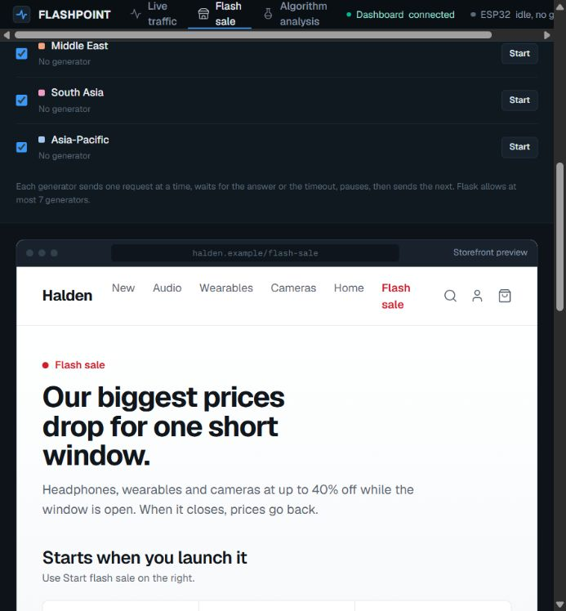
DA3 USER INTERFACE
FlashPoint flash-sale use case
Controlled demand bursts
Start one mock request generator for each selected region, up to seven in total.
Adjust the pause between requests and client timeout. The sale timer only controls the displayed countdown.
14
Notes:
https://github.com/Tanish-Desai/Esp32LoadBal/blob/76d80d56532424a05b93f037408980ff52f622d2/ui/templates/index.html
https://github.com/Tanish-Desai/Esp32LoadBal/blob/76d80d56532424a05b93f037408980ff52f622d2/ui/static/storefront.js
https://github.com/Tanish-Desai/Esp32LoadBal/blob/76d80d56532424a05b93f037408980ff52f622d2/ui/static/region-config.js
Screenshot captured from the actual local UI with no ESP32 connected and no generated traffic. Product prices and regional labels are illustrative. The storefront has no inventory or checkout service.

Slide 15
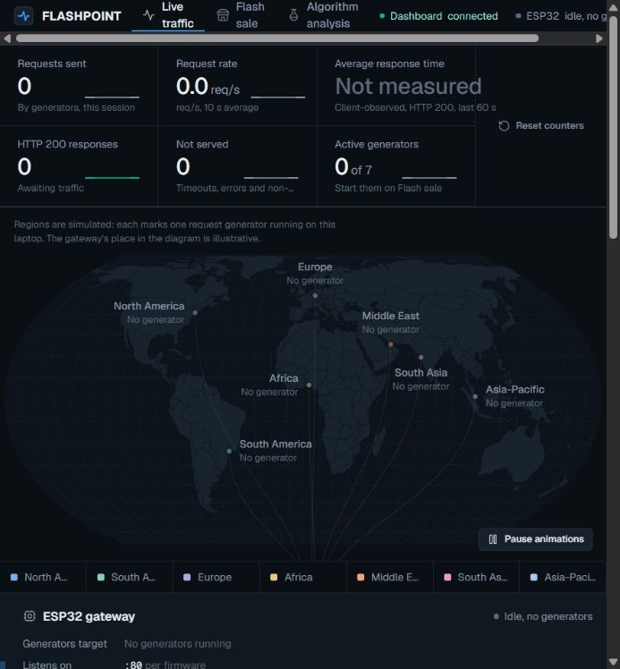
DA3 USER INTERFACE
Live routing and telemetry
Events drive the view
Request IDs connect client events to the backend that handled each request.
Charts show request rate, backend distribution and client-observed response time. The event stream exposes errors and timeouts.
15
Notes:
https://github.com/Tanish-Desai/Esp32LoadBal/blob/76d80d56532424a05b93f037408980ff52f622d2/ui/static/telemetry.js
https://github.com/Tanish-Desai/Esp32LoadBal/blob/76d80d56532424a05b93f037408980ff52f622d2/ui/static/world-map.js
https://github.com/Tanish-Desai/Esp32LoadBal/blob/76d80d56532424a05b93f037408980ff52f622d2/ui/static/charts.js
https://github.com/Tanish-Desai/Esp32LoadBal/blob/76d80d56532424a05b93f037408980ff52f622d2/ui/static/event-stream.js
Screenshot captured from the actual local UI with no traffic. Region coordinates only locate mock generators on the map. The gateway has no status endpoint and does not report its strategy.

Slide 16
REVIEW DEMONSTRATION
Flash-sale demonstration sequence
01
Configure
Start backends on 8080–8082 and select a firmware strategy at boot.
02
Route
Point generators at the ESP32 IP, port 80. Start the selected regions.
03
Degrade
Raise the delay on one backend while traffic continues.
04
Observe
Watch response time, successful responses and backend distribution.
05
Compare
Repeat with the same settings for each strategy and reset counters.
16
Notes:
https://github.com/Tanish-Desai/Esp32LoadBal/blob/76d80d56532424a05b93f037408980ff52f622d2/ui/templates/index.html
https://github.com/Tanish-Desai/Esp32LoadBal/blob/76d80d56532424a05b93f037408980ff52f622d2/ui/static/storefront.js
https://github.com/Tanish-Desai/Esp32LoadBal/blob/76d80d56532424a05b93f037408980ff52f622d2/benchmarks/run_benchmark.py
This is a demonstration protocol, not a claim that a new hardware experiment was performed during deck preparation. A direct-backend test is a connectivity check, not an ESP32 benchmark.

Slide 17
TEAM-CONFIRMED HARDWARE RUN
Hardware evaluation setup
3 backends 5 clients 120 seconds
Backend | Added delay setting | Condition
8080 | 0% of 2-second timeout | Healthy reference
8081 | 45%, approximately 900 ms | Degraded backend
8082 | 5%, approximately 100 ms | Second healthy backend
17
Notes:
https://github.com/Tanish-Desai/Esp32LoadBal/blob/76d80d56532424a05b93f037408980ff52f622d2/markdowns/05_results_and_limits.md
https://github.com/Tanish-Desai/Esp32LoadBal/blob/76d80d56532424a05b93f037408980ff52f622d2/benchmarks/run_benchmark.py
User explicitly approved use of the hardware figures. The source notes describe the run as real ESP32, 3 backends, 5 clients and 120 seconds. data/project_data.json still has null measured_results. Raw run artifacts and repeated-run intervals are not included in the repository.

Slide 18
HARDWARE RESULT
Q-learning reduced mean latency by 59.8%
310 ms
lower mean latency
than Round Robin
For the documented
120-second run
18
Notes:
https://github.com/Tanish-Desai/Esp32LoadBal/blob/76d80d56532424a05b93f037408980ff52f622d2/markdowns/05_results_and_limits.md
Team confirmation: use hardware mean latency RR=518 ms, Q-learning=208 ms, EMA=515 ms.
Calculation: (518−208)/518×100 = 59.8456%. Single documented configuration, not a universal improvement.

Slide 19
MEASURED RUN REPORTED BY THE TEAM
Hardware performance comparison
Metric | Round Robin | Q-learning | EMA
Requests served | 737 | 1,156 | 731
Mean latency | 518 ms | 208 ms | 515 ms
p95 latency | 1,186 ms | 473 ms | 1,185 ms
Throughput | 6.1 req/s | 9.6 req/s | 6.1 req/s
Timeouts | 0 | 6 | 3
Approximately 57% higher reported throughput than Round Robin
19
Notes:
https://github.com/Tanish-Desai/Esp32LoadBal/blob/76d80d56532424a05b93f037408980ff52f622d2/markdowns/05_results_and_limits.md
The team confirmed the hardware run in this task. These figures come from the results markdown, not the still-null measured_results JSON. No uncertainty interval is available. Served totals, timeout counts and throughput describe the documented run, with throughput rounded to one decimal place.
Throughput gain from rounded rates: (9.6/6.1−1)×100 = 57.38%. p95 reduction: (1186−473)/1186×100 = 60.12%.

Slide 20
SIMULATION, AVERAGES OVER 8 SEEDS
Simulation results across three scenarios
Scenario | Round Robin | Q-learning | EMA
Smart factory | 86.1% | 100.0% | 96.3%
Rural clinic | 92.0% | 100.0% | 98.7%
Retail POS outage | 84.9% | 74.5% | 97.2%
Goodput = successful answers / all offered requests
20
Notes:
https://github.com/Tanish-Desai/Esp32LoadBal/blob/76d80d56532424a05b93f037408980ff52f622d2/data/project_data.json
Section simulation_findings.scenario_results. Reproducible via benchmarks/tools/export_sim_results.mjs. This deck uses stored 8-seed aggregates, not single-seed results. Smart factory, rural clinic and retail POS are simulated scenarios, not deployments.

Slide 21
SIMULATION, AVERAGES OVER 8 SEEDS
Backend differences determine the benefit
+43.9
percentage points
QL over RR at 12×
21
Notes:
https://github.com/Tanish-Desai/Esp32LoadBal/blob/76d80d56532424a05b93f037408980ff52f622d2/data/project_data.json
Section simulation_findings.headline_finding.table. Two backends and six clients, fast backend at 60 ms, latency spread swept from 1× to 12×. Reproduce with node benchmarks/tools/exp_heterogeneity.mjs. The 8× value is specific to these settings, not a universal threshold.
At 12×: 93.7−49.8 = 43.9 percentage points.

Slide 22
SIMULATION FINDING
Known weakness under changing load
Retail POS result
Q-learning achieves 74.5% goodput, compared with 84.9% for Round Robin and 97.2% for EMA.
Cause
Nearly identical backends provide a weak initial signal. Exploration reaches its floor before the later degradation.
Experiment and remaining work
A 0.15 exploration floor lifts simulated goodput to 85.5%. Adaptive re-exploration remains future work.
22
Notes:
https://github.com/Tanish-Desai/Esp32LoadBal/blob/76d80d56532424a05b93f037408980ff52f622d2/data/project_data.json
Section simulation_findings.known_weakness. Stored aggregate results are RR=84.9%, QL=74.5%, EMA=97.2%. The narrative known_weakness.finding contains a stale RR=84.5% value, which belongs to a single-seed run. This slide consistently uses the 8-seed aggregate.
The epsilon floor experiment improves QL mean goodput to 85.5% but remains a simulation experiment. Firmware still uses 0.05. Persistence is implemented separately and does not fix stale-policy adaptation.

Slide 23
ENGINEERING ASSESSMENT
Current scope and limitations
Area | Current boundary
Capacity | Seven concurrent proxy sessions in this firmware build
Security | No TLS termination or authentication in the prototype
Workload | Local controlled tests with synthetic client traffic
Learning | A saved policy can become stale when backend conditions change
Evidence | One documented hardware run, plus separate simulations
23
Notes:
https://github.com/Tanish-Desai/Esp32LoadBal/blob/76d80d56532424a05b93f037408980ff52f622d2/esp32/MyFirstESP32/src/main.cpp
https://github.com/Tanish-Desai/Esp32LoadBal/blob/76d80d56532424a05b93f037408980ff52f622d2/ui/static/telemetry.js
https://github.com/Tanish-Desai/Esp32LoadBal/blob/76d80d56532424a05b93f037408980ff52f622d2/ui/static/region-config.js
https://github.com/Tanish-Desai/Esp32LoadBal/blob/76d80d56532424a05b93f037408980ff52f622d2/data/project_data.json
The seven-session ceiling is the current firmware configuration, not a universal immutable ESP32 silicon constraint. Retry calls may choose the same backend more than once. Feedback uses the active count at completion rather than preserving the decision-time state. No TLS code exists in this implementation.

Slide 24
CONCLUSION
Final DA3 outcome
Lower gateway cost, with
measured routing gains
Hardware result
208 ms mean latency versus 518 ms for Round Robin in the documented run.
DA3 additions
FlashPoint makes demand and routing visible. Flash persistence preserves the learned Q-table across restarts.
24
Notes:
https://github.com/Tanish-Desai/Esp32LoadBal/blob/76d80d56532424a05b93f037408980ff52f622d2/markdowns/05_results_and_limits.md
https://github.com/Tanish-Desai/Esp32LoadBal/blob/76d80d56532424a05b93f037408980ff52f622d2/ui/templates/index.html
https://github.com/Tanish-Desai/Esp32LoadBal/blob/76d80d56532424a05b93f037408980ff52f622d2/esp32/MyFirstESP32/src/main.cpp
Q-table persistence status is based on the team statement, not the synchronized source. Mean-latency improvement is specific to the documented hardware run.
The cost argument is a dedicated gateway hardware comparison. DA3 listed board prices INR 425 vs INR 7091 imply INR 6666/94.0% lower board price. See cost section and presentation/DA3_cost_basis.md. This does not represent whole-system or workload-equivalent savings.

Slide 25
SUBMISSION SOURCES
References and evidence
Implementation and hardware results
github.com/Tanish-Desai/Esp32LoadBal
Firmware, FlashPoint UI and markdowns/05_results_and_limits.md
Reproducible simulation evidence
data/project_data.json and benchmarks/tools/exp_heterogeneity.mjs
Three scenario aggregates, eight seeds per experiment
Storage terminology and implementation status
Espressif Arduino-ESP32 Preferences documentation
Q-table flash persistence: team-confirmed, code commit pending
25
Notes:
Repository evidence inspected at 76d80d56532424a05b93f037408980ff52f622d2. Both GitHub main branches synchronized before creating this deck.
https://github.com/Tanish-Desai/Esp32LoadBal/blob/76d80d56532424a05b93f037408980ff52f622d2/markdowns/05_results_and_limits.md
https://github.com/Tanish-Desai/Esp32LoadBal/blob/76d80d56532424a05b93f037408980ff52f622d2/data/project_data.json
https://github.com/Tanish-Desai/Esp32LoadBal/blob/76d80d56532424a05b93f037408980ff52f622d2/esp32/MyFirstESP32/src/main.cpp
https://github.com/Tanish-Desai/Esp32LoadBal/blob/76d80d56532424a05b93f037408980ff52f622d2/esp32/MyFirstESP32/lib/LoadBalancerAlgorithms/src/QLearning.cpp
https://github.com/Tanish-Desai/Esp32LoadBal/blob/76d80d56532424a05b93f037408980ff52f622d2/ui/static/telemetry.js
https://github.com/Tanish-Desai/Esp32LoadBal/blob/76d80d56532424a05b93f037408980ff52f622d2/ui/static/storefront.js
https://docs.espressif.com/projects/arduino-esp32/en/latest/api/preferences.html

Slide 26
COST REFERENCES
Cost sources and calculation basis
Hardware reference prices
Robocraze ESP32 30-pin CP2102 and Raspberry Pi 4, 2 GB
DA2 estimates from the project data, DA3 listing check on 28 October 2026
Operating-cost model
Pi Dramble power measurements and the DA2 ESP32 planning estimate
8,760 h/year at an assumed ₹8/kWh, with formulas in the slide notes
Managed-service comparison
AWS Elastic Load Balancing pricing, US-East-1 example base rate
Service capabilities and prototype scope differ
26
Notes:
Reference date: 28 October 2026. Full working in presentation/DA3_cost_basis.md.
https://robocraze.com/products/nodemcu-32-wifi-bluetooth-esp32-development-board30-pin
https://robocraze.com/products/raspberry-pi-4-model-b-2gb-ram
https://www.pidramble.com/wiki/benchmarks/power-consumption.html
https://aws.amazon.com/elasticloadbalancing/pricing/
https://github.com/Tanish-Desai/Esp32LoadBal/blob/4bb62e5/data/project_data.json

