Slide 1

AI Integration Orchestration Engine · FinSpark PS2 · Nucleus Software Hackathon 2026
AI Integration Orchestrator
B-DEX
Transform requirement documents into production-ready integration configs — zero manual schema mapping.
By Team:
1-comeRnd

Slide 2
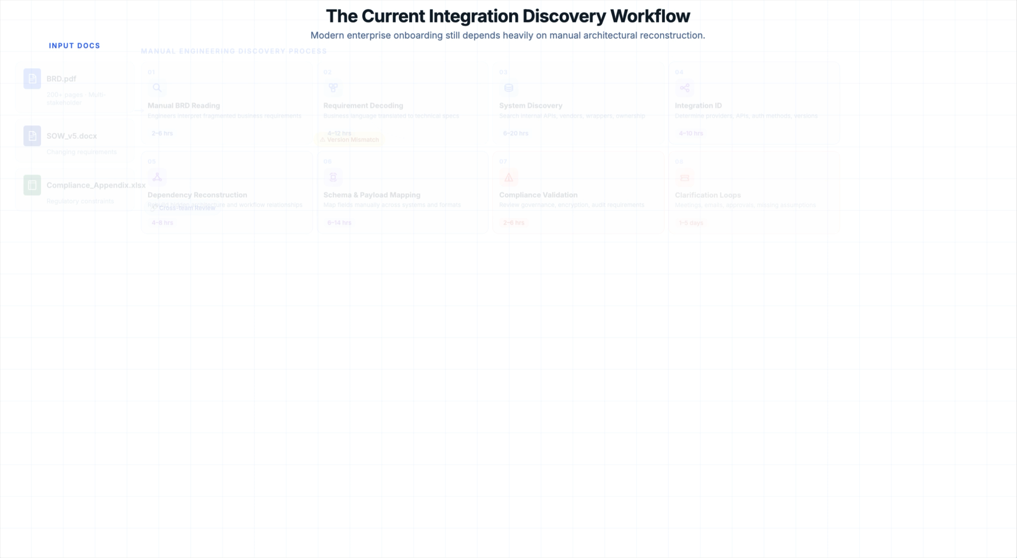

Slide 3
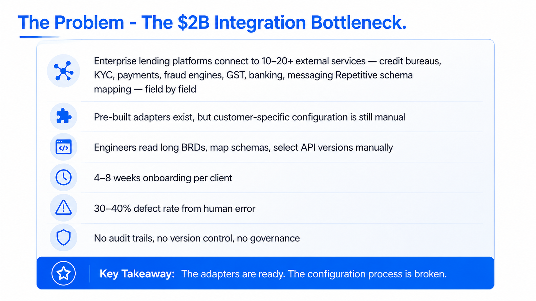

Slide 4
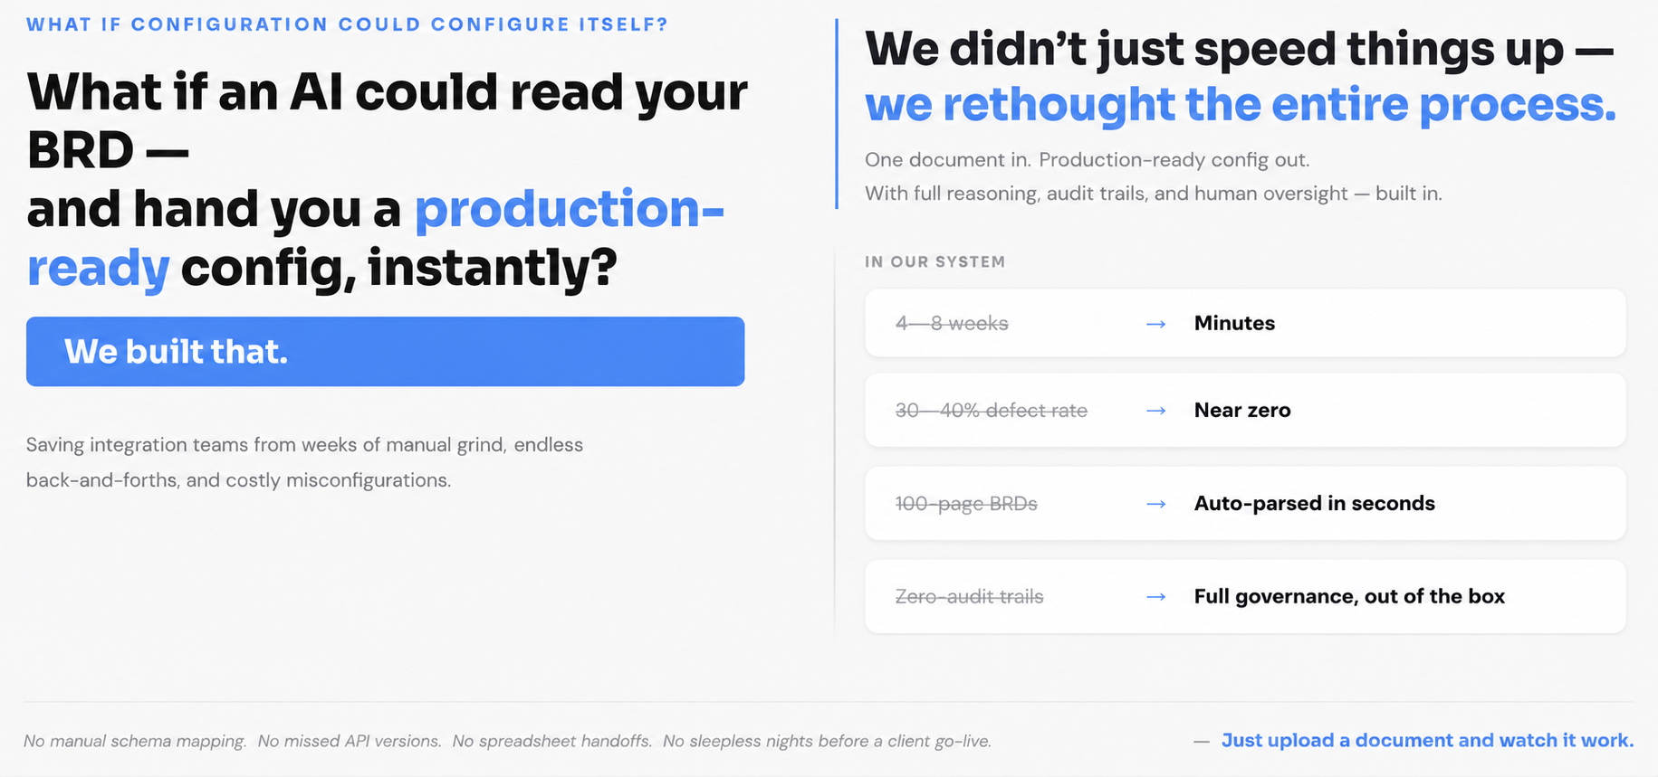

Slide 5
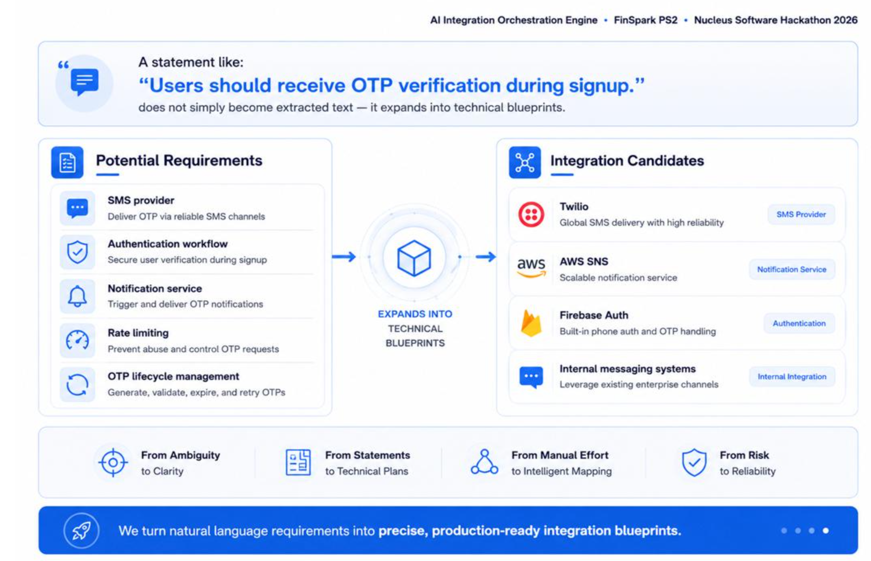

Slide 6
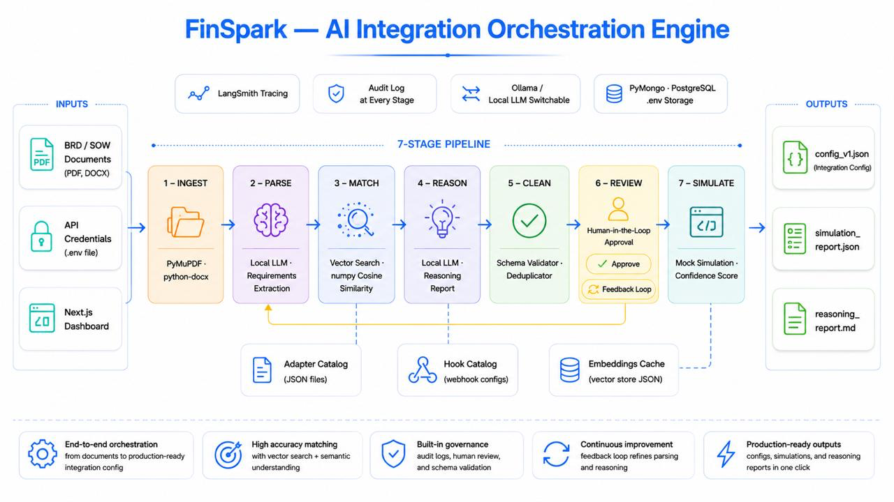

Slide 7

AI Integration Orchestration Engine · FinSpark PS2 · Nucleus Software Hackathon 2026
Phase 0 & Stage 1
00
01
Document Ingestion
Project Initialization
Supports PDF, DOCX, TXT, MD Files
PDF page-by-page · DOCX paragraphs + tables · TXT direct read
Zero AI — pure code extraction, fully deterministic
Clean structured text output → ready for Stage 2
Client name → unique ID + isolated workspace generated instantly
Config template initialized · empty credential vault created
Upload BRD/SOW (PDF, DOCX, TXT) → Run Pipeline

Slide 8
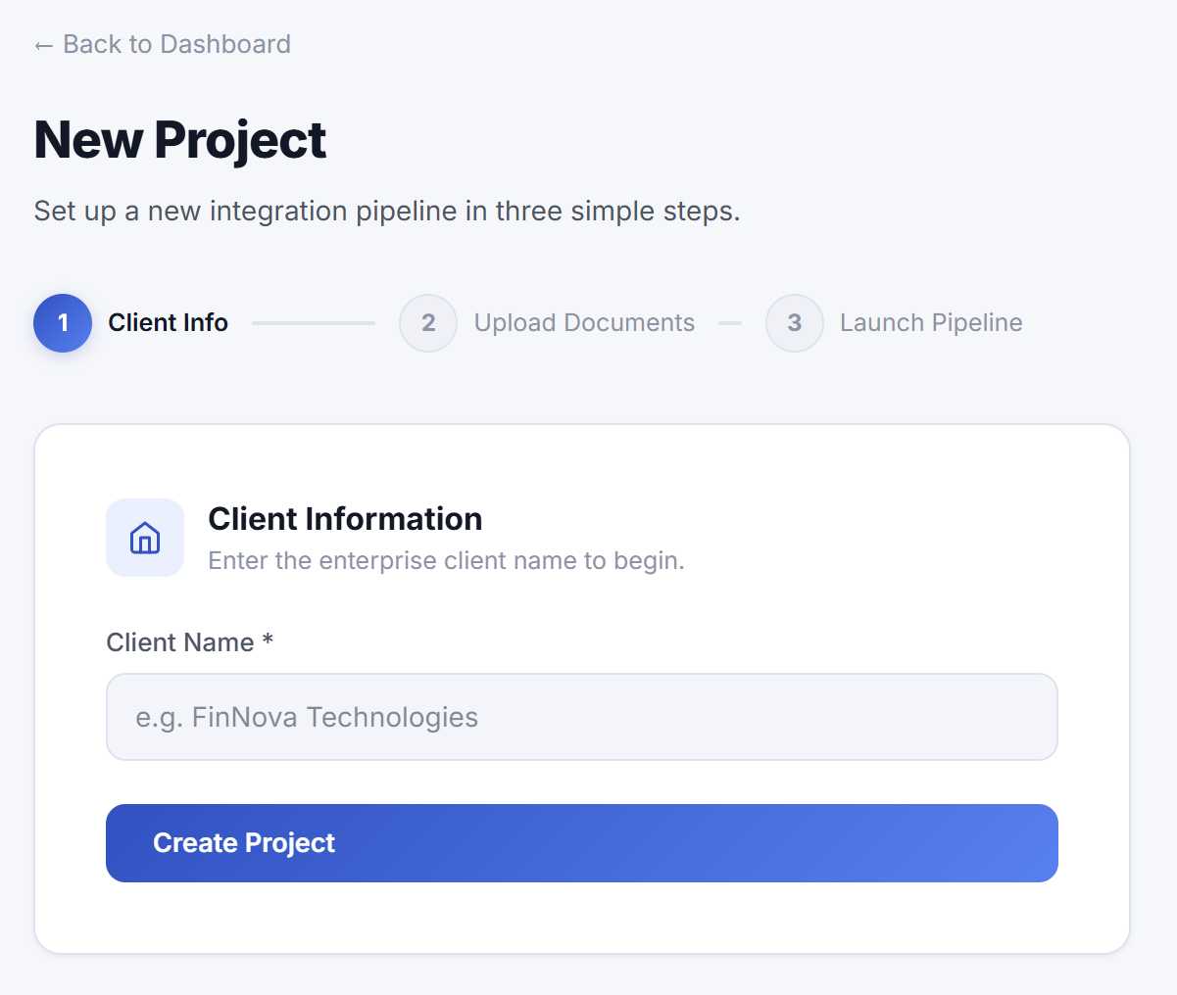
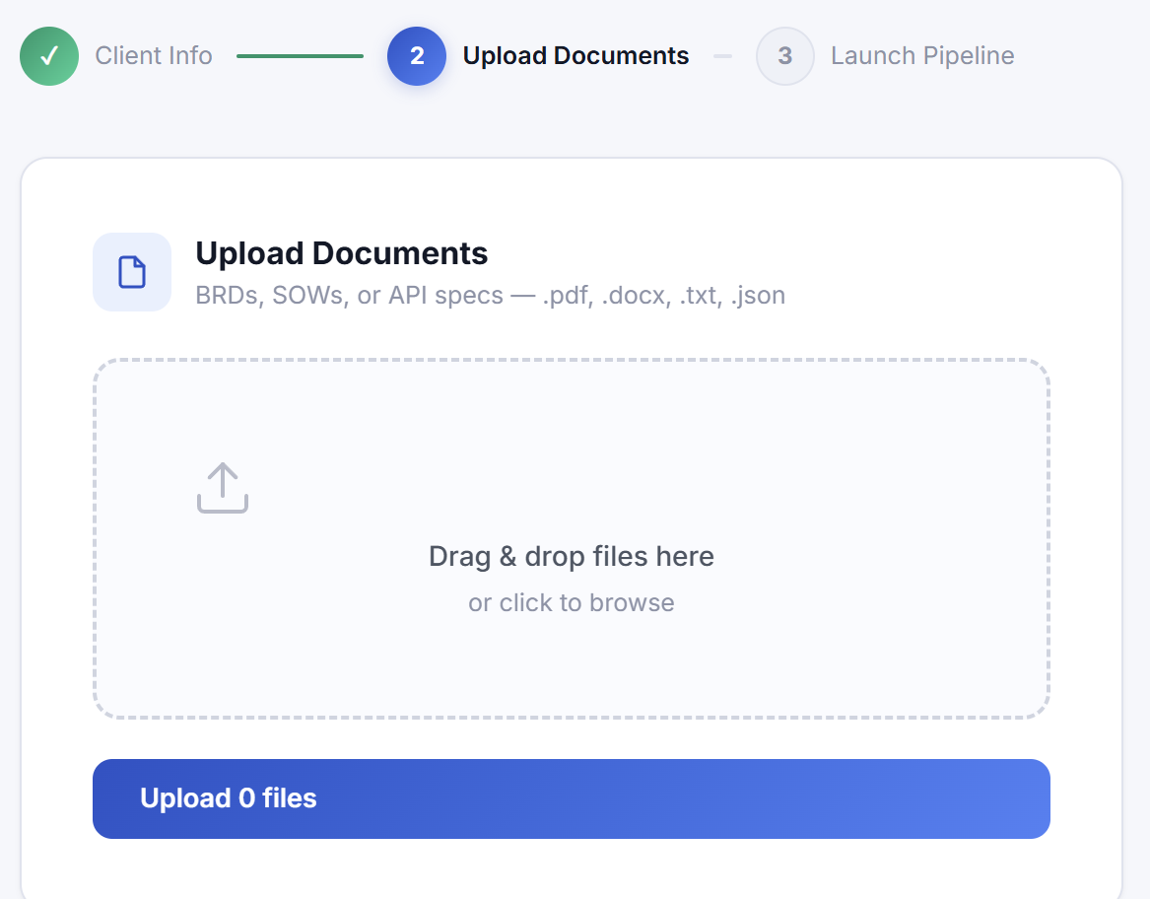
Phase- 0
Stage-1

Slide 9

AI Integration Orchestration Engine · FinSpark PS2 · Nucleus Software Hackathon 2026
Stages 2–3: Parse & Match
02
03
Requirement Parsing
Adapter Matching & Config
LLM reads BRD → extracts every integration service mentioned
Identifies: name · category · mandatory/optional · version hints · data fields
Never hallucinates — grounded strictly in uploaded documents
Al matches best adapter + version using RAG vector search
Low-confidence matches flagged for review
Full adapter config auto-filled (auth, endpoints, retries, versions)
RAG-enabled smart chunking supports 500+ adapters

Slide 10
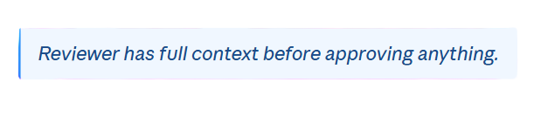
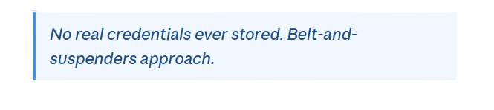
AI Integration Orchestration Engine · FinSpark PS2 · Nucleus Software Hackathon 2026
Stages 4–5: Reason & Clean
04
05
Reasoning Report
Production Cleaner
AI explains every decision — adapter choice, version, field mapping rationale
Flags missing fields, unmatched APIs, and confidence level per integration
Shown to reviewer alongside config — no black box
Strips annotations · replaces any hardcoded secrets with ENV_VAR
Programmatic sweep runs after AI — guarantees no leaks survive
Auto-restores integrations if AI accidentally dropped anything

Slide 11
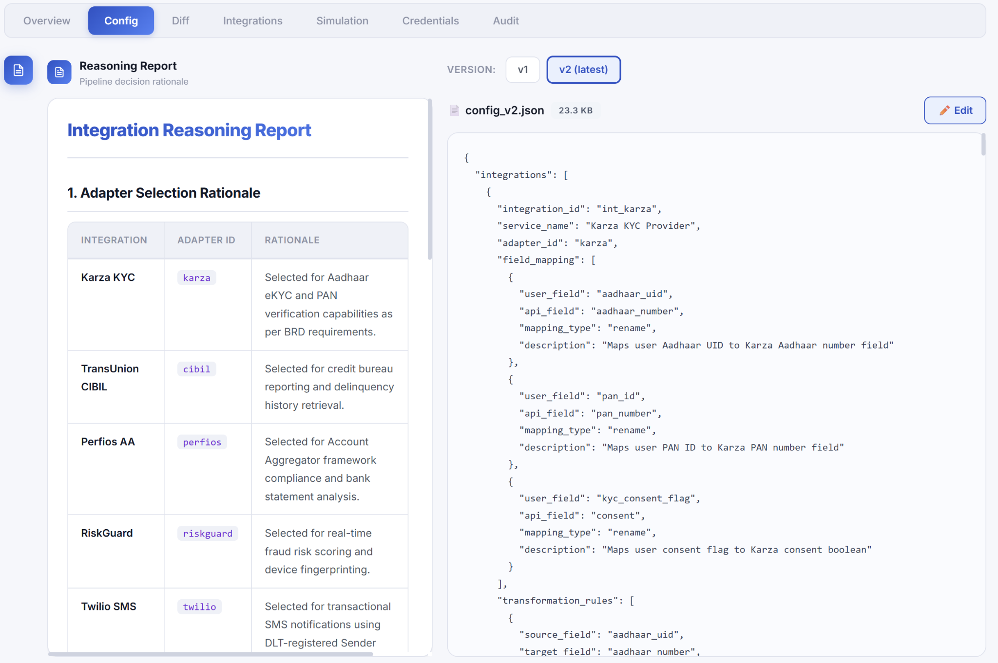

Slide 12

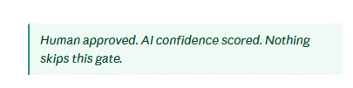
AI Integration Orchestration Engine · FinSpark PS2 · Nucleus Software Hackathon 2026
Stages 6–7: Review & Simulate
06
07
Human-in-the-Loop Review
Simulation and Testing
Each integration tested against mock API responses (10 adapters)
Confidence score 0–100 · pass/fail per integration · missing fields flagged
Status set to "production-ready" only after simulation passes
Detailed Scenario Testing checks failures, timeouts, fallbacks, version compatibility, and generates a reliability fidelity score.
Pipeline pauses — config + reasoning report shown to reviewer
Changes via plain English → Corrector LLM applies, new version saved
Max 3 iterations · then escalated — nothing auto-approves

Slide 13
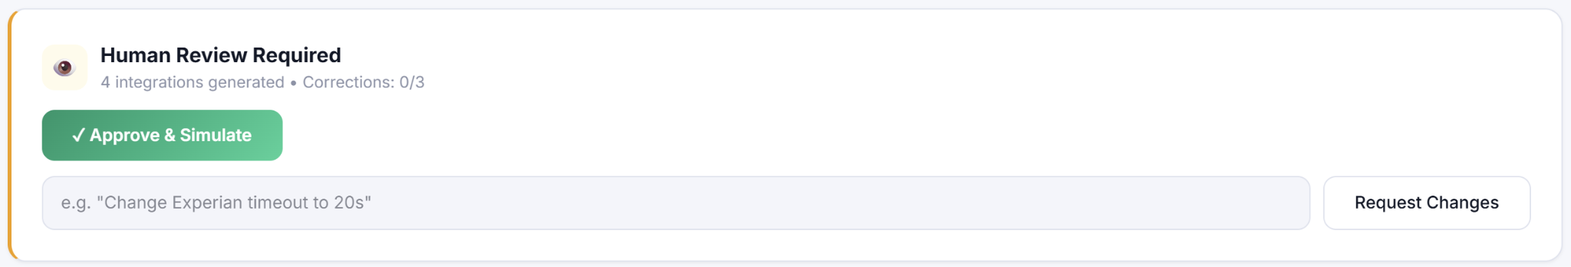

Slide 14

A look at our User-Centric UI

Slide 15
AI Integration Orchestration Engine · FinSpark PS2 · Nucleus Software Hackathon 2026
Our USPs
Full Audit Trail with Config Diff History
Explainable and Transparent AI with Full Reasoning Report
As Secure as a fortress
Human-in-the-Loop by Design
You can save all your API keys with our system and relax. All your API keys are directly saved with HashiCorp vault a multi-encrypted authentication enabled database. Only accessible via client and admin credentials.
Every change is timestamped, hashed, and traceable, with clear diffs showing exactly what was added, removed, or modified.
The system generates detailed reports explaining adapter selection, version choice, and field mapping decisions before approval.
Pipeline pauses for mandatory human review, allowing reviewers to approve or request natural-language corrections before deployment.
Using a local LLM helps your data from potential data leaks arising from working with proprietary LLMs like Gemini and ChatGPT

Slide 16
AI Integration Orchestration Engine · FinSpark PS2 · Nucleus Software Hackathon 2026
What makes us ADAPTABLE and TOUGH ?
Intelligent Deprecation and Backward Compatibility
Config Diff Viewer
Version Migration
Structured diffs between any two config versions showing exactly what was added, removed, or modified.
One-click upgrade any integration to a newer API version. Auto-picks latest stable. Rollback to previous
config versions is always available through version history.
The system automatically upgrades deprecated API versions requested in a BRD to the latest stable version, logging the reason. If an in-production API version is deprecated, the system warns users and can automatically generate a new configuration with the updated version. Multiple API versions coexist seamlessly, allowing tenants to run different versions without conflict.
Upload and Re-Run
Upload revised documents, system creates new config version, re-runs full pipeline. Full history preserved.
In-Dashboard Config Editor
Credential Vault Isolation
Batch Processing
API keys never touch config files. Configs use $ENVgeneration for missed variables.per-client env vaults. Auto-stub
Edit config JSON directly in the browser. Fully audited.
Trigger pipelines for multiple clients simultaneously. Each runs independently.

Slide 17
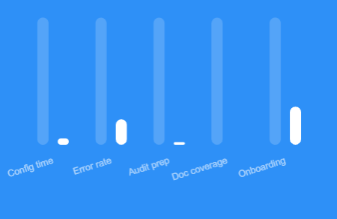
AI Integration Orchestration Engine · FinSpark PS2 · Nucleus Software Hackathon 2026
Improvement across key metrics
+95% faster · 80% fewer errors · 98% audit time saved
Business Impact
Before vs After.
95%
80%
Time Saved
Fewer Errors
Config time: 2–4 weeks → under 10 minutes.
Schema error rate: ~15% → under 3%, simulation-validated.

Slide 18
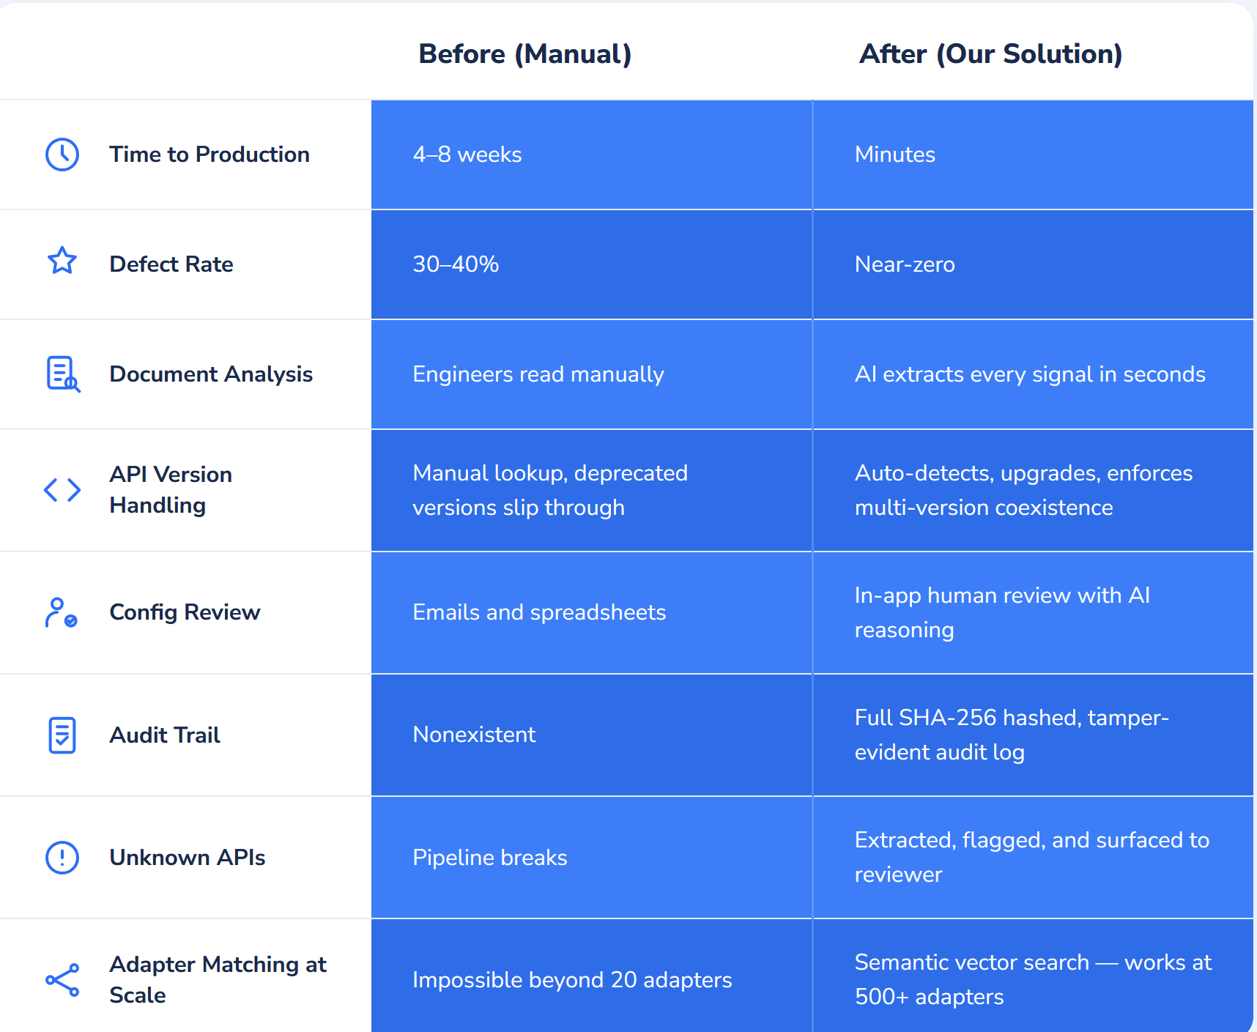
AI Integration Orchestration Engine · FinSpark PS2 · Nucleus Software Hackathon 2026
The Difference is clear

Slide 19
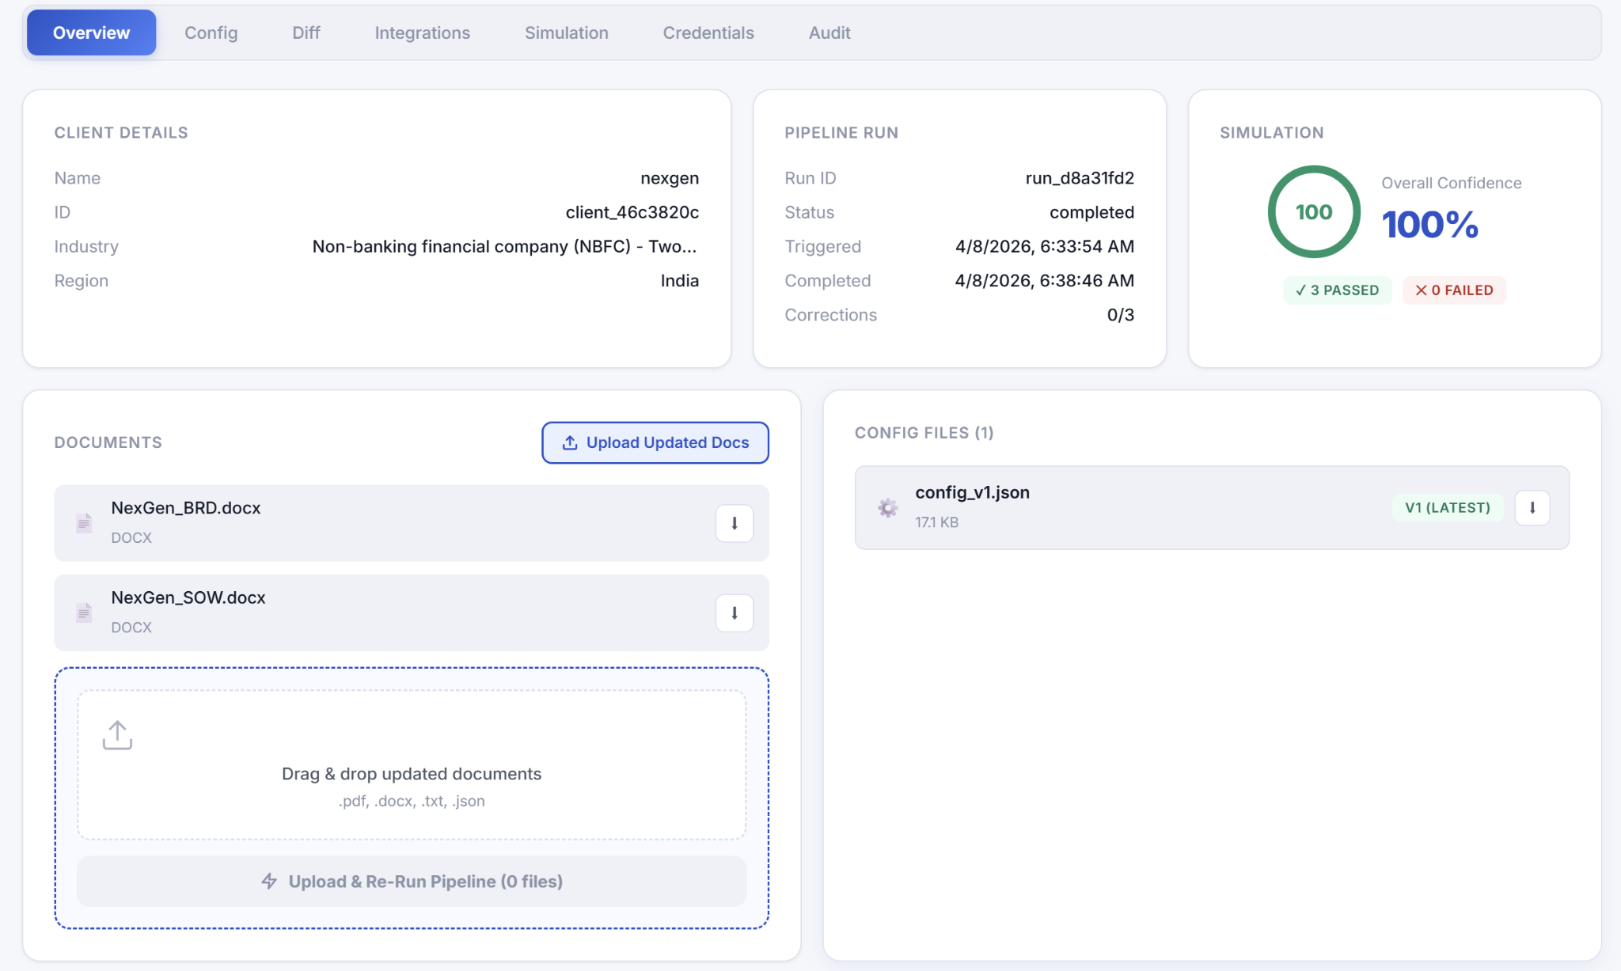

Slide 20
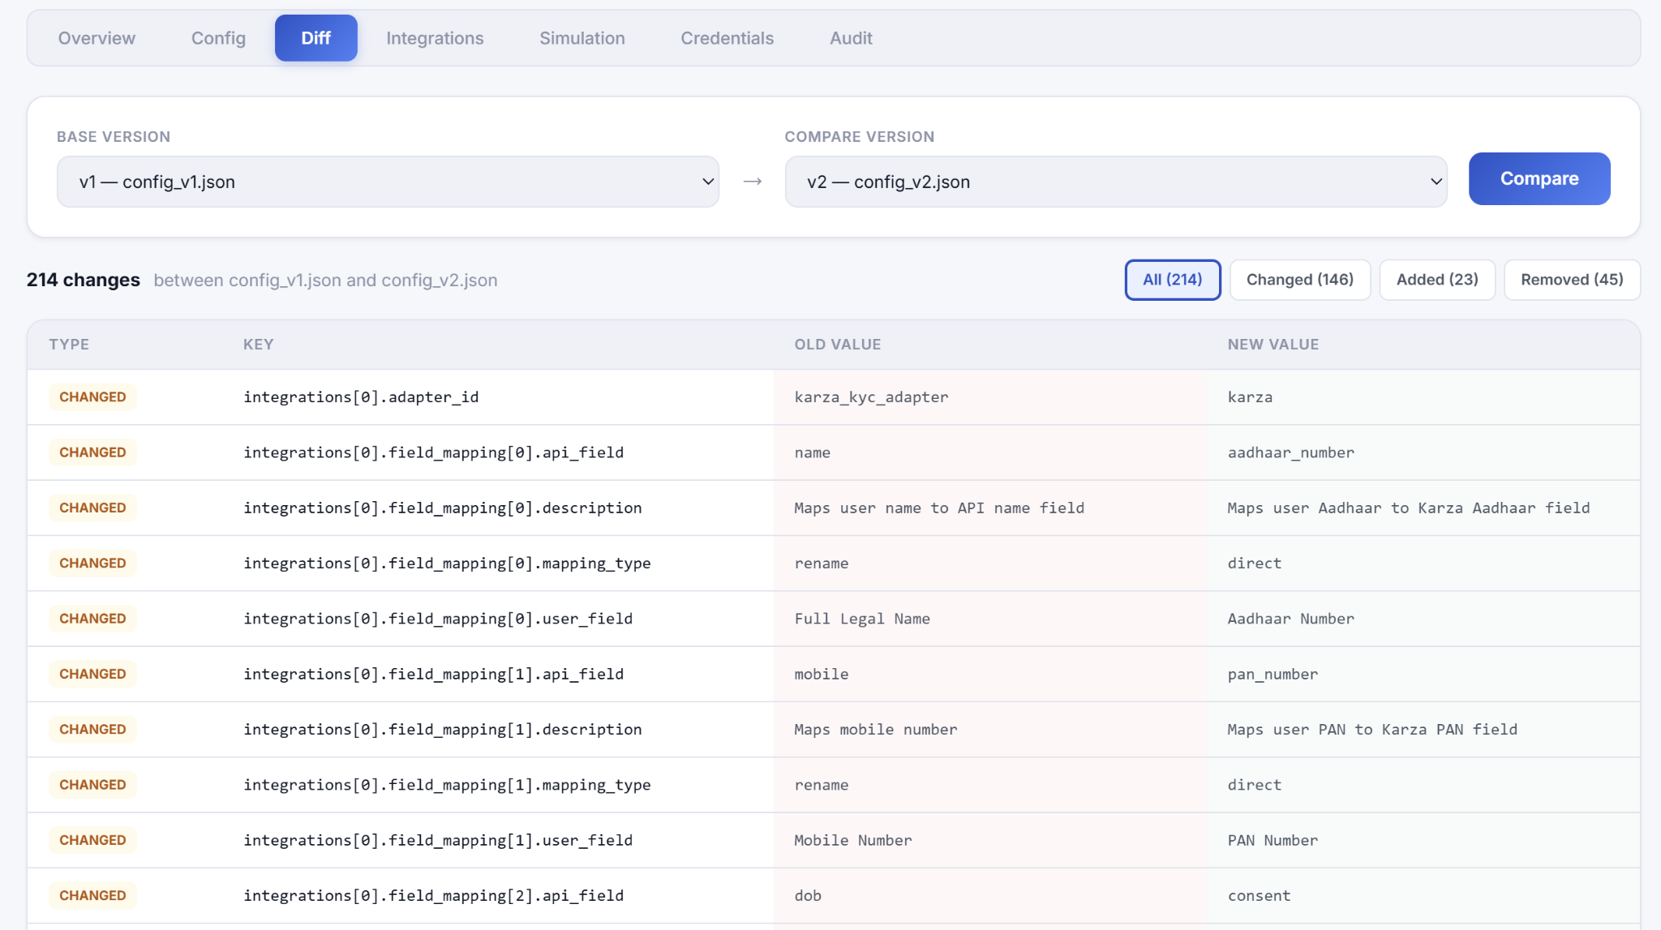

Slide 21
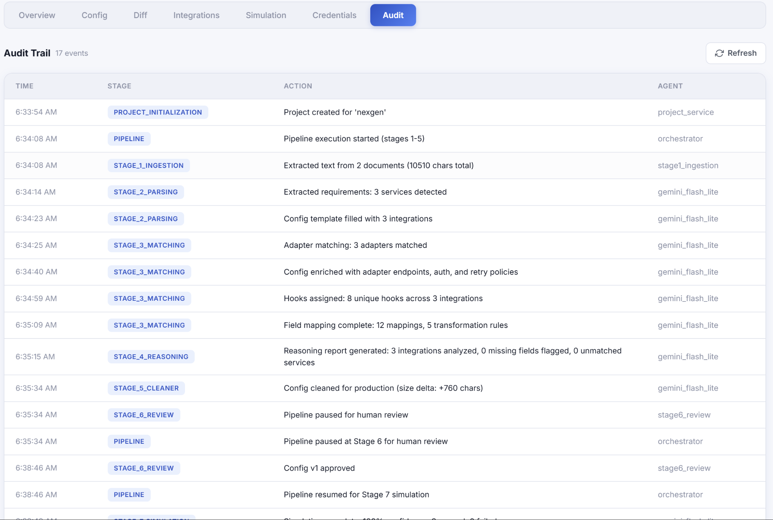

Slide 22
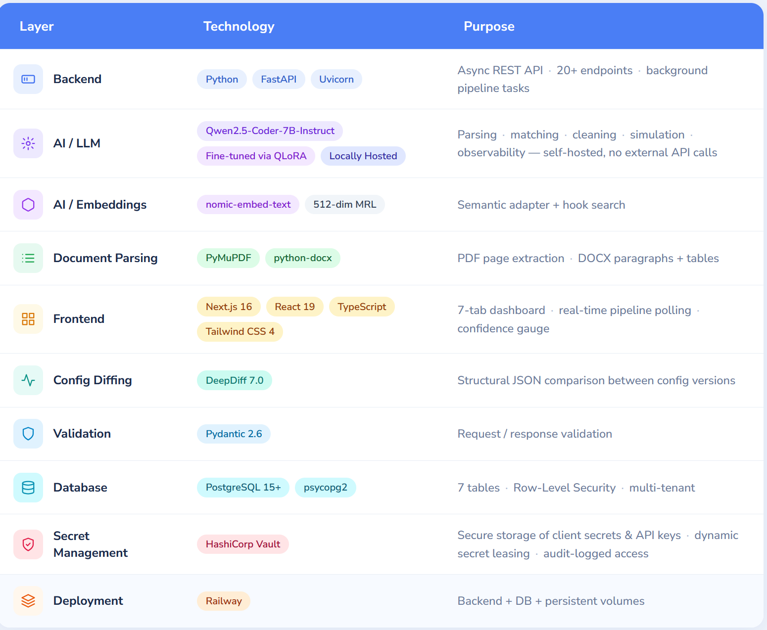
Tech Stack
AI Integration Orchestration Engine · FinSpark PS2 · Nucleus Software Hackathon 2026

Slide 23
AI Integration Orchestration Engine · FinSpark PS2 · Nucleus Software Hackathon 2026
Prototype &
Future Plans.
Fine-tuned AI model
A specialized model trained on enterprise BRDs for faster, cheaper, and more accurate results
Expanded adapter library (500+)
Grow from 12 to 500+ adapters to cover all major enterprise integration categories
Real sandbox API testing
Replace mock testing with real API environments for production-level validation
Learning from corrections
The system improves over time by learning from human feedback and reducing future errors
Database migration and OAuth
Move to production-ready infrastructure OAuth
Public adapter marketplace
Launch a platform where developers can add and share custom adapters and integrations

Slide 24


AI Integration Orchestration Engine · FinSpark PS2 · Nucleus Software Hackathon 2026
See It Live
GitHub Repo URL
Website link

Slide 25
AI Integration Orchestration Engine · FinSpark PS2 · Nucleus Software Hackathon 2026
Thank You
Looking Forward to the results :)

