Slide 1

SMART INDIA HACKATHON 2026
विश्वास · VISHWAS
AI forecast-bust detection & trust console for NCMRWF’s medium-range forecasts
Problem Statement ID: 26079
Problem Statement Title: AI-Based Forecast Bust Detection for Medium-Range Weather Forecasts
Organisation: Ministry of Earth Sciences (MoES) – NCMRWF
Theme: Disaster Management
PS Category: Software
Team ID: —
Team Name: PowerPuff Squad
330
judgements per cycle, ≈1 s
23 yrs
of NCMRWF forecast errors
0.02
calibration error on unseen years
90%
of busts flagged at Yellow+

Slide 2










विश्वास · VISHWAS
PowerPuff Squad
Proposed solution: we rate how wrong NCMRWF’s issued forecast will be, before the outcome is known.
TODAY’S GAP
WHAT VISHWAS RETURNS, PER CYCLE
INNOVATION & UNIQUENESS
NCMRWF’s duty forecaster has the forecast and the ensemble spread, but no calibrated answer to:
330 judgements = 33 subdivisions × Day 1–10, scored in ≈1 s:
Rates the forecast, not the weather
a trust layer on what NCMRWF already issues; no NWP output changes
1
Calibrated bust probability
a stated 40% really busts ≈40% of the time
“How likely is this forecast, for this region and lead day, to be badly wrong?”
2
Learned from NCMRWF’s own history
23 years of NCMRWF forecasts vs IMD rainfall
Forecast confidence map, Day 1–10
100% − bust probability, animated per lead day
IMD colour-coded level + action
Green / Yellow / Orange / Red, each with an SOP step
3
Probabilities you can write an SOP on
coastal / inland isotonic calibration, ECE 0.02
Busts cluster in rapidly evolving systems:
Monsoon depressions
Heavy rainfall
Big-miss watch
separate head for rare, costly large-amount errors
4
Two-headed risk
big-miss head lifts large-miss detection 41% → 75%
Western disturbances
Cyclones
Top-3 meteorological reasons
exact TreeSHAP, written as sentences with real numbers
Heat waves
Break / active monsoon
5
Model Trust: an honest 2nd axis
the AI flags its own low-precedent cases
The cost lands downstream: disaster managers, farmers, reservoir, power and transport planners act on a forecast nobody has rated.
Closest historical case
the most similar past forecast and how it verified
6
Humans close the loop
approved outcomes recalibrate; IMD standards, bilingual
Model self-confidence
the AI’s own precedent, on a separate violet scale
PROOF, OUT OF SAMPLE
Chennai floods, cycle of 1 Dec 2015: Tamil Nadu Day 4 rated 40%, Orange “Alert”. It busted. Flagged 4 days ahead.
D1 · Watch
D4 · 40% Alert
Busted ✓

Slide 3
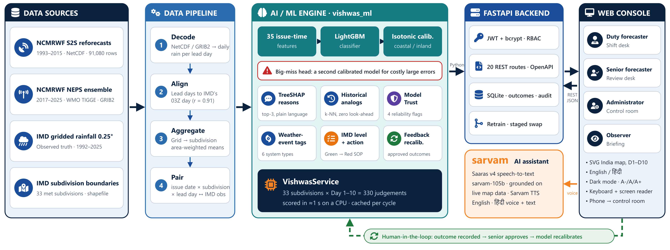
TECHNICAL APPROACH
PowerPuff Squad
Architecture: CPU-only, three tiers: Python ML engine → FastAPI REST API → accessible web console
AI / ML
Python 3.12 · LightGBM 4.7 · scikit-learn · SHAP · pandas · xarray · cfgrib · shapely
Backend
FastAPI · Uvicorn · Pydantic · SQLite · PyJWT · bcrypt
Frontend
HTML5 + vanilla JS · SVG map · EN / हिंदी
Voice AI
Sarvam: Saaras v4 · sarvam-105b · TTS

Slide 4


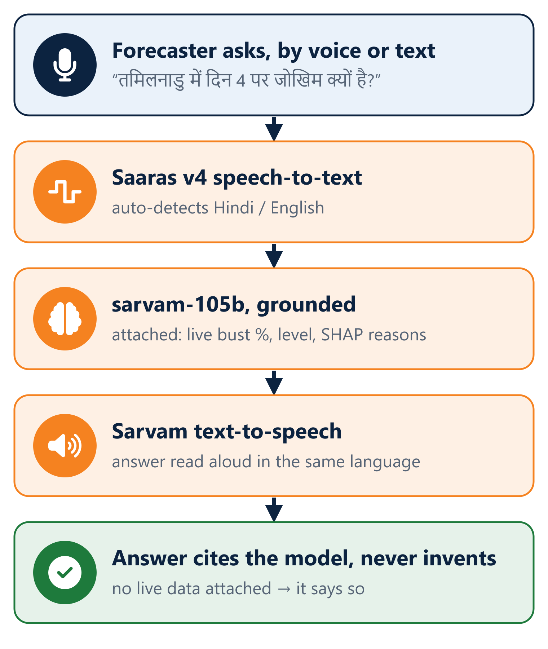

HOW VISHWAS SCORES & EXPLAINS
PowerPuff Squad
Leak-free by design: all 35 inputs are known at 00Z on the issue date; nothing leaks from the future.
1 · WHAT COUNTS AS A BUST
2 · FROM FORECAST TO EXPLAINED RISK
3 · ASK VISHWAS, BY VOICE
Magnitude bust
|forecast − observed| ≥ max(25 mm, that subdivision’s 95th-percentile error for the lead day)
35 issue-time features
amount & anomaly · distance to 2.5 mm line · lead-day consistency · pressure, wind, moisture z-scores · out-of-fold bust history · season · terrain & coast
Category bust
the rain / no-rain call was wrong at IMD’s 2.5 mm rainy-day line
LightGBM classifier
gradient-boosted trees, early stopping on a held-out calibration year
Bust = magnitude OR category. Thresholds fitted on training years only; admins can tune them.
Isotonic calibration
fitted separately for coastal and inland subdivisions, clipped 1–99%
IMD colour-coded warning ladder
Green
0–18%
No action: forecast is reliable
Big-miss head
second calibrated model; flag tuned for 15% precision, never alters the main probability
Yellow
18–38%
Cross-check the short-range nowcast
Explain every flag
TreeSHAP factor sentences · SHAP-weighted k-NN analog · 4-flag Model Trust
Orange
38–62%
Escalate for manual review
Red
62–100%
Escalate now: treat with strong caution
Tamil Nadu, Day 4 → 40% Orange. Top reason (+53%): “Forecast of 2.3 mm sits right at the 2.5 mm rain/no-rain line, so a small error flips the call.”
Powered by Sarvam AI. The API key stays on the server; a failed call degrades to a clean message.

Slide 5
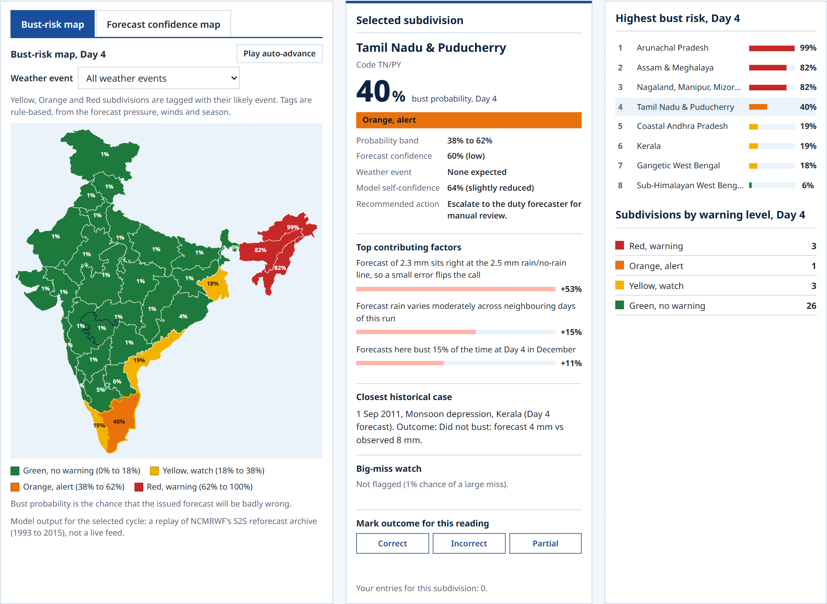
PROTOTYPE & PROVEN RESULTS
PowerPuff Squad
Built, not mocked: real NCMRWF data, tested once on unseen 2013–2015 (11,880 forecasts, 1,976 busts).
3.3×
the no-skill PR-AUC
0.020
calibration error (ECE)
90.4%
74.8%
+0.23
0.864
of busts flagged at Yellow or above
of large misses caught
Brier skill over climatology
ROC-AUC
Chennai floods · cycle of 1 Dec 2015 · out of sample
TN Day 1 · flood day
TN Day 4 → busted
TN Day 5 → busted
Coastal AP → held
Yellow · Watch
Orange · 40%
Yellow · Watch
Green · no warning
Live dashboard, 1 Dec 2015 cycle: bust-risk map, the selected subdivision’s reasons and closest case, and the highest-risk list.
88 automated tests
30 s to train
≈1 s per cycle
0 GPUs needed

Slide 6


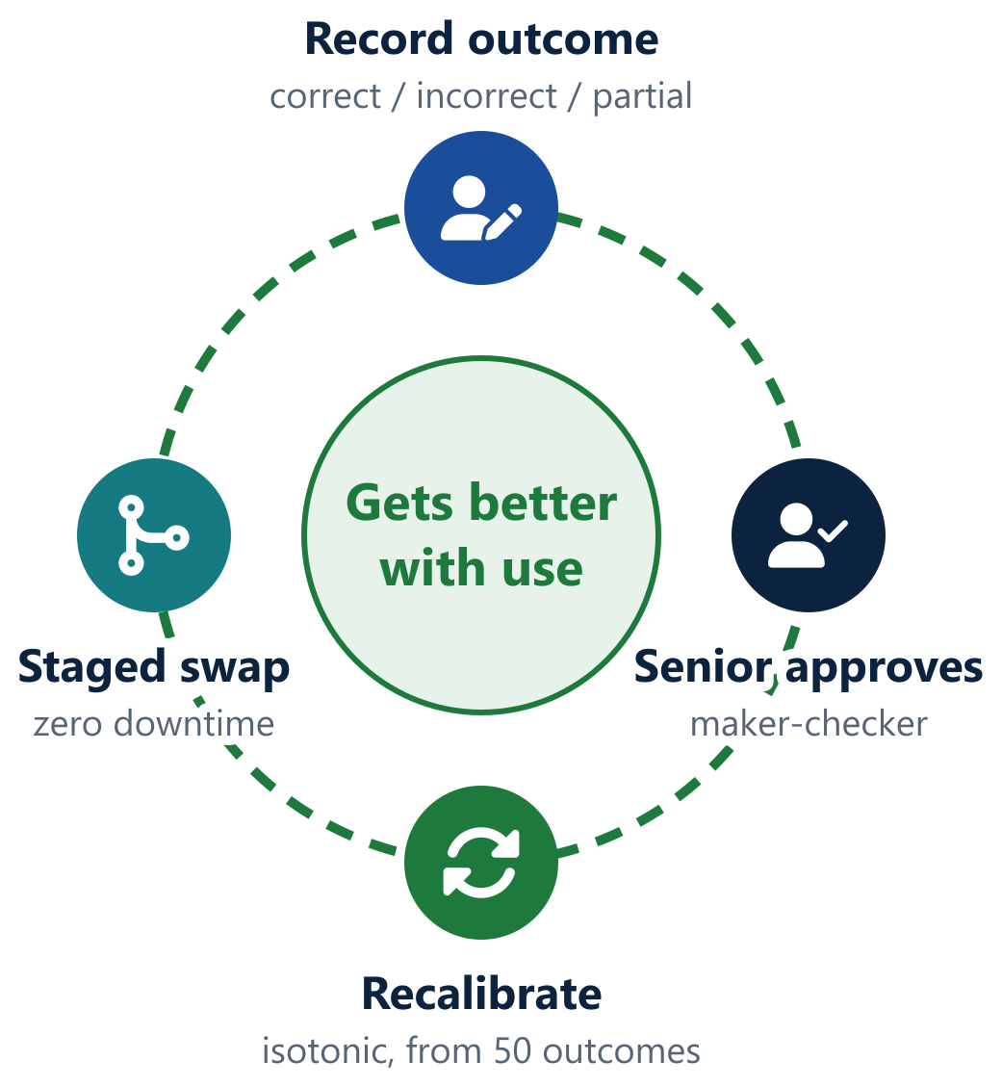




FEASIBILITY AND VIABILITY
PowerPuff Squad
Built, tested, cheap to run: uses what NCMRWF and IMD already produce, on one modest server.
Technical feasibility
Built end to end: real data → calibrated model → REST API → role-based console. 88 tests pass; CPU only.
RISKS → HOW VISHWAS HANDLES THEM
SUSTAINABLE: LEARNS WITH USE
Busts are rare (~17%) | PR-AUC as the main metric, calibrated probabilities, dedicated big-miss head
Information leakage | issue-time features only, out-of-fold history, look-ahead-free analogs, automated leakage tests
Over-fitting | year-based splits, separate validation years, test used once, bootstrap CIs
Coastal, hill & plains regimes | coastal / inland calibration, terrain & coast features, per-subdivision thresholds
Forecaster trust in AI | plain-language reasons, historical analogs, Model Trust, calibration proven on unseen years
Archive access & timing | dedicated S2S / TIGGE readers; lead days aligned to IMD’s 03Z day
Keeping the model current | approved-outcome recalibration; admin retraining with zero-downtime swap
Operational feasibility
Speaks the forecaster’s language: IMD subdivisions, colour code and rainfall thresholds; 4 roles mirror the desk.
Data feasibility
Readers for NCMRWF S2S (1993–2015) and NEPS (2017–2025); lead-day alignment verified (r = 0.77 / 0.91).
ROADMAP TO SCALE
1
Live NCUM-G / NEPS feed, scored as issued
2
District-level trust maps
Financial feasibility
100% open-source stack and open data; no per-seat licence; two processes on a single server.
Heat waves & cyclones: temperature, wind
3
4
MoES deploy: containers, PostgreSQL, SSO
5
Confidence lines in IMD & Agromet bulletins

Slide 7







IMPACT AND BENEFITS
PowerPuff Squad
Impact: a calibrated, explained confidence at issue time puts attention where the forecast is likely to fail.
330
subdivision × lead-day ratings per forecast cycle
90%
of busts land at Yellow or above, before the outcome
75%
of large, costly misses caught by the big-miss watch
4 days
of warning on the Chennai 2015 flood-day bust
Who benefits
NCMRWF & IMD forecasters
Disaster management
Farmers & Agromet units
Reservoir, power & transport
NWP developers
A map read in seconds shows which subdivisions and days need a second look, each with reasons and an action.
Warnings carry a confidence level, so preparedness scales with how reliable the forecast is.
Sowing, irrigation, spraying and harvest advisories can say how far to rely on the forecast.
Act on a trustworthy forecast; hedge on an uncertain one.
Per-subdivision SHAP factors show where and why the model errs, by season and lead day.
Uses: map, reasons, SOP step
Uses: confidence + big-miss
Uses: confidence per lead day
Uses: Day 1–10 confidence
Uses: SHAP factor record
Social
Economic
Environmental
Institutional
Better-qualified warnings protect lives and livelihoods; honest confidence builds public trust in official forecasts.
Fewer costly decisions on unreliable forecasts, fuller use of reliable ones; guidance drives crores of decisions weekly.
Better-timed irrigation and reservoir releases save water; trusted heavy-rain guidance cuts flood damage.
Every approved outcome builds a verified record of forecast skill by region, season and lead day.

Slide 8

RESEARCH AND REFERENCES
PowerPuff Squad
Grounded: built on NCMRWF and IMD data and peer-reviewed forecast-verification science.
DATA SOURCES
METHODS
1
NCMRWF Research Data Server: S2S reforecast 1993–2015. DOI 10.64349/nmrf.rds.s2s.50521 · rds.ncmrwf.gov.in/datasets/s2s-daily
7
Rodwell, M. J. et al. (2013). Characteristics of occasional poor medium-range weather forecasts. BAMS, 94(9).
2
TIGGE forecasts, origin NCMRWF (NEPS), ECMWF Data Store · ecds.ecmwf.int/datasets/tigge-forecasts
8
Ke, G. et al. (2017). LightGBM: a highly efficient gradient boosting decision tree. NeurIPS 30.
3
Pai, D. S. et al. (2014). A 0.25 × 0.25 degree daily gridded rainfall data set over India. Mausam, 65(1), 1–18.
9
Lundberg, S. M. et al. (2020). From local explanations to global understanding with explainable AI for trees. Nature MI, 2.
4
IMD meteorological subdivision boundaries · github.com/India-Meteorological-Department/Indian_met_zones
10
Zadrozny, B. & Elkan, C. (2002). Transforming classifier scores into accurate probability estimates. KDD.
5
IMD SOP for forecasting & warning: colour code; rainy day ≥ 2.5 mm, heavy rain ≥ 64.5 mm · mausam.imd.gov.in
11
Saito, T. & Rehmsmeier, M. (2015). The precision-recall plot is more informative than ROC on imbalanced data. PLoS ONE, 10(3).
6
NCMRWF operational NCUM-G and NEPS-G prediction systems · ncmrwf.gov.in
12
Wilks, D. S. (2019). Statistical Methods in the Atmospheric Sciences, 4th ed. Elsevier.
OUR RESEARCH RIGOUR
Year-based train / validation / test splits
Thresholds fitted on training years only
Test years used exactly once
Block-bootstrap 95% confidence intervals
Automated leakage tests
Cross-checked on NOAA GEFS: +0.042 PR-AUC
Code & handbook: github.com/Tanish-Shitanshu/sih2026-forecast-bust-detection

