Slide 1
ANALYSIS OF
SUMMER OLYMPICS
( 1896 – 2024 )

Slide 2
QUESTIONS TO ANSWER
Q1. What are the most dominant countries in the olympics?
Q2. What are the most efficient countries in the olympics?
Q3. How has gender participation and athlete physiology changed over the years.
Q4. Does hosting olympics have an increase in performance the following years?

Slide 3
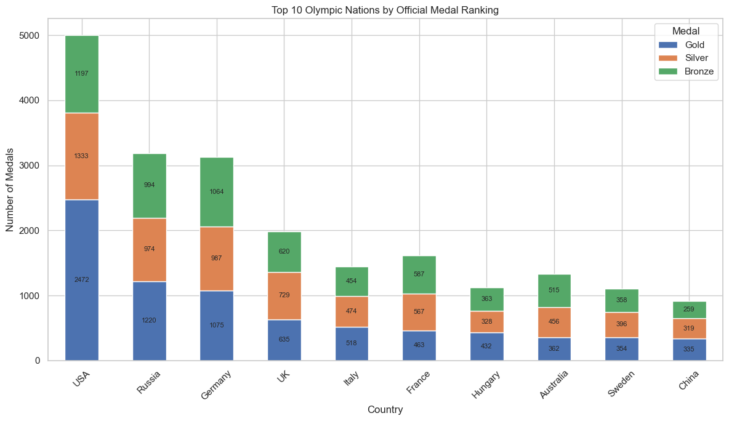
1-A : Most dominant countries
This graph shows us the most dominant countries over all the years ordered by most number of gold, silver and then bronze. USA is the most dominant country by a mile, followed by Russia and Germany.

Slide 4
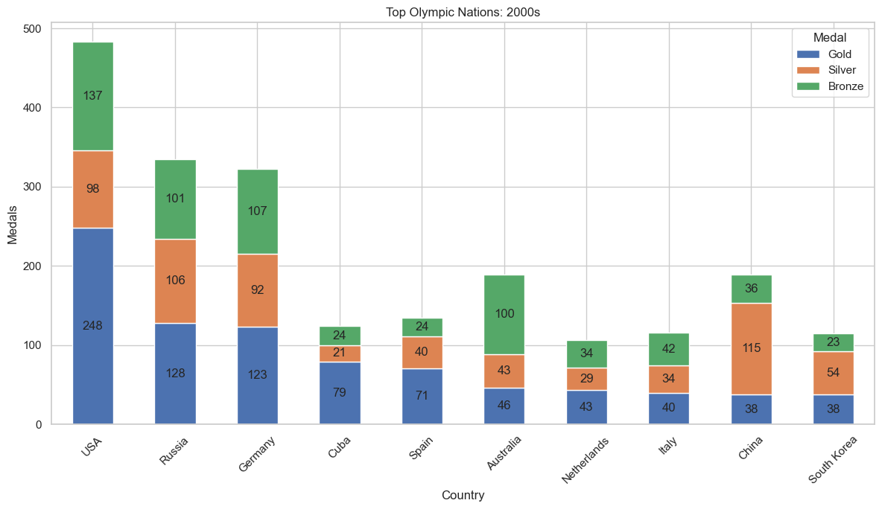
1-B : Dominant countries by decade
This graph shows the most dominant countries in the decade of 2000, countries that have strong results in recent years like Cuba, South Korea show up here, they were missing on total dominant list. Interestingly USA, Russia and Germany are still top 3.

Slide 5
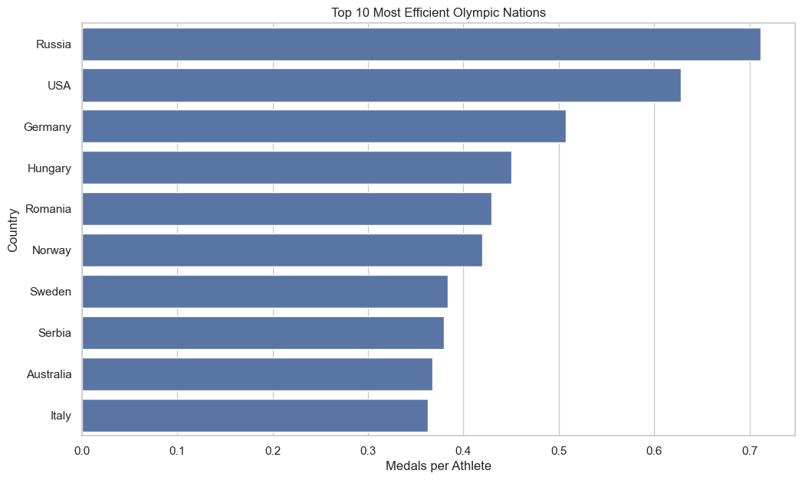
2-A : Most efficient countries
This graph shows the most efficiently performing countries in the olympics (medals / number of athletes). Romania, Norway, Sweden were missing on dominant countries list but they show up here despite less total participation due to small population they have a high winrate.

Slide 6
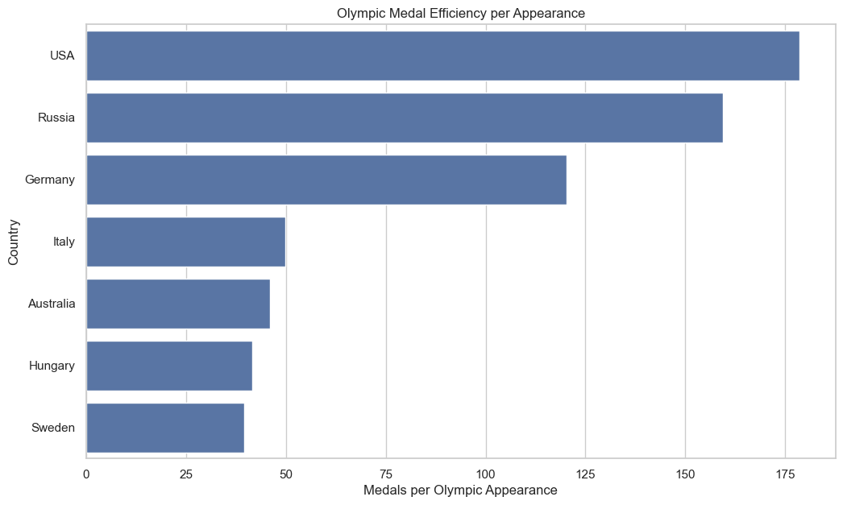
2-B : Medals per olympic appearence
This graph shows the highest countries by medals per olympic appearance ( total medals / number of times they participated ). Countries like US and Russia dominate here aswell, these countries have been putting consistent numbers at each olympics.

Slide 7
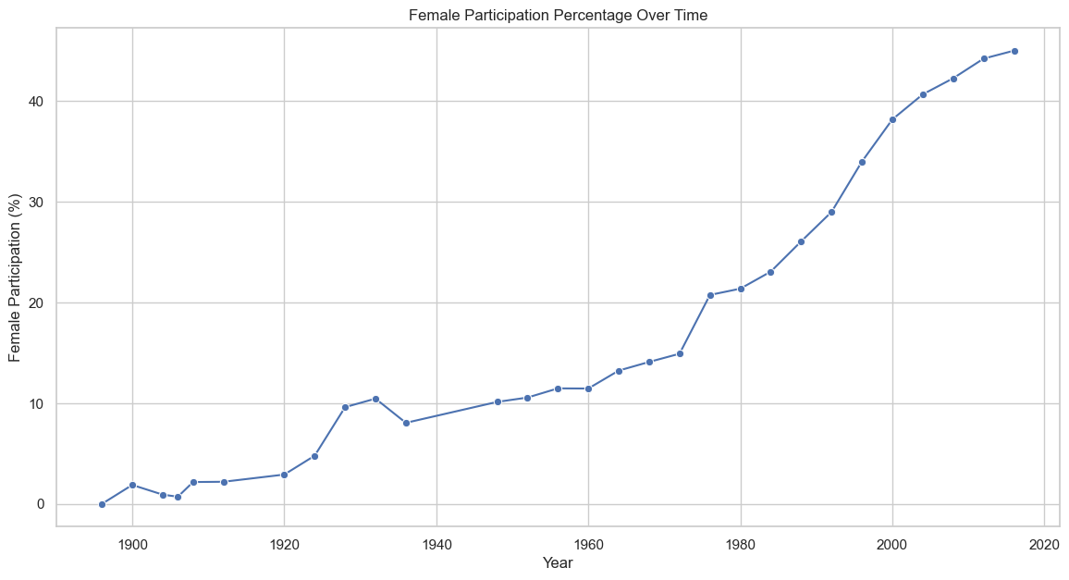
3-A : Female participation
This graph shows the female participation over the years in olympics. The graph has been steadily increasing aside from a drop near 1940s. The participation number is at almost 50% which means olympics in recent years have been having pretty much equal gender participation.

Slide 8
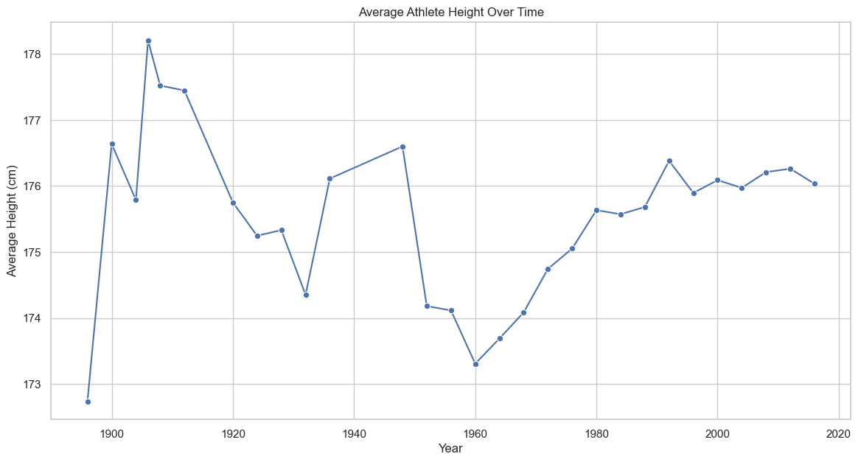
3-B(1) : Athlete physiology trend
This graph shows the trend in height of athletes over time, the highest number was reached in 1908 olympics, after that there was exponential decline, the height has been up and down between 1920s and 1960, after which it had a steady increase and it stays around ~176 in the recent editions.

Slide 9
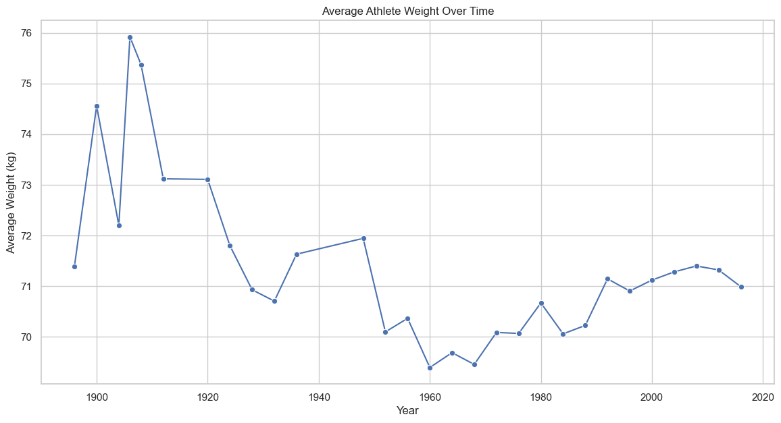
3-B(2) : Athlete physiology trend
This graph shows the trend in weight of athletes over time, the highest number was reached in 1908 olympics ( same as highest ), after that there was exponential decline, the height has been up and down between 1920s and 1960, after which it had a steady increase and decrease and it stays around 71 kgs to 72 kgs in the recent editions.

Slide 10
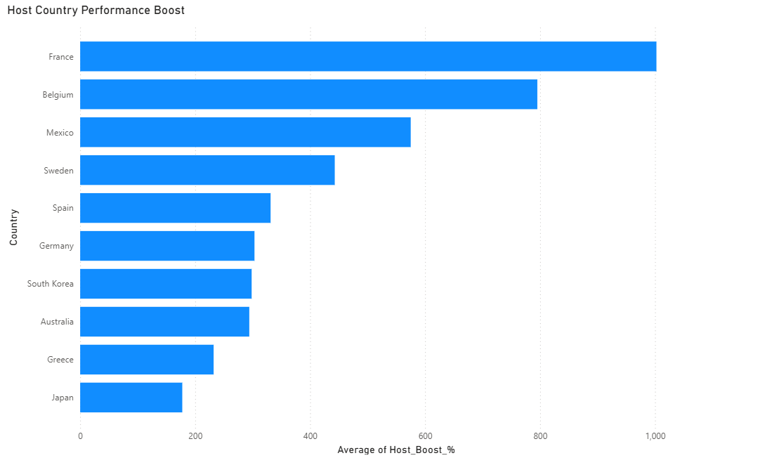
4 : Most efficient countries
This graph shows the increase in boost of medal efficiency after a country hosts olympics compared to the efficiency of last 3 olympics before hosting. We can see that a lot of countries experience a very high medal boost after hosting the olympis, france in particular having a stellar near 1000% boost, followed by belgium with near 800% and mexico at 550%+ boosts at 2nd and 3rd respectively.

Slide 11
INSIGHTS FROM THE ANALYSIS
DOMINANCE and EFFICIENCY:
USA is the most dominant countries in the olympics by a mile. However its below Russia in terms of efficiency, this means US is higher than Russia due to its high number of participants, if Russian participation increases they can take the 1st place over USA.
Small European countries like Norway, Sweden, Serbia perform really well in terms of efficiency.
Cuba performed really well in the 2000s decade despite not showing up in overall dominance or efficiency lists. It has strong recent performances with a weak history.
The list is highly dominated by European countries, 7/10 of the countries on the top 10 dominance list are European.

Slide 12
INSIGHTS FROM THE ANALYSIS
GENDER and PHSYIOLOGY TRENDS:
Female participation has been steadily increasing over the years, with recent numbers almost reaching to 50%. It can be largely attributed to upliftment of women in many third world countries in recent decades and increase in women rights.
Interesting 1908 olympics features the tallest and heaviest athletes on average, this is likely due to a lot of height/weight records from that time missing and most only having records of winners skews the average.
The world war timeline features a heavy decline in average height and weight of the athletes.
Athletes post 2000s are taller and heavier than pre 2000s generally, likely due to the better nutritional diets and more budget given to sports nowadays compared to the previous years.

Slide 13
INSIGHTS FROM THE ANALYSIS
IS IT BENEFICIAL TO HOST THE OLYMPICS?
This analysis shows that its very beneficial to host the olympics, as countries that have done that have gained a very significant boost in their medal efficiency, with France almost reaching a giant 1000% average increase. This is likely due to the fact that when a country hosts olympics, the people of that countries get to experience the sports played. Olympics introduces a lot of events that generally do not get played in the country, leading to a surge in people who are passionate about those sports.

