Slide 1
Leveraging Metaprogramming in Functional Programming
Team
Rutul Patel IMT2022021
Hemang Seth IMT2022098
Tanish Pathania IMT2022049

Slide 2
Flow of this Presentation
Meta & Functional Programming | What is meta programming and functional programming
Haskell and Haskell Templates | Haskell language, its structure and template feature in Haskell
Compile Time & Run time | Compile time and run time functional programming
Funct. Programming in Haskell | Higher Order functions, First class functions , Lazy monad evaluation
Errors Faced & Conclusion | Errors faced while making this project and Summary and Conclusion
Thank you for attending

Slide 3
What Is Meta-Programming ?
"Meta-programming is the ability of a program to treat other programs as its data. It's about writing code that reads, generates, analyzes, or transforms other code."
Key Benefits:
"Reduce Repetition: Avoid writing the same or similar code multiple times by generating it."
"Generate Boilerplate: Automatically create standard code structures (e.g., getters/setters, serialization code)."
"Implement Domain-Specific Languages (DSLs): Create small, specialized languages embedded within or built on top of a host language."
"Optimization: Analyze or transform code to improve performance."
"Introspection and Reflection: Allow a program to examine and modify its own
structure and behavior at runtime."

Slide 4
What Is Functional Programming ?
"Functional Programming is a programming paradigm that treats computation as the evaluation of mathematical functions and avoids changing state and mutable data."
Key principles:
Pure Functions: Functions that always produce the same output for the same input and have no side effects (e.g., modifying global variables, I/O).
Immutability: Data cannot be changed after it's created. New data is created instead of modifying existing data.
Declarative Style: Focusing on what needs to be done rather than how to do it.

Slide 5

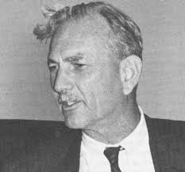
What is Haskell ?
Haskell is a purely functional programming language focused on correctness and reliability. Introduced in 1990 by academics, it unifies features from earlier languages like ML and Miranda.
With lazy evaluation, strong static typing, and immutability, Haskell ensures safe and predictable code. It avoids side effects, supports type inference, and encourages a clear, declarative coding style, making it ideal for high-assurance, scalable systems.

Slide 6
Why use Haskell for this project ?
Haskell was chosen for this project due to its strong functional programming features.
Its strong, static type system helps ensure correctness at compile time, preventing many runtime errors.
Additionally, Haskell’s support for metaprogramming through Template Haskell allowed us to automatically generate routes and database models, reducing boilerplate and improving maintainability.
Its declarative syntax makes expressing complex logic and database operations concise and easy to understand.
All of these features make Haskell an ideal choice for building our project

Slide 7

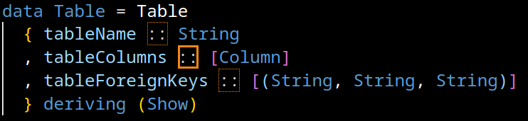

Haskell Structure modules, library, LANG, ::
MODULES are used to organize code into separate components, enabling better code management and reusability.For example, the RouteGen module in our project generates route-related code dynamically, while the Address module defines the Address data structure and its JSON instances.
LIBRARIES are collections of prewritten code that provide common functionality, such as sqlite-simple for interacting with SQLite databases, Data.Aeson for JSON handling, and System.Directory for file operations.
OVRELOADEDSTRINGS extension allows for the use of string literals with different types, such as Text or String, without explicitly converting them. It simplifies working with text data and enhances code readability.
MONADS are a way to handle side effects (like IO, state, etc.) in Haskell in a purely functional manner. The most commonly used monads in Haskell are IO, Maybe, Either, and State.
OTHER USEFUL TOOLS functors is useful for mapping over data structures, Applicative allows you to apply functions inside contexts, and Monad is for chaining computations.
PATTERN MATCHING is a powerful feature in Haskell that lets you deconstruct data types and apply logic based on their structure. It’s used in function definitions, case expressions, and list processing.

Slide 8

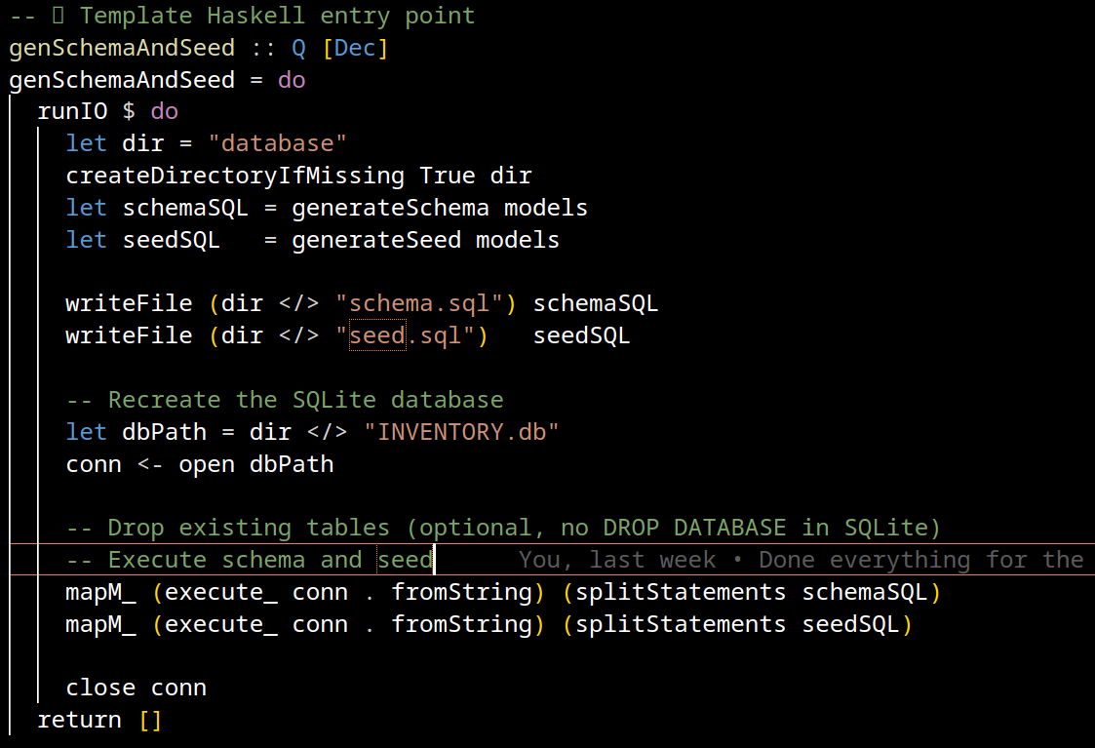
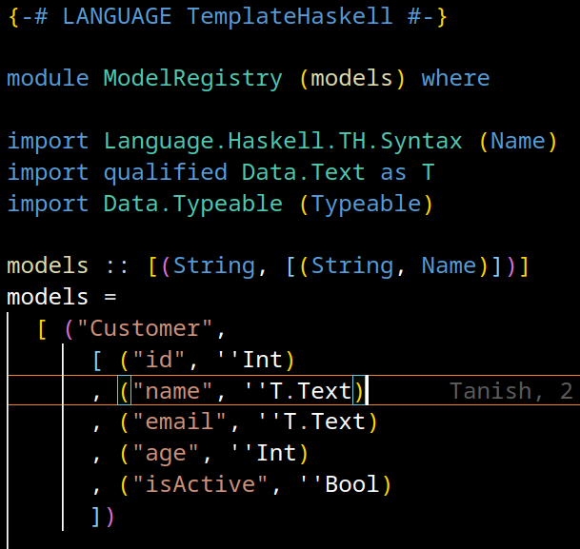
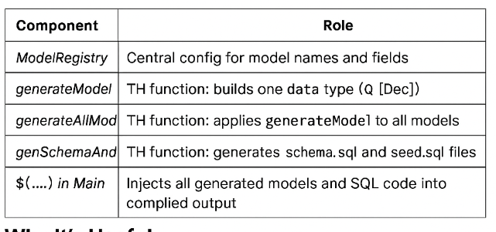
Haskell Template for Meta Programming
A Haskell meta-programming tool for compile-time code generation which enables writing Haskell that writes Haskell and uses types like Q [Dec], Q Exp, Q Type for building code
⚙️ Key Syntax:
$(...) → Splice: run TH code at compile time and insert result Example: $(generateAllModels models)
[d| ... |] → Declaration quote: inline TH code block
(not used here, but useful)
This right next is the template Haskell code that performs IO side effects at compile time via runIO

Slide 9

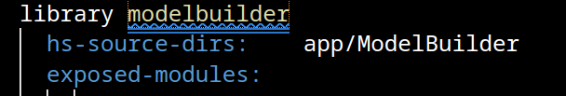
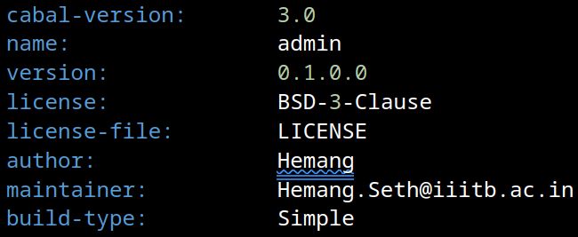
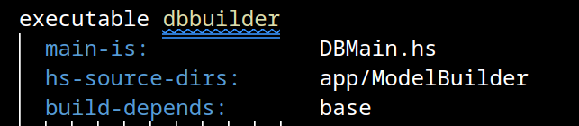
Cabal Build
Defines a Multi-Component Haskell Project Includes libraries (modelbuilder, routebuilder) and executables (admin, server, query-admin) for backend generation and runtime.
Handles Code Generation and SQL Setup Uses Template Haskell to generate model and route code, and builds schema.sql and seed.sql via dbbuilder.
Runs a Web API Server The server executable launches a Scotty-based backend with full CRUD routes on port 3000 using SQLite.
Provides an Interactive CLI Tool query-admin allows dynamic SQL query generation and testing using parsed schema information.

Slide 10
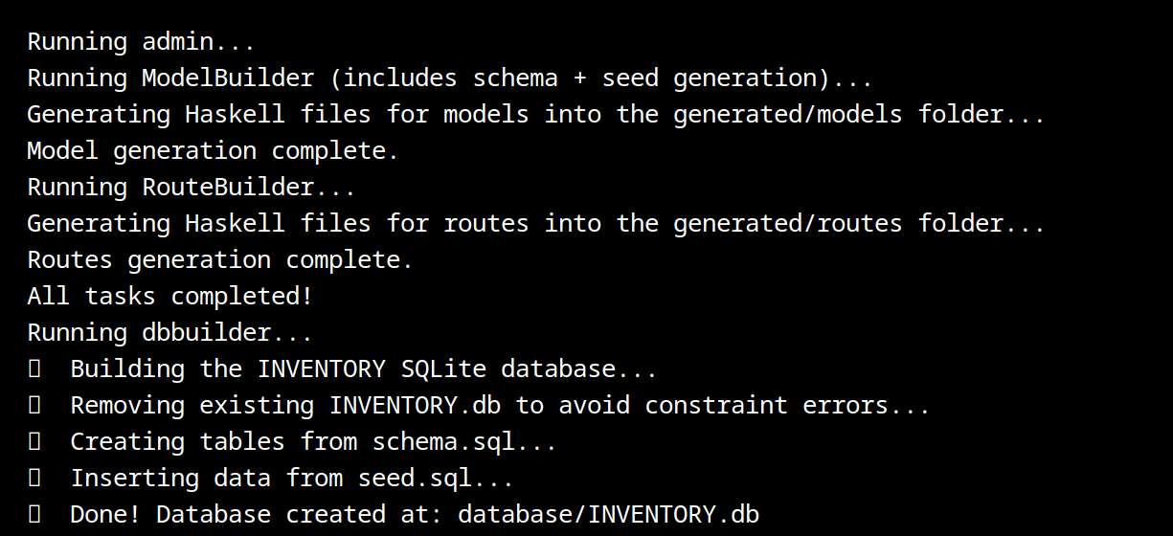
Types of Meta-Programming: Compile Time
Compile-time programming uses Haskell's Template Haskell to generate code before your program runs, embedding logic directly into the compiled binary.
INSTANCES OF COMPILE TIME IN OUR CODE
Parses schema.sql at compile time to generate models and routes.
Generates SQL seeds and schemas into the database/ folder.
Generates Routes and Models into the generated folder (CRUD)
Builds dynamic admin CLIs and API servers that are fully aware
Why It Matters:
Eliminates repetition by auto-generating boilerplate & type safety and consistency across models, routes, and queries.
Speeds up development and reduces manual errors.
Example Output: A CustomerRoutes.hs file or SQL CLI prompt is automatically generated just from a schema file using TH splices like $(generateRoutesFromRegistry)

Slide 11
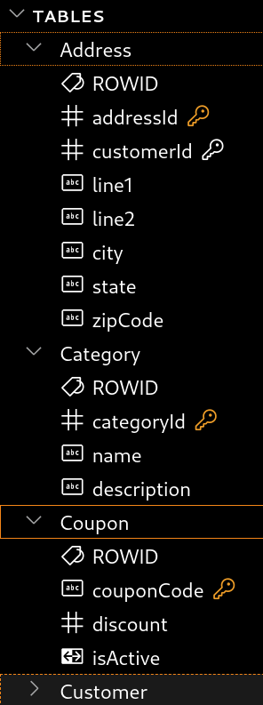
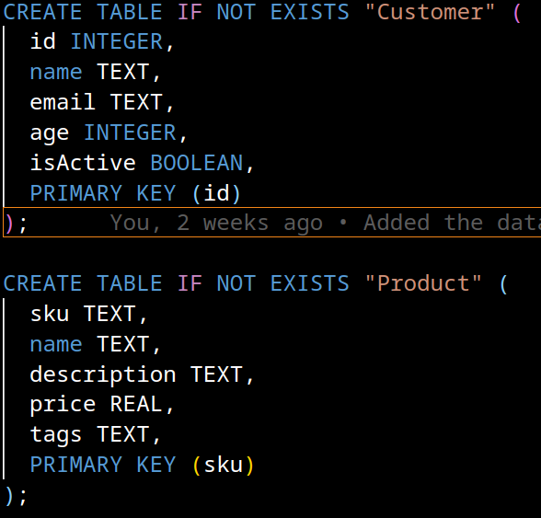
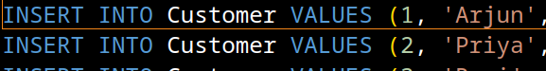
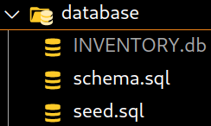
Compile Time Database
Step-by-Step Compile-Time Pipeline
Step 1: SchemaSeedBuilder.hs (using genSchemaAndSeed :: Q [Dec]) creates schema.sql, seed.sql, and builds INVENTORY.db at compile time from ModelRegistry.hs. It defines table structure, constraints, and seed data. Step 2: DBBuilder.hs parses the schema.sql from the database/ folder and maps it as Map TableName [(ColumnName, ColumnType)]. Step 3: ModelGen.hs reads this map and generates corresponding Haskell types (records) and JSON/Row instances under generated/models/*.hs using Template Haskell. Step 4: Routes and backend server code (Server.hs) interact with the pre-built INVENTORY.db, making everything consistent and type-safe.
Key Compile-Time Code (SchemaSeedBuilder.hs)
Generates and writes schema/seed SQL files using generateSchema & generateSeed. Runs them with sqlite-simple to create a fresh INVENTORY.db. Ensures primary/foreign keys, types (Text, Int, Bool), and default data are all generated automatically.

Slide 12


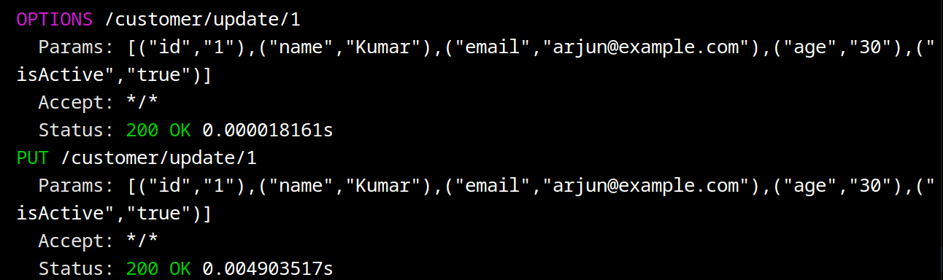
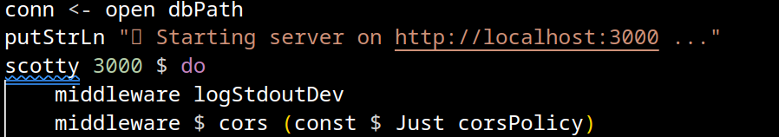
Server.hs and Models/Routes
HOW DOES THE SERVER WORKS ?
Initial Setup & Middleware The server starts on http://localhost:3000, applying middleware for request logging and CORS to allow frontend access from localhost:3001. We also use SCOTTY over here to make a server
Route Linking Each route group (Customer, Product, etc.) is modularized in Links/, and registered using qualified imports like Customer.registerRoutes conn, passing the active SQLite connection.
Database Connection The server uses sqlite-simple to connect to INVENTORY.db, ensuring all routes can directly perform CRUD operations on the database.
import qualified Links.CustomerLinks as Customer
# Note -> In several places we have used qualified , it means It means: You must prefix any function from CustomerLinks with Customer
WHY ? -> Avoids naming conflicts – if two modules have a registerRoutes, you can still use both and Improves readability – you know exactly where each function comes from.

Slide 13
Types of Meta-Programming: Runtime
Occurs while the program is executing.
The running program can inspect its own structure, modify its behavior, or even generate and execute new code dynamically.
Examples: eval() functions (JavaScript, Python), Reflection APIs (Java, C#), Dynamic Code Loading/Evaluation (possible in Haskell).
Key Feature: Offers maximum flexibility and adaptability to runtime conditions. However, can introduce performance overhead, complexity, and potential security risks (especially with untrusted input).

Slide 14
Runtime Meta-Programming via Dynamic Pipelines in Haskell
Goal: Allow users to build, name, reuse, and extend function pipelines during execution.
Why it matters:
No compile-time constraints — full flexibility.
Demonstrates runtime manipulation of first-class functions.
Enables creation of arbitrarily complex processing systems interactively.
User Choices ───► Build Pipeline ───► Save with Name
│
▼
Load Existing Pipeline ───► Extend / Run

Slide 15
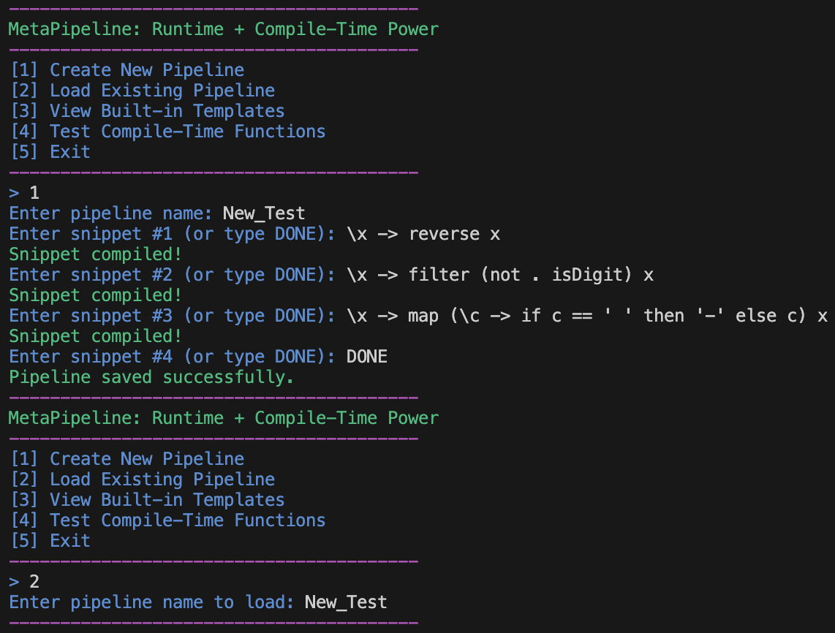
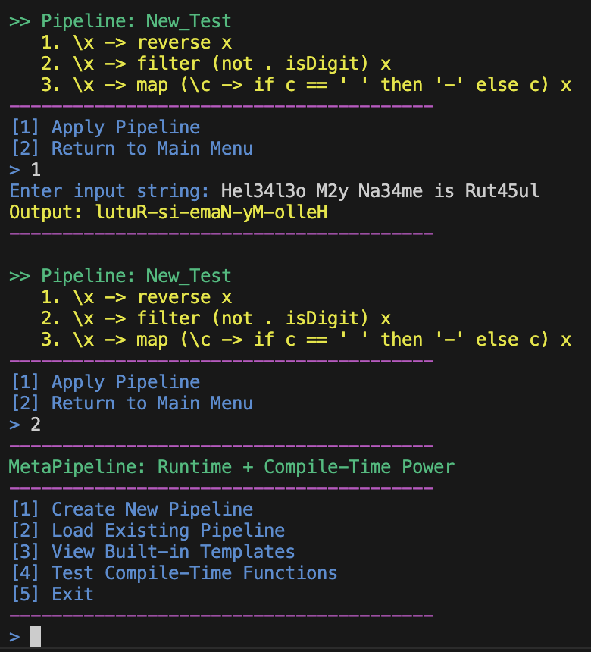
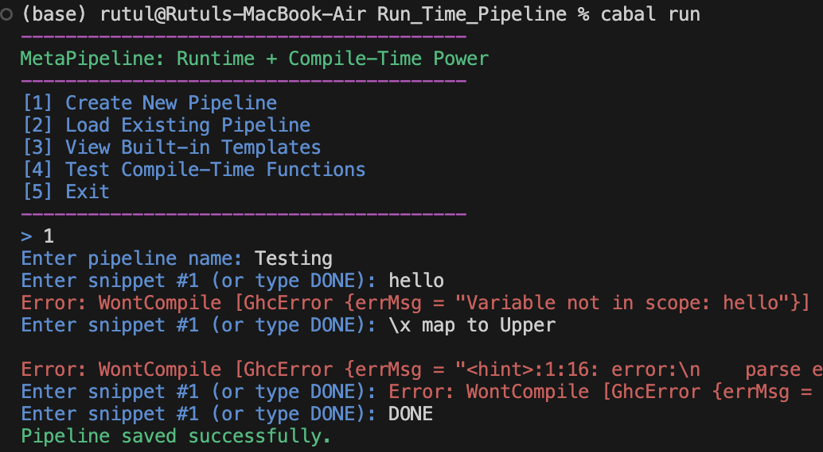

Slide 16
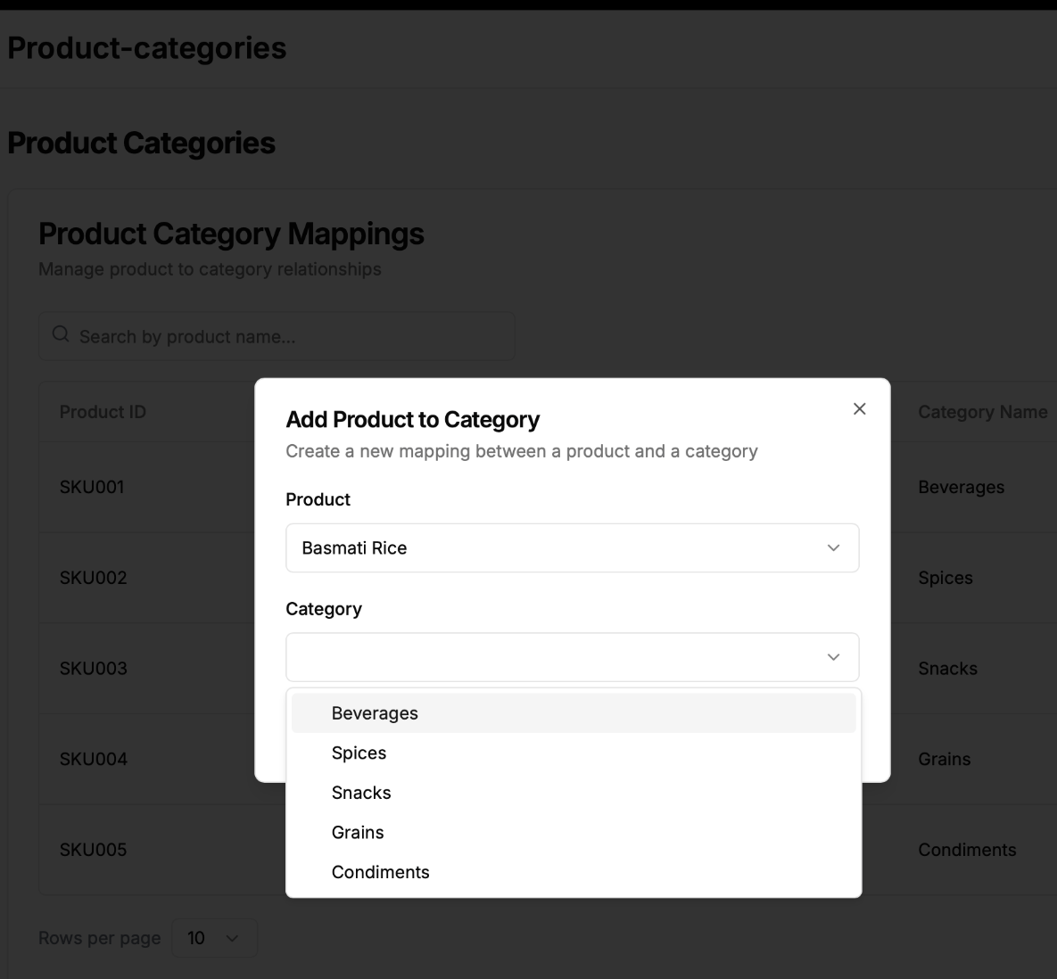
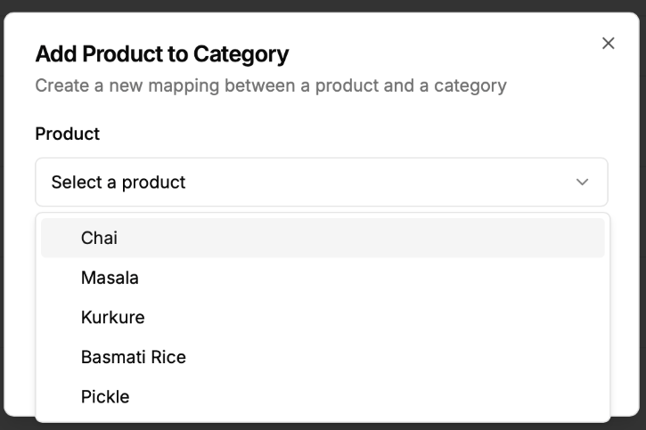
Some snapshots of the Frontend

Slide 17
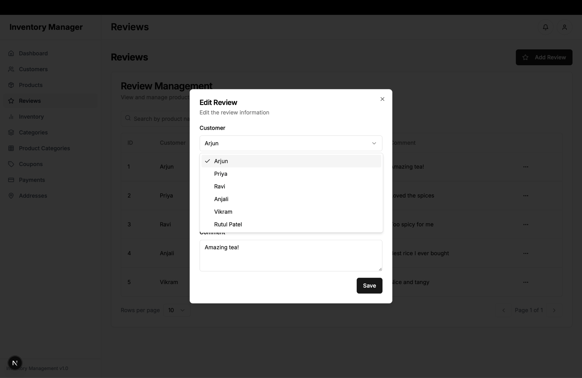

Slide 18
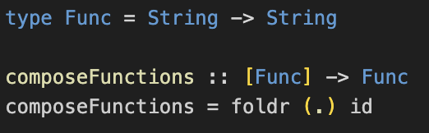
Higher-Order Functions – The Core of Functional Abstraction
A function that takes other functions as arguments or returns a function as a result.
Why They Matter:
Enable powerful abstractions and code reuse.
Essential for function composition, map/filter/reduce, and runtime meta-programming.
In Our Project:
foldr (.) id takes a list of functions and combines them using function composition.
This allows dynamic assembly of behavior from modular components.

Slide 19
Higher-Order Functions Enable Meta-Programming
Modularity: Break complex tasks into small reusable functions.
Extensibility: Users can define and plug in their own behavior.
Dynamic Behavior: Change program logic at runtime by passing/returning functions.
Our Contribution:
Showcased how higher-order functions power dynamic, user-driven computation pipelines.
Users build their logic without modifying the source code — that’s the real power.

Slide 20
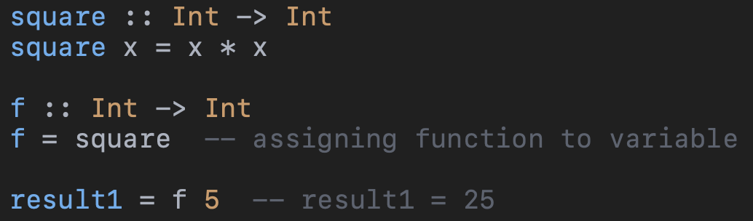
First-Class Functions – Treating Functions Like Data
Functions are treated like any other value in the programming language.
A function is first-class if:
You can store it in a variable
You can pass it as an argument
You can return it from another function
You can store it in a data structure (like a list or map)
First-class functions allow you to:
Write generic and reusable code
Build functions at runtime

Slide 21
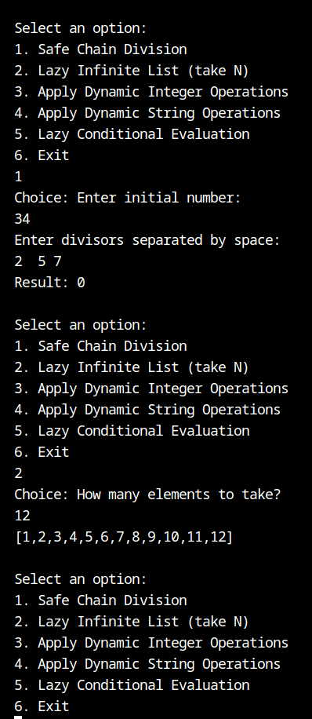
Lazy Monad Evaluation
Lazy Data Structures: Haskell's lists are lazily evaluated. Infinite lists like [1..] are computed only when needed, making memory usage efficient. Example: takeNFromInfinite 5 results in [1, 2, 3, 4, 5].
Safe Computations with Maybe Monad: The Maybe monad ensures safe computations, propagating errors (e.g., division by zero) as Nothing. Example: chainDivisions 10 [2, 0] results in Nothing due to division by zero.
Dynamic Integer Operations: Operations like doubling, incrementing are applied dynamically at runtime, evaluated lazily. Example: applyRuntimeOperations ["double", "increment"] 3 results in Just 7.
Dynamic String Transformations: Strings can be dynamically transformed based on user input (e.g., reversing, uppercasing). Example: applyRuntimeStringOperations ["reverse", "uppercase"] "hello" results in `"OLLEH".
Lazy Conditional Evaluation: Conditional expressions evaluate only the necessary branch, ensuring efficient execution. Example: lazyConditional True "True branch" "False branch" results in `"True branch".

Slide 22
Project timeline
Worked on queries on APIs , routes and all which involved testing in the POSTMAN
Made an idea about the project understood it and made a approach on it
Worked on the run time pipeline
01
02
03
04
05
06
Worked on the compile time programming decided the schema of the Database
Worked on functional programming aspects
Final project deliverables were ready

Slide 23

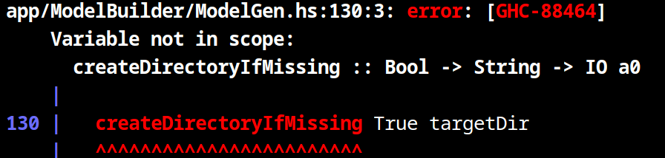
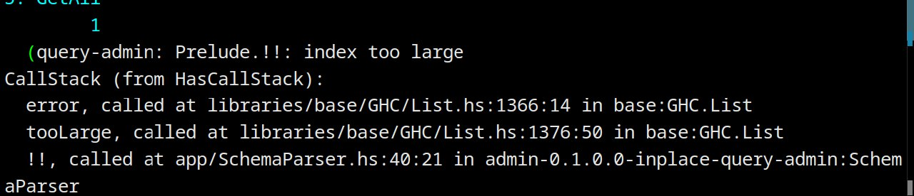
Errors Faced
The project initially failed to compile due to missing sqlite-simple in the Cabal build-depends list.
Middleware in Scotty was incorrectly used as a route, causing type mismatch errors.
Rebuilding the database without deleting the existing .db file led to primary key constraint failures during seeding.
Template Haskell code crashed at compile time due to non-idempotent DB inserts during schema and seed generation.
An "index too large" runtime crash occurred from unsafe list access using !! without bounds checking in schema parsing.

Slide 24
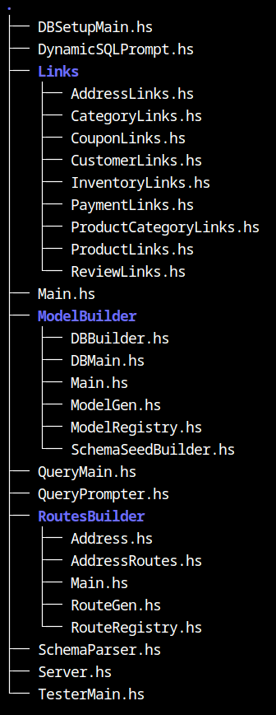
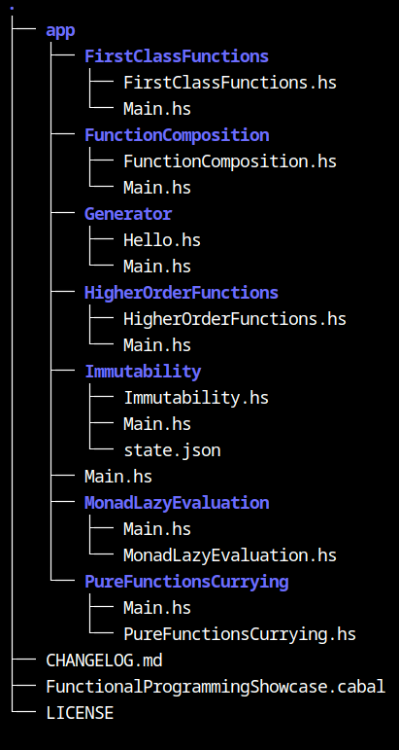
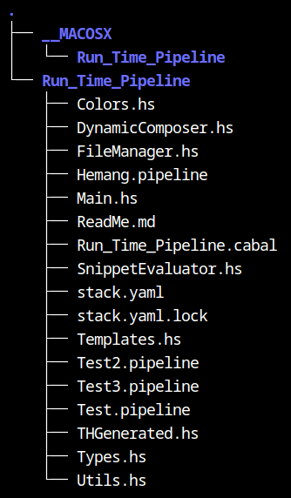
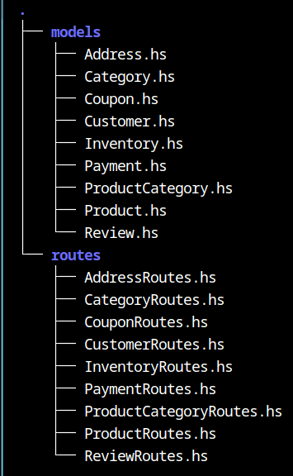
App Tree Compile Instance Tree Pipeline Tree Generated Tree

Slide 25
Thank You

