Slide 1
BOB:Autonomous Supply Chain Risk Intelligence
IBM—BOB AI INNOVATION HACKATHON 2026
Team Synora:—
TANIS BEDIA
JAY KALATHIYA
GRANTH NAKRANI
KAUSHAL SANAVADA

Slide 2

The Problem
Cascading Disruptions
Idle Fleet Assets
Weather, port strikes, and geopolitical crises ripple across hundreds of active shipments — impossible to track manually.
Fleet assets sit idle while other routes are overloaded — no system bridges the gap in real time.
Cold-Chain Vulnerability
The Challenge
A single temperature excursion can spoil $500K+ cargo — yet breaches are only discovered at delivery.
Identify affected shipments, recommend re-routing, flag idle assets, and monitor cold-chain IoT logs — all before delivery.

Slide 3
Our Solution
Disruption Identification
Deterministically matches live disruptions to exact route waypoints, legs, and destinations — zero AI guesswork.
Re-Routing Recommendations
Core Principle:
Deterministic detection + AI-powered reasoning = risk intelligence you can act on, not guess at.
AI mitigation layer (Gemini primary, Groq fallback) turns verified risk data into actionable carrier alternatives.
Cold-Chain Monitoring
Rule-based excursion engine: ≤2 hrs = moderate, >2 hrs = critical — with regulatory severity classification.

Slide 4
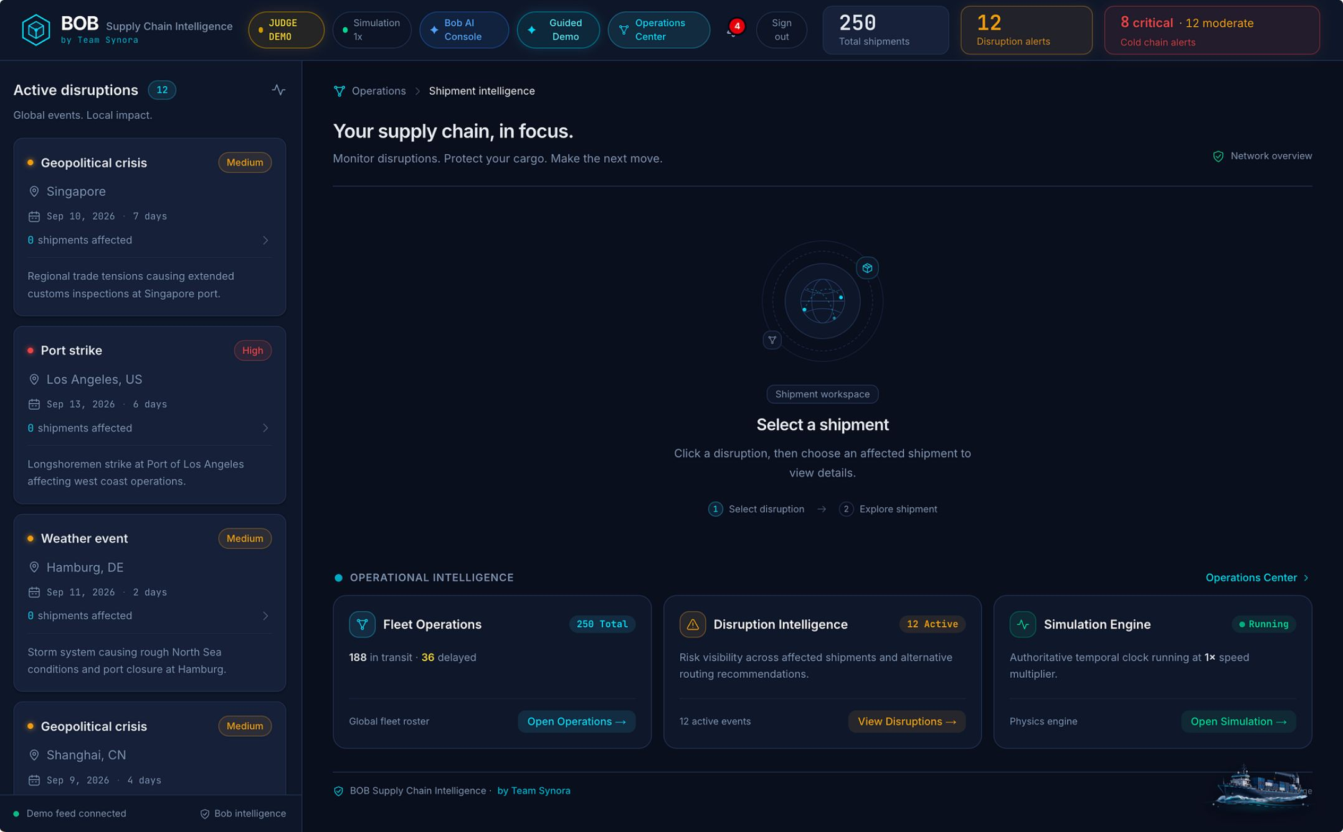

How It Works
Architecture Overview
Frontend
Next.js 16 / React 19 — responsive operational dashboard
Backend
FastAPI, Python 3.13, Pydantic v2 — deterministic engine layer
Auth & Database
Supabase PostgreSQL with Row-Level Security (RLS)
AI Layer
Gemini 1.5 Flash (primary) → Groq Llama 3.1 8B (fallback)

Slide 5

Key Feature: Deterministic Engines
Disruption Matching Engine
Matches live events to exact waypoints
Regulatory Severity Tags
Two-Engine Deterministic System
Leg and Route Precision
Why Deterministic?
Classifies violations by regulation
Identifies current leg and destination
Judges and operators need alerts they can trust and act on immediately — not outputs that require verification.
Cold-Chain Integrity Engine
Zero Hallucinated Alerts
Rule-based excursion detection
Rule-based, verifiable matches only
Disruption Matching
Cold-Chain Integrity
Rules match live events to waypoints, current leg, and destination — zero AI guesses.
Excursion engine fires on rule breach, attaches regulatory context to each violation automatically.

Slide 6



Key Feature: Resilient AI Pipeline
Primary: Gemini 1.5 Flash
Automatic Failover
Always Available
6-second timeout — fast mitigation reasoning from verified risk data
Groq running Llama 3.1 8B activates instantly if Gemini is slow or unavailable
Mitigation guidance never blocked by a single AI provider going down

Slide 7
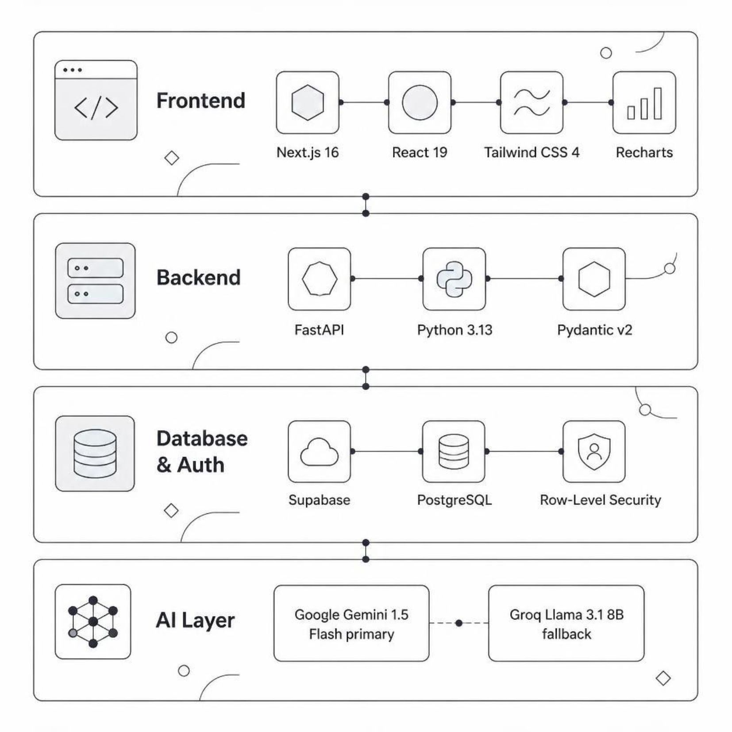

Tech Stack
Built for Production
Every layer chosen for speed, reliability, and enterprise-grade security.
Frontend
Backend
Next.js 16, React 19, Tailwind CSS 4, Recharts
FastAPI, Python 3.13, Pydantic v2
Database / Auth
AI
Supabase — PostgreSQL + Row-Level Security
Gemini 1.5 Flash (primary) · Groq / Llama 3.1 8B (fallback)

Slide 8
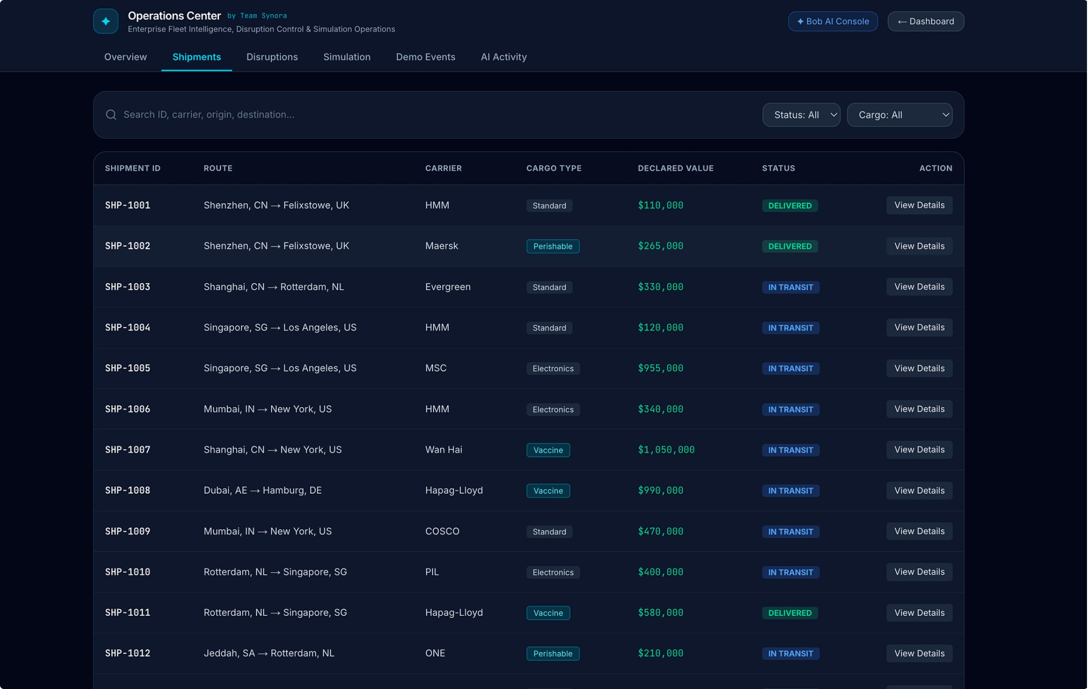

Live Demo
Real-Time Operational Dashboard
Active alerts, waypoint tracking, and interactive temperature charts — all live.
Judge Demo Access: preconfigured account with 200 synthetic shipments, 12 disruptions, and sensor logs pre-seeded. No setup required.
Explore live →
https://bob-ai-hackathon-team-synora.vercel.app/

Slide 9




Impact & Why It Matters
Faster
Trustworthy
Disruption-to-alert happens automatically — not after a human finally notices.
Deterministic core = zero hallucinated risk alerts. AI is used only where it adds genuine value.
Resilient
Applicable
Dual-AI failover means the system never goes dark — mitigation is always available.
Pharma logistics, food & perishables, high-value freight, and any cold-chain-dependent supply chain

Slide 10
THANK YOU…!!
LIVE APP LINK: https://bob-ai-hackathon-team-synora.vercel.app/
REPOSITORY:https://github.com/Tanish01234/bob-ai-hackathon-team-synora

