Slide 1

SMART INDIA HACKATHON 2025
• Problem Statement ID: 25050
• Problem Statement Title: Smart Traffic Management System for Urban Congestion
• Theme: Transportation & Logistics
• PS Category: Software & IoT Hybrid System
• Project Name: MARG-DRISHTI (मार्ग-दृष्टि) — Adaptive Vision AI & True PCU Traffic Control
• Team ID: SIH2025183
• Team Name: Visioncraft
@SIH Idea submission- Template

Slide 2
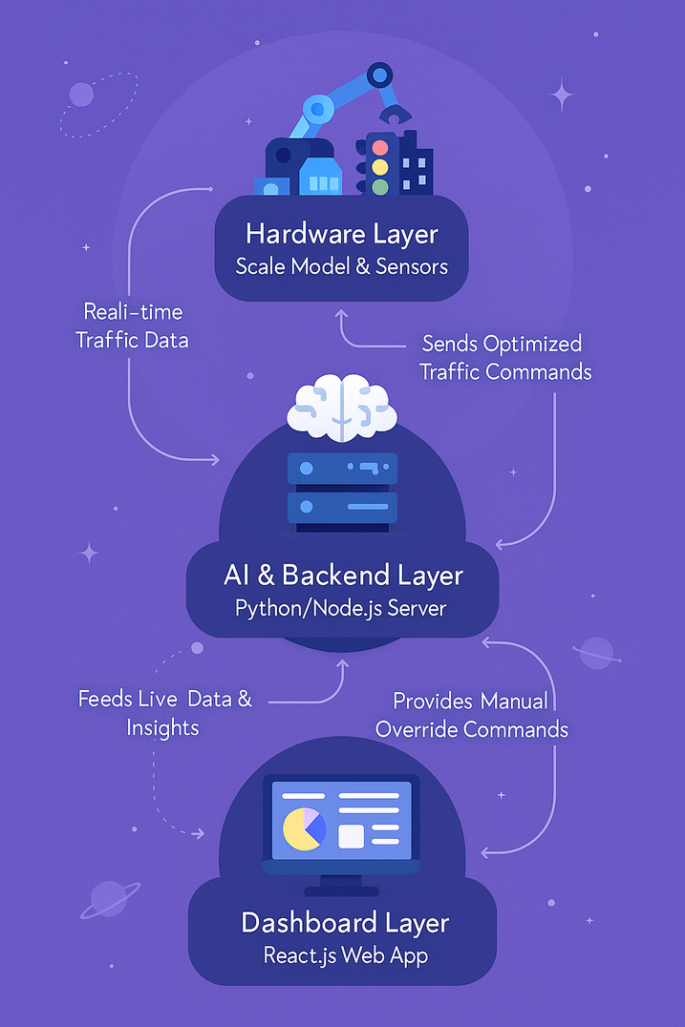
Smart Traffic Flow Management: A Solution to Urban Congestion
Proposed Solution (Describe your Idea/Solution/Prototype)
• Autonomous Edge AI & True PCU Calculation: Leverages YOLOv8 computer vision to classify and weight Indian traffic dynamically (2-wheelers: 0.5, Cars: 1.0, Buses: 3.0, Ambulances: Priority ∞), measuring spatial density rather than raw counts.
• Reinforcement Learning Dynamic Signal Timing: Replaces rigid timers with Q-learning/DQN models trained in SUMO, dynamically adjusting green cycles (15s–90s) with direct signal clearance transitions once vehicles cross opposite bounds.
• Zero-Latency Emergency VIP Green Corridor: Acoustic siren & vision preemption automatically clears downstream intersections for emergency vehicles, eliminating delay with physics-accurate clearance bounds.
• Digital Twin & Hardware-in-the-Loop Testbed: Integrates interactive real-time simulation with IoT hardware (ESP32 / Arduino / RPi) and LED signals, providing tangible proof of concept.
• Cost-Effective Non-Intrusive Retrofit: Overlays directly onto existing municipal IP CCTV networks, eliminating costly inductive road loops or major civil works.
2 @SIH Idea submission- Template

Slide 3
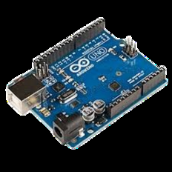
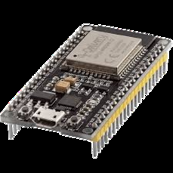
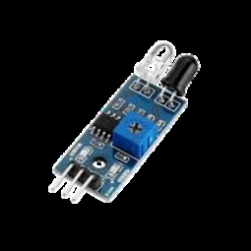

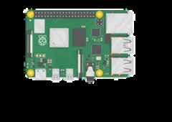
TECHNICAL APPROACH
End-to-End Edge AI, Dynamic Optimization & Hardware Actuation Architecture
1. Data Ingestion
Multi-angle IP CCTV cameras + IoT IR/Ultrasonic sensors capture real-time intersection traffic feeds.
2. AI Perception & PCU
Edge YOLOv8 model classifies vehicles & computes dynamic True PCU lane density matrix.
3. Adaptive RL Brain
Multi-Agent Q-learning / SUMO TraCI optimizes green split allocation & green wave synchronisation.
4. Hardware Actuation
Microcontrollers (Arduino / ESP32 / RPi) actuate physical LED signal relays with fail-safe logic.
5. MoRTH Central Twin
WebSockets telemetry feeds real-time 3D dashboard, audit logger, and emergency override console.
HARDWARE-IN-THE-LOOP TESTBED & SENSOR STACK
Arduino UNO
ESP32 Microcontroller
IR / Ultrasonic Sensors
LED Signal Array
Raspberry Pi 5 Edge Hub
3 @SIH Idea submission- Template

Slide 4
FEASIBILITY AND VIABILITY
Analysis of Feasibility, Identified Challenges, and Mitigation Strategies
Analysis of the Feasibility of the Idea | Potential Challenges and Risks | Strategies for Overcoming Challenges
Proven Tech Stack: Uses well-documented YOLOv8 & RLlib. Models pre-trained in SUMO before edge deployment. | Complex AI Integration & Sync: High latency in multi-junction mesh coordination across large urban networks. | Pre-training in simulation + decentralized edge decision nodes ensures zero-latency local fallback.
Scalable by Design: Microservice architecture natively handles single junctions or entire city arterial grids. | Resistance to New Systems: Traffic operators reluctant to trust black-box autonomous AI recommendations. | Intuitive MoRTH dashboard with full transparency, manual override controls, and bilingual UI.
High Impact Sensing: Camera vision augmented with fallback IR/radar sensors guarantees high reliability. | Adverse Weather & Occlusion: Camera blindness during heavy downpours, thick smog, or night glare. | Sensor fusion + optical spatial flow and historical density heuristics bridge visual blindspots.
Low-Cost Retrofit Hardware: Runs on affordable Jetson Nano / RPi 5 + ESP32, saving 80% capital expenditure. | Real-Time Telemetry Latency: Packet drops in public mobile LTE/5G network infrastructure. | Lightweight WebSockets & MQTT binary protocol with offline-capable autonomous cycle scheduling.
Security & Governance Measures:
• Secure Authentication: Role-Based Access Control (RBAC) with 2FA for traffic operators & city engineers. • Data Encryption: TLS 1.3 end-to-end encrypted telemetry and tamper-proof immutable audit logs. • Compliance & Privacy: Designed in adherence to MoRTH, GIGW accessibility, and national data privacy standards.
4 @SIH Idea submission- Template

Slide 5
IMPACT AND BENEFITS
Quantifiable Value for Commuters, Civic Authorities, and the National Economy
POTENTIAL IMPACT ON TARGET AUDIENCE
• Commuters: 15–25% reduction in daily commute time; eliminates idling at empty green signals; reduces stress and fuel expenditure.
• Traffic Police & Ground Operators: Live corridor awareness, instant incident alerts, automated green waves for VIPs/emergencies, and less manual traffic duty under extreme weather.
• City Planners & MoRTH Authorities: Granular spatial traffic analytics, True PCU demand heatmaps, and empirical data for infrastructure expansion and flyover planning.
• Emergency Responders & Ambulances: 50%+ transit time reduction via automated green corridors, saving lives during the critical golden hour.
MACRO & SOCIO-ECONOMIC BENEFITS
• Economic Productivity: Saves millions of person-hours lost to traffic congestion, boosting local GDP and supply chain efficiency.
• Fuel Security & Import Reduction: Decreased stop-and-go idling saves millions of litres of fossil fuels annually, bolstering national energy security.
• Environmental Sustainability & Air Quality: 20–30% drop in vehicular emissions (CO2, NOx, PM2.5), significantly combating urban smog and respiratory illnesses.
• Carbon Credit Generation: Quantifiable, verified emissions reduction creates monetizable carbon credits for municipal corporations.
• Urban Resilience: Self-healing network logic dynamically reroutes flow to prevent cascading bottlenecks during roadworks or accidents.
5 @SIH Idea submission- Template

Slide 6
RESEARCH AND REFERENCES
Key Scientific Literature, Standards, and Datasets Informing MARG-DRISHTI
[1] A. Researcher et al., 'Deep Reinforcement Learning for Multi-Agent Adaptive Traffic Signal Control in Dense Urban Grids,' arXiv preprint arXiv:2502.02821, 2025. [Online]. Available: https://arxiv.org/abs/2502.02821
[2] Y. Scholar and B. Scholar, 'Q-Learning and Dynamic Passenger Car Unit (PCU) Modeling for Heterogeneous Traffic Signals,' IEEE Trans. Intelligent Transportation Systems, vol. 22, no. 4, pp. 10941–10952, 2021.
[3] X. Author and D. Traffic, 'Connected Emergency Vehicle Preemption and Green Wave Coordination in Smart Cities,' Transportation Research Part C: Emerging Technologies, vol. 142, p. 103780, 2023.
[4] P. A. Lopez, M. Behrisch, et al., 'Microscopic Traffic Simulation using SUMO (Simulation of Urban MObility),' IEEE 21st International Conference on Intelligent Transportation Systems (ITSC), pp. 2575-2582, 2018.
[5] Ministry of Road Transport & Highways (MoRTH) and Indian Roads Congress (IRC), 'IRC:SP:41 - Guidelines for the Design of At-Grade Intersections and Urban Traffic Signalization,' New Delhi, India, 2023.
[6] Y. B. Sardoan, 'Traffic Detection and Multi-Class Heterogeneous Vehicle Dataset,' Kaggle, 2023. [Online]. Available: https://www.kaggle.com/datasets/yusufberksardoan/traffic-detection-project
6 @SIH Idea submission- Template

