Slide 1

AI Job Market Analysis
Uncovering trends, salaries, and opportunities in the rapidly growing AI industry using SQL & Power BI

Slide 2

Project Objectives
Market Analysis
Salary Distribution
Skills Demand
Analyze overall AI job market trends and growth patterns
Study compensation across job roles and experience levels
Identify in-demand and high-paying technical skills
Hiring Trends
Interactive Insights
Analyze company-wise and location-wise opportunities
Create dashboards for data-driven decision-making

Slide 3
Tools & Technologies
SQL
Power BI
Power Query
DAX
Querying, filtering, and aggregating job data for efficient analysis
Creating interactive dashboards and visual storytelling
Data cleaning and transformation workflows
Calculated measures and key performance indicators

Slide 4
DATA QUALITY
Data Preprocessing & Cleaning
Data preprocessing was essential to ensure accuracy and reliability. Multiple steps transformed raw data into analysis-ready insights.
01
02
03
Duplicate Removal
Missing Values
Format Standardization
Eliminated redundant records to ensure data integrity
Handled missing salary values through imputation and validation
Unified salary formats across different currencies and structures
04
05
Skill Parsing
Calculated Fields
Split skill columns into individual values for granular analysis
Created new columns and measures for deeper insights

Slide 5

SQL Analysis Deep Dive
SQL queries extracted critical insights through efficient data aggregation and filtering before visualization.
Job Volume
Salary Analysis
Total number of AI job openings across platforms
Average compensation by job role and seniority
Top Employers
Geographic Distribution
Leading companies hiring AI professionals
Location-wise job availability and concentration
Skill Demand
Most requested technical skills and competencies

Slide 6
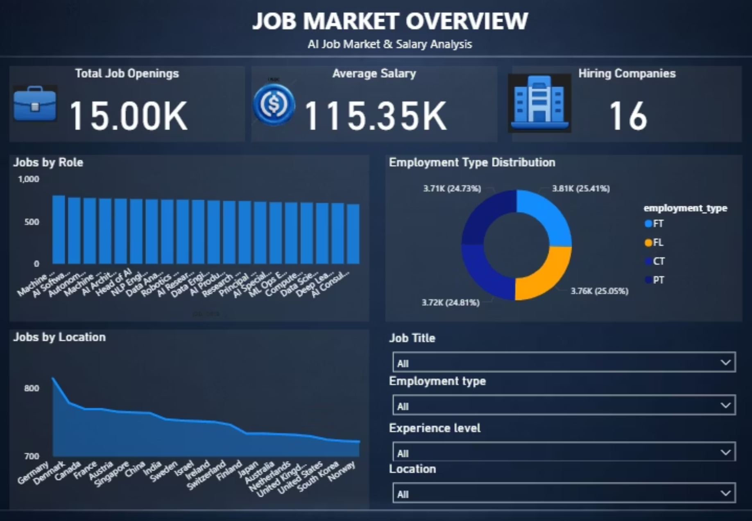
DASHBOARD 1
Job Market Overview
This dashboard provides a high-level overview of the AI job market structure, helping stakeholders understand the overall landscape and distribution of opportunities.

Slide 7
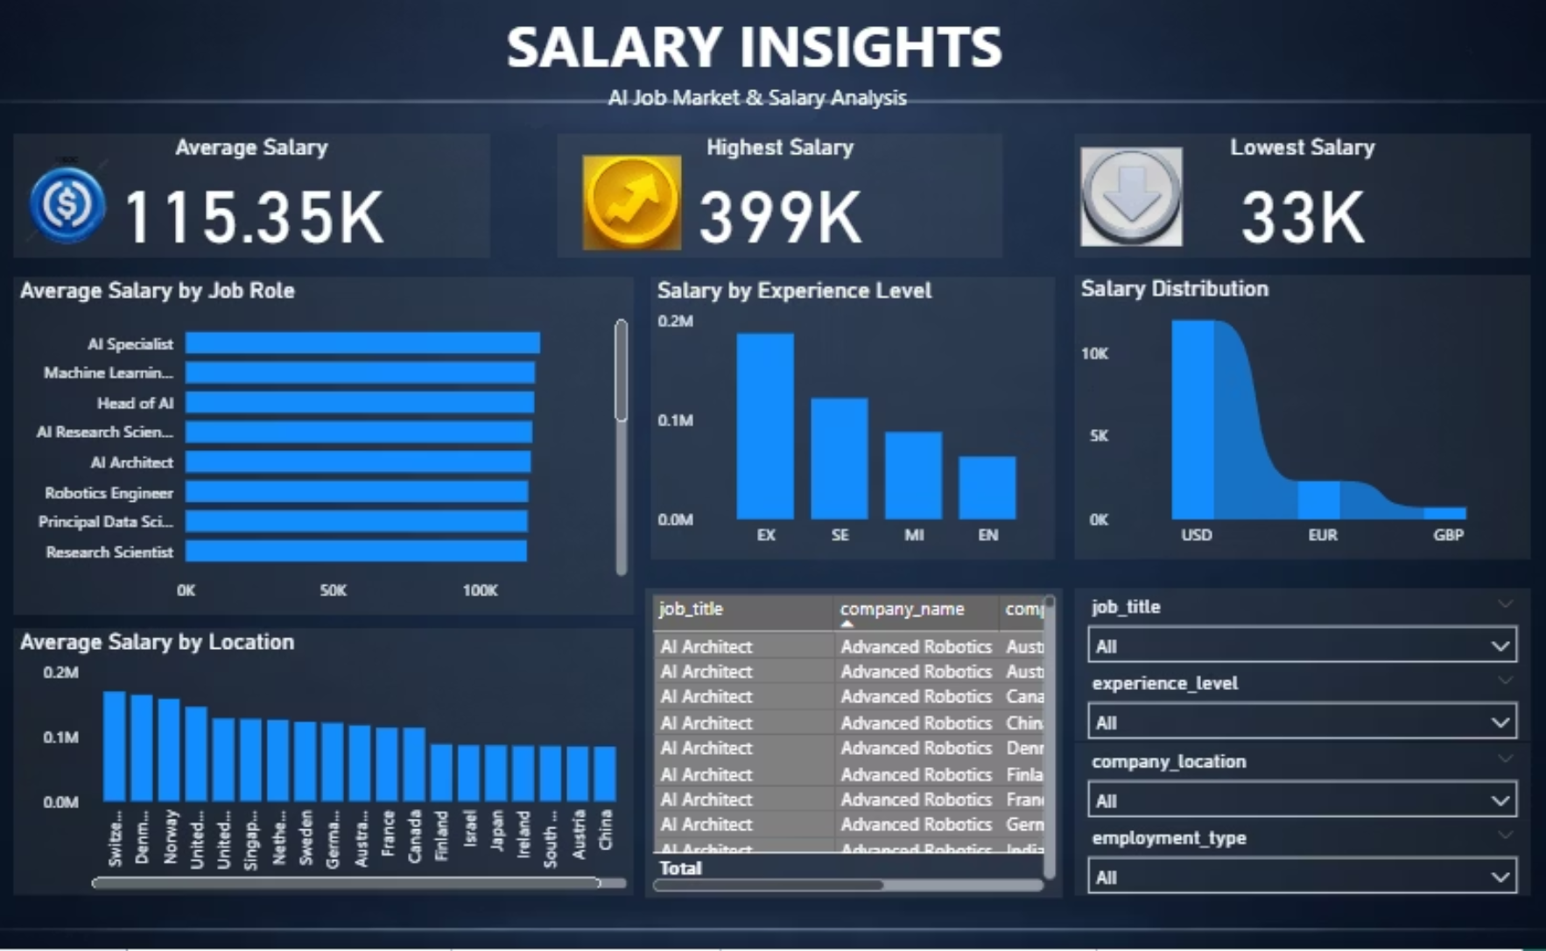
DASHBOARD 2
Role-Based Compensation
Experience Premium
Average salary by specific job titles and responsibilities
Salary comparison across entry, mid, and senior levels
Top Earners
Salary Range
The Salary Insights dashboard focuses on compensation trends.
Highest paying positions in the AI job market
Indicators for highest and lowest compensation bands
This dashboard helps job seekers understand salary expectations.

Slide 8
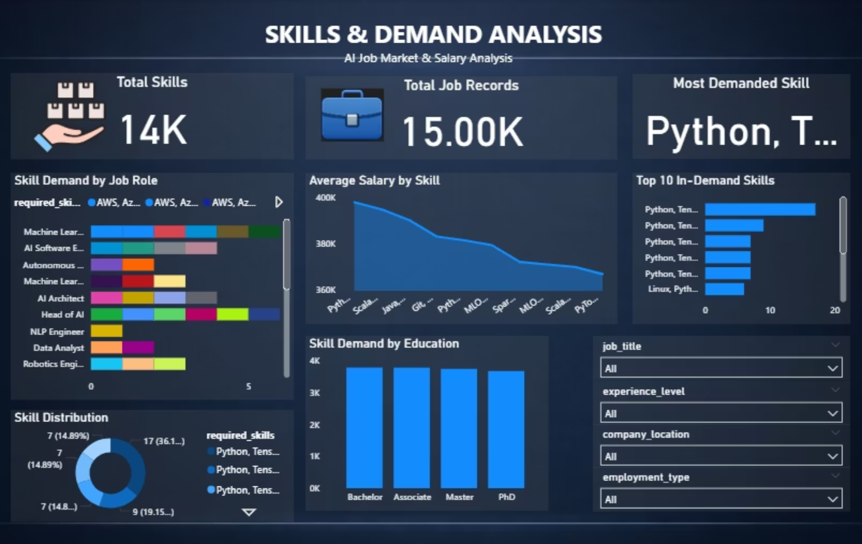
DASHBOARD 3
Skills & Demand Analysis
This dashboard analyzes skill requirements in the AI job market and highlights the importance of multi-skilled professionals.

Slide 9
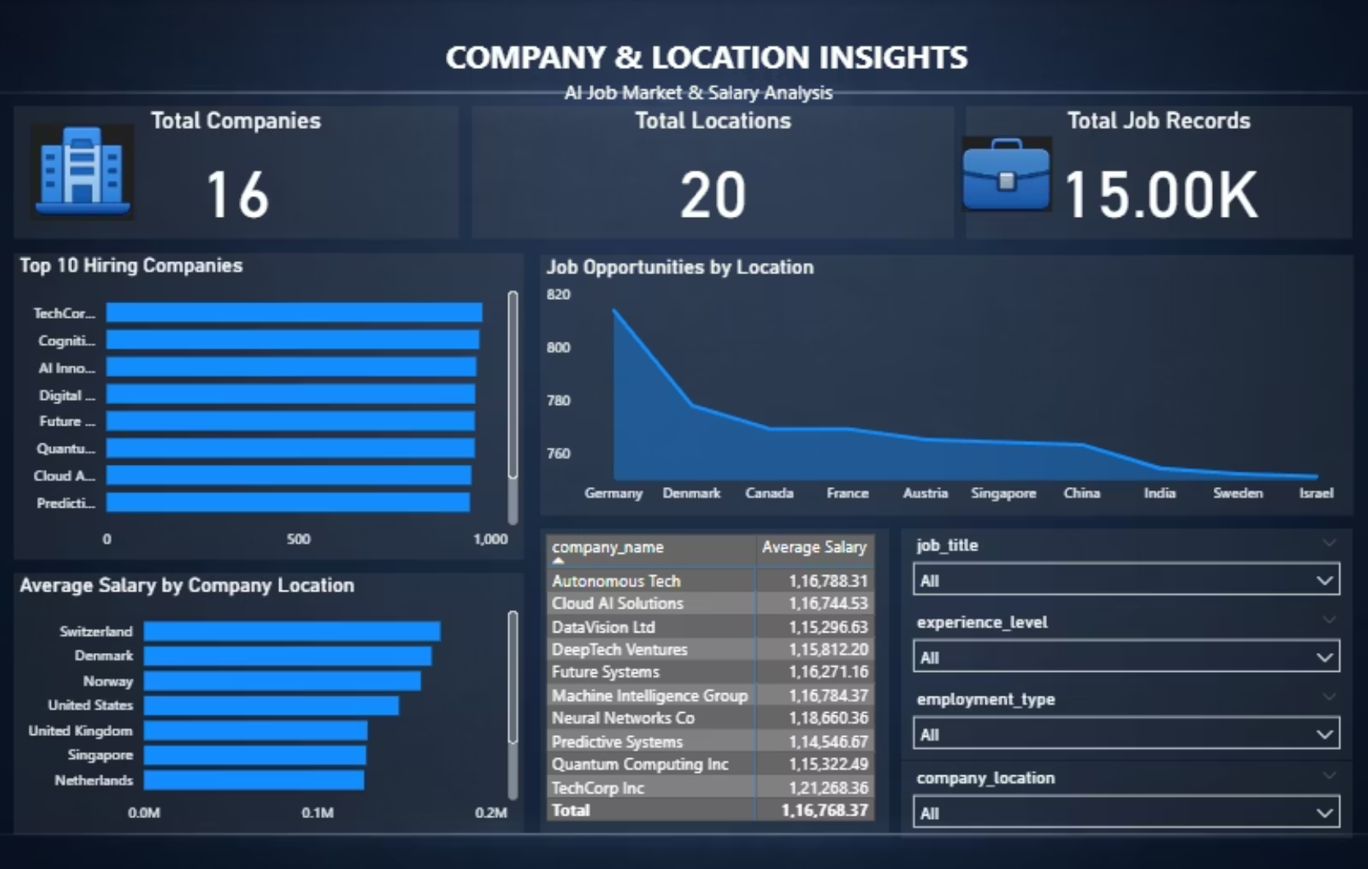
DASHBOARD 4
Company & Location Insights
1
2
Top Hiring Companies
Geographic Distribution
Leading organizations recruiting AI talent
Job availability by city and region
3
4
Regional Salaries
Company Compensation
Compensation comparison across locations
Salary trends by organization size and type
This dashboard identifies major hiring hubs and organizations, helping job seekers target their search strategically.

Slide 10

Conclusion
The project successfully demonstrates how SQL and Power BI can transform raw job data into actionable insights, providing a comprehensive understanding of the AI job market. From identifying salary trends and pinpointing in-demand skills to revealing company hiring patterns, these insights empower both job seekers and employers to make informed strategic decisions.

