Slide 1


GARMENT-FAITHFUL VIRTUAL TRY-ON
DrapixAI
Fashion commerce should show the real product, not a look-alike.
A controlled virtual try-on platform for fashion brands: product mapping, approved garment assets, Standard generation, quality gating, and brand-native delivery.
STARTUP INDIA + FUNDRAISING
VALIDATION STAGE
SH-2071 | STANDARD OUTPUT
2026 APPLICATION DECK
Product fidelity first.
Notes:
Open with the distinction: DrapixAI is infrastructure for controlled fashion commerce, not a general image-generation demo.
[Sources]
- Internal asset: apps/web/public/hero-female-tryon-v2.png
- Internal asset: apps/web/public/drapixai_logo.webp

Slide 2
01 / PROBLEM
The product page still asks shoppers to imagine the answer.
A product photograph shows the garment. It does not show whether that exact product remains recognizable on the shopper.
Will this exact garment still look like this on me?
The unanswered purchase question
01
02
03
Garment drift
Identity drift
No publishability gate
Color, print, collar, sleeve or hem can change during generation.
A plausible image is still wrong if face, pose or body silhouette moves.
Brands need a system that rejects doubtful results before shoppers see them.
DRAPIXAI | PROBLEM
02 / 18
Notes:
Keep this qualitative. The problem is not that every try-on fails; it is that brands cannot treat an uncontrolled plausible image as a product representation.
[Sources]
- Internal: docs/competitive-strategy-2026.md
- Internal: docs/public-launch-readiness-checklist.md

Slide 3
02 / SOLUTION
One controlled workflow from SKU to shopper.
The garment is prepared once, mapped to a product, and then reused through the same quality pipeline across storefront SDK and API.
01
02
03
04
05
Product sync
Garment cache
Shopper consent
Standard try-on
Publishability
SKU and product mapping
Clean 1024 x 1365 asset
Validated person image
One quality-first output
Score, reject or review
THE CONTROL LOOP
No output bypasses the gate.
SDK
REST API
SHOPIFY
Bad face, pose, body, color or background changes are rejected. Borderline cases stay in the admin review queue. Approved products become DrapixAI-ready before launch.
Same Standard pipeline
Identical product mapping and quality rules across channels.
DRAPIXAI | SOLUTION
03 / 18
Notes:
Walk left to right. The innovation is the controlled chain around generation: SKU mapping, reusable garment cache, validation, Standard generation, and publishability.
[Sources]
- Internal: docs/public-api-v1.md
- Internal: docs/catvton_quality_stack.md
- Internal: apps/web/app/page.tsx

Slide 4
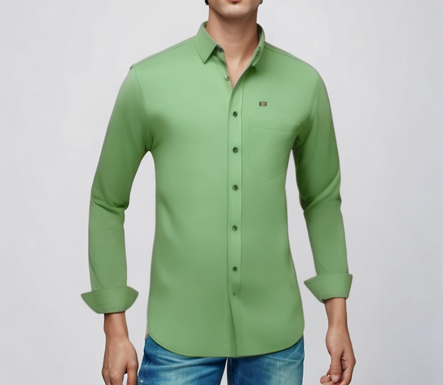
03 / PRODUCT EVIDENCE
A try-on result is inspected like product data.
DrapixAI evaluates the garment and the person separately, then returns only the result that meets the release bar.
PRODUCT ACCURACY REPORT
SKU SH-1042
01
Structured green shirt
Face + pose
Release targets shown below. Final application claims should be supported by a dated validation report.
02
Collar
Color match
Target: excellent
Print / logo
Target: excellent
03
Color
Sleeve match
Target: excellent
Hem match
Target: excellent
04
Cuff
05
Collar structure
Target: excellent
Pose retention
Target: excellent
Texture
06
Hem
0.95
10-12s
0
QUALITY RELEASE TARGET
WARM LATENCY TARGET
WARNINGS TARGET
DRAPIXAI | EVIDENCE
04 / 18
Notes:
Be explicit that 0.95 and 10-12 seconds are release targets unless a dated matrix is attached. This prevents an aspiration from being represented as audited traction.
[Sources]
- Internal asset: apps/web/public/hero-standard-tryon.png
- Internal: docs/catvton_quality_stack.md
- Internal: docs/public-launch-readiness-checklist.md

Slide 5
04 / MARKET POSITION
Different by design: not another generic endpoint.
The market contains broad generation APIs and measurement-led 3D fitting rooms. DrapixAI occupies a focused middle: product-faithful, image-based try-on with brand-controlled publishing.
Decision
Generation API
3D fitting room
DrapixAI
Primary job
Create fashion imagery
Visualize fit and size
Protect product identity
Garment input
Request-time image
Digitized 3D garment
Approved SKU cache
Output control
User inspects result
3D fit logic
Score, reject, review
Storefront model
API or app
Plugin / managed setup
SDK + API quality parity
Brand readiness
Endpoint available
Garment digitized
SKU certified before launch
EXAMPLE: FASHN API
EXAMPLE: STYLE.ME
GARMENT-FIRST CONTROL
DRAPIXAI | DIFFERENTIATION
05 / 18
Notes:
This is a category comparison, not a claim that competitors lack quality. FASHN positions around a broad API suite and fast developer access. Style.me positions around 3D garment digitization, measurements, styling, and plugins. DrapixAI's wedge is SKU-level garment preparation plus a publishability gate for image-based try-on.
[Sources]
- https://fashn.ai/products/api (accessed 2026-08-03)
- https://style.me/faq/ (accessed 2026-08-03)
- Internal: docs/competitive-strategy-2026.md

Slide 6
05 / CATEGORY REVOLUTION
Move virtual try-on from novelty to commerce assurance.
The next category leader will not simply return an attractive image. It will give brands a controlled, measurable decision about whether that image is safe to show.
DESIGNED ADVANTAGE: VALIDATE IN PILOTS
COMMON GENERATION LOOP
DRAPIXAI CONTROL LOOP
Generate > hope > display
Certify > preserve > score > publish > learn
The shopper judges whether the garment, face and pose are still trustworthy. The brand carries the reputational risk after delivery.
Every product begins with an approved SKU asset. Every result is checked against product and identity rules. Every approved output becomes measurable brand evidence.
SKU trust
Shopper protection
Brand control
Learning loop
Product-level readiness before launch
Reject identity drift; never train on shopper photos
Native UI, policy and review workflow
Feedback tied to product and result
DRAPIXAI | CATEGORY REVOLUTION
06 / 18
Notes:
This slide states DrapixAI's intended category shift. Treat it as a product thesis until signed pilots prove improvements in quality acceptance, shopper behavior and brand operations.
[Sources]
- Internal: docs/competitive-strategy-2026.md
- Internal: docs/public-launch-readiness-checklist.md

Slide 7
06 / INNOVATION
The model is one layer. The control system is the product.
DrapixAI combines AI generation with catalog preparation, quality intelligence, brand delivery, and an auditable feedback loop.
01
Garment intelligence
02
Standard generation
Background cleanup, normalization, sleeve and garment analysis, reusable product cache.
One production mode, one candidate, CatVTON pipeline, SDK/API parity.
03
Quality intelligence
04
Commerce control
Face, pose, body, color, texture and artifact scoring with automatic rejection.
Product mapping, DrapixAI-ready certification, review states, consent and retention.
INPUT
SKU PREP > STANDARD TRY-ON > QUALITY GATE > APPROVE / REJECT > SHOPPER
DRAPIXAI | INNOVATION
07 / 18
Notes:
DPIIT asks for innovation and scalability. Emphasize the system-level innovation: reusable product preparation and a policy-aware quality gate around the generation model.
[Sources]
- Internal: docs/catvton_quality_stack.md
- Internal: docs/public-api-v1.md
- Internal: docs/public-launch-readiness-checklist.md
- https://www.startupindia.gov.in/content/sih/en/startupgov/startup_recognition_page.html (accessed 2026-08-03)

Slide 8
07 / MARKET WEDGE
A focused entry into fashion-commerce infrastructure.
DrapixAI starts where product fidelity matters most: mid-market fashion brands that need a native try-on experience without an enterprise implementation cycle.
BEACHHEAD
EXPANSION
ENTERPRISE
Mid-market DTC fashion
API and mobile commerce
Dedicated capacity
Upper-body catalogs, Shopify-led storefronts, lean technical teams and a need to prove conversion before broad rollout.
The same mapped products and Standard quality pipeline delivered through public API and native mobile applications.
Private deployment, SLA, tenant controls, catalog operations and brand-specific quality governance.
BOTTOM-UP MARKET MODEL
[TARGET BRANDS] x [EXPECTED ANNUAL CONTRACT VALUE] = [BEACHHEAD SAM]
Replace bracketed assumptions with sourced targets and signed-pilot pricing before investor circulation.
DRAPIXAI | MARKET WEDGE
08 / 18
Notes:
This is a bottom-up market model, deliberately avoiding an unsupported top-down market number. Before investor circulation, define the target merchant universe, expected annual contract value and expansion assumptions with cited sources.
[Sources]
- Internal: docs/competitive-strategy-2026.md
- Internal: apps/web/app/page.tsx

Slide 9
08 / GO-TO-MARKET
Land with one product. Expand with proof.
The commercial motion reduces risk for the brand: certify a small product set, measure live shopper behavior, then grow into catalog and enterprise usage.
01
02
03
Design partner
Prove value
Expand account
SELECT 3-5 TARGET BRANDS
LAUNCH CONTROLLED TEST
CATALOG + CHANNELS
One-product pilot, signed success criteria and direct founder support.
Track activation, publishable-result rate, latency, add-to-cart and support burden.
More approved SKUs, Shopify rollout, API/mobile usage and dedicated capacity.
Activation
Quality
Commercial
Operational
Shopper starts / eligible PDP views
Publishable results / completed jobs
Add-to-cart and account expansion
Latency, retries and support tickets
DRAPIXAI | GO-TO-MARKET
09 / 18
Notes:
The go-to-market plan is a proposed motion. Replace the design-partner target and metrics with the approved founder plan, then add signed pilots or MoUs as they are obtained.
[Sources]
- Internal: docs/competitive-strategy-2026.md
- https://www.startupindia.gov.in/content/dam/invest-india/Form80IAC_Pitchdeck-Guidelines.pdf (accessed 2026-08-03)

Slide 10
09 / TECHNOLOGY
A secure, queue-based architecture that scales by tenant.
Public traffic stops at the API edge. Data services and GPU workers remain private, while per-tenant controls protect shared capacity.
SHOPPER
PUBLIC EDGE
QUEUE
GPU
RESULT
Brand storefront
Mobile app
WAF + API
SDK token
Redis / RQ
Tenant limits
CatVTON
Standard worker
Score
Store
Return
Short-lived tokens
Tenant isolation
Private data plane
Observable delivery
No permanent secret in the browser
Keys, records, limits and audit boundaries
Postgres, Redis, storage and GPU off internet
Quality, latency, warnings and webhook logs
PRIVACY COMMITMENT
Shopper photos are processed only for the requested try-on, never used for model training, excluded from logs, and not persistently retained.
DRAPIXAI | TECHNOLOGY
10 / 18
Notes:
Describe this as the intended production architecture. The privacy commitment must be enforced through encrypted temporary processing, automatic deletion, log redaction, training-data separation, customer deletion procedures and live staging tests. Tenant attack tests, secret management, and an authorized penetration test remain launch gates until documented.
[Sources]
- Internal: docs/public-launch-readiness-checklist.md
- Internal: docs/public-api-v1.md

Slide 11
10 / BUSINESS MODEL
Simple entry pricing, one quality standard.
Brands pay for publishable try-ons, not for lower-quality modes. SDK and API share the same Standard pipeline and quota logic.
STARTER
GROWTH
PRO
ENTERPRISE
$49
$199
$499
Custom
per month
per month
per month
Dedicated capacity, SLA, private deployment and catalog onboarding.
1,000 try-ons
7,500 try-ons
25,000 try-ons
Pilot one product set
Growing DTC catalog
Higher-volume storefront
SDK + API
SDK + API
SDK + API
Optional revenue lines
SKU certification | onboarding | dedicated infrastructure
Revenue status
[REPLACE WITH VERIFIED REVENUE, FUNDING AND CUSTOMER DATA BEFORE SUBMISSION]
DRAPIXAI | BUSINESS MODEL
11 / 18
Notes:
These plan amounts come from the current DrapixAI website configuration. Confirm that they remain approved before submission. Keep revenue, customer and funding data as verified facts only.
[Sources]
- Internal: apps/web/app/page.tsx
- Internal: docs/public-api-v1.md

Slide 12
11 / SCALABILITY
Start narrow, prove quality, expand by evidence.
The beachhead is upper-body fashion commerce. New categories enter production only after the same product-accuracy and latency gates are proven.
NOW
NEXT
SCALE
Upper-body Standard
Validated expansion
Commerce infrastructure
Shirts, T-shirts, polos, hoodies, kurtis, blouses and sleeveless tops.
Lower-body and full-body after category-specific quality matrices pass.
Shopify, SDK, REST API, mobile apps and dedicated enterprise capacity.
CATALOG SCALE
TRAFFIC SCALE
QUALITY SCALE
Prepare once, reuse per SKU
Queue and tenant concurrency
One release policy across channels
DRAPIXAI | SCALABILITY
12 / 18
Notes:
This roadmap is deliberately gated. Lower-body and full-body are future expansion, not current public capability claims.
[Sources]
- Internal: docs/public-launch-readiness-checklist.md
- Internal: docs/competitive-strategy-2026.md

Slide 13
12 / FUTURE PLATFORM
One shopper identity. Every try-on category.
The long-term opportunity is a category router with specialized engines, connected by one consent, SKU, quality, analytics and brand-delivery layer.
NOW
ADJACENT
Upper-body apparel
DRAPIXAI CONTROL PLANE
Jewelry + accessories
CatVTON Standard
Identity | consent | SKU | quality
Earrings, necklaces, rings, watches, eyewear, hats, bags
Routing | analytics | brand UI | retention
NEXT
ADJACENT
Full-body + layering
NOT ONE MODEL
Footwear + beauty
Apparel generation + face/hand landmarks + AR/3D rendering + calibrated shade simulation
Dresses, bottoms, outfits
Shoes, makeup shades, hair color and styles
DRAPIXAI | FUTURE PLATFORM
13 / 18
Notes:
This is a future roadmap, not a claim of current implementation. Industry offerings demonstrate that apparel, shoes, jewelry, watches, eyewear, makeup and hair try-on are technically viable, but each category requires specialized models, tracking and rendering. DrapixAI's proposed unification layer is the shared control plane.
[Sources]
- https://www.perfectcorp.com/business/products/virtual-try-on (accessed 2026-08-03)
- https://www.perfectcorp.com/business/products/3d-vto-format (accessed 2026-08-03)
- https://fashn.ai/products/api (accessed 2026-08-03)
- https://style.me/faq/ (accessed 2026-08-03)

Slide 14
13 / VALIDATION
Product foundation built. Market proof is the next milestone.
DrapixAI is at validation stage: the platform and quality workflow exist; public claims must now be backed by a dated test matrix and pilot evidence.
BUILT
VERIFY
PILOT
SCALE
Product foundation
Launch evidence
3-5 brand trials
Dedicated capacity
CatVTON engine, Standard mode, garment cache, SDK/API, dashboard and quality review.
50-case garment matrix, security checks, warm latency, tenant isolation and failure recovery.
Measure usage, acceptance, add-to-cart behavior and operational support needs.
Three concurrent users first; increase only after GPU and latency proof.
NEXT PROOF ASSET
One signed pilot or MoU plus a dated quality matrix will materially strengthen the DPIIT submission.
DRAPIXAI | VALIDATION
14 / 18
Notes:
Do not describe code completion as commercial traction. Startup India guidance asks for customer/user counts and at least one contract, work order, or MoU where available. Attach real evidence when obtained.
[Sources]
- https://www.startupindia.gov.in/content/dam/invest-india/Form80IAC_Pitchdeck-Guidelines.pdf (accessed 2026-08-03)
- Internal: docs/public-launch-readiness-checklist.md

Slide 15
14 / DPIIT ALIGNMENT
Built for innovation, scalability and economic impact.
DrapixAI aligns with the recognition test through a differentiated technology workflow and a repeatable B2B platform model.
01
Innovation
02
Scalable model
Product-aware preprocessing, cached SKU assets and a publishability gate around AI generation.
One platform can serve many brands through SDK, API, Shopify and mobile integrations.
03
Employment potential
04
Wealth creation
AI engineering, catalog operations, quality review, merchant success, security and infrastructure.
Helps Indian fashion and DTC brands own a branded, data-rich try-on experience on their storefronts.
Recognition ask
DPIIT recognition to accelerate ecosystem access, IP support, compliance readiness, hiring and brand pilots.
DRAPIXAI | DPIIT ALIGNMENT
15 / 18
Notes:
Tie every point back to potential, not guaranteed outcomes. Current DPIIT criteria include innovation or improvement and a scalable model with employment or wealth-creation potential.
[Sources]
- https://www.startupindia.gov.in/content/sih/en/startupgov/startup_recognition_page.html (accessed 2026-08-03)

Slide 16
15 / COMPANY AND TEAM
The right team slide is evidence, not decoration.
Replace every bracketed field with verified founder credentials, ownership and traction before investor or DPIIT circulation.
01
FOUNDER 01
02
FOUNDER 02
NEXT KEY HIRES
[FOUNDER / DIRECTOR NAME]
[FOUNDER / DIRECTOR NAME]
ML / quality engineer
[ROLE: PRODUCT / BUSINESS]
[ROLE: TECHNOLOGY / OPERATIONS]
Infrastructure + security
[EDUCATION] | [RELEVANT EXPERIENCE] | [RESPONSIBILITY]
[EDUCATION] | [RELEVANT EXPERIENCE] | [RESPONSIBILITY]
Merchant success + catalog ops
VERIFIED COMPANY SNAPSHOT
LEGAL ENTITY
INCORPORATED
SHAREHOLDING
[LEGAL NAME + TYPE]
[DATE + CIN / LLPIN]
[NAME | % | CITIZENSHIP]
FUNDING
REVENUE
CUSTOMERS / PILOTS
[NONE / VERIFIED DETAILS]
[VERIFIED FY-WISE DATA]
[COUNT + CONTRACT / MOU]
DRAPIXAI | COMPANY AND TEAM
16 / 18
Notes:
This is the most important founder-completion slide. Replace every bracketed field and verify it against statutory records, CVs, the cap table, accounts and signed commercial evidence.
[Sources]
- https://www.startupindia.gov.in/content/dam/invest-india/frequently-asked-question.pdf (accessed 2026-08-03)
- https://www.startupindia.gov.in/content/dam/invest-india/Form80IAC_Pitchdeck-Guidelines.pdf (accessed 2026-08-03)

Slide 17
16 / INVESTMENT
Capital should convert product proof into repeatable revenue.
The round size, runway and revenue milestone must be founder-approved. The allocation below is a proposed operating plan, not a completed financing claim.
PROPOSED USE OF FUNDS
PROPOSED ROUND
AI quality + product
35%
[SEED ASK]
Go-to-market + pilots
25%
[18-MONTH RUNWAY]
Infrastructure + security
20%
Round objective
Commerce integrations
10%
Prove quality at scale, sign reference brands, harden public infrastructure and establish repeatable onboarding.
Operations + compliance
10%
18-MONTH EVIDENCE MILESTONES
3-5 signed pilots | 50-case quality matrix | Shopify + API GA | 3-user GPU concurrency | [ARR TARGET]
DRAPIXAI | INVESTMENT
17 / 18
Notes:
Founders must approve the round amount, runway, use of funds and ARR milestone. The percentages are a proposed allocation and should be reconciled to a detailed operating model before circulation.
[Sources]
- Internal: docs/public-launch-readiness-checklist.md
- Internal: docs/competitive-strategy-2026.md

Slide 18
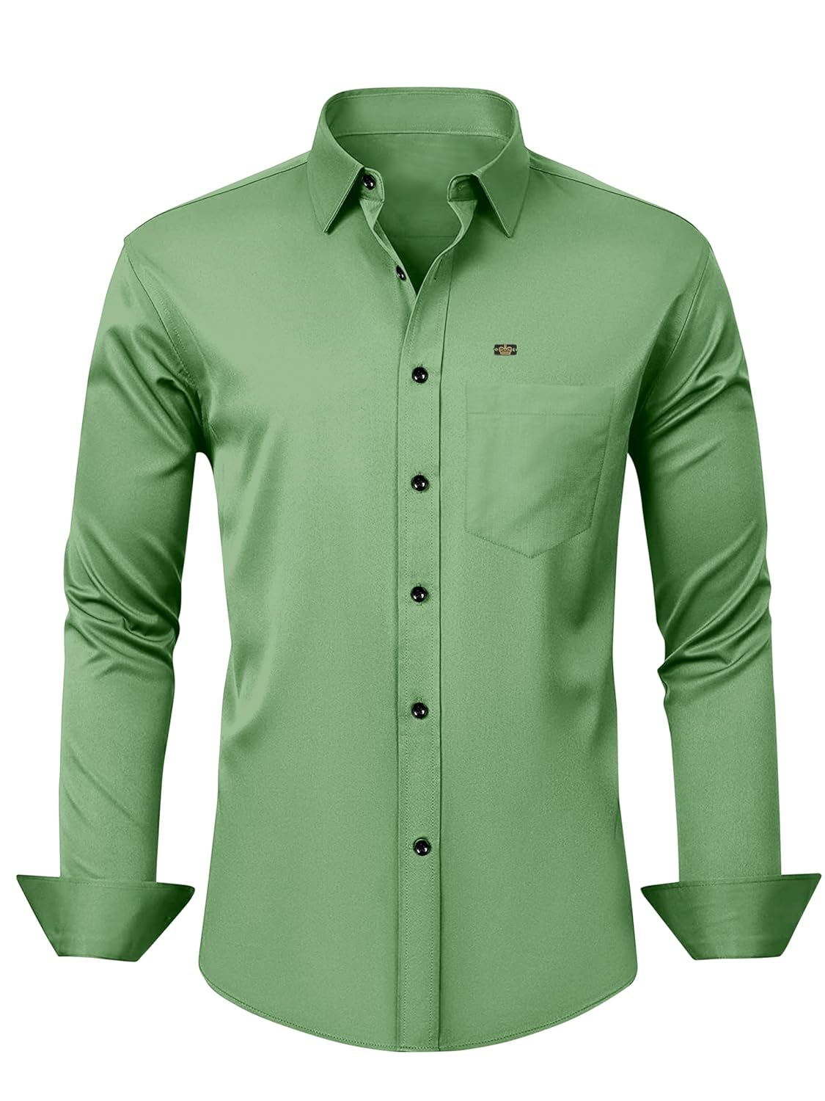

BUILT IN INDIA FOR FASHION COMMERCE
Make the real product the hero.
DrapixAI gives brands a controlled path from SKU to shopper: prepare the garment, preserve product identity, reject doubtful outputs, and publish through a native storefront experience.
PARTNERSHIP + RECOGNITION ASK
Back the validation and scale-up of garment-faithful AI infrastructure for fashion brands.
[REGISTERED EMAIL] | [WEBSITE] | [CITY, INDIA]
Notes:
Close on the product promise and the recognition ask. Replace the contact placeholders before export.
[Sources]
- Internal asset: C:/Users/tanis/OneDrive/Desktop/Results/garment_green_shirt.jpg
- Internal asset: apps/web/public/drapixai_emblem.webp

