Slide 1


GARMENT-FAITHFUL VIRTUAL TRY-ON
DrapixAI
Fashion commerce should show the real product, not a look-alike.
A controlled virtual try-on platform for fashion brands: product mapping, approved garment assets, Standard generation, quality gating, and brand-native delivery.
DPIIT STARTUP RECOGNITION
VALIDATION STAGE
SH-2071 | STANDARD OUTPUT
2026 APPLICATION DECK
Product fidelity first.
Notes:
Open with the distinction: DrapixAI is infrastructure for controlled fashion commerce, not a general image-generation demo.
[Sources]
- Internal asset: apps/web/public/hero-female-tryon-v2.png
- Internal asset: apps/web/public/drapixai_logo.webp

Slide 2
01 / PROBLEM
The product page still asks shoppers to imagine the answer.
A product photograph shows the garment. It does not show whether that exact product remains recognizable on the shopper.
Will this exact garment still look like this on me?
The unanswered purchase question
01
02
03
Garment drift
Identity drift
No publishability gate
Color, print, collar, sleeve or hem can change during generation.
A plausible image is still wrong if face, pose or body silhouette moves.
Brands need a system that rejects doubtful results before shoppers see them.
DRAPIXAI | PROBLEM
02 / 13
Notes:
Keep this qualitative. The problem is not that every try-on fails; it is that brands cannot treat an uncontrolled plausible image as a product representation.
[Sources]
- Internal: docs/competitive-strategy-2026.md
- Internal: docs/public-launch-readiness-checklist.md

Slide 3
02 / SOLUTION
One controlled workflow from SKU to shopper.
The garment is prepared once, mapped to a product, and then reused through the same quality pipeline across storefront SDK and API.
01
02
03
04
05
Product sync
Garment cache
Shopper consent
Standard try-on
Publishability
SKU and product mapping
Clean 1024 x 1365 asset
Validated person image
One quality-first output
Score, reject or review
THE CONTROL LOOP
No output bypasses the gate.
SDK
REST API
SHOPIFY
Bad face, pose, body, color or background changes are rejected. Borderline cases stay in the admin review queue. Approved products become DrapixAI-ready before launch.
Same Standard pipeline
Identical product mapping and quality rules across channels.
DRAPIXAI | SOLUTION
03 / 13
Notes:
Walk left to right. The innovation is the controlled chain around generation: SKU mapping, reusable garment cache, validation, Standard generation, and publishability.
[Sources]
- Internal: docs/public-api-v1.md
- Internal: docs/catvton_quality_stack.md
- Internal: apps/web/app/page.tsx

Slide 4
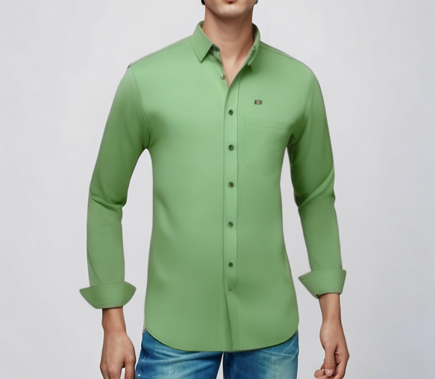
03 / PRODUCT EVIDENCE
A try-on result is inspected like product data.
DrapixAI evaluates the garment and the person separately, then returns only the result that meets the release bar.
PRODUCT ACCURACY REPORT
SKU SH-1042
01
Structured green shirt
Face + pose
Release targets shown below. Final application claims should be supported by a dated validation report.
02
Collar
Color match
Target: excellent
Print / logo
Target: excellent
03
Color
Sleeve match
Target: excellent
Hem match
Target: excellent
04
Cuff
05
Collar structure
Target: excellent
Pose retention
Target: excellent
Texture
06
Hem
0.95
10-12s
0
QUALITY RELEASE TARGET
WARM LATENCY TARGET
WARNINGS TARGET
DRAPIXAI | EVIDENCE
04 / 13
Notes:
Be explicit that 0.95 and 10-12 seconds are release targets unless a dated matrix is attached. This prevents an aspiration from being represented as audited traction.
[Sources]
- Internal asset: apps/web/public/hero-standard-tryon.png
- Internal: docs/catvton_quality_stack.md
- Internal: docs/public-launch-readiness-checklist.md

Slide 5
04 / MARKET POSITION
Different by design: not another generic endpoint.
The market contains broad generation APIs and measurement-led 3D fitting rooms. DrapixAI occupies a focused middle: product-faithful, image-based try-on with brand-controlled publishing.
Decision
Generation API
3D fitting room
DrapixAI
Primary job
Create fashion imagery
Visualize fit and size
Protect product identity
Garment input
Request-time image
Digitized 3D garment
Approved SKU cache
Output control
User inspects result
3D fit logic
Score, reject, review
Storefront model
API or app
Plugin / managed setup
SDK + API quality parity
Brand readiness
Endpoint available
Garment digitized
SKU certified before launch
EXAMPLE: FASHN API
EXAMPLE: STYLE.ME
GARMENT-FIRST CONTROL
DRAPIXAI | DIFFERENTIATION
05 / 13
Notes:
This is a category comparison, not a claim that competitors lack quality. FASHN positions around a broad API suite and fast developer access. Style.me positions around 3D garment digitization, measurements, styling, and plugins. DrapixAI's wedge is SKU-level garment preparation plus a publishability gate for image-based try-on.
[Sources]
- https://fashn.ai/products/api (accessed 2026-08-03)
- https://style.me/faq/ (accessed 2026-08-03)
- Internal: docs/competitive-strategy-2026.md

Slide 6
05 / INNOVATION
The model is one layer. The control system is the product.
DrapixAI combines AI generation with catalog preparation, quality intelligence, brand delivery, and an auditable feedback loop.
01
Garment intelligence
02
Standard generation
Background cleanup, normalization, sleeve and garment analysis, reusable product cache.
One production mode, one candidate, CatVTON pipeline, SDK/API parity.
03
Quality intelligence
04
Commerce control
Face, pose, body, color, texture and artifact scoring with automatic rejection.
Product mapping, DrapixAI-ready certification, review states, consent and retention.
INPUT
SKU PREP > STANDARD TRY-ON > QUALITY GATE > APPROVE / REJECT > SHOPPER
DRAPIXAI | INNOVATION
06 / 13
Notes:
DPIIT asks for innovation and scalability. Emphasize the system-level innovation: reusable product preparation and a policy-aware quality gate around the generation model.
[Sources]
- Internal: docs/catvton_quality_stack.md
- Internal: docs/public-api-v1.md
- Internal: docs/public-launch-readiness-checklist.md
- https://www.startupindia.gov.in/content/sih/en/startupgov/startup_recognition_page.html (accessed 2026-08-03)

Slide 7
06 / TECHNOLOGY
A secure, queue-based architecture that scales by tenant.
Public traffic stops at the API edge. Data services and GPU workers remain private, while per-tenant controls protect shared capacity.
SHOPPER
PUBLIC EDGE
QUEUE
GPU
RESULT
Brand storefront
Mobile app
WAF + API
SDK token
Redis / RQ
Tenant limits
CatVTON
Standard worker
Score
Store
Return
Short-lived tokens
Tenant isolation
Private data plane
Observable delivery
No permanent secret in the browser
Keys, records, limits and audit boundaries
Postgres, Redis, storage and GPU off internet
Quality, latency, warnings and webhook logs
DRAPIXAI | TECHNOLOGY
07 / 13
Notes:
Describe this as the intended production architecture. Live staging evidence, tenant attack tests, secret management, and an authorized penetration test remain launch gates until documented.
[Sources]
- Internal: docs/public-launch-readiness-checklist.md
- Internal: docs/public-api-v1.md

Slide 8
07 / BUSINESS MODEL
Simple entry pricing, one quality standard.
Brands pay for publishable try-ons, not for lower-quality modes. SDK and API share the same Standard pipeline and quota logic.
STARTER
GROWTH
PRO
ENTERPRISE
$49
$199
$499
Custom
per month
per month
per month
Dedicated capacity, SLA, private deployment and catalog onboarding.
1,000 try-ons
7,500 try-ons
25,000 try-ons
Pilot one product set
Growing DTC catalog
Higher-volume storefront
SDK + API
SDK + API
SDK + API
Optional revenue lines
SKU certification | onboarding | dedicated infrastructure
Revenue status
[REPLACE WITH VERIFIED REVENUE, FUNDING AND CUSTOMER DATA BEFORE SUBMISSION]
DRAPIXAI | BUSINESS MODEL
08 / 13
Notes:
These plan amounts come from the current DrapixAI website configuration. Confirm that they remain approved before submission. Keep revenue, customer and funding data as verified facts only.
[Sources]
- Internal: apps/web/app/page.tsx
- Internal: docs/public-api-v1.md

Slide 9
08 / SCALABILITY
Start narrow, prove quality, expand by evidence.
The beachhead is upper-body fashion commerce. New categories enter production only after the same product-accuracy and latency gates are proven.
NOW
NEXT
SCALE
Upper-body Standard
Validated expansion
Commerce infrastructure
Shirts, T-shirts, polos, hoodies, kurtis, blouses and sleeveless tops.
Lower-body and full-body after category-specific quality matrices pass.
Shopify, SDK, REST API, mobile apps and dedicated enterprise capacity.
CATALOG SCALE
TRAFFIC SCALE
QUALITY SCALE
Prepare once, reuse per SKU
Queue and tenant concurrency
One release policy across channels
DRAPIXAI | SCALABILITY
09 / 13
Notes:
This roadmap is deliberately gated. Lower-body and full-body are future expansion, not current public capability claims.
[Sources]
- Internal: docs/public-launch-readiness-checklist.md
- Internal: docs/competitive-strategy-2026.md

Slide 10
09 / PROGRESS
Product foundation built. Market proof is the next milestone.
DrapixAI is at validation stage: the platform and quality workflow exist; public claims must now be backed by a dated test matrix and pilot evidence.
BUILT
VERIFY
PILOT
SCALE
Product foundation
Launch evidence
3-5 brand trials
Dedicated capacity
CatVTON engine, Standard mode, garment cache, SDK/API, dashboard and quality review.
50-case garment matrix, security checks, warm latency, tenant isolation and failure recovery.
Measure usage, acceptance, add-to-cart behavior and operational support needs.
Three concurrent users first; increase only after GPU and latency proof.
NEXT PROOF ASSET
One signed pilot or MoU plus a dated quality matrix will materially strengthen the DPIIT submission.
DRAPIXAI | PROGRESS
10 / 13
Notes:
Do not describe code completion as commercial traction. Startup India guidance asks for customer/user counts and at least one contract, work order, or MoU where available. Attach real evidence when obtained.
[Sources]
- https://www.startupindia.gov.in/content/dam/invest-india/Form80IAC_Pitchdeck-Guidelines.pdf (accessed 2026-08-03)
- Internal: docs/public-launch-readiness-checklist.md

Slide 11
10 / DPIIT ALIGNMENT
Built for innovation, scalability and economic impact.
DrapixAI aligns with the recognition test through a differentiated technology workflow and a repeatable B2B platform model.
01
Innovation
02
Scalable model
Product-aware preprocessing, cached SKU assets and a publishability gate around AI generation.
One platform can serve many brands through SDK, API, Shopify and mobile integrations.
03
Employment potential
04
Wealth creation
AI engineering, catalog operations, quality review, merchant success, security and infrastructure.
Helps Indian fashion and DTC brands own a branded, data-rich try-on experience on their storefronts.
Recognition ask
DPIIT recognition to accelerate ecosystem access, IP support, compliance readiness, hiring and brand pilots.
DRAPIXAI | DPIIT ALIGNMENT
11 / 13
Notes:
Tie every point back to potential, not guaranteed outcomes. Current DPIIT criteria include innovation or improvement and a scalable model with employment or wealth-creation potential.
[Sources]
- https://www.startupindia.gov.in/content/sih/en/startupgov/startup_recognition_page.html (accessed 2026-08-03)

Slide 12
11 / COMPANY AND TEAM
Complete these verified facts before uploading the PDF.
Startup India explicitly asks for founders, directors, shareholding, funding, revenue and traction. Bracketed fields are intentional safeguards against misrepresentation.
ENTITY
OWNERSHIP AND EVIDENCE
Legal name
[LEGAL ENTITY NAME]
Shareholding
[NAME | % | CITIZENSHIP]
Entity type
[PVT LTD / LLP / PARTNERSHIP]
Funding received
[NONE / VERIFIED AMOUNT + INVESTOR]
Revenue
[FY-WISE VERIFIED REVENUE]
Incorporated
[DD MMM YYYY]
Paying customers
[VERIFIED COUNT]
CIN / LLPIN
[REGISTRATION NUMBER]
Pilot / MoU
[PARTY + DATE + EVIDENCE]
Registered office
[FULL REGISTERED ADDRESS]
Govt/incubator support
[NONE / VERIFIED DETAILS]
Website
[VERIFIED WEBSITE URL]
Awards / recognition
[NONE / VERIFIED DETAILS]
Regulatory approvals
[NOT APPLICABLE / DETAILS]
DIRECTORS AND TEAM
[NAME | CITIZENSHIP | EDUCATION | EXPERIENCE | ROLE]
Attach supporting evidence where available. Do not submit placeholders.
DRAPIXAI | COMPANY FACTS
12 / 13
Notes:
This slide is a founder action item. Replace every bracketed field with authorized, current facts and verify them against incorporation records, cap table, accounts, and signed commercial documents.
[Sources]
- https://www.startupindia.gov.in/content/dam/invest-india/frequently-asked-question.pdf (accessed 2026-08-03)
- https://www.startupindia.gov.in/content/dam/invest-india/Form80IAC_Pitchdeck-Guidelines.pdf (accessed 2026-08-03)

Slide 13
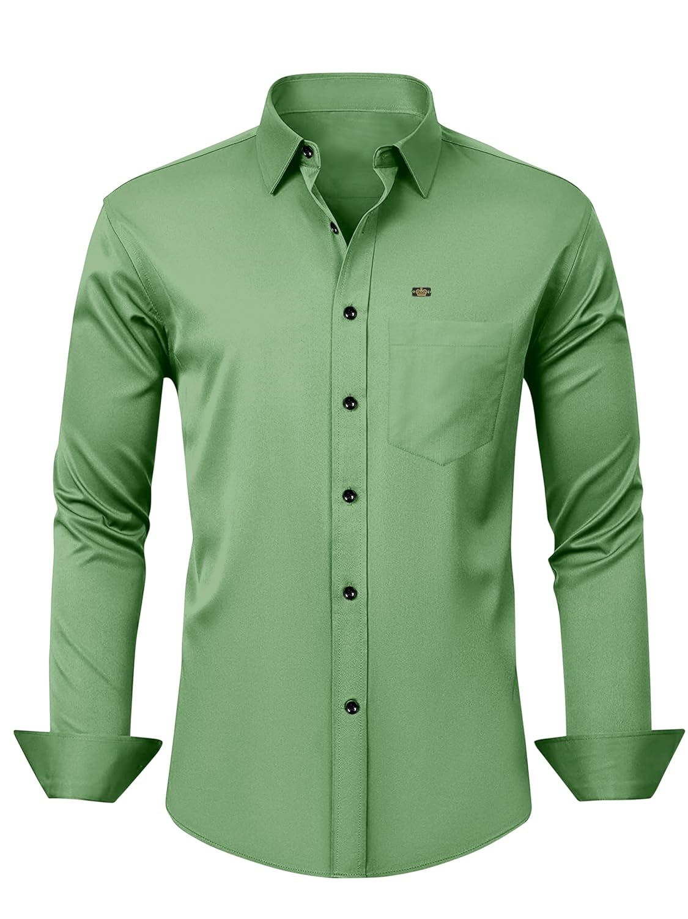

BUILT IN INDIA FOR FASHION COMMERCE
Make the real product the hero.
DrapixAI gives brands a controlled path from SKU to shopper: prepare the garment, preserve product identity, reject doubtful outputs, and publish through a native storefront experience.
DPIIT RECOGNITION ASK
Support the validation and scale-up of garment-faithful AI infrastructure for fashion brands.
[REGISTERED EMAIL] | [WEBSITE] | [CITY, INDIA]
Notes:
Close on the product promise and the recognition ask. Replace the contact placeholders before export.
[Sources]
- Internal asset: C:/Users/tanis/OneDrive/Desktop/Results/garment_green_shirt.jpg
- Internal asset: apps/web/public/drapixai_emblem.webp

