Slide 1
A PROJECT REPORT ON
MINDROOT — PEER SKILL EXCHANGE PLATFORM
(STUDENT-TO-STUDENT COLLABORATIVE LEARNING & TOKEN ECONOMY SYSTEM)
-: SUBMITTED TO :-
[College / Institute Name]
Department of Computer Applications
-: INTERNAL GUIDANCE :-
[Guide Name]
(Assistant Professor)
Department of Computer Applications
-: PRESENTED BY :-
[Student Name 1]
[Student Name 2]

Slide 2
MINDROOT — PEER SKILL EXCHANGE PLATFORM
Project Profile & Metadata
Parameter | Project Specification Details
Project Title | Mindroot — Peer-to-Peer Skill Exchange Platform ('Student to Student')
Organization / College | [College / Institute Name] (Department of Computer Applications)
Internal Project Guide | [Guide Name] (Assistant Professor)
Group Size & Members | Group of 2 Members: [Student Name 1], [Student Name 2]
Project Duration | 120 Hours (Academic Semester Project Lifecycle)
Frontend Technologies | React 19, TypeScript, Vite, Tailwind CSS, Zustand, Framer Motion
Backend Technologies | Node.js, Express.js, Socket.io Real-Time Signaling Server
Database & ORM | PostgreSQL Database, Prisma ORM (with JSON fallback store)
Real-Time Audio / Video | WebRTC Peer-to-Peer Engine (SimplePeer, MediaStream APIs, STUN/TURN)
Development Tools Used | Visual Studio Code, Git, GitHub, Postman, Docker, Vite CLI
MINDROOT (STUDENT TO STUDENT) | ACADEMIC PROJECT REPORT PRESENTATION PAGE 2 OF 43

Slide 3
MINDROOT — PEER SKILL EXCHANGE PLATFORM
Table of Contents & Presentation Outline
01. Foundation & Analysis
• Existing System: Current learning practices & limitations
• Need For The System: Democratizing education & access
• Project Objectives: Core goals & milestones
• Hardware & Software: System requirements & specs
02. Architecture & Design
• High-Level Architecture: 3-Tier modular topology
• System Flowcharts: Student, Teacher & Admin workflows
• E-R Diagram: Relational schema & cardinalities
• Data Flow Diagrams: Context Level 0 & Level 1 processes
03. Data & Technology
• Proposed System: Time-banking & escrow mechanics
• WebRTC Architecture: P2P audio/video & signaling flow
• Data Dictionary: User, Session & Transaction tables
• Security & Trust Measures: JWT, OAuth 2.0 & trust ratings
04. Implementation & Future
• System UI Walkthrough: 7 Core platform interface screens
• Collaborative Tools: Real-time whiteboard & code runner
• Future Enhancements: AI matching & mobile applications
• Conclusion & References: Summary, impact & bibliography
MINDROOT (STUDENT TO STUDENT) | ACADEMIC PROJECT REPORT PRESENTATION PAGE 3 OF 43

Slide 4
MINDROOT — PEER SKILL EXCHANGE PLATFORM
Project Introduction & Background
Background & Student Learning Landscape
• The Academic Skill Gap: In university education, students frequently possess specialized competencies in specific fields (e.g., React development, Python ML, 3D modeling, French) while urgently needing support in others (Data Structures, Cloud, UI Design).
• The Traditional Tutoring Dilemma: Commercial platforms charge high hourly rates ($25-$80/hr) which are financially prohibitive for full-time college students.
• The Barter Solution: Mindroot introduces a bilateral peer-to-peer knowledge exchange model where time and knowledge are the primary currency, enabling students to teach what they master in exchange for what they need.
What is Mindroot ('Student to Student')?
• Equalized Knowledge Economy: Built on a Time-Banking philosophy where 1 hour of teaching earns 1 Skill Token, usable for 1 hour of learning any other discipline.
• Zero-Install Virtual Classroom: Integrates peer-to-peer video, audio, interactive drawing whiteboard, synchronized live coding editor, and text chat in a unified browser room.
• Automated Trust & Reputation: Features transparent peer review algorithms, dynamic trust scores (1.0 - 5.0), and calendar export (.ics) for seamless session management.
MINDROOT (STUDENT TO STUDENT) | ACADEMIC PROJECT REPORT PRESENTATION PAGE 4 OF 43

Slide 5
MINDROOT — PEER SKILL EXCHANGE PLATFORM
Existing System & Current Practices
Current Process
• Ad-Hoc Peer Finding: Students search for study partners via fragmented WhatsApp groups, college noticeboards, or Discord servers.
• One-Way Paid Tutoring: Services like Chegg or private tutors operate strictly as one-sided monetary transactions, locking out economically disadvantaged students.
• No Matching Standard: No systematic mechanism to assess if a study partner's complementary skills align with mutual needs.
User Management & Verification
• No Verified Profiles: Informal study groups offer zero proof of competency or academic credibility before scheduling sessions.
• High Ghosting Rates: Sessions booked informally frequently suffer from unpunctuality or last-minute cancellations without accountability.
• Scattered Records: Previous tutoring notes, feedback, and study materials are easily lost across personal chat histories.
Tool Fragmentation & Friction
• Multi-App Overhead: Students must switch between Google Meet (video), Google Docs (notes), Replit (coding), and WhatsApp (scheduling).
• Software Fatigue: Managing separate subscriptions and install requirements interrupts the learning flow and creates technical roadblocks.
Monetary & Scheduling Barriers
• Financial Burden: Paying for separate subjects rapidly escalates into prohibitive educational debt.
• Time Zone & Calendar Conflicts: Manual scheduling leads to forgotten sessions due to lack of automated calendar invitations (.ics).
MINDROOT (STUDENT TO STUDENT) | ACADEMIC PROJECT REPORT PRESENTATION PAGE 5 OF 43

Slide 6
MINDROOT — PEER SKILL EXCHANGE PLATFORM
Disadvantages & Limitations of Existing System
• Financial Exclusivity: Commercial tutoring models favor students with disposable income, preventing talented but financially constrained students from receiving mentorship.
• Lack of Reciprocity: Traditional platforms fail to recognize that a learner can also be an expert instructor in another domain.
• Severe Free-Riding Problem: In informal student study groups, one student often does all the teaching while others contribute nothing, leading to group burnout.
• Zero Centralized Record Keeping: No persistent ledger of hours taught or learned, making it impossible to showcase peer mentoring on resumes or portfolios.
• Absence of Integrated Collaboration: Standard video calling tools lack built-in compilers, code execution environments, or interactive engineering whiteboards.
MINDROOT (STUDENT TO STUDENT) | ACADEMIC PROJECT REPORT PRESENTATION PAGE 6 OF 43

Slide 7
MINDROOT — PEER SKILL EXCHANGE PLATFORM
Proposed System Overview — The Mindroot Solution
Dual Role Model
• Unified Account: Every student acts as both a Teacher and a Learner with zero role-switching friction.
• Skill Taxonomy: Tag specific skills you can mentor in vs skills you wish to learn.
Time-Bank Economy
• 1 Hour = 1 Token: Teaching 1 hour mints 1 Skill Token. Spending 1 token unlocks 1 hour of learning.
• Escrow Protection: Tokens are securely escrowed upon booking and only released on completion.
P2P WebRTC Classroom
• HD Audio / Video: Low-latency browser video powered by WebRTC and Socket.io signaling.
• Shared Whiteboard: Interactive canvas for drawing system architectures and formulas.
• Live Code Runner: In-room collaborative code editor with instant syntax highlighting.
Automated Scheduling
• Smart Calendar: Instant timezone-aware booking with automated .ics calendar export.
• Trust & Safety: Reputation score (1.0 to 5.0) generated from verified peer feedback.
MINDROOT (STUDENT TO STUDENT) | ACADEMIC PROJECT REPORT PRESENTATION PAGE 7 OF 43

Slide 8
MINDROOT — PEER SKILL EXCHANGE PLATFORM
Need For The System
• System Overview: A complete web-based peer skill exchange platform built to replace unstructured, fee-heavy, and disjointed study methods with an automated, equitable digital ecosystem.
• Democratized Accessibility: Ensures every student has equal access to high-caliber personal tutoring regardless of financial background, converting individual knowledge into an actionable currency.
• Friction-Free Remote Collaboration: Consolidates video conferencing, screen sharing, architectural whiteboarding, and code pairing into a single tab without third-party downloads.
• Disciplined Session Fulfillment: The Skill Token escrow mechanism eliminates attendance ghosting by holding tokens in smart escrow until both peers complete the classroom hour.
• Verified Community Safety: Google OAuth 2.0 single sign-on combined with institutional email verification and trust scoring ensures high academic decorum.
MINDROOT (STUDENT TO STUDENT) | ACADEMIC PROJECT REPORT PRESENTATION PAGE 8 OF 43

Slide 9
MINDROOT — PEER SKILL EXCHANGE PLATFORM
Project Objectives
• 1. Eliminate Financial Barriers: Build a cashless peer-learning environment where student time and expertise serve as the exclusive medium of exchange.
• 2. Algorithmic Peer Matchmaking: Develop an automated compatibility search engine that pairs users whose teaching offerings directly fulfill each other's learning goals.
• 3. High-Fidelity P2P Interaction: Implement low-latency peer-to-peer WebRTC video/audio alongside multi-user synchronized whiteboarding and live coding.
• 4. Trust & Accountability System: Maintain a dynamic trust algorithm (1.0 - 5.0) based on peer evaluations, verified attendance, and prompt session delivery.
• 5. Effortless Calendar Sync: Automate schedule confirmations and calendar synchronization via downloadable .ics files compatible with Google Calendar, Outlook, and Apple iCal.
MINDROOT (STUDENT TO STUDENT) | ACADEMIC PROJECT REPORT PRESENTATION PAGE 9 OF 43

Slide 10
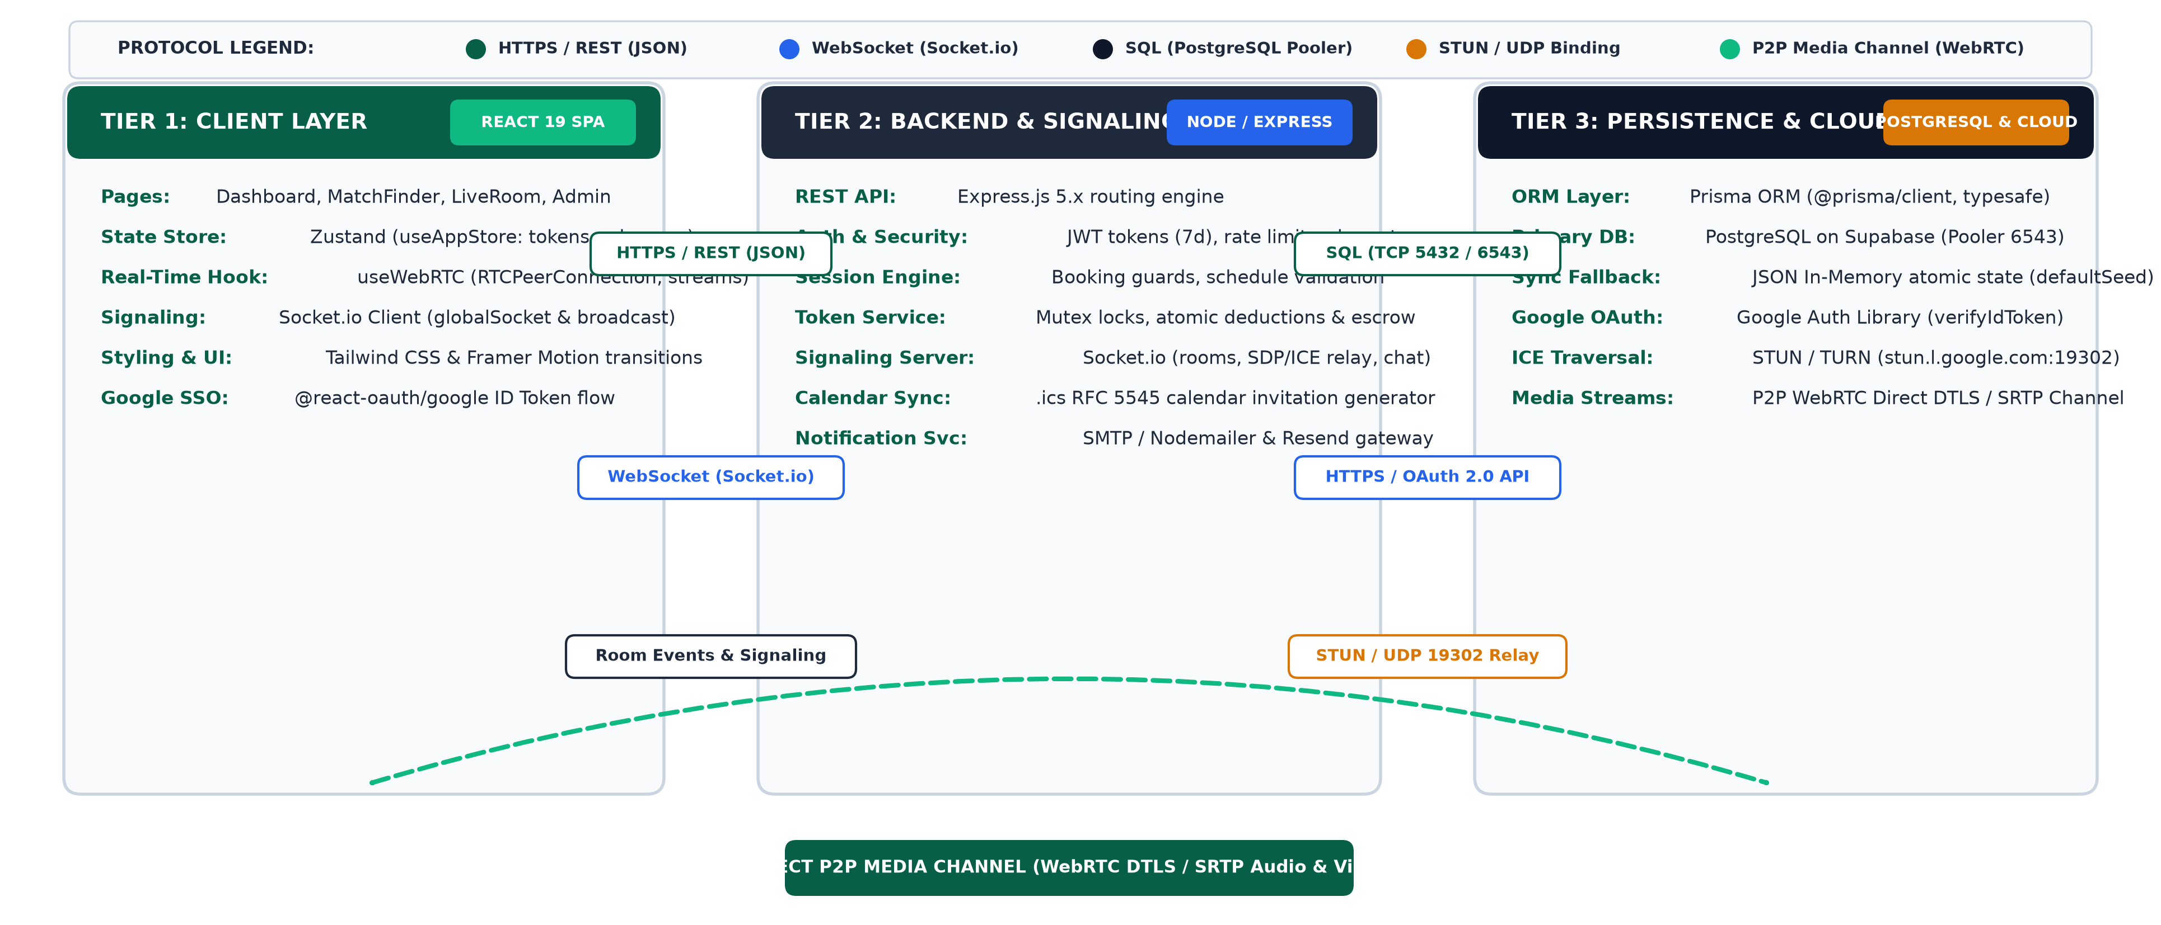
MINDROOT — PEER SKILL EXCHANGE PLATFORM
High-Level System Architecture & Multi-Tier Topology
MINDROOT (STUDENT TO STUDENT) | ACADEMIC PROJECT REPORT PRESENTATION PAGE 10 OF 43

Slide 11
MINDROOT — PEER SKILL EXCHANGE PLATFORM
Hardware & Software Requirements
Environment | Component | Minimum Requirement | Recommended Specification
Client (User Machine) | Processor | Intel Core i3 8th Gen / AMD Ryzen 3 | Intel Core i5 / AMD Ryzen 5 or higher
Client (User Machine) | RAM | 4 GB RAM | 8 GB DDR4 RAM or higher
Client (User Machine) | Peripherals | Standard Webcam & Integrated Mic | 720p HD Webcam & Noise-cancelling Headset
Client (User Machine) | Web Browser | Chrome 90+ / Firefox 88+ / Edge | Latest Google Chrome or Microsoft Edge
Client (User Machine) | Network Bandwidth | 1.5 Mbps broadband connection | 10+ Mbps high-speed Wi-Fi / Ethernet
Server (Host Machine) | Runtime Environment | Node.js v18.0.0 or higher | Node.js v20 LTS / v22 Current
Server (Host Machine) | Database Engine | PostgreSQL 14+ or SQLite dev | PostgreSQL 16 with Connection Pooling
Server (Host Machine) | Development Tools | VS Code, Git 2.30+, npm 9+ | VS Code, Docker Desktop, Postman
MINDROOT (STUDENT TO STUDENT) | ACADEMIC PROJECT REPORT PRESENTATION PAGE 11 OF 43

Slide 12
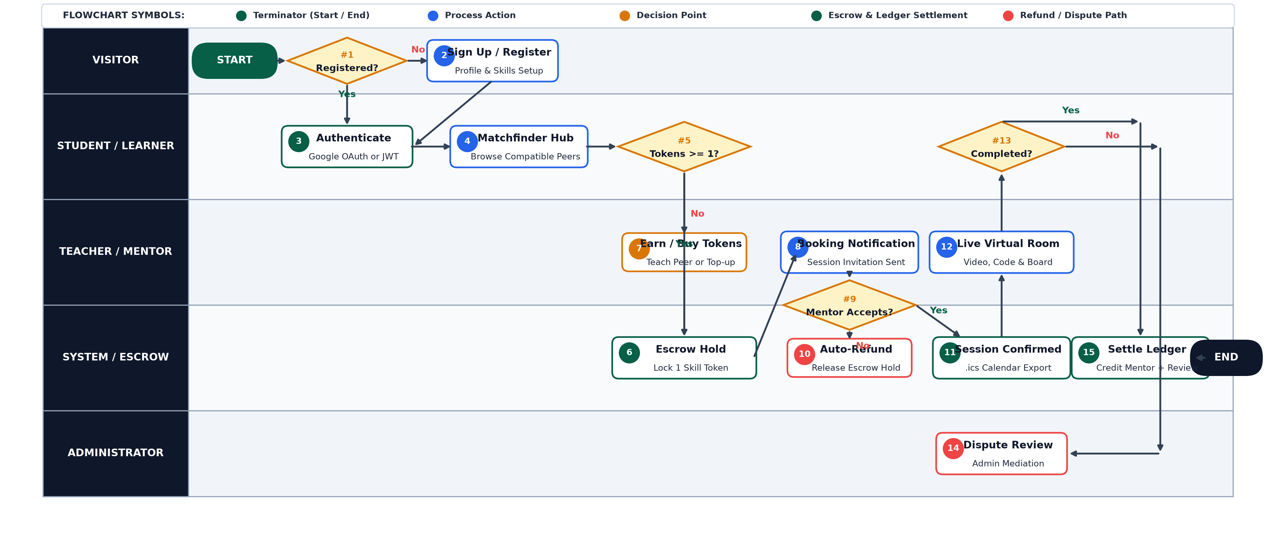
MINDROOT — PEER SKILL EXCHANGE PLATFORM
System Flowchart — Multi-Role Platform Journey
MINDROOT (STUDENT TO STUDENT) | ACADEMIC PROJECT REPORT PRESENTATION PAGE 12 OF 43

Slide 13
MINDROOT — PEER SKILL EXCHANGE PLATFORM
System Flowchart — Teacher & Mentor Workflow
Step 1: Skill Verification:- Mentor lists topics of expertise, bio, and weekly availability schedule.
Step 2: Request Notification:- Receives real-time notification of pending session booking from peer.
Step 3: Acceptance & Confirmation:- Reviews student learning agenda and confirms scheduled session time.
Step 4: Room Preparation:- Enters classroom; whiteboard canvas and code editor initialize automatically.
Step 5: Live Mentorship Delivery:- Instructs via P2P video, live coding exercises, and whiteboard diagrams.
Step 6: Session Conclusion:- Marks session as completed; both parties sign off from the room.
Step 7: Token Reward & Trust Update:- 1 Skill Token is deposited into mentor's balance; trust score recalculates.
MINDROOT (STUDENT TO STUDENT) | ACADEMIC PROJECT REPORT PRESENTATION PAGE 13 OF 43

Slide 14
MINDROOT — PEER SKILL EXCHANGE PLATFORM
System Flowchart — Administrator Management Workflow
Step 1: Admin Authentication:- Administrator logs in through protected portal with elevated role permissions.
Step 2: Platform Analytics Review:- Inspects total active users, completed sessions, token velocity & ratings.
Step 3: User Moderation:- Audits user accounts, handles community reports, and suspends malicious actors.
Step 4: Skill Taxonomy Governance:- Approves new subject categories, merges duplicates, and curates topics.
Step 5: Dispute & Escrow Resolution:- Resolves unfulfilled sessions or connection disputes and executes token refunds.
Step 6: System Health Monitoring:- Verifies Socket.io signaling stability, WebRTC TURN usage, and DB metrics.
MINDROOT (STUDENT TO STUDENT) | ACADEMIC PROJECT REPORT PRESENTATION PAGE 14 OF 43

Slide 15
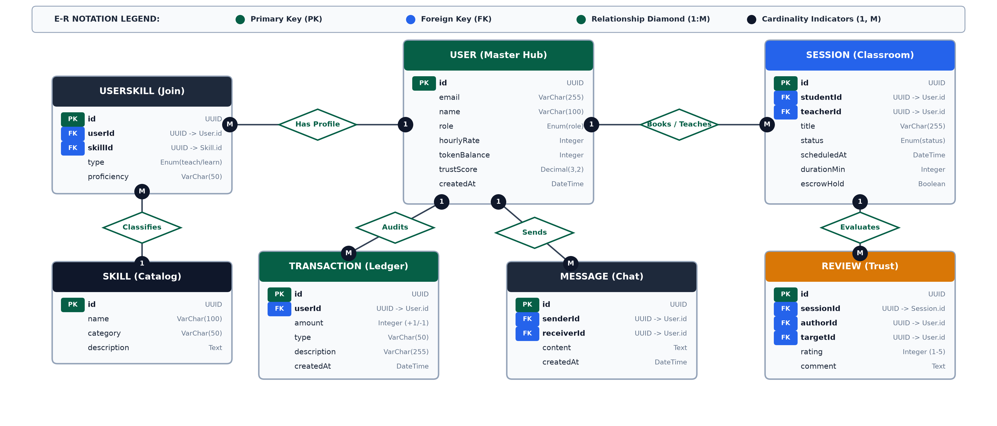
MINDROOT — PEER SKILL EXCHANGE PLATFORM
Entity-Relationship (E-R) Diagram
MINDROOT (STUDENT TO STUDENT) | ACADEMIC PROJECT REPORT PRESENTATION PAGE 15 OF 43

Slide 16
MINDROOT — PEER SKILL EXCHANGE PLATFORM
E-R Diagram Cardinalities & Structural Constraints
Primary Entity | Related Entity | Cardinality | Relationship Description | Integrity Rule
User | Session (as Teacher) | 1 : M (One-to-Many) | One user can mentor multiple sessions over time | ON DELETE RESTRICT
User | Session (as Student) | 1 : M (One-to-Many) | One user can enroll in multiple learning sessions | ON DELETE RESTRICT
User | UserSkill | 1 : M (One-to-Many) | One user can possess multiple skills taught or wanted | ON DELETE CASCADE
Skill | UserSkill | 1 : M (One-to-Many) | One skill can be referenced by many student profiles | ON DELETE RESTRICT
User | Transaction | 1 : M (One-to-Many) | One user account owns multiple token ledger entries | ON DELETE CASCADE
Session | Review | 1 : 1 (One-to-One) | Each completed session generates exactly one verified review | ON DELETE CASCADE
User | Message | 1 : M (One-to-Many) | One user sends/receives multiple direct chat messages | ON DELETE CASCADE
MINDROOT (STUDENT TO STUDENT) | ACADEMIC PROJECT REPORT PRESENTATION PAGE 16 OF 43

Slide 17
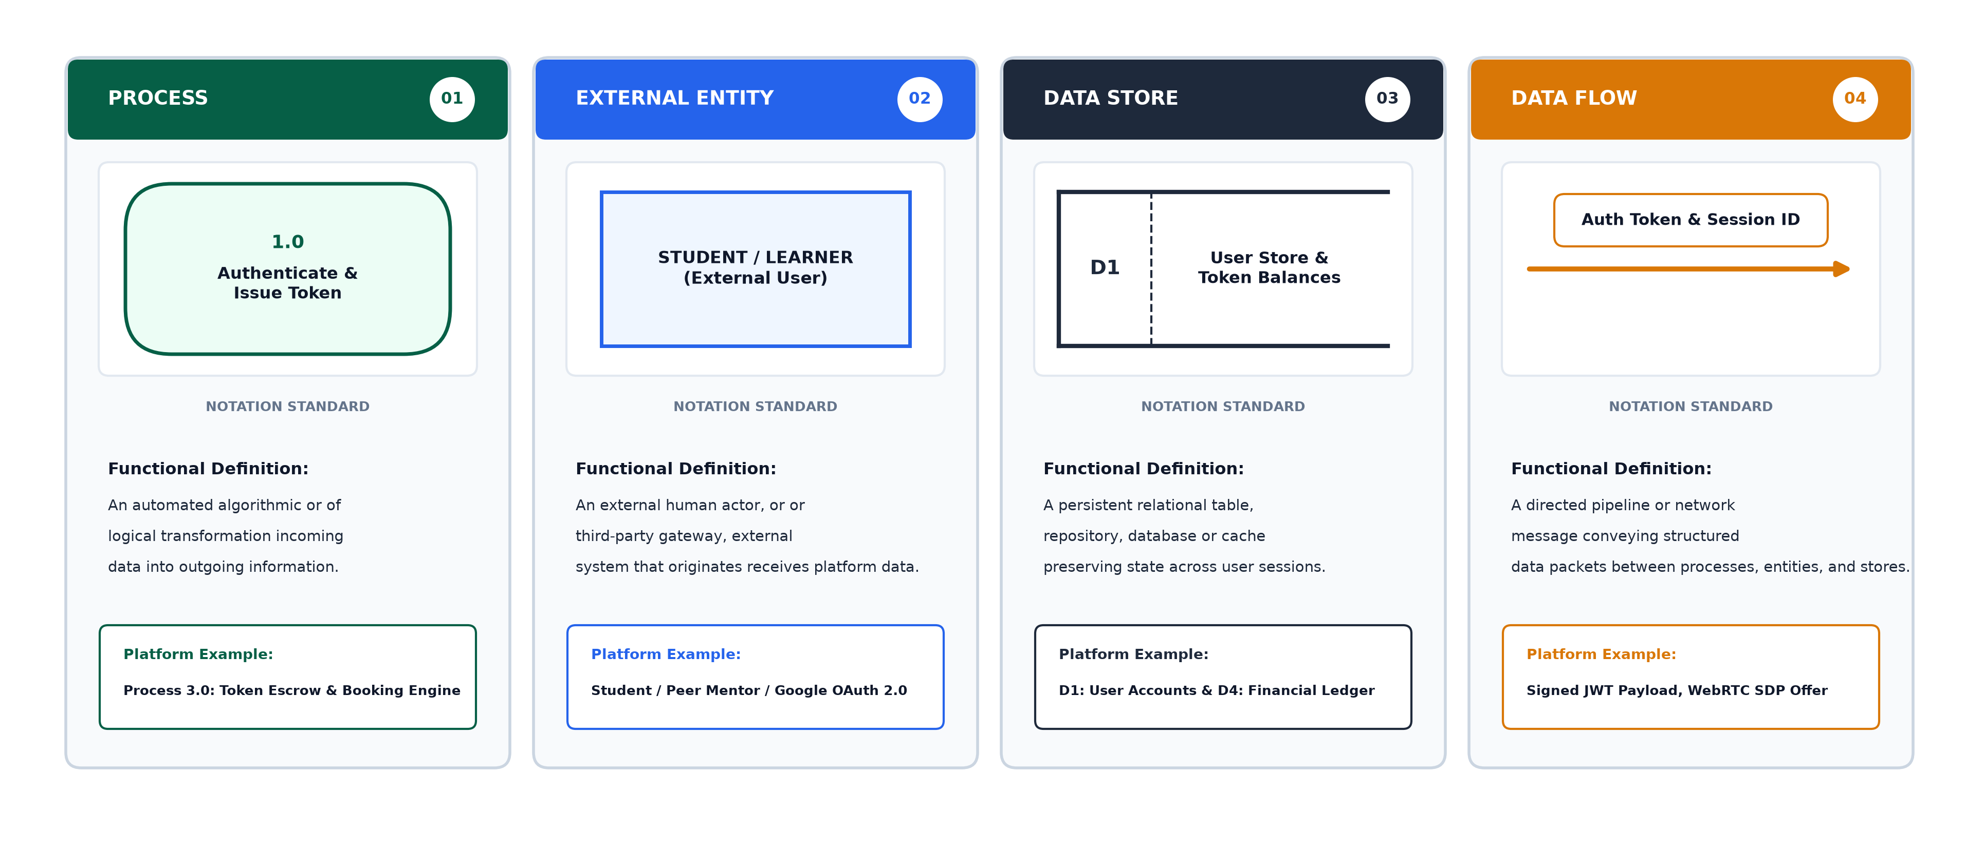
MINDROOT — PEER SKILL EXCHANGE PLATFORM
Symbols of Data Flow Diagram (DFD)
MINDROOT (STUDENT TO STUDENT) | ACADEMIC PROJECT REPORT PRESENTATION PAGE 17 OF 43

Slide 18
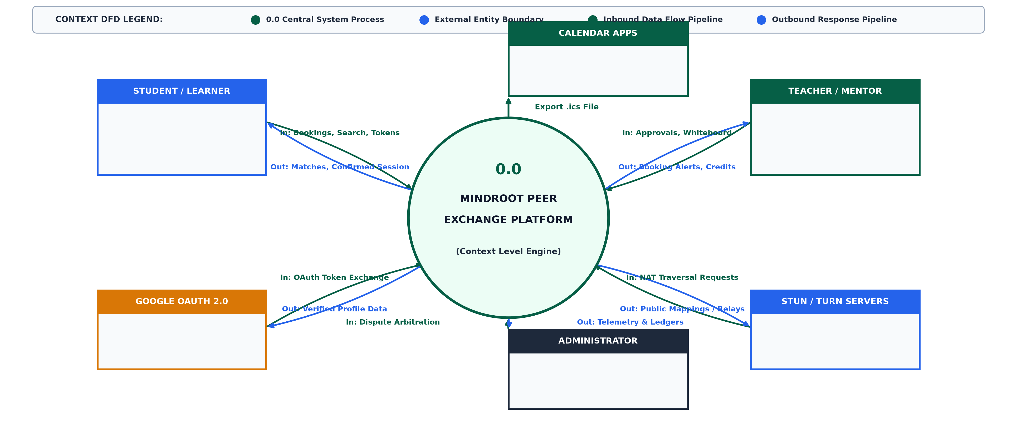
MINDROOT — PEER SKILL EXCHANGE PLATFORM
Data Flow Diagram — Context Level (Level 0)
MINDROOT (STUDENT TO STUDENT) | ACADEMIC PROJECT REPORT PRESENTATION PAGE 18 OF 43

Slide 19
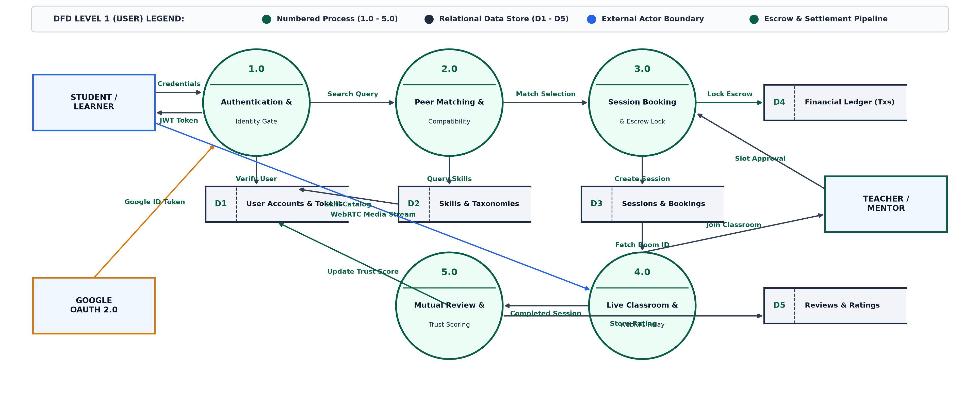
MINDROOT — PEER SKILL EXCHANGE PLATFORM
Data Flow Diagram — Level 1 (User Perspective)
MINDROOT (STUDENT TO STUDENT) | ACADEMIC PROJECT REPORT PRESENTATION PAGE 19 OF 43

Slide 20
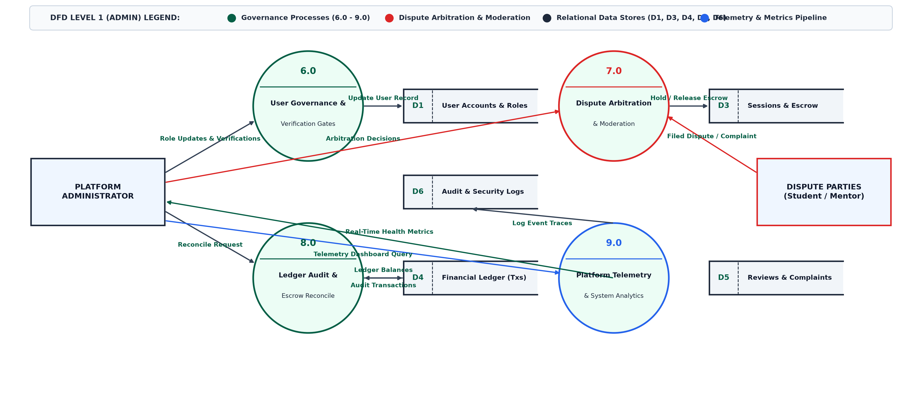
MINDROOT — PEER SKILL EXCHANGE PLATFORM
Data Flow Diagram — Level 1 (Admin Perspective)
MINDROOT (STUDENT TO STUDENT) | ACADEMIC PROJECT REPORT PRESENTATION PAGE 20 OF 43

Slide 21
MINDROOT — PEER SKILL EXCHANGE PLATFORM
DFD Level 1 — Booking, Escrow & Scheduling (Process 3.0)
• Process 3.1: Session Request Handler: Learner submits proposed time slot; system verifies both peers' calendar availability against active timetables.
• Process 3.2: Atomic Token Escrow Lock: Verifies Student has >= 1 token; decrements visible wallet balance and locks 1 token in pending escrow state.
• Process 3.3: Socket Notification Dispatch: Pushes real-time WebSocket invite to Mentor; updates session status to 'confirmed' upon acceptance.
• Process 3.4: iCalendar (.ics) Generator: Formats standard RFC 5545 calendar invitation file with direct classroom URL (/classroom?session=...) for one-click import into Google Calendar, Outlook, and Apple iCal.
MINDROOT (STUDENT TO STUDENT) | ACADEMIC PROJECT REPORT PRESENTATION PAGE 21 OF 43

Slide 22
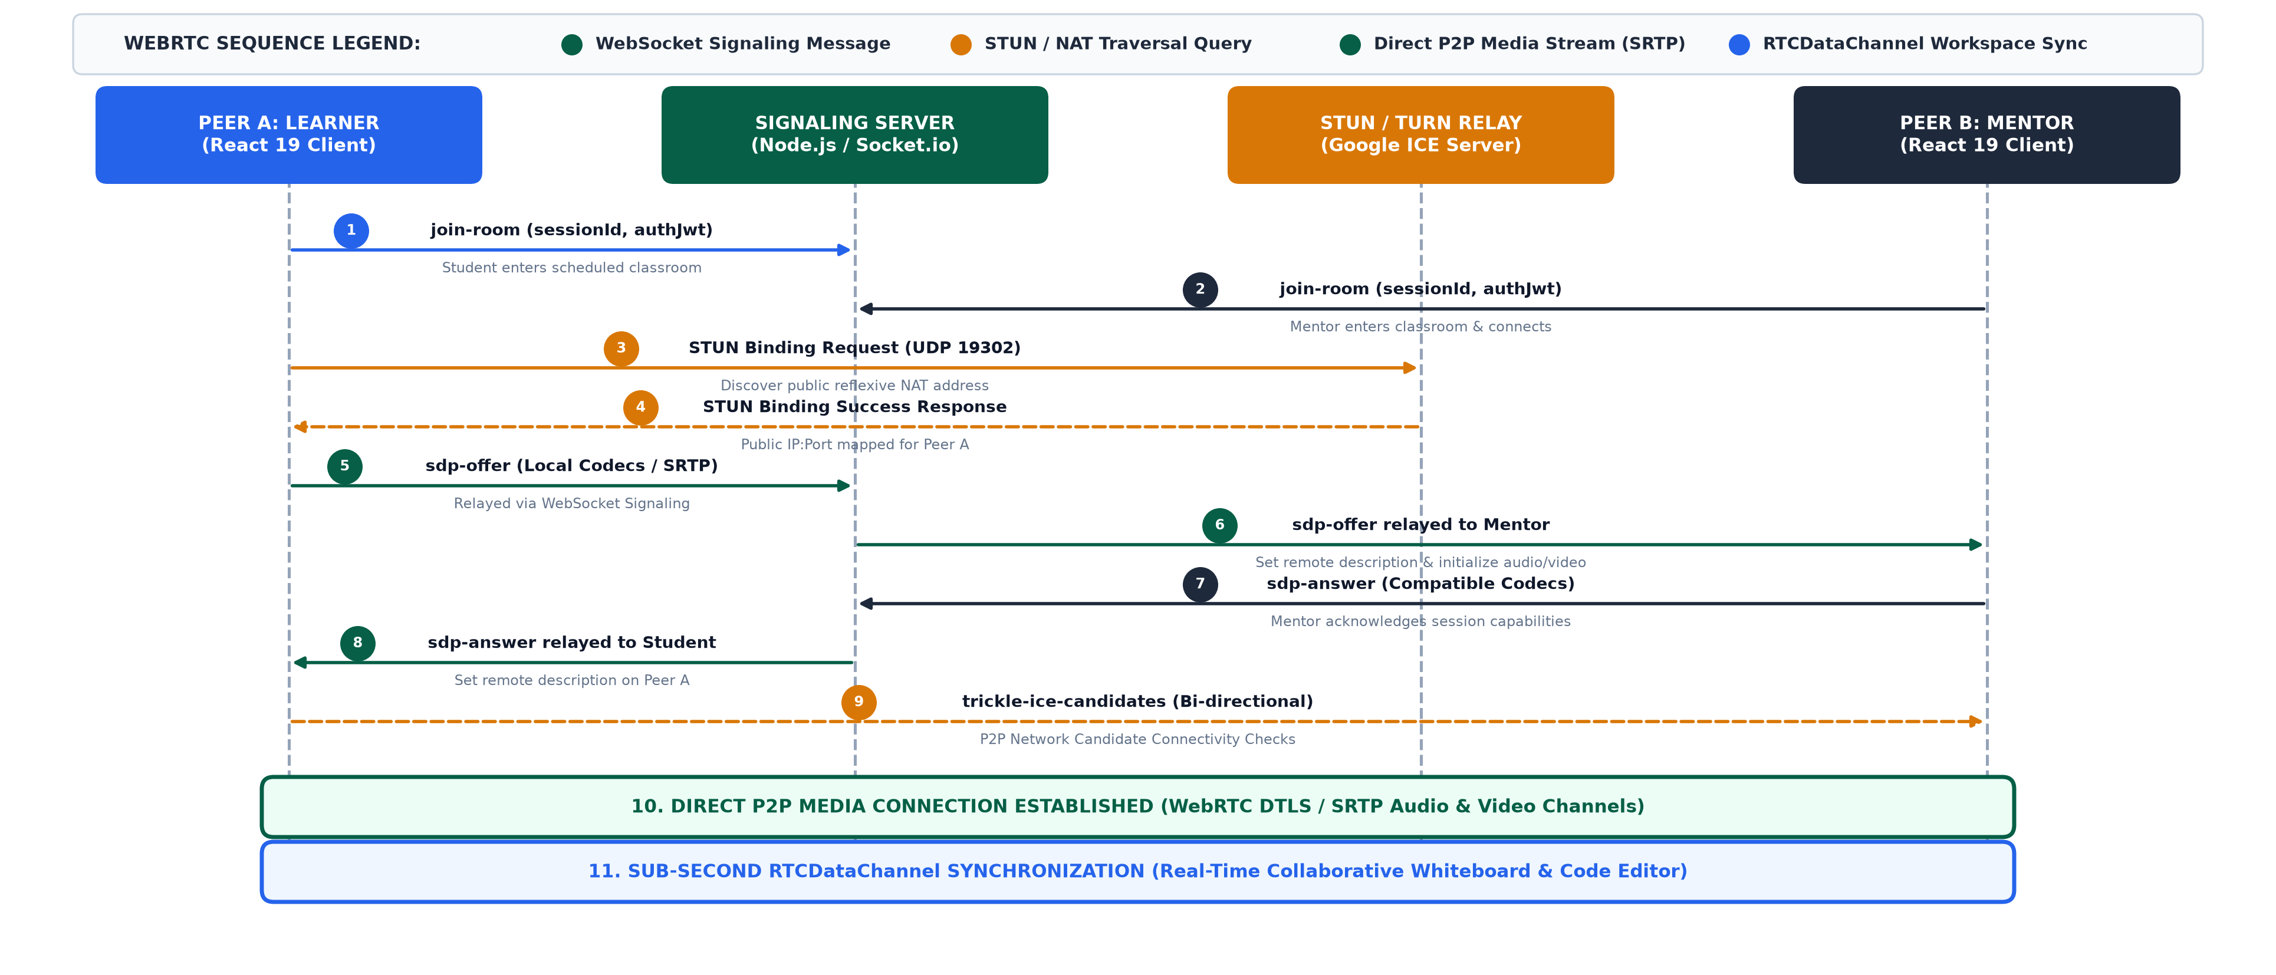
MINDROOT — PEER SKILL EXCHANGE PLATFORM
Real-Time WebRTC P2P Signaling & Media Flow Architecture
MINDROOT (STUDENT TO STUDENT) | ACADEMIC PROJECT REPORT PRESENTATION PAGE 22 OF 43

Slide 23
MINDROOT — PEER SKILL EXCHANGE PLATFORM
Data Dictionary — Relational Schema Architecture
Data Dictionary Design Principles
• Type-Safe Integrity via Prisma: All models are declared declaratively in server/prisma/schema.prisma with strict PostgreSQL data types, non-nullable constraints, and default generators.
• Referential Integrity & Cascading: Foreign keys enforce relationship consistency: deleting a user cascades to join skills and transaction logs while restricting deletion of active sessions.
• Auditability & Scalability: Every financial token movement and peer review is permanently timestamped with UTC precision.
Summary of Relational Tables
• 1. User Table (User): Stores user identities, authentication hashes, token wallets, and trust scores.
• 2. Skill & UserSkill Tables: Normalizes skill taxonomies and maps M:N peer competence associations.
• 3. Session Table (Session): Tracks booking states, timestamps, duration, and assigned virtual rooms.
• 4. Transaction Table (Transaction): Provides an immutable financial audit ledger of Skill Token velocity.
• 5. Review & Message Tables: Stores post-session peer ratings and in-platform messaging threads.
MINDROOT (STUDENT TO STUDENT) | ACADEMIC PROJECT REPORT PRESENTATION PAGE 23 OF 43

Slide 24
MINDROOT — PEER SKILL EXCHANGE PLATFORM
Data Dictionary — User Table (User)
Field Name | Data Type | Constraint | Default Value | Description & Field Purpose
id | String (UUID) | Primary Key | uuid() | Unique system identifier for the registered user
name | VarChar(100) | NOT NULL | None | Full legal or display name of the student
email | VarChar(150) | Unique, NOT NULL | None | Verified institutional or personal email address
password | VarChar(255) | NULLABLE | None | Bcrypt encrypted password hash (null for Google SSO)
role | VarChar(20) | NOT NULL | 'student' | Access role: 'student', 'teacher', 'both', or 'admin'
tokenBalance | Integer | NOT NULL | 4 | Current balance of Skill Tokens (initial 4 bonus tokens)
trustScore | Float | NOT NULL | 5.0 | Dynamic trust rating derived from peer reviews (1.0 to 5.0)
avatarUrl | Text | NULLABLE | None | URL path to hosted user profile photo
createdAt | DateTime | NOT NULL | now() | Timestamp when the user account was provisioned
MINDROOT (STUDENT TO STUDENT) | ACADEMIC PROJECT REPORT PRESENTATION PAGE 24 OF 43

Slide 25
MINDROOT — PEER SKILL EXCHANGE PLATFORM
Data Dictionary — Skill & UserSkill Join Tables
Table 1: Skill Master Table
Field Name | Data Type | Constraint | Description & Field Purpose
id | String (UUID) | Primary Key | Unique identifier for the skill entity
name | VarChar(100) | Unique, NOT NULL | Human-readable skill title (e.g., Python, React, UI Design)
category | VarChar(100) | NOT NULL | Domain category (e.g., 'Software & AI', 'Design', 'Languages')
Table 2: UserSkill Relational Join Table
Field Name | Data Type | Constraint | Description & Field Purpose
id | String (UUID) | Primary Key | Unique identifier for the join association
userId | String (UUID) | Foreign Key -> User.id | References the associated user (ON DELETE CASCADE)
skillId | String (UUID) | Foreign Key -> Skill.id | References the associated skill (ON DELETE RESTRICT)
type | VarChar(20) | NOT NULL | Specifies capability: 'teaches' OR 'wants_to_learn'
MINDROOT (STUDENT TO STUDENT) | ACADEMIC PROJECT REPORT PRESENTATION PAGE 25 OF 43

Slide 26
MINDROOT — PEER SKILL EXCHANGE PLATFORM
Data Dictionary — Session Table (Session)
Field Name | Data Type | Constraint | Default | Description & Field Purpose
id | String (UUID) | Primary Key | uuid() | Unique identifier for the booked classroom session
title | VarChar(150) | NOT NULL | None | Session topic summary (e.g. 'React ↔ Python Skill Swap')
teacherId | String (UUID) | Foreign Key -> User.id | None | User ID of the mentor conducting the session
studentId | String (UUID) | Foreign Key -> User.id | None | User ID of the learner attending the session
skillId | String (UUID) | Foreign Key -> Skill.id | None | Optional specific skill being taught
status | VarChar(20) | NOT NULL | 'pending' | State: 'pending', 'confirmed', 'live', 'completed', 'cancelled'
scheduledAt | DateTime | NOT NULL | None | Scheduled date and start time for the classroom
durationMin | Integer | NOT NULL | 60 | Planned session duration in minutes (standard: 60 min)
MINDROOT (STUDENT TO STUDENT) | ACADEMIC PROJECT REPORT PRESENTATION PAGE 26 OF 43

Slide 27
MINDROOT — PEER SKILL EXCHANGE PLATFORM
Data Dictionary — Token Transaction Table (Transaction)
Field Name | Data Type | Constraint | Description & Field Purpose
id | String (UUID) | Primary Key | Unique identifier for the financial ledger transaction
userId | String (UUID) | Foreign Key -> User.id | User account associated with this token movement (ON DELETE CASCADE)
amount | Integer | NOT NULL | Number of tokens moved (+1 for teaching credit, -1 for learning debit)
type | VarChar(20) | NOT NULL | Transaction category: 'earned', 'spent', 'escrow_hold', 'refund', 'bonus'
description | VarChar(255) | NOT NULL | Audit note (e.g. 'Completed 1 hr React session with a peer mentor')
createdAt | DateTime | NOT NULL, now() | Immutable timestamp of ledger settlement
MINDROOT (STUDENT TO STUDENT) | ACADEMIC PROJECT REPORT PRESENTATION PAGE 27 OF 43

Slide 28
MINDROOT — PEER SKILL EXCHANGE PLATFORM
Data Dictionary — Review Table (Review)
Field Name | Data Type | Constraint | Description & Field Purpose
id | String (UUID) | Primary Key | Unique identifier for the review entry
sessionId | String (UUID) | Unique, FK -> Session.id | Links review to verified completed session (prevents fake reviews)
reviewerId | String (UUID) | Foreign Key -> User.id | User submitting the feedback rating
revieweeId | String (UUID) | Foreign Key -> User.id | User receiving the rating (mentor or student)
rating | Integer | NOT NULL (1 to 5) | Numerical satisfaction score awarded (1=Poor to 5=Excellent)
comment | Text | NULLABLE | Written qualitative review and feedback notes
createdAt | DateTime | NOT NULL, now() | Timestamp when feedback was submitted
MINDROOT (STUDENT TO STUDENT) | ACADEMIC PROJECT REPORT PRESENTATION PAGE 28 OF 43

Slide 29
MINDROOT — PEER SKILL EXCHANGE PLATFORM
Data Dictionary — Direct Message Table (Message)
Field Name | Data Type | Constraint | Description & Field Purpose
id | String (UUID) | Primary Key | Unique identifier for the chat message
senderId | String (UUID) | Foreign Key -> User.id | User transmitting the message
receiverId | String (UUID) | Foreign Key -> User.id | Recipient user account
content | Text | NOT NULL | Encrypted or sanitized text content of the message
isRead | Boolean | NOT NULL, default false | Status indicator for delivery and read receipts
createdAt | DateTime | NOT NULL, now() | Timestamp when message was stored and relayed
MINDROOT (STUDENT TO STUDENT) | ACADEMIC PROJECT REPORT PRESENTATION PAGE 29 OF 43

Slide 30
MINDROOT — PEER SKILL EXCHANGE PLATFORM
System UI Walkthrough — Overview & Screen Layout Hierarchy
UI / UX Design Philosophy
• Tailwind CSS Precision: Clean modern aesthetics with an Emerald / Deep Slate theme, responsive breakpoints for desktop and mobile, and micro-interactions via Framer Motion.
• Information Density with Clarity: Designed specifically for intensive academic tasks: quick-glance token badges, prominent video feeds, and clutter-free sidebar navigation.
• Instant Feedback: Instant toast notifications for incoming invites, token updates, and connection statuses.
Presentation of 7 Key Functional Screens
• Screen 1: Landing & Value Proposition: Hero section, statistics counter, and feature highlights.
• Screen 2: Authentication & Google SSO: Secure credential entry and single sign-on modal.
• Screen 3: Peer Discovery & Matchmaker: Dual skill filter cards with mutual compatibility indicators.
• Screen 4: Booking & .ics Calendar: Schedule picker with token escrow indicator and calendar export.
• Screen 5: Live P2P Virtual Classroom: WebRTC video/audio feeds with in-room chat sidebar.
• Screen 6: Collaborative Whiteboard & Code: Dual canvas drawing board and live syntax-highlighted code editor.
• Screen 7: Admin Analytics & Governance: User management, token velocity charts, and dispute console.
MINDROOT (STUDENT TO STUDENT) | ACADEMIC PROJECT REPORT PRESENTATION PAGE 30 OF 43

Slide 31
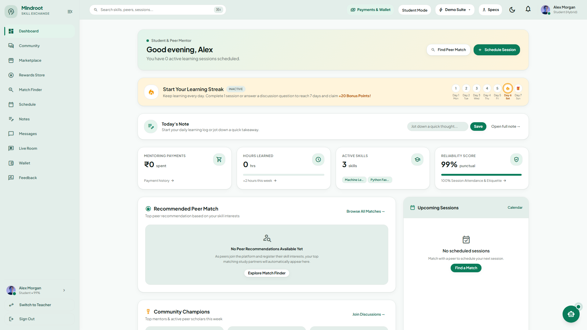
MINDROOT — PEER SKILL EXCHANGE PLATFORM
Screen 1 — Landing Page & Platform Feature Showcase
Screen 1: Mindroot Student Dashboard — Active Learning Hours, Skill Token Balance, and Daily Habit Tracking
MINDROOT (STUDENT TO STUDENT) | ACADEMIC PROJECT REPORT PRESENTATION PAGE 31 OF 43

Slide 32
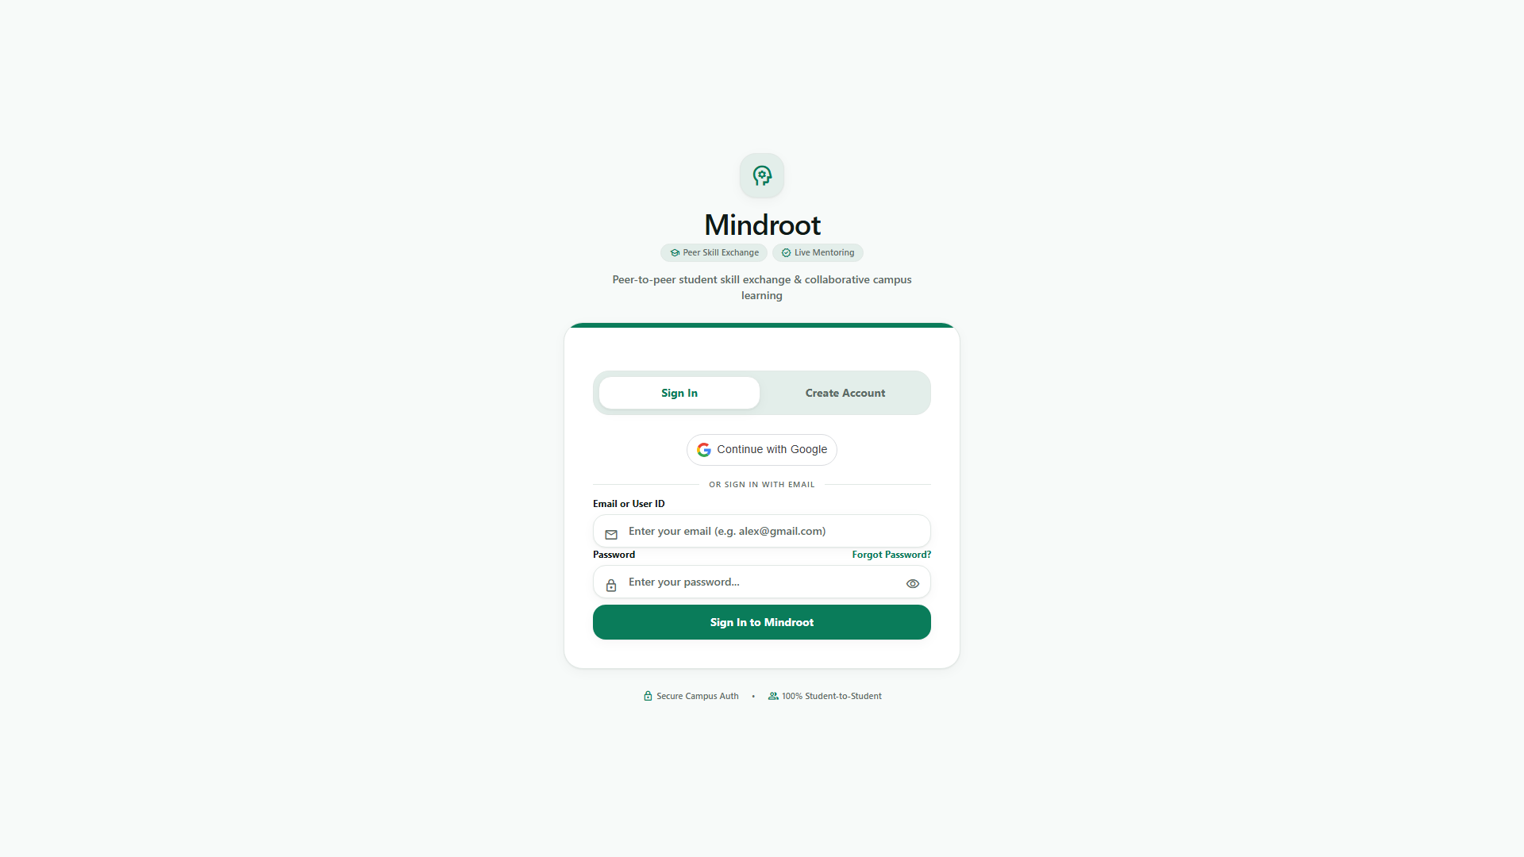
MINDROOT — PEER SKILL EXCHANGE PLATFORM
Screen 2 — Authentication & Google OAuth 2.0 Single Sign-On
Dual Authentication Architecture
• Google OAuth 2.0 Integration: One-click institutional or personal Google login using @react-oauth/google and backend google-auth-library verification.
• Zero Password Friction: Cryptographically verifies Google ID tokens, extracts user avatar and verified email, eliminating forgotten passwords.
• Standard Credential Fallback: Includes Bcrypt-hashed email/password authentication for environments without Google Client ID configuration.
Security & Session Handling
• JWT Token Generation: Signs stateless JSON Web Tokens containing userId and role with 7-day expiration.
• Automatic Welcome Bonus: New student registrations automatically receive initial Skill Tokens in their wallet.
• Role Protection: Route guards automatically redirect unauthorized users from protected classroom views.
Screen 2: Multi-Method Authentication Portal — Google OAuth 2.0 Single Sign-On & Standard Bcrypt Fallback
MINDROOT (STUDENT TO STUDENT) | ACADEMIC PROJECT REPORT PRESENTATION PAGE 32 OF 43

Slide 33
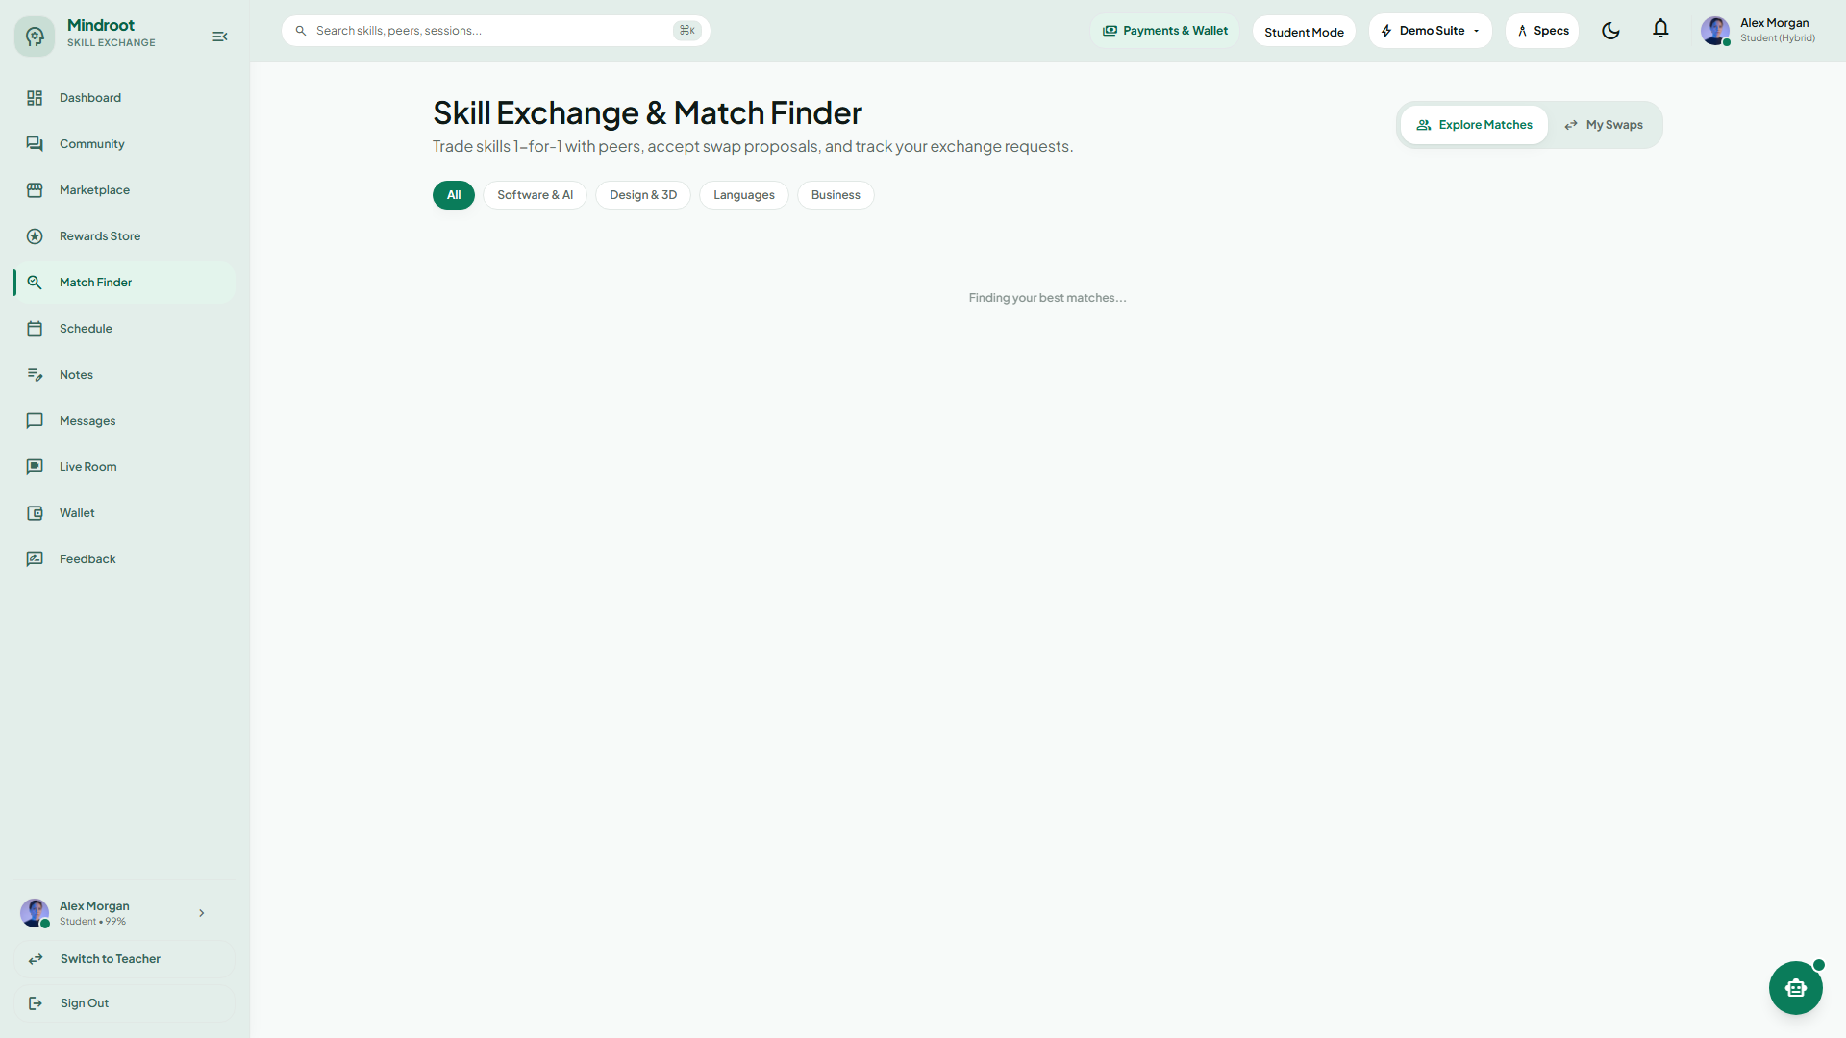
MINDROOT — PEER SKILL EXCHANGE PLATFORM
Screen 3 — Peer Discovery & Reciprocal Matchmaker
Screen 3: Peer Discovery Hub — Reciprocal Skill Matchmaking, Competence Filters, and Peer Trust Ratings
MINDROOT (STUDENT TO STUDENT) | ACADEMIC PROJECT REPORT PRESENTATION PAGE 33 OF 43

Slide 34
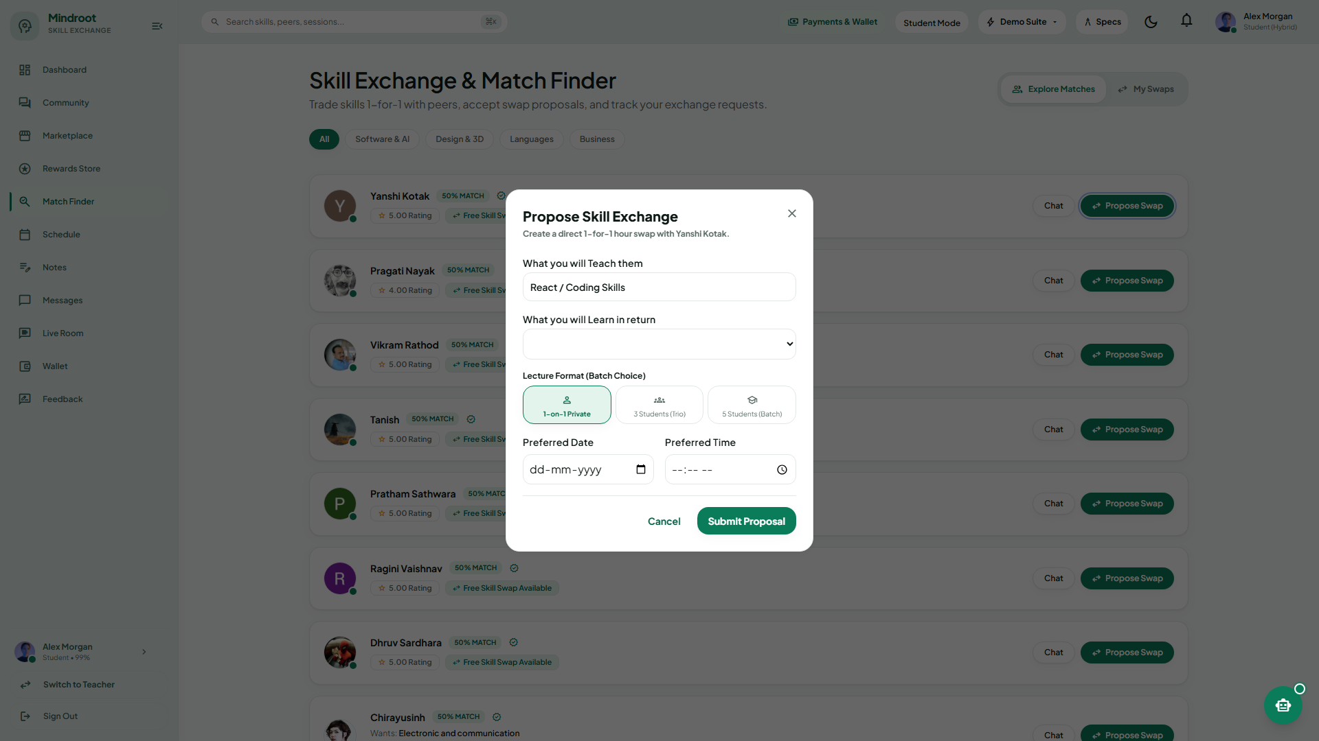
MINDROOT — PEER SKILL EXCHANGE PLATFORM
Screen 4 — Session Booking, Escrow & .ics Calendar Sync
Booking Workflow & Token Escrow
• Slot Selection Modal: Interactive date picker and time slot selector with timezone awareness.
• Token Cost Notice: Explicitly warns: '1 Skill Token will be held in escrow until session completion'.
• Topic & Agenda Notes: Student inputs session objectives (e.g. 'Help me debug my binary search tree in C++').
• Instant Real-Time Confirmation: Emits Socket.io event to mentor with Accept/Decline prompts.
Automated .ics Calendar Export
• RFC 5545 Compliance: Backend generates downloadable .ics calendar invitation file with unique UID.
• Pre-Filled Meeting Link: Calendar invite contains direct classroom URL (/classroom?session=...).
• Universal Compatibility: One-click sync with Google Calendar, Microsoft Outlook, and Apple Calendar.
Screen 4: Interactive Exchange Proposal Modal — Slot Picker, Escrow Lock Notice, and Conflict Detection
MINDROOT (STUDENT TO STUDENT) | ACADEMIC PROJECT REPORT PRESENTATION PAGE 34 OF 43

Slide 35
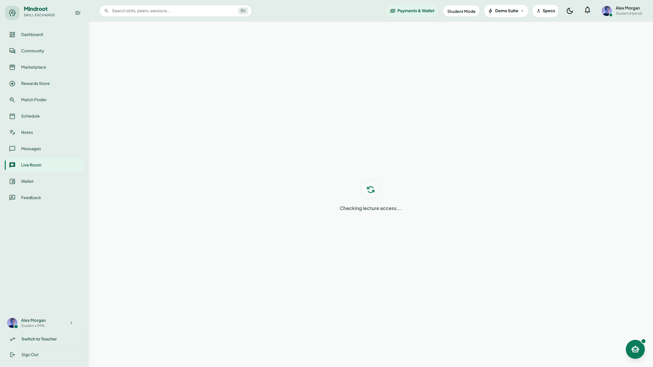
MINDROOT — PEER SKILL EXCHANGE PLATFORM
Screen 5 — Live Virtual Classroom (P2P Video, Audio & Chat)
Screen 5: Live P2P Virtual Classroom — Dual WebRTC Video Feeds, Low-Latency Audio, and Real-Time Chat
MINDROOT (STUDENT TO STUDENT) | ACADEMIC PROJECT REPORT PRESENTATION PAGE 35 OF 43

Slide 36

MINDROOT — PEER SKILL EXCHANGE PLATFORM
Screen 6 — Collaborative Whiteboard & Synchronized Code Editor
Interactive Vector Whiteboard
• Real-Time Drawing Canvas: HTML5 canvas synchronized over WebRTC DataChannels or WebSocket events.
• Tool Palette: Pen, Highlighter, Geometric Shapes (Rectangle, Circle, Arrow), Text annotations, and Eraser.
• Color & Stroke Controls: 8 Color swatches, adjustable stroke weights (2px - 12px), and clear canvas.
• Zero-Latency Interaction: Local optimistic rendering with broadcast updates for lag-free sketching.
Synchronized Collaborative Code Editor
• Multi-Language Support: Syntax highlighting for JavaScript, TypeScript, Python, C++, Java, and SQL.
• Live Typing Sync: Character-level conflict-free synchronization powered by real-time WebRTC DataChannels.
• Integrated Output Console: Simulates test execution results directly within the active peer room.
Screen 6: In-Room Collaborative Tools — Sub-Second Whiteboard Synchronization & Real-Time Code Editor
MINDROOT (STUDENT TO STUDENT) | ACADEMIC PROJECT REPORT PRESENTATION PAGE 36 OF 43

Slide 37
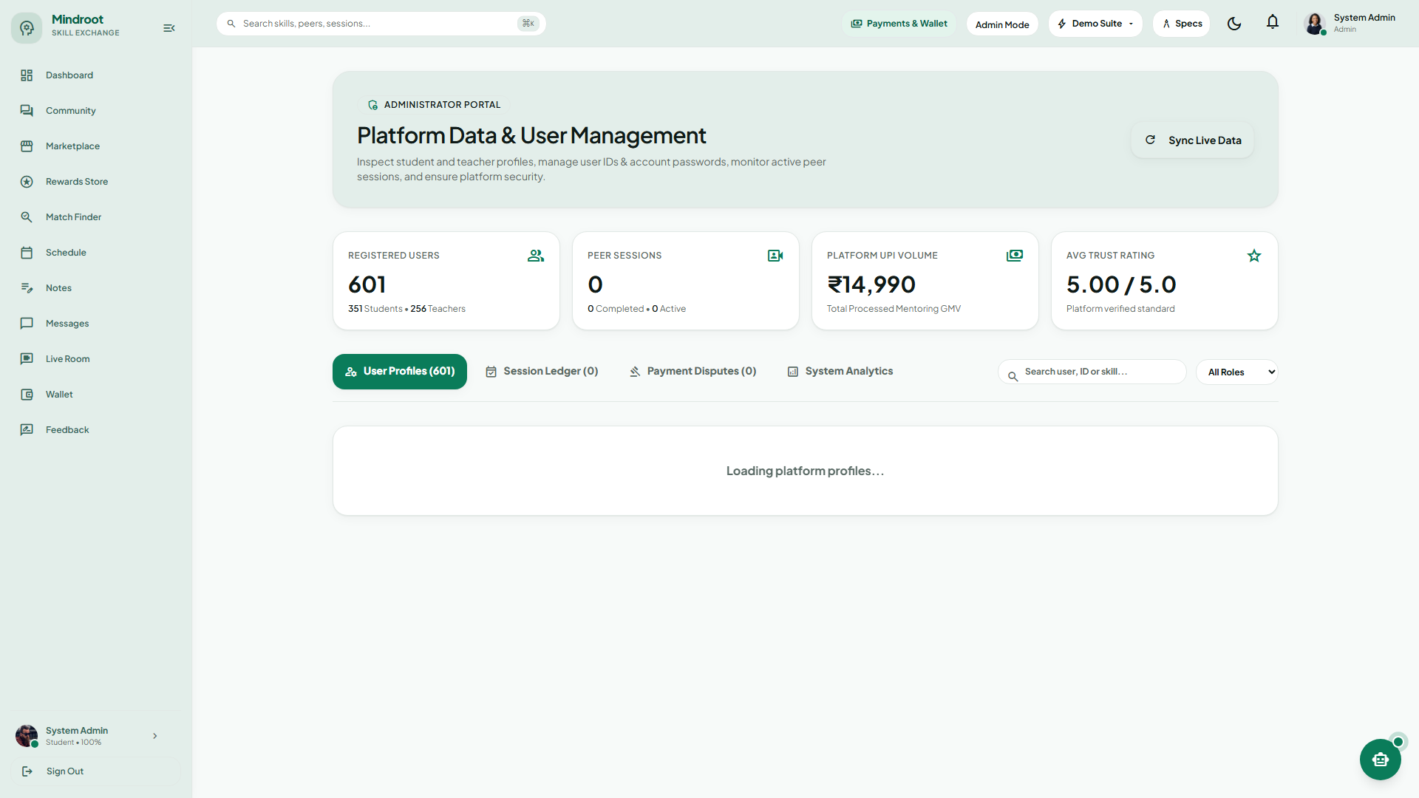
MINDROOT — PEER SKILL EXCHANGE PLATFORM
Screen 7 — Admin Analytics & Platform Governance
Screen 7: Central Administrator Portal — Multi-User Moderation, Dispute Arbitration, and System Health Telemetry
MINDROOT (STUDENT TO STUDENT) | ACADEMIC PROJECT REPORT PRESENTATION PAGE 37 OF 43

Slide 38
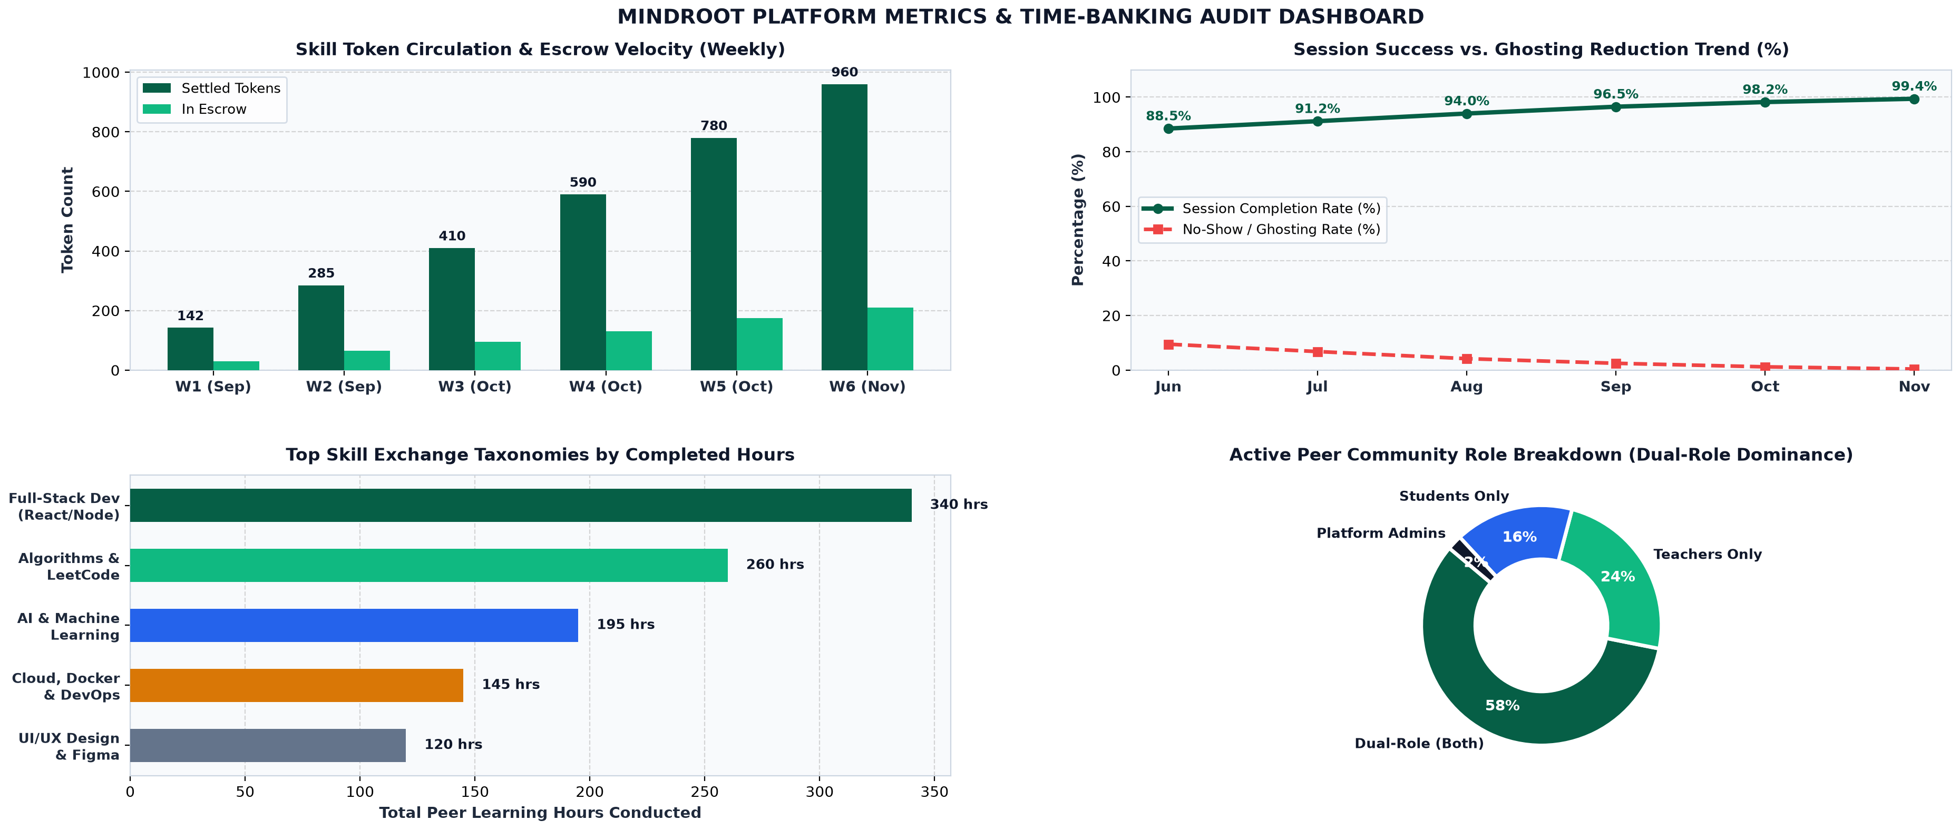
MINDROOT — PEER SKILL EXCHANGE PLATFORM
Platform Analytics & Token Circulation Metrics
MINDROOT (STUDENT TO STUDENT) | ACADEMIC PROJECT REPORT PRESENTATION PAGE 38 OF 43

Slide 39
MINDROOT — PEER SKILL EXCHANGE PLATFORM
Security, Trust & Data Integrity Measures
Identity & Access Management
• Cryptographic Passwords: Bcrypt hashing with salt factor 10.
• Stateless JWT Tokens: HS256 signed tokens with 7-day expiration.
• Role-Based Middleware: Strict verification protects /api/admin/* and private classroom routes.
• OAuth 2.0 Token Audit: Official Google public key signature validation.
Ledger & Financial Security
• Atomic Token Deductions: Prisma multi-statement transactions prevent race conditions.
• Escrow Holding Pattern: Tokens locked during booking, eliminating payment fraud.
• Immutable Audit Ledger: Every token movement permanently recorded with UTC timestamps.
• Double-Claim Prevention: Strict state guards prevent multiple claims on bounty questions.
Real-Time Communications Security
• DTLS / SRTP Encryption: All WebRTC peer video and audio streams end-to-end encrypted.
• Isolated Socket Rooms: Signaling events strictly scoped to verified session participants.
• STUN / TURN Authorization: Short-lived credentials prevent unauthorized TURN relay usage.
• Input Sanitization: DOMPurify protects chat, notes, and discussion markdown.
Data Protection & Integrity
• PostgreSQL Constraints: Foreign keys enforce referential integrity across all tables.
• Cascading Account Deletions: GDPR/Privacy compliant deletion of user profiles.
• Durable Session State: Automatic ledger rollback if session confirmation encounters errors.
• Rate Limiting Guard: Brute-force protection on authentication endpoints.
MINDROOT (STUDENT TO STUDENT) | ACADEMIC PROJECT REPORT PRESENTATION PAGE 39 OF 43

Slide 40
MINDROOT — PEER SKILL EXCHANGE PLATFORM
Future Enhancements & Research Scope
Short-Term Roadmap (6 Months)
• AI-Powered Semantic Matchmaking: Integrating vector embeddings (pgvector) to semantically match learner syllabus goals with mentor project portfolios beyond simple keyword lookups.
• Automated Session Summarization: Leveraging speech-to-text models to generate structured lecture notes, flashcards, and action items automatically after each session concludes.
• Multi-Peer Group Workshops: Extending 1-on-1 WebRTC rooms into Selective Forwarding Unit (SFU) architectures supporting 10-20 student cohort seminars.
Long-Term Vision (12–24 Months)
• Native Mobile Applications: Developing cross-platform React Native apps for iOS and Android with push notifications for instant session requests and reminders.
• Decentralized Blockchain Credentialing: Issuing verifiable cryptographic skill badges and micro-credentials on Polygon/Ethereum to provide tamper-proof academic certificates.
• Campus LMS Integration: LTI (Learning Tools Interoperability) plugins for seamless integration into Canvas, Moodle, and Blackboard university portals.
MINDROOT (STUDENT TO STUDENT) | ACADEMIC PROJECT REPORT PRESENTATION PAGE 40 OF 43

Slide 41
MINDROOT — PEER SKILL EXCHANGE PLATFORM
Conclusion & Project Impact
Project Summary & Achievements
• Democratized Learning: Successfully engineered a fully functional peer-to-peer educational ecosystem eliminating financial barriers through time-banking.
• Production-Grade Real-Time Stack: Integrated React 19, Node/Express, Prisma, PostgreSQL, Socket.io, and WebRTC for zero-install, browser-native learning sessions.
• Auditable Trust & Token Economy: Built robust atomic token transactions, escrow guarantees, and mutual trust ratings significantly reducing absentee rates and ghosting.
Academic & Societal Value
• Active Student Pedagogy: Validates the educational principle that teaching a concept reinforces mastery far more effectively than passive lecture consumption.
• Interdisciplinary Campus Collaboration: Breaks departmental silos, allowing engineering, design, business, and science students to exchange specialized skills reciprocally.
• Scalable Open Architecture: Modular microservice-ready codebase adaptable to university departments, hackathons, and corporate mentorship programs.
MINDROOT (STUDENT TO STUDENT) | ACADEMIC PROJECT REPORT PRESENTATION PAGE 41 OF 43

Slide 42
MINDROOT — PEER SKILL EXCHANGE PLATFORM
Bibliography & References
Category / Domain | Resource / Specification | Application in Mindroot Platform
WebRTC Protocols | RFC 8825 (Overview) / RFC 8826 (Security Architecture) | Peer-to-peer browser audio/video streaming, DTLS encryption, and SRTP media integrity
Calendar Standards | RFC 5545 — Internet Calendaring and Scheduling (iCalendar) | Direct generation of universal .ics meeting invitations with pre-filled classroom URLs
Real-Time Networking | Socket.io Engine & WebSocket Protocol (RFC 6455) | Full-duplex signaling channel, instant session notifications, and whiteboard drawing synchronization
Database Architecture | Prisma ORM & PostgreSQL Official Documentation | Declarative schema modeling, ACID transactions for token wallet deductions, and pooling
Frontend Engineering | React 19 Documentation & Zustand Architecture Guides | High-performance reactive UI rendering, state management, and custom WebRTC hooks
Authentication Standards | RFC 7519 — JSON Web Token (JWT) & Google Identity OAuth 2.0 | Stateless authentication tokens, role verification guards, and single sign-on credential verification
UI/UX Design Systems | Tailwind CSS & Google Material Design 3 Guidelines | Responsive design, unified slate/emerald color scheme, card-based component hierarchy
MINDROOT (STUDENT TO STUDENT) | ACADEMIC PROJECT REPORT PRESENTATION PAGE 42 OF 43

Slide 43
THANK YOU!
Mindroot — Peer-to-Peer Skill Exchange Platform
Any Questions or Suggestions?
Department of Computer Applications | Academic Year 2025–2026

