Slide 1
DHWANI
By: Tanish Bhola
SOUND GENERATION from Images
controlled with HAND GESTURES

Slide 2
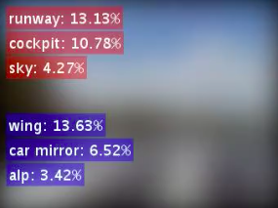

SOUNDNET

Slide 3








MOBILENET

Slide 4
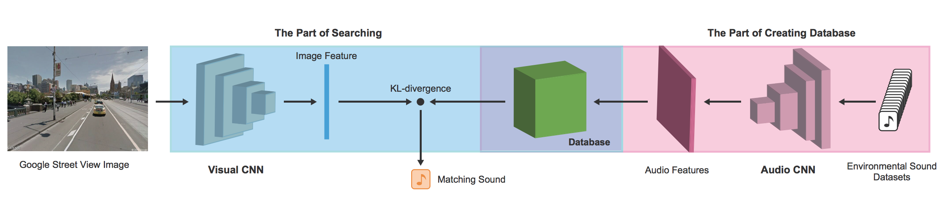
SOUND GENERATION

Slide 5
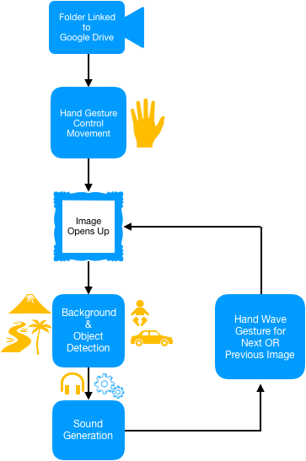
Dhwani’s WorkFlow

Slide 6
APPLICATIONS
Reliving Past moments
Customizable Restaurant Ambience
Exploring places without even visiting them

Slide 7
FUTURE SCOPE
Application on Video/Sequence of Images
Hand Gesture Control with Bare Hands
Songs Recommendation

Slide 8
THANK YOU

