Slide 1
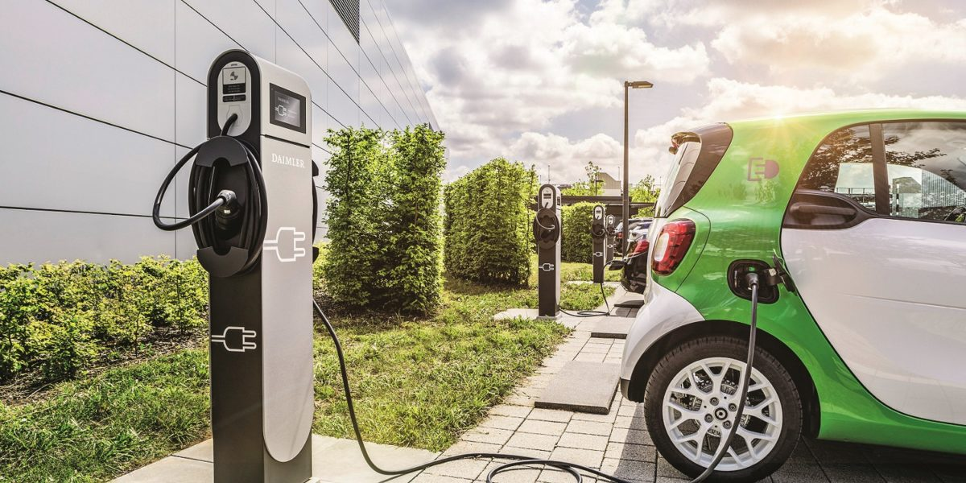
SMART-EV
DYNAMIC PRICING OF EV STATIONS

Slide 2

Predicting :-
Dynamic Price of EV (Electronic Vehicle) charging station
Approximate Waiting Period

Slide 3
Machine Learning Model Used:
REGRESSION

Slide 4
Parameters used for Model Training
Number of Cars
Time
Day/Night

Slide 5
01 Data Generation
Used a simple Python Script to generate Dataset
02 Car Detection
Used YOLO(You look only Once), an Object detection model for detecting cars and get the total count of it.

Slide 6
03 Model Training
PyTorch has been used for Model Training
04 Securing Model
The model is made secure using Encrypted Deep learning with the help of PySyft library

Slide 7
THANK YOU !

