Slide 1

Kolhapur Institute of Technology’s College of Engineering (Empowered Autonomous)
A Project Phase-II Presentation on :- | CCTV Footage Analysis Through Computer Vision and Deep Learning.
Presented By: Under Guidance of:
Pranav Mrs. K.M.Tamboli
Sham
Sanket
Tanish

Slide 2
GROUP MEMBERS
Name Roll No.
SHAM - 23
SANKET - 37
TANISH - 18
PRANAV - 28

Slide 3
PROBLEM STATEMENT
The rapid growth of CCTV surveillance systems generates a large volume of video data, making manual monitoring time-consuming and inefficient. This project addresses the problem by using Computer Vision and Deep Learning techniques to automatically analyze CCTV footage. The system detects objects such as people and vehicles and extracts important information from videos. It then generates timestamp-based descriptions using attributes like type, color, and size, allowing users to quickly understand events without watching the entire footage. This approach improves efficiency, reduces human effort, and enhances accuracy in surveillance tasks. It is especially useful in applications such as security monitoring, crime investigation, traffic analysis, and smart surveillance systems.

Slide 4
OBJECTIVES
Automate CCTV Video Analysis
Enable Attribute-Based Video Search
Convert Video Frames into Vector Representations
Create Timestamp-Based Indexing
Reduce Time Required for Video Investigation
Develop a User-Friendly Search Interface

Slide 5
LITERATURE REVIEW
Serial No. | Year of Publication | Title | Authors | Publications | Methododlogy | QOS Parameters | Limitations
1. | March 2024 | Design of a real‑time crime monitoring system using deep learning techniques | Md. Muktadir Mukto, Mahamudul Hasan, Md. Maiyaz Al Mahmud, kramul Haque | Intelligent Systems with Applications | Weapon detection using YOLOv5Violence detection using MobileNetv2Face recognition using LBPH (Local Binary Pattern Histogram) | Weapon detection: > 80% accuracy Violence detection: ~95% accuracy Face recognition: ~97% accuracy | Dataset dependencies, Computing requirements
2. | 2023 | Building Occupancy Detection and Localization Using CCTV Camera and Deep Learning | Shushan Hu Peng Wang Cathal Hoare James O’Donnell | IEEE Internet of Things Journal | Machine learning / deep learning models for detection. Real‑time alerts or classification of criminal behaviour. | detection rate, precision, recall | Model dependence on training data quality
3. | 2018 | Deep Learning Based Surveillance System for Open Critical Areas | Francesco TurchiniLorenzo SeidenariTiberio UricchioAlberto Del Bimbo | Inventions (MDPI) | Detecting objects (people, vehicles, etc.) using deep learning models. Tracking their movement through video streams. Counting objects and identifying anomalous behavior. | Object counting and detection accuracy in real‑world challenges | Dependence on video quality
4. | 2019 | Proposed System for Criminal Detection and Recognition on CCTV Data using Cloud and Machine Learning | Samit Shirsat, Aakash Naik, Darshan Tamse, Jaysingh Yadav | 2019 International Conference on Vision Towards Emerging Trends in Communication and Networking | The system uses CCTV cameras and OpenCV-based machine learning algorithms to detect and recognize faces. The detected faces are matched with a criminal database stored in the cloud to identify criminals automatically. | The system solves the problem of slow and inefficient manual monitoring of CCTV footage. | The system’s accuracy depends on lighting conditions and image quality of CCTV footage.

Slide 6
5. | 2025 | A Lightweight Real-Time CCTV Surveillance Framework for the Education Sector Using Machine Learning. | Naeem Ahmed, Abdullah Alqahtani, Fahad Alotaibi | Journal of Advances in Information Technology (JAIT) | Uses CCTV with machine learning (Haar Cascade, FaceNet, SVM) to detect and recognize people in real time. | Provides automated real-time surveillance and improves security by detecting unauthorized persons quickly. | Accuracy may reduce due to poor lighting or image quality and requires good dataset and computing resources.
6. | 2021 | Deep Learning Based Smart Surveillance System for Suspicious Activity Detection | A. K. Singh, P. K. Singh, and other co-authors | Materials Today: Proceedings (Elsevier / ScienceDirect) | Uses deep learning to analyze CCTV video frames and detect suspicious activities automatically. | Reduces manual CCTV monitoring and enables automatic detection of suspicious behavior. | Performance may reduce due to poor video quality and requires large datasets and high computation.
7. | 2021 | Design of an Intelligent Video Surveillance System for Crime Prevention: Applying Deep Learning Technology | Chang-Soo Sung, Joo-Yeon Park | Multimedia Tools and Applications (Springer) | Uses deep learning with CCTV video analysis to automatically detect suspicious activities and crimes in real time. | Reduces manual CCTV monitoring and enables automatic crime detection for faster response. | Performance may be affected by complex environments and video quality, and deep learning models require large training data and high computation.
8. | 2022 | AI-Based Intelligent Video Surveillance System for Security Monitoring | A. Al-Ghamdi, M. Al-Harbi, and other co-authors | Abu Dhabi International Petroleum Exhibition & Conference (ADIPEC) | Uses AI and computer vision to analyze CCTV video streams and detect suspicious activities automatically. | Provides real-time automated surveillance and reduces manual monitoring effort. | Performance may depend on video quality and computational resources.
9. | 2024 | Design of a Real-Time Crime Monitoring System Using Deep Learning Techniques | Md. Muktadir Mukto, Mahamudul Hasan, Md. Maiyaz Al Mahmud | Intelligent Systems with Applications (Elsevier / ScienceDirect) | Uses deep learning with CCTV surveillance to detect crimes in real time through weapon detection, violence detection, and face recognition. | Automates crime monitoring and reduces human CCTV supervision by detecting criminal activities instantly. | Accuracy may depend on dataset quality and computational resources for deep learning models.

Slide 7
KEY GAPS IDENTIFIED
Data Dependency: Performance drops with poor lighting, low-quality or limited datasets.
High Computational Cost: Requires GPUs and high resources, not suitable for low-cost setups.
Poor Performance in Complex Scenes: Struggles in crowded and dynamic environments.
4. Lack of Integrated System: Most works focus on single tasks (only detection or recognition).
5. Low Generalization: Models fail to adapt to different environments.
6. Limited Automation: Weak alert/response mechanisms after detection.

Slide 8
TECH-STACK
FrontEnd
Core: HTML5, CSS3, JavaScript (ES6+)
Design: Glassmorphism Dark UI (Flexbox & Grid)
Visualization: Chart.js (real-time analytics & object stats)
Networking: Fetch API & XMLHttpRequest (XHR)
BackEnd
Server: Uvicorn
AI Model: YOLO (Object Detection)
Processing: OpenCV (frame extraction & image processing)
Data Storage
Storage: Local Disk (/data/crops/)
Image Handling: Automatic cropped object saving (JPEG)
Config Management: python-dotenv

Slide 9
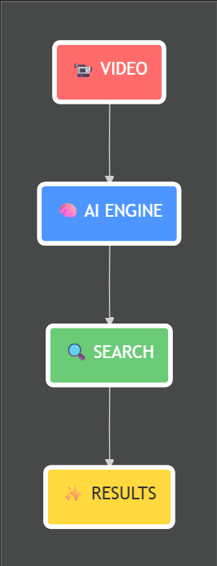
DATAFLOW DIAGRAM

Slide 10
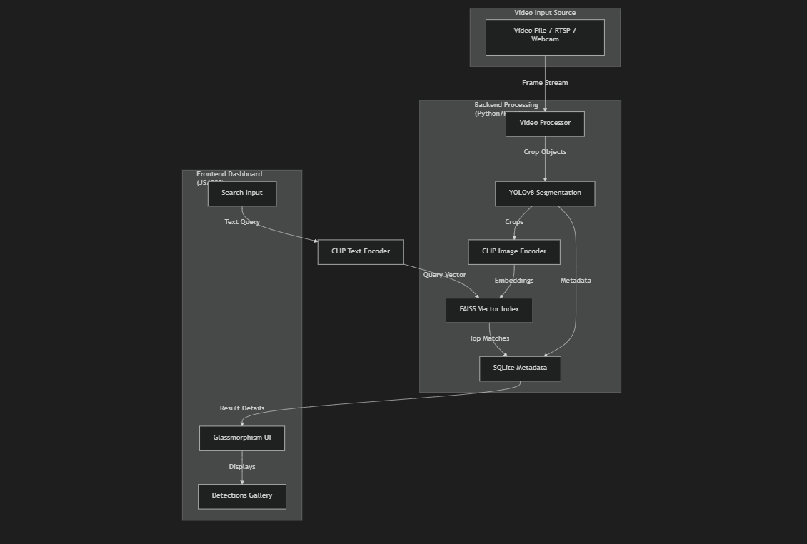
SYSTEM DIAGRAM

Slide 11
CONCLUSION
In conclusion, the proposed CCTV Footage Analysis System provides an efficient and automated solution for handling large volumes of surveillance data. By leveraging Computer Vision and Deep Learning, it reduces the need for manual monitoring and enables quick interpretation of video content through structured, timestamp-based descriptions. This improves accuracy, saves time, and enhances decision-making in critical situations. Overall, the system contributes to smarter and more effective surveillance, making it highly valuable for security, traffic management, and crime investigation applications

