Slide 1
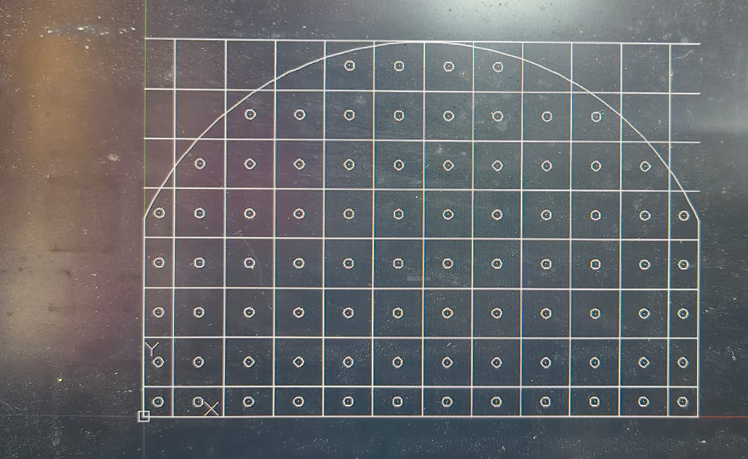
Burn Cut Blast Design
& Performance Analysis
Underground blast design in AutoCAD with Excel calculations and safety checks
Prepared by
Lakshay Soni
Project: Burn cut design with AutoCAD drawings, Excel calculations, and fragmentation, vibration and sensitivity analysis
This deck includes definitions, formulas, calculation tables, AutoCAD screenshots, and blast performance and safety analysis.
Burn Cut in Underground Blasting
Slide 1

Slide 2
Project Overview
Burn Cut in Underground Blasting
What the presentation covers
Main idea
Why this method?
Burn cut is a parallel-hole blasting pattern used in underground excavation.
It creates an initial cavity in the rock face so the remaining holes can break rock efficiently.
The design process in this project uses AutoCAD for geometry and Excel for charge and burden calculations.
Good for hard rock excavation
Improves fragmentation and advance
Works with a single free face
Useful for tunnels and drifts
What is included in this deck?
Definitions and cut types
AutoCAD top, side and front views
Excel inputs, formulas and output tables
Blast performance and safety analysis
Slide 2

Slide 3
Burn Cut: Definition
Burn Cut in Underground Blasting
A core concept in underground drilling and blasting
Definition
Important terms
Burn cut is a drilling pattern in which one or more empty holes are placed near the center of the face and the surrounding charged holes are drilled parallel to them.
The empty holes act as a relief space so the rock can break towards the cavity created by the first blast.
Empty hole
A hole with no explosive to create space
Charge hole
Hole loaded with explosive
Burden
Distance from hole to free face
Key points
Stemming
Inert material at the top of a hole
Parallel holes are used instead of angled holes.
The cut creates the first free face inside the face.
It is especially useful in hard rock.
Relief
Void that helps rock breakage
Slide 3

Slide 4
Burn Cut Design Basics
Burn Cut in Underground Blasting
How the pattern is formed in the face
Geometry of a burn cut
Design constraints
The central empty holes create the cavity. The surrounding holes are fired in sequence so the broken rock moves into the void.
Single free face
Rock type and strength
Hole diameter and depth
Explosive type and load
Sequence of firing
Empty holes
Common hole groups
Charged holes
Cut holes or cut spreader holes
Stoping holes around the cut
Wall, roof and floor holes
Lifters near the floor
Slide 4

Slide 5
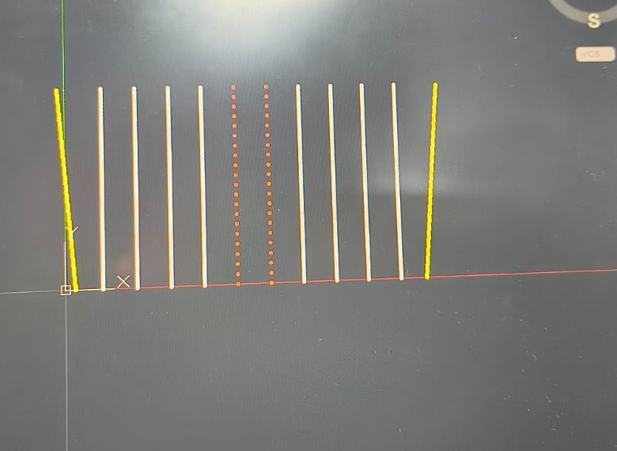
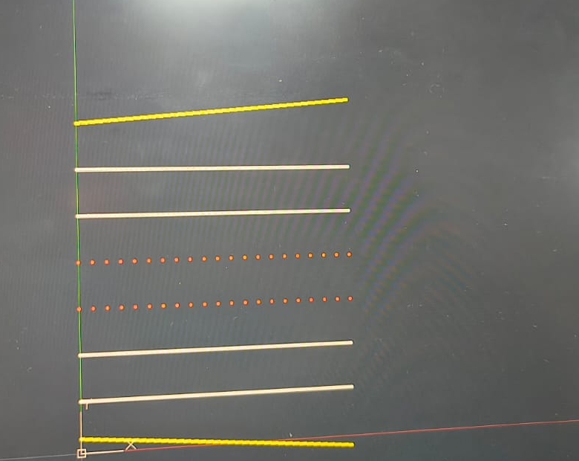
AutoCAD Views Created
Burn Cut in Underground Blasting
Top view, side view and front view of the burn cut pattern
Top view
Side view
Front view
Top view
Side view
Front view
Each view helps verify spacing, alignment, depth and the position of the cut holes.
Slide 5

Slide 6
Front View
Burn Cut in Underground Blasting
Full face arrangement of holes in the burn cut pattern
Front view screenshot
Use this view to show the symmetry of the hole pattern and the curved boundary of the face.
Slide 6

Slide 7
Side View
Burn Cut in Underground Blasting
Hole inclination and level arrangement
Side view screenshot
This view is useful to explain the depth, parallel alignment and the position of the empty holes.
Slide 7

Slide 8
Top View
Burn Cut in Underground Blasting
Plan view of the burn cut layout
Top view screenshot
This view helps in checking spacing, row pattern and the relationship between cut holes and stoping holes.
Slide 8

Slide 9
Excel Inputs and Formulas
Burn Cut in Underground Blasting
The main values used in the burn cut calculation sheet
Input values from Excel
Formulas used
Diameter of empty holes (De)
102 mm
Stemming length
T = 10 × d
Length of holes (L)
3 m
Charge length
Lc = L - T
Charge hole diameter (d)
45 mm
Rock constant (C)
0.6
Charge concentration
Q(kg/m) = 7.85 × 10^-4 × d² × density
Explosive density
0.85 g/cm³
Burden equation
B = 0.88 × q^0.35
RWS
1
Total powder factor
PF = Q_total / rock volume
Slide 9

Slide 10
Cut Section Calculations
Burn Cut in Underground Blasting
Worked values from the Excel sheet for the first four sections
Calculated burn cut sections
Section
Burden B (m)
Side A (m)
q (kg/m)
Q = q×4
Q×L
First
0.153
0.216
0.377
1.509
3.847
Second
0.216
0.459
0.356
1.423
3.627
Third
0.459
0.974
0.754
3.018
7.695
Fourth
0.974
2.066
1.600
6.401
16.323
These values match the Excel calculations used to design the burn cut sections.
Slide 10

Slide 11
Rest Holes and Final Results
Burn Cut in Underground Blasting
Total charge and powder factor from the Excel file
Remaining hole calculations
Final values from Excel
Q(kg/m)
1.351
Cut charge total
31.49 kg
Burden B (m)
0.978
Other holes charge total
60.80 kg
Floor holes
12
Wall holes
8
92.30 kg
Total charge Q_total
Roof holes
8
Stoping holes
Rock volume
58.8 m³
50
Powder factor
1.570 kg/m³
The powder factor gives a quick idea of how much explosive is used per cubic meter of rock.
Slide 11

Slide 12
Fragmentation Estimate (Kuz-Ram Model)
Burn Cut in Underground Blasting
Predicting the mean rock fragment size produced by the existing blast design
Kuz-Ram formula
Inputs used (from this design)
X50 = A × (V0/Qe)^0.8 × Qe^(1/6) × (115/RWS)^(19/30)
X50 = mean fragment size (cm)
A = rock factor (blastability index)
V0/Qe = rock volume broken per kg of explosive = 1 / powder factor
Qe = mass of explosive per hole (kg)
RWS = relative weight strength vs. ANFO (%)
Rock factor, A (assumed: competent hard rock) | 10
Powder factor (from Excel sheet) | 1.570 kg/m³
V0/Qe = 1 / powder factor | 0.637 m³/kg
Total charge / total holes ≈ Qe (avg. per hole) | 92.30 kg / 94 ≈ 0.98 kg
Relative weight strength, RWS (ANFO-equivalent) | 100%
Estimated mean fragment size: X50 ≈ 7.6 cm
This is a design-stage estimate — A and Qe are assumed/averaged values that would normally be refined against site-specific rock mass data and monitored blast results.
Slide 13

Slide 13
Design Sensitivity: Burden vs. Hole Diameter
Burn Cut in Underground Blasting
How the allowable burden changes as charge-hole diameter increases
Calculated values
Burden vs. hole diameter
Burden B (m)
d (mm) | q (kg/m) | B (m)
25 | 0.417 | 0.648
32 | 0.683 | 0.770
38 | 0.964 | 0.869
45 | 1.351 | 0.978
51 | 1.735 | 1.067
64 | 2.734 | 1.251
76 | 3.856 | 1.411
1.41
1.25
1.07
0.98
0.87
0.77
0.65
25
32
38
45
51
64
76
Hole diameter d (mm)
d = 45 mm (highlighted) is the diameter actually used in this design.
Larger holes take a proportionally larger charge, which allows a wider burden — this is the design trade-off between hole count, drilling cost and charge per hole.
Slide 14

Slide 14
Blast Vibration & Safety (PPV Check)
Burn Cut in Underground Blasting
Estimating ground vibration using the USBM scaled-distance approach
Scaled-distance formula
Predicted PPV vs. distance
PPV = K × (D / √W)^(-B)
D = distance from the blast (m)
W = max. charge weight per delay (kg) = 6.4 kg here
K, B = site constants (typical USBM values: K = 1140, B = 1.6)
Distance D (m) | Predicted PPV (mm/s) | Note
5 | 383 | Exceeds mine-structure limit
10 | 126 | Exceeds mine-structure limit
20 | 42 | Within mine-structure limit
30 | 22 | Within mine-structure limit
50 | 10 | Within mine-structure limit
Safe standoff distance for this charge (W = 6.4 kg):
≈ 18 m for a 50 mm/s limit (typical mine structures)
≈ 75 m for a 5 mm/s limit (sensitive/heritage structures)
K and B are standard illustrative USBM values — a real site would calibrate these from monitored test-blast vibration records.
Slide 15

Slide 15
Initiation Sequence & Timing
Burn Cut in Underground Blasting
Delay sequence that controls how broken rock moves toward the cut
Firing sequence, cut outward to perimeter
Cut
(sections 1-2)
Cut
(sections 3-4)
Stoping
holes
Wall
holes
Roof
holes
Floor /
lifters
0 ms
50 ms
100 ms
150 ms
175 ms
200 ms
Sequence direction → each group is fired after the previous one has had time to move rock into the newly created void.
Why this order: the central cut fires first to create a free face inside the heading; stoping holes then break toward that cavity; perimeter (wall/roof) holes shape the profile; floor lifters fire last to clear the muck fully.
Slide 16

Slide 16
Cut Pattern Comparison
Burn Cut in Underground Blasting
How burn cut compares with other common parallel and angled cut types
Cut type | Hole arrangement | Best suited to | Key advantage
Burn cut | Parallel holes; empty relief hole(s) at center | Hard, competent rock; small-to-medium drifts | High advance per round; simple parallel drilling
Wedge (V) cut | Angled holes forming a V toward the face | Medium-strength rock; wider tunnels | Works across a range of rock types, no empty holes needed
Fan cut | Angled holes radiating from a central point | Larger cross-sections; weaker rock | Efficient for large openings
Pyramid (diamond) cut | Angled holes converging to one point | Very hard rock; small drifts | Deep, tight cavity; strong initial relief
Why burn cut was chosen here: it works with a single free face and purely parallel drilling — well suited to hard rock drifting, where accurately aligning angled holes (as wedge or fan cuts need) is harder in practice.
Slide 17

Slide 17
Conclusion
Burn Cut in Underground Blasting
Key takeaways from the design and analysis
Key points
Burn cut is suitable for underground hard-rock blasting.
The empty holes create the initial relief cavity.
AutoCAD helps visualize the hole pattern clearly.
Excel helps calculate burden, charge and powder factor.
Thank you
Lakshay Soni
Slide 17

