Slide 1
Community Health Fair
MEDISCANAI
AI-BASED DISEASE DETECTION SYSTEM
MEDISCANAI.COM
Team: Tanish Sahore | Mandip Singh || Lovely Professional University

Slide 2

THE PROBLEM WITH TRADITIONAL HEALTHCARE
Why Change is Needed
Traditional healthcare systems face critical challenges that impact patient outcomes. Delayed diagnoses often result from overworked physicians and limited diagnostic tools. Rural and underserved communities struggle with limited accessibility to specialist care. Human error in manual diagnosis leads to misdiagnosis rates of up to 12%. Long wait times for appointments and test results delay critical treatment decisions, putting lives at risk.

Slide 3

OBJECTIVES
What MediScanAI Aims to Achieve
• Early Disease Detection: Identify potential health risks before they become critical through predictive AI analysis
• Accessible Healthcare: Provide instant medical insights to users regardless of location or time constraints
• AI-Powered Accuracy: Leverage machine learning algorithms trained on extensive medical datasets for reliable predictions
• Seamless User Experience: Deliver an intuitive interface that simplifies complex health data into actionable insights

Slide 4
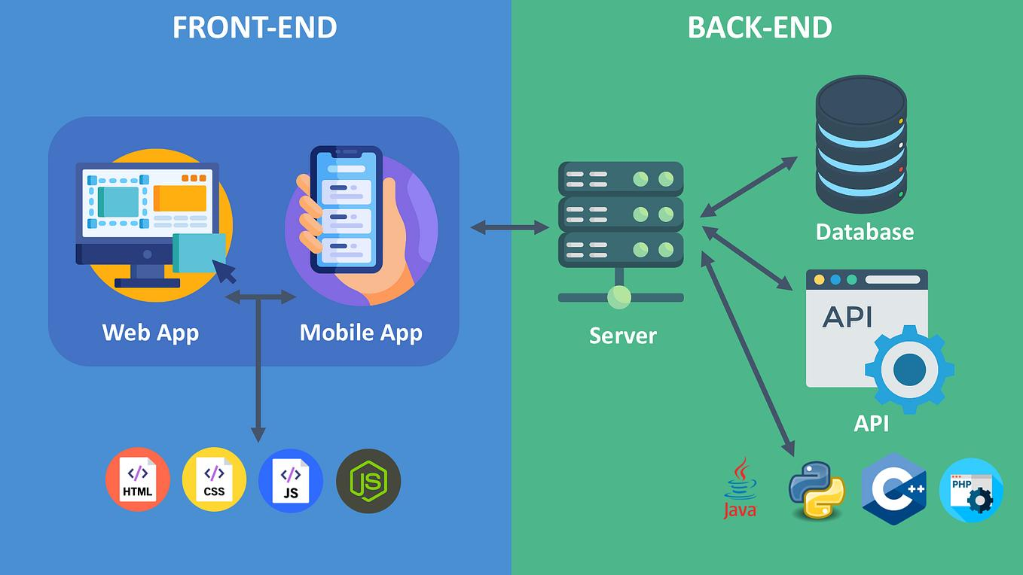
SYSTEM ARCHITECTURE
Technical Infrastructure Overview
Frontend: React.js with responsive UI components and real-time data visualization. Backend: Python Flask API handling requests and business logic. AI Model: Machine Learning algorithms for disease prediction. Database: Secure patient data storage with encryption. Cloud: AWS infrastructure for scalable, reliable deployment.

Slide 5

WORKING OF THE SYSTEM
Step-by-Step Process Flow
  User Input: Patient enters health data including blood pressure, glucose levels, BMI, age, and lifestyle factors through the intuitive dashboard interface.
  Data Processing: The system validates, normalizes, and preprocesses the input data to ensure accuracy and compatibility with the AI model.
  AI Analysis: Our trained machine learning model analyzes the processed data using advanced algorithms to detect patterns and anomalies.
  Risk Assessment: The system calculates disease probability scores and categorizes risk levels (Low, Medium, High) based on AI predictions.
  Results & Recommendations: Users receive comprehensive results including health scores, personalized tips, and doctor consultation suggestions.

Slide 6

AI MODEL EXPLANATION
How MediScanAI Predicts Disease Risk
Our machine learning model processes key health parameters to generate accurate disease predictions:
• Input Parameters: Blood Pressure, Glucose Levels, BMI, Age, Cholesterol, Heart Rate, Family History
• ML Processing: Data normalization → Feature extraction → Neural network analysis → Pattern recognition
• Output: Disease probability score (0-100%), Risk classification (Low/Medium/High), Confidence interval
The model achieves 94% accuracy through ensemble learning techniques combining Random Forest and Deep Neural Networks.

Slide 7

KEY FEATURES OF MEDISCANAI
Comprehensive Healthcare Solutions
Smart Dashboard for real-time health monitoring • AI-Powered Disease Detection with instant analysis • Seamless Doctor Booking integration • Detailed Health Reports with actionable insights • Emergency Alert System for critical situations

Slide 8
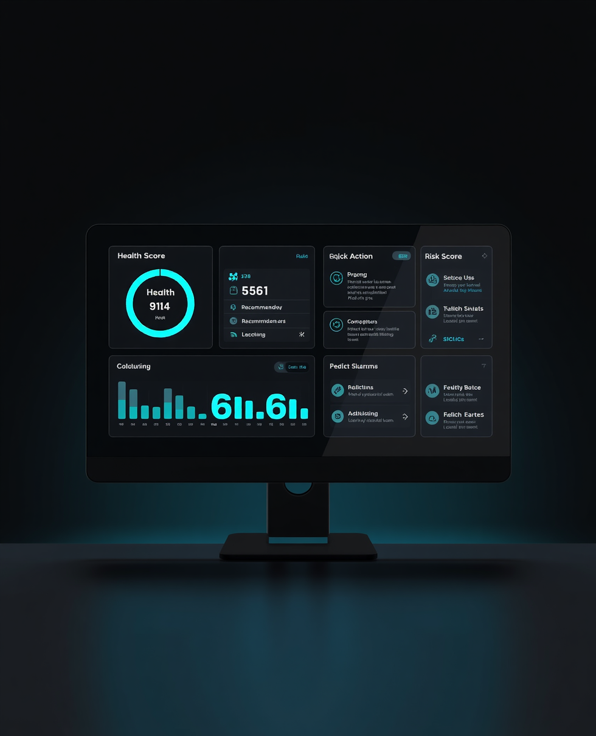
DASHBOARD OVERVIEW
Your Health at a Glance
The MediScanAI dashboard provides a comprehensive health overview featuring a dynamic Health Score (0-100), color-coded Risk Level indicators (Low/Medium/High), Quick Actions for instant disease screening and doctor booking, and Personalized Recommendations based on your health profile and AI analysis.

Slide 9

DISEASE DETECTION MODULE
Smart Health Parameter Input Interface
The Disease Detection Module features an intuitive input interface where users enter key health parameters for AI analysis. Required inputs include Blood Pressure (systolic/diastolic readings), Glucose Levels (fasting and post-meal), Body Mass Index (BMI), Resting Heart Rate, and Cholesterol Levels (HDL, LDL, total). Additional fields capture age, gender, smoking status, and family medical history. The clean form design guides users through each parameter with helpful tooltips and normal range indicators, ensuring accurate data collection for precise disease prediction.

Slide 10
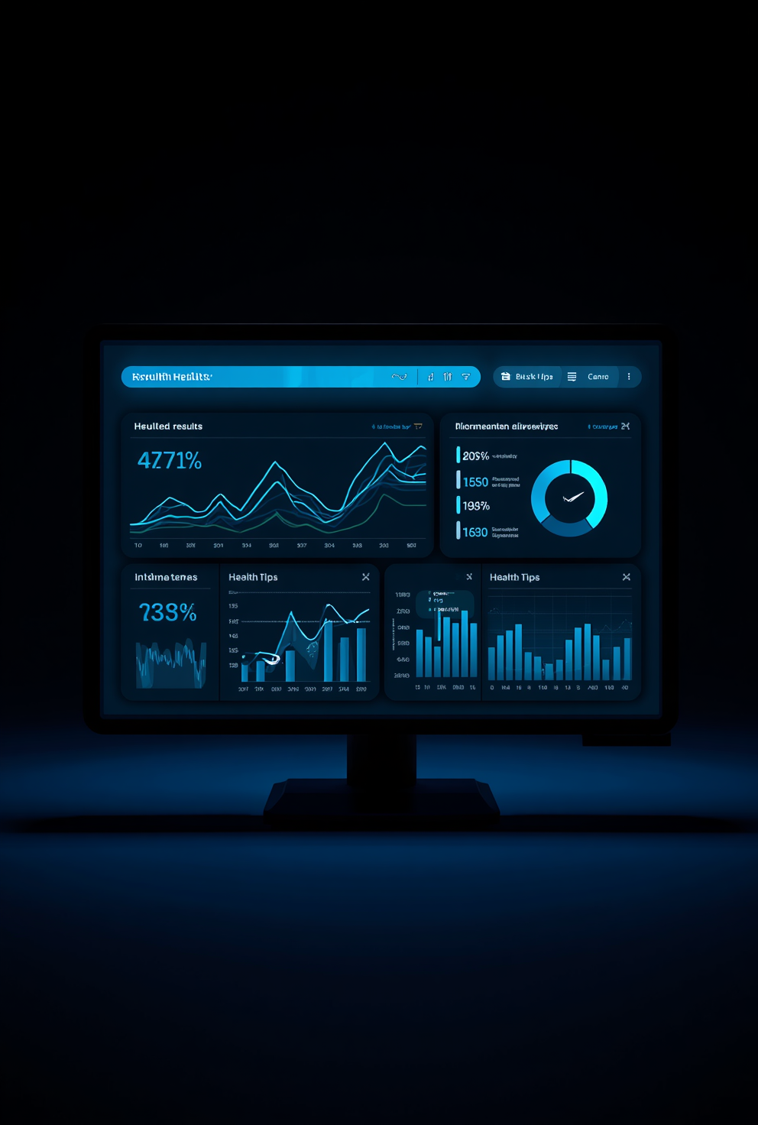
OUTPUT & RESULTS
Understanding Your Health Analysis
MediScanAI delivers comprehensive results through three key outputs: Disease Probability Percentage showing the likelihood of specific conditions based on your health data, Risk Level Classification categorizing your health status as Low, Moderate, or High risk with color-coded indicators, and Personalized Health Tips providing actionable recommendations tailored to your unique health profile. Results are displayed in an intuitive dashboard with visual graphs and easy-to-understand metrics for informed decision-making.

Slide 11

TECHNOLOGIES USED
Our Technical Stack
Frontend: HTML5, CSS3, JavaScript for responsive and intuitive user interfaces. Backend: Python Flask framework for robust API development and server-side logic. AI/ML: Scikit-learn, TensorFlow for disease prediction models. Cloud: AWS EC2, S3, and Lambda for scalable deployment and storage.

Slide 12

ADVANTAGES
Why Choose MediScanAI?
Fast Diagnosis: AI-powered analysis delivers instant results, reducing wait times from days to seconds.
24/7 Accessibility: Access health assessments anytime, anywhere, without scheduling appointments.
User-Friendly Interface: Intuitive design requires no technical expertise, making healthcare accessible to all.
Cost-Effective: Reduces healthcare costs by minimizing unnecessary hospital visits and enabling early intervention.

Slide 13

FUTURE SCOPE
Development Roadmap & Expansion Plans
• Mobile App Development: Native iOS and Android applications for on-the-go health monitoring
• Wearable Integration: Real-time data sync with smartwatches and fitness trackers
• Multi-Language Support: Expanding accessibility to global users with localized interfaces
• Expanded Disease Coverage: Adding detection modules for cardiac, neurological, and rare diseases

Slide 14
THANK YOU!
Project by:
Tanish Sahore | Mandip Singh
12408996 12412592
Lovely Professional University
WWW.MEDISCANAI.COM

