Slide 1
Cyber Security Awareness Program
Be a Cyber Smart
Report and Presentation
For 40 Individuals
Tanish Sahore
12408996
Notes:
Be a Cyber Smart

Slide 2
Introduction
In today’s digital age, cyber security has become a necessity. With growing dependence on smartphones, online banking and social media, individuals face threats such as malware and identity theft. This program was conducted to educate 40 individuals on cyber risks and provide practical strategies to protect personal and financial data.
Notes:
This program raises awareness about growing cyber threats and teaches individuals how to protect their personal and financial data.

Slide 3
Problem Identification
The key problem identified was the lack of cyber security awareness. Most individuals used weak passwords, ignored updates or shared data carelessly. The main cause: insufficient digital literacy and negligence in online practices.
Notes:
The main problem identified was the lack of cyber security awareness caused by weak digital literacy and careless online practices.

Slide 4
Objectives
To spread awareness about cyber threats
To encourage safe practices like strong passwords
To promote responsible use of social media
To ensure secure digital payments
To introduce cyber laws and reporting mechanisms
Notes:
The main objective is to educate individuals on safe online practices, secure digital behavior, and awareness of cyber security.

Slide 5
Steps Taken to Achieve Objectives
1. Planning & Preparation – WNS Content
2. Training Sessions – Threats, passwords, safe browsing, social media safety
3. Practical Demonstrations – Phishing simulation, password tests, case studies
4. Evaluation – Post-program tests
Notes:
The objectives were achieved through structured planning, interactive training, practical demonstrations, and post-program evaluation.

Slide 6
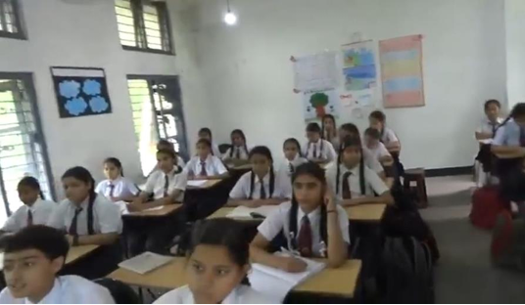
Pictures of training session
Notes:
The geo-tagged picture of Rupnagar Punjab

Slide 7

Notes:
The geo-tagged picture of Rupnagar Punjab

Slide 8
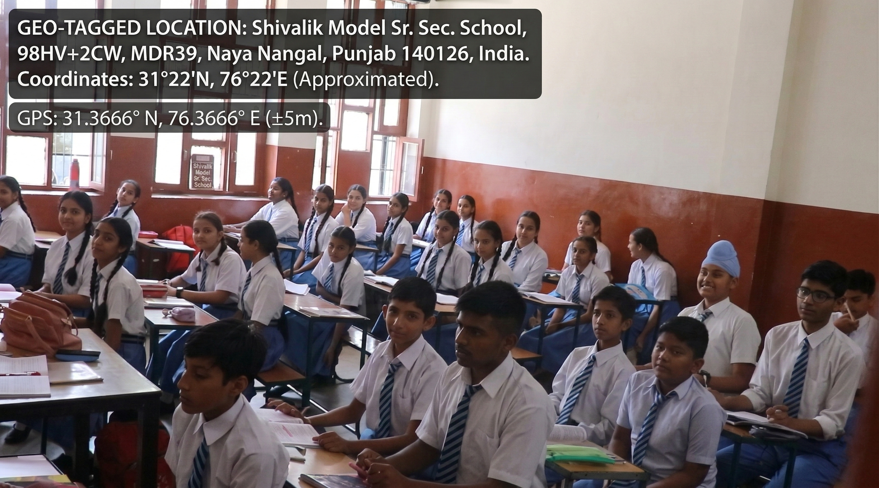
Notes:
The geo-tagged picture of Rupnagar Punjab

Slide 9
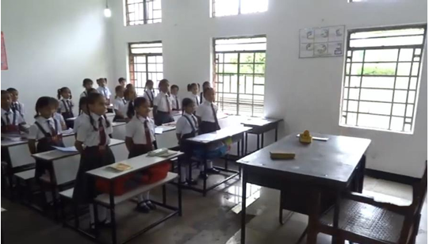
Notes:
The geo-tagged picture of Rupnagar Punjab

Slide 10

Notes:
List of Students

Slide 11
Effectiveness of the Project
The program was highly effective: awareness improved.
Participants secured accounts with stronger passwords.
Many pledged to spread awareness further, creating a ripple effect.
Notes:
Empowered participants, strengthened security, and sparked a ripple of awareness—our project made a lasting impact.

Slide 12
Identified Societal Problems
1. Digital Illiteracy – Lack of basic knowledge in using digital tools safely
2. Financial Fraud – Increasing cases of UPI scams, phishing, and fake websites
Notes:
Digital illiteracy and rising financial fraud demand urgent awareness and smarter cybersecurity habits.

Slide 13
Conclusion
The program empowered 40 individuals with essential cyber safety knowledge. By promoting responsible online behavior, secure transactions, and awareness of laws, it strengthened community resilience. Participants now act as ambassadors of cyber safety.
Notes:
40 people learned important online safety skills and can now spread awareness in their community.

Slide 14
Thank You
Report and Presentation
For 40 Individuals

