Slide 1
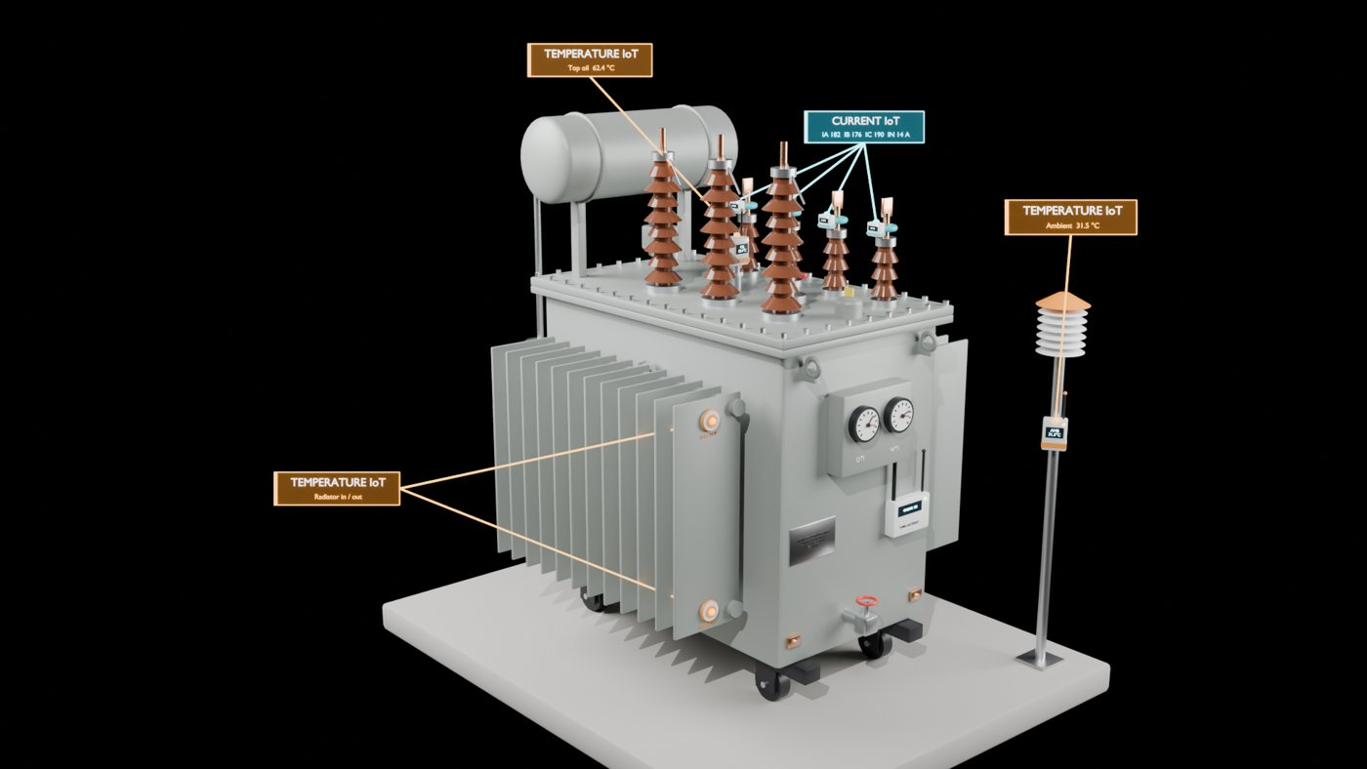
Digital Twin of a CPRI Distribution Transformer
HACKATHON PROJECT
Oil-immersed, 3-phase · 630 kVA · 11 / 0.433 kV · ONAN
See it in 3D. Protect it with CPRI settings. Predict faults with IEC 60076-7.
Notes:
A digital twin of the CPRI reference distribution transformer: a 3D model you can take apart, protection rules using the CPRI OTI and WTI settings, and predictive maintenance built on the IEC 60076-7 thermal model.

Slide 2

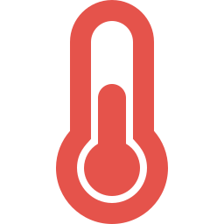

Distribution transformers fail without warning
Faults are found after the fact
Fixed alarms react late
Instruments drift unnoticed
Most distribution transformers are checked on periodic visits. A hot winding or a slow oil leak is noticed only when the unit trips or fails.
An OTI dial alarms at a set temperature. It cannot tell whether the oil is hot from load, a hot day, or a blocked radiator.
A CT, PT or temperature probe that reads 1 % off quietly corrupts every rule that depends on it.
Notes:
Three gaps: problems are discovered after failure, fixed thresholds react late and without context, and measuring instruments drift without anyone noticing.

Slide 3



One twin: see it, protect it, predict it
See it
Protect it
Predict it
A 3D model of the transformer, inside and out. Sensors glow by status and the camera flies to the part that needs attention.
Alarm and trip rules on CPRI settings: OTI 95 / 105 °C and WTI 105 / 120 °C, plus overload and voltage limits.
IEC 60076-7 thermal model, insulation ageing, temperature-corrected oil leak, tank pressure and instrument drift.
Today the twin plays simulated sensor data. CSV upload and a readings API let real instrument data take its place.
Notes:
The twin combines three things in one dashboard. The data is simulated for the hackathon, but the backend accepts uploaded CSVs and posted readings, so real instruments can feed it.

Slide 4


Scales in software, not in sheet metal
No rig to build
Real-unit accuracy
One code, any unit
A physical IoT model must be built, wired and calibrated for every transformer. Ours needs a new config file, not new hardware.
A scale model's sensors measure the scale model. Our twin runs IEC 60076-7 physics on the real unit's ratings and CPRI settings.
Every twin shares the same 3D engine, protection rules and dashboard. Twinning the next transformer costs zero fabrication.
A physical model twins one transformer. Software twins the whole fleet.

Slide 5
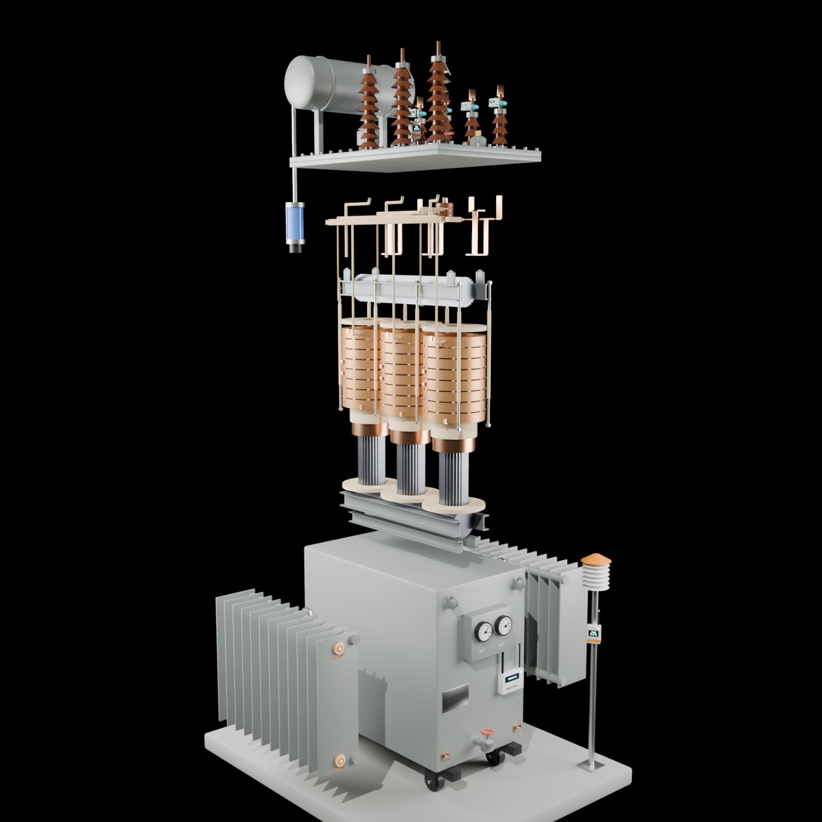
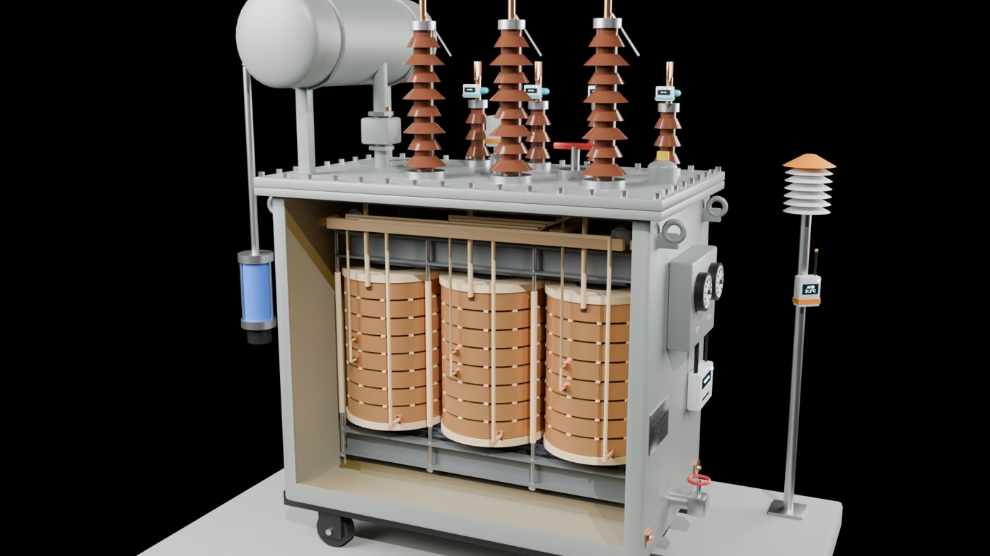
The 3D twin: take it apart, look inside
Blender Python script → GLB → three.js in the browser
Stepped 3-limb core, HV disc and LV foil coils, tap switch, oil
Solid, Cutaway and X-ray views; Explode / Assemble animation
Sensors glow by status; the camera flies to the alarming part
Notes:
The model is generated by a Blender script, so it can be rebuilt and re-exported. Exploded on the left, cutaway on the right. In the dashboard the camera automatically focuses on whichever monitor is worst.

Slide 6



System architecture
Field instruments
FastAPI backend
PostgreSQL
Dashboard
Simulated IoT: CTs, PTs, OTI, WTI, winding probe, ambient, pressure, oil volume
Protection rules, IEC 60076-7 analytics and the two-timebar model
Readings, alerts and the maintenance sheet
3D twin, monitor cards, graphs, two timebars, signal list
REST API /api/twin2/timebar/1 and /2 · /api/alerts · /api/maintenance · CSV upload and export of every dataset
Notes:
Instruments feed the FastAPI backend, which evaluates the rules and analytics and stores results in PostgreSQL. The dashboard reads the two-timebar payloads and alerts over REST.

Slide 7
Every simulated IoT maps to a real instrument
Simulated signal | Real-world instrument | On a real DT?
LV current and voltage | LT CTs and a DT energy meter or monitoring unit (DTMU) | Yes
11 kV current and voltage | 11 kV CT and PT with a meter or relay | At the feeder / RMU
20 ms per-cycle RMS | Class A power-quality analyser (IEC 61000-4-30) | Survey only
Top oil (OTI) | OTI dial, or PT100 in a thermowell with 4–20 mA | Usually
Winding (WTI) | WTI dial with image heater on an LV CT, or electronic WTI | Uncommon < 1 MVA
Winding hot spot | Fibre-optic probes cast into the winding | Test units only
Ambient | Shielded PT100 or thermistor | With a DTMU
Tank pressure | Pressure-relief valve; pressure transducer | PRV common
Oil level | Magnetic oil-level gauge with low-level switch | Yes
Notes:
Each simulated signal has a real counterpart used in Indian DISCOM practice. The right column says honestly how common it is on a real distribution transformer: fibre-optic hot-spot probes, for example, are only fitted in test units.

Slide 8
From simulated IoT to real hardware
IoT in the twin | Manufacturer and model | Notes
LV current R / Y / B | Siemens 4NC5432-2DH21 (1000/5 A, class 0.5 CT) | Three CTs, one per phase
Loading, LV voltage, current RMS | Schneider PowerLogic PM8240 (METSEPM8240) | Meter that feeds the twin
11 kV voltage | Arteche VRJ-17 outdoor VT | 11 kV ratio set by maker
Top oil (OTI) | Qualitrol RTD 103-010-01 | Fits the OTI pocket
Ambient | Vaisala HMP155 | Shielded temperature channel
Winding (WTI) | Qualitrol 130 Thermal Plate | Needs a 1 A CT input
Winding hot spot | Qualitrol / Neoptix T2 T2S-01-20-0 (fibre optic) | Fitted at manufacture
Tank pressure | WIKA S-20 pressure transmitter | Range to be specified
Oil level / leak | Qualitrol 039 system, remote unit 039-018-01 (CS-48120) | Plus a tank-mounted gauge
CT / PT accuracy | Fluke 1777 Power Quality Analyzer | Portable reference
Probe accuracy | Fluke Calibration 1524 readout | With a reference probe
Serial to Ethernet | Moxa MGate MB3170I-T | Modbus RTU to TCP
Candidate hardware, not a final procurement list: full order codes depend on the installation. Hot spot, ageing and leak analytics stay in software.

Slide 9
Two timebars: fast physics and slow wear
Timebar 1 · one day
Timebar 2 · one year
15 Jul 2026, fast signals
1 Jul 2026 – 30 Jun 2027, daily
20 ms
Voltage and current, 3 phases, both windings
1 day
Oil volume balance (leak detection)
1 s
Top oil, WTI, measured winding, IEC model
1 day
CT, PT and temperature-probe deviation
1 min
Ambient, tank pressure, precision devices
Notes:
Timebar 1 plays one day at the rates real protection needs: 20 ms electrical, 1 s thermal, 1 minute for slow signals. Timebar 2 plays a year of daily readings for problems that build over months: oil leaks and instrument drift. Each has its own player and speed control.

Slide 10




Protection rules on CPRI settings
Top oil (OTI)
Winding (WTI)
95 °C alarm · 105 °C trip
105 °C alarm · 120 °C trip
CPRI setting
CPRI setting, absolute temperature
Loading
Voltage
> 100 % warning · > 120 % for 2 s trip
11 kV (MV): ±6 % · 433 V (LV): ±6 %
Hackathon setting; I_rated 33.07 A HV, 840 A LV
Rule 54 and CEA; HV would be +6 / −9 %
Thermal TRIP = OTI trip OR WTI trip. The two are judged independently and never averaged. Winding rise over ambient is kept for analytics only.
Notes:
All thresholds come from the CPRI reference transformer. OTI and WTI each trip on their own. The 120 % for 2 seconds overload trip is the setting the hackathon asked for. Voltage limits follow Indian Electricity Rule 54.

Slide 11
Every limit traces to a standard
Parameter | Limit used in the twin | Source
Voltage, LV and MV | Under −6 % · Over +6 % | Indian Electricity Rules, Rule 54; CEA regulations
Voltage, HV | Under −9 % · Over +6 % | Indian Electricity Rules, Rule 54; CEA regulations
Top oil (OTI) | 95 °C warning · 105 °C critical | CPRI pre-commissioning test checklist
Winding (WTI) | 105 °C warning · 120 °C critical | CPRI pre-commissioning test checklist
Loading | 120 % permissible limit | Specified by our project mentor
Impedance | Z = 4 % | BIS, IS 2026
Short-circuit current | Isc = I_rated × 100 / Z % → 827 A (11 kV) · 21 kA (433 V) | Derived from IS 2026 impedance
Rated current: I = S / (√3 · V) = 33.07 A on 11 kV and 840 A on 433 V for the 630 kVA unit. Thresholds live in config, so a different unit or standard is a config change, not a code change.

Slide 12
Predicting winding trouble with IEC 60076-7
Load factor
K = I / I_rated
Top-oil rise (with first-order lag)
ΔT_Ou = ΔT_Or · ((1 + R·K²) / (1 + R))^x
Hot spot (measured top-oil method)
T_H = T_O + H·g_r·K^y
Winding residual
R_W = measured − expected; flag at ≥ 1.5 K and growing
Relative ageing
V = 2^((T_H − 98) / 6), L_EQ = Σ V·dt
Cooling flag
measured top-oil rise > 1.15 × model over 30 min
Flags never trip: WINDING_EXCESS_HEATING, ACCELERATED_THERMAL_AGEING (60-min mean V > 1) and COOLING_DEGRADATION go to the maintenance sheet.
Notes:
The IEC 60076-7 model says what the winding should be at this load and weather. If the measured winding runs 1.5 K or more above that and the gap keeps growing, we flag excess heating. The ageing rate doubles every 6 K above 98 °C, which is why a few hot hours matter.

Slide 13


Oil leaks, tank pressure and instrument drift
Oil leak
Tank pressure
Precision devices
V_exp = V_ref · [1 + β(T_oil − T_ref)]
R = V_meas − V_exp
dV = β · V_oil · (T1 − T0)
P1 = P0 · (T1/T0) · (V_gas0/V_gas1)
dev = |meas − ref| / ref × 100
per phase: R, Y, B
OIL_LEAK
R < −3 L
WARNING
185 kPa or 30-min trend
MAINTENANCE
dev > 1 %
MINIMUM_OIL_LEVEL
V_meas < 288 L
LIMIT
230 kPa (assumed)
Temperature-corrected, so oil shrinking on a cool night is not read as a leak.
Sealed-tank gas law in kelvin; gauge = absolute − atmospheric.
CT, PT and temperature probe are recalibrated when any phase drifts.
Notes:
Oil volume is compared with what it should be at today's oil temperature, so normal thermal contraction is not mistaken for a leak. Tank pressure uses the ideal gas law for a sealed tank. Precision devices are compared with a reference per phase; more than 1 % calls for recalibration.

Slide 14
Demo: one day on timebar 1
Status
00:00
06:00
12:00
18:00
24:00
03:20
Light-load over-voltage, primary +7.3 % for 88 s
OVERVOLTAGE
05:12
Winding probe drops out for 20 s
Data error, no trip
07:45
2 s voltage dip, primary −8.8 %
UNDERVOLTAGE
10:08
Feeder transferred on (112 %), then a 128 % surge
Overload trip
11:00
Radiator fans fail and a winding duct blocks
OTI trip at 105 °C
13:43
Pressure peaks at 201.8 kPa, 28 kPa below the limit
PRESSURE_WARNING
17:30
Evening peak near 117 %, one radiator bank still out
WTI trip at 120 °C
20:42
Current device Y phase drifts past 1 %
PRECISION_CURRENT
Notes:
Every rule fires at least once in the simulated day. Highlights: the overload trip at 10:08, the cooling failure that ends in an OTI trip, the pressure peak caught 28 kPa below the limit, and the evening WTI trip.

Slide 15
Demo: one year on timebar 2
365
2
3
days
oil leaks
precision devices
of daily oil-volume and precision-device readings, 1 Jul 2026 to 30 Jun 2027
The first is caught by the −3 L leak alarm and repaired. The second reaches the minimum oil level before repair.
CT, PT and temperature probe each drift past 1 % two or three times, about every four months, and are recalibrated.
Each signal lands in the maintenance sheet with its time, the recommended action and whether it was resolved.
Notes:
Timebar 2 shows slow wear. One leak is caught early by the tolerance alarm; the other is allowed to reach the minimum oil level to show that flag. Instrument drift is caught and recalibrated a few days later.

Slide 16
Ask the twin: chatbot and LLM
Grounded chatbot
LLM explains
Guardrails verify
Answers at both timebar cursors: oil, winding, repairs, what needs maintenance. Every answer cites check numbers.
Gemini 2.5 Flash turns the evidence into plain language. JSON mode, temperature 0; the API key stays on the server.
Every fact the LLM states is checked against the evidence. On failure or timeout, the grounded answer is shown.
The engine computes every risk score. The optional LLM only explains it and never changes a number.

Slide 17
DIGITAL TRANSFORMER TWIN
Thank you
Notes:
Close with the path from prototype to a field-ready twin, then switch to the live dashboard.

