Slide 1
AI-POWERED DYNAMIC RISK ASSESSMENT FOR P2P INSURANCE
TEAM 56
TARS
FinTech
RV College of engineering

Slide 2
WHAT IS P2P INSURANCE?
Peer-to-peer (P2P) Insurance is a community-driven model where individuals with similar insurance needs join groups and pool their money to cover claims. Instead of relying entirely on traditional insurance companies, members contribute to a shared fund and approve payouts collectively.
This approach reduces costs by
Cutting out intermediaries
Increases transparency through group involvement and fosters trust among participants.
Any unused funds can be refunded or rolled over, making it a cost-effective and fair alternative to conventional insurance.

Slide 3


PROBLEM STATEMENT
LIMITATIONS OF TRADITIONAL RISK MODELS
Traditional insurance models are rigid and lack the flexibility to adapt to the evolving, real-time needs of Peer-to-Peer (P2P) insurance platforms. They struggle to incorporate community-based feedback, real-time data streams, and user behavior insights effectively.
Static and Inflexible
Outdated risk models fail to adapt to rapidly changing conditions and user behaviors.
Lack of Contextual Data
Absence of real-time data and community insights leads to inaccurate risk profiling.

Slide 4
REAL-TIME DATA AND COMMUNITY INSIGHTS
Predictive Analytics
Predictive Analytics for Risk Profiling AI Models Rooted in Historical Data Using a machine learning model trained on static inputs like health records, claims history, demographic data, and lifestyle factors to predict a credible Risk_score. Enable periodic updates to the model using anonymized historical data from the P2P network.
Crowdsourced Intelligence
Crowdsourced Intelligence in Underwriting Informed by Experience Leverage insights from the P2P community, such as aggregated claims trends and shared experiences, to fine-tune underwriting policies. Use community-based metrics (e.g., average risk scores for similar profiles) to benchmark individual assessments.

Slide 5
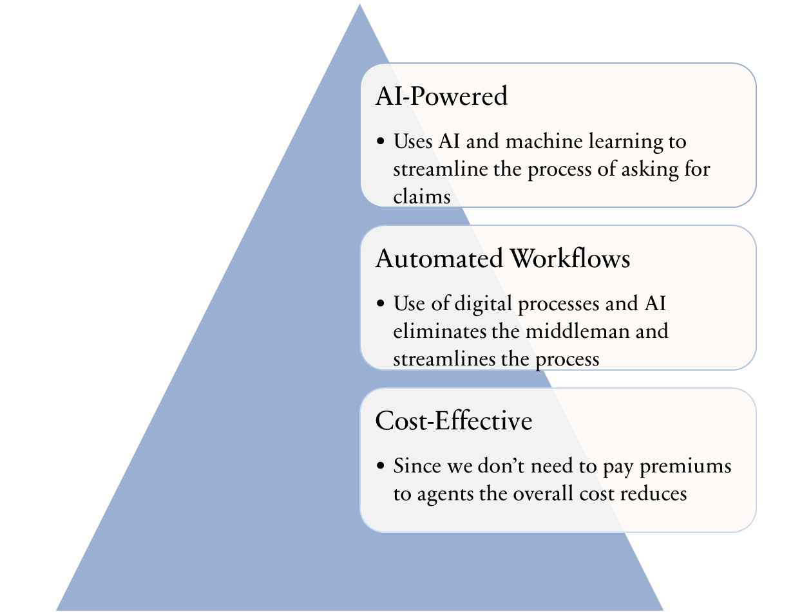
EFFECTIVE DELIVERY TECHNIQUES

Slide 6
OUR APPROACH
DATA COLLECTION - Datasets have been collected from kaggle and modified , for individuals with the following specifications-name,age,gender,occupation,preexisting health condition,smoker,bmi,family history(of disease),claims,policy type,income.
DATA PREPROCESSING - We have performed data cleaning and have converted categories of datas to numbers for easy accessibility.Normalisation of data has also been done to facilitate scaling and processing.
Ex: for family history-Cancer:5 (very high).Heart Disease:4 (high)Stroke:4 (high),Kidney Disease:3.5 (moderately high),Diabetes:3 (moderate),None:0 (no risk)
Divide the dataset into training and test aset and use it to train a regression model the aim of which is to assign a risk score to individuals based on the above parameters.This level assigned will determine the level of credibility in asking for claims.

Slide 7
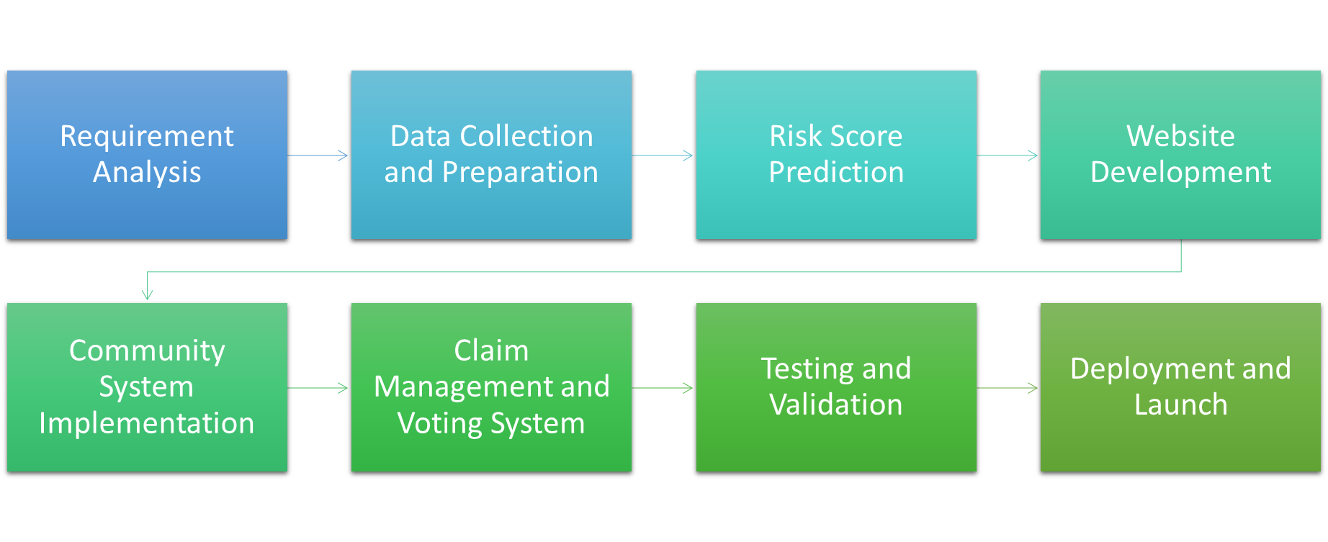
METHODOLOGY

Slide 8
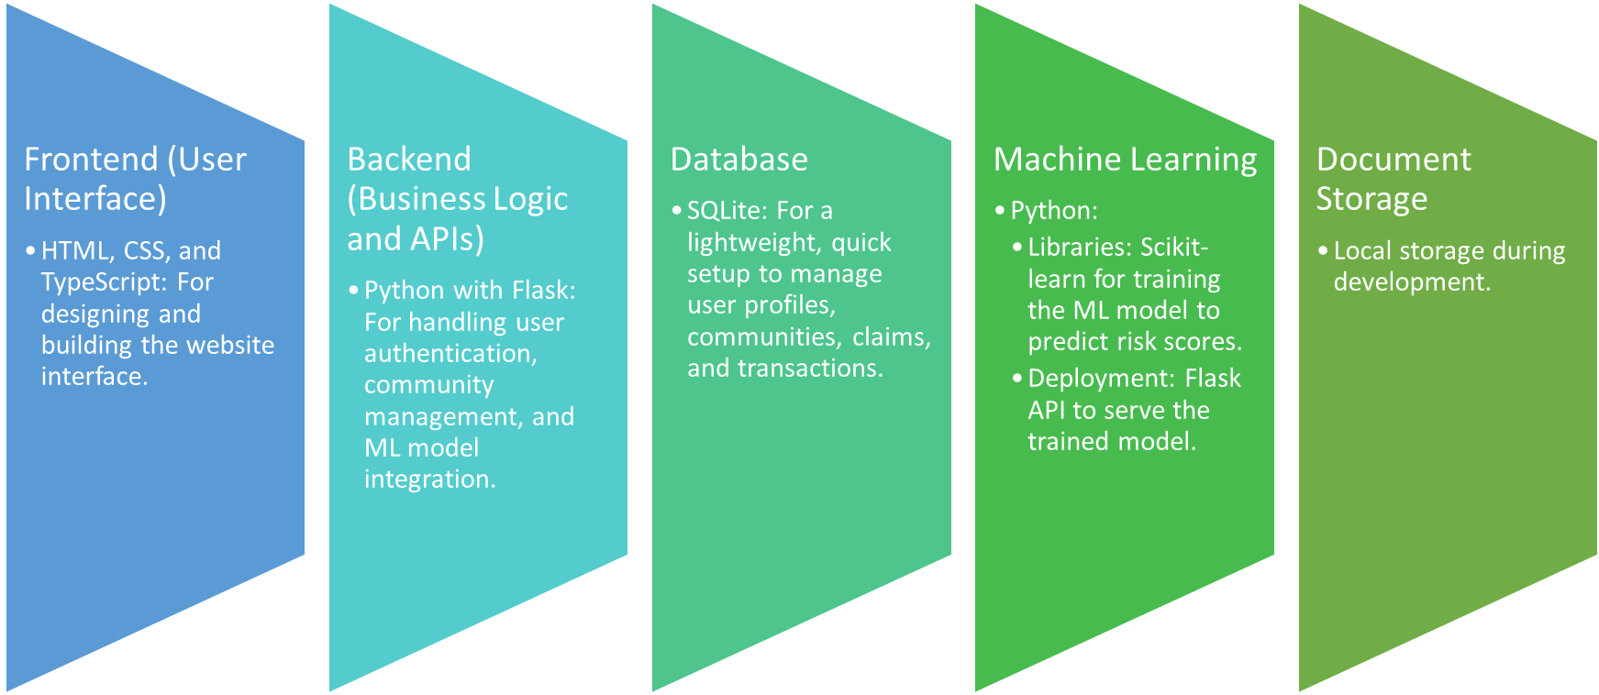
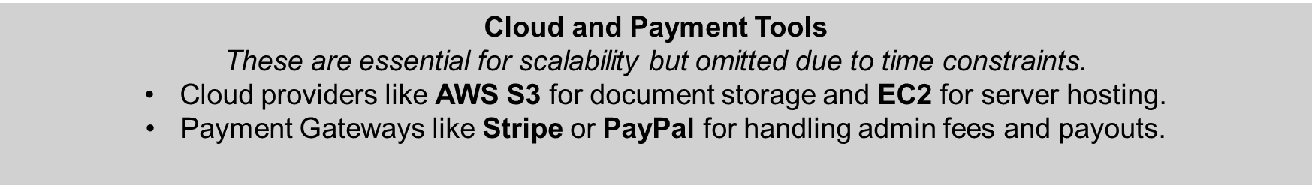
TECH STACK

Slide 9
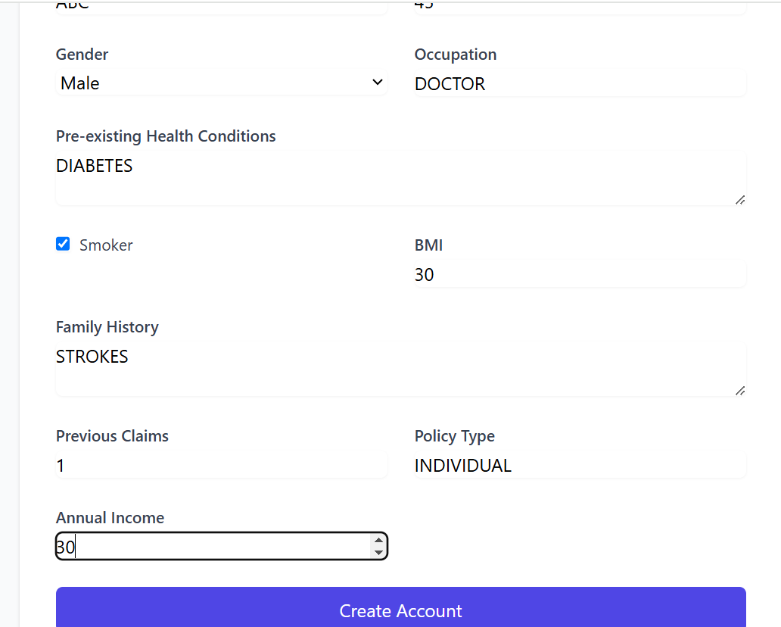
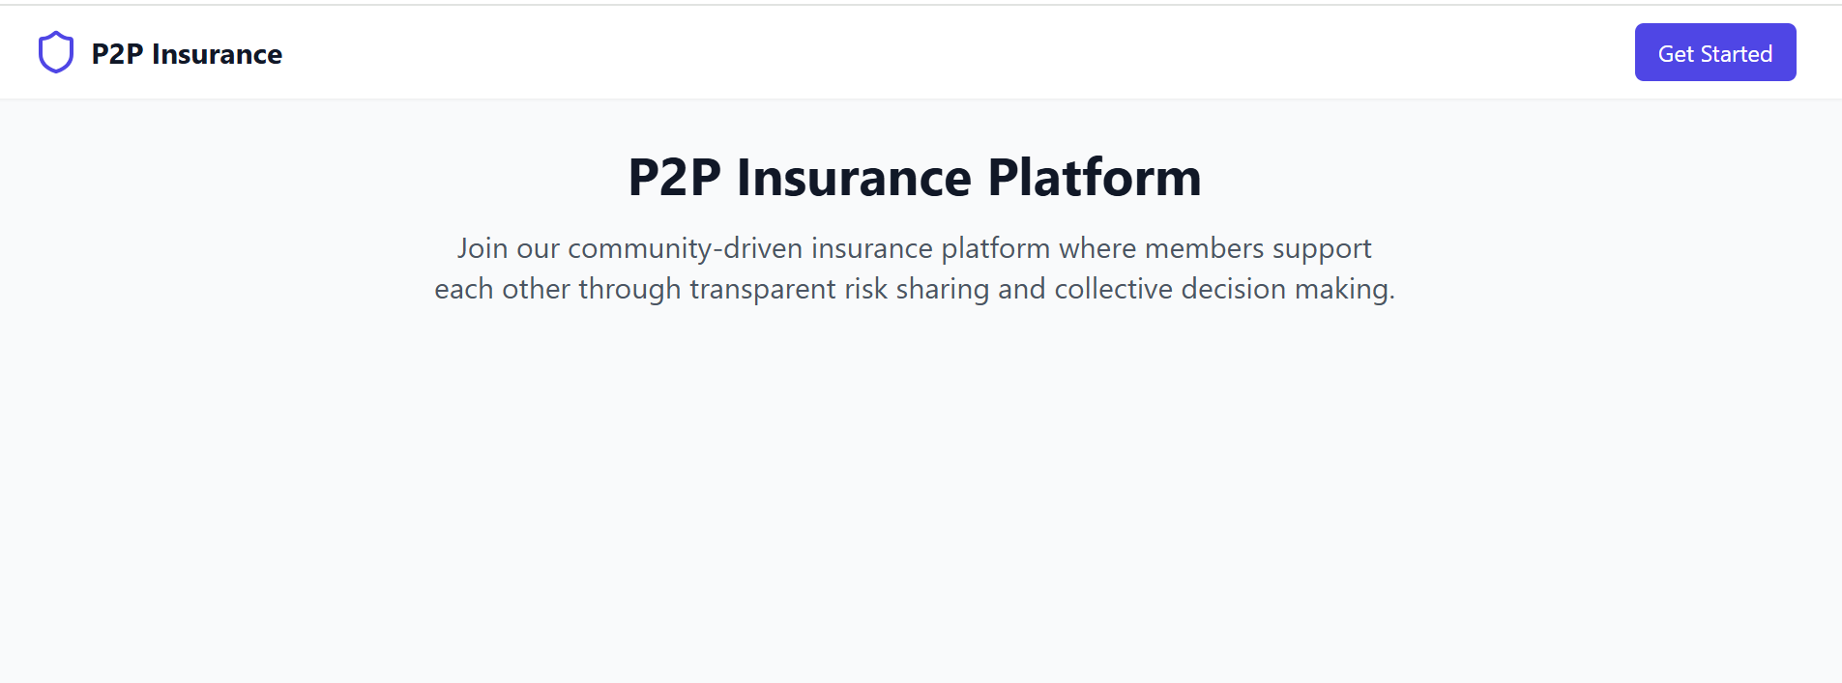
OUR PROGRESS AT CHECKPOINT 2

Slide 10
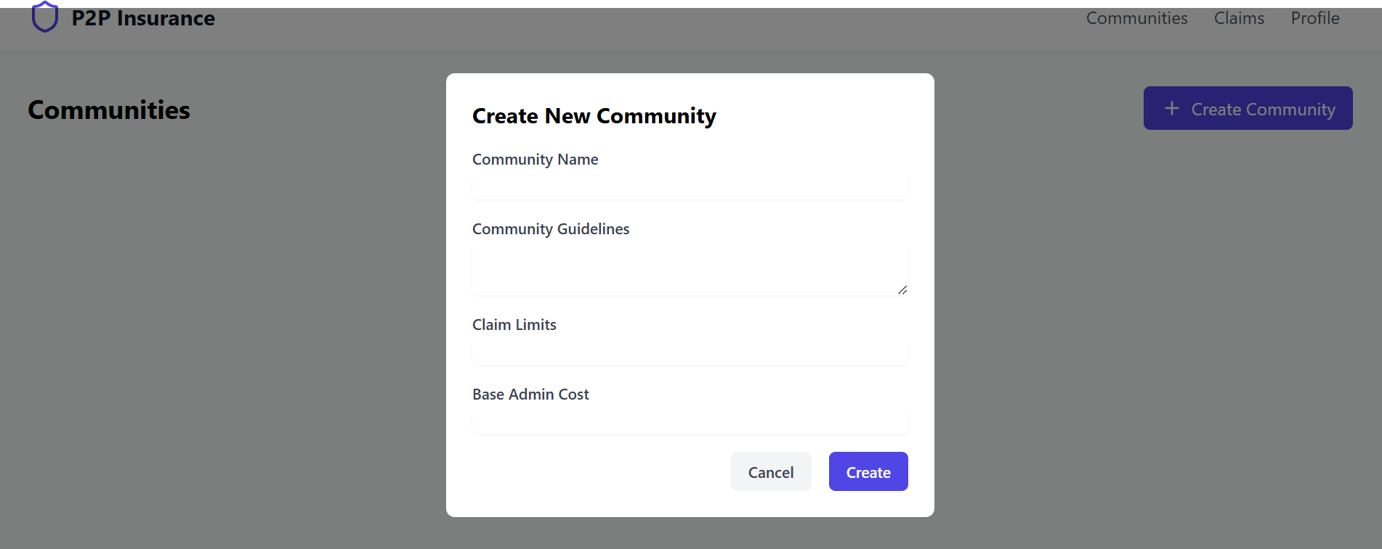
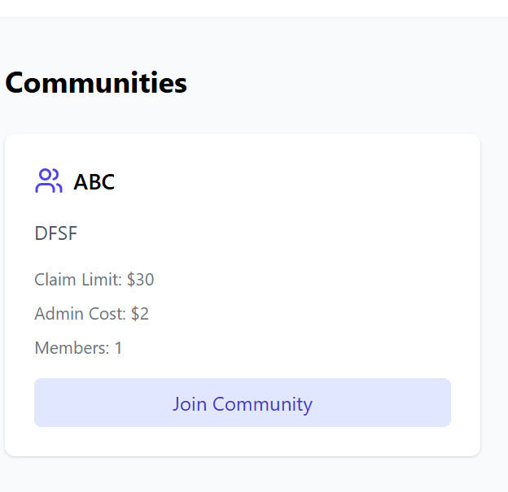

Slide 11
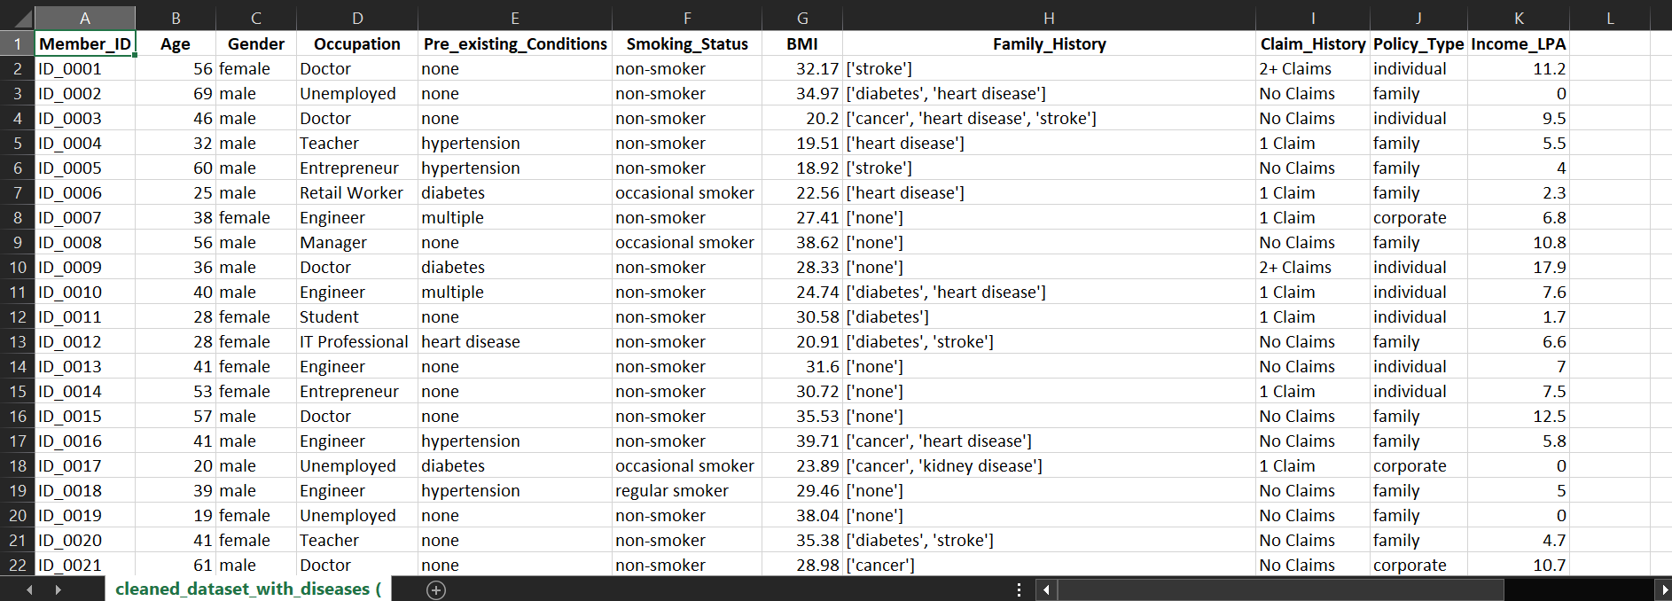
SAMPLE DATASET FOR HEALTH INSURANCE
Number of records: 1000

Slide 12
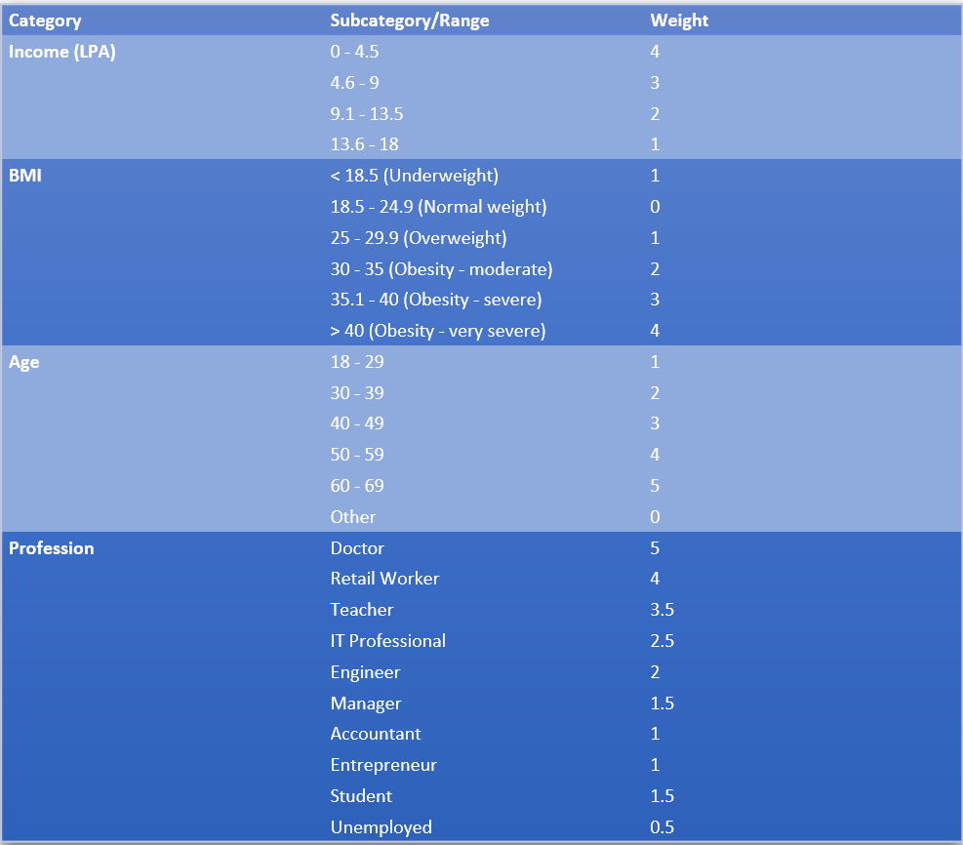
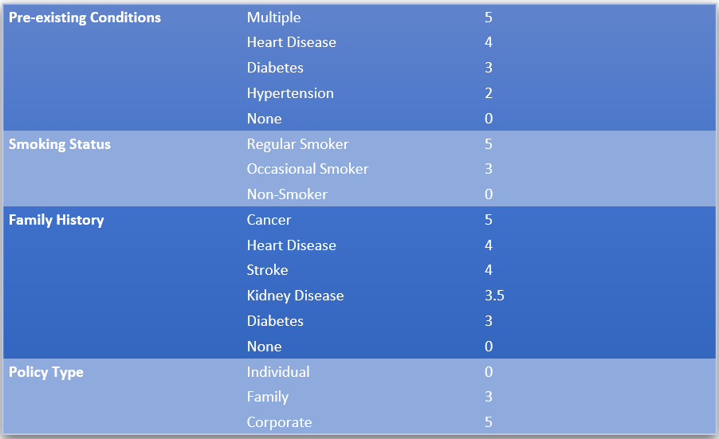
WEIGHTS TAKEN
Additionally, each category has its own separate weight.

Slide 13
WHAT NEXT?
1.Tonight, our focus will be on finalizing an algorithm to train the dataset effectively, enabling the development of a machine learning model capable of predicting risk scores. This model will analyze input data and generate a risk score based on specific criteria. Once the model is trained and evaluated, we will proceed to integrate it into a user-friendly front-end interface.
2.The front-end will feature a system where users can input responses to a series of well-defined questions, designed to assess the factors contributing to the risk score. Based on these responses, the machine learning model will calculate and display the predicted risk score in real-time.
3.Additionally, we will develop a voting system to streamline the approval process for claims. This system will allow relevant stakeholders to review the predicted risk score and cast their votes on whether a claim should be approved or rejected, ensuring a collaborative and transparent decision-making process. The integration of the model with the front-end and the voting mechanism will make the system intuitive and efficient for all users involved.

Slide 14
PRODUCT AT THE END OF CHECKPOINT 3
At the end of checkpoint 3 we have successfully trained the model to calculate the risk score based on parameters entered during profile creation
A website has been deployed which calculates the score based on the model and also gives some recommendations.Lastly a create community option is present which enables the user to create/join a community and request for a claim.
This creates a poll for its approval.

Slide 15
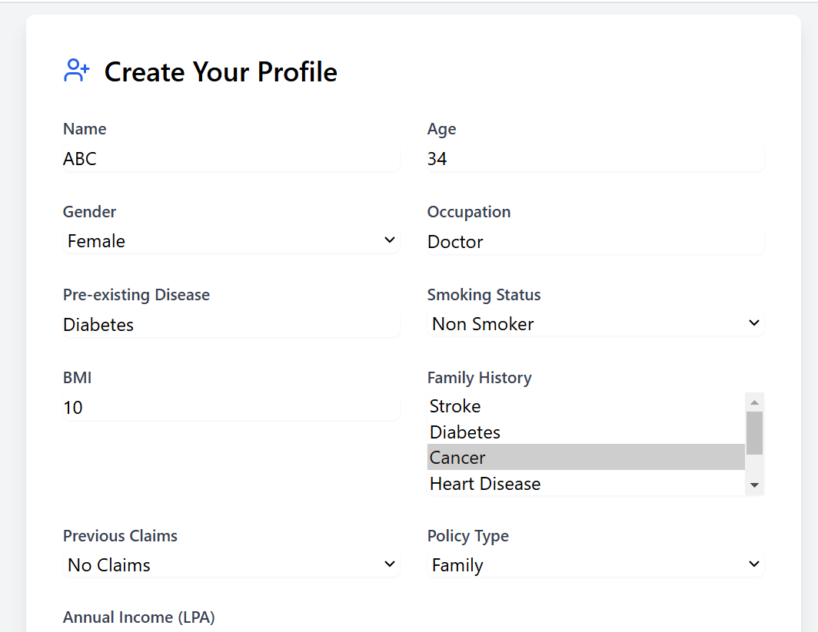
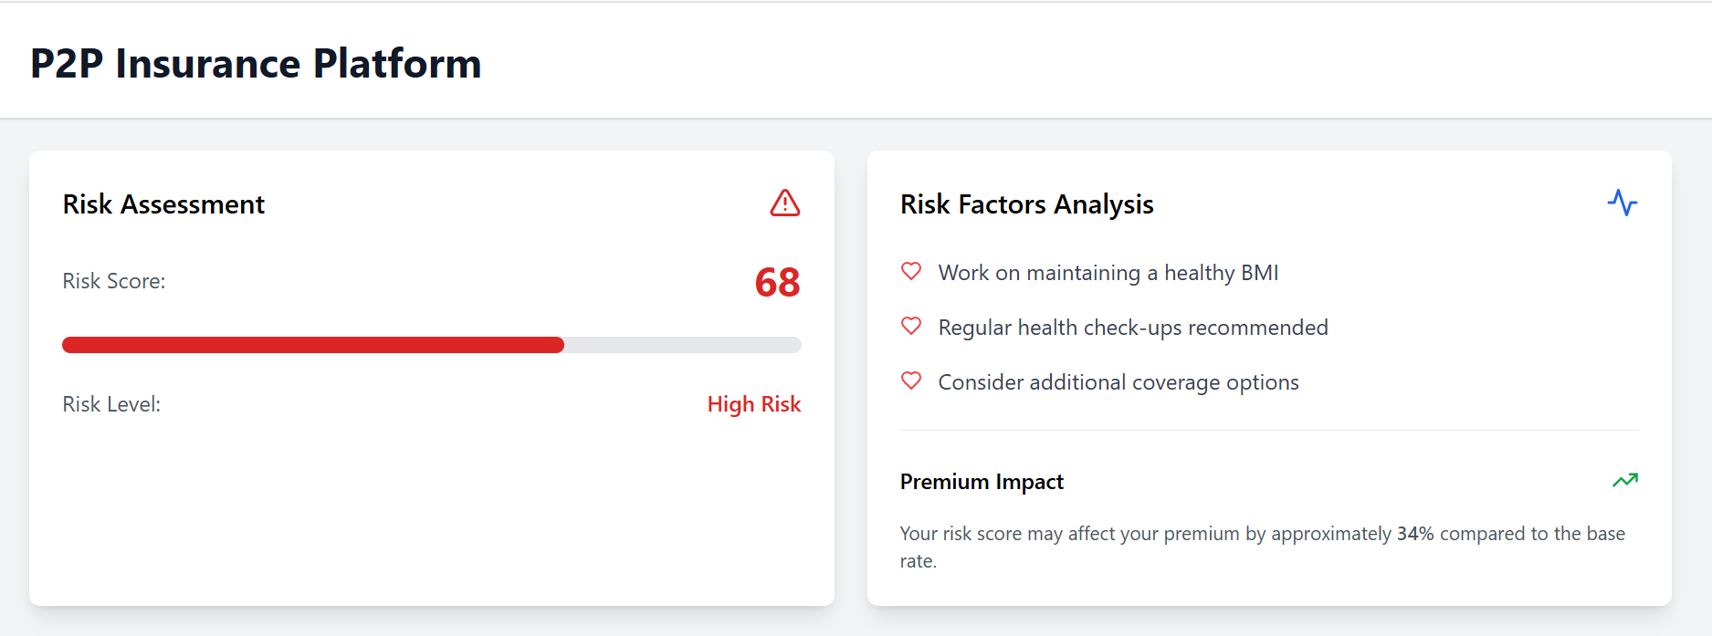

Slide 16
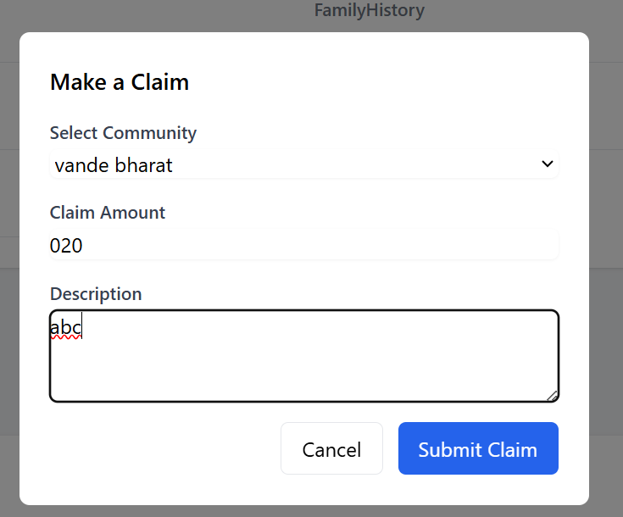
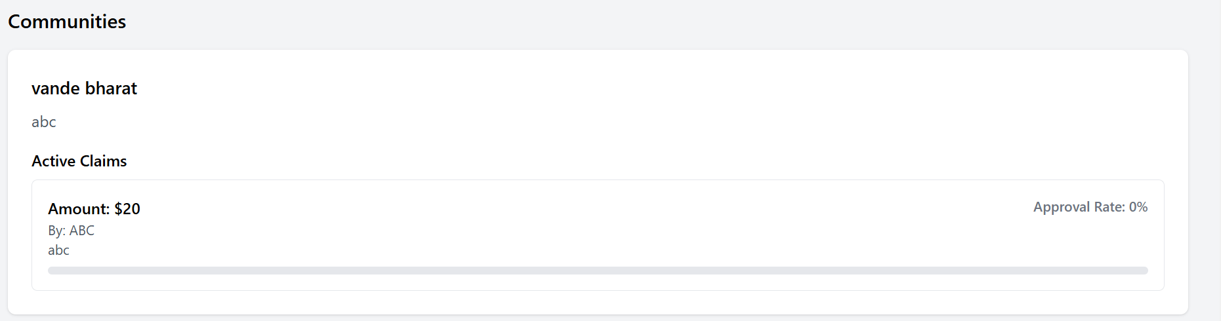

Slide 17
BUILDING TRUST
Clearly communicate risk factors to concerned community
Transparency
Ensures fair pricing that in accordance with user profiles and behaviors.
Fairness
Has a proper protocol for claim processing
Accountability

Slide 18
Future Ideas to Implement:
01
Expansion of Insurance Types
Home Insurance
Vehicle Insurance
Travel Insurance
Small Business Insurance
02
Community Recommendations
Suggest communities based on:
Risk scores.
User demographics and interests.
03
Approval Process for Joining Communities
Allow community creators or admins to review and approve new members before joining
04
Risk-Based Claim Validation
Introduce an AI model to assist in initial claim verification by cross-referencing data patterns.
05
Advanced Voting System
Introduce weight-based voting:
Users with lower risk scores have greater voting influence.
06
Reward System
Implement a reward mechanism for users with consistently low-risk behavior (e.g., discounts on admin costs or extra benefits).

Slide 19
THANK YOU
Team TARS
Surabhi R
Tanisha Srivastava
Surya Prakash G.
Surya Narayan

