Slide 1
Shell Bootcamp 2024 3 Reflections for Week #2<>
<Tanisha Agrawal>
Date : 30-Aug-2024

Slide 2
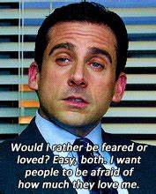
About Me
Everything in life happens for a reason

Slide 3

My learnings from this week!

Slide 4

Learning 1 | My takeaways
Soft Skills Day 1:
Types of people in a team(CART example)
Neuroplasticity
Etiquette
POWER technique
I see people manage their work-life with such grace and mannerism in the office.

Slide 5
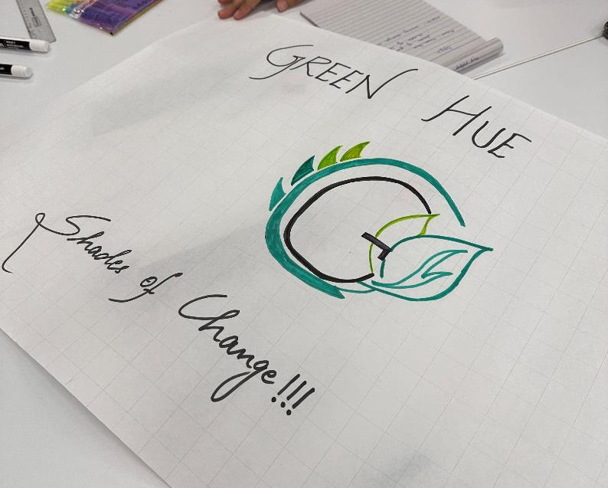
Learning 2 | My takeaways
Soft skills Day 2 and 3
Grooming
Stakeholders
Interest power grid
Tuckman model
Presentation skills

Slide 6
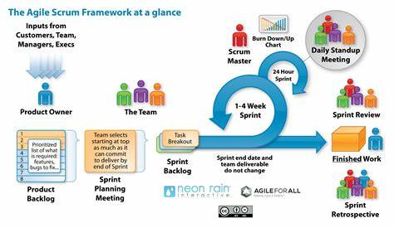
Learning 3 | My takeaways
Technical Bootcamp day 1&2
Introduction to business analytics
Detail explanation to what business analysts do
SDLC and its models
Requirement analysis, elicitation and management

Slide 7

Relevance of learnings for my organization

Slide 8

Learning 1 | Relevance for Shell
The CART analogy helps us identify different kinds of workers and how we could identify our own role in a project at Shell. Clear and effective communication is something our organization believes in strongly.
By fostering growth mind-set, employees try and enhance their own performance and quality of work. The culture here nurtures minds that want to flourish by helping them guide through the goals they set for themselves.

Slide 9
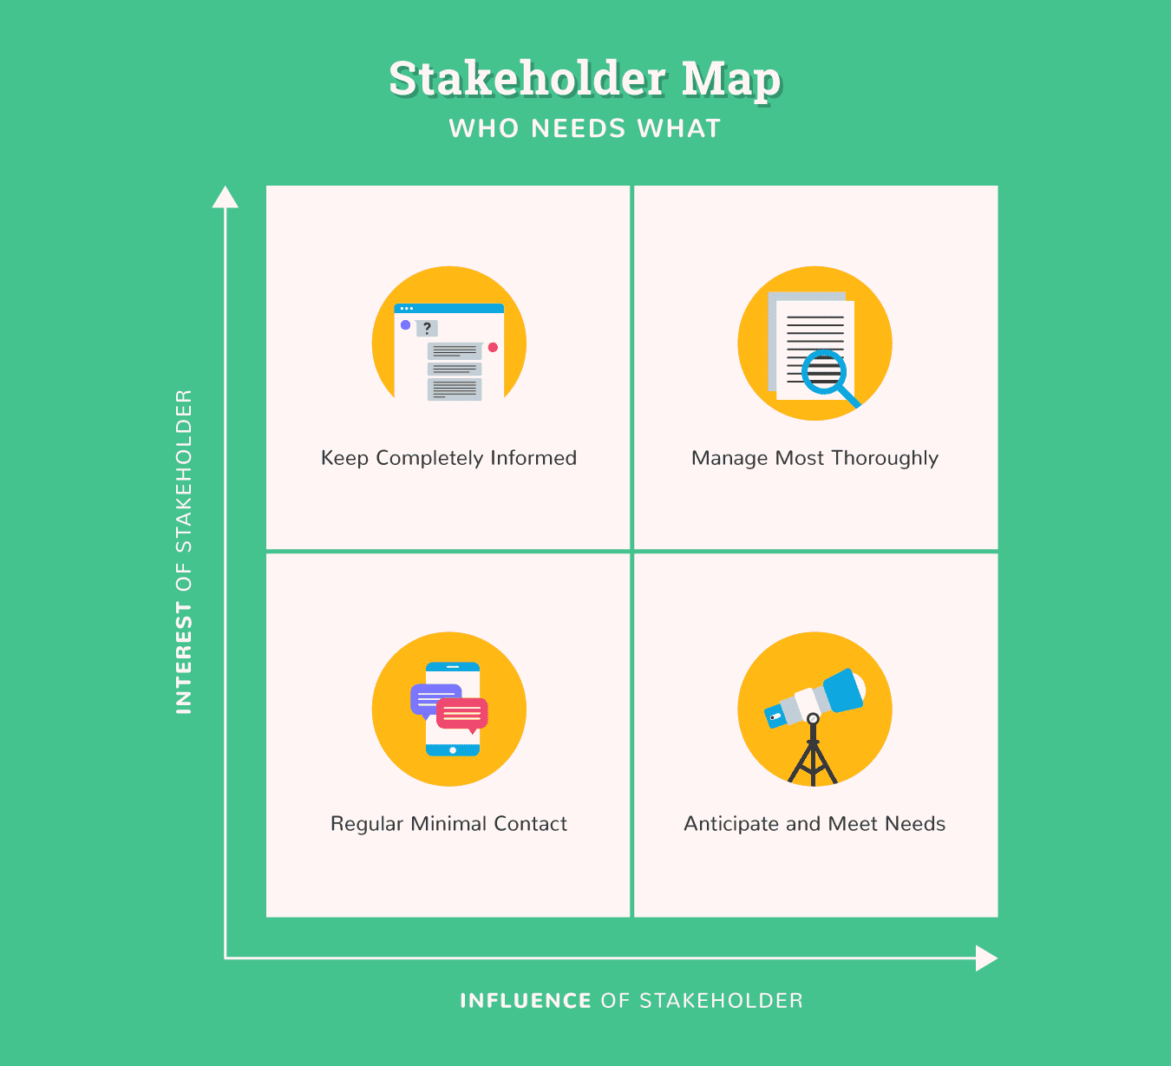
Learning 2 | Relevance for Shell
A true example of open communication is the ability of a fresher right out of project to be able to talk to a senior level employee by simply scheduling a GTKY.
Stakeholder management is crucial for Shell because of the complexity of our operations.

Slide 10
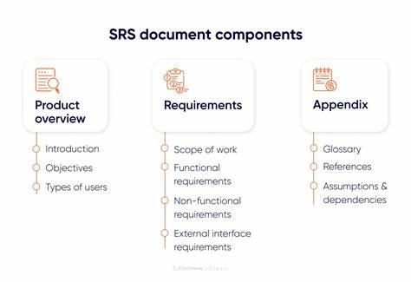
Learning 3 | Relevance for Shell
Shell uses Scrum-Agile Model which is not only provides risk mitigation, but also shorter timelines, continuous improvement and cost reduction.
SRS and BRD explanations and activity helped me understand their significance in a project.

Slide 11

Challenges in implementing learning

Slide 12

Challenge faced while implementing Learning 1
Challenge- It was hard to interact with people because everyone wanted to stay in their own shell.
Solution- Trying to talk to my colleagues during tea breaks
https://github.com/Tanisha-agr/Shell-Freshers-Tech-Bootcamp.git

Slide 13
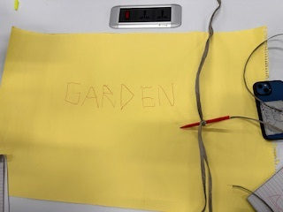
Challenge faced while implementing Learning 2
Challenge- Thorough understanding on stakeholder management but it being a little dull in comparison
Solution- Interactive sessions with activities by Nitya ma’am
https://github.com/Tanisha-agr/Shell-Freshers-Tech-Bootcamp.git

Slide 14

Challenge faced while implementing Learning 3
Challenge- Implementing BRD and SRS properly
Solution- Taking input that our instructor gave us
https://github.com/Tanisha-agr/Shell-Freshers-Tech-Bootcamp.git

Slide 15

Action Plan

Slide 16
My Action Plan for this Week
Actions
Timeline
Status
Review everything covered so far in the training
Read up on the ppts provided to us so far
Status of the same by the end of the week

Slide 17

Learning is also Fun!

Slide 18
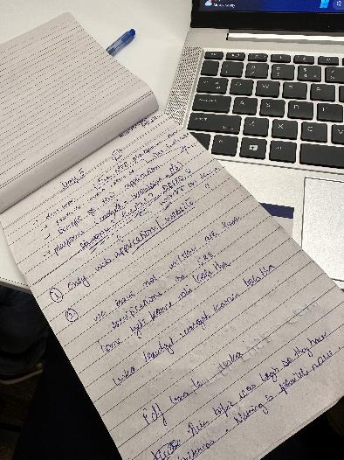
Learning is also Fun!
Nitya Ma’am made a dull topic like stakeholder management and made it interactive and fun. She also gave me an example of how a person can give criticism respectfully.
Sohil sir’s Activity about making a BRD and SRS helped us take a sneak peek into how projects start.

Slide 19

Summary
This week we learned about importance of soft skills at work-place and proper etiquette along with the initial technical know how about business analytics and agile model.
The next phase includes hands on exercise on Azure DevOps which is essential for my role as a software engineer.
The proper learning agenda about the model we use at our company i.e. Scrum Agile along with many roles a business analyst plays is key as I move ahead.

Slide 20
Thank You

