Slide 1
AuraShield
FemTech Force
Bhavini Verma
Nitisha Mishra
Tanisha Gupta

Slide 2
PROBLEM STATEMENT
WOMEN SAFETY
Women safety is a major concern
Emergencies happen suddenly
Manual systems may fail
Single-sensor → unreliable
No automatic real-time detection
NEED
Automatic detection
No user action
Instant alert system

Slide 3
YOUR SOLUTION:
Hardware & Sensing
Wearable Form Factor: Continuous, unobtrusive monitoring.
Multi-Sensor Array: Tracks heart rate, stress levels, ambient sound, and physical motion.
Real-Time Processing: Powered by an ESP32 microcontroller for instantaneous data handling.
Intelligent Architecture
"Chip-Inspired" Decision Engine: Combines and analyzes multiple sensor inputs simultaneously.
Rapid State Classification: Instantly categorizes user status as SAFE, ALERT, or DANGER.
High Reliability: Sensor fusion minimizes false positives and ensures fast detection.
Emergency Action & Tracking
Automated SOS Routing: Device ➔ Connected Smartphone ➔ Emergency Contacts.
Pinpoint Location: Integrated GPS sends real-time Google Maps links.
Live Web Dashboard: Remote monitoring of user status, live sensor data, and location tracking.

Slide 4
IMPLEMENTATION IN VIT:
• Useful for outings in Vellore and outside campus. • Supports inter-college competitions and travel across states. • Works during late-night(nightslips) or special permission outings.
• Provides safety for solo travel or less crowded routes.
• Helps during late-night travel (bus/train/cab journeys) • Sends real-time alert and location to phone. • Alerts can be shared with wardens, chief wardens and parents. • Maintains continuous safety monitoring beyond campus boundaries.
• Ensures safety while traveling to home and returning to campus from leave.

Slide 5
BUSINESS IDEA:
• Combines hardware prototype and custom chip design.
• Compact chip-based design for low power and daily use. • Chip reduces size, cost and power consumption. • Enables compact wearable forms (band/watch/necklace/etc). • Scalable from prototype to real product. • Target market: individuals and institutions (B2C & B2B). • Revenue: device sales and subscription services. • High potential in wearable safety market.

Slide 6
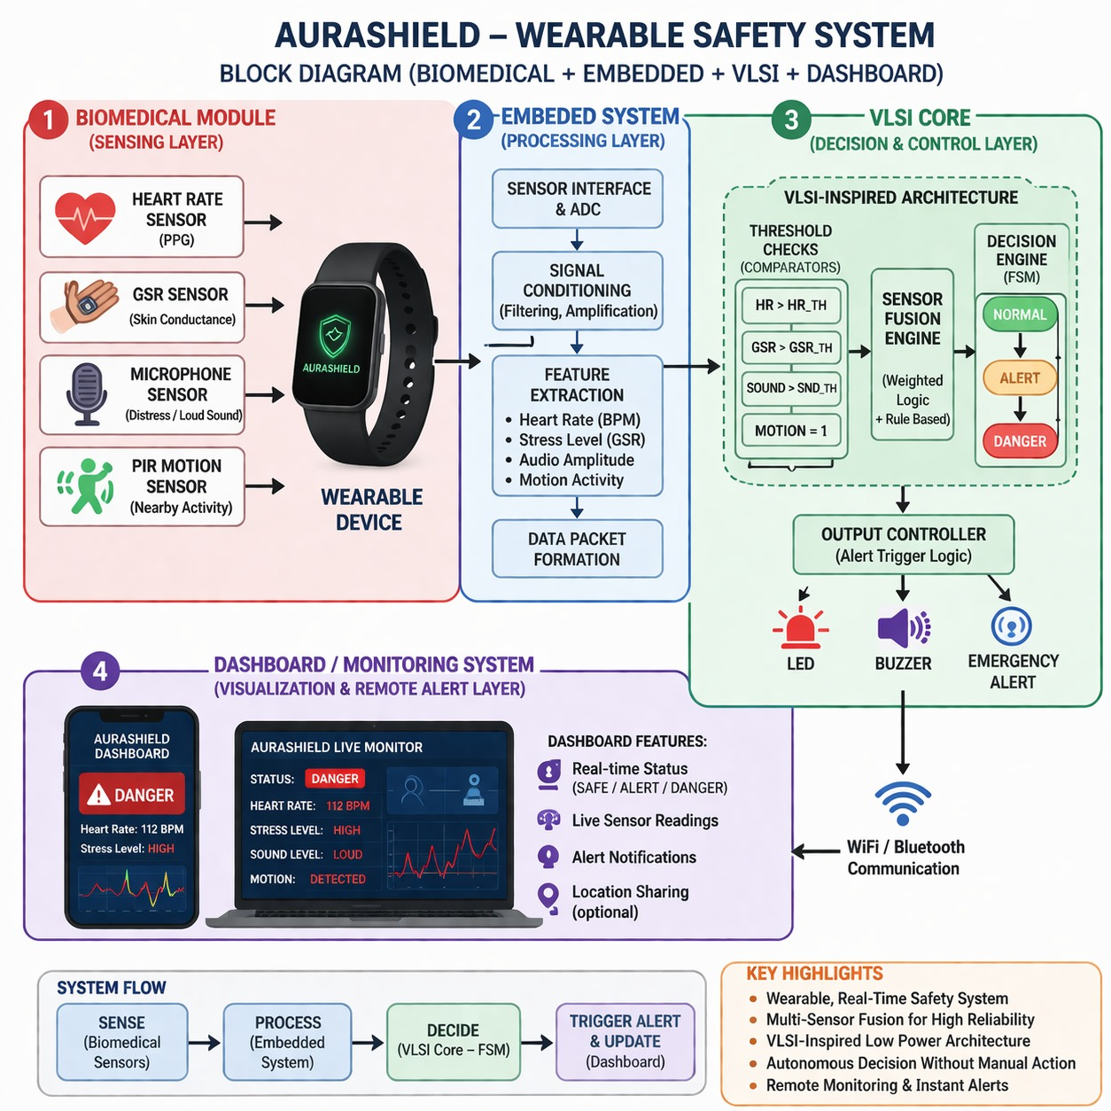

Slide 7



AVATAR

Slide 8
Thank you.

