Slide 1
ORDER PROCESSING SYSTEM
TEAM NAME : CODETODECODE(wfs-7)
CODEFURY PROJECT-2020

Slide 2
TEAM MEMBERS
AIMAN KHAN
ANKIT RUPAPARA
RAJ KUMAR
RUPALI TRIPATHI
UJJWAL MISHRA
AMAN SARAFF
JAY PANCHAL
RANU SHARMA
TANISHA AGRAWAL

Slide 3
PROJECT FEATURES :
Authorization and Authentication for Employee and Customer.
Employee can create new quote and generates the invoice.
Employee can also import details of product items via JSON or XML file.
Customer can view its invoice or pending orders.
Customer can also approve its pending orders.
Automated expiry and completion of orders.

Slide 4
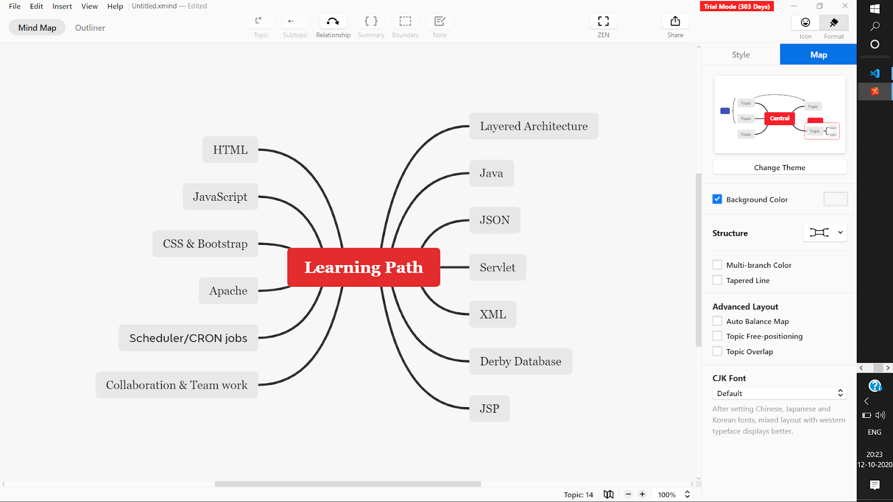
LEARNING PATH

Slide 5
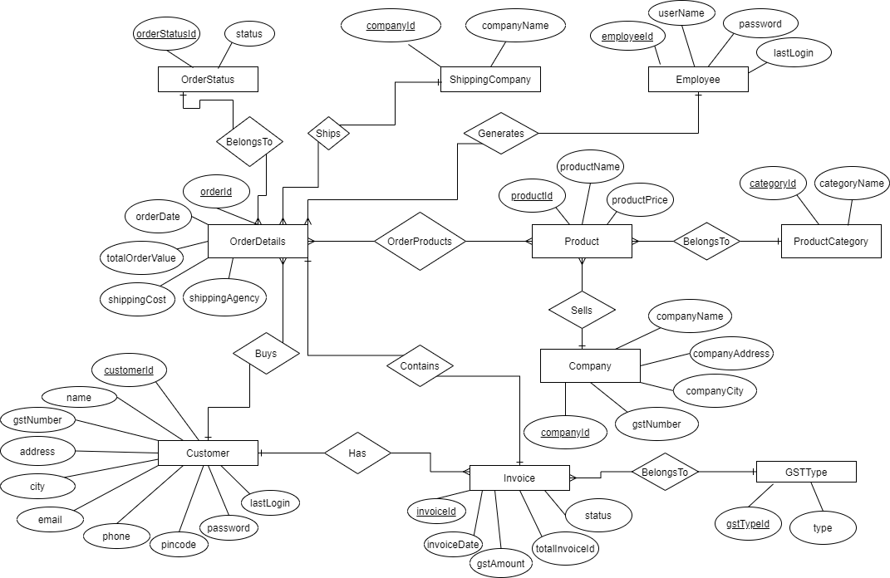
Entity-relationship diagram

Slide 6
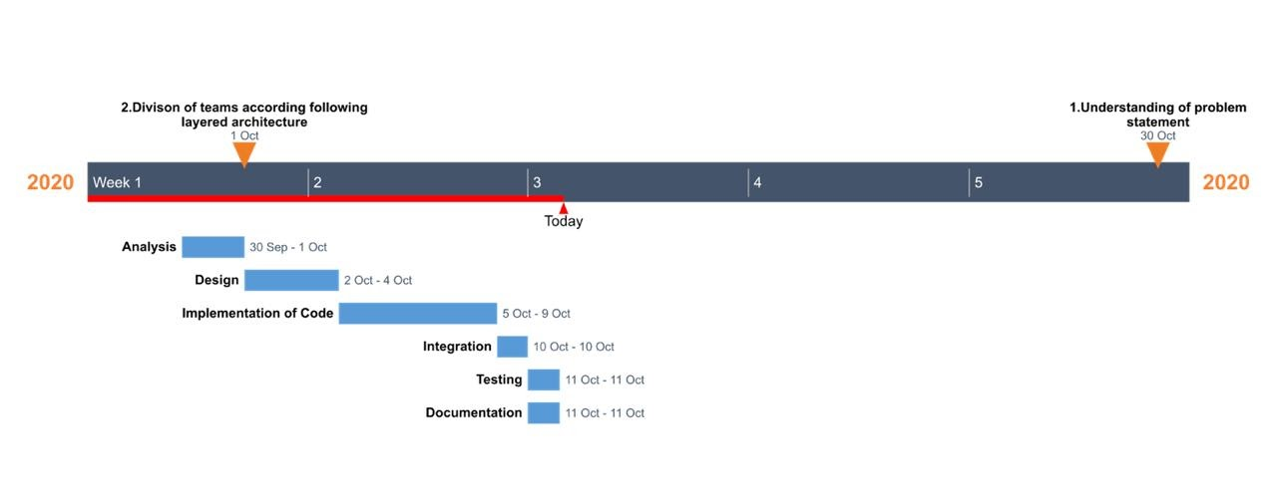
PROJECT PLANNING

Slide 7
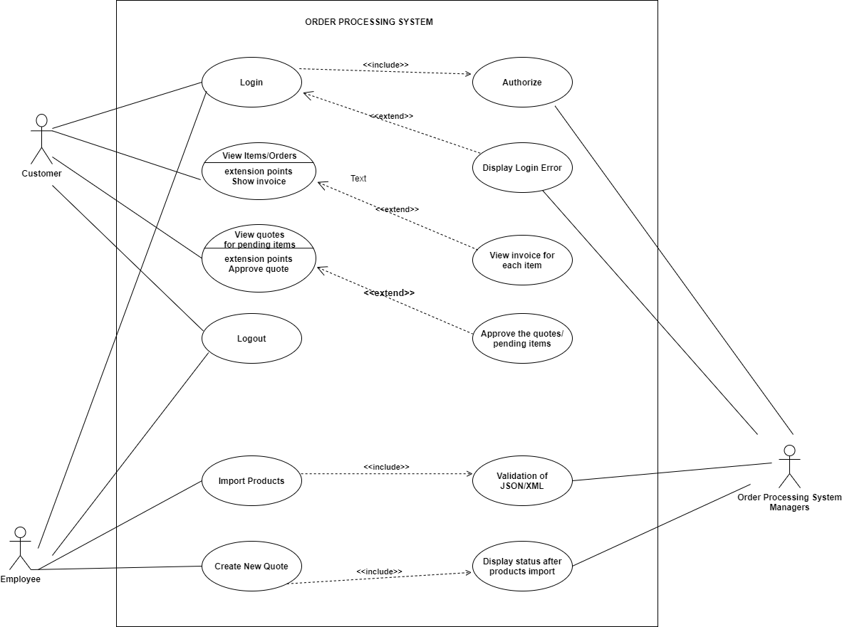
USE-CASE DIAGRAM

Slide 8
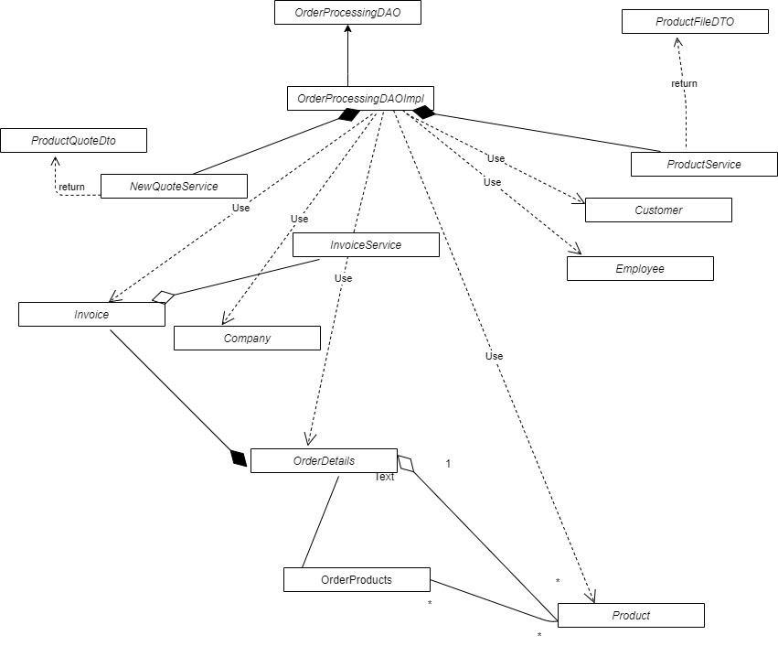
Class diagram

Slide 9
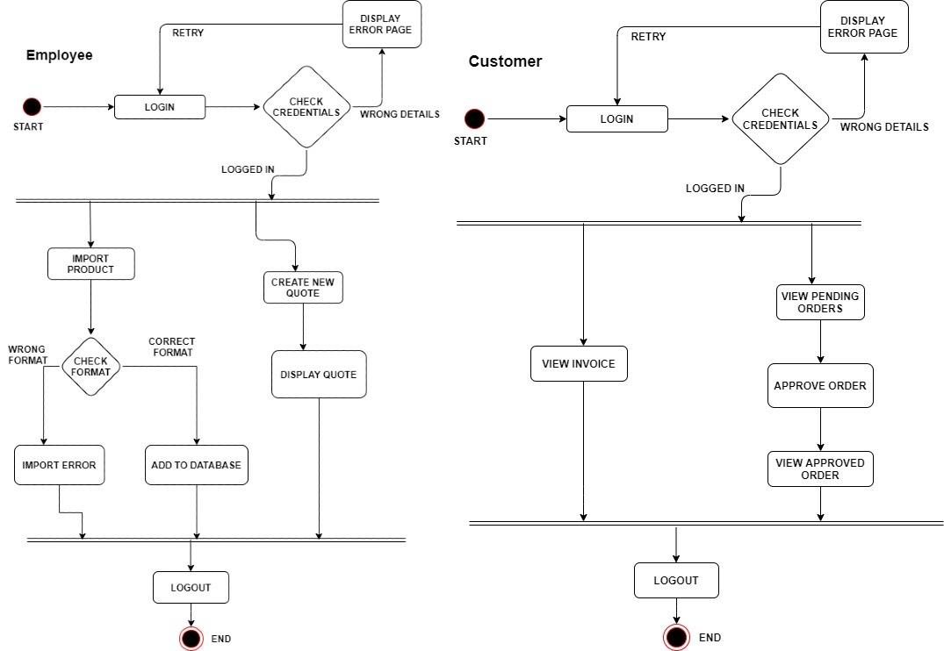
Activity diagram

Slide 10
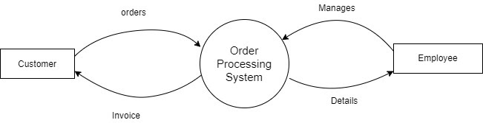
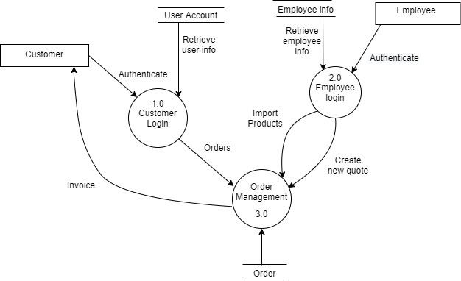
Data-flow-diagram
Level 0:
Level 1:

Slide 11
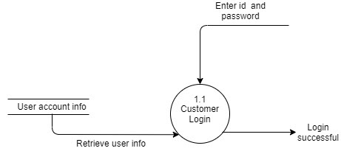
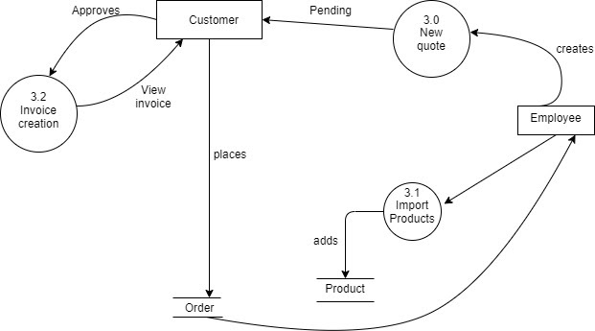
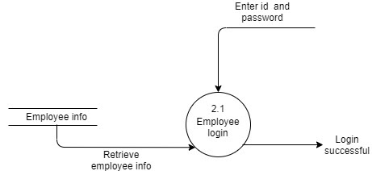
level 2.1
LEVEL 2.3
LEVEL 2.3

