Slide 1
POWER BI • DATA ANALYTICS PROJECT
F1 PERFORMANCE
HUB
Turning qualifying and lap-time records into an interactive analytical story
A project about comparison, context, and responsible interpretation—not just charts.
TANISHA SHAH • COMPUTER ENGINEERING • SEMESTER 5
01

Slide 2
01 / PROJECT IN ONE MINUTE
What this project actually does
A Power BI report that turns two related data tables into several complementary performance views.
QUALIFYING RECORDS
LAP-TIME RECORDS
COVERAGE
ENTITIES
11,120
77,840
2000–2026
20 / 10
One record per driver–race combination
Seven lap records per qualifying entity/race
Generated year labels; not a verified race calendar
Driver identifiers / constructor identifiers
THE ANALYTICAL FLOW
CORE PRINCIPLE
A dashboard is useful when each visual answers a question. A number is not meaningful until its definition, direction, population and limitations are clear.
01
Baseline
What does the overall dataset look like?
02
Compare
How do driver and constructor indicators differ?
03
Track change
How do qualifying and lap-time patterns vary over time?
04
Interpret
What can be concluded—and what cannot?
02

Slide 3
02 / PURPOSE
The problem: one average cannot explain performance
The project is structured around the questions a viewer should be able to investigate.
QUESTIONS THE REPORT IS DESIGNED TO ANSWER
WHAT “SUCCESS” MEANS HERE
What is the overall qualifying-position baseline across the selected records?
Consistent metric definitions across report pages.
Which driver and constructor identifiers have different reported qualifying-edge values?
Ability to move from overview to focused comparisons.
Does Q3 reach tell the same story as average qualifying position?
Visuals that expose patterns rather than imply unsupported causes.
How does average qualifying position vary by season?
Clear disclosure that the add-on dataset is synthetic.
How does average lap time vary by lap number and year?
No unsupported claim that the sample represents real F1 history.
03

Slide 4
03 / DATA & PROVENANCE
Know the data before interpreting the charts
QUALIFYING TABLE
LAP-TIME TABLE
TOTAL DATA ROWS
YEAR LABELS
11,120 rows
77,840 rows
88,960
27 years
Year, round, keys, qualifying position and Q1/Q2/Q3 times
Seven lap records per driver–race combination
Excludes headers; two tables should not be blindly merged
2000 through 2026 inclusive
DATA GRAIN & JOIN LOGIC
Qualifying grain: one row per driver per race.
Lap-time grain: seven lap records per river per race.
Keys use SYN_ namespaces and are intentionally not original F1 IDs.
The workbook recommends keeping these tables separate unless a verified mapping is created.
04

Slide 5
04 / METHOD
How the data becomes an interactive report
A transparent workflow helps users understand where the metrics come from.
SOURCE
PREPARE
MODEL
ANALYSE
PRESENT
Excel workbook
Check grain & keys
Keep tables separate
Define measures
Power BI pages
Two synthetic tables
Validate row counts
Avoid false joins
Position, reach, lap time
Overview → detail
WHY THE GRAIN MATTERS
WHAT TO VERIFY IN POWER BI
Qualifying and lap-time rows represent different levels of detail. Combining them without careful modelling can duplicate qualifying records and distort averages.
Check data types, row counts, relationship direction, filter behaviour, and each measure against a small manual calculation.
05

Slide 6
05 / METRIC GUIDE
What each KPI means—and what it does not
Definitions and direction should be explained before comparing values.
Average qualifying position
Mean of the qualifying-position values included by the current filters.
Lower is better because position 1 is ahead of position 10.
Q3 reach rate
Share of included records meeting the dashboard’s Q3-reach rule.
A rate of 50% is not the same as average position.
Position spread (5.78)
A standard-deviation-style measure reported by the dashboard.
Larger spread means more variation; confirm the exact population and filter context.
Best Q3 time (76.219 s)
Lowest qualifying Q3 time recorded in the current view.
A minimum is an extreme value, not a typical performance measure.
06

Slide 7
06 / OVERVIEW PAGE
Reading the overall baseline
The overview is a reference point, not a final judgement of any one driver or constructor.
AVERAGE QUALIFYING POSITION
Q3 REACH RATE
POSITION SPREAD
BEST Q3 TIME
10.48
50.0%
5.78
76.219 s
Read lower positions as better
About half under the report’s reach definition
Variation around the average
Fastest observed Q3 time in current view
HOW TO READ THESE TOGETHER
INTERPRETATION
These metrics describe different dimensions. The overview becomes useful when the viewer asks which measure answers their question—not when they collapse everything into one rank.
10.48 summarises the average position across the filtered records.
50.0% summarises advancement frequency under the report’s Q3 rule.
5.78 adds a measure of variation; it is not a score where bigger is better.
76.219 seconds is a minimum and can be affected by the fastest single record.
07

Slide 8
07 / DRIVER PAGE
Driver comparison: relative edge is not a finishing position
The report surfaces the strongest reported positive and negative edge values; interpret signs using the dashboard’s own measure definition.
REPORTED QUALIFYING EDGE
WHAT THIS VIEW TELLS YOU
SYN D15
+0.46
Edge values provide a relative comparison under the dashboard’s calculation.
The sign must be interpreted from the actual measure definition.
SYN D13
+0.43
These values are not raw qualifying positions or lap times.
Use Q3 reach and position spread as complementary checks.
SYN D10
-0.37
driver IDs do not identify real F1 drivers.
08

Slide 9
08 / CONSTRUCTOR PAGE
Constructor comparison: team-level signals
The same analytical logic can be applied to constructor identifiers without treating one measure as a complete ranking.
REPORTED CONSTRUCTOR QUALIFYING EDGE
QUESTIONS TO ASK
SYN T08
+0.28
Does the edge value agree with Q3 reach in the same filter context?
SYN T06
+0.16
Is the constructor’s average position stable across seasons?
Does a team-level average hide variation between drivers?
SYN T07
+0.14
Are comparisons based on comparable sample sizes?
SYN T03
-0.20
Are all labels synthetic rather than real constructor names?
09

Slide 10
09 / SEASON PAGE
Seasonal trend: a narrow range still needs context
The current dashboard shows average qualifying position between approximately 10.38 and 10.60.
REPORTED SEASONAL AVERAGE POSITION RANGE
WHAT THIS SUGGESTS
10.38
10.60
The reported range is narrow, so avoid claiming a dramatic long-term shift based on this view alone.
Lowest around 2011
Highest around 2015
WHY INCLUDE Q3 REACH TOO?
CAUTION
Average position describes where results sit; Q3 reach describes how often the defined advancement threshold is met. A season can move differently on each measure.
The data is synthetic. Seasonal patterns demonstrate how the report can be used; they are not evidence of real-world Formula 1 era changes.
10

Slide 11
10 / LAP-TIME PAGE
Lap-time analysis: identify the pattern, then investigate it
The dashboard reports average lap time rising from about 94.46 seconds on lap 1 to 97.48 seconds on lap 7.
LAP 1 AVERAGE
LAP 7 AVERAGE
DIFFERENCE
MEASURE
94.46 s
97.48 s
+3.02 s
Average
Reported dashboard value
Reported dashboard value
Lap 7 minus lap 1
Not fastest-lap time
WHAT CAN BE SAID
WHAT FURTHER ANALYSIS WOULD NEED
To investigate cause, add and validate variables such as circuit, weather, tyre compound, pit stops, safety-car periods and race context. Those causes are not established by this chart alone.
The current view shows a higher average time at later lap numbers.
The difference is descriptive, not proof of why the pattern occurs.
Average lap time can be influenced by sample composition and filtering.
11

Slide 12
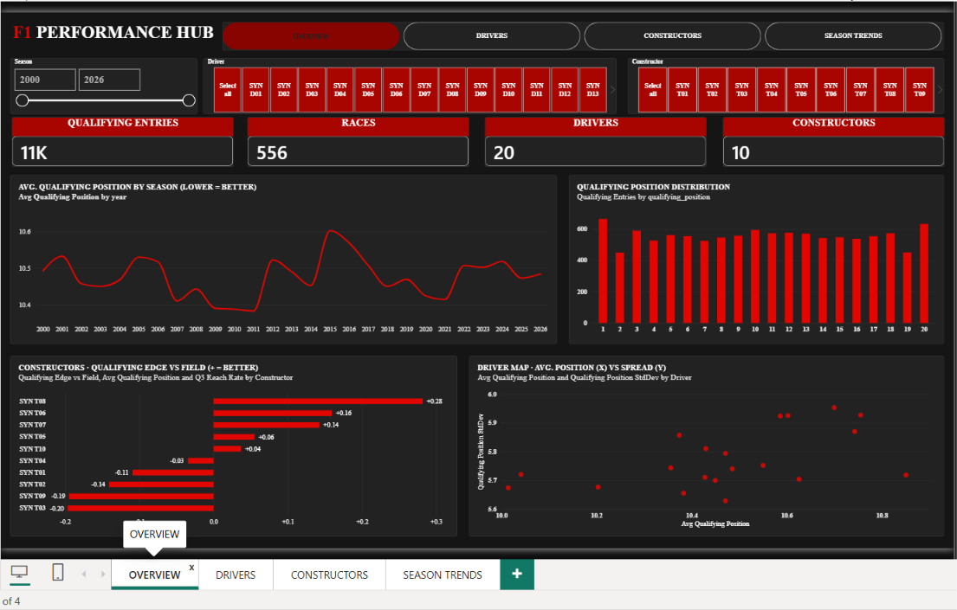
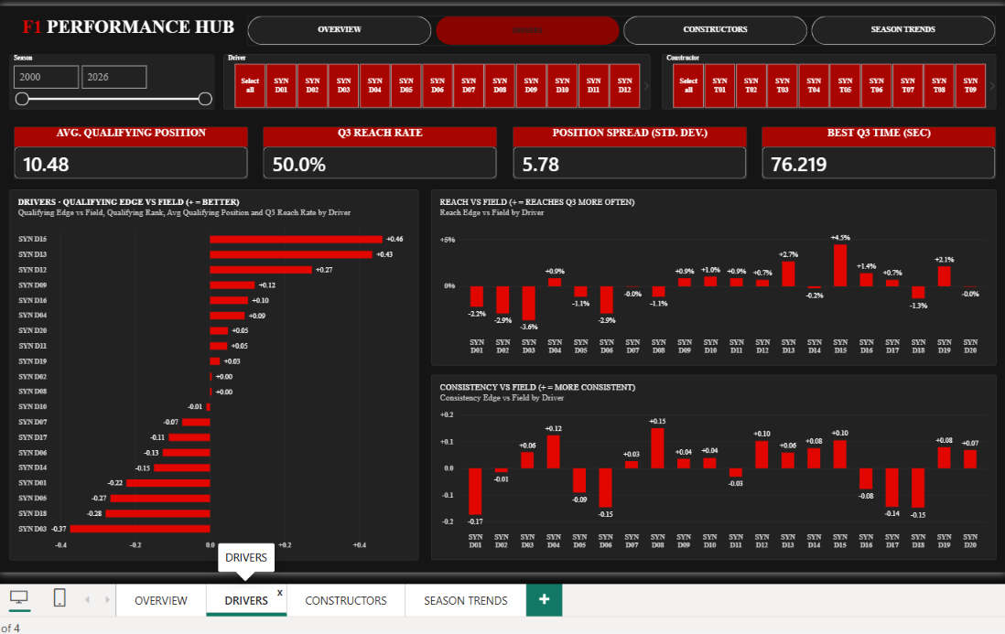
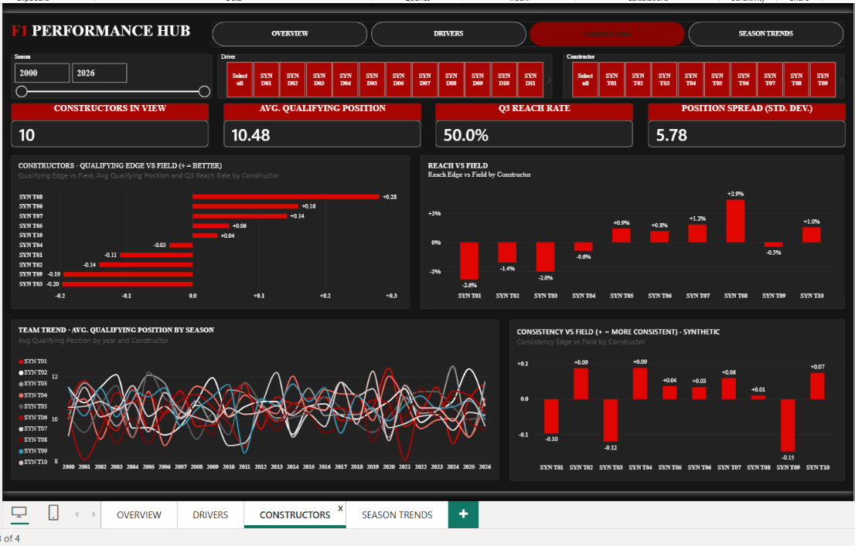
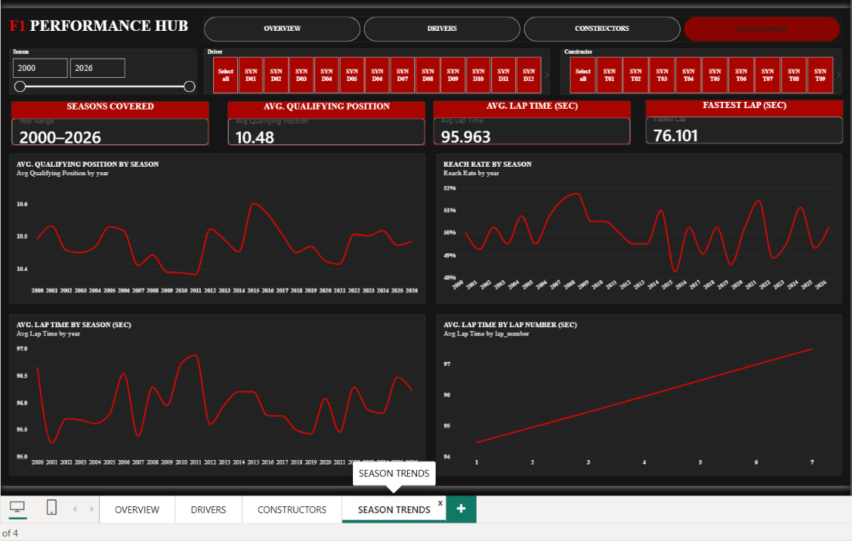
11 / REPORT WALKTHROUGH
The four Power BI pages work as one analytical journey
Use the actual report pages to explain how a viewer moves from summary to comparison and time-based exploration.
01 OVERVIEW
Establish the baseline and scan distributions.
02 DRIVERS
Compare driver-level indicators.
03 CONSTRUCTORS
Inspect team-level edge, reach and variation.
04 SEASON TRENDS
Explore year-based and lap-number patterns.
12

Slide 13
12 / SYNTHESIS
What the combined analysis tells us
The value is the combination of measures—not an unsupported “best driver” or “best constructor” claim.
01 / Baseline
02 / Driver signals
The overview gives a common reference point: 10.48 average qualifying position, 50.0% Q3 reach and 5.78 position spread.
The report surfaces relative edge values, but those values must be read with their calculation definition and the other driver indicators.
03 / Team patterns
04 / Time dimension
Constructor views make group-level comparison possible while reminding us that averages can hide driver-level variation.
Season and lap-number views reveal descriptive patterns; they do not by themselves explain the cause of those patterns.
BOTTOM LINE
The report demonstrates a multi-angle analysis workflow; the synthetic dataset limits real-world conclusions.
13

Slide 14
13 / QUALITY & LIMITATIONS
What should be validated before stronger conclusions
This slide is part of the analysis: credible reporting explains both the findings and their boundaries.
CURRENT LIMITATIONS
NEXT ITERATION
All qualifying positions and lap times in the add-on workbook are synthetic.
Add a data dictionary with every KPI formula and direction.
keys do not map to original F1 IDs.
Create a validation page for row counts, missing values and filter logic.
Year coverage is generated and is not a verified race calendar.
Label synthetic data in report titles/tooltips and presentation captions.
Edge measure sign and formula should be documented in the report.
Use verified official data only if the goal changes to historical F1 analysis.
Comparisons can be distorted if filters create unequal samples.
Add race context variables before attempting causal explanations.
14

Slide 15
14 / PROJECT CONTRIBUTION
What I built and what I learned
A project explanation should connect the Power BI artefact to the analytical decisions behind it.
DATA PREPARATION
ANALYTICAL DESIGN
INTERPRETATION
2 tables
4 views
Multi-KPI
Inspected grain, row counts and key namespaces
Overview, drivers, constructors and season trends
Compared position, reach, spread and time patterns
TECHNICAL SKILLS DEMONSTRATED
ANALYTICAL SKILLS DEMONSTRATED
Data modelling awareness and grain validation
Separating correlation/pattern from explanation
KPI interpretation and visual storytelling
Recognising when averages hide variation
Power BI page structure and cross-view reasoning
Communicating assumptions and data limitations
15

Slide 16
15 / CONCLUSION
A dashboard is a tool for asking better questions
F1 Performance Hub connects a baseline to entity comparisons and time-based views in a single interactive reporting experience.
The strongest outcome is not one headline number. It is a repeatable way to inspect performance from multiple angles while keeping the data’s limitations visible.
01
Start with context
02
Compare complementary measures
03
Explore time-based patterns
04
Validate before concluding
FINAL NOTE
This is a dataset Power BI analytics demonstration. Any claim about actual Formula 1 performance would require verified historical data.
16

Slide 17
F1 PERFORMANCE HUB
THANK YOU.
Questions & discussion
From raw records → to meaningful comparisons → to responsible interpretation.
TANISHA SHAH • COMPUTER ENGINEERING
17

