Slide 1


Ad-Hoc Insights
Consumer Goods
SQL-Based Business Analysis
Presented by : Tanisha Sood

Slide 2
About AtliQ Hardwares
AtliQ Hardwares is one of the leading computer hardware manufacturers in India, with a strong global presence.

Slide 3
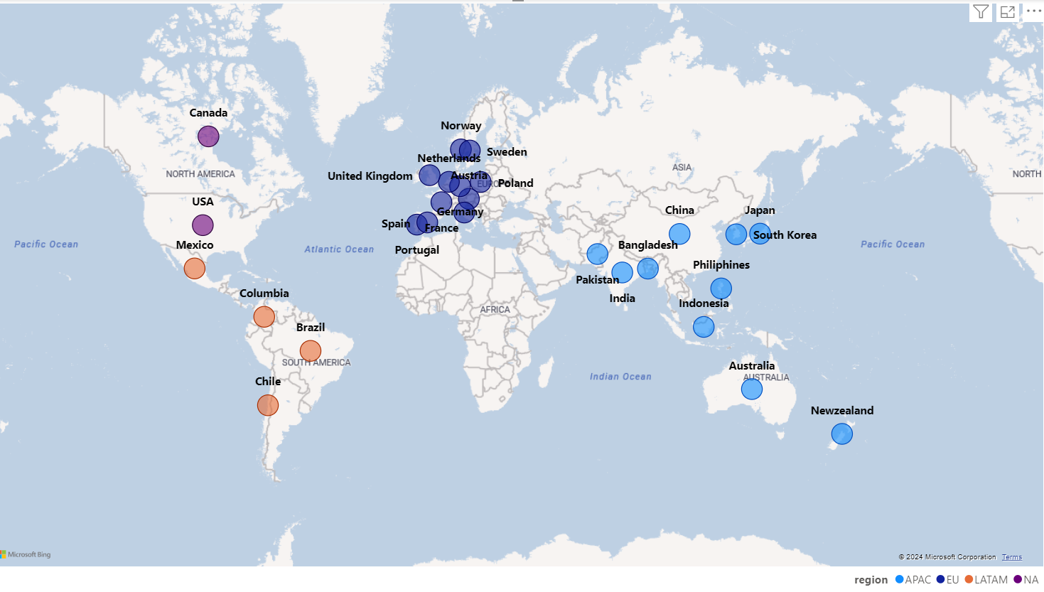
Market
AtliQ Hardwares operates in multiple regions, including APAC, EU, LATAM, and EN markets.
Strong presence in key markets: North America, South America, Europe, and Asia-Pacific.
Expanding network to drive innovation and global collaboration.

Slide 4






AtliQ’s Product Line
Division | Segment | Category
P & A | Peripherals | Internal HDD Graphic Card Processors MotherBoard
P & A | Accessories | Mouse Keyboard Batteries
PC | Notebook | Personal Laptop Business Laptop Gaming Laptop
PC | Desktop | Business Laptop Personal Desktop
N & S | Storage | External Solid State Drives USB Flash Drives
N & S | Networking | Wi fi extender

Slide 5


The Data Dilemma at AtliQ
We need to talk. The management is struggling to make quick, data-driven decisions. They feel like they don’t have enough insights at their fingertips.
Are we lacking the right tools or the right people

Slide 6
It’s not just about tools. We need skilled analysts who can extract insights from data quickly and efficiently.
That makes sense. But hiring the right people isn’t easy. What exactly are you looking for?

Slide 7
Tech skills and soft skills. Someone who knows SQL, can analyze data effectively, and can communicate insights clearly.
Finding that mix isn’t easy. How do you plan to evaluate them?

Slide 8
A SQL Challenge—to test problem-solving and analytical thinking..
Smart! That way, we hire based on real-world skills.

Slide 9

HOW ATLIQ OPERATES
A Fiscal Year (FY) is a 12-month financial reporting period used by businesses for accounting and budgeting. It does not always align with the calendar year
AtliQ's fiscal year runs from September 1st to August 31st each year.
Available sales data covers FY 2020 to FY 2021.
FY 2020 → September 2019 – August 2020
FY 2021 → September 2020 – August 2021

Slide 10
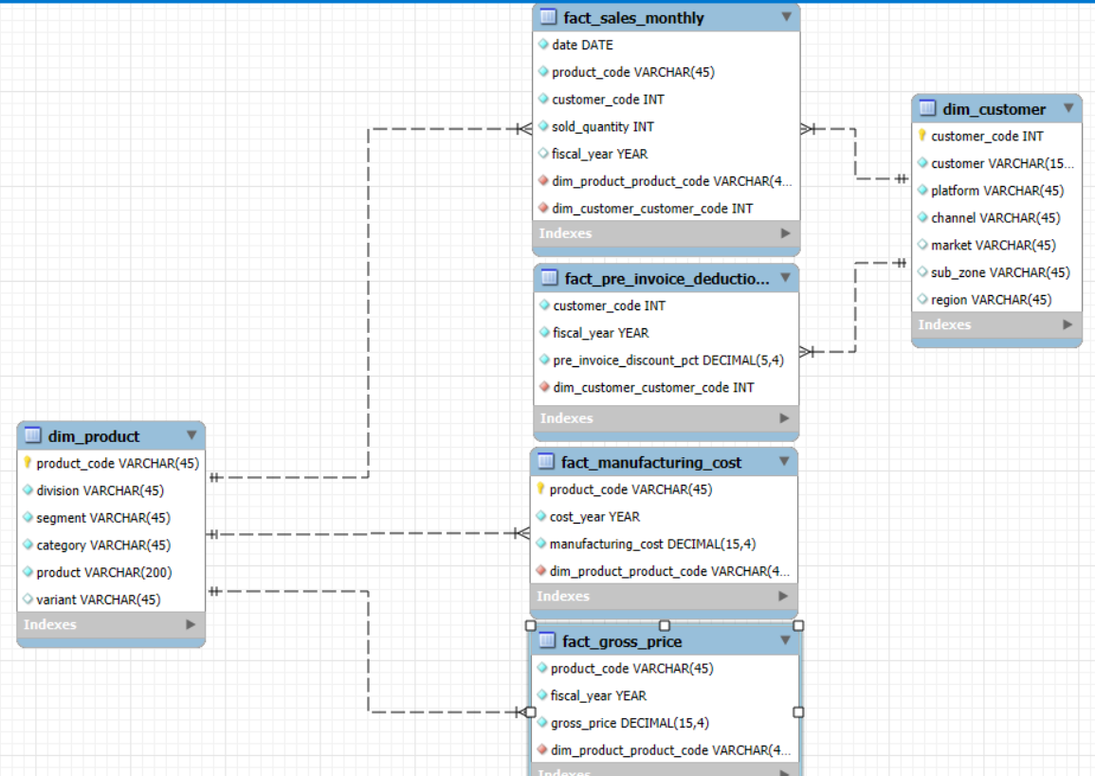
Dataset

Slide 11

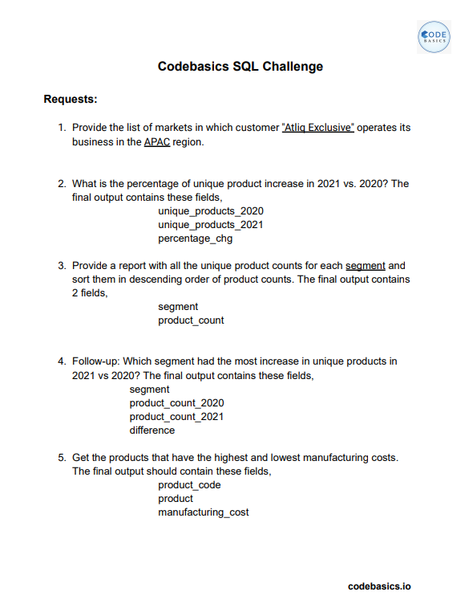
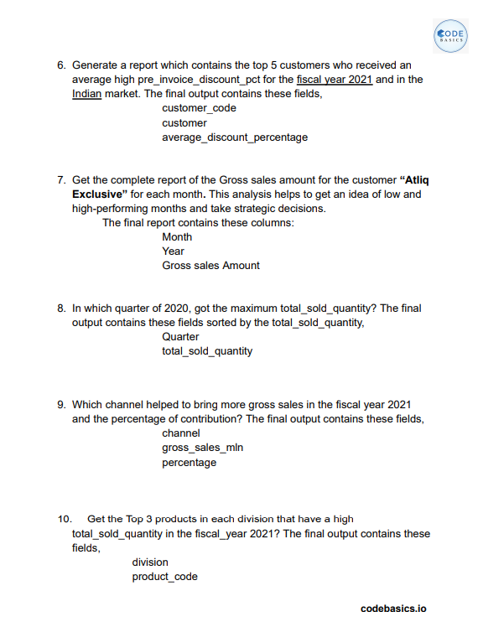
Ad-hoc requests

Slide 12
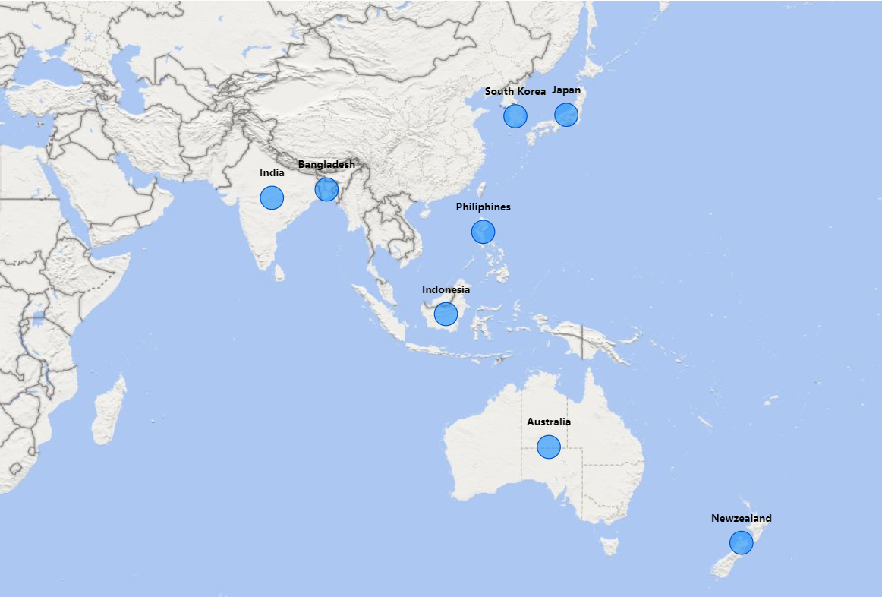
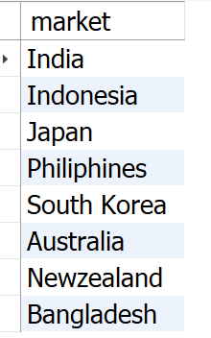

1. Provide the list of markets in which customer “Atliq Exclusive" operates its business in the APAC region.
Input
Output
SELECT DISTINCT market
FROM dim_customer
WHERE customer = 'Atliq Exclusive'
AND region = 'APAC'
ORDER BY market;
Insight : AtliQ Exclusive operates in eight countries within the APAC region, demonstrating a significant regional market presence.

Slide 13
2.What is the percentage of unique product increase in 2021 vs. 2020? The final output contains these fields, unique_products_2020, unique_products_2021, percentage_chg .
Input
WITH CTE2020 AS (
SELECT COUNT(DISTINCT product_code) AS Unique_Products_2020
FROM fact_gross_price
WHERE fiscal_year = 2020
),
CTE2021 AS (
SELECT COUNT(DISTINCT product_code) AS Unique_Products_2021
FROM fact_gross_price
WHERE fiscal_year = 2021
)
SELECT
O.Unique_Products_2020 AS Unique_Products_2020,
T.Unique_Products_2021 AS Unique_Products_2021,
ROUND(
((T.Unique_Products_2021 - O.Unique_Products_2020) * 100.0) / O.Unique_Products_2020, 2 ) AS Percentage_Change
FROM
CTE2020 O, CTE2021 T;

Slide 14
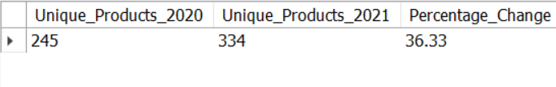
Output
36.33%
Insights :
1. The number of unique products expanded from 245 in 2020 to 334 in 2021, marking a 36.33% increase. 📈
2. This significant growth showcases AtliQ's commitment to innovation and meeting diverse customer demands.

Slide 15
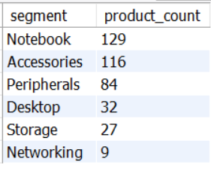
3. Provide a report with all the unique product counts for each segment and sort them in descending order of product counts. The final output contains 2 fields, segment, product_count.
Input
Output
SELECT
segment,
COUNT(DISTINCT product_code) AS product_count
FROM
dim_product
GROUP BY
segment
ORDER BY
product_count DESC;
Insights :
1. Notebooks, Accessories, and Peripherals dominate AtliQ’s portfolio, comprising 82.87% of products.
2. Desktops, Storage, and Networking hold a smaller 17.13% share.
3. AtliQ should align these categories with market trends to boost their presence.

Slide 16
4. Follow-up: Which segment had the most increase in unique products in 2021 vs 2020? The final output contains these fields, segment, product_count_2020, product_count_2021, difference.
Input
WITH CTE2020 AS (
SELECT COUNT(DISTINCT product_code) AS Unique_Products_2020
FROM fact_gross_price
WHERE fiscal_year = 2020
),
CTE2021 AS (
SELECT COUNT(DISTINCT product_code) AS Unique_Products_2021
FROM fact_gross_price
WHERE fiscal_year = 2021
)
SELECT
O.Unique_Products_2020 AS Unique_Products_2020,
T.Unique_Products_2021 AS Unique_Products_2021,
ROUND(
((T.Unique_Products_2021 - O.Unique_Products_2020) * 100.0) / O.Unique_Products_2020,
2
) AS Percentage_Change
FROM CTE2020 O, CTE2021 T;

Slide 17
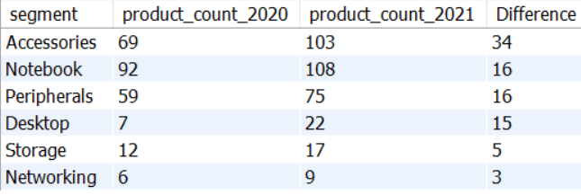
Output
Insight :
Accessories led the growth, adding 34 new products from 2020 to 2021.
Desktop products saw a 214% surge, marking a significant expansion.
Storage & Networking had minimal growth, adding only a few new products.

Slide 18
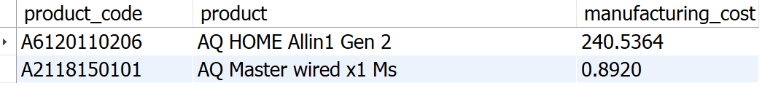
5. Get the products that have the highest and lowest manufacturing costs. The final output should contain these fields, product_code ,product, manufacturing_cost .
Input
Output
SELECT
P.product_code,
P.product,
F.manufacturing_cost
FROM
dim_product P
JOIN
fact_manufacturing_cost F
ON
P.product_code = F.product_code
WHERE
F.manufacturing_cost IN (
(SELECT MAX(manufacturing_cost) FROM fact_manufacturing_cost),
(SELECT MIN(manufacturing_cost) FROM fact_manufacturing_cost)
)
ORDER BY
F.manufacturing_cost DESC;
Highest Manufacturing Cost Product
Lowest Manufacturing Cost Product

Slide 19
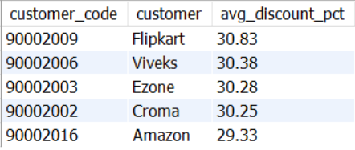
6. Generate a report which contains the top 5 customers who received an average high pre_invoice_discount_pct for the fiscal year 2021 and in the Indian market. The final output contains these fields, customer_code, customer, average_discount_percentage .
Input
Output
SELECT
C.customer_code,
C.customer,
ROUND(AVG(P.pre_invoice_discount_pct) * 100, 2) AS avg_discount_pct
FROM
dim_Customer C
JOIN
fact_pre_invoice_deductions P
ON
C.customer_code = P.customer_code
WHERE
P.fiscal_year = 2021
AND C.market = 'India'
GROUP BY
C.customer_code, C.customer
ORDER BY
avg_discount_pct DESC
LIMIT 5;
Insight :
Flipkart secured the highest average discount of 30.83%.
AtliQ maintained a consistent discount strategy, offering its top 5 customers discounts ranging between 29.33% and 30.83%.

Slide 20
7. Get the complete report of the Gross sales amount for the customer “AtliQ Exclusive” for each month. This analysis helps to get an idea of low and high-performing months and take strategic decisions. The final report contains these columns: Month, Year, Gross sales Amount.
Input
SELECT
MONTHNAME(s.date) AS Month,
s.fiscal_year AS Year,
SUM(s.sold_quantity * g.gross_price) AS Gross_sales
FROM fact_sales_monthly s
JOIN fact_gross_price g
ON s.product_code = g.product_code
JOIN dim_customer c
ON s.customer_code = c.customer_code
WHERE c.customer = "AtliQ Exclusive"
GROUP BY Month, Year
ORDER BY Year ASC;

Slide 21
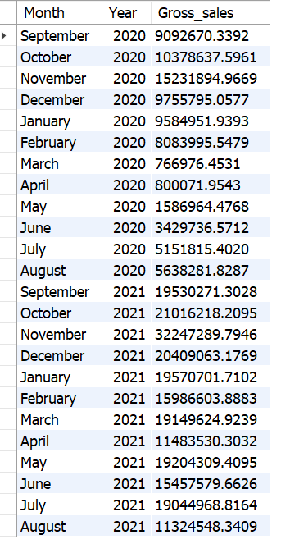
Output
Insight: Sales Recovery: March to May 2020 saw the lowest sales, likely due to the COVID-19 impact, with recovery starting in June.
Peak Performance: November 2020 recorded the highest sales at 15.23M.
Year-over-Year Growth: Sales in 2021 showed significant growth compared to 2020.
2021 Highlights: November had the highest sales at 32.25M, while August recorded the lowest at 11.32M.

Slide 22
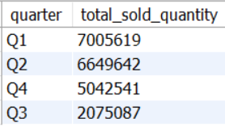
8. In which quarter of 2020, got the maximum total_sold_quantity? The final output contains these fields sorted by the total_sold_quantity, Quarter, total_sold_quantity.
Input
Output
SELECT
CASE
WHEN MONTH(date) IN (9, 10, 11) THEN 'Q1'
WHEN MONTH(date) IN (12, 1, 2) THEN 'Q2'
WHEN MONTH(date) IN (3, 4, 5) THEN 'Q3'
WHEN MONTH(date) IN (6, 7, 8) THEN 'Q4'
END AS quarter,
SUM(sold_quantity) AS total_sold_quantity
FROM fact_sales_monthly
WHERE fiscal_year = "2020"
GROUP BY quarter
ORDER BY total_sold_quantity DESC;
Insights :
Achieved the highest sales volume of approximately 7 million units in Q1 2020, demonstrating strong market performance early in the year.
Analyzed a significant sales decline in Q3 2020 (March–May), likely due to the COVID-19 pandemic, highlighting market challenges and shifting consumer behavior.

Slide 23
9. Which channel helped to bring more gross sales in the fiscal year 2021 and the percentage of contribution? The final output contains these fields, channel, gross_sales_mln, percentage.
Input
WITH CTE AS (
SELECT
C.channel,
ROUND(SUM((G.gross_price * S.sold_quantity) / 1000000), 2) AS gross_sales_mln
FROM
dim_customer C
JOIN
fact_sales_monthly S ON C.customer_code = S.customer_code
JOIN
fact_gross_price G ON S.product_code = G.product_code
WHERE
S.fiscal_year = 2021
GROUP BY
C.channel
)
SELECT
*,
CONCAT(
ROUND(gross_sales_mln * 100 / (SELECT SUM(gross_sales_mln) FROM CTE), 2),
" %"
) AS pct_contribution
FROM
CTE
ORDER BY
pct_contribution DESC;

Slide 24
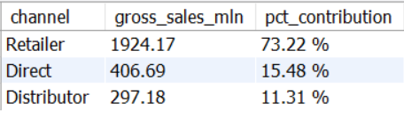
Output
Insights:
Retail Channel Dominance: Led to a significant contribution of 73.22% to AtliQ's total gross sales, showcasing the strength of the retailer network.
Direct & Distributor Channels: Together contributed a smaller 26.79% to the total sales, highlighting potential areas for further development in these channels.

Slide 25
10. Get the Top 3 products in each division that have a high total_sold_quantity in the fiscal_year 2021? The final output contains these fields, division product_code product total_sold_quantity rank_order.
WITH CTE AS (
SELECT
S.product_code,
P.product,
P.division,
SUM(S.sold_quantity) AS total_sold_quantity,
DENSE_RANK() OVER (PARTITION BY P.division ORDER BY SUM(S.sold_quantity) DESC) AS rank_order
FROM
dim_customer C
JOIN
fact_sales_monthly S ON C.customer_code = S.customer_code
JOIN
dim_product P ON P.product_code = S.product_code
WHERE
fiscal_year = "2021"
GROUP BY
S.product_code, P.product, P.division
)
SELECT
*
FROM
CTE
WHERE
rank_order <= 3;
Input

Slide 26
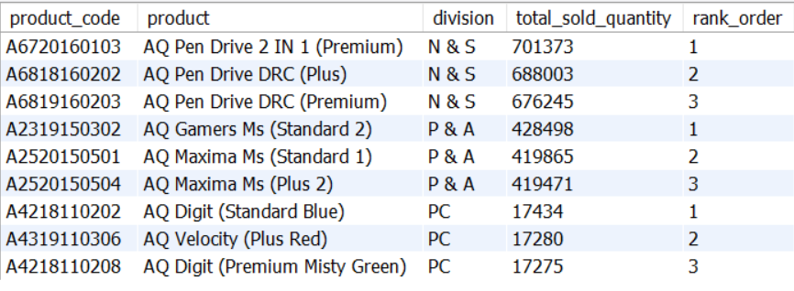
Output
Insights:
N & S Division: Pen drives lead the top three sales spots.
P & A Division: Mice dominate the top three products.
PC Division: Personal laptops are the top sellers.

Slide 27
Recommendations:
Adjust Discount Strategies: Fine-tune discount rates to drive higher gross sales from customers.
Focus on Key Segments: Prioritize products in Desktops, Storage, and Networking to align with customer trends and industry demands.
Leverage Multi-Channel Marketing: Use a mix of digital, social media, and traditional platforms with strategic pricing and promotions to maximize customer engagement.
Act on Customer Feedback: Continuously gather customer insights to enhance offerings and improve the overall experience.
Invest in Sales Team Development: Provide ongoing training to sales teams to stay ahead of market trends and boost performance.

Slide 28

Keep analyzing, innovating, and growing.
Thank you for your time!

