Slide 1


FINANCE & SUPPLY CHAIN ANALYTICS AT ATLIQ HARDWARE

Slide 2

About Atliq Hardware
AtliQ Hardware is a globally recognized leader in electronics manufacturing, known for its expertise in designing and producing high-quality hardware products. The company offers a diverse range of electronic devices, including personal computers, printers, mice, and various other computer peripherals, catering to the evolving needs of customers worldwide.
With a strong commitment to innovation and excellence, AtliQ Hardware continuously enhances its product line to stay ahead of market trends.

Slide 3

Optimizing Atliq Hardware’s Operations: Challenges & Solutions
Problem Statement:
Atliq Hardware faces significant challenges in managing large and complex datasets in Excel. The current data management system at Atliq Hardware lacks scalability and efficiency, limiting the company’s ability to process large datasets and extract actionable insights. Relying on Excel for data analysis leads to delays in decision-making, affecting operational efficiency, sales growth, and inventory management. The company needs a robust solution to streamline data processing and enable real-time analysis.
Project Overview
This project aims to optimize Atliq Hardware’s data operations by leveraging SQL for efficient data management and analysis. SQL will be used to handle large datasets, improve query performance, and provide deep insights into sales trends, customer preferences, and supply chain efficiency. By transforming raw data into actionable intelligence, the project will enable AtliQ Hardware to make data-driven decisions, enhance operational workflows, and boost overall business performance.

Slide 4

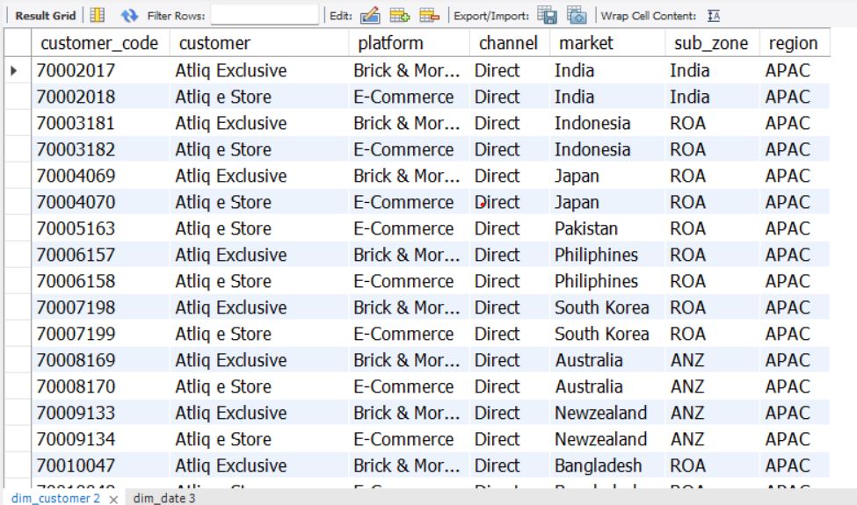
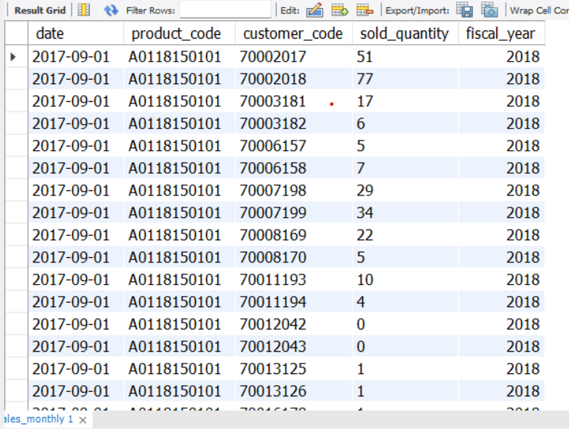
DATASET
Our dataset consists of Dimension Tables and Fact Tables,
which help in structuring and analyzing Atliq Hardware’s
data efficiently.
Dimension Tables:
DIM_CUSTOMER – Contains customer-related details.
DIM_DATE – Stores date-related attributes for time-
based analysis.
DIM_PRODUCT – Includes product-specific information.
Fact Tables:
FACT_FORECAST_MONTHLY – Monthly sales forecast data.
FACT_FREIGHT_COST – Shipping and logistics costs.
FACT_GROSS_PRICE – Gross pricing details before deductions.
FACT_MANUFACTURING_COST – Costs incurred in production.
FACT_POST_INVOICE_DEDUCTIONS – Deductions applied after invoicing.
FACT_PRE_INVOICE_DEDUCTIONS – Deductions applied before invoicing.
FACT_SALES_MONTHLY – Monthly recorded sales data.

Slide 5

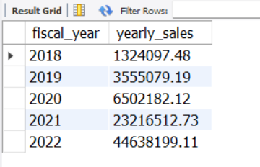
Generate a yearly report for Croma India where there are two columns:
1. Fiscal Year
2. Total Gross Sales amount In that year from Croma
SELECT
get_fiscal_year(date) as fiscal_year,
sum(round(sold_quantity*g.gross_price,2)) as yearly_sales
FROM fact_sales_monthly s
JOIN fact_gross_price g
ON
g.fiscal_year=get_fiscal_year(s.date) and
g.product_code=s.product_code
WHERE
customer_code=90002002
GROUP BY get_fiscal_year(date)
ORDER BY fiscal_year;

Slide 6
Write a stored procedure that can retrieve market badge
i.e. if total sold quantity > 5 million that market is considered
"Gold" else "Silver"
CREATE PROCEDURE `get_market_badge`
(
IN in_market VARCHAR(45),
IN in_fiscal_year YEAR,
OUT out_level VARCHAR(45)
)
BEGIN
DECLARE qty INT DEFAULT 0;
# Default market is India
IF in_market = "" THEN
SET in_market="India";
END IF;

Slide 7
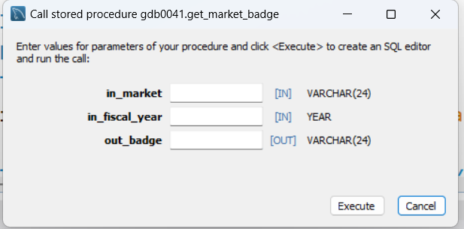
# Retrieve total sold quantity for a given market in a given year
SELECT
SUM(s.sold_quantity) INTO qty
FROM fact_sales_monthly s
JOIN dim_customer c
ON s.customer_code=c.customer_code
WHERE
get_fiscal_year(s.date)=in_fiscal_year
AND c.market=in_market;
# Determine Gold vs Silver status
IF qty > 5000000 THEN
SET out_level = 'Gold';
ELSE
SET out_level = 'Silver';
END IF;
END

Slide 8
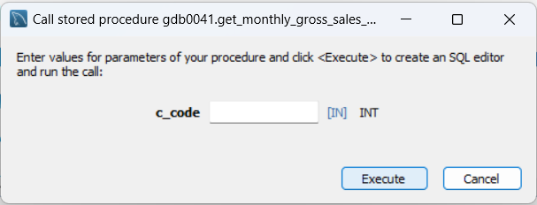
Generate monthly gross sales report for any customer using stored procedure
CREATE ` PROCEDURE ` get_monthly_gross_sales_for_customer`(c_code INT)
BEGIN
SELECT f.date,SUM(g.gross_price*f.sold_quantity) as t_gross_price
FROM fact_sales_monthly f
JOIN fact_gross_price g
ON g.product_code=f.product_code AND g.fiscal_year=GET_FISCAL_YEAR(f.date)
WHERE customer_code = c_code
GROUP BY f.date;
END

Slide 9
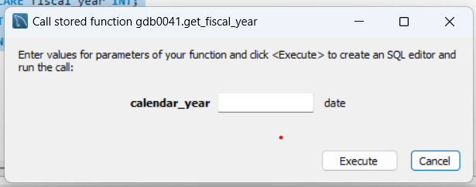
Create a function get_fiscal_year to get fiscal year by passing the date
CREATE ` FUNCTION `get_fiscal_year`
( calendar_year DATE )
RETURNS int
DETERMINISTIC
BEGIN
DECLARE fiscal_year INT;
SET fiscal_year=YEAR(DATE_ADD(calendar_year,INTERVAL 4 MONTH));
RETURN fiscal_year;
END

Slide 10
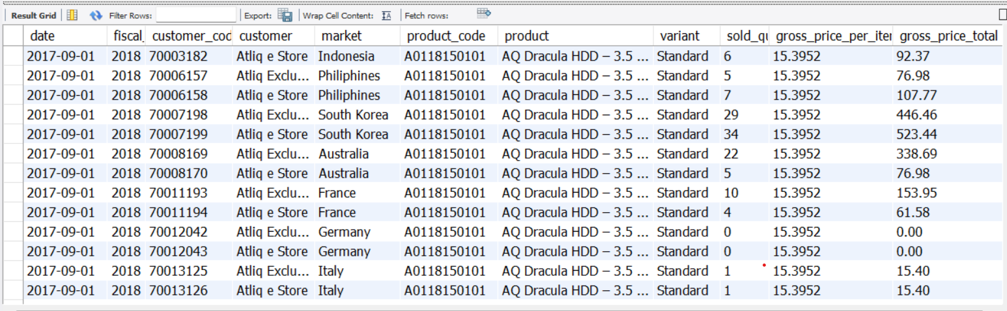
Create a view for gross sales. It should have the following columns,
date, fiscal_year, customer_code, customer, market, product_code, product, variant, sold_quanity, gross_price_per_item, gross_price_total
CREATE VIEW `gross sales` AS
SELECT
s.date,s.fiscal_year, s.customer_code,
c.customer, c.market, s.product_code,
p.product, p.variant, s.sold_quantity,
g.gross_price as gross_price_per_item,
round(s.sold_quantity*g.gross_price,2) as gross_price_total
FROM fact_sales_monthly s
JOIN dim_product p ON s.product_code=p.product_code
JOIN dim_customer c ON s.customer_code=c.customer_code
JOIN fact_gross_price g ON g.fiscal_year=s.fiscal_year
AND g.product_code=s.product_code;

Slide 11
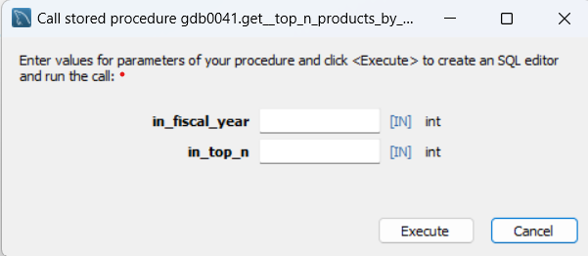
Write a stored procedure to get the top n products by net sales for a given year. Use product name without a variant. Input of stored procedure is fiscal_year and top_n parameter
CREATE PROCEDURE get_top_n_products_by_net_sales(
in_fiscal_year int,
in_top_n int
)
BEGIN
SELECT
product,
round(sum(net_sales)/1000000,2) as net_sales_mln
FROM gdb041.net_sales
WHERE fiscal_year=in_fiscal_year
GROUP BY product
ORDER BY net_sales_mln desc
LIMIT in_top_n;
END

Slide 12
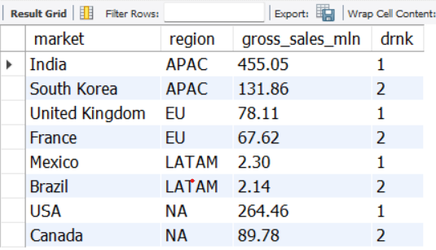
Retrieve the top 2 markets in every region by their gross sales amount in FY=2021.
WITH CTE1 AS
(
SELECT g.market,c.region,round(sum(gross_price_total)/1000000,2) AS gross_sales_mln
FROM gross_sales g
JOIN dim_customer c
ON c.customer_code=g.customer_code
WHERE fiscal_year=2021
GROUP BY g.market,c.region
ORDER BY gross_sales_mln desc),
CTE2 AS
(
SELECT
*,DENSE_RANK() OVER(PARTITION BY region ORDER BY gross_sales_mln desc) AS drnk FROM CTE1
)
SELECT * FROM CTE2 WHERE drnk<=2;

Slide 13
Thank You
Let’s Connect!!

