Slide 1
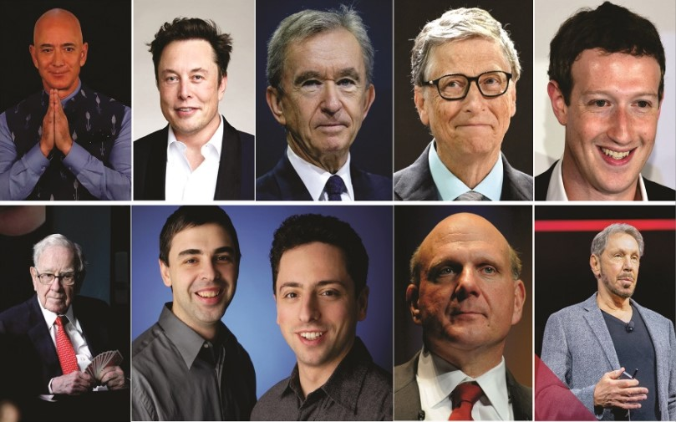
Billionaires Dataset Analysis

Slide 2
Billionaires Dataset Analysis
This Dataset contains list of all the people categorized as Billionaires of 2021 by Forbes in their 35th Annual World's Billionaires List.
Source: https://www.kaggle.com/alexanderbader/forbes-billionaires-of-2021-20
https://www.kaggle.com/v4rsh1th/bloombergbillionairesdata

Slide 3
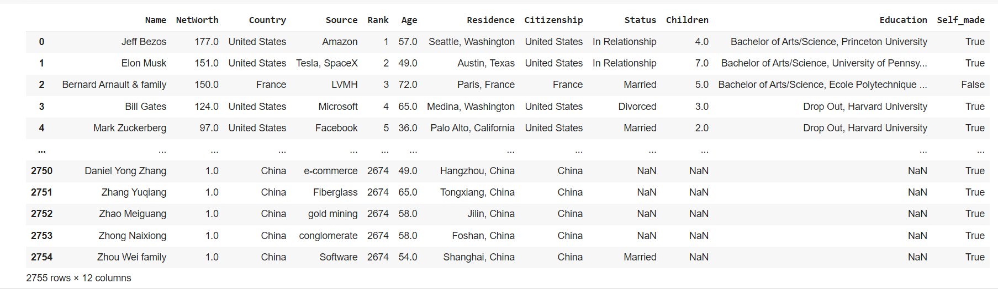
Dataset

Slide 4
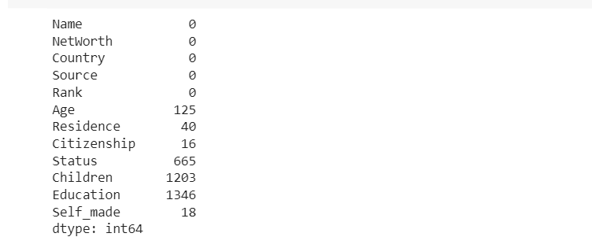
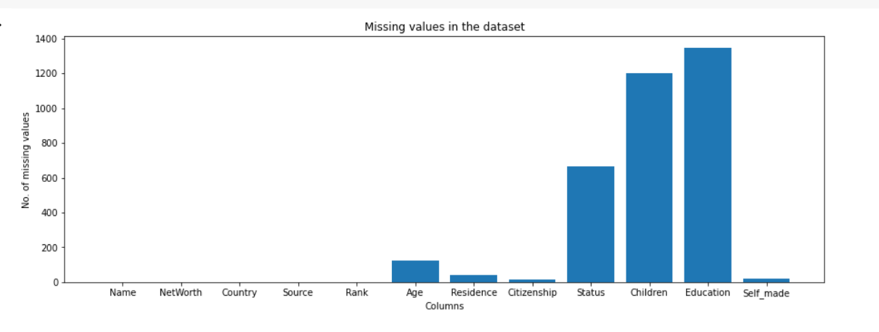
Missing Values

Slide 5
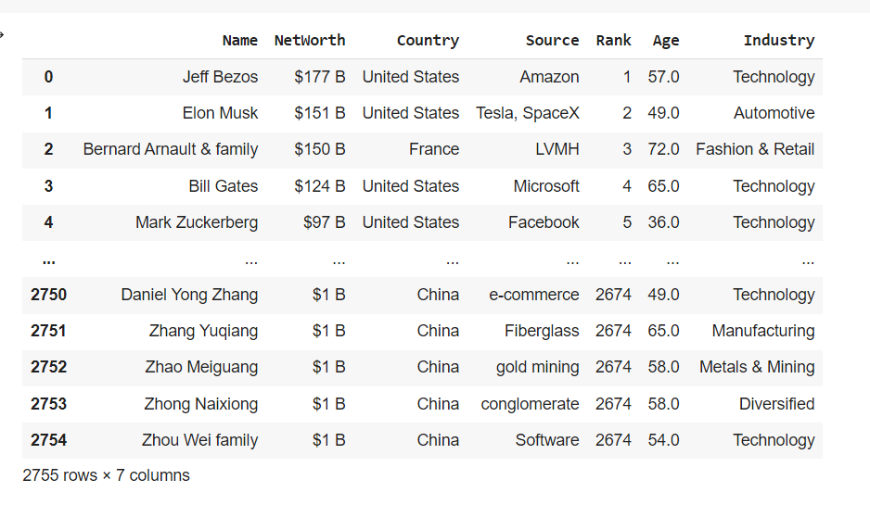
Handling Missing Values
This is another dataset from here some of the missing values were filled in the original dataset
Another feature Industry was added to the original dataset.

Slide 6
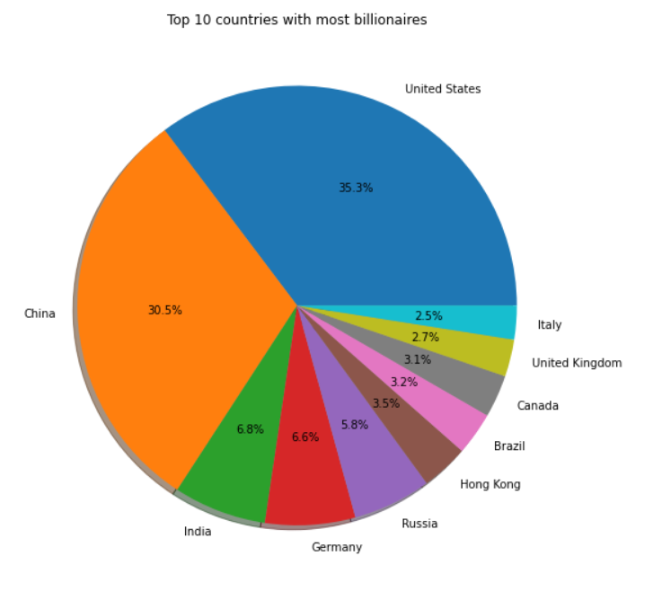
Top 5 countries with most billionaires
USA
China
India
Germany
Russia

Slide 7
Top 5 Indian Billionaires
Rank | Name | Net Worth (in Billion USD $)
10 | Mukesh Ambani | 84.5
24 | Gautam Adani & family | 50.5
71 | Shiv Nadar | 23.5
117 | Radhakishan Damani | 16.5
121 | Uday Kotak | 15.9
There are 140 billionaires from India, with 1 being in top 10.

Slide 8
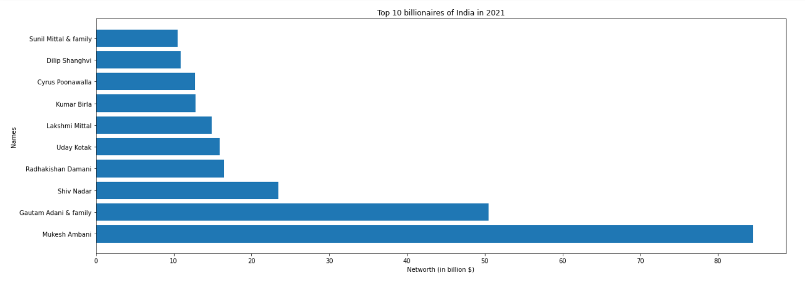
Top 10 Indian Billionaires Net worth

Slide 9
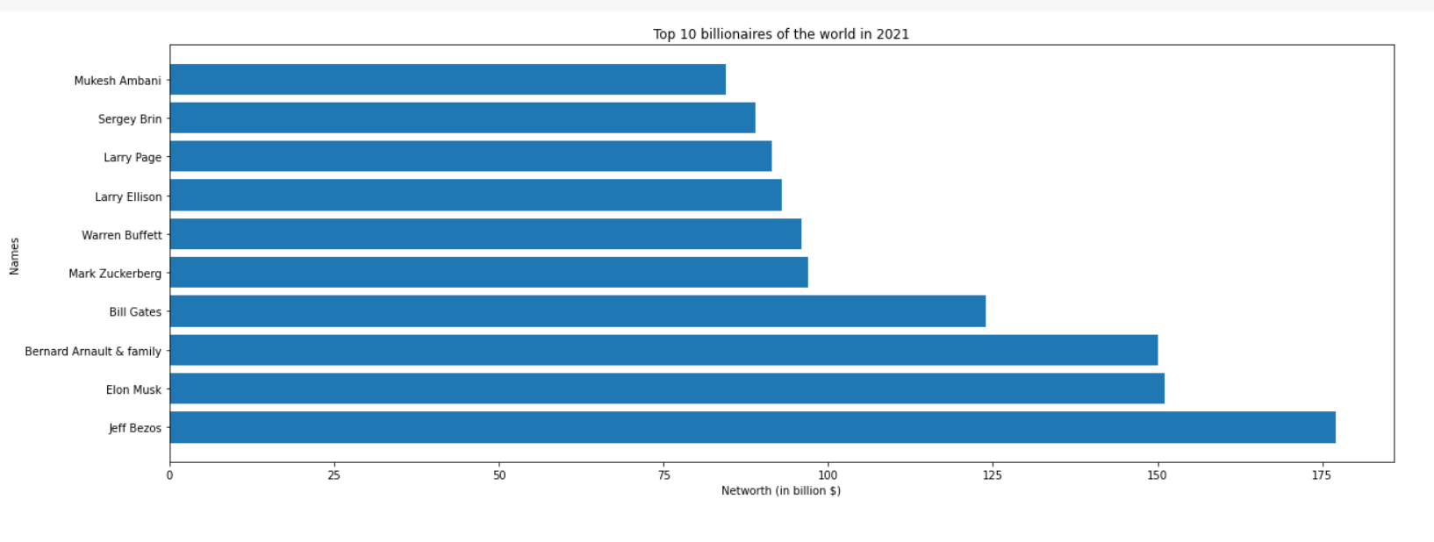
Top 10 Richest people in the world

Slide 10
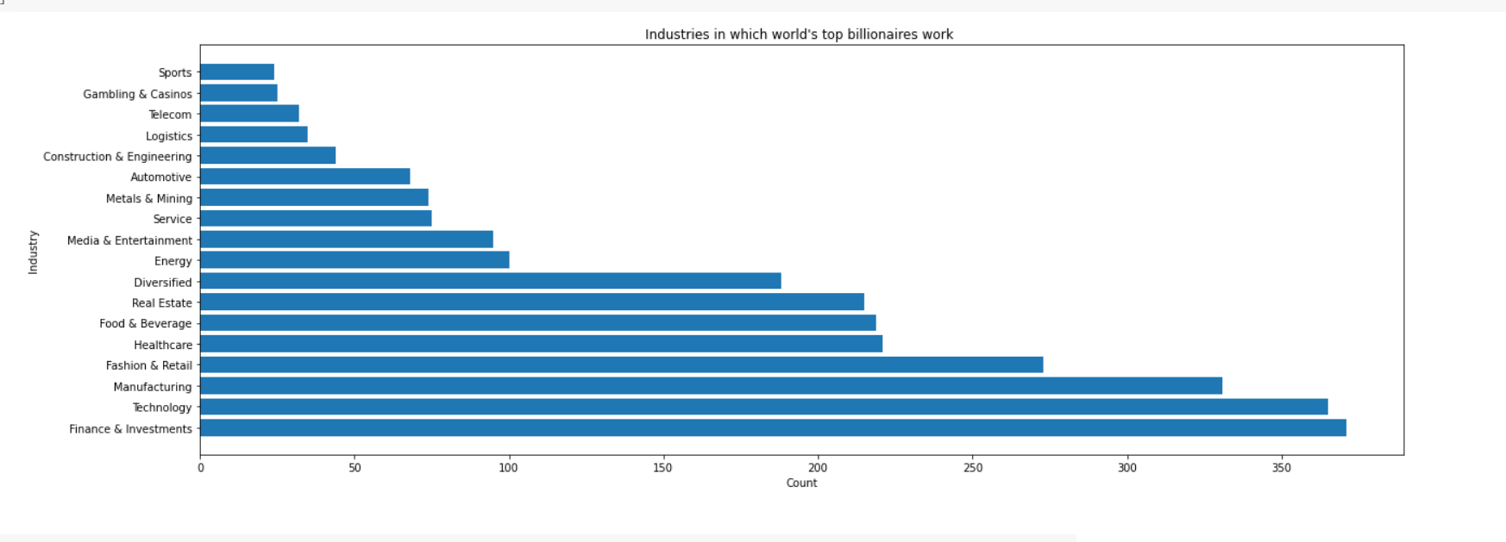
Industries

Slide 11
Majority of the billionaires work in these top 5 industries:
1. Finance & Investment 2. Technology 3. Manufacturing 4. Fashion & Retail 5. Healthcare

Slide 12
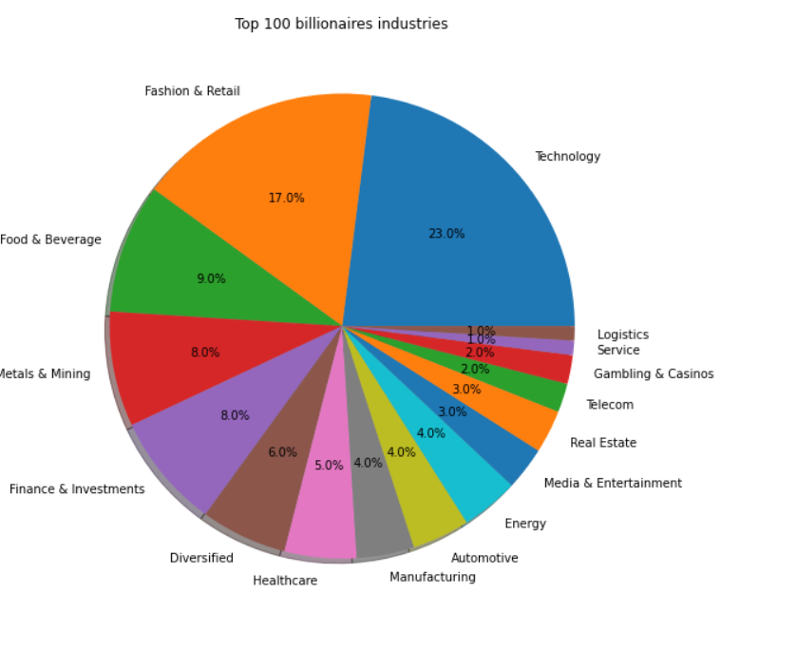
Top 100 billionaires Industries
1. Technology
2. Fashion & Retail 3. Food & Beverage 4. Metals & Mining
5. Finance & Investment

Slide 13
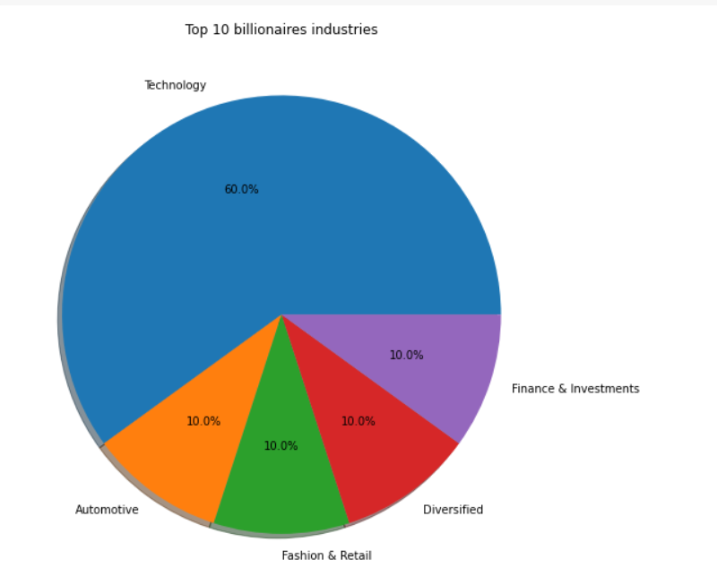
Top 10 billionaires Industries
Technology definitely seems like a promising industry.

Slide 14
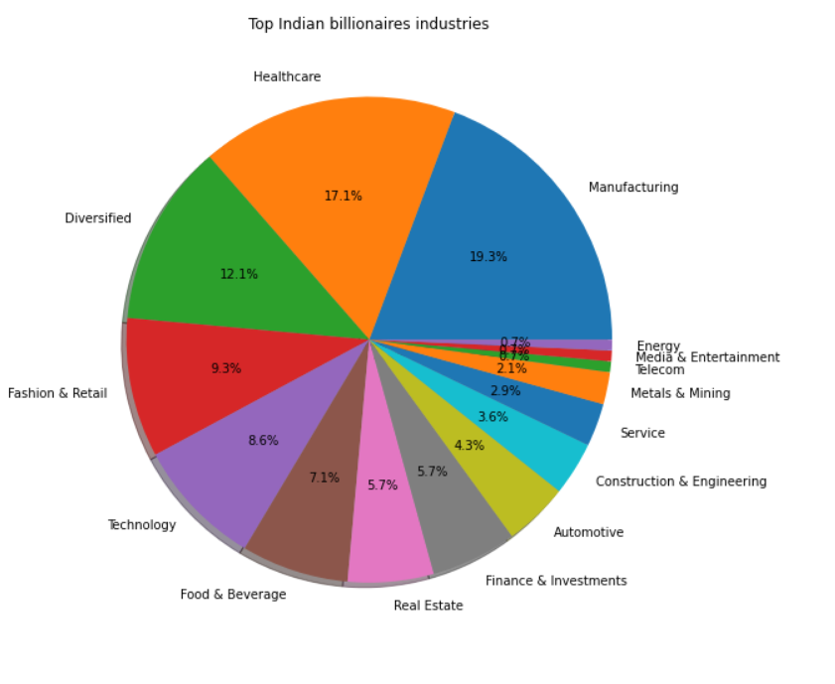
Top Indian billionaires Industries
These are the top 5 industries pursued by Indian
billionaires: 1. Manufacturing 2. Healthcare 3. Diversified 4. Fashion & Retail 5. Technology

Slide 15
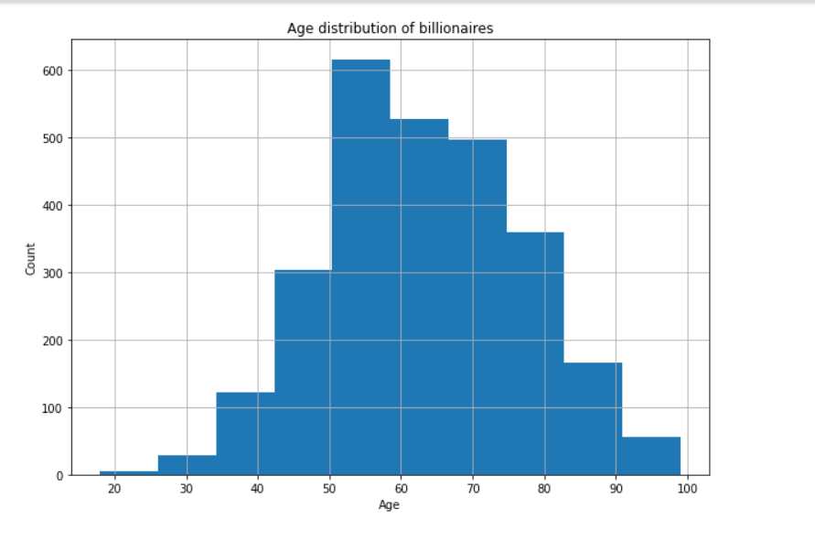
Age Distribution
It is clearly visible that majority of the billionaires lie in the age range of 50 - 60 about 699.
Mean Age = 63.11
Median Age = 63
Billionaires with age under 30 = 10
Billionaires with age above 90 = 55

Slide 16
Extremes of Age
Youngest Billionaire
Oldest Billionaire
Rank | Name | Age | Net Worth (in Billion $)
925 | Kevin David Lehmann | 18 | 3.3
Rank | Name | Age | Net Worth (in Billion $)
1580 | George Joseph | 99 | 2.0

Slide 17
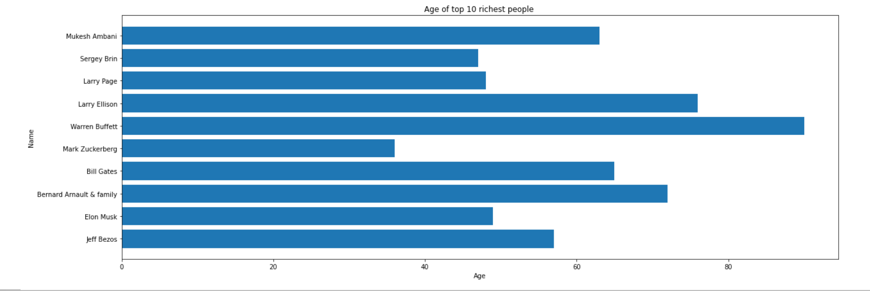
Age of top 10 richest people
Mark Zukerberg is the youngest in the top 10.
Warren Buffett is the oldest in the top 10.
Mean Age = 60.3
Median Age = 60

Slide 18
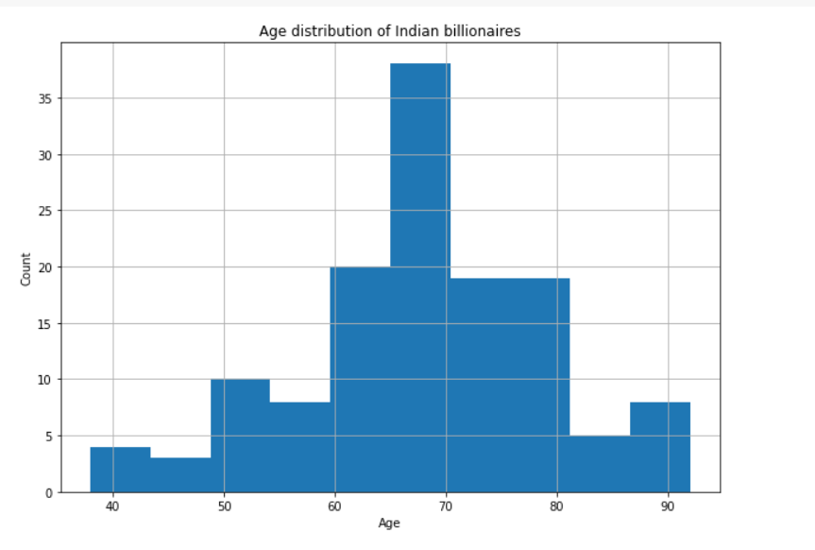
Indian Billionaires Age distribution
In India, majority of the
billionaires are in the age group 65 - 70.

Slide 19
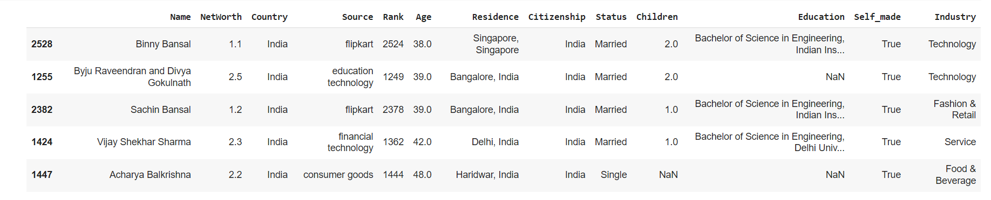
Top 5 Youngest Indian Billionaires

Slide 20
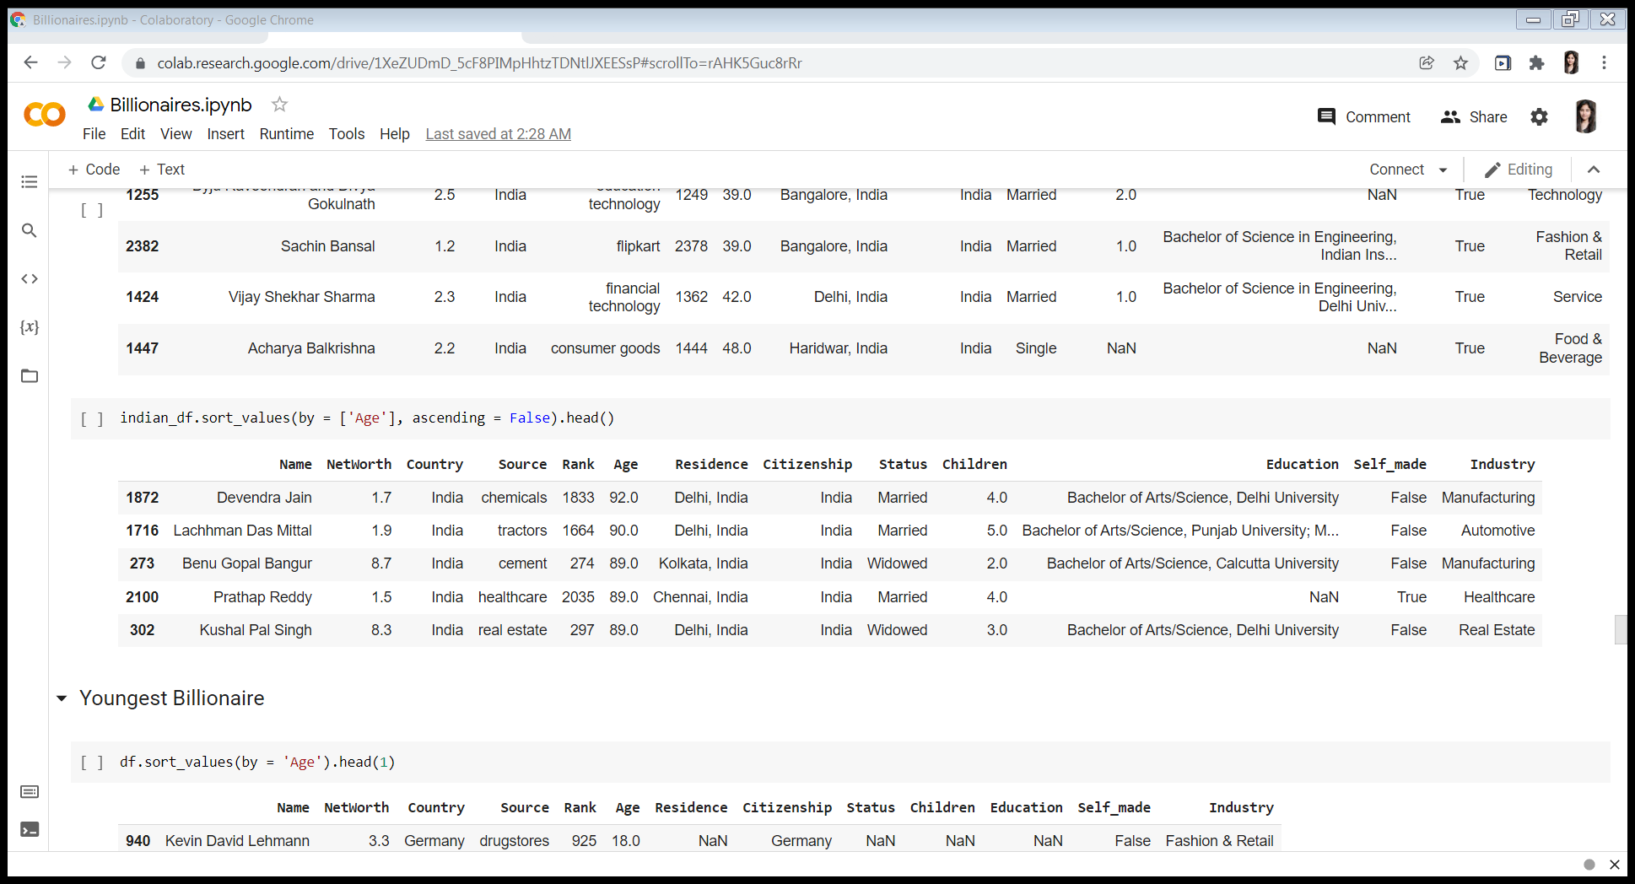
Top 5 Oldest Indian Billionaires

Slide 21
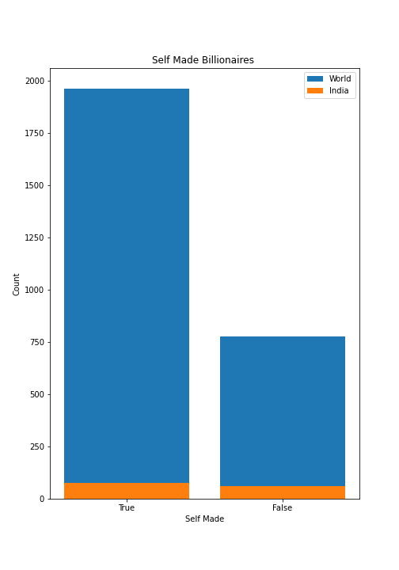
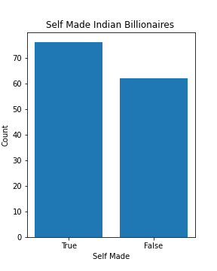
Self Made Billionaires

Slide 22
New Features from existing
From the original dataset, the Education column has been split into
2 new columns –
Course
Institute

Slide 23
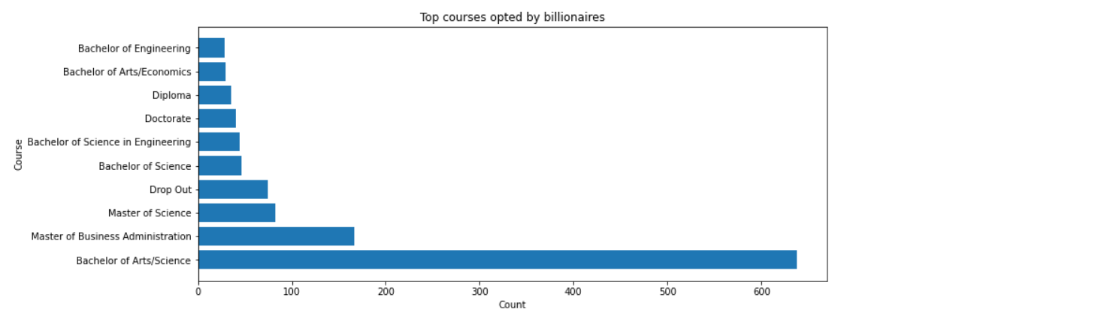
Top courses opted by billionaires

Slide 24
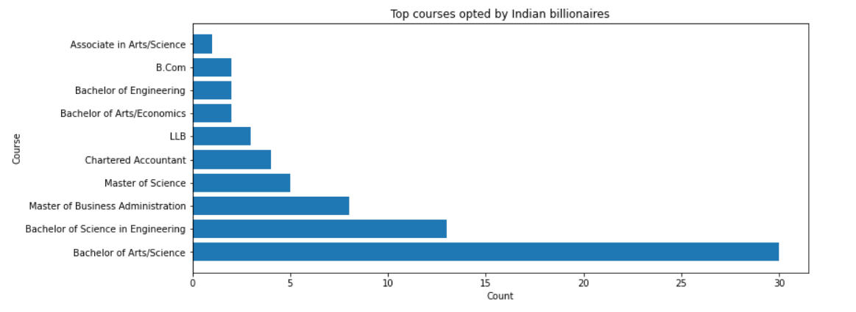
Top courses opted by Indian billionaires

Slide 25
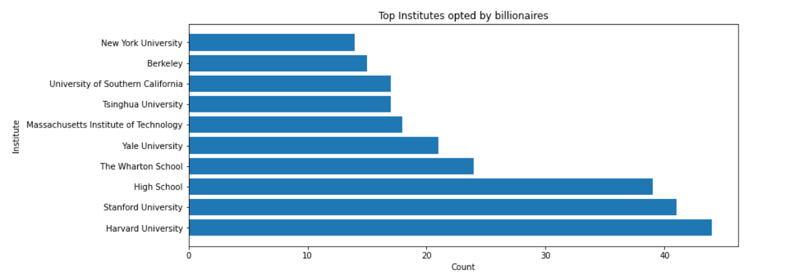
Top Institute opted by billionaires

Slide 26
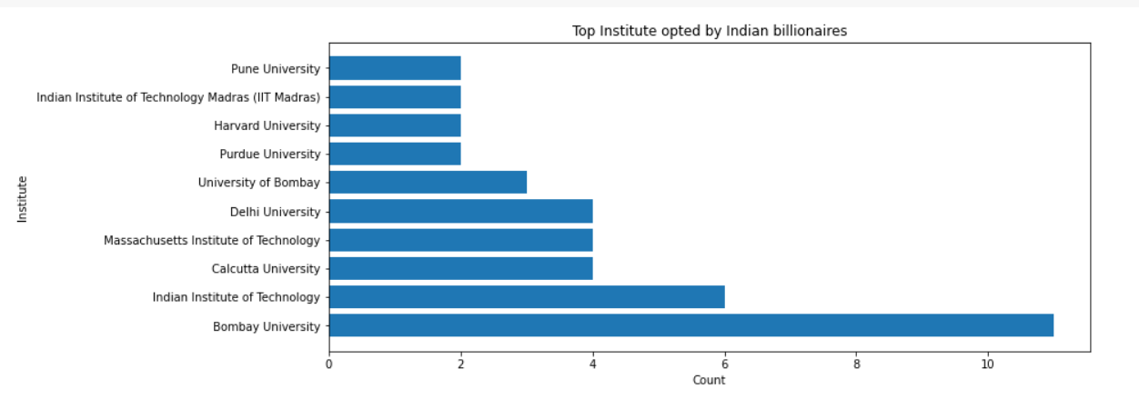
Top Institute opted by Indian billionaires

Slide 27
THANK YOU
Created by-
TANISHA YADAV

