Slide 1

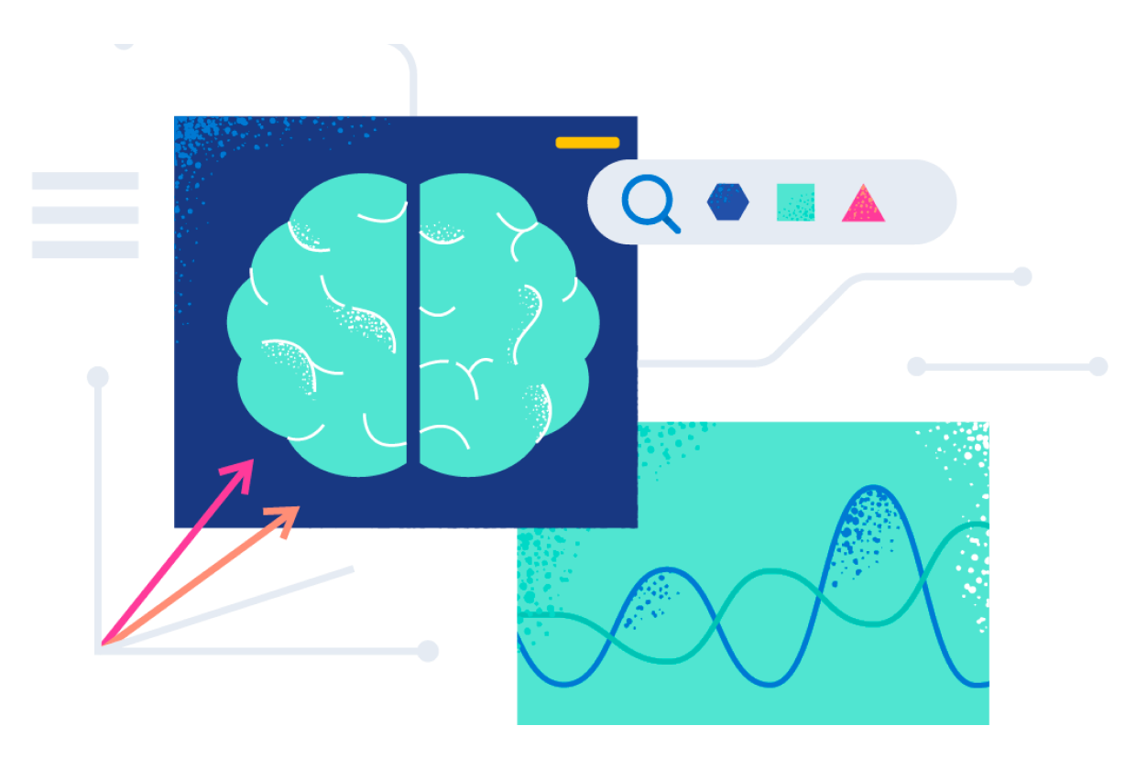
AI DRIVEN ELASTIC SEARCH GENERATOR
Submitted By: Tanisha Agrawal, 2016851
Student - B.Tech. (IT), Banasthali Vidyapith

Slide 2







Contents
Conclusion
Introduction
Google -API Key
References
Tools and tech
Literature review
Architecture

Slide 3
Introduction

Slide 4
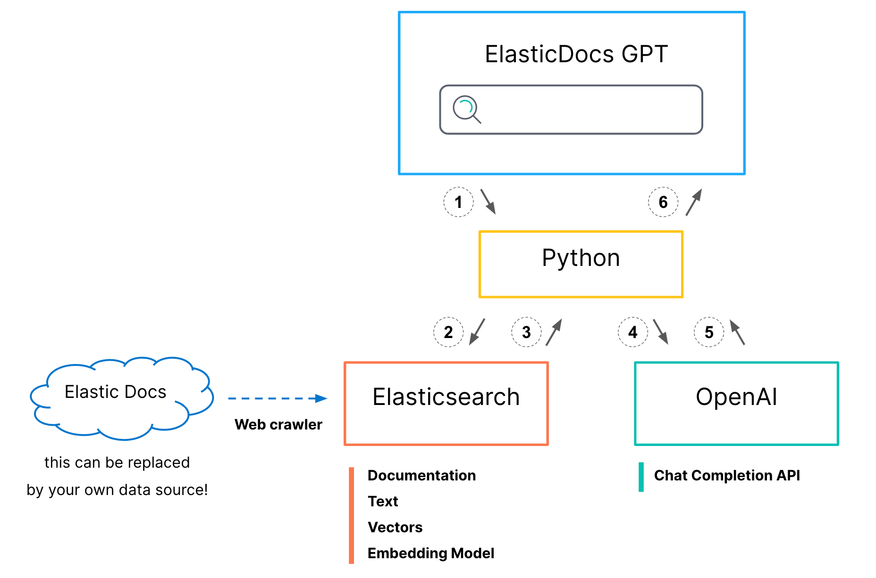
“The AI-Driven Elastic Search Generator” project leverages the capabilities of artificial intelligence to enhance the efficiency and effectiveness of search operations within large datasets. Traditional search mechanisms often struggle with processing speed and accuracy when handling vast amounts of data. This project aims to address these limitations by integrating advanced AI algorithms with Elasticsearch, a widely-used search and analytics engine.

Slide 5
Problem Statement
. Despite the powerful features of Elasticsearch, there is a significant need for more intelligent search mechanisms that can handle complex queries, deliver relevant results quickly, and adapt to user behaviour over time. Current search solutions struggle with processing large volumes of data while maintaining high accuracy and relevance. This project addresses these issues by developing an AI-Driven Elastic Search Generator that integrates machine learning and NLP to enhance the overall search process.

Slide 6
Objective
To develop a system that integrates AI with Elasticsearch for dynamic query optimization.

Slide 7
Methodology
The methodology section outlines the comprehensive approach taken to design, develop, and evaluate the AI-Driven Elastic Search Generator. It covers the system architecture, data collection, preprocessing, development of machine learning models, natural language processing (NLP) techniques, integration with Elasticsearch, and the evaluation process

Slide 8
Introduction
System Architecture
Elastic Search Configuration
System Performance
AI Integration
Challenges & Solutions
Implementations Details
Security Consideration
User Interface
Future Work

Slide 9
Literature Survey

Slide 10
AI in Search Technologies
Artificial intelligence has profoundly impacted various fields, including search technologies. AI-driven search engines leverage machine learning models and natural language processing (NLP) techniques to enhance search performance. These technologies enable the understanding of user intent, personalization of search results, and continuous learning from user interactions

Slide 11
Machine Learning Models for Search Optimization
Machine learning models play a crucial role in optimizing search queries and improving relevance scoring. Supervised learning models, such as Support Vector Machines (SVMs) and neural networks, can be trained on labeled data to predict relevant search results. Unsupervised learning models, including clustering algorithms and topic modeling, help in organizing and categorizing search results. Reinforcement learning, where models learn from user interactions, can dynamically adjust search algorithms to improve performance over time

Slide 12
ARCHITECTURE

Slide 13
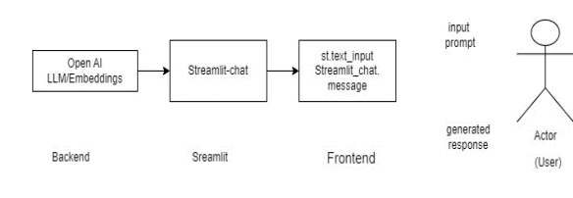

Slide 14
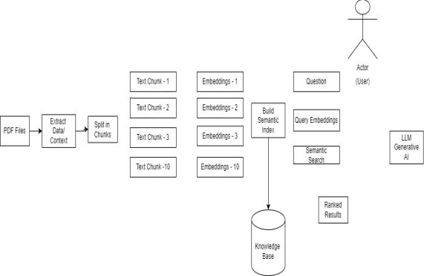

Slide 15
Tools and Technologies used

Slide 16






streamlit
Streamlit turns data scripts into shareable web apps in minutes. All in pure Python . No Front-End experience required.
Langchain
provides AI developers with tools to connect language models with external data sources
Python
Earth is the third planet from the Sun and the only one that harbors life
Tools & Tech
ChromaDB
Developed for storing and using vector embeddings
google-generative ai
AI was used to understand and recommend information. Now, generative
PyPDF2
Used to create, manipulate and decode portable documents

Slide 17
Google-API Key

Slide 18



Slide 19
Process-flow:
>> Split uploaded pdf files into chunks using text splitter
>> Embed the chunks into vectors and save in local using Google Generative Embedding Model
>> Define a prompt template (this is optional but recommended, so AI has less chance to hallucinate)
>> Using Gemini-pro LLM model get the response based on user input

Slide 20


Slide 21


Slide 22
FINAL OUTPUT

Slide 23
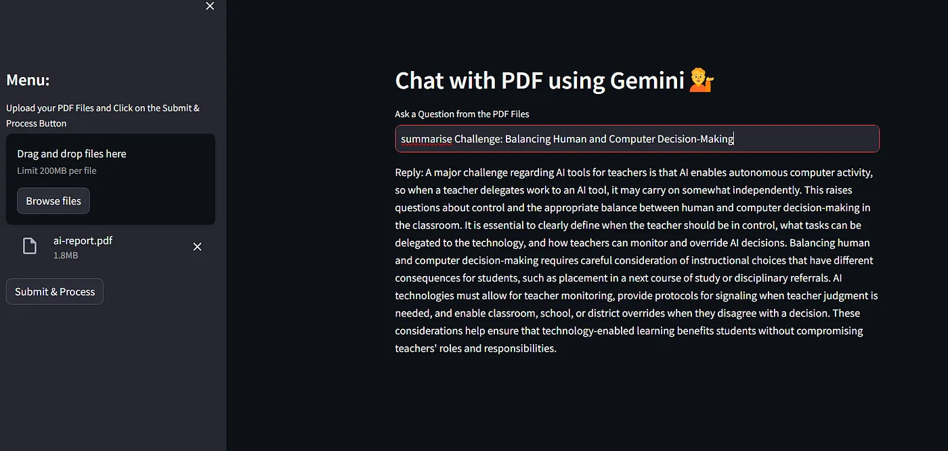

Slide 24
Conclusion
The AI-Driven Elastic Search Generator project set out to enhance the search and analytics capabilities of traditional Elasticsearch by integrating advanced artificial intelligence (AI) techniques. Through the meticulous design, development, and evaluation processes, this project has demonstrated significant improvements in search relevance, accuracy, and user satisfaction.

Slide 25
References
Manning, C. D., Raghavan, P., & Schütze, H. (2008). Introduction to Information Retrieval. Cambridge University Press..
Russell, S., & Norvig, P. (2016). Artificial Intelligence: A Modern Approach.
Jurafsky, D., & Martin, J. H. (2020). Speech and Language Processing (3rd ed.). Pearson.
Books
Research Papers
Mikolov, T., Chen, K., Corrado, G., & Dean, J. (2013). Efficient estimation of word representations in vector space. arXiv preprint arXiv:1301.3781
Devlin, J., Chang, M. W., Lee, K., & Toutanova, K. (2019). BERT: Pre training of Deep Bidirectional Transformers for Language Understanding. Proceedings of NAACL-HLT

Slide 26
Articles and Online Resources
Elastic. (n.d.). Elastic Search: The Official Distributed Search & Analytics Engine. Retrieved from https://www.elastic.co/elasticsearch/
Tutorials and Guides
Chaturvedi, A. (2020). How to Build a Search Engine with Python and Elasticsearch. Real Python. Retrieved from https://realpython.com/build search-engine-python-elasticsearch/
Tools and Frameworks
React. (n.d.). React.js - A JavaScript library for building user interfaces. Retrieved from https://reactjs.org/
Flask. (n.d.). Flask Documentation. Retrieved from https://flask.palletsprojects.com/

Slide 27
Documentation
TensorFlow. (n.d.). TensorFlow Documentation. Retrieved from https://www.tensorflow.org/
PyTorch. (n.d.). PyTorch Documentation. Retrieved from https://pytorch.org/docs/
Apache Kafka. (n.d.). Apache Kafka Documentation. Retrieved from https://kafka.apache.org/documentation/

Slide 28
Thank You

