Slide 1

Customer Churn Analysis Using Exploratory Data Analysis
Presented by: Tanisha Dolas
Tools: Python | Pandas | Matplotlib | Seaborn

Slide 2

Problem Statement
Customer churn is an important challenge for service-based businesses, as losing customers can affect revenue and business growth.
This project aims to analyze customer data using Exploratory Data Analysis (EDA) to understand customer characteristics, service usage, contract types, tenure, and billing patterns, and identify factors associated with customer churn..
The analysis will help generate meaningful insights that can support customer retention strategies.

Slide 3
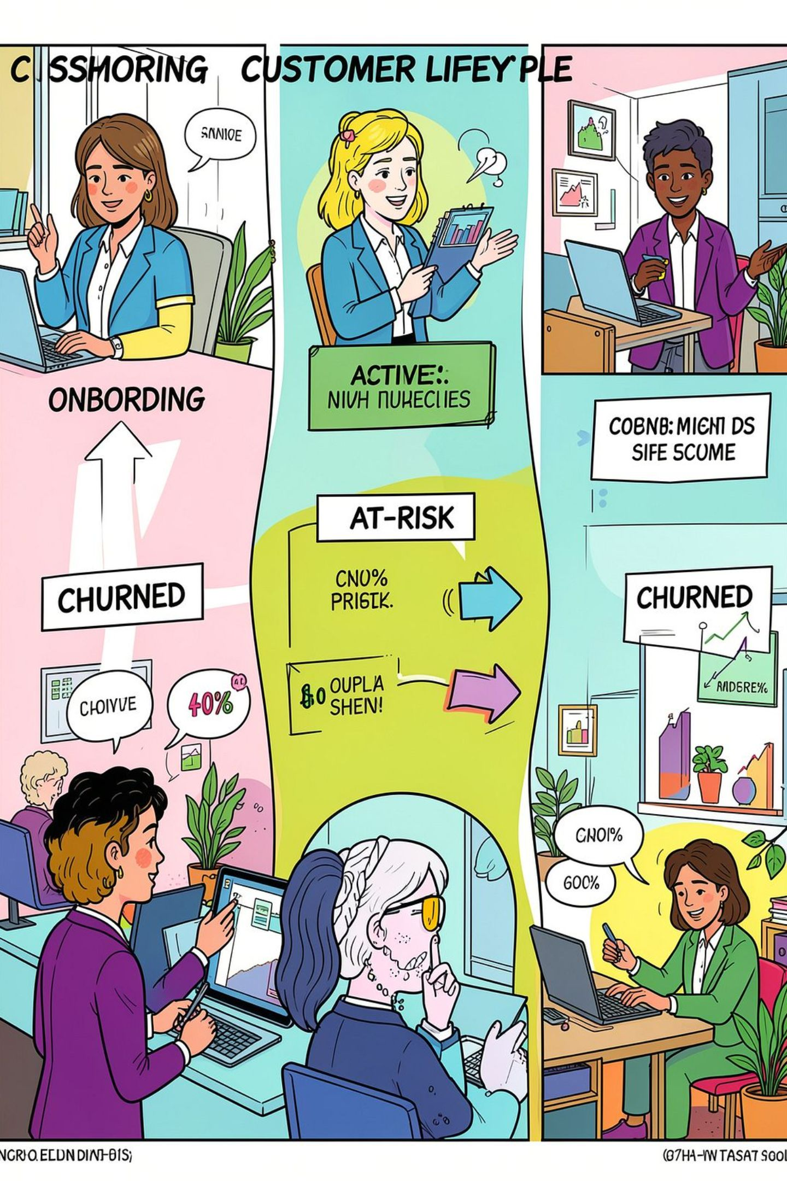
Objectives
Understand customer characteristics and service patterns.
Clean and preprocess the customer data.
Analyze customer and churn distributions.
Identify relationships between customer attributes and churn.
Discover important patterns using multivariate analysis.
Generate insights to understand customer churn

Slide 4
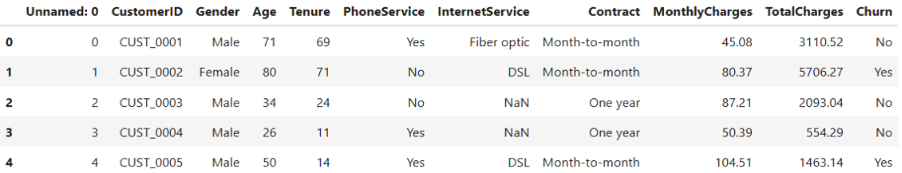
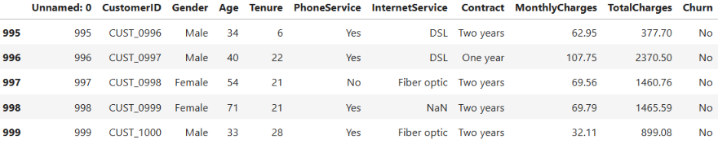
Dataset Overview
Dataset Shape: (1000, 11)
Top 5 Records
Numerical Features
Age
Tenure
MonthlyCharges
TotalCharges
Categorical features
Gender
PhoneService
InternetService
Contract
Churn
Last 5 Records
Identifier
CustomerID

Slide 5

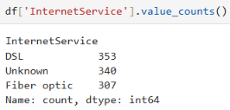
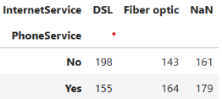
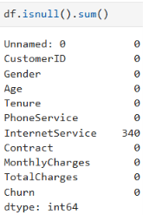

Data Cleaning & Preprocessing
Duplicate Check
Replacing missing values with ‘Unknown’
Complete duplicate rows: 0
Missing-value analysis
340 missing Internet Service values are split across both PhoneService categories. So we cannot say that missing InternetService means "No internet“. Therefore missing values are replace by ‘Unknown’.
Dropped irrelevant Column
InternetService: 340 missing values

Slide 6
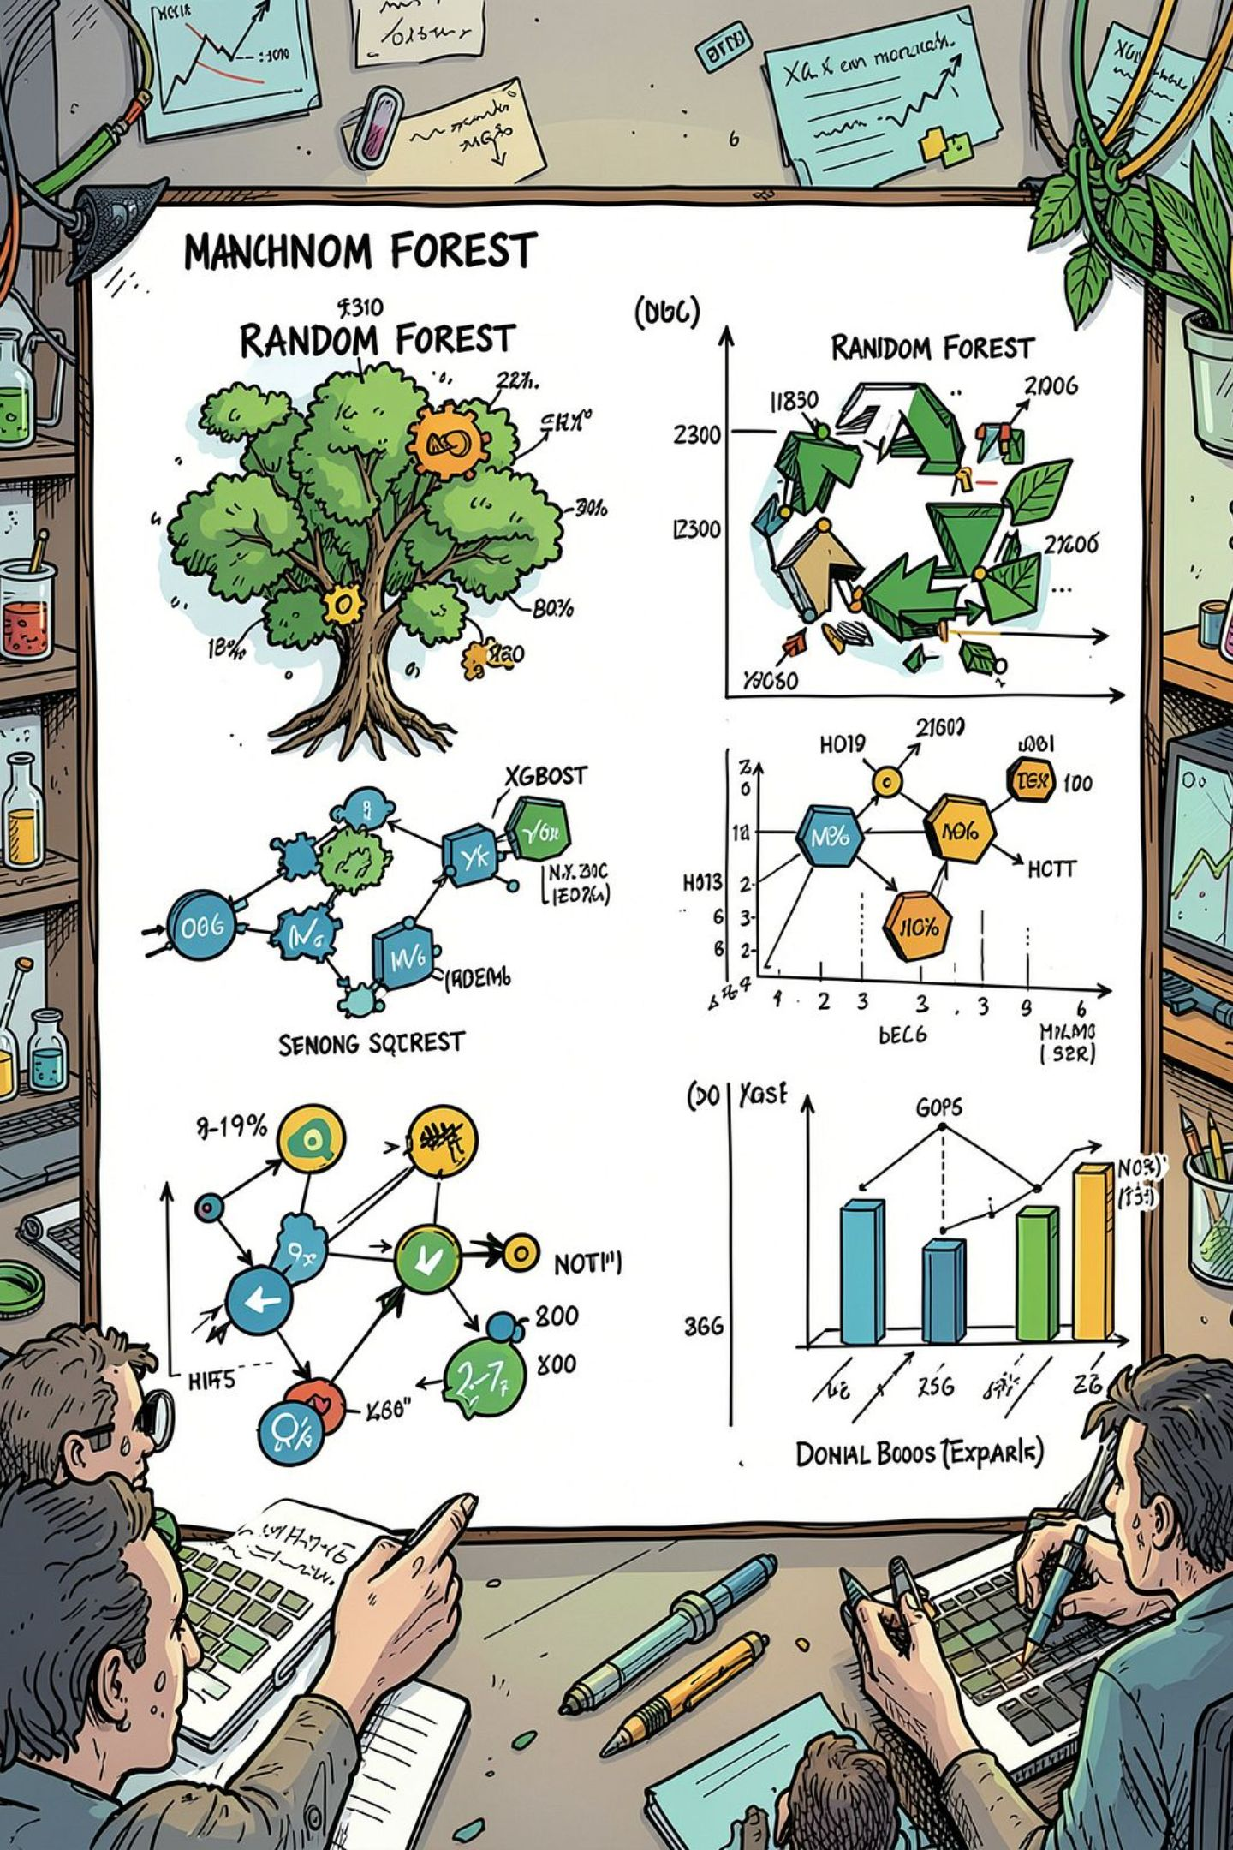

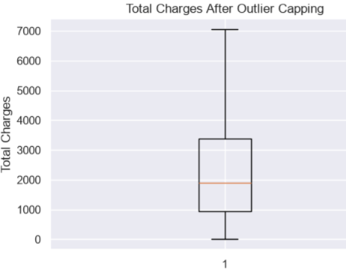
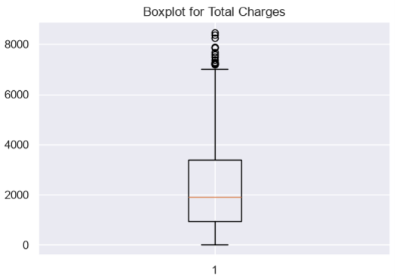
Outlier Analysis
IQR-based capping
Boxplot for Total Charges
Calculated Q1, Q3 and IQR
Applied the 1.5 × IQR rule
Capped extreme values instead of deleting records
Outliers were identified in TotalCharges and treated using IQR-based capping.

Slide 7
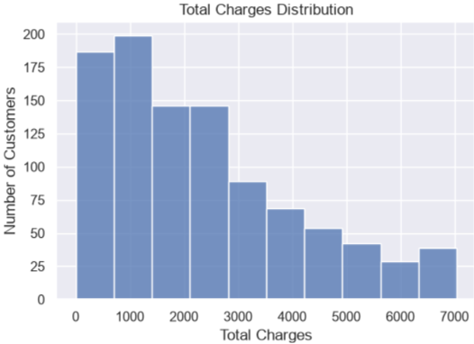
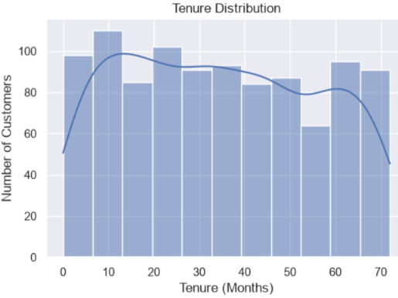
Univariate Analysis
Total Charges Distribution
Tenure Distribution
Insights
Insights
Customers have tenure ranging from 0 to 72 months.
The dataset contains both new and long-term customers.
The distribution shows how long customers have been using the service.
Most customers have lower-to-moderate total charges.
Fewer customers have higher total charges.
The distribution is positively skewed.

Slide 8
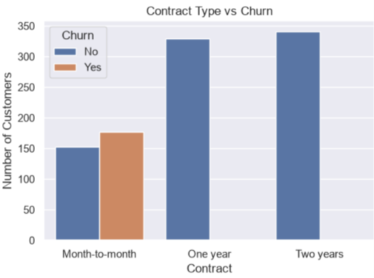
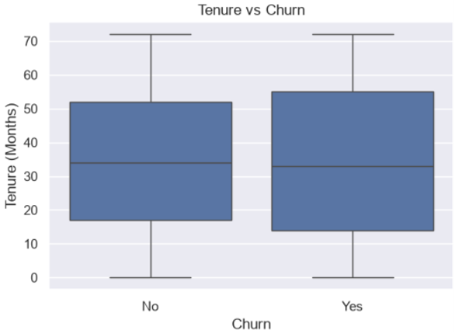
Bivariate Analysis
Contract Type vs Churn
Tenure vs Churn
2
3
Insights
Insights
Churn is concentrated among month-to-month contract customers in this dataset.
One-year and two-year contracts show no visible churned customers in this dataset.
This shows an association between contract type and churn.
The tenure distributions of churned and retained customers are broadly similar.
Both groups have a wide range of tenure values.
There is no large difference in their median tenure.

Slide 9

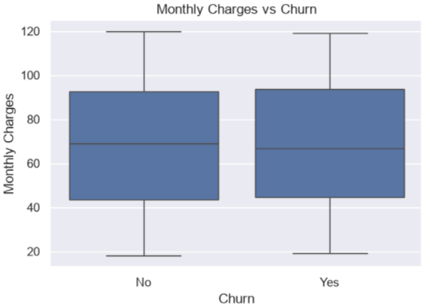
Monthly Charges vs Churn
Insights
Monthly charges show considerable overlap between churned and retained customers.
Both groups have similar ranges of monthly charges.
The graph does not show a clear separation between the two groups.

Slide 10
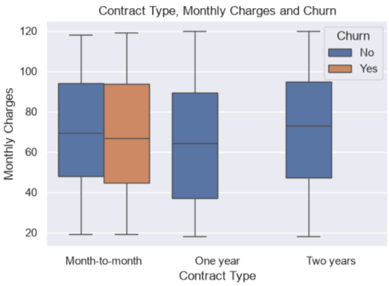
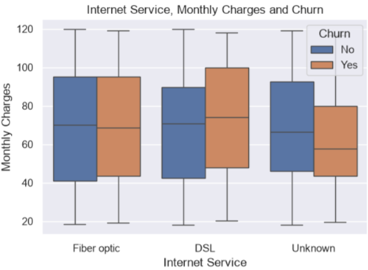
Multivariate Analysis
Contract Type, Monthly Charges & Churn
Internet Service , Monthly Charges & Churn
Insights
Monthly charges vary across the different InternetService categories.
We can compare these charge patterns between churned and retained customers.
The Unknown category represents the values that were missing in the original InternetService column and were handled during preprocessing.
Combines three variables instead of looking at them separately.
Monthly charge distributions can be compared between churn groups within different contract types.
The month-to-month category contains both churned and retained customers.

Slide 11
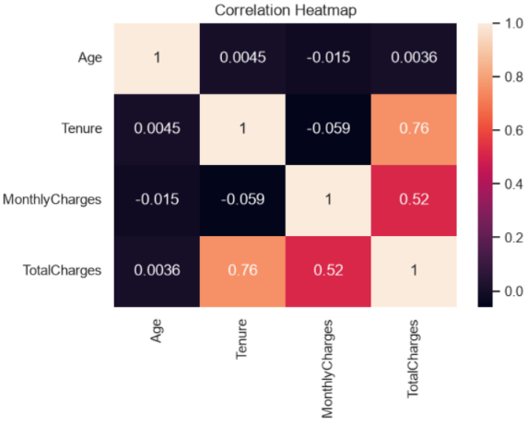
Correlation Heatmap
Insights
Tenure and TotalCharges have a strong positive correlation of 0.76.
MonthlyCharges and TotalCharges have a moderate positive correlation of 0.52.
Age has very weak correlations with the other numerical variables.
Tenure and MonthlyCharges have a very weak correlation of -0.059.

Slide 12

Key Insights & Conclusion
Key Findings
Month-to-month contracts show the visible churn pattern.
Tenure is broadly similar for both churn groups.
Monthly charges have considerable overlap between churn groups.
Tenure & TotalCharges show strong correlation (0.76).
TotalCharges was treated using IQR-based capping.
Conclusion
EDA helped identify key customer patterns and factors associated with churn, providing useful insights into customer behavior and retention.

Slide 13
Thank you ☺

