Slide 1

LEGAL SEAFOODS ONE PAGE WEBSITE FINAL
By: Tanisha Garner
GIT 417

Slide 2
PROJECT REQUIREMENTS
Build a one-page website that is 1280px wide (fixed)
Include valid and properly functional HTML, CSS and JavaScript (all in separate files)
Include features such as a Product Display, Guessing Games and a Contact Form
Implement a light or dark mode feature

Slide 3

TARGET AUDIENCE
The target audience of Legal Seafoods are families, middle-aged folks, people who love seafood, and (more niched) wine enthusiast.
DEMOGRAPHICS
Ages: 30 - 75
Middle to high income
Families
Tourists
HOW WILL THIS SITE BE USEFUL TO MY AUDIENCE ?
People will visit this site to get a better understanding of the history, mission and some of our most prided dishes that we offer. They will also be able to play a game to win a free lobster roll, along with being able to contact us through our form.

Slide 4
BACKGROUND
In this project my main goal was to create a one-page website for a mock-business, company or brand of my choosing. Working in the service industry, I decided to create a mock one-page website for Legal seafoods here in the New England area.
THE PROCESS
I first started by creating some wireframes drawn by hand to get a visual representation of the layout of each section and their elements. As I drew out each section from beginning to completion, I thought about how to make each section fit in a visually appealing, yet simple way.

Slide 5
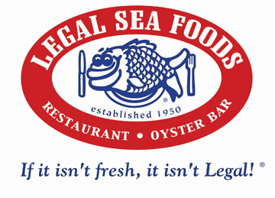
BRAND
Founded in 1950 in Cambridge, Massachusetts (originally a fish market).
Known for fresh, high-quality seafood and New England classics like clam chowder, lobster, and oysters.
Operates over 20 locations, mainly in Massachusetts.
Strict seafood standards – once partnered with the USDA to inspect fish for safety and quality.
Offers a mix of casual and upscale dining environments and experiences.
Committed to sustainability – avoids overfished or non-eco-friendly seafood (e.g., discontinued Chilean sea bass).
Features a robust wine program and curated pairings, catering to food and wine lovers.
Runs the Legal Net Rewards program that offering points, discounts, and exclusive perks.
Has a strong regional identity to the new England area while also expanding that to a new and farthest location in Chicago, Illinois.

Slide 6
CONTENT
Because I chose to create my project around a real business, I gathered image content from their website along with images on their social media platforms to use in different sections of my page.

Slide 7
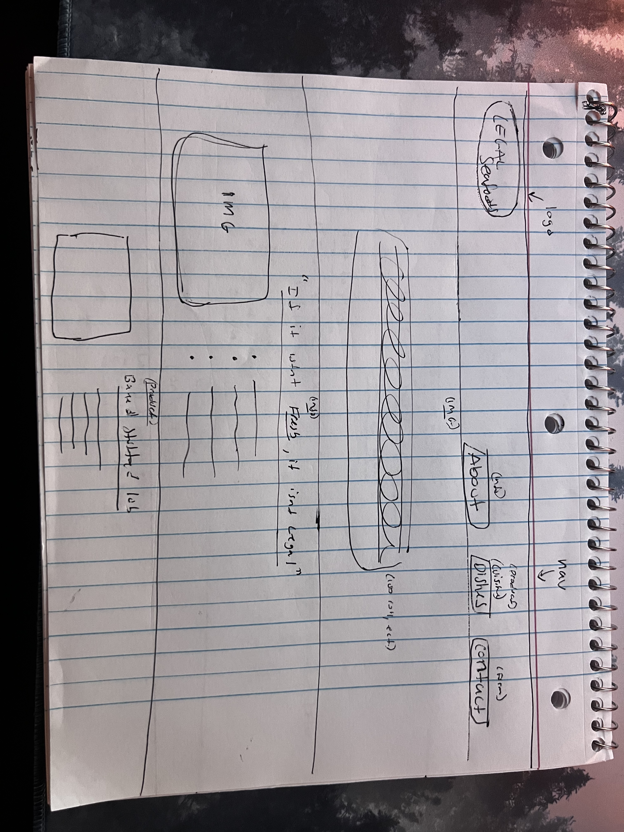
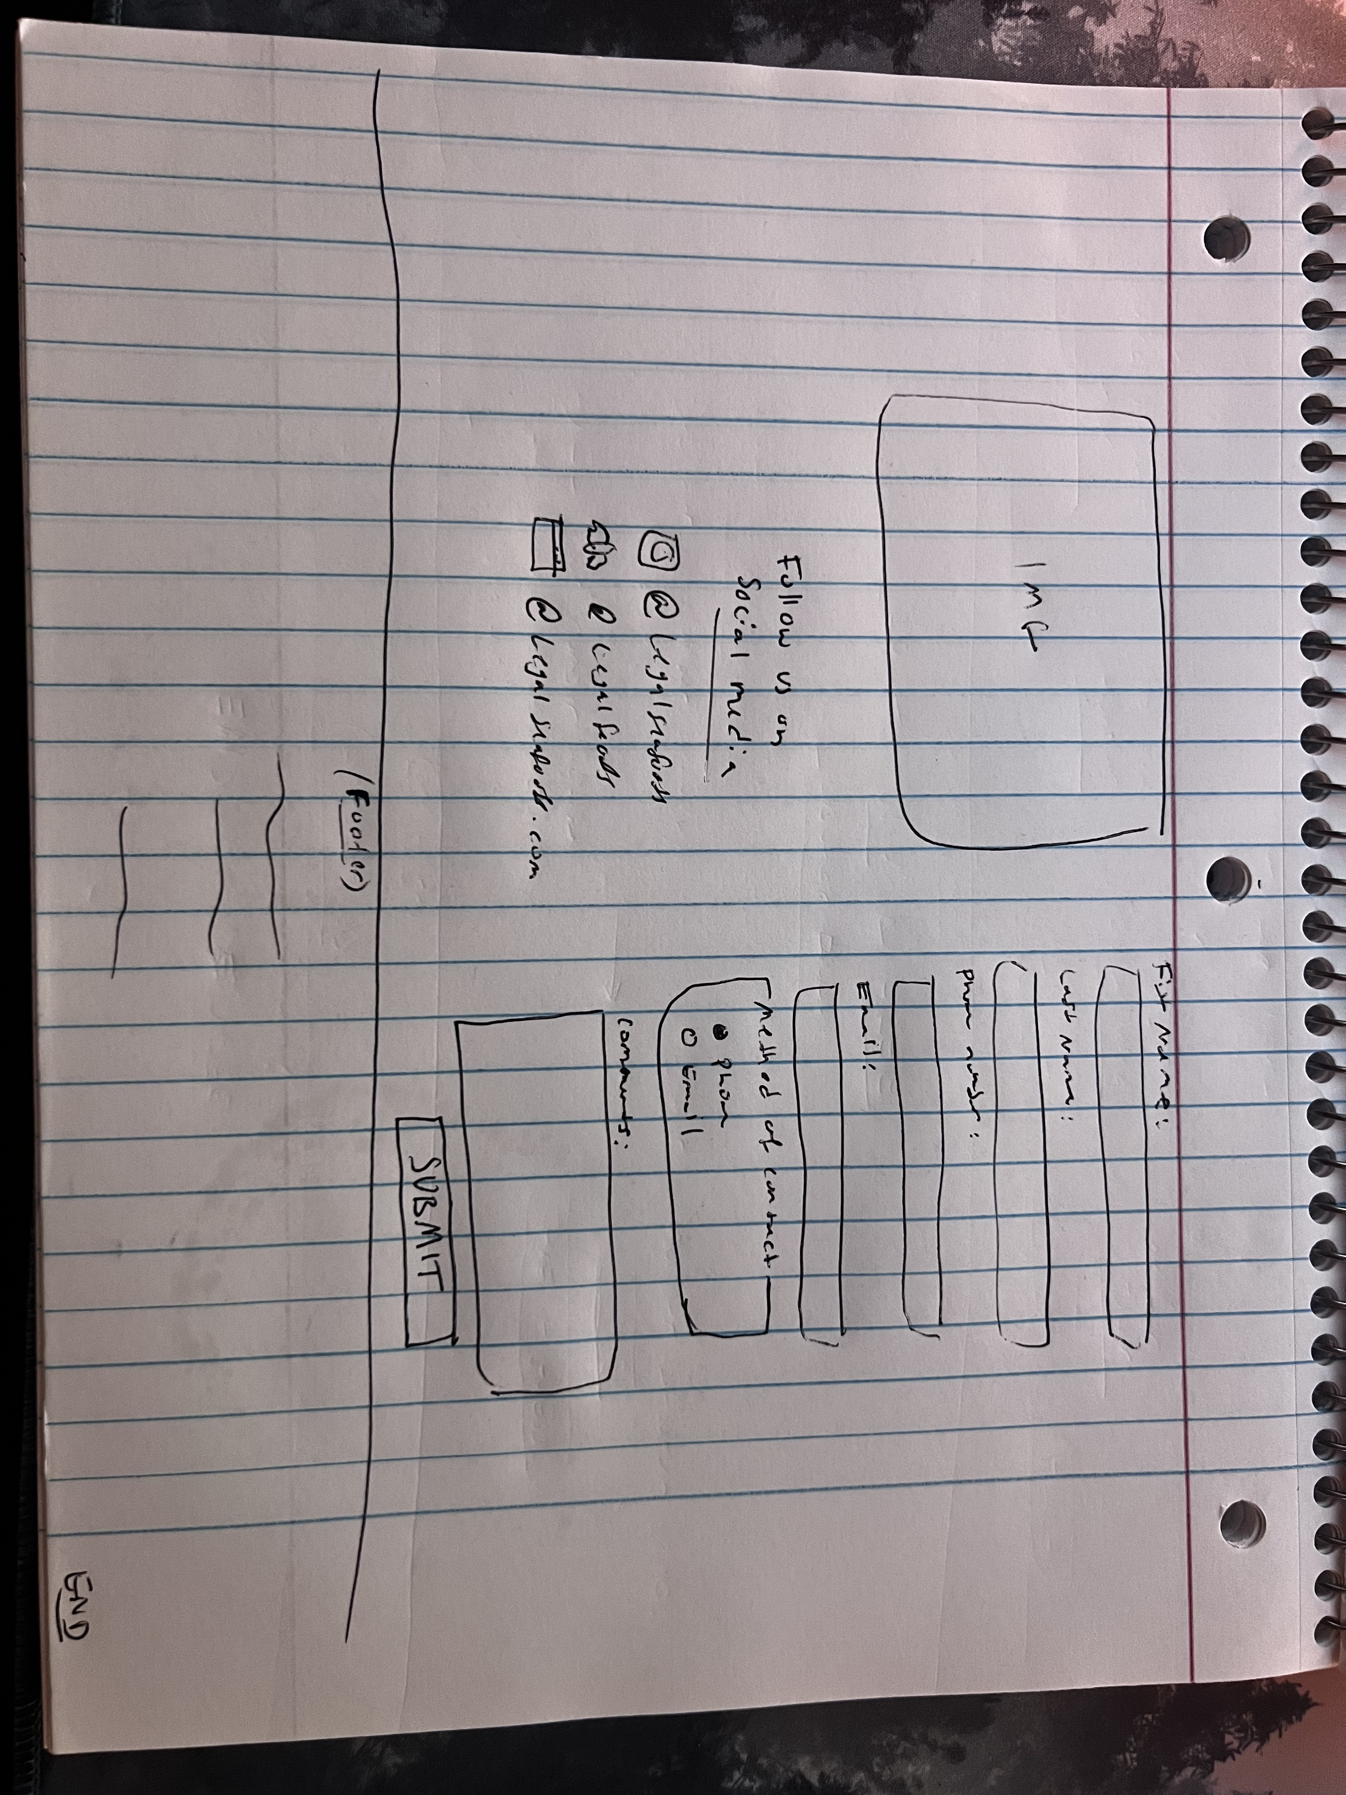
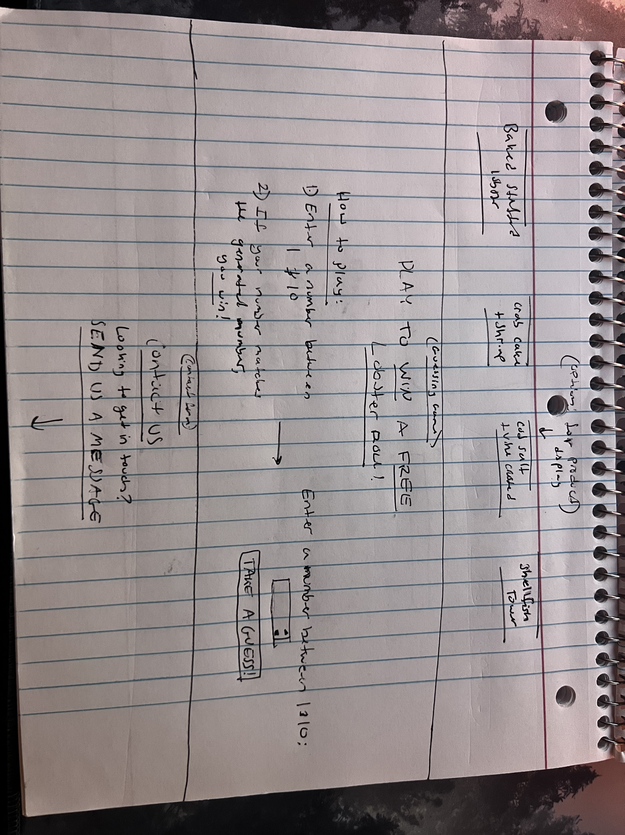
WIREFRAMES

Slide 8

HTML
I wrote the HTML code for my website based on the wireframe that I created. My wireframe was a useful guide into simplifying the structure of my page with visual representations.
I made sure to draw out lines where I knew I wanted sections to start and end. I used sections and divs to make it easy to later code for CSS styling of the page. While coding each section of my HTML, I made sure to give all of my elements proper Ids and classes.

Slide 9

CSS
Using the Ids and Classes linked to elements in my HTML file; I was able to target certain elements and style them based on the theme of the brand.

Slide 10
JAVASCRIPT
After completing my HTML and CSS files for the layout and styling of the website, I now had to include JavaScript to implement features in the product requirements.
The first feature I implemented in JS was the Product Switcher Display. I made sure to connect all proper Ids from button and product variables in my HTML and loop them through to correspond a button to a dish. I made sure to add a function that only showcases one dish and its description at a time.
The second feature I implemented was the Form and making sure it validates. I did this by creating an eventListener that only displays an error message is the user (guest) leaves an input field blank or a radio button unselected. I prevented the form from submitting if all input fields weren’t filled out with the proper information. If all information was filled out, the user (guest) would receive “Thank you” message and the form inputs would clear, indicating the message was “sent”.

Slide 11
REFLECTION
If I had more time to complete this project, I would have perfected the site by adding a a menu to the page. I also would have added a map that can show the different locations we have in New England. I would implement JavaScript to make it clickable and show a pop up of the information based on the location selected.
I learned a lot about how design paired with the functionality that JavaScript provides. This project has given me a better understanding of how they three languages work and how they are woven together for a complete project.
In the future I can improve on how to better connect between the languages and improve on my knowledge of JavaScript to further condense and clean up my code.

