Slide 2
“Cloud Computing and Virtualization Technology” PROJECT TITLE
Heart Disease Detection Using Machine Learning Algorithm in JAVA
Project Guide
Mr Abhirup Khanna

Slide 3

Under the guidance of:
Mr. Abhirup Khanna
Professor, Department of Systematics
SCHOOL OF COMPUTER SCIENCE, UPES.
SUBMITTED BY:
Tanisha Goyal CSE-CCVT R110219144
Vishal Gupta CSE-CCVT R110219153
Vishakha Sharma CSE-CCVT R110219151

Slide 4
INTRODUCTION
Heart is the next major organ comparing to brain which has more priority in human body.
Heart diseases have become a major concern to deal with as studies show that the number of deaths due to heart diseases have increased significantly over the past few decades in India, in fact it has become the leading cause of death in India
This is where Machine Learning comes into play. Machine Learning helps in predicting the Heart diseases, and the predictions made are quite accurate.

Slide 5
ABSTRACT
The correct prediction of heart disease can prevent life threats, and incorrect prediction can prove to be fatal at the same time. Heart disease describes a range of conditions that affect your heart.
Cardiovascular diseases are the leading cause of deaths annually, as per the World Health Organization. Various unhealthy activities are the reason for the increase in the risk of heart disease like cholesterol, obesity, hypertension, etc.
In this project, we have used Naïve Bayes Algorithm and analyzing dataset which consist of 14 main attributes.

Slide 6
PROBLEM STATEMENT
Heart disease can also sedentary someone’s life. If heart diseases are detected earlier then they can be treated properly and can be kept under control.
In this project, earlier detection is the main key.
We will be using Naïve Bayes Algorithm to detect Heart Disease.

Slide 7
OBJECTIVES
Our objective behind this project is to develop a heart disease detection system with accurate few tests and attributes present in heart disease.
Our goal is to predict the risk of having heart disease with few attributes and faster efficiency in form of datasets.
Also, the system will help to provide effective treatment to future patients and can also avoid severe consequences.

Slide 8
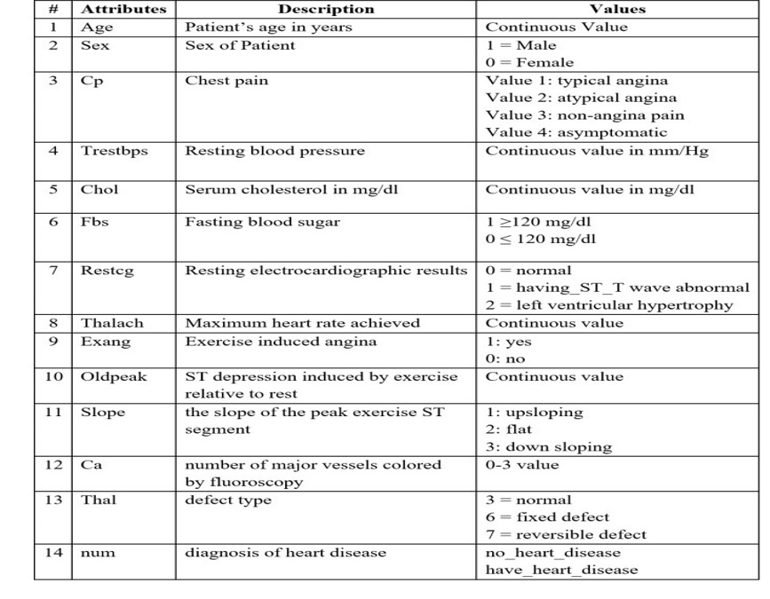
ATTRIBUTES

Slide 9
METHODOLOGY
The Heart Disease Detection System (HDDS) is done by using Naïve Bayes Algorithm.
Record set with medical attributes was obtained from the KAGGLE Heart Disease Database. With the help of the database the patterns significant to the heart attack detection are extracted.
The attribute “Diagnosis” is identified as the detectable attribute with the value as “1” for patients with disease and value “0” for patients with no disease.

Slide 10
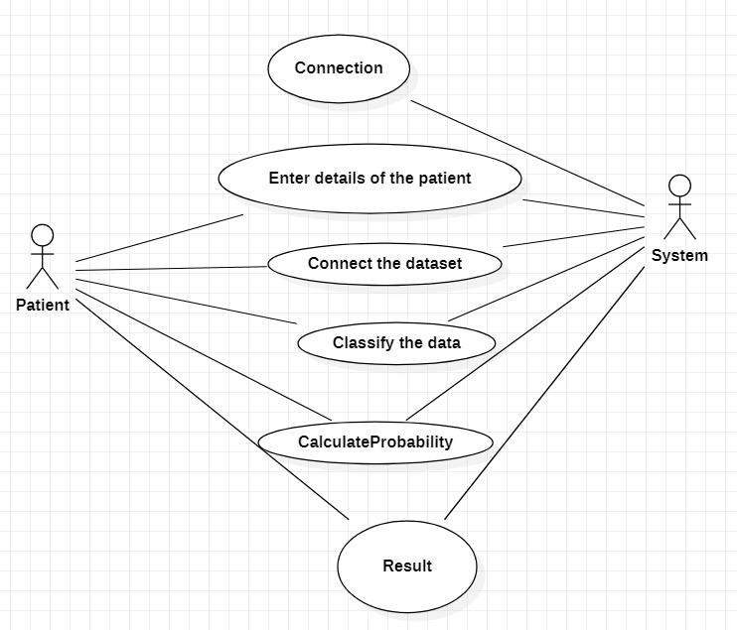
USE CASE DIAGRAM

Slide 11
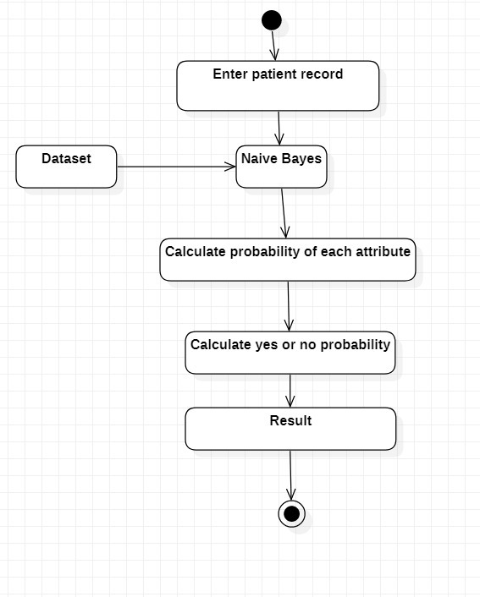
ACTIVITY DIAGRAM

Slide 12
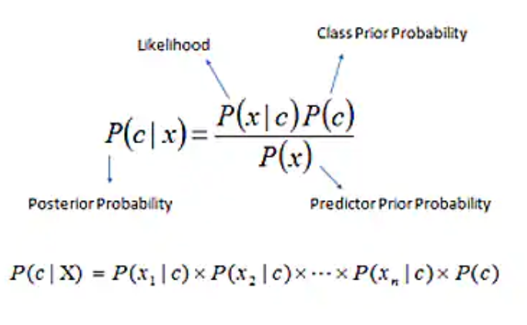
ALGORITHM APPROACH
Naïve Bayes (NB):
The naive bayes classification algo is a probabilistic classifier.
It is based on probability models that incorporate strong independence assumptions.
It is a simple technique for constructing classifiers models that assign class labels to problems.

Slide 13
WHY PREFER NAÏVE BAYES ALGORITHM?
This algorithm is used to create the model with predictive capabilities.
It deals better with big datasets.
It is preferred when attributes are independent of each other.

Slide 14
BAYES CLASSIFIER USED IN THIS MODEL
Using medical profiles such as age, gender, Chest pain, blood sugar, blood pressure, ECG, etc.
Predict the likelihood of patients getting heart disease.
It will be implemented in JAVA as table which can take medical test parameters as the user input.

Slide 15
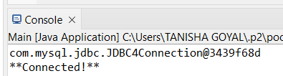
IMPLEMENTATION Connection
package Connection;
import java.sql.*;
public class MysqlConnection {
public static Connection getConnection()
{ Connection con=null;
try
{
con=DriverManager.getConnection("jdbc:mysql://localhost/rec","root","");
}
catch(Exception e) {
e.printStackTrace();}
return con;}
public static void main(String args[]) {
Connection con=getConnection();
System.out.println(con);
if(con==null) {
System.out.println("Not Connected!");}
else
{
System.out.println("**Connected!**");
}

Slide 16
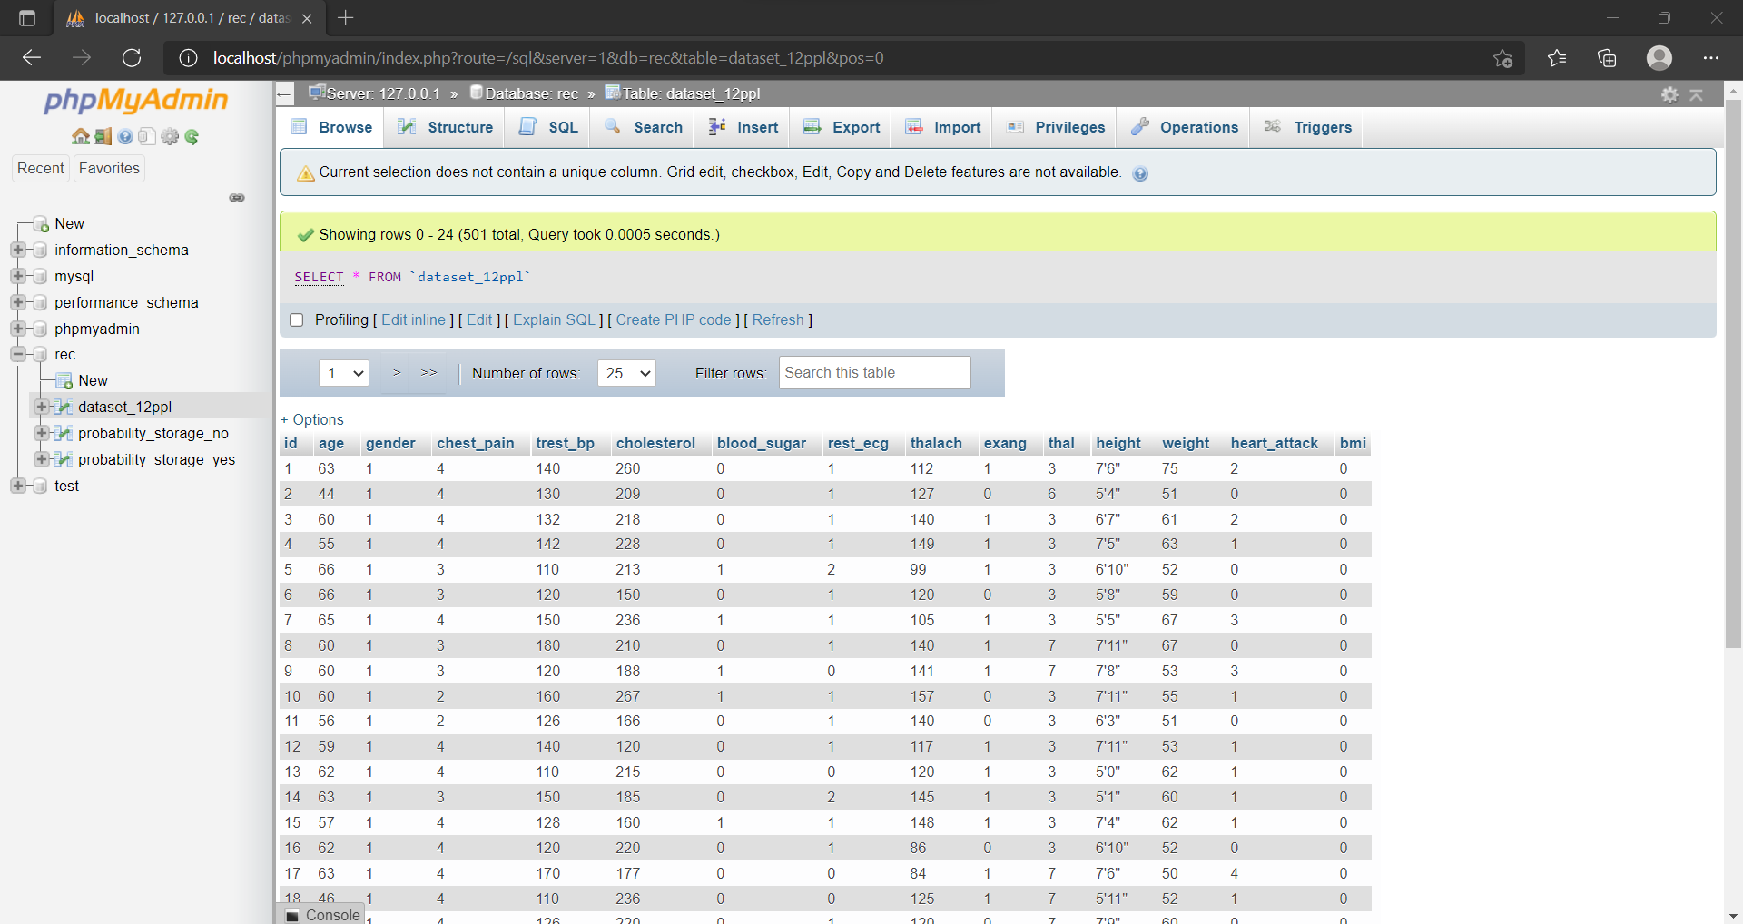
IMPLEMENTATION DataFilter
package Connection;
import java.util.*;
import java.sql.*;
import java.util.HashMap;
class patient
{
int id,age, gender;
int cholesterol, trest_bp, chest_pain;
int blood_sugar, rest_ecg;
int thalach, ps,exang, thal, bmi=0,
int heart_attack,value;
float height, weight;

Slide 17
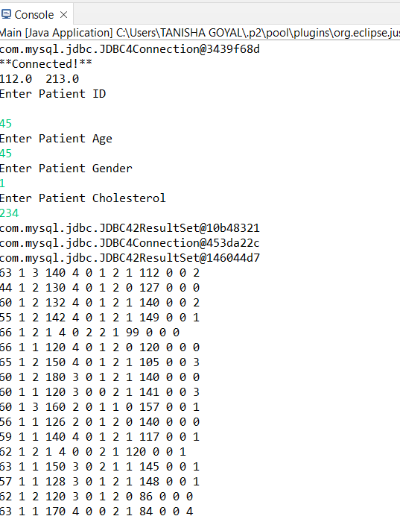
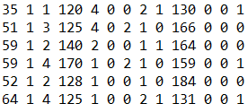
IMPLEMENTATION Naïve Bayes Used
EXTERNAL_HA_YES = HA_YES/ (float) total;
EXTERNAL_HA_NO = HA_NO / (float) total;
System.out.println(HA_YES+" "+HA_NO);
System.out.println(age + " " + gender + " " + cholesterol + " "+ trest_bp + " " + chest_pain + " " + blood_sugar + " "+ rest_ecg + " " + thalach + " " + exang + " " + thal + " " + height + " " + weight + " " + heart_attack);

Slide 18
CONCLUSION
Presently the system has been using 14 attributes of Kaggle dataset.
The dataset is stored in XAMPP Control Panel which can run on a local web server on the system.
The system is expandable in the sense that more number of records or attributes can be incorporated in this model.

Slide 19
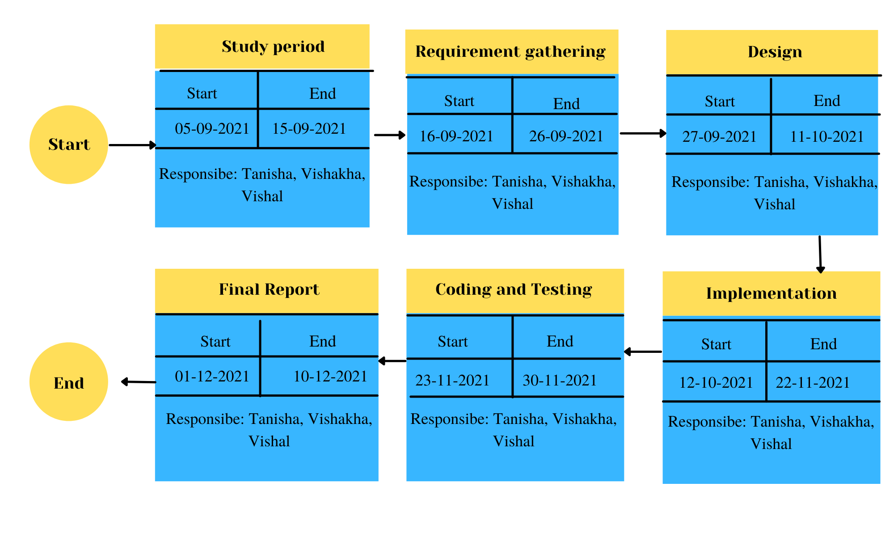
PERT Chart

Slide 20
REFERENCES
Ijirset.com. 2021. Different Data Mining Approaches for Predicting Heart Disease. [online] Available at: <http://www.ijirset.com/upload/2016/icete/cse/17_45_ICETE16_CSE_PID122.pdf>
Brownlee, J., 2021. Naive Bayes for Machine Learning. [online] Machine Learning Mastery. Available at: <https://machinelearningmastery.com/naive-bayes-for-machine-learning/>.
Research.ijcaonline.org. 2021. A Heart Disease Prediction Model using SVM-Decision Trees-Logistic Regression (SDL). [online] Available at: <https://research.ijcaonline.org/volume68/number16/pxc3887250.pdf>.
Enggjournals.com. 2021. PREDICTION OF HEART DISEASE USING K-MEANS and ARTIFICIAL NEURAL NETWORK as HYBRID APPROACH to IMPROVE ACCURACY. [online] Available at: <https://www.enggjournals.com/ijet/docs/IJET17-09-04-101.pdf>

Slide 21
GITHUB LINKS OF TEAM MEMBERS
https://github.com/Tanishagoyal12/Heart-Disease-Detection-Using-NB-Algo-in-JAVA
https://github.com/Vishu8
https://github.com/vishalgupta783

