Slide 1
Examining Unemployment Rates During Covid
Tanisha Kapoor
Lilla Bartkó
CoderGirl Data Science
28 April 2021

Slide 2
Background
2020 novel Coronavirus (COVID-19) pandemic hit US
March 2020: lockdown policies began, unfolded nationwide
April 2020: enormous job loss, esp. in service sectors
Unemployment rate hit all time high (14.8%)
Some groups of workers were hit harder than others
How did unemployment rates break down across demographic groups?

Slide 3
Method
EDA using data from Federal Reserve Economic Data (FRED) database
Accessed using API key (Quandl)
Obtained records for 17 groups
Gender, Race/Ethnicity, Age, Highest Level of Education
Visualized with time series plots

Slide 4
Method
EDA using data from Federal Reserve Economic Data (FRED) database
Accessed using API key (Quandl)
Obtained records for 17 groups
Gender, Race/Ethnicity, Age, Highest Level of Education
Visualized with time series plots

Slide 5
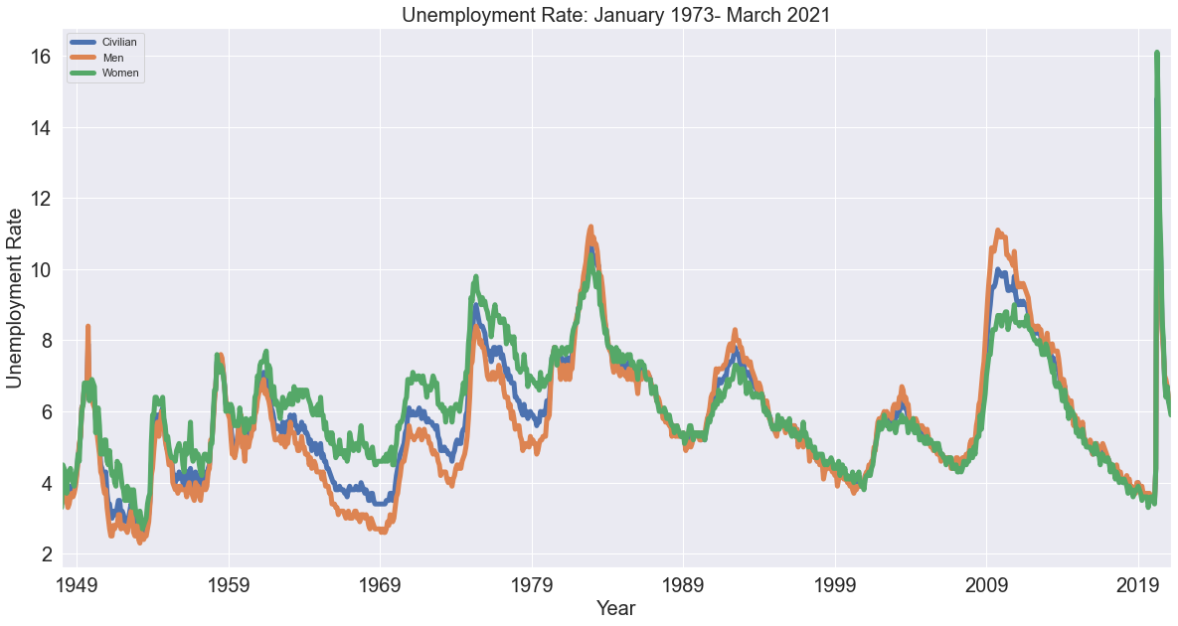
Unemployment Rate: January 1948 - March 2021
Data from Federal Reserve Economic Data https://www.quandl.com/data/FRED-Federal-Reserve-Economic-Data
Notes:
To provide some context, this figure shows the changes in unemployment rate over the past four decades. Notice that there are two periods here – a smaller scale one, about an 8 year cycle, and then a larger one that is about 20 years (this is even more evident if you look at the entire data set, starting with 1948). The overall unemployment rate, labeled as “Civilian”, is plotted in blue,. Prior to 2020, this rate ranged from a low of about 4.5% to about 11%. That sharp peak that stands out at the right is the peak unemployment rate that was reported in April 2020 – this represents claims filed after the COVID pandemic lockdown. The civilian rate reached over 16%, the highest in recorded history. We also show the different unemployment rates for women (green) and men (orange). Over the past 40 years, for some unemployment peaks, the rate was higher for women (mid-1970’s) than for men, but for most of the unemployment peaks, men had a higher rate of unemployment. This is most pronounced in 2009-2010, representing the results of the financial crisis of 2008. In the following slides, we’ll drill down to examine the COVID year and consider how the unemployment rate breaks across different demographic groups.

Slide 6
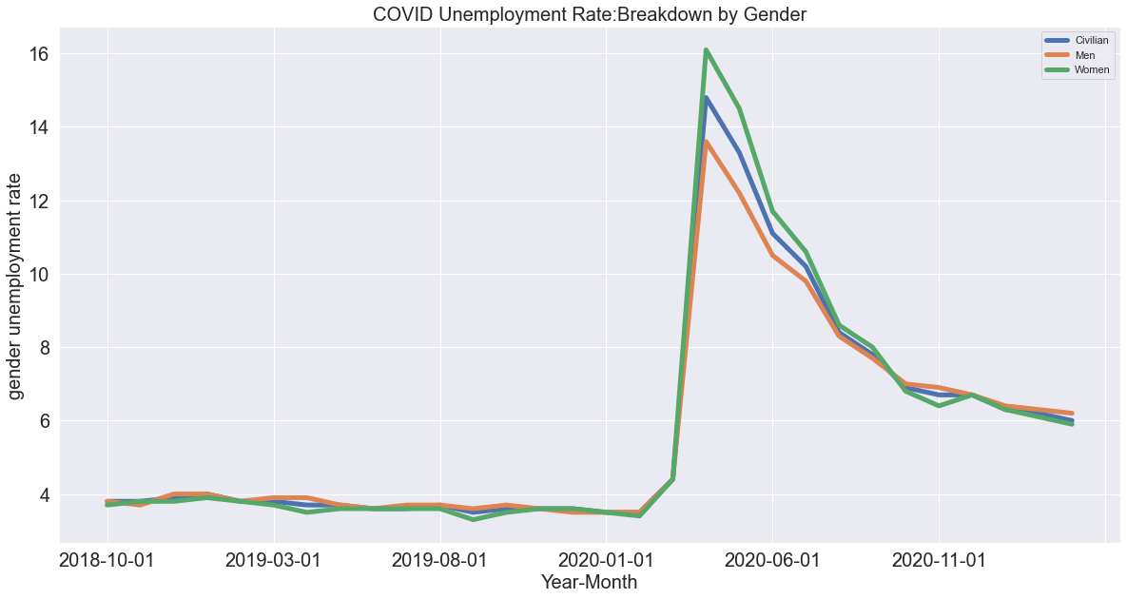
COVID Unemployment Rate:
Breakdown by Gender
Overall rate maxed at 14.8%
Women’s rate (16.1%) was higher than men’s (13.6%)
One year later, gender gap has narrowed, and men > women
Data from Federal Reserve Economic Data https://www.quandl.com/data/FRED-Federal-Reserve-Economic-Data
Notes:
To provide some context, this figure shows the changes in unemployment rate over the past four decades. Notice that there are two periods here – a smaller scale one, about an 8 year cycle, and then a larger one that is about 20 years (this is even more evident if you look at the entire data set, starting with 1948). The overall unemployment rate, labeled as “Civilian”, is plotted in blue,. Prior to 2020, this rate ranged from a low of about 4.5% to about 11%. That sharp peak that stands out at the right is the peak unemployment rate that was reported in April 2020 – this represents claims filed after the COVID pandemic lockdown. The civilian rate reached over 16%, the highest in recorded history. We also show the different unemployment rates for women (green) and men (orange). Over the past 40 years, for some unemployment peaks, the rate was higher for women (mid-1970’s) than for men, but for most of the unemployment peaks, men had a higher rate of unemployment. This is most pronounced in 2009-2010, representing the results of the financial crisis of 2008. In the following slides, we’ll drill down to examine the COVID year and consider how the unemployment rate breaks across different demographic groups.

Slide 7
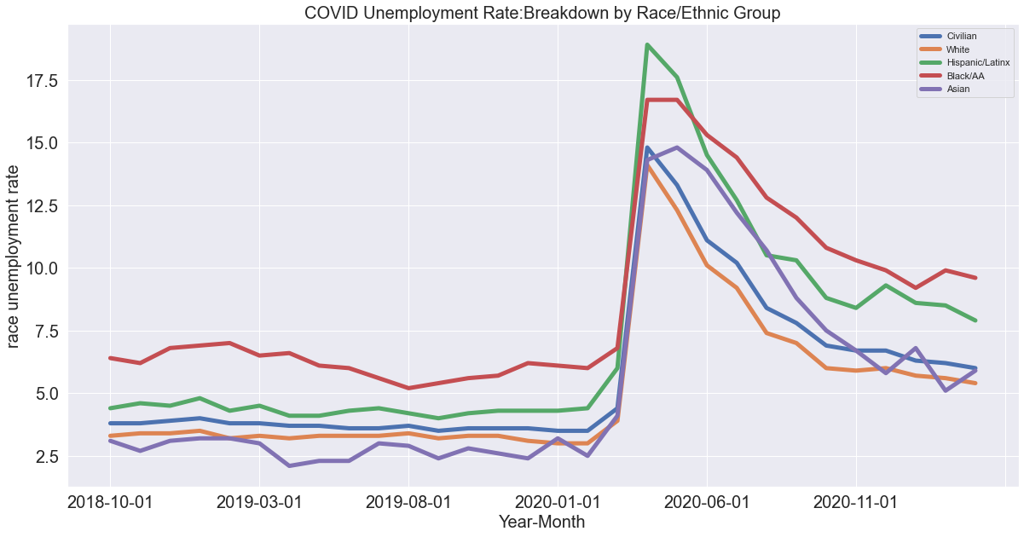
COVID Unemployment Rate:
Breakdown by Race/Ethnic Group
Peak unemployment rates highest for People of Color
Hispanic/Latinx had most dramatic increase
One year later, race gap remains, weakest recovery for Blacks, strongest for White/Asians
Data from Federal Reserve Economic Data https://www.quandl.com/data/FRED-Federal-Reserve-Economic-Data
Notes:
At the peak of unemployment (14.8%), Hispanic/Latinx had the highest rate (18.9%), followed by Black/African American (16.7). Asians (14.3%) were almost tied with Whites (14.1%). Almost one year after the pandemic, unemployment rates have decreased for all groups, yet some have recovered more slowly than others. Asians and Whites recovered most quickly and have the lowest rate (5.9% and 5.4%, respectively); Blacks have had the slowest recovery and have the highest rate (9.6%) at this time. Note: in pre-pandemic times, Blacks had the highest unemployment rate (hovering around 6.5%) and lowest for Asians (around 2.5%). Overall, Hispanic/Latinx group had the most dramatic increase in unemployment rate (#NUMBER?).

Slide 8
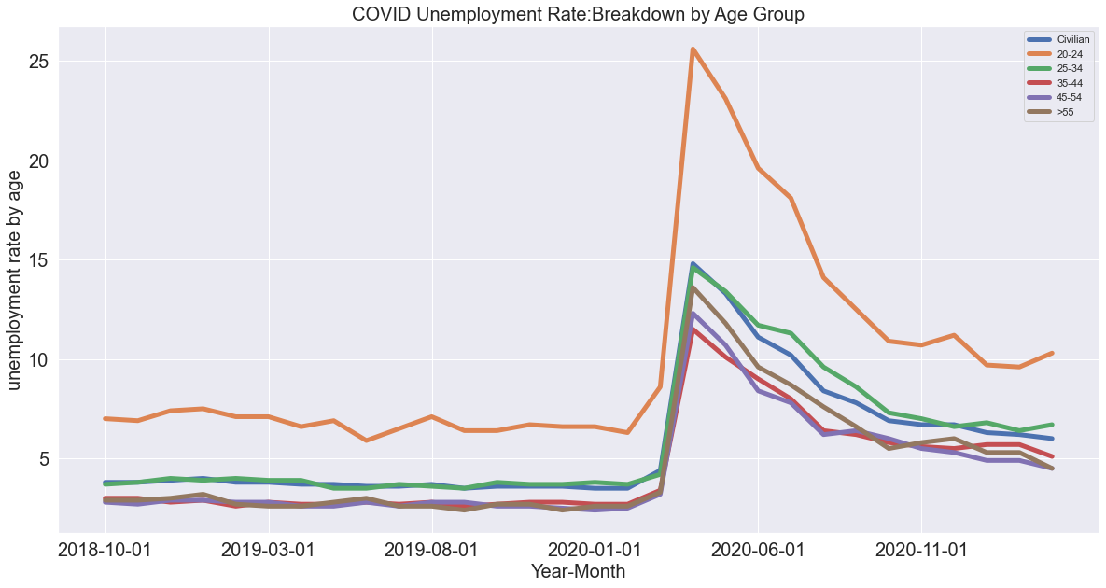
COVID Unemployment Rate:
Breakdown by Age Group
Peak unemployment rates highest for people under 25 (25.6%)
Historically, this group tends to have highest unemployment rate
They had the biggest increase in rate (19 points)
People 35 and over had the lowest rates best recovery
Data from Federal Reserve Economic Data https://www.quandl.com/data/FRED-Federal-Reserve-Economic-Data
Notes:
Here we see the time series for age groups. The youngest age group (20-24) had the highest rate of unemployment (25.6%); this result is consistent with the historical record. However, they did sustain the biggest change in unemployment rate (increase from January 2020 to April 2020 of 19 percentage points). (The other age groups all had an increase in unemployment by approximately 9 percentage points.) The next highest rate of unemployment was in the 25-34 category (14.6%). Older people (>55) was the next group to file the most unemployment claims; people 35 and over have had the best recovery.

Slide 9
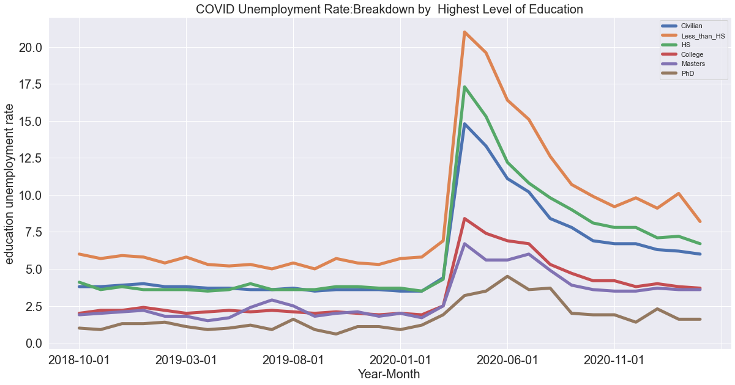
COVID Unemployment Rate:
Breakdown by Highest Level of Education
Level of education strongly segregates workforce into two groups
High school diploma or less had highest peak rate, biggest increase, slowest recovery
At least a bachelor’s had lower peak; rates have approach pre-pandemic numbers much more quickly
Data from Federal Reserve Economic Data https://www.quandl.com/data/FRED-Federal-Reserve-Economic-Data
Notes:
Finally, we look at the relationship between highest education level attained and unemployment rate. Note that the level of education is for all workers of age 25 and above. Those with the highest amount of education experienced the least job loss during the pandemic. For those with a PhD or equivalent level of education, their work lives were effectively unchanged. They may have had to work at home, but they were still employed. This particular group also did not experience the sharp peak in unemployment; maximum unemployment (4.5%) occurred in June, two months after the peak for all other groups. In contrast, the greatest unemployment rates were for those with a high school diploma (17.3%) or no diploma (21%). Having attained at least a bachelor's degree distinguishes two main groups.

Slide 10
Conclusions
Unemployment rates were highest for:
Women
People of Color
Hispanics/Latinx had highest amount of loss
Blacks have slowest recovery
Whites and Asians have lowest rates of unemployment, one year later
Young people, followed by people > 55
People with a high school diploma (or less)

Slide 11
Conclusions
Unemployment rates were lowest for:
Men
Whites
People between 34-55
People with at least a bachelor’s degree
Level of education attained segregates impact and recovery more than anything else.

Slide 12
Future Investigations
Time series data (date/rate) limited kinds of questions we could explore
Interesting to examine:
intersection of groups (e.g. race by gender or highest level of education attained
rates by employment sector
correlation with level of education attained
Need some raw data (counts of individuals per group per year, etc.)

