Slide 1
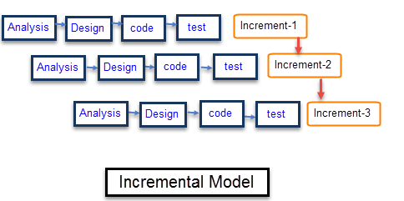
Acropolis Institute of Technology and research
Dept. of Computer Science & Engineering
Transcribe
Aim of our project is to make this application user friendly and efficient. This application can be used by anyone who has an android device and fulfills the basic requirement.
Transcribe is an android based application which is capable of scanning the image either from the gallery or from the camera. It converts the text from the image into the required language. It can also covert the text we type into different language and produce the output into a voice form. It is also used to give input in a voice form and produce output through speaker i.e. speech to text translation.
Purpose
OVERVIEW
Conclusion
This is to conclude that the project that we undertook was worked upon with a sincere effort. Most of the requirements have been fulfilled up to the mark and the requirements which have been remaining, can be completed with a short extension.
People travelling to different places find it difficult to communicate with local people as they do not know the language. They are unable to interpret the words written on any board or banner. So there is a need to develop text information extraction systems that can identify and recognize text that is contained in the images.
The scopes of this project are:
• Provide an efficient system for image to text conversion along with text to speech and speech to text conversion.
• Provide effective solutions and make them available at a single platform.
• Provide simpler version of the converter.
Model Used
Requirements
The Specific requirements of his project is
From user point of view is
1. Internet Connection
2. Basic general knowledge of internet.
3. Camera embedded device
Submitted by:
Tanisha Singhai 0827CS181223
Shruti Kanungo 0827CS181201
Srashti Gupta 0827CS181215
Vaishnavi Tiwari 0827CS181230

