Slide 1

QR CODE GENERATOR USING DEEP LEARNING
Final evaluation
Presented by:
Aakash Bhat (2020a1r039
Harshdeep Singh (2020a1r046)
Tanish Gupta (2020a1r057)
Snowber Hamid (2020a1r065)
Yuraj Khajuria (2020a1r047)
DEPARTMENT OF COMPUTER SCIENCE AND ENGINEERING
MIET(Autonomous),JAMMU

Slide 2
Contents
Problem Statement
Solution
Teck Stack & Modules
Features
Workflow

Slide 3
Problem Statement
The previous Barcodes were able to store only 20 alphanumeric characters.
One way of scanning – top to bottom
Data stored in one dimensional array of pixels
Dedicated scanner is required

Slide 4
Solution
The data stored in a QR code can include website URLs, phone numbers, or up to 4,000 characters of text.
QR codes can also be used to:
Link directly to download an app on the Apple App Store or
Google play store.
Authenticate online accounts and verify login details
QR codes are frequently used to track information about products in a supply chain.

Slide 5
Teck Stack & Modules
QR Code module
HTML – (used for creating structure of web page)
CSS – (describes how HTML elements are to be displayed on screen)
Django – (makes it easier to build web pages using Python)

Slide 6
Features
Quick and error free
More informative
Cost-Effective
Scannability

Slide 7
WORKFLOW

Slide 8
Workflow input
(URL)
P
Press the generate button
ress the generate button
QR code generated
ode generated
C
Clicking on the above QR we can download the application as well
licking on the above QR we can download the application as well

Slide 9
Demonstration

Slide 10
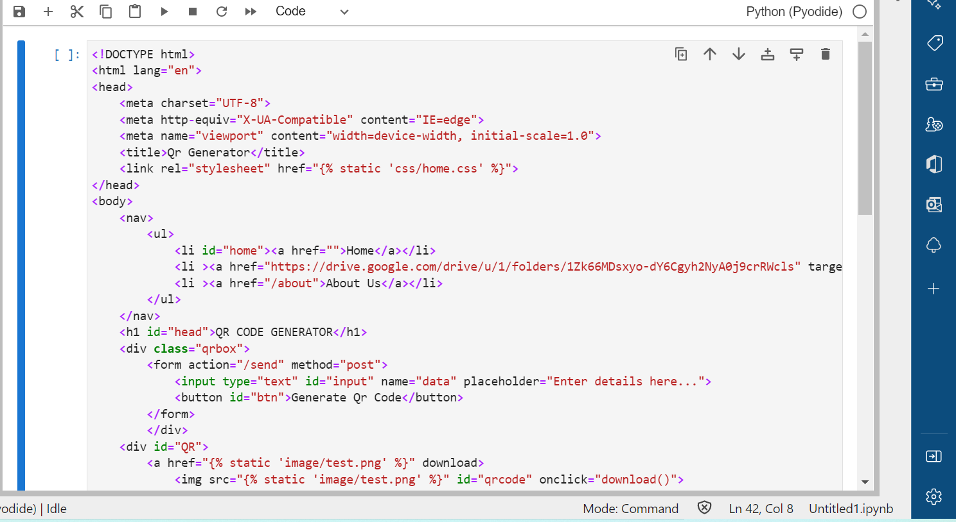

Slide 11
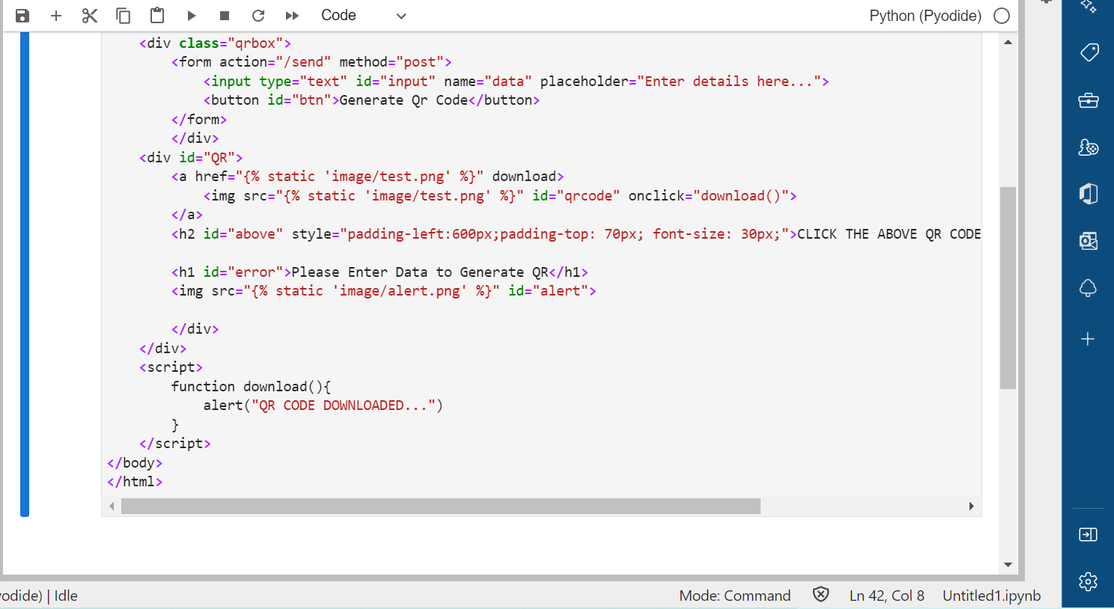

Slide 12
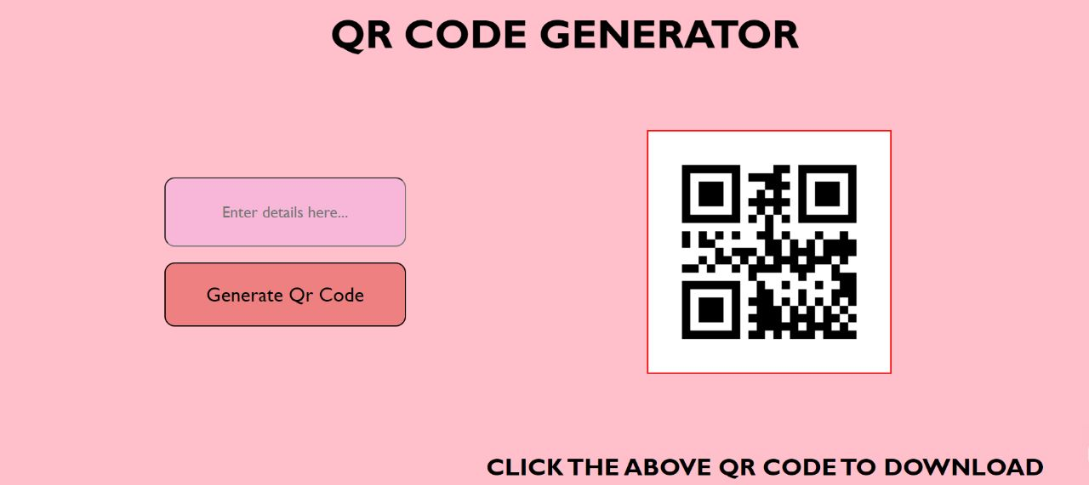

Slide 13
REFERENCES:
1:https://www.geeksforgeeks.org/introduction-to-python/
2:https://www.simplilearn.com/what-is-python-used-for-article
3:https://www.w3schools.com/Css/css_intro.asp
4:https://www.w3schools.com/django/index.php

