Slide 1



WHOLE MART
Web 2.0
“Our business is taking care of your business.”
Contribution By:-
Harshit ,Kratika ,Shikha(Presentator) ,Shivali ,Tanishi ,Tushar

Slide 2


INTRODUCTION
BUYING AND SELLING OF VARIOUS GOODS IN BULK QUANTITY.
DECISION MAKING FRAMEWORK AND OPERATIONS FOR SAVING TIME.
BILLING SYSTEM WILL BE INCLUDED BY DISCOUNT DONE BY WHOLESALER
GST WILL BE INCLUDED WITH PRICE.
NEED IS TO REDUCE PAPERWORK.
BARGAINING OF PRODUCTS
Notes:
Need is to reduce the paperwork,B to B,Barganing,variable discount at variable products.

Slide 3

MODULES
LOGIN
PRODUCT/OFFER
BILLING
PRICE DECISION
PAYMENT
FEEDBACK

Slide 4







EXPECTED OUTPUT
OFFER ZONE
COSMETIC PRODUCT
HOME PRODUCT
FOOD PRODUCT
PERSONAL CARE
WHOLE SELLER PORTAL

Slide 5



Offer
milk
curd
ghee
paneer
Butter
cheese
 | home | cosmetic | food | hair | dairy
dairy
milk
Price/pc | Qty
₹ 22.00 | 10
₹ 20.00 | 50
₹ 17.00 | 100
Fresh Amul milk:
½ L packet
ADD TO CART
- Qty +

Slide 6


Product | Quantity | Price | Add Qty
Atta | 3 P of 10 kg | Rs.362 Per p | ADD
Olive oil | 2 Ltr bottle | Rs.1199 | ADD
Coffee | 500 gm | Rs.213 | ADD
Leaf tea | 5 kg | Rs.378 Per kg | ADD
Antiseptic liq. | 2*500 | Rs.207 Per 500 ml | ADD
TOTAL |  | Rs.2139
Proceed to Order

Slide 7





ORDER FORM
ADDRESS
CITY
STATE
PHONE 1
PHONE 2
EMAIL-ID
NAME

Slide 8



Wholesaler’s Login
USERNAME
PASSWORD
User Name:
Password:

Slide 9



Whole seller portal
Client Order Report
Name of client
Address of client
Request
Product | Qty | Price
Milk | 50 | 1000
Ghee | 5 | 1500
1
2
Total Price | 2500
Billing
Notes:
Add name,address

Slide 10
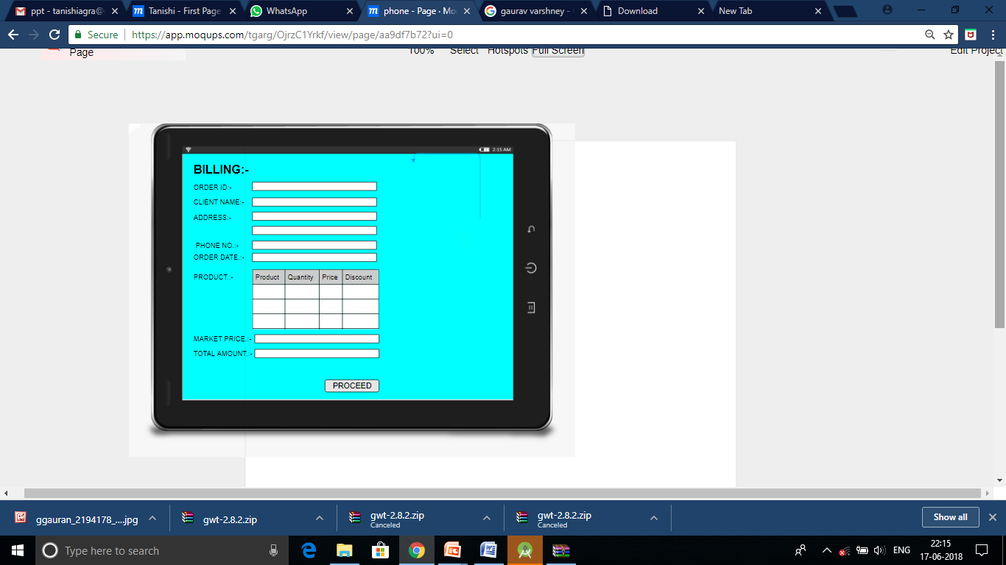

Whole Seller Generates Bill

Slide 11

Billing and Payment
Payment:
Bheem UPI
Enter Username :
Password :
Total Amount :
Submit

Slide 12


BILLING DETAILS
NAME
ADDRESS
PH.NO
DELIVERY DATE
AMOUNT PAID
TOTAL BILL
DISCOUNT

Slide 13
Client Order Manage Stock
Report
Client Name | Total Amount | Amount Paid | Amount Left
Rajesh Sharma | 40000 | 10000 | 30000
Vijay Kumar | 65000 | 15000 | 50000
Shiva | 50000 | 9000 | 41000

Slide 14
Description Of Client
Order No.:
AB01
Name: Rajesh Sharma
Address: 14A Shah Market , Agra
Phone No.: 8654328769
Order:
Product | Quantity | Price(each)
Hair Oil | 40 | 180
Hide N Seek | 100 | 60
Amount Paid:2500
Amount Left: 9000

Slide 15

USECASE DIAGRAM
Login/Signup
Product &
Offer
Price Decision
Billing/
Payment
END USER
WHOLESALER
Delivery Date & Delivery

Slide 16



ARCHITECTURE DIAGRAM
ORDER FORM SENDING TO WHOLESALER
RECIEVING THE CLIENT INFO WITH ORDER
NOTIFY THE ACCEPTANCE OF REQUEST AND FURTHER PROCEED TO PAYMENT
ORDER ACCEPTED
Client
Wholesaler

Slide 17

SOFTWARE REQUIREMENT
Developer’s Side
Android Studio
Backend- NoSQL Architecture
Java IDE
Cloud Side
Operating System
Space on cloud required to store data
End- user side
Android Operating System

Slide 18

HARDWARE REQUIREMENT
Developer’s Side
Computer or laptop with 8GB RAM and 1TB hard disk
Cloud Side
Server Computer with i3 processor
End- user side
Android Supporting Mobile Phones

Slide 19


THANKS! for listening us
Inspiration Of the Day
HAVE A NICE DAY

