Slide 1

Honeypots in Cybersecurity
A strategic deception tool used to detect, deflect, and study cyber threats — before they reach real assets.

Slide 2


What Is a Honeypot?
A honeypot is a security mechanism — typically a fake system, server, application, or network — designed to mimic a real target and attract attackers.
Unlike firewalls or IDS that defend, honeypots invite interaction to gather intelligence on attacker behavior, tools, and techniques.
Key principle: Any traffic to a honeypot is, by definition, suspicious — there is no legitimate reason for a user to access it.

Slide 3

Why Honeypots Are Used
Threat Intelligence
Capture real-world attack data — malware samples, TTPs, and attacker infrastructure — to strengthen defenses.
Early Warning
Detect intrusions before they escalate. Honeypots alert teams to active reconnaissance or exploitation attempts.
Distraction & Delay
Divert attacker attention from production systems, buying time for defenders to respond.
Research & Training
Study attacker behavior in a controlled environment and train security teams on real threat scenarios.

Slide 4
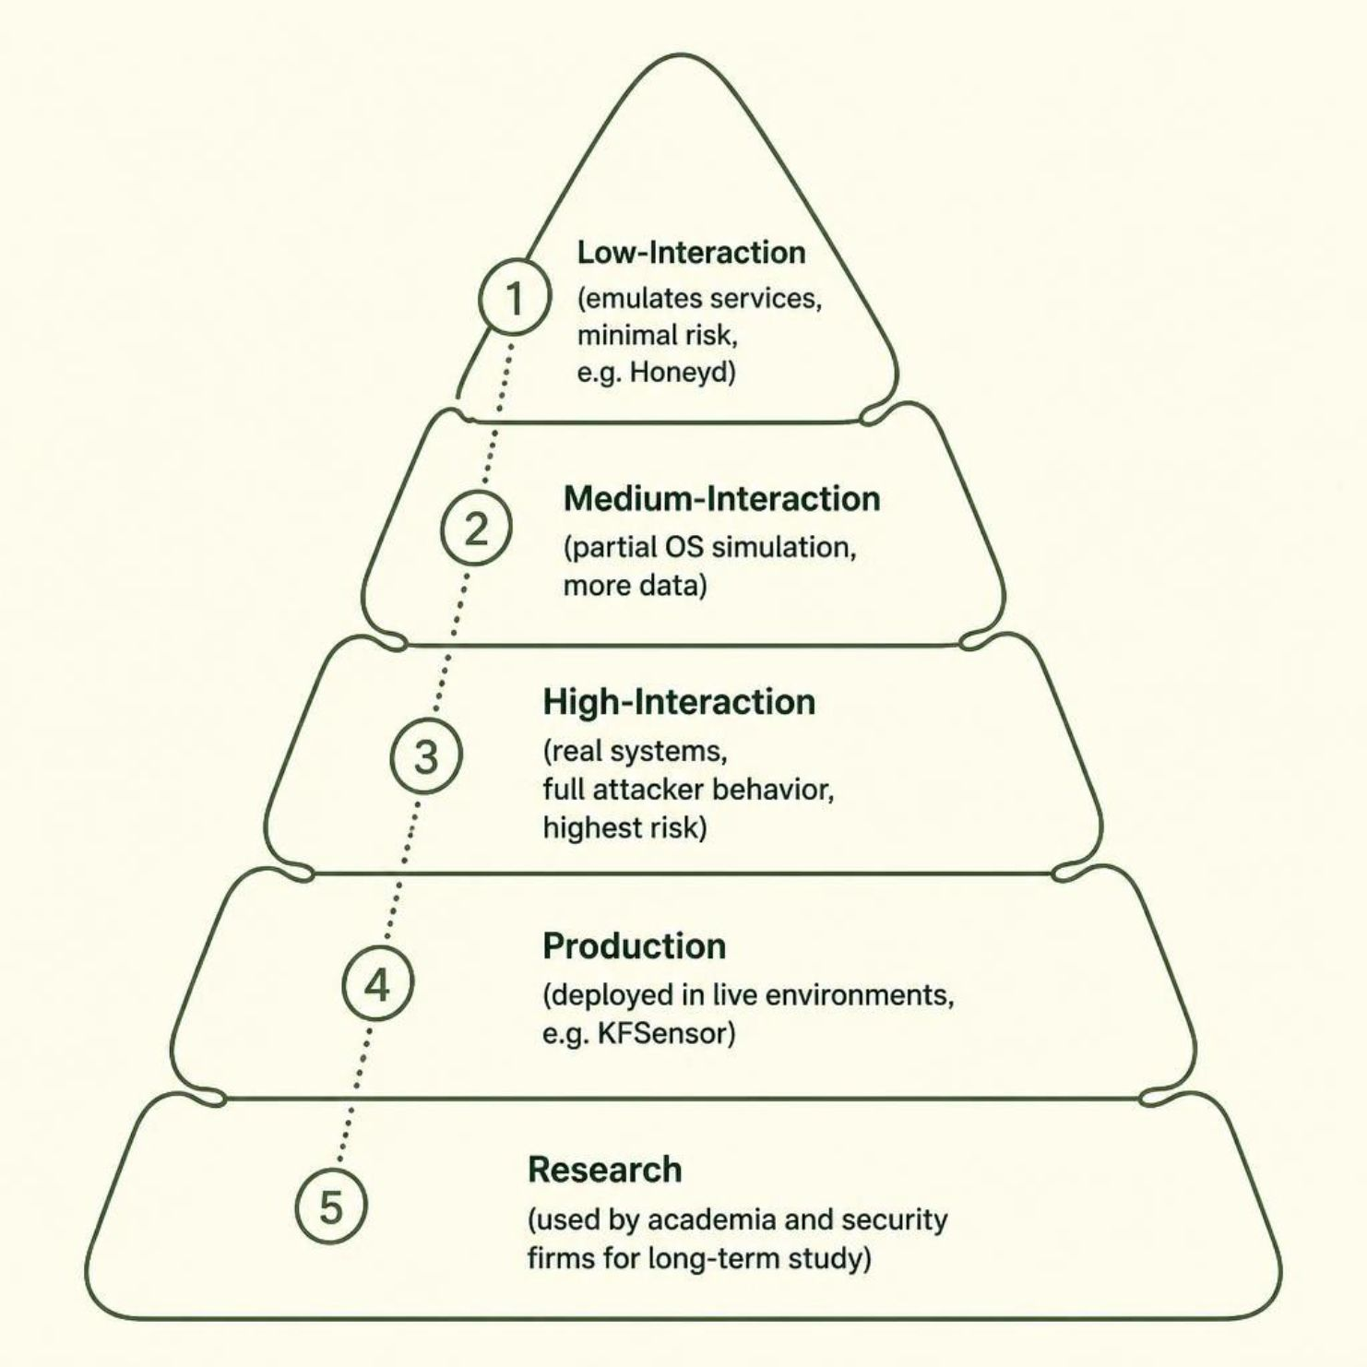


Types of Honeypots
Honeypots are classified by level of interaction and deployment purpose:
Low-Interaction
Emulates services — safe, easy to deploy.
High-Interaction
Real systems that allow full attacker engagement — rich data, higher risk.
Production vs. Research
Production protects live environments; research supports long-term threat study.

Slide 5
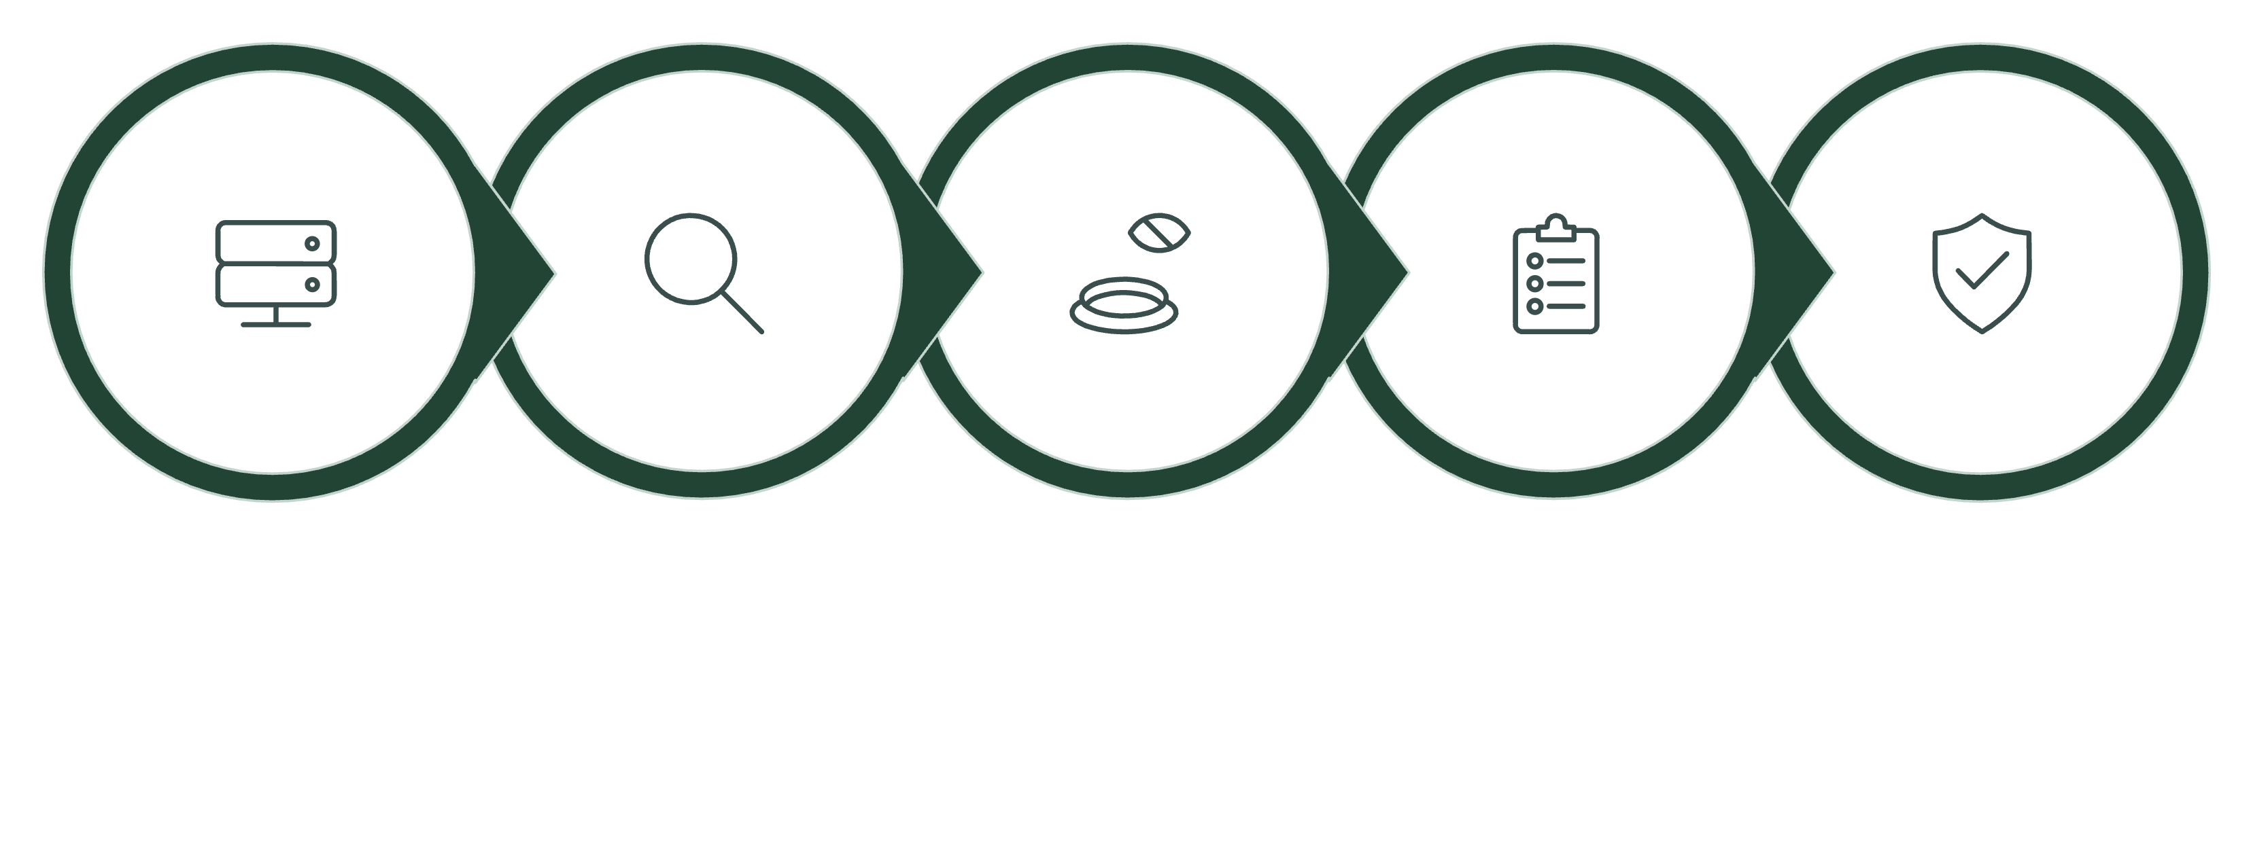
How Honeypots Work
Deploy Decoy
Attacker Finds It
Attacker Interacts
Honeypot Logs
Analyze & Respond
The entire interaction is monitored and logged — giving defenders a complete picture of attacker methodology without risking real assets.

Slide 6

Honeypots vs. Honeynets
🍯 Honeypot
🕸️ Honeynet
A single decoy system — one server, one service, or one application designed to attract attackers and capture their behavior in a controlled environment.
A network of multiple honeypots simulating an entire environment — servers, firewalls, and internal systems — to observe how attackers move, pivot, and escalate once inside.
Best for monitoring attacks against one exposed asset, such as a fake SSH server, web app, or database
Lower complexity and easier to deploy, tune, and maintain
Useful for collecting focused threat intelligence, detecting scanning activity, and studying exploit attempts against a specific target
Limited scope of data, but often enough for testing alerts, validating defenses, or distracting opportunistic attackers
Best for mimicking a realistic enterprise environment, such as a small office network or segmented production lab
Richer attacker behavior data, including lateral movement, privilege escalation, and command-and-control activity
Can include web servers, file shares, database systems, routers, and fake internal services to make the environment believable
Requires a honeynet gateway or similar control layer to safely monitor traffic and prevent the environment from being used as a launch point
In practice, a honeypot is ideal when you want depth on one target, while a honeynet is better when you want to understand attacker behavior across an entire simulated environment.

Slide 7





Advantages of Honeypots
Zero False Positives
Any interaction with a honeypot is inherently malicious — eliminating noise common in traditional monitoring.
Deep Threat Visibility
Reveals attacker tools, techniques, and procedures (TTPs) that standard defenses never see.
Reduces Attack Surface
Diverts attackers away from production systems, reducing the likelihood of a successful breach.
Forensic Evidence
Captured data can support incident response, legal proceedings, and threat attribution.

Slide 8

Limitations & Risks
⚠️ Limited Scope
⚠️ Risk of Compromise
⚠️ Detection by Attackers
⚠️ Legal & Ethical Concerns
Honeypots only see traffic aimed at them. They can miss broader attacks elsewhere.
Misconfigured high-interaction honeypots can be exploited. Isolation and monitoring are critical.
Skilled attackers may spot fake services or odd behavior and avoid them or plant false signals.
Honeypots can raise privacy, consent, and retention issues. Check regulations before deploying.

Slide 9



Real-World Use Cases
Google's GCP Honeypots
Microsoft Threat Intelligence
Financial Sector
Google deploys honeypots across its cloud infrastructure to detect exploitation attempts and gather threat intelligence at scale.
Banks deploy honeypots to detect lateral movement, credential theft, and insider threats within their networks.
Microsoft uses honeypots to track APT groups, collect malware samples, and feed findings into Defender and Sentinel.

Slide 10
Thank You!

