Slide 1

UE23CS441A – Capstone Project Phase – 3
Project Progress Review # 1
Project Title : Federated Fraud Detection using Temporal Graph Transformers with Differential Privacy
Project ID : [Enter Project ID]
Project Guide : [Enter Project Guide Name]
Project Team : [Enter Team Member Names]

Slide 2
Title of the Project
Outline
Abstract and Scope of the Project
Summary of Work Completed
  Pipeline built and validated; inferences from the literature survey
System Architecture and Modules
List of Tasks / Modules with Individual Contribution
Demonstration and Testing of Completed Modules
Project Timeline (Gantt Chart)
References

Slide 3
Federated Fraud Detection using Temporal Graph Transformers with Differential Privacy
Abstract and Scope
The problem: fraud patterns often span banks, but raw transaction data can never be pooled between them.
Our approach: a Temporal Graph Transformer + contrastive learning model, trained via Federated Learning (FedAvg/FedProx) across 10 simulated banks, protected by client-level Differential Privacy.
In scope:
  Real trained model + real FL/DP training loop (not illustrative)
  Honest benchmark vs. RandomForest & centralized-deep baselines
  Full-stack live demo - FastAPI backend + React frontend
Documented out of scope:
  Real PaySim data unavailable -> schema-matched synthetic dataset used
  Graph branch simplified (per-account, not multi-entity graph yet)
  Homomorphic encryption / secure aggregation: reference code, not wired into training

Slide 4
Federated Fraud Detection using Temporal Graph Transformers with Differential Privacy
Summary of Work Done in Capstone Project Phase - 1
Implemented the full model: temporal Transformer + graph branch + cross-modal fusion + dual heads (BCE + contrastive).
Built the Federated Learning + client-level Differential Privacy training loop across 10 simulated bank clients.
Found & fixed 3 real bugs via critical self-review: unrealistic synthetic data, an over-parameterized/collapsing model, and a NaN-masking bug hiding a training failure.
Validated with a real 4-model comparison and a full 9-point epsilon-vs-utility sweep - not fabricated numbers.
Built a full-stack live demo: FastAPI backend + React frontend, real inference and real live training from the browser.
Key inferences from the literature survey:
  Non-IID bank data -> FedProx's proximal term over plain FedAvg
  Naive DP composition silently blows the privacy budget -> client-level DP-FedAvg (McMahan et al., 2018)
  DP noise scales with sqrt(parameters) -> model right-sizing is a DP prerequisite, not just a modeling nicety

Slide 5
Title of the Project
Architecture
Raw data never leaves a client - only clipped, noised updates are ever aggregated.
10 Simulated Banks
(non-IID transaction data)
Local Training
Temporal Graph Transformer
+ Contrastive Head
Client-Level DP
Clip + Gaussian Noise
repeated every FL round
Server: FedProx Weighted Aggregation of Clipped + Noised Updates
Updated Global Model
Real-Time Inference API
(FastAPI backend)

Slide 6
Federated Fraud Detection using Temporal Graph Transformers with Differential Privacy
List of Tasks/Modules
Data Generation & Feature Engineering
  Schema-matched synthetic PaySim-style generator (overlapping fraud/legit distributions + 12% quiet fraud)
  10-dim normalized features per transaction; last-10-transaction sequences per account
Model Architecture
  Temporal Transformer (4 layers) + graph branch + cross-modal fusion + dual heads (BCE + contrastive)
Federated Learning Engine
  FedAvg / FedProx orchestration across 10 simulated bank clients, non-IID aware
Differential Privacy Layer
  Client-level DP-FedAvg: per-round update clipping + Gaussian noise, configurable (epsilon, delta)
Evaluation & Benchmarking
  Shared held-out test harness; 4-model comparison suite; epsilon-vs-utility sweep tool
Backend API & Frontend Dashboard
  FastAPI (real checkpoint, live training jobs) + React/TypeScript/Tailwind/Recharts
Tools & Technologies (all open-source)
  PyTorch, NumPy/Pandas, FastAPI, Flower, React, Vite, TailwindCSS, Git

Slide 7
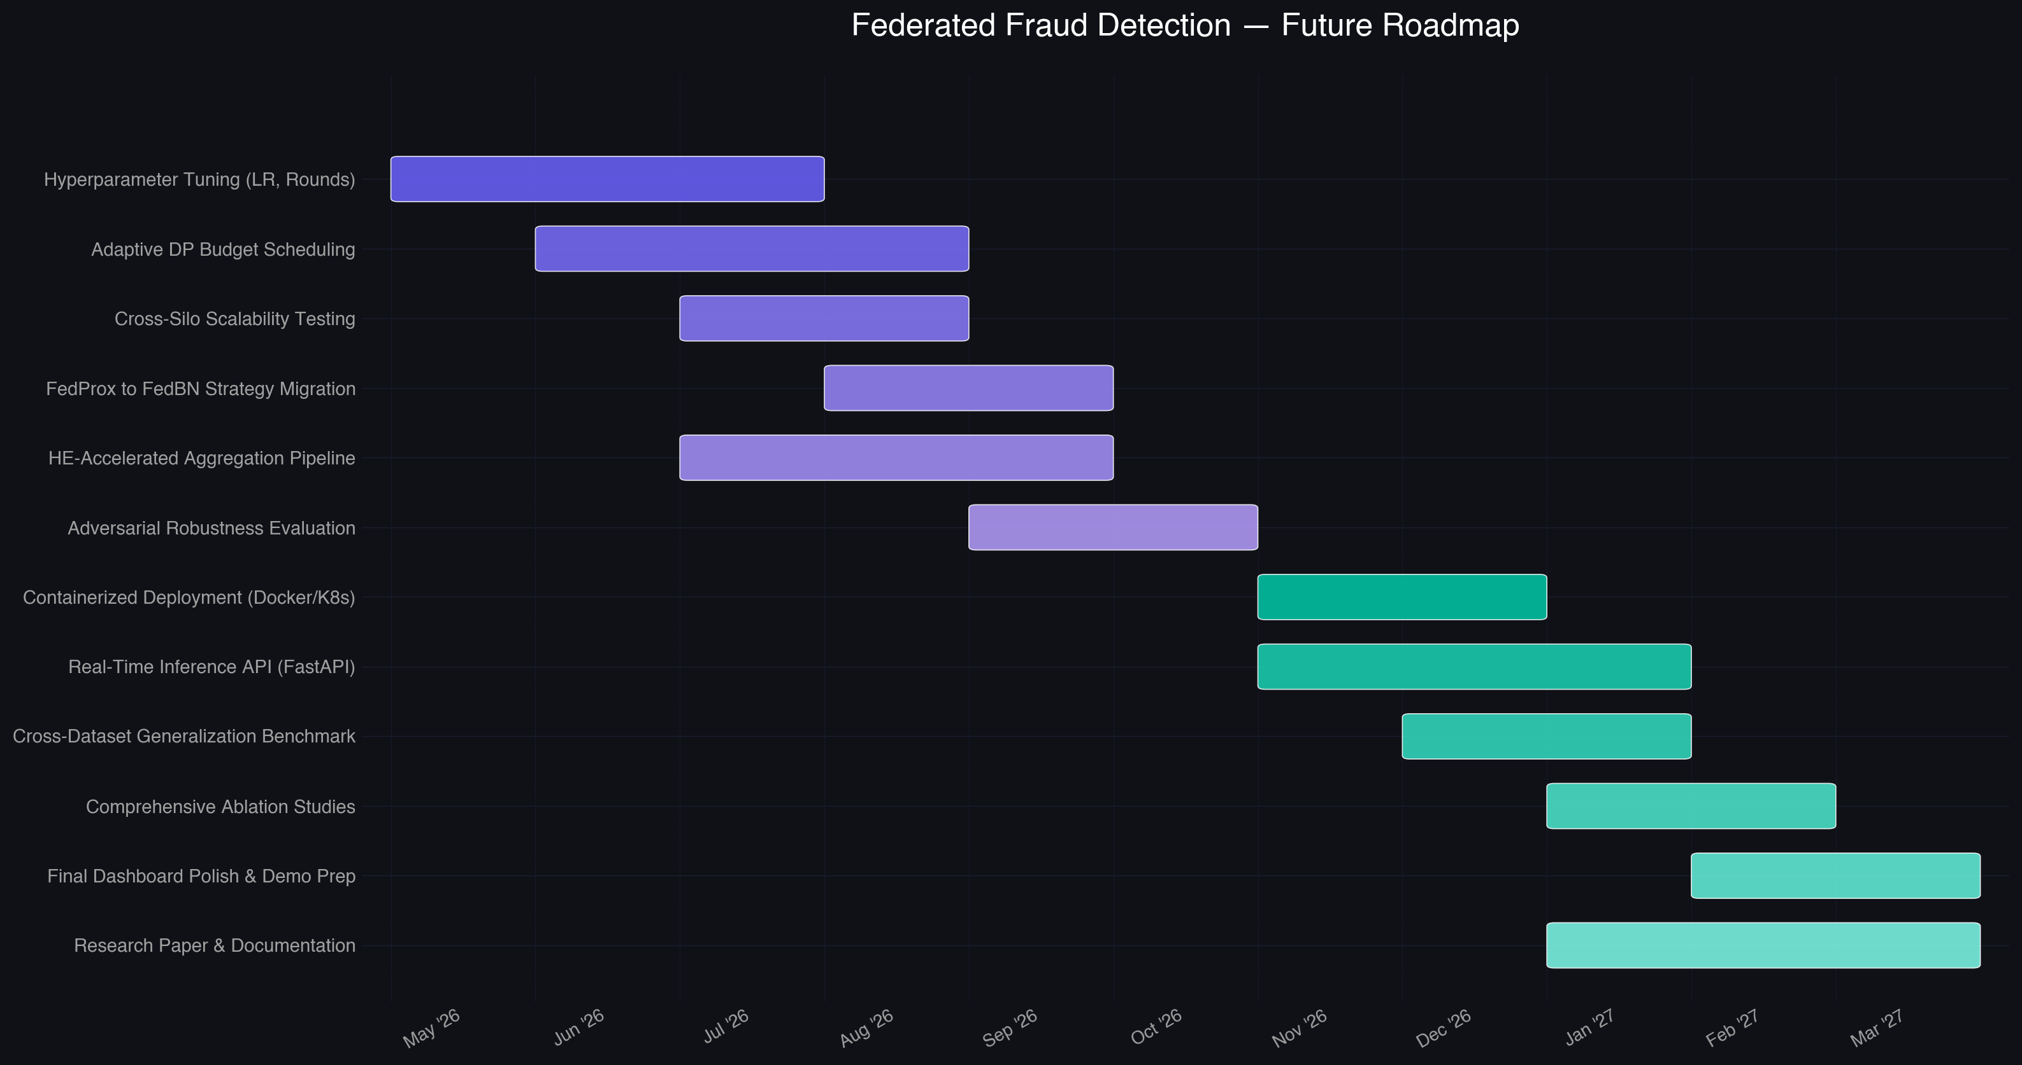
Title of the Project
Individual Contribution
Team Member | Module(s) | Key Contribution
[Member 1] | Data Pipeline & Features | Synthetic data generator, feature engineering, sequence construction
[Member 2] | Model & FL/DP Training | Temporal Graph Transformer, FedAvg/FedProx loop, DP-FedAvg mechanism
[Member 3] | Backend & Evaluation | FastAPI service, model comparison suite, epsilon-utility sweep
[Member 4] | Frontend & Integration | React dashboard, live inference/training UI
Planned roadmap, Phase 3-4 (Gantt chart)
Fill in team member names + individual lines-of-code/time-spent once finalized.

Slide 8
Federated Fraud Detection using Temporal Graph Transformers with Differential Privacy
Demonstration and Testing of the Modules Completed
Live single-transaction scoring: manual input -> real model inference -> fraud probability + anomaly score.
CSV batch upload: any schema, automatic column-mapping suggestion, live per-row predictions (disclosed sampling cap on very large files).
Live federated training from the browser: a real FedProx + DP-FedAvg run, with live per-round accuracy/F1/ROC-AUC charting.
Testing performed:
  All models evaluated on one identical held-out test set (6,000 sequences, 362 fraud) for a fair comparison
  Verified the DP mechanism's real effect via a 9-point epsilon sweep (destroyed at low epsilon, recovers by epsilon ~20-50)
  Verified no representation collapse via before/after internal-feature diagnostics
  Load-tested CSV inference on 200K+ row files after finding & fixing a real request-handling bug

Slide 9
Federated Fraud Detection using Temporal Graph Transformers with Differential Privacy
References
[1] H. B. McMahan, E. Moore, D. Ramage, S. Hampson, and B. A. y Arcas, "Communication-Efficient Learning of Deep Networks from Decentralized Data," AISTATS, 2017.
[2] T. Li, A. K. Sahu, M. Zaheer, M. Sanjabi, A. Talwalkar, and V. Smith, "Federated Optimization in Heterogeneous Networks," MLSys, 2020.
[3] H. B. McMahan, D. Ramage, K. Talwar, and L. Zhang, "Learning Differentially Private Recurrent Language Models," ICLR, 2018.
[4] C. Dwork and A. Roth, "The Algorithmic Foundations of Differential Privacy," Foundations and Trends in Theoretical Computer Science, 2014.
[5] M. Abadi et al., "Deep Learning with Differential Privacy," ACM CCS, 2016.
[6] K. Bonawitz et al., "Practical Secure Aggregation for Privacy-Preserving Machine Learning," ACM CCS, 2017.
[7] P. Paillier, "Public-Key Cryptosystems Based on Composite Degree Residuosity Classes," EUROCRYPT, 1999.
[8] E. A. Lopez-Rojas, A. Elmir, and S. Ahmed, "PaySim: A Financial Mobile Money Simulator for Fraud Detection," 28th European Modeling and Simulation Symposium, 2016.

Slide 10
Thank You

