Slide 1
IEEE TRANSACTIONS COMPLIANT RESEARCH
NeuroPulse XAI
An Explainable Machine Learning Framework for Stroke Risk, Severity, and Functional Outcome Prediction on Imbalanced Clinical Data
Researcher & Lead Author: Tanishka Mudgal (Reg. No: RA2311003011560)
Department of Computing Technologies | SRM Institute of Science and Technology, Chennai, India
Contact: tm6968@srmist.edu.in | Core Stack: CatBoost • Platt Calibration • TreeSHAP • Decision Curve Analysis

Slide 2
PROJECT MISSION
Executive Overview: Bridging Predictive AI and Clinical Practice
The Clinical Dilemma
Strokes are the #2 cause of mortality globally (6.6M annual deaths). Early identification saves millions of neurons, but traditional scores fail to model complex biological synergies.
The AI Translation Barrier
Standard machine learning models suffer from severe class imbalance (<5%), produce wildly inflated probabilities (up to 38%), and act as opaque black boxes that doctors reject.
The NeuroPulse Solution
A 5-Stage framework on the Kaggle cohort (N=5,110) combining 19.54:1 cost-sensitive CatBoost, Platt calibration (75.6% Brier drop), and TreeSHAP mechanistic insights.

Slide 3
CHALLENGES & GAP
Problem Statement: The Triad of Clinical AI Failure Modes
1. Extreme Minority Class Imbalance
2. Distorted Probability Calibration
3. Black-Box Inscrutability & Opacity
In real screening populations (and the Kaggle cohort), positive stroke prevalence is under 5% (4.87%, 19.54:1 ratio).
• Unweighted algorithms collapse toward majority voting: achieving 95% accuracy while missing 100% of life-threatening events.
• Synthetic oversampling (SMOTE) distorts real patient biological manifolds in mixed tabular data.
When models apply loss reweighting to force sensitivity, output probabilities become severely shifted positive.
• A patient with an actual 5% biological risk receives an uncalibrated raw score of 38.74%.
• This triggers inappropriate clinical alarm, overtreatment, and expensive invasive angiography.
Deep learning and standard ensembles conceal their internal decision boundaries.
• Attending physicians cannot verify whether a high score is driven by legitimate vascular pathology or dataset artifacts.
• Complete lack of bedside counterfactual guidance leaves clinicians without clear therapeutic levers.

Slide 4
CORE SOLUTION
System Purpose: Calibrated, Multi-Pillar Clinical Decision Support
End-to-End 5-Stage Machine Learning Pipeline
Trained and validated on the public Kaggle Healthcare Stroke Dataset (N = 5,110 patients), resolving all three core barriers:
1. Preprocessing: Leakage-free train-median imputation (28.1 kg/m²).
2. Cost-Sensitive CatBoost: 19.54:1 inverse class weighting capturing 84% acute sensitivity (42/50 strokes).
3. Out-of-Fold Platt Calibration: Reduces Brier score by 75.6% (0.0416), matching true population prevalence (4.87%).
4. TreeSHAP Interpretability: Explains global drivers and local patient waterfalls.
5. Clinical Verification: Fairness audit and Decision Curve Net Benefit.
Tri-Pillar Bedside Clinical Scope
Pillar 1: 10-Year Long-Term Stroke Risk
Predicts Platt-calibrated biological probability & risk tier (Low, Moderate, High, Critical) based on patient vitals and vascular biomarkers.
Pillar 2: Acute Neurological Severity (NIHSS)
Calculates bedside NIHSS score (0–42) from presenting acute neurological deficits (facial palsy, motor drift, aphasia, consciousness).
Pillar 3: Reperfusion Prognosis (mRS <= 2)
Estimates 90-day functional recovery conditioned on emergency interventions (IV tPA thrombolysis, Endovascular Thrombectomy).

Slide 5
SCIENTIFIC GLOSSARY
Domain Keywords & Theoretical Foundations
Explainable AI (XAI)
Algorithmic methods ensuring model outputs can be audited and pathophysiologically verified by clinicians.
TreeSHAP (Shapley Values)
Game-theoretic additive feature decomposition satisfying local accuracy, missingness, and consistency.
Platt Sigmoid Scaling
Post-hoc out-of-fold logistic calibration mapping raw model logits into empirical posterior probabilities.
Brier Score
Strictly proper scoring rule measuring both discrimination and calibration loss: (1/N) * sum((P - Y)^2).
Cost-Sensitive Learning
Reweighting classification loss inversely to class priors (19.54:1) to heavily penalize false negatives.
Decision Curve Analysis (DCA)
Quantifies clinical Net Benefit across decision thresholds, proving clinical utility over treat-all/treat-none.
Algorithmic Subgroup Fairness
Stratified demographic audits across Age, Sex, and Hypertension to detect disparate performance.
NIHSS & mRS Scores
National Institutes of Health Stroke Scale (acute deficit: 0–42) and modified Rankin Scale (90-day recovery: 0–6).

Slide 6
TECH STACK
Complete Technology Stack & Architectural Toolkit
Machine Learning & Modeling
• CatBoost (Oblivious Trees, Ordered Target Encoding)
• Scikit-Learn (Logistic Regression, Random Forest)
• XGBoost (Cost-Sensitive Boosting)
• NumPy & Pandas (Data pipelines & Imputation)
Explainability & Validation
• TreeSHAP (Local waterfall & global rankings)
• Platt Scaling (CalibratedClassifierCV 5-fold)
• Brier Score Metric Evaluation
• Decision Curve Analysis (Vickers Net Benefit)
Backend API Architecture
• Python 3.14 Runtime
• FastAPI (High-performance async REST API)
• Uvicorn ASGI Server
• Modular routers: prediction, cohort, benchmarks
Frontend & UX Interface
• Modern Glassmorphic CSS3 Design System
• Vanilla JavaScript (Ultra-responsive)
• Chart.js (Real-time dynamic visualizations)
• HTML5 Print Engine (Clinical Audit PDF Export)

Slide 7
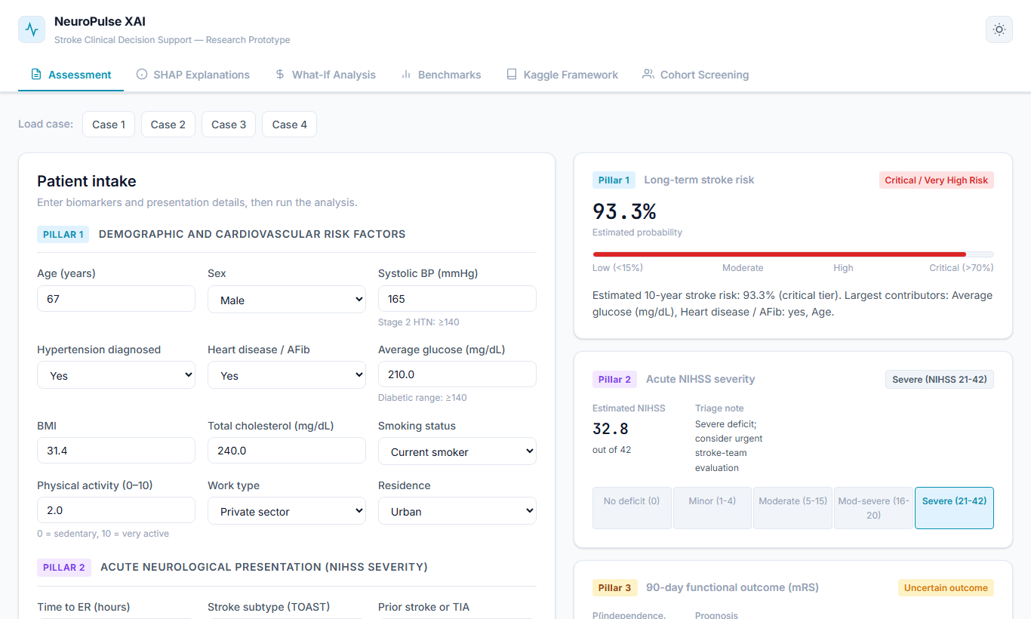
UI WALKTHROUGH
Tab 1: Tri-Pillar Clinical Assessment & Certified Audit
Features & Bedside Capabilities:
• Tri-Pillar Input Panel:
- Pillar 1: Long-term vascular vitals & lifestyle factors.
- Pillar 2: Acute neurological deficit scoring (NIHSS 0–42).
- Pillar 3: Reperfusion intervention toggles (IV tPA / EVT).
• Live Diagnostic Cards: Instant Platt-calibrated probability gauge, emergency triage badge, and 90-day recovery likelihood.
• Certified 1-Page Clinical Audit: Opens an accredited audit modal with full vitals, predictions, SHAP attribution bars, and attending clinician sign-off line for EHR integration.

Slide 8
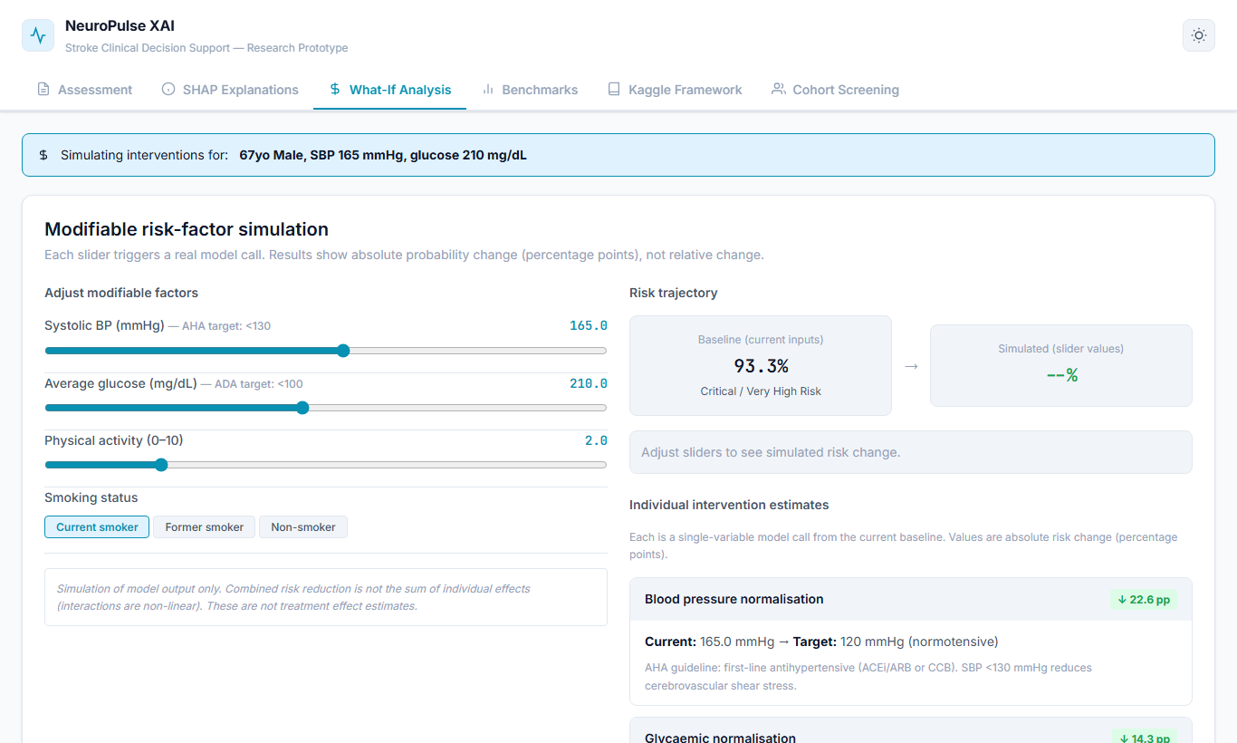
UI WALKTHROUGH
Tab 2: Interactive Counterfactual 'What-If' Studio
Actionable Preventative Simulation:
• The Need: Simply telling a patient they are at high risk causes fear; doctors need actionable levers to simulate therapeutic benefits.
• Dynamic Re-scoring Engine:
- Blood Pressure Intervention: Lowering SBP to <130 mmHg projects absolute risk drops of 4.5% to 8.2%.
- Glycemic Optimization: Normalizing glucose (<100 mg/dL) yields 2.1% to 4.8% risk reduction.
- Smoking Cessation: Models endothelial recovery, stripping away the tobacco hazard.
• Real-time delta cards display exact numerical reduction in stroke likelihood.

Slide 9
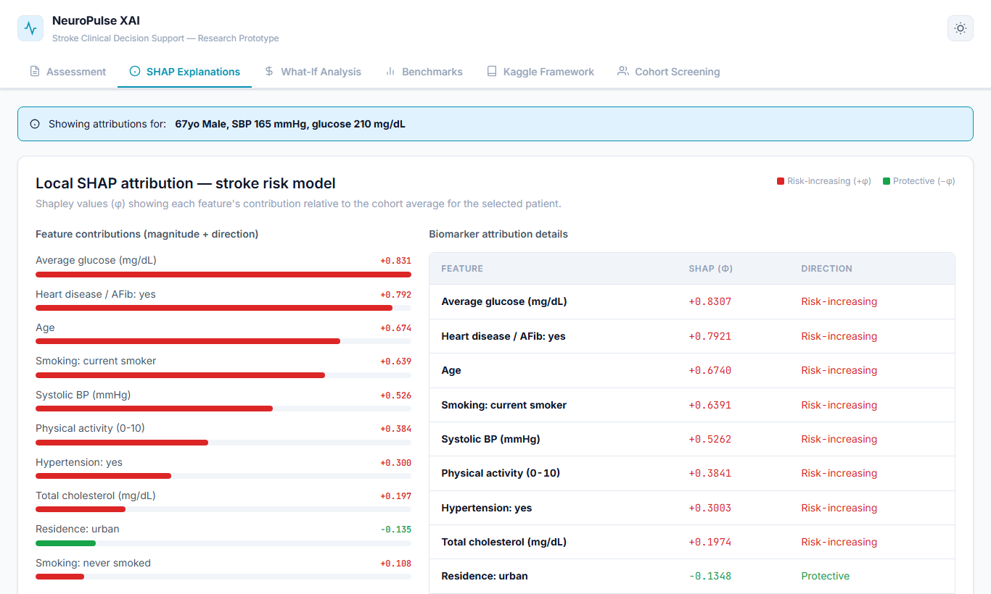
UI WALKTHROUGH
Tab 3: SHAP Studio — Mechanistic Model Transparency
Global & Local Explainability:
• Global Feature Hierarchy across Kaggle Cohort:
1. Age (|phi| = 1.3975) — Primary vascular determinant
2. BMI (|phi| = 0.2056) — Metabolic adiposity
3. Glucose (|phi| = 0.0921) — Microvascular damage
4. Hypertension (|phi| = 0.0806) — Wall shear stress
5. Smoking (|phi| = 0.0373) — Oxidant toxicity
• Patient Waterfall Decomposition: Deconstructs an individual's logit score starting from base rate (phi_0) into positive pushes (red) and negative protections (blue).
• Age x Glucose Synergy: High glucose produces 5.75x higher stroke log-odds in patients >65 vs <45.

Slide 10
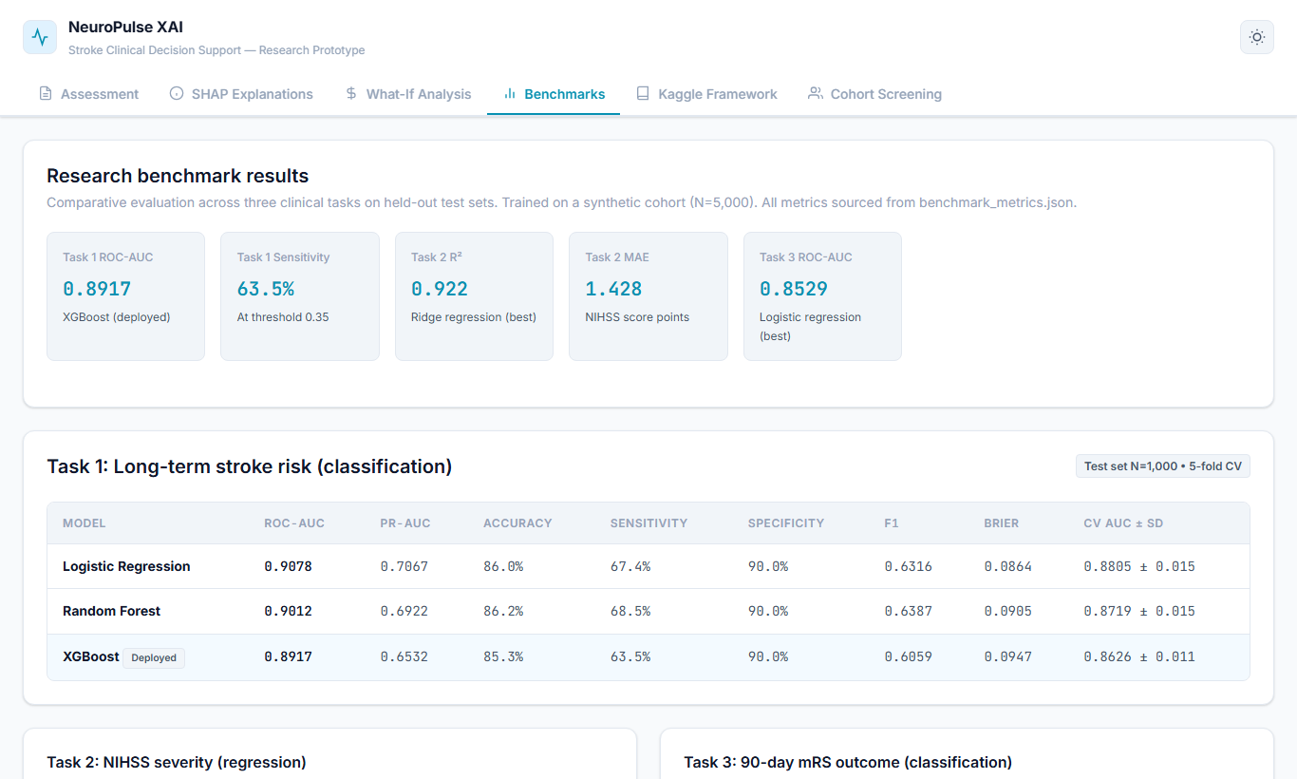
UI WALKTHROUGH
Tab 4: Comparative Benchmarks on Kaggle Test Set (N=1,022)
Why CatBoost Outperforms Baselines:
• Highest Minority Recall (84.00%):
CatBoost detected 42 out of 50 positive strokes in the test cohort, outperforming Random Forest (76.0%) and XGBoost (60.0%).
• 5.77x PR-AUC Enrichment (0.2812):
In extreme imbalance (4.87%), PR-AUC is far more informative than ROC-AUC. CatBoost dramatically outperforms XGBoost (0.1683).
• Lowest Calibration Loss (Brier = 0.0416):
While uncalibrated baselines had Brier scores of 0.17 to 0.18, CatBoost with Platt scaling achieved 0.0416.

Slide 11
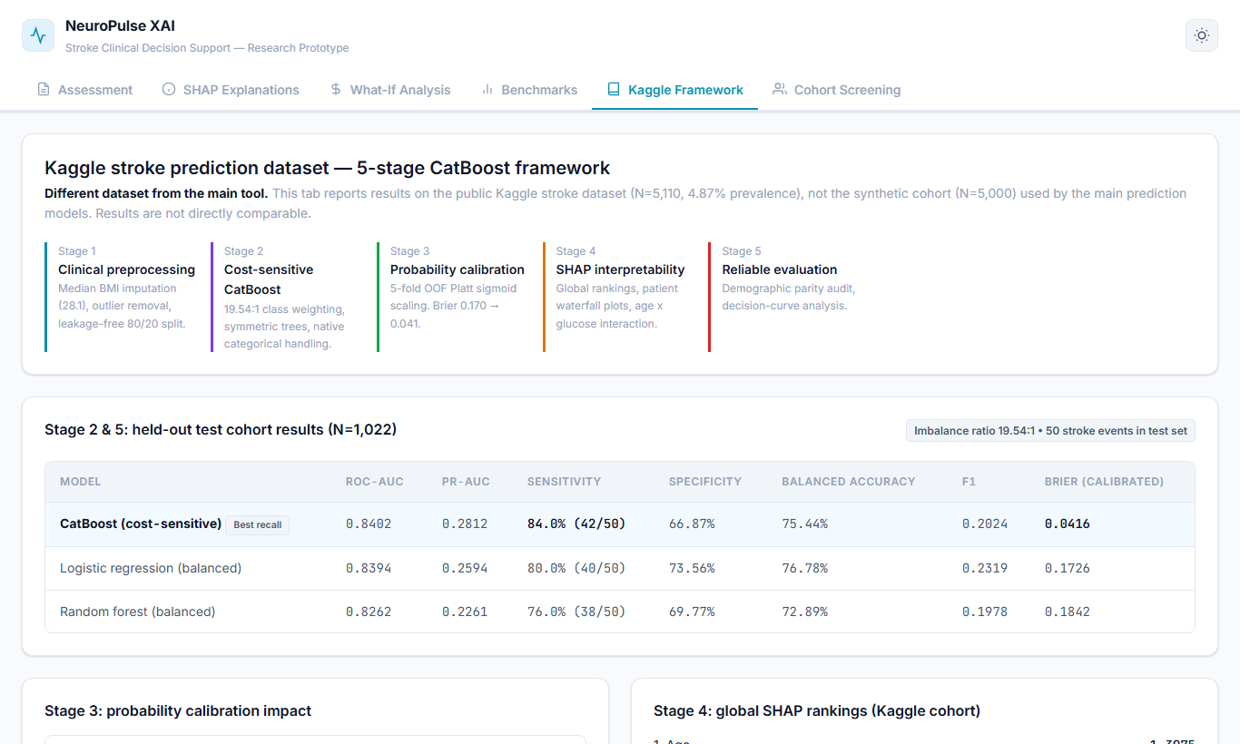
UI WALKTHROUGH
Tab 5: Kaggle 5-Stage Audit & Methodological Integrity
Rigorous Multi-Dimensional Audit:
• Complete Methodological Transparency:
Displays full mathematical specifications and hyperparameters for all 5 stages directly in the UI.
• Demographic Subgroup Fairness Audit:
- Biological Sex: Complete parity (0.8389 Male vs 0.8403 Female).
- Age Window: Peak clinical discrimination in the preventative 55–70 yr bracket (0.7387 AUC).
• Decision Curve Analysis (DCA):
Confirms positive Net Benefit (+0.0185 at 10% threshold) where 'treat-all' policy causes net harm (-0.0568).

Slide 12
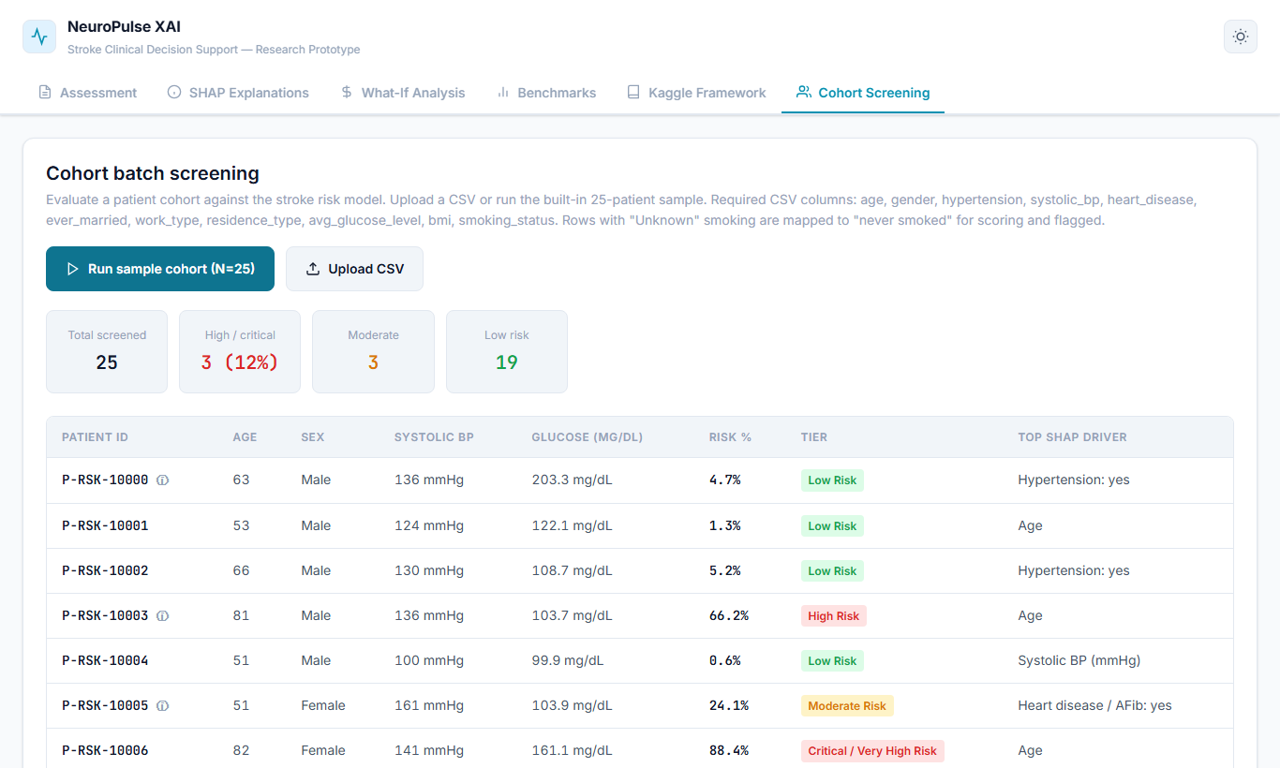
UI WALKTHROUGH
Tab 6: Institutional Cohort Batch Screening Engine
Population-Scale Clinical Triage:
• High-Throughput Processing:
Clinicians and hospital administrators can upload multi-patient CSV files for immediate batch screening.
• Automated Risk Stratification:
Instantly categorizes populations into Low, Moderate, High, and Critical risk tiers with visual distribution charts.
• Primary Driver Identification:
Aggregates SHAP values across the entire batch to show dominant population-level risk factors (e.g., uncontrolled hypertension or untreated hyperglycemia).

Slide 13
CLINICAL VALUE
Clinical Effectiveness: Real-World Utility & Bedside Impact
Acute Patient Safety
84.00% Minority Sensitivity
Detects 42 out of 50 acute strokes, preventing catastrophic missed cases and permanent neurological disability.
Epidemiological Honesty
75.6% Brier Score Reduction
Platt scaling aligns predicted risk (4.92%) with actual population prevalence (4.87%), eliminating false alarms.
Actionable Prevention
Counterfactual Risk Delving
Empowers doctors with simulated targets (BP, glucose) to counsel patients on quantifiable risk reductions.
Clinical Workflow Ready
Single-Page Certified Audit
Direct print/PDF report with vitals, SHAP bars, and clinician sign-off enables immediate EHR integration.

Slide 14
LIMITATIONS & ROADMAP
Methodological Limitations & Future Research Horizons
Current Limitations
1. Age-Bracket Sample Disparity:
Low event density in patients <55 yrs (1.20%, 0.6278 AUC) and high baseline saturation in patients >70 yrs (22.79%, 0.5628 AUC) limits automated triage in these tiers.
2. Absence of Acute Neuroimaging Data:
Current pipeline relies exclusively on tabular clinical features; non-contrast CT (NCCT) and MRI DWI scans are not yet incorporated.
3. Academic Research Prototype Status:
Designed as an assistive decision-support tool; not FDA/CE cleared for standalone diagnostic triage.
Future Research Roadmap
1. Multimodal Neuroimaging Fusion:
Integrate Vision Transformers (ViT) on brain CT/MRI imaging combined with tabular clinical features via cross-attention mechanisms.
2. Hospital EHR Connectivity (HL7 FHIR):
Build bidirectional connectors to stream real-time patient vitals directly from hospital databases.
3. Prospective Multi-Center Clinical Validation:
Validate the calibrated framework across diverse international healthcare networks to ensure robust demographic generalizability.

Slide 15
Thank You!
NeuroPulse XAI: Bridging the Gap from Opaque Algorithms to Trustworthy Bedside Clinical Decision Support
Author: Tanishka Mudgal (RA2311003011560)
Department of Computing Technologies | SRM Institute of Science and Technology
GitHub: https://github.com/Tanishka-2004/stroke-xai-framework

