Slide 1
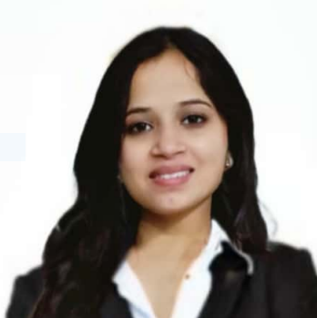


Tanishka Thakur
Masters of Computer Application
2017 - 2022
Analyst/Software Engineer
Skills
Mumbai
C# | C# Basics, Loops, OOPS, Collections, Arrays
.NET | ASP.NET Core, ASP.NET with MVC and Web API, Entity Framework
Angular | Components, Services, Modules, Routing, Forms & Validation
Database | Microsoft SQL Server
UI Tech | HTML 5 & CSS 3, Angular, MVC
Tools | Postman, Swagger, Microsoft SQL Server Management Studio, Visual Studio, Visual Studio Code, GitHub
Add On skills | Communication, Team Management, Time Management, Peer Learning
tanishka.thakur@capgemini.com
+91 7692028352
A4
Full Stack Developer
Hands on experience in developing web pages using HTML5, CSS3, Object Oriented C#.
Proficient in creating Web page Application in Angular with Authentication, Angular reactive forms, angular routing.
Attended ITransform Bootcamp(ASP. Net Core and Angular).
Attended training in CAMP(Capgemini Accelerated Mentorship Program).
Railway Reservation System
Completed end to end case study of Railway Reservation System along with JWT authentication, Web API for backend, SQL server for database and Angular used for the user interface.
Check out my work on GitHub

