Slide 1

JAYAWANTRAO SAWANT COLLEGE OF ENGINEERING, HADAPSAR, PUNE
Unit I
Fundamentals of Programming

Slide 2
Importance of Studying Programming Languages
JAYAWANTRAO SAWANT COLLEGE OF ENGINEERING, HADAPSAR, PUNE
Following are the reasons for studying the programming language concepts –
1) Increased capacity to express ideas:
variety of programming constructs.
Programmer can understand various data structures, control structures abstractions and their ability.
To express the ideas they ware to implement.

Slide 3
2) Improved background for choosing appropriate language:
JAYAWANTRAO SAWANT COLLEGE OF ENGINEERING, HADAPSAR, PUNE
One can be aware of its variety of features.
While developing a software application programmer can make appropriate selection of the language whose features are most applicable.
For example - if application requirement is use of GUI then the programmer will choose Visual basic as a programming language.

Slide 4
3) Increased ability to learn a new language:
JAYAWANTRAO SAWANT COLLEGE OF ENGINEERING, HADAPSAR, PUNE
Due to the knowledge of programming constructs and implementation techniques programmer can learn new language easily.
4) Better understanding of significance of implementation:
By learning and understanding different languages, programmer can know the reasons behind the language design.
This knowledge leads to use the language more intelligently.

Slide 5
5) Better use of languages that are already
JAYAWANTRAO SAWANT COLLEGE OF ENGINEERING, HADAPSAR, PUNE
known:
By studying the concepts of programming languages, programmers can learn about previously unknown and unused parts of the languages they already use and begin to use those features.
6) Overall advancement of computing:
By understanding variety of features of programming languages such as arrays, dynamic arrays, strings, dynamic memory allocation, generic programming - the programmer can use these features for advance level implementation and computing.

Slide 6
History of Programming Languages
JAYAWANTRAO SAWANT COLLEGE OF ENGINEERING, HADAPSAR, PUNE
First programming language was invented way back in 1843-Ada Lovelace came up with the first-ever machine algorithm for an early computing machine that she wrote down on a piece of paper because no computers existed at the time.
Programming languages have obviously come a long way since then but in order to understand the history of programming languages, one must first acknowledge their origin.
Listed below is a timeline of the history of programming languages. The first known programming languages were complicated machine codes that were manually inputted into early computing machines.

Slide 7
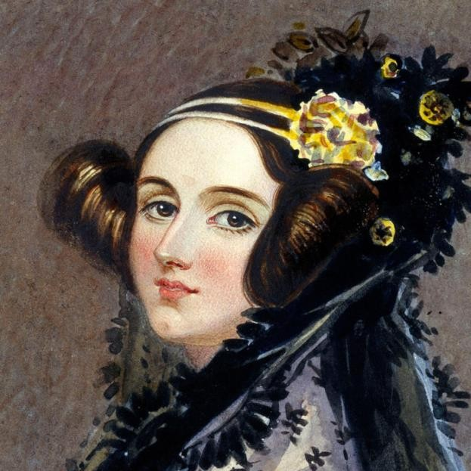
JAYAWANTRAO SAWANT COLLEGE OF ENGINEERING, HADAPSAR, PUNE
1843: Ada Lovelace’s machine algorithm
Ada Lovelace invents the
first-ever machine algorithm for Charles Babbage’s
Difference Machine that lays the foundation for all programming languages.

Slide 8
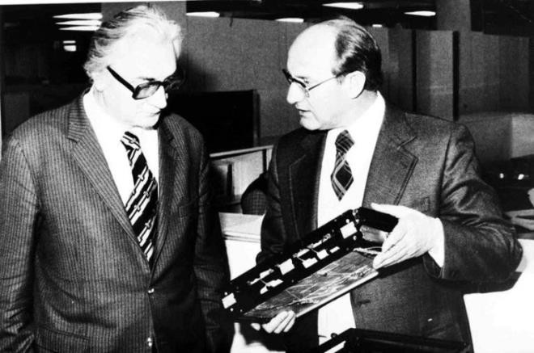
JAYAWANTRAO SAWANT COLLEGE OF ENGINEERING, HADAPSAR, PUNE
1944-45: Plankalkül
Somewhere between 1944-45, Konrad Zuse developed the first ‘real’ programming language called Plankalkül (Plan Calculus). Zeus’s language (among other things) allowed for the creations of procedures, which stored chunks of code that could be invoked over and over to perform routine operations.

Slide 9
JAYAWANTRAO SAWANT COLLEGE OF ENGINEERING, HADAPSAR, PUNE
1949: Assembly Language
Assembly language was used in the Electronic Delay Storage Automatic Calculator (EDSAC). Assembly language was a type of low-level programming language that simplified the language of machine code. In other words, the specific instructions necessary to operate a computer.
1949: Shortcode
Shortcode (or Short-order code), was the first High- Level Language (HLL) suggested by John McCauley in 1949. However, it was William Schmitt who implemented it for the BINAC computer the same year and for the UNIVAC in 1950.

Slide 10
JAYAWANTRAO SAWANT COLLEGE OF ENGINEERING, HADAPSAR, PUNE
1952: Autocode
Autocode was a general term used for a family of programming languages. First developed by Alick Glennie for the Mark 1 computer at the University of Manchester, Autocode was the first-ever compiled language to be implemented meaning that it can be translated directly into machine code using a program called a compiler. Autocode was used on the Ferranti Pegasus and Sirius early computing machines in addition to the Mark 1.

Slide 11
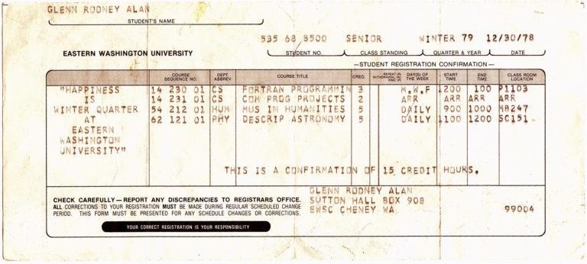
JAYAWANTRAO SAWANT COLLEGE OF ENGINEERING, HADAPSAR, PUNE
1957: FORTRAN
FORmula TRANslation or FORTRAN was created by John Backus and is considered to be the oldest programming language in use today. The programming language was created for high-level scientific, mathematical, and statistical computations. FORTRAN is still in use today in some of the world’s most advanced supercomputers.

Slide 12
JAYAWANTRAO SAWANT COLLEGE OF ENGINEERING, HADAPSAR, PUNE
1958: ALGOL (Algorithmic Language)
Algorithmic language or ALGOL was created by a joint committee of American and European computer scientists. ALGOL served as the starting point for the development of some of the most important programming languages including Pascal, C, C++, and Java.

Slide 13

JAYAWANTRAO SAWANT COLLEGE OF ENGINEERING, HADAPSAR, PUNE
1958: LISP (List Processor)
List processor or LISP was invented by John
McCarthy at the Technology (MIT).
Massachusetts Originally
Institute of purposed for
artificial intelligence, LISP is one of the oldest programming languages still in use today and can be used in the place of Ruby or Python. Companies such as Acceleration, Boeing, and Genworks are still using LISP in their tech stacks.

Slide 14

JAYAWANTRAO SAWANT COLLEGE OF ENGINEERING, HADAPSAR, PUNE
1959: COBOL (Common Business Oriented Language)
Common Business Oriented Language (COBOL), is the programming language behind many credit card processors, ATMs, telephone and cell calls, hospital signals, and traffic signals systems (just to name a few). The development of the language was led by Dr. Grace Murray Hopper and was designed so that it could run on all brands and types of computers. COBOL is still used to this day primarily for banking and gamification systems.

Slide 15

JAYAWANTRAO SAWANT COLLEGE OF ENGINEERING, HADAPSAR, PUNE
1964: BASIC (Beginner’s All-Purpose Symbolic Instruction Code)
Beginners All-Purpose Symbolic Instruction Code or BASIC was developed by a group of students at Dartmouth College. The language was written for students who did not have a strong understanding of mathematics or computers. The language was developed further by Microsoft founders Bill Gates and Paul Allen and became the first marketable product of the company.
•

Slide 16

JAYAWANTRAO SAWANT COLLEGE OF ENGINEERING, HADAPSAR,
1970: PASCAL
Named after the French mathematician Blaise Pascal, Niklaus Wirth developed the programming language in his honor. It was developed as a learning tool for computer programming which meant it was easy to learn. It was favored by Apple in the company’s early days, because of its ease of use and power.

Slide 17

JAYAWANTRAO SAWANT COLLEGE OF ENGINEERING, HADAPSAR, PUNE
1972: Smalltalk
Developed at the Xerox Palo Alto Research Centre by Alan Kay, Adele Goldberg, and Dan Ingalls, Smalltalk allowed for computer programmers to modify code on the fly. It introduced a variety of programming language aspects that are visible languages of today such as Python, Java, and Ruby. Companies such as Leafly, Logitech, and CrowdStrike state they use Smalltalk in their tech stacks.

Slide 18

1972: C
JAYAWANTRAO SAWANT COLLEGE OF ENGINEERING, HADAPSAR, PUNE
Developed by Dennis Ritchie at the Bell Telephone Laboratories for use with the Unix operating system. It was called C because it was based on an earlier language called ‘B’. Many of the current leading languages are derivatives of C including; C#, Java, JavaScript, Perl, PHP, and Python. It also has been/still being used by huge companies like Google, Facebook, and Apple.

Slide 19

JAYAWANTRAO SAWANT COLLEGE OF ENGINEERING, HADAPSAR, PUNE
1972: SQL (SEQUEL at the time)
SQL was first developed by IBM researchers Raymond Boyce and Donald Chamberlain. SEQUEL (as it was referred to at the time), is used for viewing and changing information that is stored in databases. Nowadays the language is an acronym – SQL, which stands for Structured Query Language. There are a plethora of companies that use SQL and some of them include Microsoft and Accenture.

Slide 20
1980/81: Ada
JAYAWANTRAO SAWANT COLLEGE OF ENGINEERING, HADAPSAR, PUNE
Ada was originally designed by a team led by Jean Ichbiah of CUU Honeywell Bull under contract to the United States Department of Defense. Named after the mid-19th-century mathematician Ada Lovelace, Ada is a structured, statically typed, imperative, wide- spectrum, and object-oriented high-level programming language. Ada was extended from other popular programming languages at the time such as Pascal. Ada is used for air-traffic management systems in countries such as Australia, Belgium, and Germany as well as a host of other transport and space projects.

Slide 21
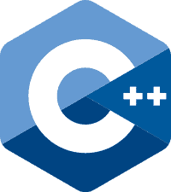
1983: C++
JAYAWANTRAO SAWANT COLLEGE OF ENGINEERING, HADAPSAR, PUNE
Bjarne Stroustrup modified the C language at the Bell Labs, C++ is an extension of C with enhancements such as classes, virtual functions, and templates. It has been listed in the top 10 programming languages since 1986 and received Hall of Fame status in 2003. C++ is used in MS Office, Adobe Photoshop, game engines, and other high-performance software.

Slide 22

JAYAWANTRAO SAWANT COLLEGE OF ENGINEERING, HADAPSAR, PUNE
1983: Objective-C
Developed by Brad Cox and Tom Love, Objective-C is the main programming language used to write software for macOS and iOS, Apple’s operating systems.
•

Slide 23
1987: Perl
JAYAWANTRAO SAWANT COLLEGE OF ENGINEERING, HADAPSAR, PUNE
Perl was created by Larry Wall and is a general-purpose, high-level programming language. It was originally designed as a scripting language designed for text editing but nowadays it’s widely used for many purposes such as CGI, database applications, system administration, network programming, and graphic programming.

Slide 24
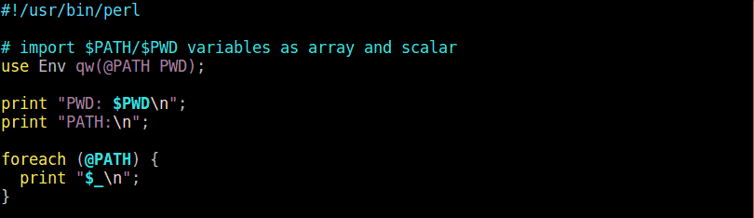
JAYAWANTRAO SAWANT COLLEGE OF ENGINEERING, HADAPSAR, PUNE

Slide 25

JAYAWANTRAO SAWANT COLLEGE OF ENGINEERING, HADAPSAR, PUNE
1990: Haskell
Haskell is a general-purpose programming language named after the American logician and mathematician Haskell Brooks Curry. It is a purely functional
programming mathematical.
language meaning it’s primarily It’s used across multiple industries
particularly those that deal with complicated calculations, records, and number-crunching. Like many other programming languages from this era, it is not overly common to see Haskell in use for well- known applications. With that said, the programming language has been used to write a number of games one of which is Nikki and the Robots.

Slide 26

JAYAWANTRAO SAWANT COLLEGE OF ENGINEERING, HADAPSAR, PUNE
1991: Python
Named Python’, Rossum.
after the British comedy troupe ‘Monty
Python was developed by Guido Van
It is a general-purpose, high-level
programming language created to support a variety of programming styles and be fun to use (a number of the tutorials, samples, and instructions often contain Monty Python references). Python is, to this day, one of the most popular programming languages in the world is used by companies such as Google, yahoo, and Spotify.

Slide 27
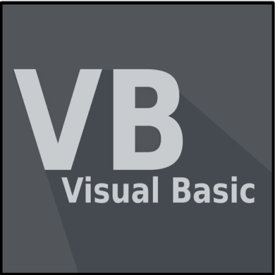
JAYAWANTRAO SAWANT COLLEGE OF ENGINEERING, HADAPSAR, PUNE
1991: Visual Basic
Developed by Microsoft, Visual Basic allows programmers to utilize a drag-and-drop style of choosing and changing pre-selected chunks of code through a graphical user interface (GUI). The language is not overly used these days however Microsoft has used portions Visual Basic to a number of their applications like Word, Excel, and Access.

Slide 28

1993: Ruby
JAYAWANTRAO SAWANT COLLEGE OF ENGINEERING, HADAPSAR, PUNE
Created by Yukihiro Matsumoto, Ruby is an interpreted high-level programming language. A teaching language which was influenced by Perl, Ada, Lisp, and Smalltalk – among others. Ruby’s primary uses are for web applications development and Ruby on Rails. Twitter, Hulu, and Groupon are some well-known examples of companies that use Ruby.
•

Slide 29
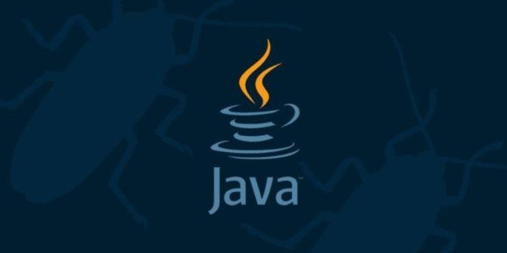
1990: Java
JAYAWANTRAO SAWANT COLLEGE OF ENGINEERING, HADAPSAR, PUNE
Java is a general-purpose, high-level language created by James Gosling for an interactive TV project. It has cross-platform functionality and is consistently among the top of the world’s most popular programming languages. Java can be found everywhere, from computers to smartphones to parking meters.

Slide 30

1995: PHP
JAYAWANTRAO SAWANT COLLEGE OF ENGINEERING, HADAPSAR, PUNE
Formerly known as ‘Personal Home Page’ which now stands for ‘Hypertext Preprocessor’, PHP was developed by Rasmus Lerdorf. Its primary uses include building and maintaining dynamic web pages, as well as server-side development. Some of the biggest companies from across the globe use PHP including Facebook, Wikipedia, Digg, WordPress, and Joomla.

Slide 31
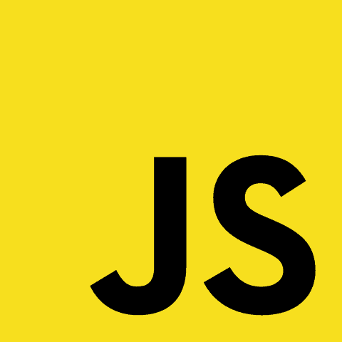
JAYAWANTRAO SAWANT COLLEGE OF ENGINEERING, HADAPSAR, PUNE
1995: JavaScript
JavaScript was created by Brendan Eich, this language is primarily used for dynamic web development, PDF documents, web browsers, and desktop widgets. Almost every major website uses JavaScript. Gmail, Adobe Photoshop, and Mozilla Firefox include some well-known examples.

Slide 32
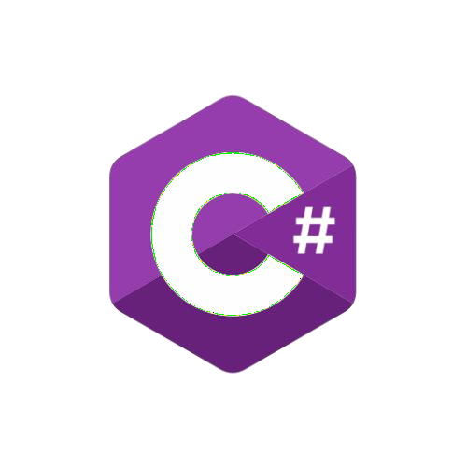
2000: C#
JAYAWANTRAO SAWANT COLLEGE OF ENGINEERING, HADAPSAR, PUNE
Developed at Microsoft with the hope of combining the computing ability of C++ with the simplicity of Visual Basic, C# is based on C++ and shares many similarities with Java. The language is used in almost all Microsoft products and is seen primarily in developing desktop applications.

Slide 33

2003: Scala
JAYAWANTRAO SAWANT COLLEGE OF ENGINEERING, HADAPSAR, PUNE
Developed by Martin Odersky, Scala which combines mathematical functional programming and organized object-oriented programming. Scala’s compatibility with Java makes it helpful with Android development. Linkedin, Twitter, Foursquare, and Netflix are just a few examples of the many companies that use Scala in their tech stacks.

Slide 34

JAYAWANTRAO SAWANT COLLEGE OF ENGINEERING, HADAPSAR, PUNE
2003: Groovy
Derived from Java, Groovy was developed by James Strachan and Bob McWhirter. The language improves productivity because of its succinct and easy to learn. Some well-known companies that are using Groovy in their tech stacks are Starbucks, Transferwise, and Craftbase.

Slide 35

2009: Go
JAYAWANTRAO SAWANT COLLEGE OF ENGINEERING, HADAPSAR, PUNE
Go was developed by Google to address issues that occur due to large software systems. Due to its simple and modern structure, Go has gained popularity among some of the largest tech companies around the world such as Google, Uber, Twitch, and Dropbox.
•

Slide 36

2014: Swift
JAYAWANTRAO SAWANT COLLEGE OF ENGINEERING, HADAPSAR, PUNE
Developed by Apple as a replacement for C, C++, and Objective-C, Swift was developed with the intention to be easier than the aforementioned languages and allow less room for error. Swift’s versatility means it can be used for desktop, mobile, and cloud applications. Leading language app ‘Duolingo’ launched a new app that was written in Swift.

Slide 37
JAYAWANTRAO SAWANT COLLEGE OF ENGINEERING, HADAPSAR, PUNE
What old programming languages are still used today?
Not all programming languages last forever. Whether it’s a result of developments in technology or simply being replaced by a more sophisticated language. With that said, there are some old programming languages that are still being used by IT professionals today:
FORTRAN
The initial version of FORTRAN was proposed at IBM by John Backus way back in 1953. It was the first optimizer compiler and was widely used for scientific work because it’s optimized code competed favorably with hand-written assembly code. The language is still used to this day on some of the world’s fastest supercomputers. There have been a string of updates since 1953 with the most recent version released in 2018.
COBOL
COBOL was developed back in 1959 and was one of the first high- level programming languages. Despite being invented so long ago COBOL is still hugely prevalent today. In the US alone, 43% of banking systems are built on COBOL, accounting for 95% of ATM swipes, and 80% of in-person transactions.

Slide 38
Role of Programming Languages
JAYAWANTRAO SAWANT COLLEGE OF ENGINEERING, HADAPSAR, PUNE
Evolution of Major Programming Languages
1. FORTRAN 1:
Designed for new IBM 704, which had index registers and floating point hardware.
From this language onwards the idea of compilation came into existence.
The first implemented version of Fortran has following features.
Names could have up to six characters.
Post-test counting loop such as DO was present.
It has formatted I/O
It allows user defined subprograms.
There were no data typing statements

Slide 39
2.FORTRAN II:
JAYAWANTRAO SAWANT COLLEGE OF ENGINEERING, HADAPSAR, PUNE
Distributed in 1958
Independent compilation FORTRAN II
was supported for

Slide 40
3. FORTRAN IV,77,90:
JAYAWANTRAO SAWANT COLLEGE OF ENGINEERING, HADAPSAR, PUNE
Evolved during 1960-62
Has explicit type declarations
There was logical selection statement
Subprogram names could be parameters.
Standardized as FORTRAN 66 in 1966
In FORTRAN 77 the character sting handling features was introduced. IF-THEN-ELSE statement were introduced.
Most significant changes took place in FORTRAN 90 by allowing use of modules, dynamic arrays, pointers, recursion, CASE statements, parameter type checking.

Slide 41
4. Functional Programming: LISP:
JAYAWANTRAO SAWANT COLLEGE OF ENGINEERING, HADAPSAR, PUNE
List processing language.
Used in the research of Al.
The syntax is based on lambda calculus.
5. ALGOL 60:
Supports the block structure.
Has two parameter passing methods.
Supports the subprogram recursion.

Slide 42
6. COBOL:
JAYAWANTRAO SAWANT COLLEGE OF ENGINEERING, HADAPSAR, PUNE
The first macro facility in a high level language.
Has a support for hierarchical data structures.
Contains nested selection statements.
Long names for variables up to 30 characters were allowed with hyphens.
Has separate data division.
7.BASIC :
Easy to use and learn.
The current popular version of BASIC is visual basic.

Slide 43
8. PL/I:
JAYAWANTRAO SAWANT COLLEGE OF ENGINEERING, HADAPSAR, PUNE
Designed by IBM and SHARE.
Characterized by dynamic typing allocation.
and dynamic storage
Variables are untyped i.e. A variable acquires a type when it is assigned a value
Storage is allocated to a variable when it is assigned a value.
9. PASCAL:
Designed initially for teaching structured programming.
Was small, simple and easy to learn.
10. C:
Developed in 1972 for system programming.
Has powerful set of operators.
Though designed as a systems language, it has been used in many application areas.

Slide 44
JAYAWANTRAO SAWANT COLLEGE OF ENGINEERING, HADAPSAR, PUNE
11. PROLOG:
Based on formal logic.
Is Non-procedural language.
Considered to be intelligent database system that uses an inferencing process to infer the truth of given queries.
It is comparatively inefficient.
12. ADA:
For design of this language required huge design effort, involving hundreds of people, much money, and about eight years.
By allowing use of packages, ADA has a support for data abstraction.
Support the exception handling mechanism.
Allows the use of generic units and concurrency mechanism.
Contains more flexible libraries.

Slide 45
13. C++:
JAYAWANTRAO SAWANT COLLEGE OF ENGINEERING, HADAPSAR, PUNE
Developed as Bell labs in 1980.
Support features.
14. JAVA:
for both procedural and object oriented
Developed by Sun Microsystems in 1990. .It is based on C++.
Supports only OOP.
Contains references but no pointers.
Has a facility and support for applets and concurrency.
Has libraries for applets, GUIs, database access.
Is widely used for web programming.

Slide 46
15. Scripting Languages for WEB:
JAYAWANTRAO SAWANT COLLEGE OF ENGINEERING, HADAPSAR, PUNE
Various scripting languages such as Perl, PHP, Python, JavaScript, Ruby and so are used as a scripting languages for web programming.
16. .NET Language: C#:
Is based on C++, Java, and Delphi.
Includes pointers, delegates, properties, enumeration types, a limited kind dynamic typing, and anonymous types.
Is evolving rapidly.

Slide 47
17.Markup/Programming Hybrid Languages:
JAYAWANTRAO SAWANT COLLEGE OF ENGINEERING, HADAPSAR, PUNE
XSLT: eXtensible
Stylesheet (XSTL)
Language transforms
Transformation
XMLdocuments for display.
Java Server technologies documents.
Pages: a collection of
dynamic Web
to support

Slide 48
Attributes of Good Language
JAYAWANTRAO SAWANT COLLEGE OF ENGINEERING, HADAPSAR, PUNE
Various attributes of good languages are –
Clarity, simplicity and unity:
Orthogonality:
features expects that the meaning is context independent. For instance - Pointer should be able to point to any type of variable or data structure.
This feature makes the language easier to learn and programs are easier to write.

Slide 49
3. Naturalness for application:
JAYAWANTRAO SAWANT COLLEGE OF ENGINEERING, HADAPSAR, PUNE
Abstraction
Program verification
Program environment:
Portability:

Slide 50
8. Cost of use: The cost is major element in evaluation of any programming language. The cost can be computed for various factors such as-
JAYAWANTRAO SAWANT COLLEGE OF ENGINEERING, HADAPSAR, PUNE
Cost of program execution: Cost of program execution is particularly important for large production programs that will be executed repeatedly. The program execution cost is greatly reduced due to use of optimizing compilers, efficient register allocation, and design of efficient runtime support mechanism.
Cost of program translation: For compiling the large programs/systems, the compilers take too much time. This increases the overall cost. In such a case, it is important to have a fast and efficient compiler rather than a compiler that produces optimized executable code.
Cost of program creation, testing and use: The cost is involved in program designing, coding, testing and modifying. The Smalltalk and Perl are cost effective languages in this aspect.
Cost of program maintenance: The maintenance cost can be four times more than that of development cost. The cost of maintenance depend on various characteristics of the language mainly it is dependent upon readability.

Slide 51
Programming Environments
JAYAWANTRAO SAWANT COLLEGE OF ENGINEERING, HADAPSAR, PUNE
Definition: Programming environment environment in which the programs
is an
can be
created and tested.
It consists of a collection of support tools that are used in software development. Each support tool is basically one kind of program which is used by the programmer during the stages of creation of program. These tools are editors, debuggers, verifiers, data generators and so on.

Slide 52
Effect on Language Design
JAYAWANTRAO SAWANT COLLEGE OF ENGINEERING, HADAPSAR, PUNE
The programming environment influences on language design in two major areas namely separate compilation and testing and debugging.
Separate Compilation
Testing/Debugging
Separate compilation: There are varying number of programmers working on design, code and test the parts of programs. This require the language to be structured so that individual subprograms or other parts can be separately compiled and executed without requirement of other part. Later on these parts are to be merged into a final program.

Slide 53
JAYAWANTRAO SAWANT COLLEGE OF ENGINEERING, HADAPSAR, PUNE
Separate compilation is difficult because compiling one subprogram may need some information which is present in some other sub program or sometimes shared data is also used in the program due to which separate compilation is not possible. To solve this problem, some languages have adopted certain features that aid separate compilation. These features are-
The statements such as extern can be used to indicate that particular data is used from other subprogram.
Languages use scoping rules to hide names. One subprogram can be contained within another subprogram so that the name of the outer subprograms are known to separately compiled subprogram.
In object oriented programming, the feature like inheritance can be used to use the shared data.

Slide 54
Testing and Debugging:
Many languages contain some features that help in testing and debugging. For example
JAYAWANTRAO SAWANT COLLEGE OF ENGINEERING, HADAPSAR, PUNE
1. Breakpoint Feature: By this feature, the programmer can set the breakpoints in the program. When the breakpoint is reached during the execution of the program, the execution of the program is interrupted and control is given to the programmer. The programmer can then inspect the program for testing and debugging.

Slide 55
2. Execution Trace Feature: By this feature particular variable or statement can be tagged for tracing during the execution of the program.
JAYAWANTRAO SAWANT COLLEGE OF ENGINEERING, HADAPSAR, PUNE
3. Assertions: The assertions is a conditional expression which is inserted as separate statement in a program. For example following is a Java Code fragment in which the assertion is used
System.out.print("Enter your age: "); int age reader.nextInt();
Assertion.assert(age<18, "You are not allowed to vote");

Slide 56
Environment Framework
JAYAWANTRAO SAWANT COLLEGE OF ENGINEERING, HADAPSAR, PUNE
Environment framework is nothing but the collection of infrastructure services that can be used for program development purpose. These services are data repository Graphical user interface, security and communication services.
Borland JBuilder is a programming environment that provides integrated compiler, editor and debugger for Java development.
The modern programming environment makes use of Visual Studio .NET for developing the applications using C#, Visual Basic, .NET, Jscript, J# and so on.
Unix is an old programming environment and has a strong support for various powerful tools for software production and maintenance. The UNIX GUI runs on the top of basic UNIX kernel. Typical examples of such GUI are GNOME and KDE.

Slide 57
Impact of Machine Architectures.
JAYAWANTRAO SAWANT COLLEGE OF ENGINEERING, HADAPSAR, PUNE
1.Data:
The built in data types can be directly manipulated by hardware primitive operations. Such built in data types are- integer, floating point numbers, double precision floating point numbers, and strings The data is stored and processed within data storage components of a computer. The three major data storage components are –
Main memory: Main memory consists of bits subdivided into fixed
length words.
High-speed Registers: The contents of registers represent either data or the memory address of main memory containing data.
External Files: The external files is generally stored on hard disk or on CD ROM. It contains records.

Slide 58
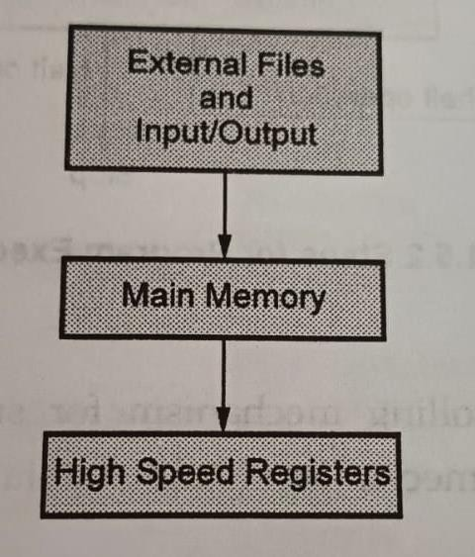
JAYAWANTRAO SAWANT COLLEGE OF ENGINEERING, HADAPSAR, PUNE
Data storage components

Slide 59
2. Primitive Operations
JAYAWANTRAO SAWANT COLLEGE OF ENGINEERING, HADAPSAR, PUNE
A computer contains a set of built-in primitive operations such as addition, multiplication, subtraction and division.
The primitive operations are also used for controlling the sequence of execution of programming statements.
3. Sequence Control
Computer must provide the mechanism for controlling the flow of execution of programming instruction. This mechanism is called as sequence control.
Various primitive operations are used for sequence control. These operations transfer the control flow from one memory location to another.
The next instruction to be executed is determined by the special purpose register called program counter(PC).
The mechanism of execution of programming instruction is illustrated by following figure.

Slide 60
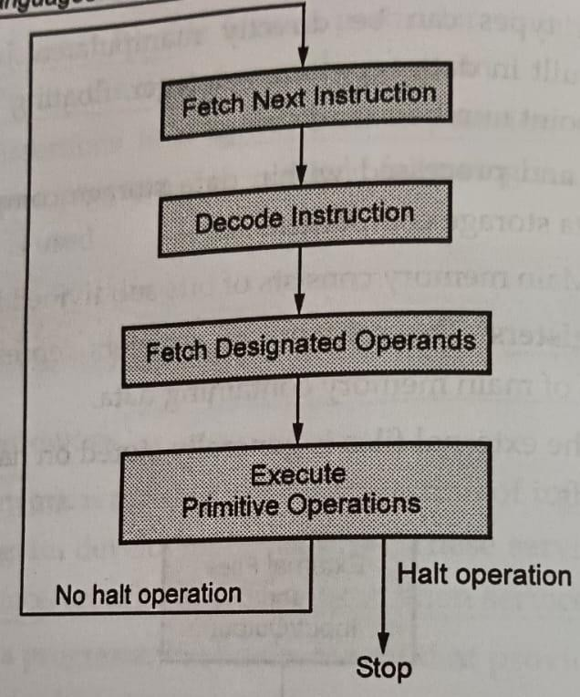
JAYAWANTRAO SAWANT COLLEGE OF ENGINEERING, HADAPSAR, PUNE
Steps for Program Execution

Slide 61
4. Data Access
JAYAWANTRAO SAWANT COLLEGE OF ENGINEERING, HADAPSAR, PUNE
Computer provides a controlling mechanism for supplying data for execution of programming instruction. This mechanism is called data access
5. Storage Management
Computer provides the mechanism for controlling the storage for programs and data resources.
There are three types of storage components in computer and those are - (1) Main Memory (ii) High speed Registers and (iii) External Files.
Sometimes the speed of CPU and main memory does not get synchronized. Hence then a special memory called cache memory is used.
A cache memory is high speed small memory situated in between the main memory and CPU. The data present in the cache memory is immediately available CPU.

Slide 62
6. Operating Environment
JAYAWANTRAO SAWANT COLLEGE OF ENGINEERING, HADAPSAR, PUNE
Computer provides the mechanism by which external programs help in execution of application or user programs which constitutes the programming environment.
The operating environment consists of peripheral storage and I/O devices.

Slide 63
Translators and Virtual Architectures
JAYAWANTRAO SAWANT COLLEGE OF ENGINEERING, HADAPSAR, PUNE
The process
of translation of a program from high level
programming language to low level machine language is performed in following steps-
The program modules are separately translated into relocatable machine code. This translator is called as compiler.
These translated modules are linked together in a relocatable unit. This task is carried out by linker or linkage editor.
Finally the complete program is loaded into the memory as an executable machine code. This task is carried out by loader.
The modern translation technique uses the combined two technique- translation and the interpretation. That means the source code is translated into intermediate code and then the intermediate code is interpreted.

Slide 64
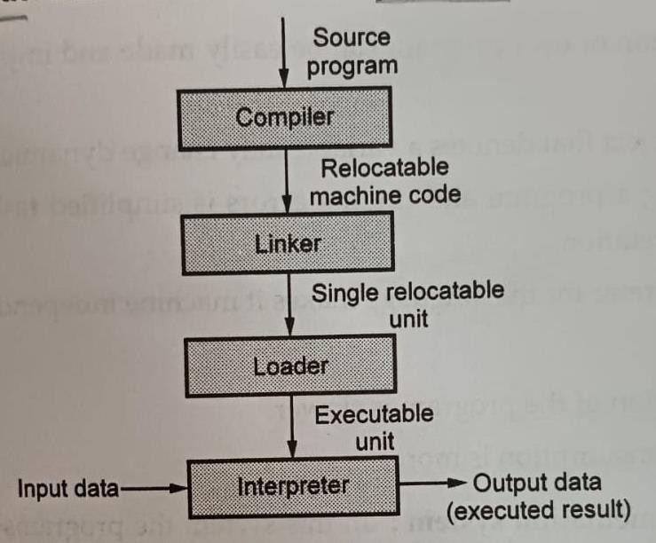
JAYAWANTRAO SAWANT COLLEGE OF ENGINEERING, HADAPSAR, PUNE
Language processing using translation

Slide 65
Methods of Program Implementation
JAYAWANTRAO SAWANT COLLEGE OF ENGINEERING, HADAPSAR, PUNE
The three methods of language implementation are
Compilation: This is a process in which the high level programs are translated into machine language.
Pure interpretation: In this process, programs are interpreted line by line to target program.

Slide 66
Advantages:
JAYAWANTRAO SAWANT COLLEGE OF ENGINEERING, HADAPSAR, PUNE
Modification of user program can be easily made and implemented as execution proceeds.
Type of object that denotes a variable may change dynamically
Debugging a program and finding errors is simplified task for a program used for interpretation.
The interpreter for the language makes it machine independent.

Slide 67
Disadvantages:
JAYAWANTRAO SAWANT COLLEGE OF ENGINEERING, HADAPSAR, PUNE
The execution of the program is slower.
Memory consumption is more.
3)Hybrid implementation system:
In this system the programs are translated using both interpreter and compiler.
Using compilers the high level programs are translated into intermediate language. These intermediate languages are easy to interpret. The interpreter interprets the intermediate language to form the machine code.
Examples - Perl is implemented using with hybrid implementation system. Initially implementation of Java were all hybrid. The intermediate form of Java code is called as byte code. This byte code provides the facility of execution of the code on any platform. Thus portability to any machine(Platform independence) can be achieved using byte code.
The Just-In-Time (JIT) compiler is a component of the Java Runtime Environment that improves the performance of Java applications at run time. Java programs consists of classes, which contain platform neutral byte code that can be interpreted by a Java Virtual Machine(JVM) on many different computer architectures. At runtime, the JVM loads the class files, determines the semantics of each individual byte code, and performs the appropriate computation.

Slide 68
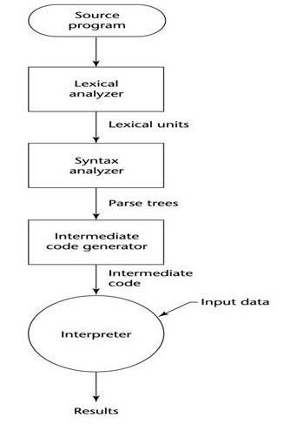
JAYAWANTRAO SAWANT COLLEGE OF ENGINEERING, HADAPSAR, PUNE
Hybrid implementation system

Slide 69
Compiler | Interpreter
The compiler scans the whole program in one go. | Translates the program one statement at a time.
As it scans the code in one go, the errors (if any) are shown at the end together. | Considering it scans code one line at a time, errors are shown line by line.
The main advantage of compilers is its execution time. | Due to interpreters being slow in executing the object code, it is preferred less.
It converts the source code into object code. | It does not convert source code into object code instead it scans it line by line
It does not require source code for later execution. | It requires source code for later execution.
Execution of the program takes place only after the whole program is compiled. | Execution of the program happens after every line is checked or evaluated.
The machine code is stored in the disk storage. | Machine code is nowhere stored.
Compilers more often take a large amount of time for analyzing the source code. | In comparison, Interpreters take less time for analyzing the source code.
It is more efficient. | It is less efficient.
CPU utilization is more. | CPU utilization is less.

Slide 70
Concept of Preprocessor
JAYAWANTRAO SAWANT COLLEGE OF ENGINEERING, HADAPSAR, PUNE
Definition: Preprocessor is a program that processes a program just before the program is compiled.
Preprocessor instructions are embedded in the program.
Preprocessor macros (instructions) are commonly used to specify that code from another file is to be included.
For example: The C preprocessor expands #include or #define in the following mariner-
#include "mytestfile.h"
causes the preprocessor to copy the contents of mytestfile.h into the program atthe position of the #include.
#define SIZE 5
In the program we can declare an array of size 5 in following manner- int a[SIZE];

Slide 71
Virtual Computers
JAYAWANTRAO SAWANT COLLEGE OF ENGINEERING, HADAPSAR, PUNE
Definition of Virtual Machine : Virtual machine is a piece of software which simulates the actual machine environment. An implementation of programming language requires that the programs in the language are analysed and then translated into a form that can be run by interpreter i.e. on virtual machine first and then on actual real machine.
For a virtual machine environment the source program is translated into an intermediary abstract form which is then interpretively executed.
In this case, the source program first goes through three stages such as lexical analyser, syntax analyser and type checker. Then the abstract syntax obtained from these three phases is interpreted to get the translated output.
Due to this feature it is possible to execute the abstract code on any
desired platform.
For example - Java virtual machine is a kind of virtual machine which plays an important role in achieving the platform independence.

Slide 72
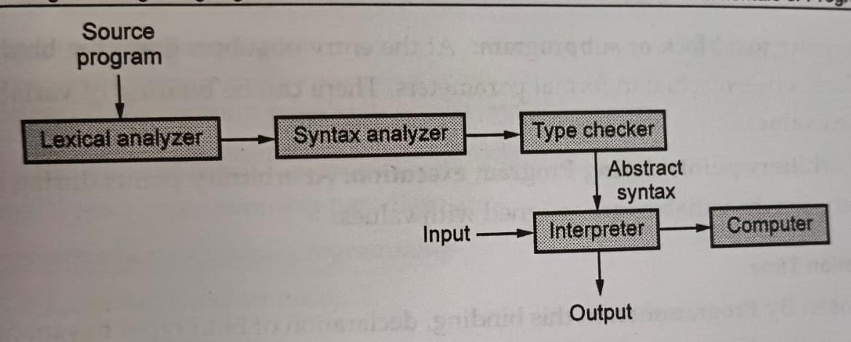
JAYAWANTRAO SAWANT COLLEGE OF ENGINEERING, HADAPSAR, PUNE
Structure of virtual machine

Slide 73
Binding and Binding Times
JAYAWANTRAO SAWANT COLLEGE OF ENGINEERING, HADAPSAR, PUNE
Any program contain various entities such as variables, routines, control statements and so on. These entities have special properties. These properties are called attributes. For example - the programming entity routine or function has number of parameters, type of parameters, parameter passing methods and so on. Specifying the nature of attributes is called binding.
The time at which the choice for binding occurs is called binding times.
There are various classes of Binding types and these are represented by following figure-

Slide 74
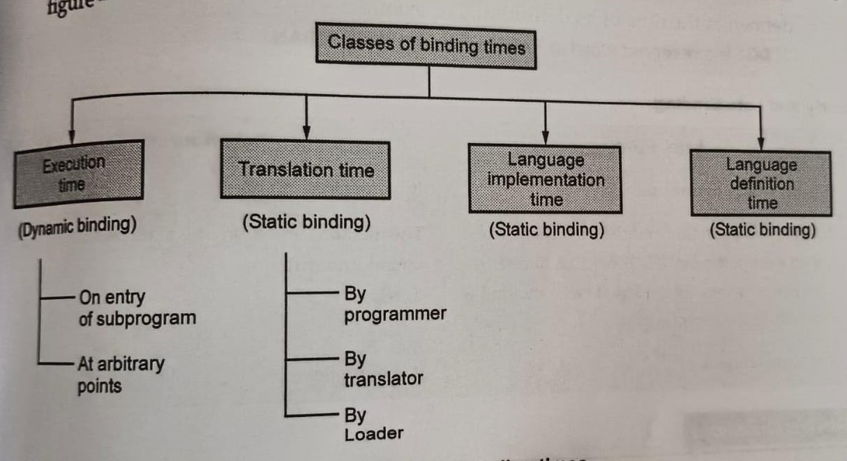
JAYAWANTRAO SAWANT COLLEGE OF ENGINEERING, HADAPSAR, PUNE
Classes of binding times

Slide 75
JAYAWANTRAO SAWANT COLLEGE OF ENGINEERING, HADAPSAR, PUNE
1.Execution Time
There are many bindings that are performed during execution of the program. These type of binding are also called as dynamic binding or Run time binding.
At entry to a block or subprogram: At the entry of subprogram the binding take place between actual to formal parameters. There can be binding of variables with their values.
At arbitrary points during Program execution: At arbitrary points during program execution the variables are assigned with values.

Slide 76
2. Translation Time
JAYAWANTRAO SAWANT COLLEGE OF ENGINEERING, HADAPSAR, PUNE
Chosen By Programmer. In this binding, declaration of bind types to variable name occurs. Similarly the binding between values and constants occur.
Chosen by Loader. Some bindings are chosen by loader. For example – global variables to location source program to object program representation.
3. Language Implementation Time
In this type of binding, bind the values to the representation in computer.
Also there is binding of operations and statements to semantics of
operations.
4. Language Definition Time:
Most of the structures of programming languages is fixed at the time the language is defined. Hence binding occurs as per the structure of the program that has been defined at the time of its definition. For example-"DO" is a reserved word in PASCAL but not in FORTRAN.

Slide 77
JAYAWANTRAO SAWANT COLLEGE OF ENGINEERING, HADAPSAR, PUNE
Early and Late Binding
Early Binding | Late Binding
It is a compile-time process | It is a run-time process
The method definition and method call are linked during the compile time. | The method definition and method call are linked during the run time.
Actual object is not used for binding. | Actual object is used for binding.
For example: Method overloading | For example: Method overriding
Program execution is faster | Program execution is slower

Slide 78
Programming paradigms- Introduction to programming
JAYAWANTRAO SAWANT COLLEGE OF ENGINEERING, HADAPSAR, PUNE
paradigms
Definition: Programming paradigm can be defined as a method of problem solving and an approach to programming language design. Various types of programming paradigm are-
1, Imperative or procedural programming
Object oriented programming
Functional programming
Logic programming
Examples of various programming languages based on the above mentioned paradigm is as shown by
following table.

Slide 79
Imperative Programming
JAYAWANTRAO SAWANT COLLEGE OF ENGINEERING, HADAPSAR, PUNE
The Latin word impetrate means driven or statement oriented language.
The imperative programming is also called as procedural programming language.
A program consists of sequence of statements. After execution of each statement the values are stored in the memory.
The central features of this language are variables, iterations and assignment statements Examples of imperative programming are - C, Pascal, Ada, Fortran and so on.

Slide 80
JAYAWANTRAO SAWANT COLLEGE OF ENGINEERING, HADAPSAR, PUNE
Merits:
Simple to implement.
These languages have low memory utilibzation.

Slide 81
JAYAWANTRAO SAWANT COLLEGE OF ENGINEERING, HADAPSAR, PUNE
Demerits:
Large complex problems can not be implemented using this category of language.
Parallel programming is not possible in this language.
This language is less productive and at low level compared to other programming languages.

Slide 82
Object Oriental Programming
JAYAWANTRAO SAWANT COLLEGE OF ENGINEERING, HADAPSAR, PUNE
In this language everything modeled as object. Hence is the name.
This language has a modular programming approach in which data and functions a are bound in one entity called class.
This programming paradigm has gained a great popularity in recent years because of its characteristic features such as data abstraction, encapsulation, inheritance polymorphism and so on.
Examples of object oriented programming languages are Smalltalk, C++, Java,

Slide 83
Merits:
JAYAWANTRAO SAWANT COLLEGE OF ENGINEERING, HADAPSAR, PUNE
It provides a modular programming approach.
It provides abstract data type in which some of the implementation details can be hidden and protected.
Modifying the code for maintenance become easy, due to modules in the program Modification in one module can not disturb the rest of the code.
Finding bugs become easy.
Object oriented programming provides good
framework for code library from which the
and
software components can be easily used
modified by the programmer.

Slide 84
Demerits:
JAYAWANTRAO SAWANT COLLEGE OF ENGINEERING, HADAPSAR, PUNE
Sometimes real world objects can not be realized easily. Hence it is complex implement.
Some of the members(data or methods) of the class are hidden. Hence they can not be accessed by the objects of other class.
In object oriented programming everything is arranged in the form of modules. For the lower level applications it is not desirable feature.

Slide 85
Functional Programming
JAYAWANTRAO SAWANT COLLEGE OF ENGINEERING, HADAPSAR, PUNE
In this paradigm the computations are expressed in the form of functions.
Functional programming paradigms treat values as single entities. Unlike variables, values are never modified. Instead, values are transformed into new values.
Computations of functional languages are performed largely through applying functions to values, i.e., (+ 10 20). This expression is interpreted as 10+20. The result 30 will be returned.
For building more complex functions the previously developed functions are used. Thus program development proceeds by developing simple function development to complex function development.
Examples of function programming are LISP, Haskell, ML

Slide 86
JAYAWANTRAO SAWANT COLLEGE OF ENGINEERING, HADAPSAR, PUNE
Merits :
Due to use of functions the programs are easy to understand.
The functions are reusable.
It is possible to develop and maintain large programs consisting of large number of functions.
Demerits:
Functional programming is less efficient than the other languages.
They consume large amount of time and memory for execution.
Purely functional programming is not a good option for commercial software development.

Slide 87
Logic Programming
JAYAWANTRAO SAWANT COLLEGE OF ENGINEERING, HADAPSAR, PUNE
In this paradigm we express computation in terms of mathematical logic only. It is also called as rule based programming approach.
Rules are specified in no special order.
It supports for declarative programming approach. In this approach how the computations take place is explained.
The logic paradigm focuses on predicate logic, in which the basic concept is a relation.
Example of Logic programming is Prolog.
Merits:1. This programming paradigm is reliable.

Slide 88
2. The program can be quickly developed using this approach as it makes use of true/false statements rather than objects.
JAYAWANTRAO SAWANT COLLEGE OF ENGINEERING, HADAPSAR, PUNE
3. It is best suitable for the problems in which knowledge base can be established.
Demerits:
Execution of the program is very slow.
True/false statements can not solve most of the problems.
It can solve only limited set of problems efficiently.

Slide 89
A case study: Retail Sales application
JAYAWANTRAO SAWANT COLLEGE OF ENGINEERING, HADAPSAR, PUNE
http://mit.wu.ac.th/mit/images/editor/files/C h%2006(3).pdf
https://hbr.org/2015/06/case-study-can- retailers-win-back-shoppers-who-browse- then-buy-online

