Slide 1

Unit III
JAYAWANTRAO SAWANT COLLEGE OF ENGINEERING, HADAPSAR, PUNE
Java as Object Oriented Programming Language Overview

Slide 2
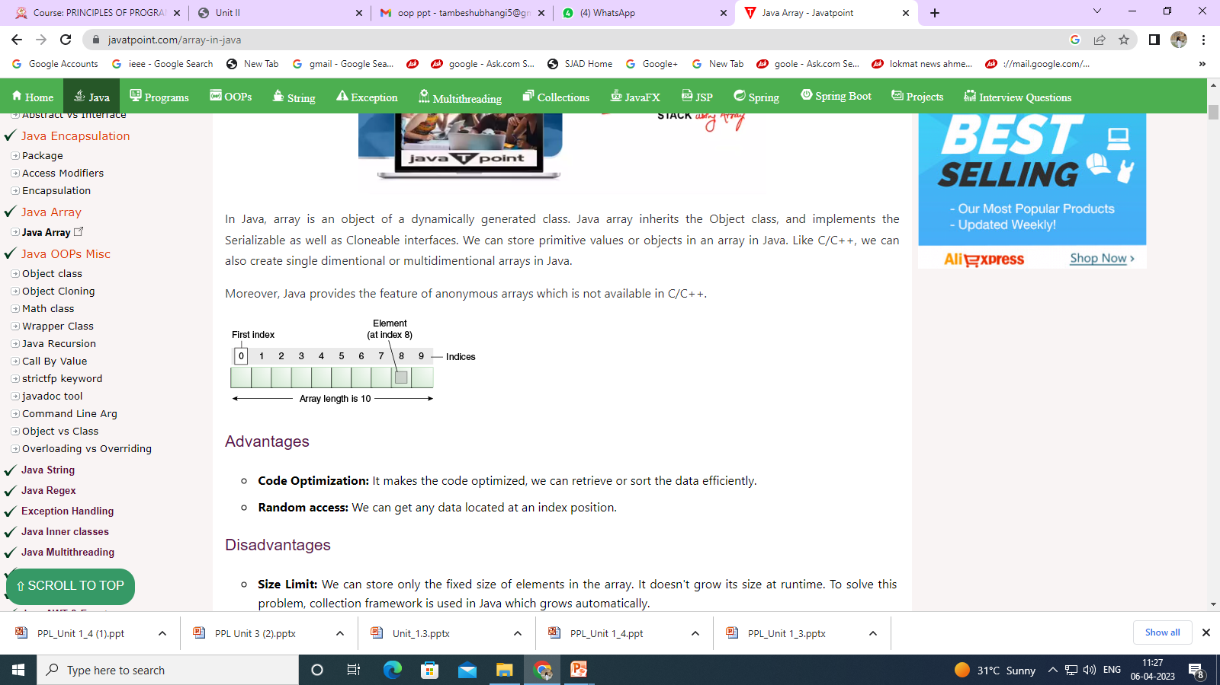
Fundamentals of JAVA, Arrays
JAYAWANTRAO SAWANT COLLEGE OF ENGINEERING, HADAPSAR, PUNE
An array is a collection of similar type of elements which has contiguous memory location.
Java array is an object which contains elements of a similar data type. Additionally, The elements of an array are stored in a contiguous memory location.
Array in Java is index-based, the first element of the array is stored at the 0th index, 2nd element is stored on 1st index and so on.

Slide 3
Types of Array in java
JAYAWANTRAO SAWANT COLLEGE OF ENGINEERING, HADAPSAR, PUNE
1. Single Dimensional Array
2. Multidimensional Array

Slide 4
One Dimensional Array
JAYAWANTRAO SAWANT COLLEGE OF ENGINEERING, HADAPSAR, PUNE
A One-Dimensional Array in Java programming is a special type of variable that can store multiple values of only a single data type such as int, float, double, char, etc. at a contagious location in computer memory.
A one-dimensional array in Java is a collection of similar types of elements stored at contiguous memory locations. The data is stored in a continuous manner, which makes operations like search, delete, insert etc., much easier.
It is clear from the name that a one-dimensional array in java must deal with only one parameter. Entities of similar types can be stored together using one-dimensional arrays. It can store primitive data types (int, float, char, etc.) or objects.

Slide 5
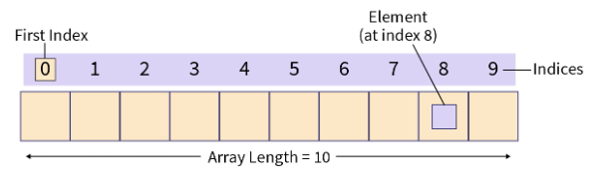
JAYAWANTRAO SAWANT COLLEGE OF ENGINEERING, HADAPSAR, PUNE
One Dimensional Array
A one-dimensional array can be visualized as a single row or a column of array elements that are represented by a variable name and whose elements are accessed by index values.
Declaration of one-dimensional array:
data-type: The data type determines the data type of each element present in the array-like char, int, float, objects etc.
var-name: It is the name of the reference variable which points to the array object stored in the heap memory.

Slide 6
JAYAWANTRAO SAWANT COLLEGE OF ENGINEERING, HADAPSAR, PUNE
One Dimensional Array
int Array[];
long longArray[];
float floatArray[];
double doubleArray[];
char charArray[];

Slide 7
JAYAWANTRAO SAWANT COLLEGE OF ENGINEERING, HADAPSAR, PUNE
One-dimensional array in Java
Construction of one-dimensional array in Java
There are mainly two ways to create an array in java :
1. We can declare and store the values directly at the time of declaration :
int marks[ ] = { 90, 97, 95, 99, 100 };
2. The second way of creating an array is by first declaring the array and then allocating the memory through the new keyword :
var-name = new type[size];
Here size determines the max number of elements that can be stored in the array, To allocate memory using new we must specify the type and number of elements in the array.
int[] Number = new int[10];

Slide 8
JAYAWANTRAO SAWANT COLLEGE OF ENGINEERING, HADAPSAR, PUNE
One-dimensional array in Java
public class AssignValues {
public static void main(String args[])
{ int number[]; // array declared
number = new int[10]; // allocating memory, initialization
number[0] = 11;
number[1] = 22;
number[2] = 33;
number[3] = 44;
number[4] = 55;
} }

Slide 9
JAYAWANTRAO SAWANT COLLEGE OF ENGINEERING, HADAPSAR, PUNE
One-dimensional array in Java
public class Example {
public static void main(String args[])
{
int arr[] = { 1, 5, 10, 15, 20 }; // initializing array
for (int i = 0; i < arr.length; i++)
{
System.out.println(arr[i] + " "); // printing array elements
} } }

Slide 10
JAYAWANTRAO SAWANT COLLEGE OF ENGINEERING, HADAPSAR, PUNE
Multi-dimensional array in Java
An array is a homogeneous data structure that stores data of the same type in contiguous memory locations. Multidimensional Arrays can be thought of as an array inside the array i.e. elements inside a multidimensional array are arrays themselves. They can hold more than one row and column in tabular form.
A multidimensional array is an array of arrays.
Multidimensional arrays are useful when you want to store data as a tabular form, like a table with rows and columns.

Slide 11
JAYAWANTRAO SAWANT COLLEGE OF ENGINEERING, HADAPSAR, PUNE
Multi-dimensional array in Java
To create a two-dimensional array, add each array within its own set of curly braces:
Example:
int[][] myNumbers = { {1, 2, 3, 4}, {5, 6, 7} };
Access Elements
To access the elements of the myNumbers array, specify two indexes: one for the array, and one for the element inside that array. This example accesses the third element (2) in the second array (1) of myNumbers:
Example:
int[][] myNumbers = { {1, 2, 3, 4}, {5, 6, 7} }; System.out.println(myNumbers[1][2]); // Outputs 7

Slide 12
JAYAWANTRAO SAWANT COLLEGE OF ENGINEERING, HADAPSAR, PUNE
Multi-dimensional array in Java
Loop Through a Multi-Dimensional Array:
We can also use a for loop inside another for loop to get the elements of a two-dimensional array (we still have to point to the two indexes):
Example:
public class Main { public static void main(String[] args)
{
int[][] myNumbers = { {1, 2, 3, 4}, {5, 6, 7} };
for (int i = 0; i < myNumbers.length; ++i)
{ for(int j = 0; j < myNumbers[i].length; ++j)
{
System.out.println(myNumbers[i][j]);
} }
}
}
Union

Slide 13
JAYAWANTRAO SAWANT COLLEGE OF ENGINEERING, HADAPSAR, PUNE
Multi-dimensional array in Java 2Dmensional Arrays :2
class TwoDArray {
public static void main(String args[]) {
int twoD[][]= new int[4][5];
int i, j, k = 0;
for(i=0; i<4; i++)
for(j=0; j<5; j++) {
twoD[i][j] = k;
k++;
}
for(i=0; i<4; i++) {
for(j=0; j<5; j++)
System.out.print(twoD[i][j] + " ");
System.out.println(); } } }
D
interface

Slide 14
JAYAWANTRAO SAWANT COLLEGE OF ENGINEERING, HADAPSAR, PUNE
Multi-dimensional array in Java 3 Dmensional Arrays :2
class ThreeDMatrix {
public static void main(String args[]) {
int threeD[][][] = new int[3][4][5];
int i, j, k;
for(i=0; i<3; i++)
for(j=0; j<4; j++)
for(k=0; k<5; k++)
threeD[i][j][k] = i * j * k;
for(i=0; i<3; i++) {
for(j=0; j<4; j++) {
for(k=0; k<5; k++)
System.out.print(threeD[i][j][k] + " ");
System.out.println(); }
System.out.println(); } } }

Slide 15
JAYAWANTRAO SAWANT COLLEGE OF ENGINEERING, HADAPSAR, PUNE
Alternative Array Declaration
There is a second form that can be used to declare an array:
type[ ] var-name;
Here, the square brackets follow the type specifier, not the name of the array variable. For example, the following two declarations are equivalent:
int counter [] = new int[3];
int [] counter = new int[3];
The following declarations are also equivalent:
char table[][] = new char[3][4];
char [][] table = new char[3][4];
This alternative declaration form offers convenience when declaring several arrays at the same time. For example,
Int[] nums,nums2,nums3; //creates 3 arrays

Slide 16

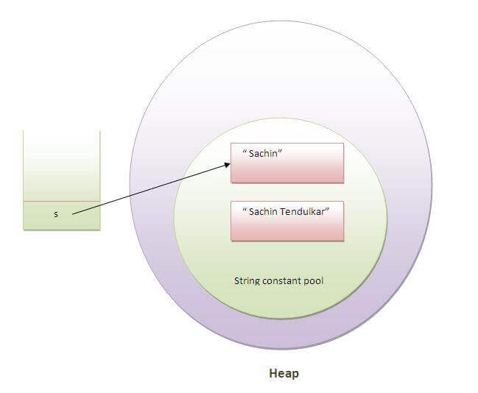
JAYAWANTRAO SAWANT COLLEGE OF ENGINEERING, HADAPSAR, PUNE
STRING ARE IMMUTABLE

Slide 17
STRINGS IN JAVA
String objects are handled specially by the compiler.
String is the only class which has "implicit" instantiation.
The String class is defined in the java.lang package.
Strings are immutable.
The value of a String object can never be changed.
For mutable Strings, use the StringBuffer class.

Slide 18

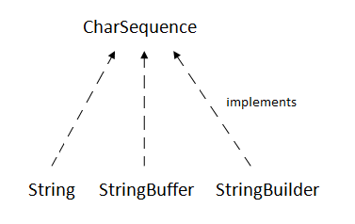

Slide 19
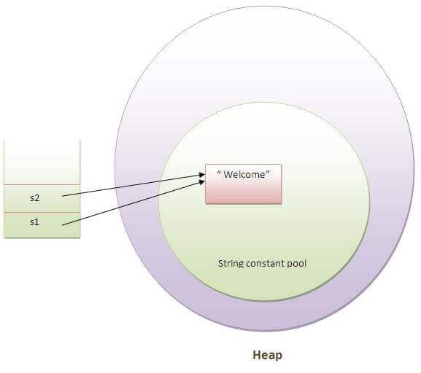
STRING CONSTANT POOL

Slide 20
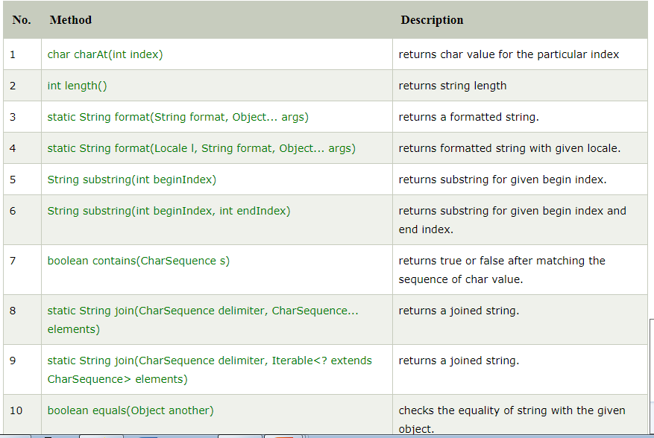

Slide 21
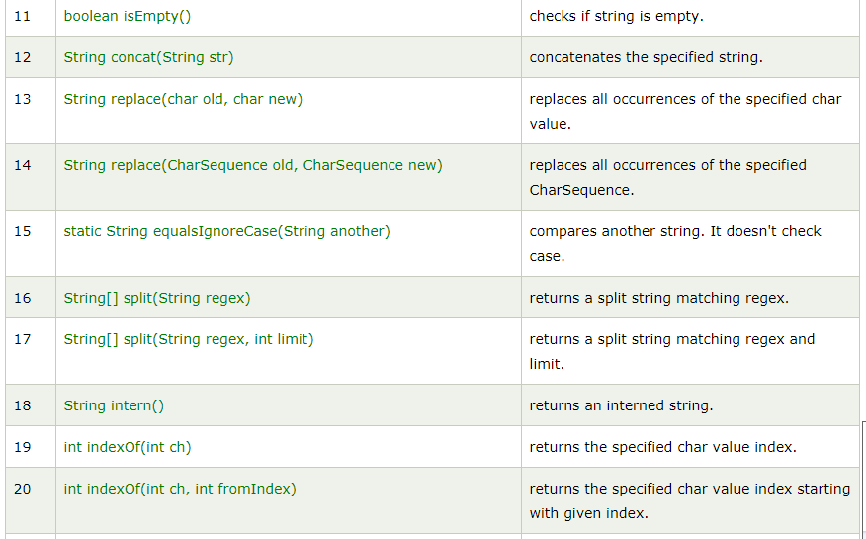

Slide 22
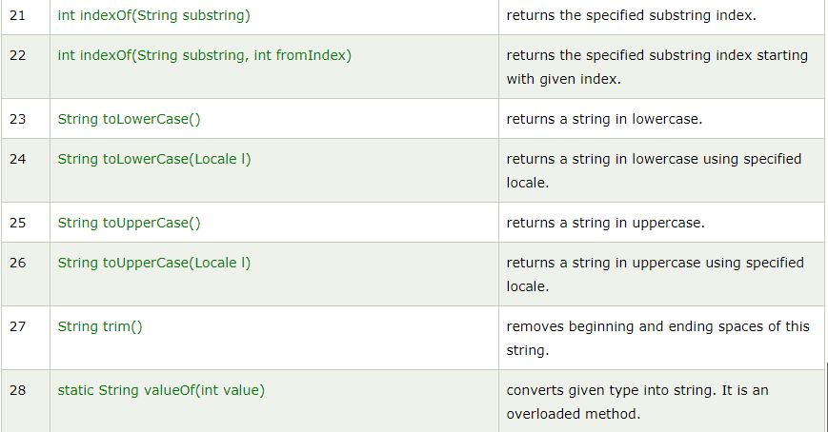

Slide 23
A Simple Class
class Box {
double width;
double height;
double depth;
}
// This class declares an object of type Box.
class BoxDemo {
public static void main(String args[]) {
Box mybox = new Box();
double vol;
// assign values to mybox's instance variables
mybox.width = 10;
mybox.height = 20;
mybox.depth = 15;
// compute volume of box
vol = mybox.width * mybox.height * mybox.depth;
System.out.println("Volume is " + vol);
}
}

Slide 24


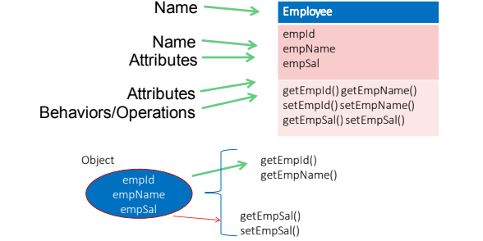

CLASSES & OBJECTS

Slide 25
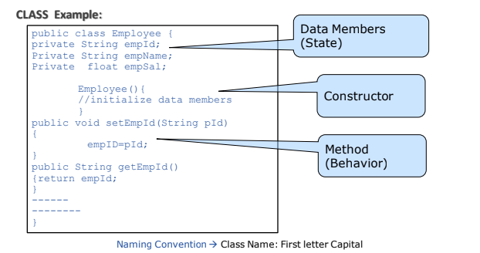
CLASSES & OBJECTS

Slide 26
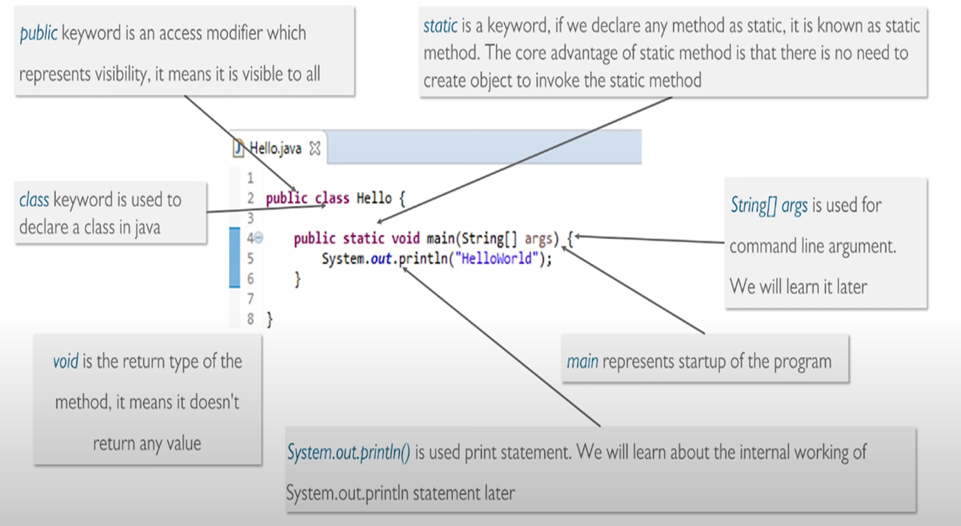
HELLO WORLD PROGRAM !!

Slide 27
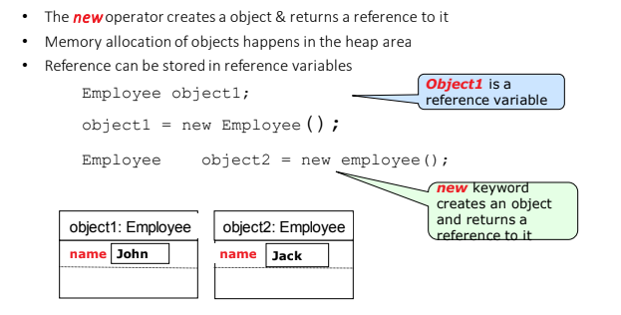
CLASSES & OBJECTS

Slide 28
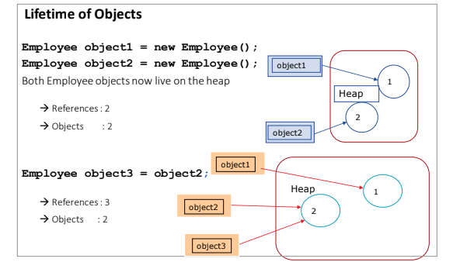
CLASSES & OBJECTS

Slide 29
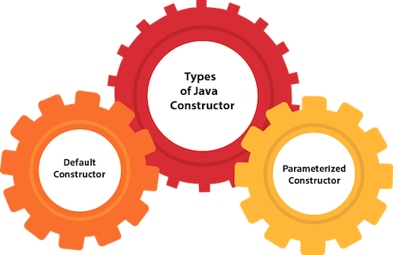
CLASS & OBJECTS
COPY CONSTRUCTOR ????

Slide 30
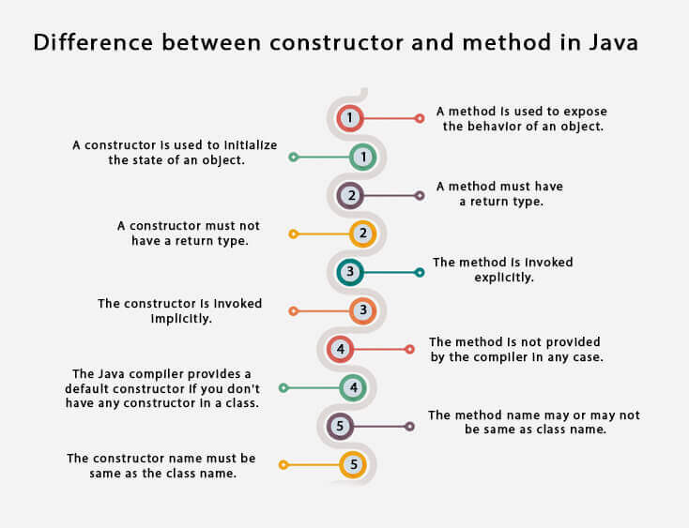
CLASS & OBJECTS

Slide 31
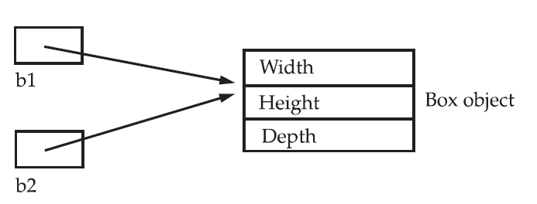
Assigning Object Reference Variables
Box b1 = new Box();
Box b2 = b1;
Box b1 = new Box();
Box b2 = b1;
// ...
b1 = null;

Slide 32
JAYAWANTRAO SAWANT COLLEGE OF ENGINEERING, HADAPSAR, PUNE
Constructors
In Java, a constructor is a block of codes similar to the method. It is called when an instance of the class is created. At the time of calling constructor, memory for the object is allocated in the memory.
It is a special type of method which is used to initialize the object.
Every time an object is created using the new() keyword, at least one constructor is called.

Slide 33
JAYAWANTRAO SAWANT COLLEGE OF ENGINEERING, HADAPSAR, PUNE
Constructors
Types of Java constructors:
Default constructor (no-arg constructor)
Parameterized constructor

Slide 34
JAYAWANTRAO SAWANT COLLEGE OF ENGINEERING, HADAPSAR, PUNE
constructor
1. Default Constructor :
A constructor is called "Default Constructor" when it doesn't have any parameter.
Syntax of default constructor:
class_name()
{ }
2. parameterized Constructor :
A constructor which has a specific number of parameters is called a parameterized constructor.
Why use the parameterized constructor?
The parameterized constructor is used to provide different values to distinct objects. However, you can provide the same values also.

Slide 35
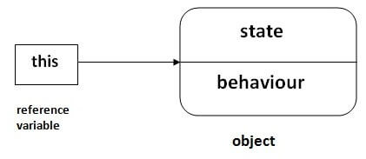
JAYAWANTRAO SAWANT COLLEGE OF ENGINEERING, HADAPSAR, PUNE
this keyword
this is a reference variable that refers to the current object.

Slide 36
JAYAWANTRAO SAWANT COLLEGE OF ENGINEERING, HADAPSAR, PUNE
Usage of java this keyword
Here is given the 6 usage of java this keyword.
this can be used to refer current class instance variable.
this can be used to invoke current class method (implicitly)
this() can be used to invoke current class constructor.
this can be passed as an argument in the method call.
this can be passed as argument in the constructor call.
this can be used to return the current class instance from the method.

Slide 37
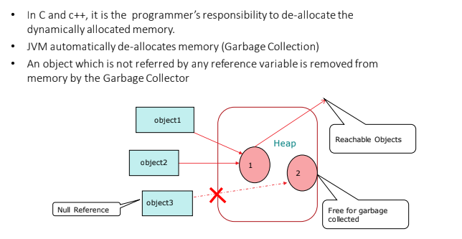
GARBAGE COLLECTION

Slide 38
GARBAGE COLLECTION
Finalize() is the method of Object class.
This method is called just before an object is garbage collected.
finalize() method overrides to dispose system resources, perform clean-up activities and minimize memory leaks.
SYNTAX :protected void finalize() throws Throwable

Slide 39
JAYAWANTRAO SAWANT COLLEGE OF ENGINEERING, HADAPSAR, PUNE
Finalized () Method
Before destroying an object, Garbage Collector calls finalize() method on the object to perform cleanup activities. Once finalize() method completes, Garbage Collector destroys that object.
finalize() method is present in Object class with following prototype.
Syntax
protected void finalize() throws Throwable

Slide 40
JAYAWANTRAO SAWANT COLLEGE OF ENGINEERING, HADAPSAR, PUNE
Finalized () Method
The finalize() method called by Garbage Collector not JVM. Although Garbage Collector is one of the module of JVM.
Object class finalize() method has empty implementation, thus it is recommended to override finalize() method to dispose of system resources or to perform other cleanup.
The finalize() method is never invoked more than once for any given object.
If an uncaught exception is thrown by the finalize() method, the exception is ignored and finalization of that object terminates.

Slide 41
JAYAWANTRAO SAWANT COLLEGE OF ENGINEERING, HADAPSAR, PUNE
Method Overloading in Java
If a class has multiple methods having same name but different in parameters, it is known as Method Overloading.
If we have to perform only one operation, having same name of the methods increases the readability of the program.
Suppose you have to perform addition of the given numbers but there can be any number of arguments, if you write the method such as a(int,int) for two parameters, and b(int,int,int) for three parameters then it may be difficult for you as well as other programmers to understand the behavior of the method because its name differs.

Slide 42
JAYAWANTRAO SAWANT COLLEGE OF ENGINEERING, HADAPSAR, PUNE
Advantage of method overloading
Method overloading increases the readability of the program.
Different ways to overload the method
There are two ways to overload the method in java
By changing number of arguments
By changing the data type

Slide 43
JAYAWANTRAO SAWANT COLLEGE OF ENGINEERING, HADAPSAR, PUNE
Argument Passing
There are mainly two ways of passing arguments to methods:
• Pass by value
• Pass by reference

Slide 44
JAYAWANTRAO SAWANT COLLEGE OF ENGINEERING, HADAPSAR, PUNE
Pass by value
Pass by value:
When the arguments are passed using the pass by value mechanism, only a copy of the variables are passed which has the scope within the method which receives the copy of these variables. The changes made to the parameters inside the methods are not returned to the calling method. This ensures that the value of the variables in the calling method will remain unchanged after return from the calling method.

Slide 45
JAYAWANTRAO SAWANT COLLEGE OF ENGINEERING, HADAPSAR, PUNE
pass by reference mechanism
pass by reference mechanism: when parameters are passed to the methods, the calling method returns the changed value of the variables to the called method. The call by reference mechanism is not used by Java for passing parameters to the methods. Rather it manipulates objects by reference and hence all object variables are referenced. Program illustrates the call by reference mechanism in Java.

Slide 46
JAYAWANTRAO SAWANT COLLEGE OF ENGINEERING, HADAPSAR, PUNE
Object as Parameter
A method can take an objects as a parameter. For example, in the following program, the method setData( ) takes three parameter. The first parameter is an Data object. If you pass an object as an argument to a method, the mechanism that applies is called pass-by-reference, because a copy of the reference contained in the variable is transferred to the method, not a copy of the object itself.

Slide 47
JAYAWANTRAO SAWANT COLLEGE OF ENGINEERING, HADAPSAR, PUNE
Returning Object
In Java, a method can return any type of data, including class types that you can create. For example, in the following Java program, the method incrByTen() returns an object in which the value of a is ten greater than it is in the invoking object.

Slide 48
JAYAWANTRAO SAWANT COLLEGE OF ENGINEERING, HADAPSAR, PUNE
Access Control
Access level modifiers determine whether other classes can use a particular field or invoke a particular method. There are two levels of access control: At the top level— public , or package-private (no explicit modifier). At the member level— public , private , protected , or package-private (no explicit modifier).

Slide 49
JAYAWANTRAO SAWANT COLLEGE OF ENGINEERING, HADAPSAR, PUNE
Static
The static keyword in Java is used for memory management mainly. We can apply static keyword with variables, methods, blocks and nested classes. The static keyword belongs to the class than an instance of the class.
The static can be:
Variable (also known as a class variable)
Method (also known as a class method)
Block
Nested class

Slide 50
JAYAWANTRAO SAWANT COLLEGE OF ENGINEERING, HADAPSAR, PUNE
Final
The final keyword in java is used to restrict the user. The java final keyword can be used in many context. Final can be:
variable
method
class
The final keyword can be applied with the variables, a final variable that have no value it is called blank final variable or uninitialized final variable. It can be initialized in the constructor only. The blank final variable can be static also which will be initialized in the static block only. We will have detailed learning of these. Let's first learn the basics of final keyword.

Slide 51
JAYAWANTRAO SAWANT COLLEGE OF ENGINEERING, HADAPSAR, PUNE
Nested and Inner Class
Java inner class or nested class is a class that is declared inside the class or interface.
We use inner classes to logically group classes and interfaces in one place to be more readable and maintainable.
Additionally, it can access all the members of the outer class, including private data members and methods.

Slide 52
JAYAWANTRAO SAWANT COLLEGE OF ENGINEERING, HADAPSAR, PUNE
Command Line Argument
The java command-line argument is an argument i.e. passed at the time of running the java program.
The arguments passed from the console can be received in the java program and it can be used as an input.
So, it provides a convenient way to check the behavior of the program for the different values. You can pass N (1,2,3 and so on) numbers of arguments from the command prompt.

Slide 53
JAYAWANTRAO SAWANT COLLEGE OF ENGINEERING, HADAPSAR, PUNE
Variable – Length arguments
A method with variable length arguments(Varargs) in Java can have zero or multiple arguments. Variable length arguments are most useful when the number of arguments to be passed to the method is not known beforehand. They also reduce the code as overloaded methods are not required

