Slide 1

Unit VI
JAYAWANTRAO SAWANT COLLEGE OF ENGINEERING, HADAPSAR, PUNE
Logical and Functional Programming

Slide 2
Brief Intro
JAYAWANTRAO SAWANT COLLEGE OF ENGINEERING, HADAPSAR, PUNE
Lisp: List Processor
Designed in 1958 by McCarthy (2nd oldest programming language)
Functional programming language
Interpreted
Based on symbolic expressions, lists, functions, recursion.

Slide 3
Symbols and Numbers
JAYAWANTRAO SAWANT COLLEGE OF ENGINEERING, HADAPSAR, PUNE
Symbol
String of characters (letters, digits, and hyphens)
Examples: x Move a1 turn-right SQR
NOT case sensitive
Number
Examples: 123 -1.234 8e99 -7.8E-23
Just like int or double constants in C/Java

Slide 4
Lists
JAYAWANTRAO SAWANT COLLEGE OF ENGINEERING, HADAPSAR, PUNE
List: Sequence of symbols, numbers, or lists
Examples:
(a b c d e 1 2 3)
(This list (contains (4 elements)) (really))
Expressions that aren’t lists are atoms
Examples: A 1 the
The empty list is nil
nil is a special symbol
both a list and an atom

Slide 5
JAYAWANTRAO SAWANT COLLEGE OF ENGINEERING, HADAPSAR, PUNE
Lisp Expressions and the Lisp Interpreter
The interpreter repeatedly:
Prompts for a well-formed expression
Evaluates the expression
Returns a response
Examples:
> (+ 1 5) > (square 5)
6 25
> ’(square 5) > (first ’((a b) c (1 2) 3)
(square 5) (a b)

Slide 6
JAYAWANTRAO SAWANT COLLEGE OF ENGINEERING, HADAPSAR, PUNE
Built-in Functions
Numeric Functions
List Access Functions
List Construction Functions
Predicates
quote and setq
defun
Special Functions: if, cond, loop

Slide 7
JAYAWANTRAO SAWANT COLLEGE OF ENGINEERING, HADAPSAR, PUNE
Numeric Functions
Example: (+ 5 8 3 2)
+ - * /
sqrt
expt
min max
abs mod round
sin cos tan

Slide 8
JAYAWANTRAO SAWANT COLLEGE OF ENGINEERING, HADAPSAR, PUNE
List Access Functions
first or CAR: returns the first element of its argument list
rest or CDR: returns a list containing all but the first element of a list
last: returns the last element (as a list) of a list
length: returns the number of elements in a list

Slide 9
JAYAWANTRAO SAWANT COLLEGE OF ENGINEERING, HADAPSAR, PUNE
List Construction Functions
cons: takes two arguments; returns the result of inserting the first argument in front of the second argument (opposite of car)
append: takes two list arguments; returns a concatenation of the two lists
list: returns a list of all its arguments

Slide 10
JAYAWANTRAO SAWANT COLLEGE OF ENGINEERING, HADAPSAR, PUNE
Predicates
listp numberp integerp stringp atom
NOTE: nil is false, T is true
null: checks if the argument is nil
= equal eq eql
and or not

Slide 11
JAYAWANTRAO SAWANT COLLEGE OF ENGINEERING, HADAPSAR, PUNE
quote
quote or ’ prevents an expression from being evaluated
(quote exp) same as ’exp
> a
Error because a is unbound/can’t be evaluated
>’a
a
>(+ 3 2)
5
>’(+ 3 2)
(+ 3 2)

Slide 12
JAYAWANTRAO SAWANT COLLEGE OF ENGINEERING, HADAPSAR, PUNE
setq
setq stores a value for a symbol
>(setq a 5)
5
>a
5
>(setq b a)
5
>(setq c ’a)
a
>(setq acts ’(s l r))
(s l r)
Union

Slide 13
JAYAWANTRAO SAWANT COLLEGE OF ENGINEERING, HADAPSAR, PUNE
Evaluating a symbol
>’a
a
>(setq a 5)
5
>a
5
>’a
a
D
interface

Slide 14
JAYAWANTRAO SAWANT COLLEGE OF ENGINEERING, HADAPSAR, PUNE
defun
(defun func-name (args) body )
body may contain some elements in args
body may contain several expressions
Last expression is the one returned

Slide 15
JAYAWANTRAO SAWANT COLLEGE OF ENGINEERING, HADAPSAR, PUNE
Special Functions
(if condition then-result else-result)
(cond (test1 result1) (test2 result2) … )
You would often have a final condition that captures all remaining cases (T (whatever …))
(loop …)

Slide 16
JAYAWANTRAO SAWANT COLLEGE OF ENGINEERING, HADAPSAR, PUNE
load
Create a text file containing Lisp expressions
Suppose the file is named file.lisp
Type in the expression:
> (load ’file.lisp)

Slide 17
JAYAWANTRAO SAWANT COLLEGE OF ENGINEERING, HADAPSAR, PUNE
Some Examples
Define functions that
Computes the square of its argument
Computes the absolute value of its argument
Computes n!
Reverses the elements in a list
Flattens a list (removes nested lists)
For the last 3 problems, use recursion instead of iteration

Slide 18
JAYAWANTRAO SAWANT COLLEGE OF ENGINEERING, HADAPSAR, PUNE
square and myabs
(defun square(n) (* n n))
; abs is already defined as a builtin ☺
(defun myabs(n)
(if (< n 0) (- n) n )
)

Slide 19
JAYAWANTRAO SAWANT COLLEGE OF ENGINEERING, HADAPSAR, PUNE
factorial
Recurrence:
n! = 1 if n = 0
n*(n-1)! otherwise
(defun factorial(n)
(if (= n 0) 1 (* n (factorial (- n 1 ))) )
)

Slide 20
JAYAWANTRAO SAWANT COLLEGE OF ENGINEERING, HADAPSAR, PUNE
The rev function
(reverse is already defined as a built-in)
Recurrence:
If nil, return nil
Otherwise, append the reverse of the rest (cdr l) with a list containing the first (list (car l))

Slide 21
JAYAWANTRAO SAWANT COLLEGE OF ENGINEERING, HADAPSAR, PUNE
The flatten function
Three cases: nil, (car l) is an atom, or (car l) is a list
Recurrence:
If nil, return nil
If (car l) is an atom, insert (car l) into (flatten (cdr l))
If (car l) is a list, append (flatten (car l)) and (flatten (cdr l))

Slide 22
JAYAWANTRAO SAWANT COLLEGE OF ENGINEERING, HADAPSAR, PUNE
Logic programming
we defines facts and rules and give this to the
logic program
Ask it what we want to know
It will look and reason, using available facts
and rules, and then tells us an answer (or
answers)

Slide 23
JAYAWANTRAO SAWANT COLLEGE OF ENGINEERING, HADAPSAR, PUNE
Fact and rule
Comes from Horn clause
H🡨B1,B2,…Bn
Which means if all the Bs are true, then H is also true
In Prolog, we write fact in the form
predicate(atom1,….)
Predicate is a name that we give to a relation
An atom is a constant value, usually written in lower case
Fact is the H part of horn clause
Rule is in the form
predicate(Var1,…):- predicate1(…), predicate2(…), …
Where Var1 is a variable, usually begins with upper case
Yes, it’s just a rewriting of
H🡨B1,B2,…Bn
Fact is a rule that does not have the right hand side.

Slide 24
JAYAWANTRAO SAWANT COLLEGE OF ENGINEERING, HADAPSAR, PUNE
Prolog reasoning
If we have this fact and rule
rainy(london).
rainy(bangkok).
dull(X):- rainy(X).
It’ll give C= bangkok
If it cannot find any more answer, it will answer “no”

Slide 25
JAYAWANTRAO SAWANT COLLEGE OF ENGINEERING, HADAPSAR, PUNE
We can ask (or query) prolog on its command prompt
?- dull(C). (is there a C that makes this predicate true?)
It will automatically try to substitute atoms in its fact into its rule such that our
question gives the answer true
in this example, we begin with dull(X), so the program first chooses an atom for X,
that is london (our first atom in this example)
The program looks to see if there is rainy(london). There is!
So the substitution gives the result “true”
The Prolog will answer
C= london
To find an alternative answer, type “;” and “Enter”
”

Slide 26
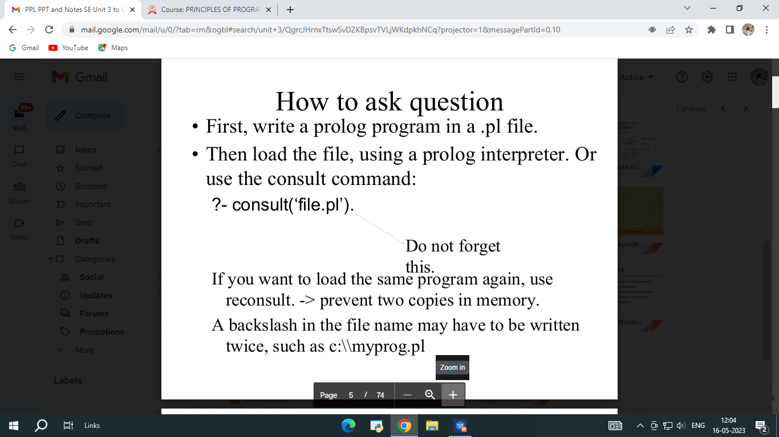
JAYAWANTRAO SAWANT COLLEGE OF ENGINEERING, HADAPSAR, PUNE

Slide 27
JAYAWANTRAO SAWANT COLLEGE OF ENGINEERING, HADAPSAR, PUNE
syntax
Atom
Names of individual and predicates.
Normally begins with a lowercase letter.
Can contain letters, digits, underscore.
Anything in single quotes are also atom:
‘don’’t worry’
‘a very long atom’
‘’.

Slide 28
JAYAWANTRAO SAWANT COLLEGE OF ENGINEERING, HADAPSAR, PUNE
Variable
Begin with capital letter or underscore.
A variable name can contain letters, digits,
underscore.
Which_ever
_howdy

